Slide 1
Duplicate Requests
Moshe Shechter | Alma Product Manager

Slide 2
Currently, there is a forced 10 minute wait time before submitting duplicate resource sharing requests for the same title. We very often have patrons requesting multiple parts of a set that requires library staff to submit additional requests on behalf of the patron.
How can that be achieved without having to wait between subsequent requests ?

Slide 3
If I submit a request ….

Slide 4
… and then another identical one then I get blocked

Slide 5
However, if I submit the request with ‘Save and Edit ….

Slide 6
… then I can add volume information

Slide 7
Saving with different volume information will allow saving separate requests, without having to wait
This is true with the following fields:
Volume
Chapter
Pages
Note

Slide 8
This is true also from Primo

Slide 9
This is true also from Primo

Slide 10
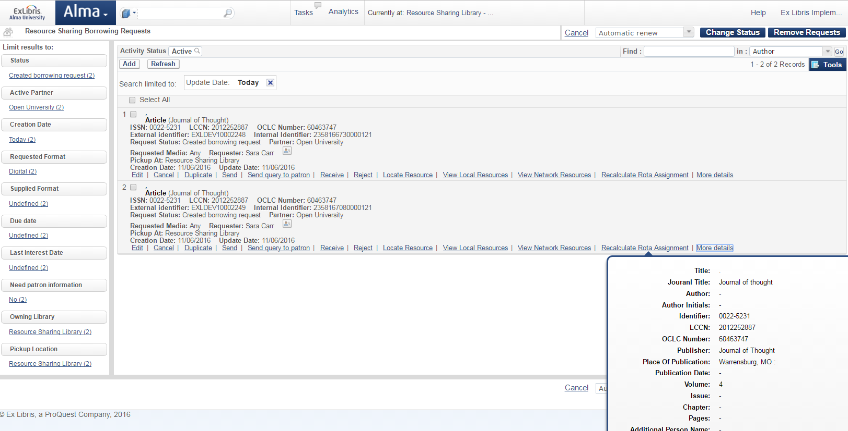
Both requests have been placed, with no waiting

Slide 11
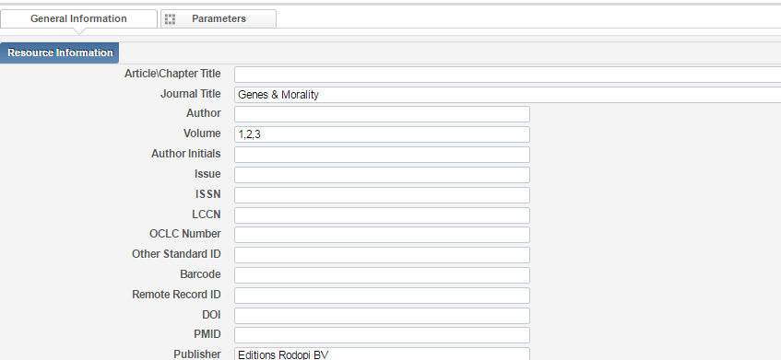
Please note that it is not necessary to place multiple requests for multiple volumes. It is possible to manage a single request for multiple items, and receive all of the requested volumes using one request.
This can be done by indicating a number of volumes in the volume field (or issue/pages).

Slide 12
For more information on managing multiple items in one request, please refer to https://knowledge.exlibrisgroup.com/Alma/Product_Documentation/Alma_Online_Help_(English)/Fulfillment/050Resource_Sharing/050Receiving_and_Shipping_Items#Receiving_or_Shipping_Multiple_Items_for_a_Single_Request

Slide 13
THANK YOU

