Slide 1
Using the shelf-ready process
Yoel Kortick | Senior Librarian

Slide 2
Agenda
1
What is "shelf-ready"?
2
"Shelf-ready" in Alma
3
A real example - the initial order creation
4
A real example - the update inventory and arrival
5
Accompanying files

Slide 3
What is "shelf-ready"?
The term “shelf-ready” may be defined as follows:
The receiving of physical collection¹ materials to the library from a vendor including catalog records and physical processing. The physical processing may include for example barcodes, spine labels, and security devices (such as RFID chips).
¹ Note that strictly speaking ‘shelf-ready’ refers to physical materials, however similar processes do exist for electronic materials even though they do not ‘arrive’ and are not prepared for a ‘shelf’. The vendor ‘Dawson’ for example uses the shelf-ready process for electronic portfolios and Alma ‘update inventory’ profile allows for electronic inventory.

Slide 4
What is "shelf-ready"?
The primary aim of the shelf-ready process is to
Automate both the acquisitions and metadata import processes.
Use human resources which are typically part of the acquisitions process in a more efficient manner

Slide 5
What is "shelf-ready"?
Typically when purchasing a book it may take much manual effort to get it to the shelf for patron use
Shelf-ready aims to shift that processing from the library to the vendor.
Instead of the library investing resources in copy cataloging, barcoding and labeling books, the vendor will do it.
The book will arrive to the library “shelf-ready”.

Slide 6
What is "shelf-ready"?
In addition to this presentation you may wish to also see the document “Dawson Shelf Ready Best Practices” which relates specifically to using the shelf-ready process with the vendor Dawson.
It is referred to in the On Line help at ‘Managing Record Imports Using Profiles > Configuring New Import Profiles > Profile Types’

Slide 7
Agenda
1
What is "shelf-ready"?
2
"Shelf-ready" in Alma
3
A real example - the initial order creation
4
A real example - the update inventory and arrival
5
Accompanying files

Slide 8
"Shelf-ready" in Alma – step one of three
In Alma the “shelf-ready” process works as follows:
An acquisitions order and corresponding bibliographic record is created. This may be done via one of the following methods
Import profile of type ‘New Order’ uploading a brief (‘skeleton’ or ‘stub’) record and EOD (Embedded Order Data)
Directly in the vendor system using an API which creates the order and corresponding bibliographic record in Alma
Manual method

Slide 9
"Shelf-ready" in Alma – step two of three
The vendor sends a file including the originally ordered bibliographic record as well as the PO Line information and item information.
This file is imported via an import profile of type ‘update inventory’
During import a match is made on the existing POL via one the following two fields:
Additional PO Line Reference
Vendor Reference Number field
The bibliographic record is enriched with the new record via either merge or overlay
The holdings record call number may optionally be updated
The item may optionally be marked as received

Slide 10
"Shelf-ready" in Alma – step three of three
The vendor sends the physical item ready with barcode, spine label and possibly security chip
Item may be placed directly on shelf
http://i.telegraph.co.uk/multimedia/archive/01681/bookshop_1681062c.jpg

Slide 11
Agenda
1
What is "shelf-ready"?
2
"Shelf-ready" in Alma
3
A real example - the initial order creation
4
A real example - the update inventory and arrival
5
Accompanying files

Slide 12
A real example - the initial order creation
We stated previously that the initial order and corresponding bibliographic record may be created via
An Import profile of type ‘New Order’
Directly in the vendor system using an API which creates the order and corresponding bibliographic record in Alma
Manual method
In the case here we will create the initial order and corresponding bibliographic record via an import profile of type ‘New Order’
We will use vendor ‘J & S’

Slide 13
A real example - the initial order creation
First the records will be updated via profile ‘New Order J and S’ which is type ‘New Order’
Then the records will be updated via profile ‘Update Inventory J and S’ which is type ‘Update Inventory’
The profile ‘Update Inventory J and S’ which is type ‘Update Inventory’ will also do ‘Receive item’

Slide 14
A real example - the initial order creation
<?xml version="1.0" encoding="UTF-8"?>
<record xmlns="http://www.loc.gov/MARC21/slim" xmlns:cinclude="http://apache.org/cocoon/include/1.0" xmlns:zs="http://www.loc.gov/zing/srw/">
<leader>00914cam a2200277 a 4500</leader>
<controlfield tag="001">916816</controlfield>
<controlfield tag="005">19930407142104.4</controlfield>
<controlfield tag="008">821119s1983 nyua b 001 0 eng </controlfield>
<datafield tag="035" ind1=" " ind2=" ">
<subfield code="a">82021375</subfield>
</datafield>
<datafield tag="020" ind1=" " ind2=" ">
<subfield code="a">0470273933</subfield>
</datafield>
<datafield tag="050" ind1="0" ind2="0">
<subfield code="a">Z665</subfield>
<subfield code="b">.R37 1983</subfield>
</datafield>
<datafield tag="100" ind1="2" ind2=" ">
<subfield code="a">Ravichandra Rao, I. K.</subfield>
<subfield code="q">(Inna Kedage)</subfield>
</datafield>
<datafield tag="245" ind1="1" ind2="0">
<subfield code="a">Quantitative methods for library and information science /</subfield>
<subfield code="c">by I.K. Ravichandra Rao.</subfield>
</datafield>
<datafield tag="980" ind1=" " ind2=" ">
<subfield code="b">20150917-2</subfield>
</datafield>
<datafield tag="981" ind1=" " ind2=" ">
<subfield code="a">POL-20150917-2</subfield>
<subfield code="b">VENREFNUM-20150917-2</subfield>
<subfield code="c">IA</subfield>
<subfield code="d">50.00</subfield>
<subfield code="e">PONUM-20150917-2</subfield>
<subfield code=“f">VENINVNUM-20150917-2</subfield>
</datafield>
</record>
Input file
Bibliographic Information
EOD Information

Slide 15
A real example - the initial order creation
Here is the Inventory and EOD Information in the file and the Inventory information in the input profile
<datafield tag="980" ind1=" " ind2=" ">
<subfield code="b">20150917-2</subfield>
</datafield>
<datafield tag="981" ind1=" " ind2=" ">
<subfield code="a">POL-20150917-2</subfield>
<subfield code="b">VENREFNUM-20150917-2</subfield>
<subfield code="c">IA</subfield>
<subfield code="d">50.00</subfield>
<subfield code="e">PONUM-20150917-2</subfield>
<subfield code="e">VENINVNUM-20150917-2</subfield>
</datafield>

Slide 16
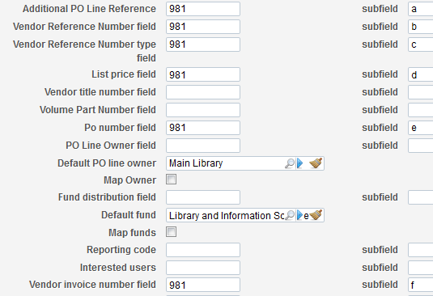
A real example - the initial order creation
Here is the Inventory and EOD Information in the file and the PO Line information in the input profile
<datafield tag="980" ind1=" " ind2=" ">
<subfield code="b">20150917-2</subfield>
</datafield>
<datafield tag="981" ind1=" " ind2=" ">
<subfield code="a">POL-20150917-2</subfield>
<subfield code="b">VENREFNUM-20150917-2</subfield>
<subfield code="c">IA</subfield>
<subfield code="d">50.00</subfield>
<subfield code="e">PONUM-20150917-2</subfield>
<subfield code=“f">VENINVNUM-20150917-2</subfield>
</datafield>

Slide 17
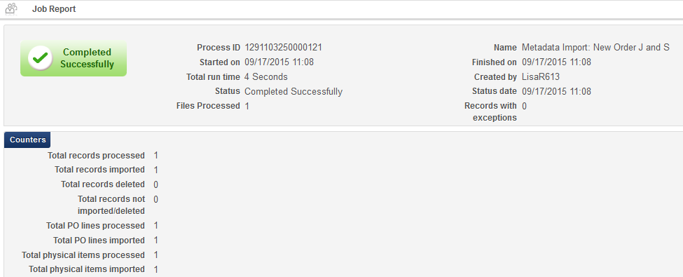
A real example - the initial order creation
After importing via the profile the bibliographic record is created with an order

Slide 18
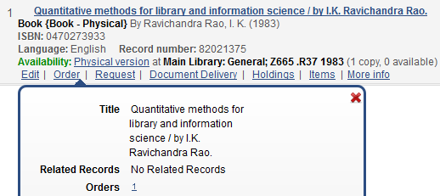
A real example - the initial order creation
The bibliographic record is created with an order

Slide 19
A real example - the initial order creation
The item and order have information from the input file according to the profile
980 $$b
981 $$d

Slide 20
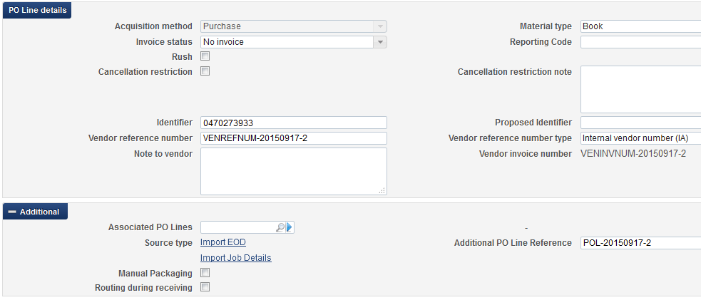
A real example - the initial order creation
The item and order have information from the input file according to the profile
981 $$b
981 $$f
981 $$c
981 $$a

Slide 21
Agenda
1
What is "shelf-ready"?
2
"Shelf-ready" in Alma
3
A real example - the initial order creation
4
A real example - the update inventory and arrival
5
Accompanying files

Slide 22
A real example - the update inventory and arrival
Now the vendor sends the full bibliographic information and matching ‘Additional POL reference’ number.
The bibliographic record has additional fields:
082
260
300
500 (2x)
504
650 (3x)

Slide 23
A real example - the update inventory and arrival
The update inventory import profile will match by “Match method” “By PO Line”

Slide 24
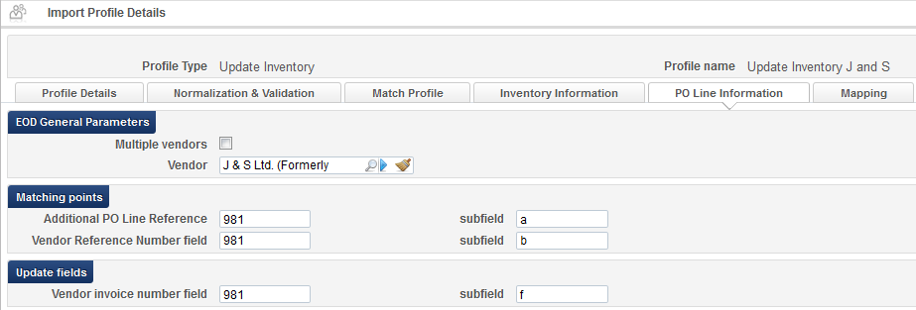
A real example - the update inventory and arrival
When it matches by PO Line method it will look at the ‘Additional PO Line Reference” and if no match exists then it will look at the “Vendor Reference Number Field”

Slide 25
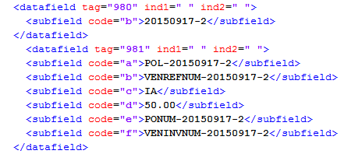
A real example - the update inventory and arrival
The match will be made because the same match points are in the input file and in the actual existing order.
Only one of them needs to be present.

Slide 26
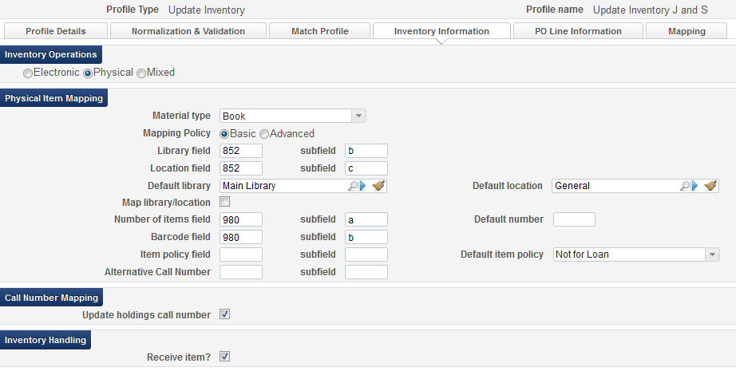
A real example - the update inventory and arrival
Note also that in the input profile of type ‘Update Inventory’ we have specified to receive the item.

Slide 27
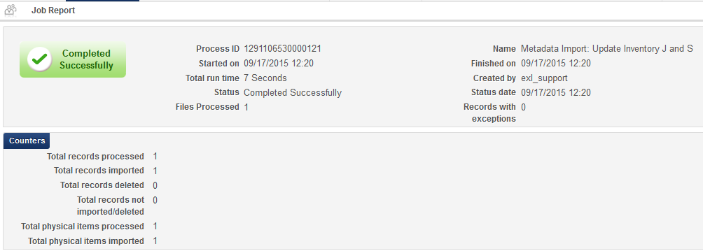
A real example - the update inventory and arrival
The new file with existing ‘Additional PO Line Reference” and richer bibliographic information is loaded.
The match was made

Slide 28
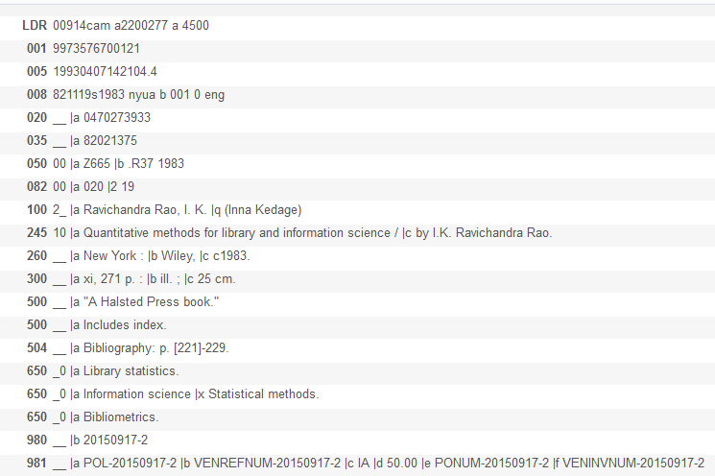
A real example - the update inventory and arrival
The bibliographic record has been enriched with new fields

Slide 29
A real example - the update inventory and arrival
The item was automatically received at the acquisitions department

Slide 30
Agenda
1
What is "shelf-ready"?
2
"Shelf-ready" in Alma
3
A real example - the initial order creation
4
A real example - the update inventory and arrival
5
Accompanying files

Slide 31
Accompanying files
Using the shelf-ready process 82021375_J_and_S_stub.xml
This is the initial file uploaded from the vendor. It was uploaded via the ‘New Order’ type import profile. It is sometimes referred to as a stub record, or skeleton record. It is usually a brief bibliographic record and also includes the EOD information

Slide 32
Accompanying files
Using the shelf-ready process 82021375_J_and_S_full.xml
This is the final file uploaded from the vendor. It was uploaded via the ‘Update Inventory’ type import profile. It is usually a full bibliographic record and also includes the EOD information.
The file includes either the ‘Additional PO Line Reference” or the “Vendor Reference Number Field” of the existing order in order for it to match on the existing order and record.

Slide 33
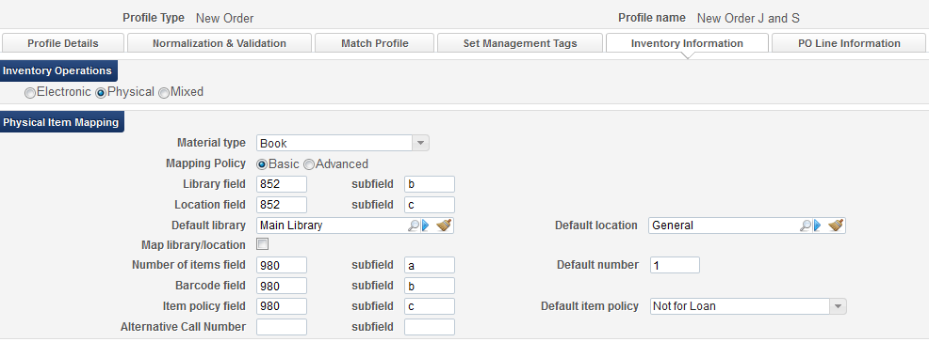
Accompanying files
‘Inventory Information’ tab of the import profile of type ‘New Order’

Slide 34
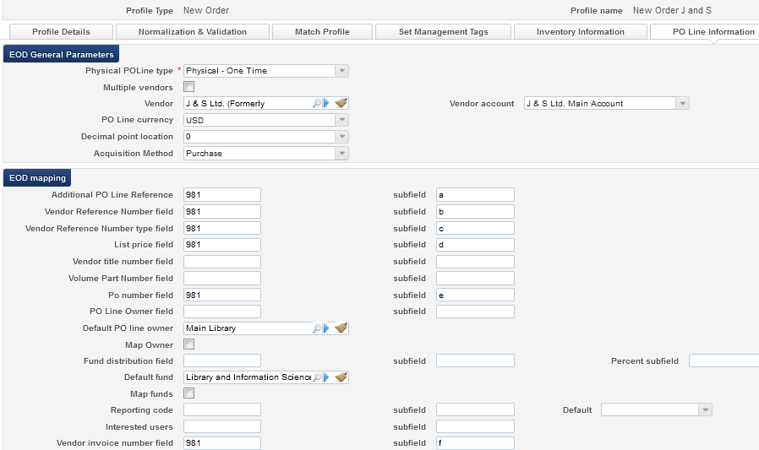
Accompanying files
‘PO Line Information’ tab of the import profile of type ‘New Order’

Slide 35
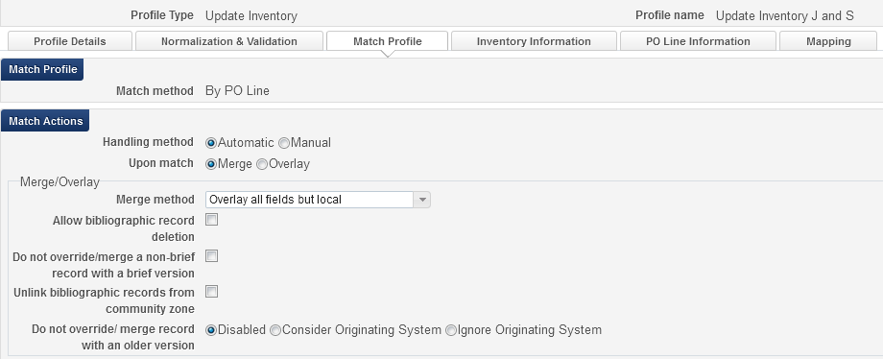
Accompanying files
‘Match Profile’ tab of the import profile of type ‘Update Inventory’

Slide 36
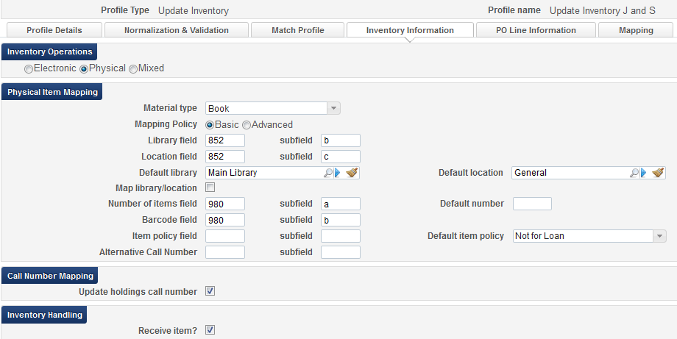
Accompanying files
‘Inventory Information’ tab of the import profile of type ‘Update Inventory’

Slide 37
Accompanying files
‘PO Line Information’ tab of the import profile of type ‘Update Inventory’

Slide 38
THANK YOU
Yoel.Kortick@exlibrisgroup.com

