Slide 1
How to use the TIMESTAMPADD parameter to retrieve by today - X time in an Alma Analytics report
Yoel Kortick
Senior Librarian

Slide 2
Introduction
Applying the TIMESTAMPADD filter on transaction date
Applying the TIMESTAMPADD filter on loan date
Other date filters

Slide 3
Introduction
See also “Alma Analytics SQL Filter Examples” at https://developers.exlibrisgroup.com/blog/alma-analytics-sql-filter-examples/
There may be cases where the library is creating a report and does not want to “hard code” a date.
For example the library may not want to know which items arrived from Sept. 06 – 12, but instead want to know which items arrived in the last week.
Similarly, the library may wish to know how many loans were made by users of group “Undergraduate” in the past year.

Slide 4
Introduction
By using a variable which controls the date the report is “dynamic” in that any time it is opened it automatically retrieves by the current date minus a certain amount of days, weeks, months or years.
The variable is called TIMESTAMPADD
Thus weekly reports may be called, for example, “Number of … in the last week”

Slide 5
Applying the TIMESTAMPADD filter on transaction date

Slide 6
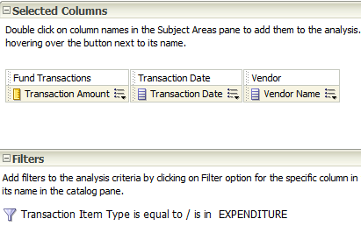
Applying the TIMESTAMPADD filter on transaction date
Here is a report with transaction of type expenditure with amount, vendor and date

Slide 7
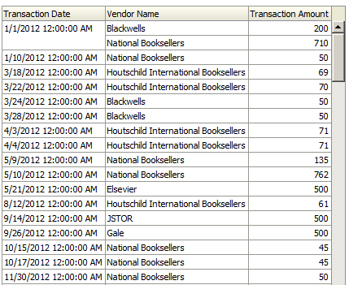
Applying the TIMESTAMPADD filter on transaction date
Here is a report with transaction of type expenditure with amount, vendor and date

Slide 8
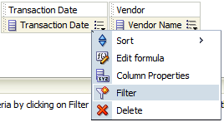
Applying the TIMESTAMPADD filter on transaction date
Create any filter on the transaction date

Slide 9
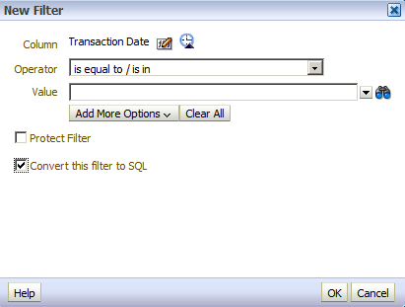
Applying the TIMESTAMPADD filter on transaction date
Select “Convert to SQL” and click OK

Slide 10
Applying the TIMESTAMPADD filter on transaction date
Now we see that we have: "Transaction Date"."Transaction Date" =
We need to change this to reflect the kind of date retrieval we want

Slide 11
Applying the TIMESTAMPADD filter on transaction date
If we want all transactions in the last 14 days: "Transaction Date"."Transaction Date" >= TIMESTAMPADD(SQL_TSI_DAY, -14, CURRENT_DATE)
If we want all transactions in the last 2 years: "Transaction Date"."Transaction Date" >= TIMESTAMPADD(SQL_TSI_YEAR, -2, CURRENT_DATE)
If we want all transactions in the last 3 months: "Transaction Date"."Transaction Date" >= TIMESTAMPADD(SQL_TSI_MONTH, -3, CURRENT_DATE)
If we want all transactions in the last 1 week: "Transaction Date"."Transaction Date" >= TIMESTAMPADD(SQL_TSI_WEEK, -1, CURRENT_DATE)
If we want all dates between today and 1 month from now: "Borrower Details"."Expiry Date" BETWEEN (CURRENT_DATE) AND TIMESTAMPADD(SQL_TSI_MONTH, +1, CURRENT_DATE)

Slide 12
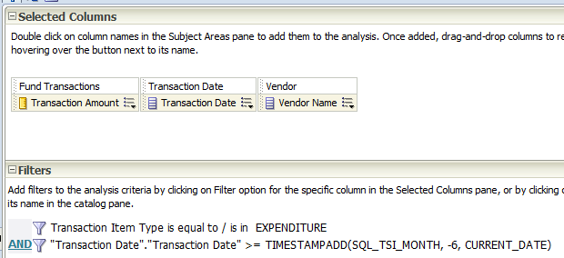
Applying the TIMESTAMPADD filter on transaction date
For example here we will get all transactions in the past six months:

Slide 13
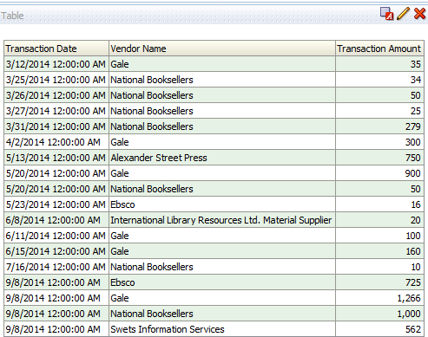
Applying the TIMESTAMPADD filter on transaction date
Here we have transactions for the last six months

Slide 14
Applying the TIMESTAMPADD filter on loan date

Slide 15
Applying the TIMESTAMPADD filter on loan date
Now the library will make a report of the total amount of loans made at a circulation desk of the main library within different time spans
This will include
In the last week
In the last month
In the last year

Slide 16
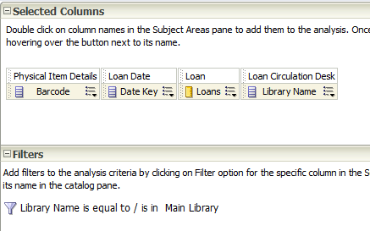
Applying the TIMESTAMPADD filter on loan date
Here we have a report of all loans made at a circulation desk of the main library

Slide 17
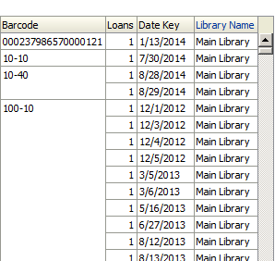
Applying the TIMESTAMPADD filter on loan date
The output gives each loan for each time

Slide 18
Applying the TIMESTAMPADD filter on loan date
In order to use the timestamp add we will do “Filter > Convert to SQL” on the "Loan Date"."Loan Date" and change as follows:
If we want all loans made in the last 14 days: "Loan Date"."Loan Date" >= TIMESTAMPADD(SQL_TSI_DAY, -14, CURRENT_DATE)
If we want all loans made in the last 2 years: "Loan Date"."Loan Date" >= TIMESTAMPADD(SQL_TSI_YEAR, -2, CURRENT_DATE)
If we want all loans made in the last 3 months: "Loan Date"."Loan Date" >= TIMESTAMPADD(SQL_TSI_MONTH, -3, CURRENT_DATE)
If we want all loans made in the last 1 week: "Loan Date"."Loan Date" >= TIMESTAMPADD(SQL_TSI_WEEK, -1, CURRENT_DATE)

Slide 19
Applying the TIMESTAMPADD filter on loan date
It is also possible to define a filter for a date to start at the beginning of ‘X’ previous months. For example, “2 months ago beginning with the first of the month”
If today is Sept. 18 then this will give since Aug. 1 "Loan Date"."Loan Date" >= TIMESTAMPADD(SQL_TSI_MONTH, -1, TIMESTAMPADD( SQL_TSI_DAY , DAYOFMONTH( CURRENT_DATE) * -(1) + 1, CURRENT_DATE))
If today is Sept. 18 then this will give since July. 1 "Loan Date"."Loan Date" >= TIMESTAMPADD(SQL_TSI_MONTH, -2, TIMESTAMPADD( SQL_TSI_DAY , DAYOFMONTH( CURRENT_DATE) * -(1) + 1, CURRENT_DATE))

Slide 20
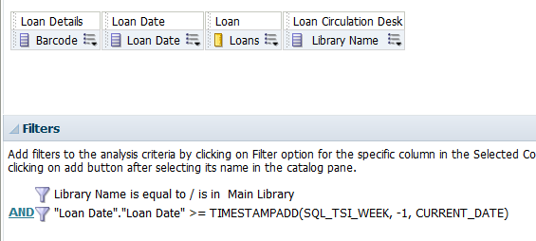
Applying the TIMESTAMPADD filter on loan date
Here for example is a filter retrieving the loans made in the last week

Slide 21
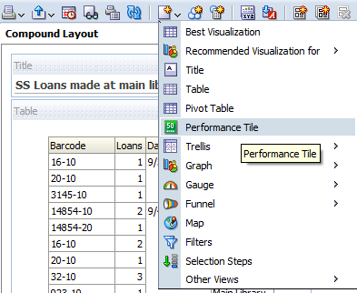
Applying the TIMESTAMPADD filter on loan date
What most interests the person viewing the report is not the specific barcodes but rather the total amount.
So we add a “Performance tile”

Slide 22
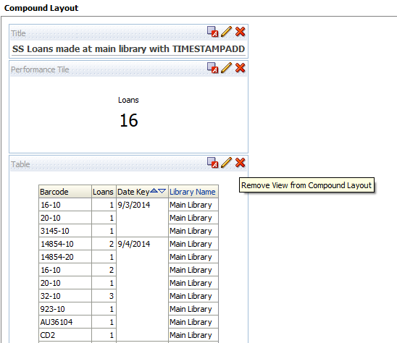
Applying the TIMESTAMPADD filter on loan date
We can then move the performance tile to the top and if desired remove the table with the specific barcodes.

Slide 23
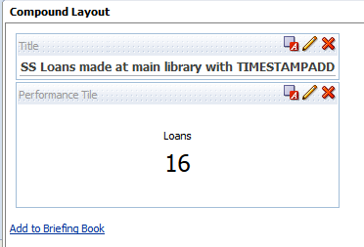
Applying the TIMESTAMPADD filter on loan date
Now the library has a report with the number of loans made in the last week and the filter will never need to be changed.
It will always show the last week.

Slide 24
Other date filters

Slide 25
Other date filters
It is also possible to define a filter the current year. Not “one year ago” but rather “the current year”. If today is Sept. 02, 2015 then it will start at Jan. 01, 2015
YEAR("Physical Item Details"."Receiving Date") = YEAR(CURRENT_DATE)

Slide 26
Other date filters
It is also possible to define a filter the current month. Not “one month ago” but rather “the current month”. If today is Sept. 02, 2015 then it will start at Sept. 01, 2015
MONTH("Physical Item Details"."Receiving Date") = MONTH(CURRENT_DATE)
But we will not want all cases of receiving month Sept. In that case we would get all years where the month is Sept. We will want receiving month current month and receiving year current year

Slide 27
Other date filters
It is also possible to display from the date just the year, or just the month, or just the day
YEAR("Physical Item Details"."Receiving Date")
MONTH("Physical Item Details"."Receiving Date")
DAY("Physical Item Details"."Receiving Date")

Slide 28
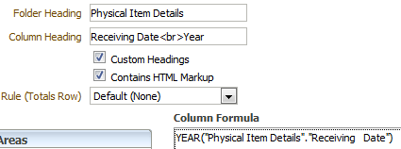
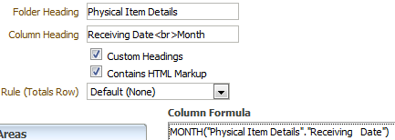
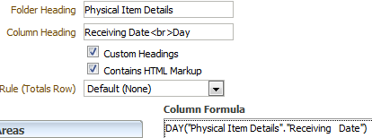
Other date filters

Slide 29
Other date filters
To retrieve by date of entire previous year
YEAR("Physical Item Details"."Receiving Date") = YEAR(CURRENT_DATE)
To retrieve by date of entire previous month
YEAR("PO Line"."Receiving Date (Latest in POL)") = YEAR(CURRENT_DATE) AND MONTH("PO Line"."Receiving Date (Latest in POL)") = (extract(month from current_date)-1))
To retrieve by date of entire previous week
YEAR("PO Line"."Receiving Date (Latest in POL)") = YEAR(CURRENT_DATE) AND WEEK("PO Line"."Receiving Date (Latest in POL)") = WEEK(CURRENT_DATE)-1

Slide 30
Other date filters
To retrieve by date greater than or equal to Jan. 1st 5 years ago (1st day of 1st month 5 years ago)
>= TIMESTAMPADD( SQL_TSI_YEAR , -5, TIMESTAMPADD( SQL_TSI_DAY , EXTRACT( DAY_OF_YEAR FROM CURRENT_DATE) * -(1) +1, CURRENT_DATE))

Slide 31
Thank you!
Yoel.kortick@exlibrisgroup.com

