Slide 1
How to create an Alma Analytics report of fund expenditures by fiscal period format and subject
Yoel Kortick
Senior Librarian

Slide 2
Agenda
Introduction
Fund Expenditures
Adding the Format
Adding the Subject

Slide 3
Introduction

Slide 4
Introduction
In this presentation we will show how to create a report of fund expenditures by fiscal year, format and subject.
This will be done in three stages for the purposes of creating a clear explanation.
Note that in addition to the method presented here additional methods exist, each of which can be adjusted to the needs and workflows of the specific institution.

Slide 5
Fund Expenditures

Slide 6
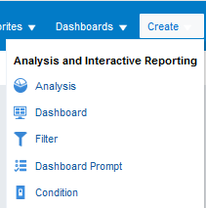
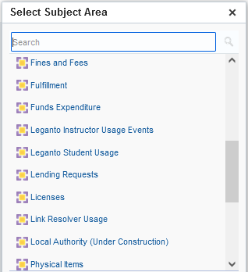
Fund Expenditures
In order to create the report of fund expenditures we will create a new report in the Fund Expenditures subject area.

Slide 7
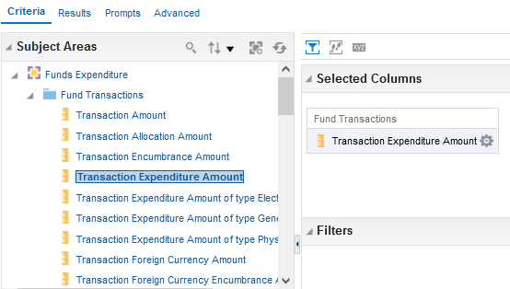
Fund Expenditures
Display the Transaction Expenditure Amount

Slide 8
Fund Expenditures
Display the Fund Name

Slide 9
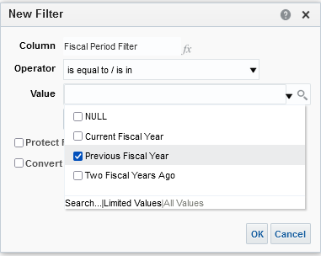
Fund Expenditures
Filter the fiscal period as desired. For example here we are filtering by “Fiscal Period Filter” (from the “Fiscal Period” folder) = Previous Fiscal Year

Slide 10
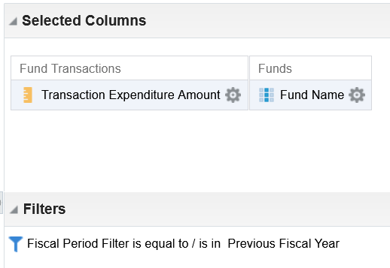
Fund Expenditures
So now we have a situation like this:
We removed the “Fiscal Period Description” from the display and left in the filter. We do not need to display it.

Slide 11
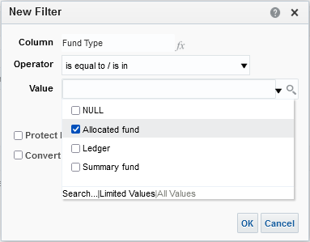
Fund Expenditures
Depending on the purpose of the report we would most likely want to also filter by “Fund Type” (from the “Fund Ledger” folder)

Slide 12
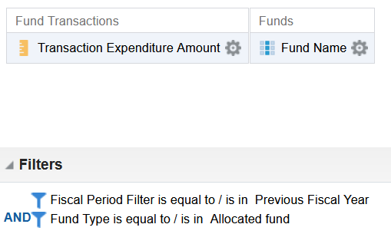
Fund Expenditures
So now we are displaying the Transaction expenditure amount and the Fund Ledger name.
We are filtering by the Fiscal period (Previous Fiscal Year) and Fund Type (Allocated)

Slide 13
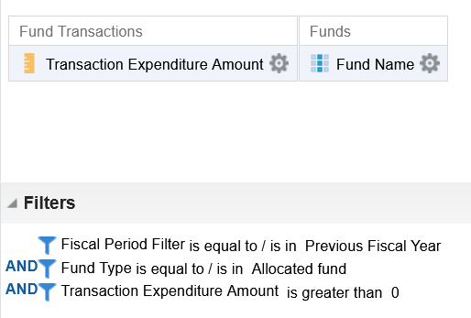
Fund Expenditures
Now we have added another filter “Transaction expenditure amount > 0”.

Slide 14
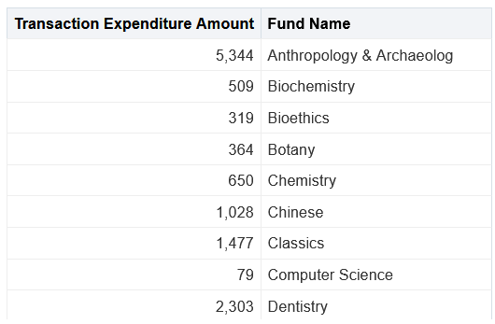
Fund Expenditures
Results

Slide 15
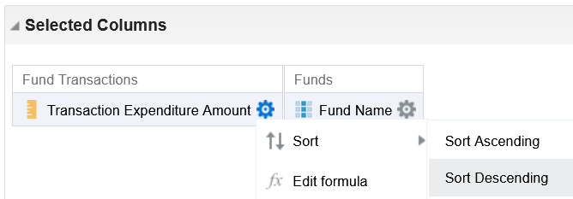
Fund Expenditures
We may wish to now make the report more “presentable” and “meaningful” by sorting the amount and putting in a graph form
From the criteria tab sort the transaction expenditure amount descending

Slide 16
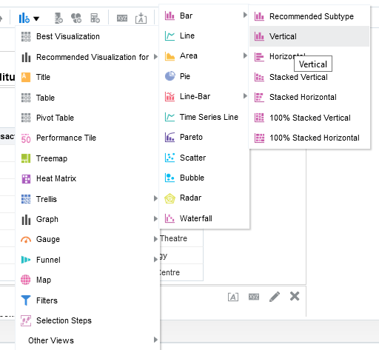
Fund Expenditures
From the results tab add a bar graph visualization

Slide 17
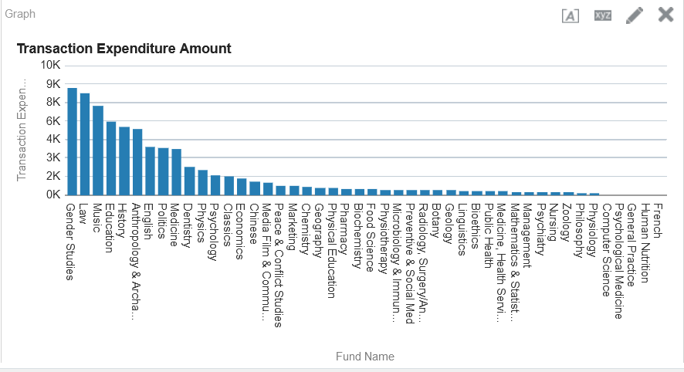
Fund Expenditures
And here are our results

Slide 18
Adding the Format

Slide 19
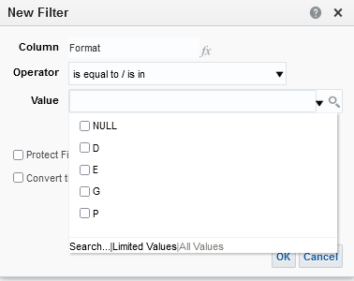
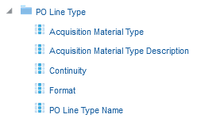
Adding the Format
The “format” may be taken from a variety of places
The “Format” of the PO Line Type would be “E” for Electronic”, “P” for Print, “D” for Digital or “G” for Generic.

Slide 20
Adding the Format
We could also take the format from the bibliographic record material type.
This would bring one of the following formats:
Books (BK)
Journals (CR)
Computer files (CF)
Maps (MP)
Music (MU
Visual materials (VM)
Mixed materials (MX)

Slide 21
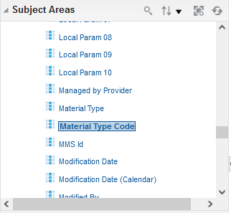
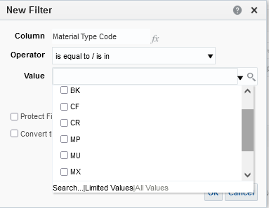
Adding the Format
The format of the bibliographic record

Slide 22
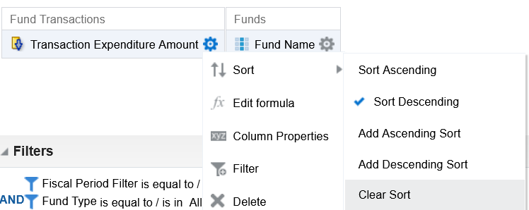
Adding the Format
We will now add the format from the PO Line Type. Before doing so we will remove the sort descending on the transaction amount so that the formats will be grouped (sorted) together.

Slide 23
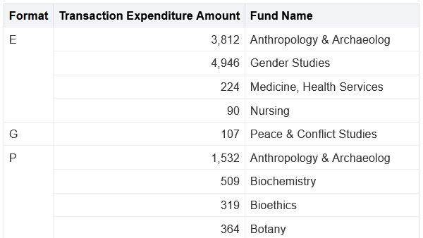
Adding the Format
If we add the format with no filter as the first column and the fund as the second column then we can see the results for each format per fund
Here we added the PO Line Type format

Slide 24
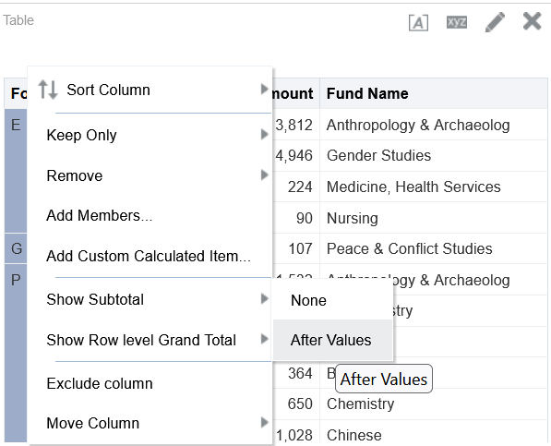
Adding the Format
We can also get the subtotal per format by right-clicking the “Format“ column header and choosing “show subtotal after values”

Slide 25
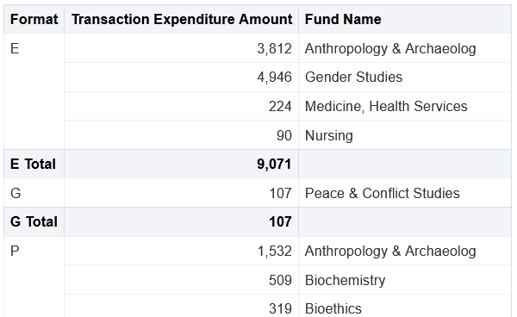
Adding the Format
Now we have the sum per format (this is just the beginning of the report this we do not see the sum for format P)

Slide 26
Adding the Subject

Slide 27
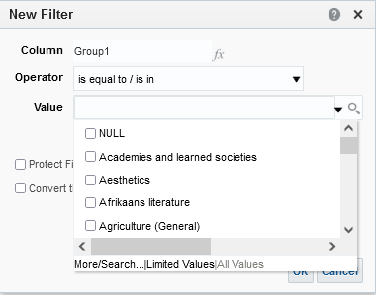
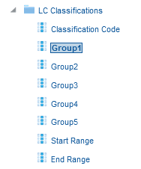
Adding the Subject
The “subject” may be taken from a variety of places
For example it can come from the ‘LC Classifications Group 1”

Slide 28
Adding the Subject
If we add the LC Classifications group 1 with no filter as the first column (instead of the PO Line Format) and the fund as the second column then we can see the results for each subject per fund
Here we added the LC Classifications group 1

