Slide 1
How to add a non-Analytics widget to the Alma Dashboard
Yoel Kortick
Senior Librarian

Slide 2
Introduction
Step One – Create or identify URL
Step Two – Make widget refer to URL
Step Three – Add to dashboard

Slide 3
Introduction

Slide 4
Introduction
This presentation will describe how to create and add a non-Analytics widget to the Alma dashboard.
This can be useful to enable users to quickly and easily access particular web sites from the Alma dashboard.
In order to add an Analytics widget to the dashboard see Running Analytics Reports and Displaying Them in Alma

Slide 5
Step One – Create or identify URL

Slide 6
Step One – Create or identify URL
The first step is to create a page (or identify an existing page) to which the URL of the Widget will refer.
It must be a URL which may be accessed by the user and PC for which Alma will include the Widget

Slide 7
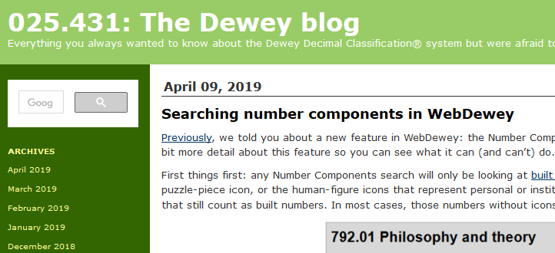
Step One – Create or identify URL
We will use this. It is at URL https://ddc.typepad.com/

Slide 8
Step Two – Make widget refer to URL

Slide 9
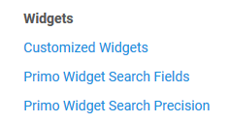
Step Two – Make widget refer to URL
Access the widget configuration via: Configuration > General > Widgets > Customize Widgets

Slide 10
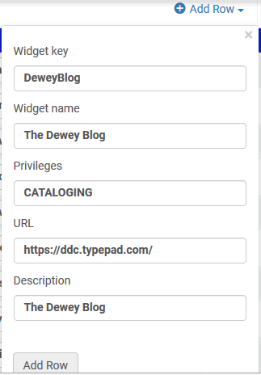
Step Two – Make widget refer to URL
Add the widget to refer to the URL.
In the “Create a New Mapping Row” section fill in fields as follows
The Privileges come from column “Value” (not “Code”) in the privileges report from Administration > User management > Privileges Report

Slide 11
Step Two – Make widget refer to URL
After clicking ‘Add Row’ the new widget is added
The URL has gotten added “url=” at the beginning. We added it in the mapping row without the “url=“ at the beginning.

Slide 12
Step Two – Make widget refer to URL
In the Privileges section we added “CATALOGING”.
We took that value from the column “Value” (not “Code”) in the privileges report from “Administration > User management > Privileges Report”

Slide 13
Step Three – Add to Dashboard

Slide 14
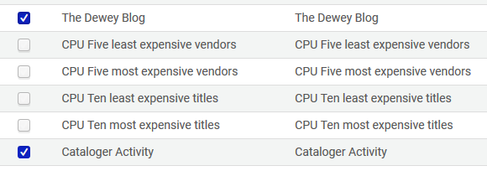
Step Three – Add to Dashboard
Any user (with specified privilege) can add this to his dashboard by clicking “Add Widget” and then clicking the relevant check mark
Click here to make it active on dashboard

Slide 15
Step Three – Add to Dashboard
This user has the privilege CATALOGING so he does see the option to add the widget
This user does not have the privilege CATALOGING so he does not see the option to add the widget

Slide 16
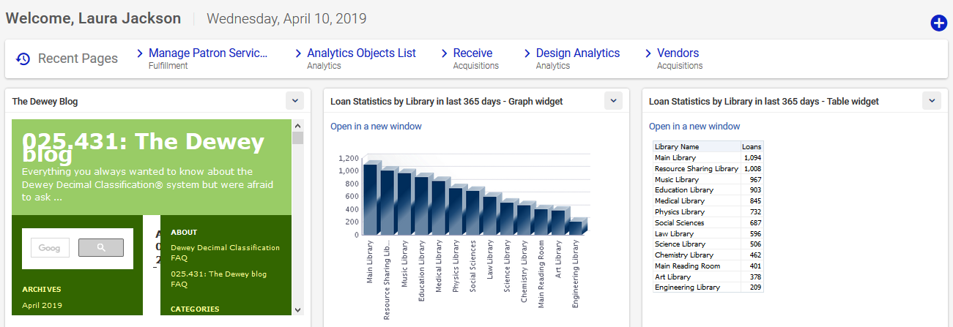
Step Three – Add to Dashboard
After clicking the checkmark the widget appears on the dashboard

Slide 17
xxx@exlibrisgroup.com

