Slide 1
Publishing non-preferred terms to Primo
Yoel Kortick Senior Librarian
https://pixabay.com/en/library-la-trobe-study-students-1400313/

Slide 2
The publishing profile
The sample record
The published record
The results in Primo
Broader and narrower terms
https://slidemodel.com/templates/animated-rainbow-business-powerpoint-template/
http://image.shutterstock.com/z/stock-photo-business-hand-writing-blank-agenda-list-130255148.jpg

Slide 3
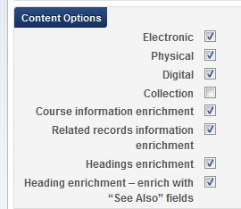
The publishing profile
The option to publish (or not publish) the related terms from the authority record is defined in the publishing profile
The first checkbox refers to the 4XX
The second checkbox refers to 5XX

Slide 4
The publishing profile
The sample record
The published record
The results in Primo
Broader and narrower terms
https://slidemodel.com/templates/animated-rainbow-business-powerpoint-template/
http://image.shutterstock.com/z/stock-photo-business-hand-writing-blank-agenda-list-130255148.jpg

Slide 5
The sample record
MMSID 9948425890001381 has 600 field with: $$a Tchaikovsky, Peter Ilich, $$d 1840-1893.
This is connected to an authority record with many related terms

Slide 6
The publishing profile
The sample record
The published record
The results in Primo
Broader and narrower terms
https://slidemodel.com/templates/animated-rainbow-business-powerpoint-template/
http://image.shutterstock.com/z/stock-photo-business-hand-writing-blank-agenda-list-130255148.jpg

Slide 7
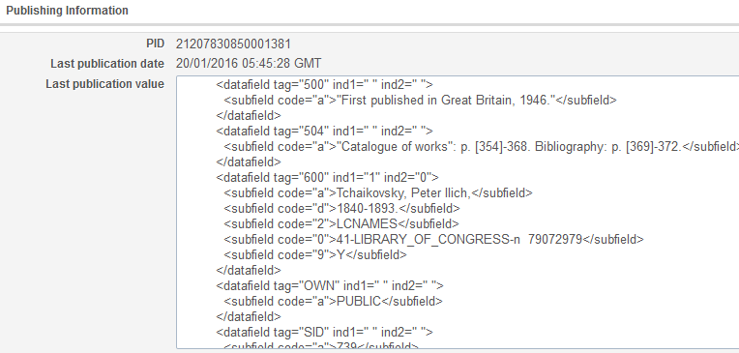
The published record
The published record contains both the preferred term which is in the bibliographic record as well as the non-preferred terms from the authority record
This is the preferred term in the bibliographic record as it appears in the published record
The subfield 9 with Y means it is a preferred term

Slide 8
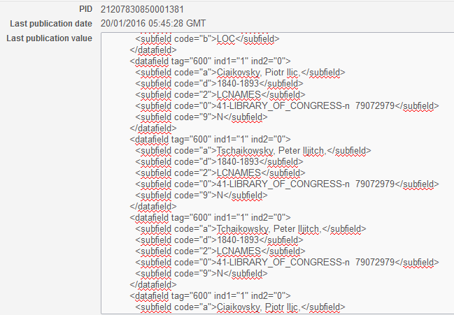
The published record
The published record contains both the preferred term which is in the bibliographic record as well as the non-preferred terms from the authority record
These are non preferred 4XX headings from the authority record which appear in the published record to Primo
The subfield 9 with N means it is a non preferred term

Slide 9
The published record
<datafield tag="600" ind1="1" ind2="0">
<subfield code="a">Tchaikovsky, Peter Ilich,</subfield>
<subfield code="d">1840-1893.</subfield>
<subfield code="2">LCNAMES</subfield>
<subfield code="0">41-LIBRARY_OF_CONGRESS-n 79072979</subfield>
<subfield code="9">Y</subfield>
</datafield>
<datafield tag="600" ind1="1" ind2="0">
<subfield code="a">Ciaikovsky, Piotr Ilic,</subfield>
<subfield code="d">1840-1893</subfield>
<subfield code="2">LCNAMES</subfield>
<subfield code="0">41-LIBRARY_OF_CONGRESS-n 79072979</subfield>
<subfield code="9">N</subfield>
</datafield>
<datafield tag="600" ind1="1" ind2="0">
<subfield code="a">Tschaikowsky, Peter Iljitch,</subfield>
<subfield code="d">1840-1893</subfield>
<subfield code="2">LCNAMES</subfield>
<subfield code="0">41-LIBRARY_OF_CONGRESS-n 79072979</subfield>
<subfield code="9">N</subfield>
</datafield>
<datafield tag="600" ind1="1" ind2="0">
<subfield code="a">Чайковский, Петр Ильич,</subfield>
<subfield code="d">1840-1893</subfield>
<subfield code="2">LCNAMES</subfield>
<subfield code="0">41-LIBRARY_OF_CONGRESS-n 79072979</subfield>
<subfield code="9">N</subfield>
</datafield>
The differentiation using the subfield 9 Y or N allows the library to make normalization rules in Primo.
For example the library may wish to display headings with Y and index headings with Y or N.

Slide 10
The publishing profile
The sample record
The published record
The results in Primo
Broader and narrower terms
https://slidemodel.com/templates/animated-rainbow-business-powerpoint-template/
http://image.shutterstock.com/z/stock-photo-business-hand-writing-blank-agenda-list-130255148.jpg

Slide 11
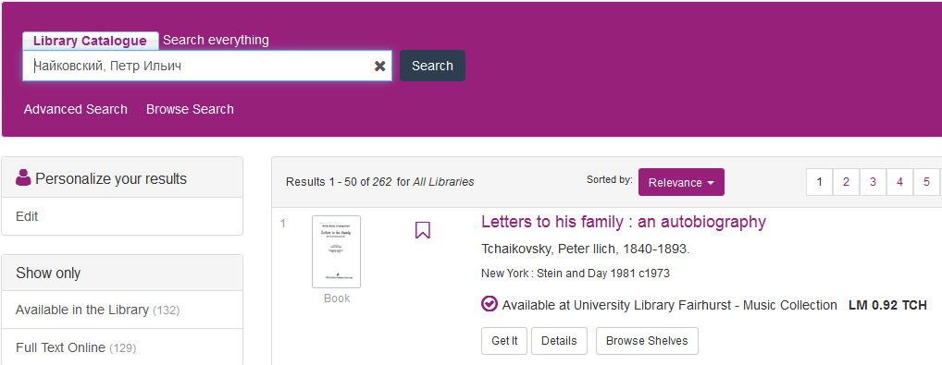
The results in Primo
In Primo it is then possible to search by the non preferred term (because it was published from Alma and indexed in Primo) and find the record which contains only the preferred term
Search by non-preferred term
Find records which contain only the preferred term

Slide 12
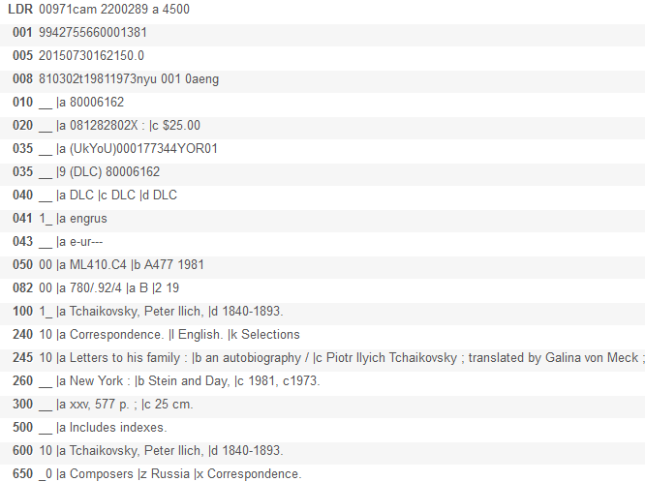
The results in Primo
This is the record which was found in Primo when searching by Чайковский, Петр Ильич
The term Чайковский, Петр Ильич does not appear in the record, but it is a non preferred term for Tchaikovsky, Peter Ilich1840-1893

Slide 13
The publishing profile
The sample record
The published record
The results in Primo
Broader and narrower terms
https://slidemodel.com/templates/animated-rainbow-business-powerpoint-template/
http://image.shutterstock.com/z/stock-photo-business-hand-writing-blank-agenda-list-130255148.jpg

Slide 14
The broader and narrower term
Note also that the broader and narrower terms are also published to Primo and can this be retrieved by the end user.
The institution can index them as “subject” or specifically as the relevant “broader term” or “narrower term”.

Slide 15
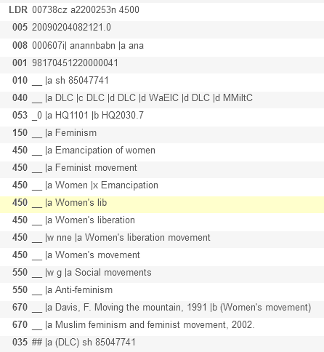
The broader and narrower term
Here for example is the Alma Community Zone showing the Library of Congress Subject heading for “Feminism”.
You can see that “broader term” is “social movements”.

Slide 16
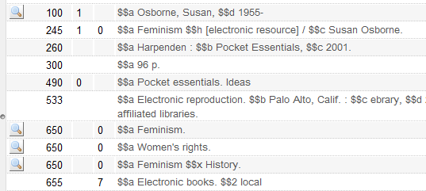
The broader and narrower term
Here we have MMS ID 9958305130601381 title “Feminism” by “Susan Osborne” linked to the authority record

Slide 17
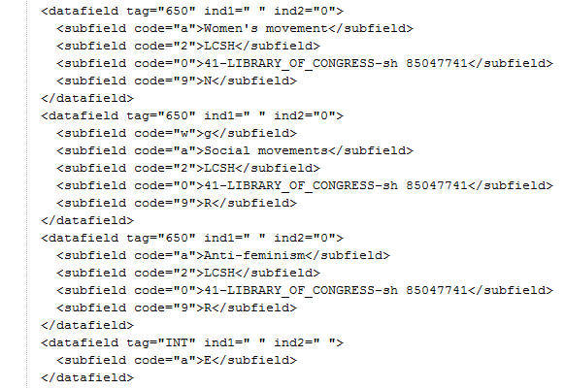
The broader and narrower term
The broader term is published to primo and can then be indexed and search as a broader term

Slide 18
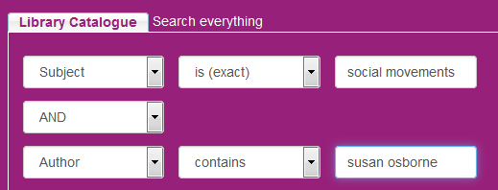
The broader and narrower term
We search Primo here for the author and the subject broader term

Slide 19
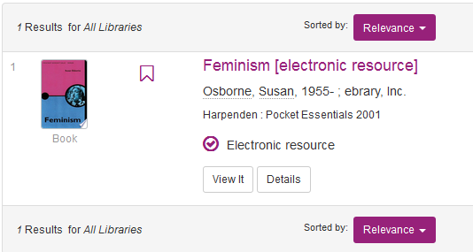
The broader and narrower term
The record is retrieved

Slide 20
Thank you
Yoel Kortick Senior Librarian
https://pixabay.com/en/library-la-trobe-study-students-1400313/

