Slide 1
MARC extensions
Yoel Kortick | Senior Librarian
https://upload.wikimedia.org/wikipedia/commons/c/c6/Vienna_University_of_Technology_DSC1189.jpg
Technische Universität Wien
http://pds.exblog.jp/pds/1/201010/12/50/d0162650_4111788.jpg

Slide 2
Introduction
Two examples where customization is needed
Adding a field with an extension pack
Tentative future developments
https://slidemodel.com/templates/animated-rainbow-business-powerpoint-template/
http://image.shutterstock.com/z/stock-photo-business-hand-writing-blank-agenda-list-130255148.jpg

Slide 3
Introduction
The sample MARC extension xml file used in this presentation may be downloaded here.
In addition to this presentation it is recommended to see the following:
Editing MARC-Based Profiles with Extension Packs
How to add German BSZ extension pack

Slide 4
Introduction
Alma comes “Out of the box” with standard MARC 21 profiles for bibliographic, authority and holdings records
These profiles are in accordance with the official MARC 21 standards.
In some cases, however, a library may wish to adjust the MARC 21 profiles.
This may be due to, for example
The sharing of records with another organization which catalogs records in a manner which differs from the standard MARC 21 rules
Local regional uses of MARC which differ from the standard MARC 21 rules

Slide 5
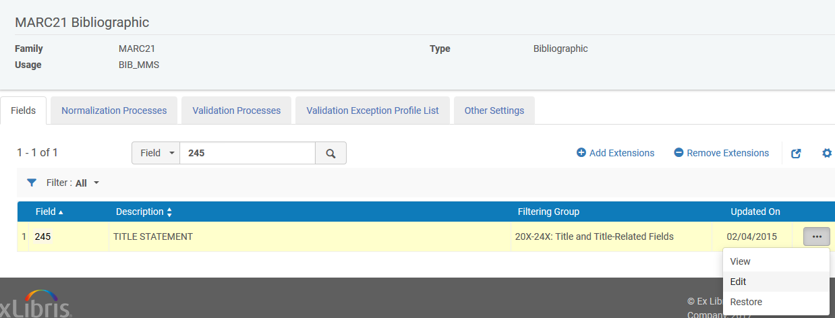
Introduction
In order to change the “Out of the box” MARC 21 profile it is possible to
Manually change the field(s) one by one
Add an extension pack and globally change one or many fields via an input file
This presentation will deal with the use of the extension pack
Option 2
Option 1

Slide 6
Introduction
Note that in this presentation we are adding the MARC extension for the MARC 21 bibliographic profile.
However, it is also possible to add extension files for the other metadata configuration profiles.

Slide 7
Introduction
Example where customization is needed
Adding a field with an extension pack
Tentative future developments
https://slidemodel.com/templates/animated-rainbow-business-powerpoint-template/
http://image.shutterstock.com/z/stock-photo-business-hand-writing-blank-agenda-list-130255148.jpg

Slide 8
Example where customization is needed
A region of libraries might use the bibliographic 019 as a matching field for a national database
For example this is done by libraries in Australia, and the 019 is used to match against records in the Australian National Bibliographic Database (ANBD)
See for example here where it states “MARC field 019: is used to assist with precise matching of records between the ANBD and local library databases, for example, when updating records on the local system with records from the ANBD.”

Slide 9
Example where customization is needed
Also, a group of libraries might use the 029 field as a “Other System Control Number”.
This field is often used by OCLC as a system control number from other non-OCLC systems.
See for example here where it states “OCLC uses field 029 for system control numbers for records from non-OCLC automated systems (e.g., Library and Archives Canada, the British Library, WorldCat Cataloging Partners vendors, etc.). OCLC uses these numbers to process and track records from other systems.”

Slide 10
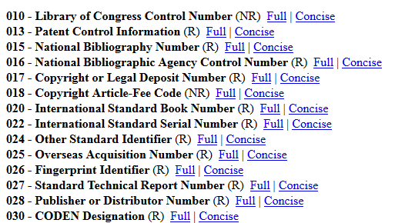
Example where customization is needed
Neither the 019 or the 029 are official MARC fields and therefore do not appear in the official list of 01X-09X fields as published by LOC here.
No 019
No 029

Slide 11
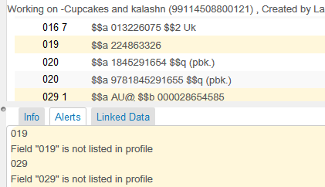
Example where customization is needed
Similarly, the 019 and 029 are not in the official MARC 21 bibliographic profile of Alma. Therefore when a record is saved with one or both of these fields the following warning will be received

Slide 12
Introduction
Two examples where customization is needed
Adding a field with an extension pack
Tentative future developments
https://slidemodel.com/templates/animated-rainbow-business-powerpoint-template/
http://image.shutterstock.com/z/stock-photo-business-hand-writing-blank-agenda-list-130255148.jpg

Slide 13
Adding a field with an extension pack
Step 1 is to take sample MARC 21 xml extension pack file in this presentation, or a different version from one of the following two locations:
Example from Developers Network
Example from On Line Help

Slide 14
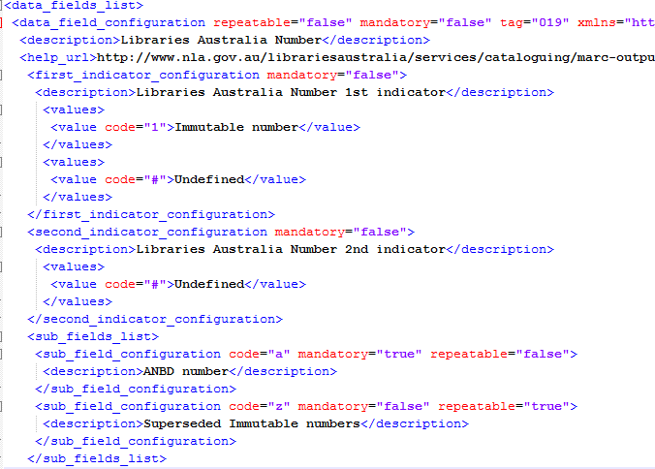
Adding an extension pack
Step 2 is to edit the file to accommodate the desired changes to the MARC 21 profile.

Slide 15
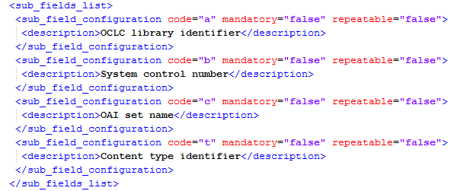
Adding an extension pack
For 029 field, for example, the section for subfields will be defined in the following format:

Slide 16
Adding an extension pack
Step 3 is to add the file as an extension pack to the bibliographic profile

Slide 17
Adding an extension pack
Step 3 is to add the file as an extension pack to the bibliographic profile

Slide 18
Adding an extension pack
The extension is successfully loaded
Click “Deploy” after the file is loaded

Slide 19
Adding an extension pack
The 019 and 029 fields have been added to the profile with definitions from the extension pack xml file

Slide 20
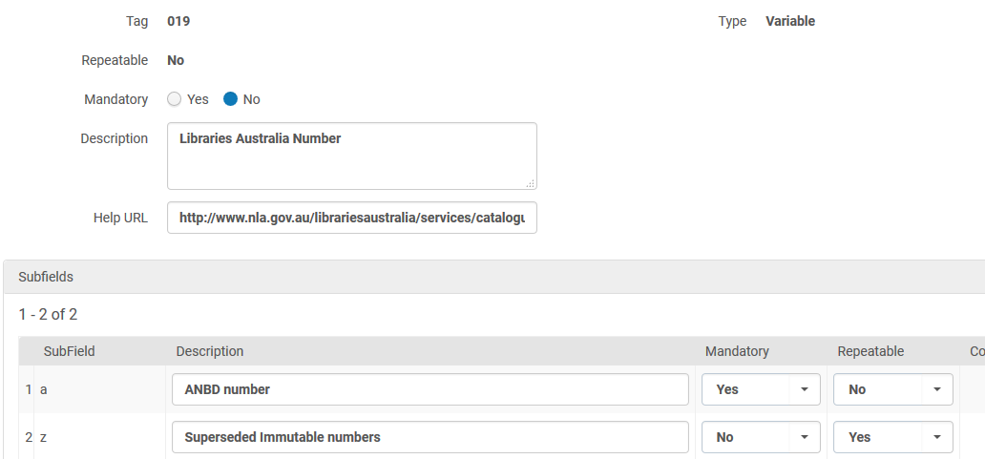
Adding an extension pack
The 019 and 029 fields have been added to the profile with definitions from the extension pack xml file

Slide 21
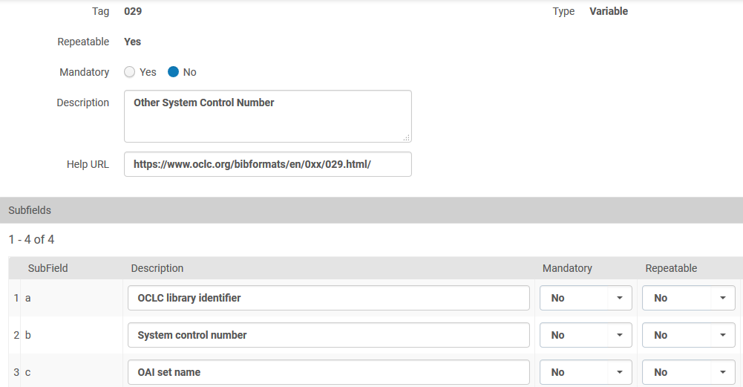
Adding an extension pack
The 019 and 029 fields have been added to the profile with definitions from the extension pack xml file

Slide 22
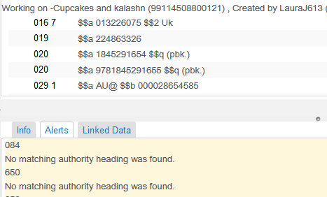
Adding an extension pack
And now there is no error message for the 019 or 029 field because they are a “legal” part of the bibliographic profile
The presence of a 019 or 029 does not cause a warning message

Slide 23
Adding an extension pack
Note: In the case of a consortial setup depending on configuration the extension pack may be needed to be added in the network institution to influence the consortial member institutions.

Slide 24
Introduction
Two examples where customization is needed
Adding a field with an extension pack
Tentative future developments
https://slidemodel.com/templates/animated-rainbow-business-powerpoint-template/
http://image.shutterstock.com/z/stock-photo-business-hand-writing-blank-agenda-list-130255148.jpg

Slide 25
Tentative future developments
It will be tentatively possible to download the extension pack file from the bibliographic profile for purposes of editing and reloading (internal: 2017 Q1 URM-45100)
New option to download file will be added here, will be part of sharing option

Slide 26
Tentative future developments
It will be possible to share the extension pack file with the community as well as copy a file from the community (internal: 2017 Q1 URM-45100)
New option to share file will be added here

Slide 27
Thank you yoel.Kortick@exlibrisgroup.com
https://upload.wikimedia.org/wikipedia/commons/c/c6/Vienna_University_of_Technology_DSC1189.jpg
Technische Universität Wien
http://pds.exblog.jp/pds/1/201010/12/50/d0162650_4111788.jpg

