Slide 1
Indication rules and set filtering
Yoel Kortick Senior Librarian
http://www.thisiscolossal.com/2017/06/enchanting-libraries-by-photographer-thibaud-poirier/

Slide 2
Introduction
Creating indication rules and processes
Using an indication rule on a set
https://slidemodel.com/templates/animated-rainbow-business-powerpoint-template/
http://image.shutterstock.com/z/stock-photo-business-hand-writing-blank-agenda-list-130255148.jpg

Slide 3
Introduction
Indication rules are used to retrieve data according the presence (or non-presence) of data in fields or subfields.
Unlike indexes, the indication rules can work on any field / subfield / content combination and does not require that the field has been indexed.
The data is retrieved by building an indication rule and then running it to filter a set.

Slide 4
Introduction
For example a library might want to retrieve all records which contain a 76X - 78X Linking entry field
A set could be made of all records (or a subset of the records) and then an indication rule could be run which would contain a 76X - 78X Linking entry field.
A new itemized set is made with the results of the indication rule filtering the set.

Slide 5
Introduction
The indication rules are written in a specific syntax which is based on the same syntax as the indication rules
Several example are available here: https://knowledge.exlibrisgroup.com/@api/deki/files/51522/Rules_-_Indication_rule_examples.docx

Slide 6
Introduction
This presentation will not discuss the specific syntax of the indication rules.
The focus here will be specifically on how the indication rules are created as well as how and where the rules may be used.
An in depth explanation of the syntax as well as several examples may be found in the Knowledge center in the “Working with Indication Rules” section

Slide 7
Introduction
Creating indication rules and processes
Using an indication rule on a set
https://slidemodel.com/templates/animated-rainbow-business-powerpoint-template/
http://image.shutterstock.com/z/stock-photo-business-hand-writing-blank-agenda-list-130255148.jpg

Slide 8
Creating indication rules and processes
The indication rules are created either
In the metadata editor via menu “File > new > indication rules”
From the left pane by doing “duplicate” on an existing indication rule
By copying an existing rule from the community

Slide 9
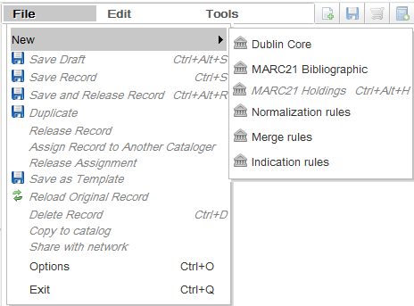
Creating indication rules and processes
In the metadata editor via menu “File > new > indication rules”

Slide 10
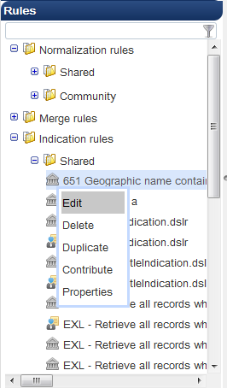
Creating indication rules and processes
From the left pane by doing “duplicate” on an existing indication rule

Slide 11
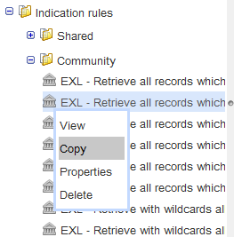
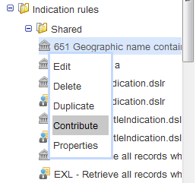
Creating indication rules and processes
By copying an existing rule from the community
Contribute rule to the community
Copy rule to the community

Slide 12
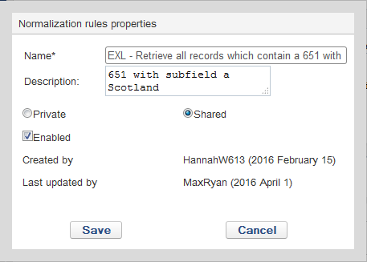
Creating indication rules and processes
indication rule properties
A logical name and description to later know what this rule does
Choose shared if you want other uses to also access this rule
Choose enabled if you want this rule to be active. When still editing and testing you may wish to leave it not enabled

Slide 13
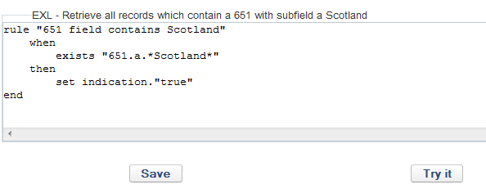
Creating indication rules and processes
After defining the properties enter (or edit existing) text of the indication rule and click ‘save’
This rule will find records which have “Scotland” in the 651 field. This is not possible via regular search because 651 is indexed in “Subjects” and “Subjects (LC)” along with many other fields.

Slide 14
Testing the indication rules
an indication rule can be tested as follows:
Open a bibliographic record in edit mode
Switch to split editor mode.
Leave the bibliographic record in the left pane of split window
Focus on the right pane of split window
Select the indication rule and choose “edit”
Click “Try It” on the rule
Results will be either True or False

Slide 15
Testing the indication rules
Preview the results of the indication rule

Slide 16
Testing the indication rules
Preview the results of the indication rule
Results is false because the rule looks for any record with a 651 which contains Scotland

Slide 17
Testing the indication rules
Preview the results of the indication rule
Results is true because the rule looks for any record with a 651 which contains Scotland

Slide 18
Introduction
Creating indication rules and processes
Using an indication rule on a set
https://slidemodel.com/templates/animated-rainbow-business-powerpoint-template/
http://image.shutterstock.com/z/stock-photo-business-hand-writing-blank-agenda-list-130255148.jpg

Slide 19
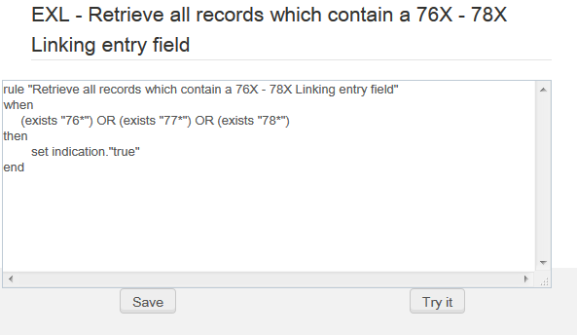
Using an indication rule on a set
We will now use the following rule which filters for records which contain a 76X - 78X Linking entry field

Slide 20
Using an indication rule on a set
From the list of sets we choose “Filter Set”

Slide 21
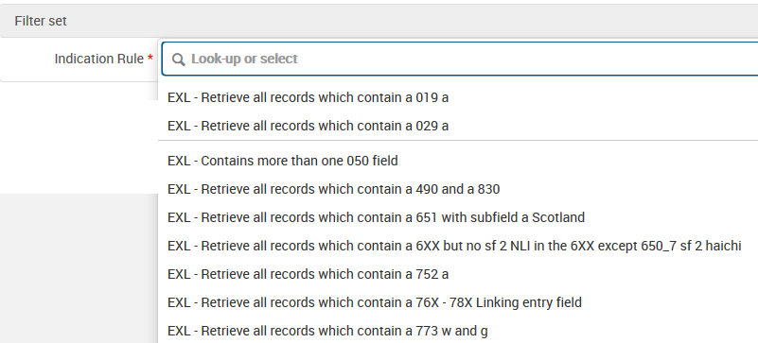
Using an indication rule on a set
Choose the indication rule to run on the set

Slide 22
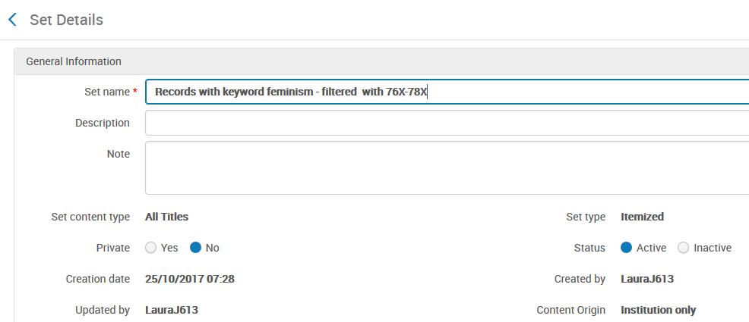
Using an indication rule on a set
Give a name to the new set and submit

Slide 23
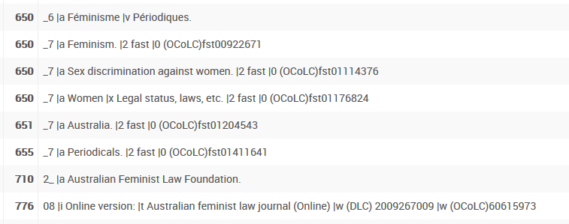
Using an indication rule on a set
See that all records in the new set have a field within the range of 76X-78X

Slide 24
Thank you
Yoel Kortick Senior Librarian
http://www.thisiscolossal.com/2017/06/enchanting-libraries-by-photographer-thibaud-poirier/

