Slide 1
Merge Rules and Routines
Yoel Kortick | Senior Librarian

Slide 2
Agenda
Introduction
Configuring the merge routine to the type of import
Sample merge routine for import from search external resource
Sample merge routine for import from import profile
Merge two records but keep original 77X fields

Slide 3
Introduction – when are they used
This presentation should be used in addition to the On Line help at ‘Metadata Management > Working with Merge Rule’
The merge routines are used when
Merging a record from ‘Search External Resources’ with an existing Alma record
Merging a record from an ‘Import profile’ with an existing Alma record
Importing records from OCLC
Merging two already existing records

Slide 4
Introduction – the ‘preferred’ record
When performing the merge via ‘Search External Resources’ the ‘Preferred’ (also known as ‘Primary’) record is the ‘External’ record.
When performing the merge via an ‘Import Profile’ the ‘Preferred’ record is the record which already exists in Alma.
When performing the merge via a `OCLC Connexion’ the ‘Preferred’ record is the record which already exists in Alma.
When performing the merge of two existing records the ‘Preferred’ record is the record in the left pane of the Alma metadata editor

Slide 5
Introduction – the parameters
There are three parameters used in the merge routines:
Add
Remove
Replace
For in-depth details of these parameters see the on-line help section “Merge Rules - Syntax and Examples“.

Slide 6
Introduction - ‘Search External Resources’
When importing records from the ‘Search External Resources’ the ‘external’ record will become the new record and then the
‘Remove’ parameter means ‘remove the field from the new record’.
‘Add’ parameter means ‘Add the field from the existing Alma record to the new record’.
‘Replace’ means `replace the field(s) in the new record with the field(s) from the Alma record’. This is the same as a ‘remove’ followed by an ‘add’.
For more in depth explanations of the parameters see the On Line Help at: ‘Metadata Management > Working with Merge Rules > Merge Rules - Syntax and Examples’

Slide 7
Introduction - ‘Search External Resources’
Record already in Alma
Record in External Resource
(Preferred record)
New Record
Data
Data
Fields are removed with REMOVE parameter
Fields are added and replaced with fields from the record already in Alma with the ADD and REPLACE parameters
Final Record

Slide 8
Introduction - ‘Import Profile’
When importing records from ‘Import profile’ the record which exists in Alma becomes the new record and then the
‘Remove’ parameter means ‘Remove the field from the new record.
‘Add’ parameter means ‘add the field from the input file to the new record’.
‘Replace’ means `replace the field in the new record with the field(s) from the input file’. This is the same as a ‘remove’ followed by an ‘add’.

Slide 9
Introduction - ‘Import Profile’
Record already in Alma
(Preferred record)
Record in input file
Data
New Record
Data
Fields are removed with REMOVE parameter
Fields are added and replaced with fields from the record in the input file with the ADD and REPLACE parameters
Final Record

Slide 10
Agenda
Introduction
Configuring the merge routine to the type of import
Sample merge routine for import from search external resource
Sample merge routine for import from import profile
Merge two records but keep original 77X fields

Slide 11
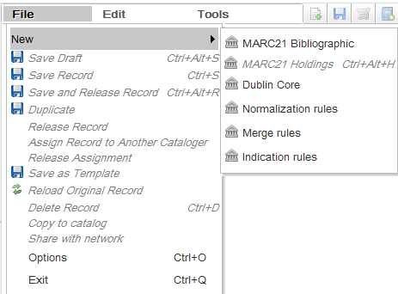
Configuring the merge routine to the type of import
The merge routines are created in the metadata editor via the ‘File > New” option

Slide 12
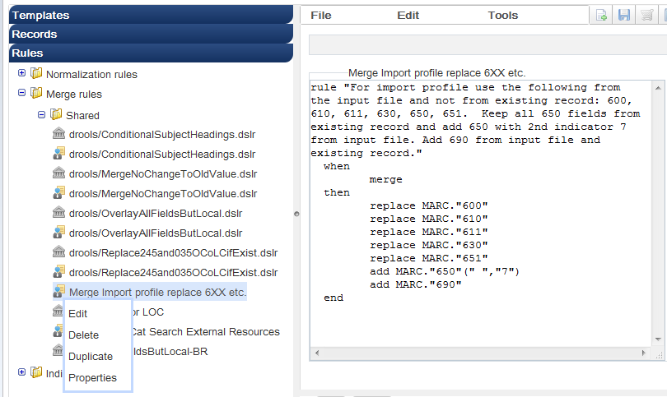
Configuring the merge routine to the type of import
The merge routines are edited via the navigation pane “Rules” section in the metadata editor

Slide 13
Configuring the merge routine to the type of import
Once the rule is made it must be “attributed” to a specific processes where it will take effect.
If the goal is to have the merge routine take effect when importing from a specific external resource via search external resource then the merge rule should be added to the “Merge Method” field of the external search resource
The external search resource is edited under Resource Management Configuration menu > Search Configuration > External Search Resources

Slide 14
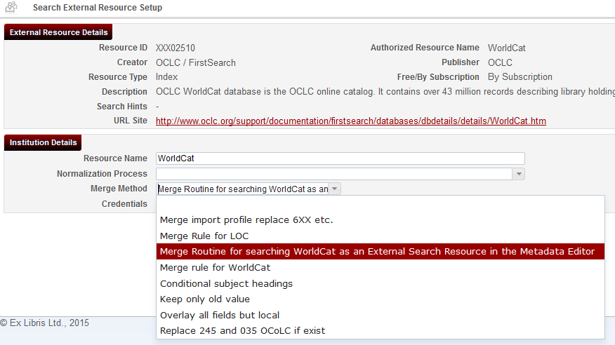
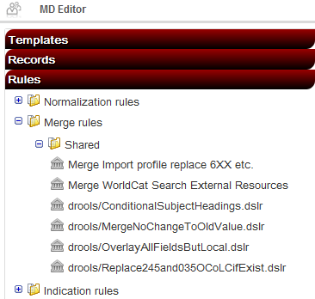
Configuring the merge routine to the type of import

Slide 15
Configuring the merge routine to the type of import
If the goal is to have the merge routine take effect when running an import profile then the merge rule should be added to the “Merge Method” field of the import profile
The import profile is edited under Resource Management Configuration menu > Record Import > Import Profiles

Slide 16
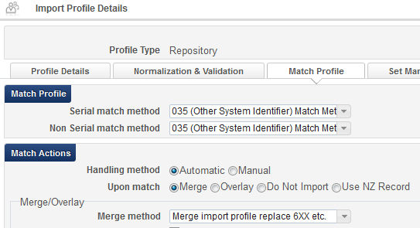
Configuring the merge routine to the type of import

Slide 17
Configuring the merge routine to the type of import
If the goal is to have the merge routine take effect when using OCLC Connexion then the merge rule should be added to the “Merge Method” field of the OCLC Connexion integration profile
The OCLC Connexion integration profile is edited under General Configuration Menu > External Systems > Integration Profiles

Slide 18
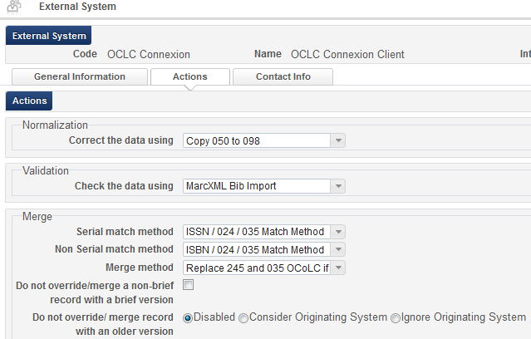
Configuring the merge routine to the type of import

Slide 19
Configuring the merge routine to the type of import
If the goal is to have the merge routine take effect when merging two existing records in the metadata editor then the merge rule is chosen in the user interface

Slide 20
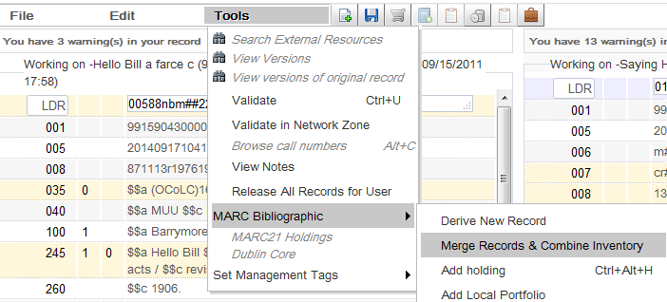
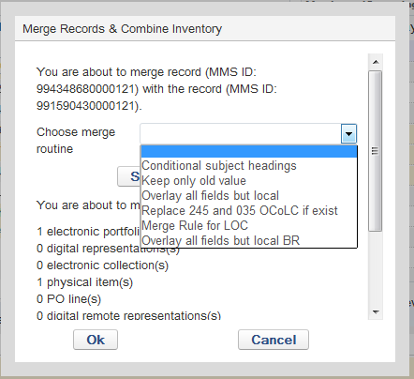
Configuring the merge routine to the type of import

Slide 21
Agenda
Introduction
Configuring the merge routine to the type of import
Sample merge routine for import from search external resource
Sample merge routine for import from import profile
Merge two records but keep original 77X fields

Slide 22
Sample merge routine for import from search external resource
The merge rule in this example is designed to be used when ‘copy cataloging’ from WorldCat.
In other words, the merge rule will be used when the following occurs:
Cataloger is in Metadata editor and has record open in edit mode
Cataloger does ‘Search External Resources’
Right pane opens with search option
Cataloger searches for matching record in WorldCat
Cataloger finds desired record and chooses ’Copy & Merge’ or ‘Merge Preview’

Slide 23
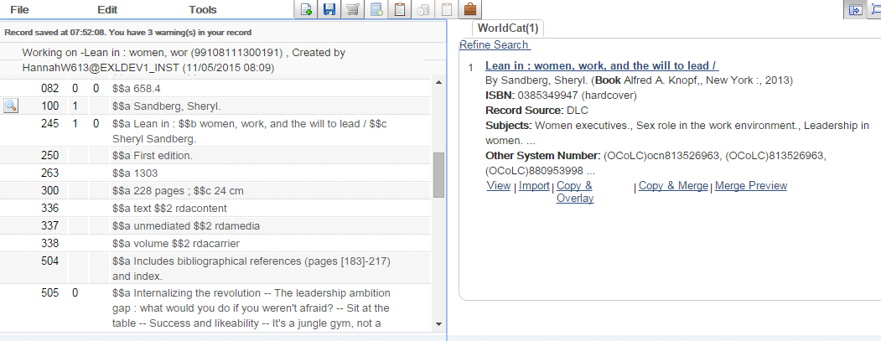
Sample merge routine for import from search external resource
Choose “Copy & Merge” for record (This example has ‘Other System Number’ 813526963)

Slide 24
Sample merge routine for import from search external resource
The merge rule in this example is designed to do as follows:
Take all fields from incoming (preferred) record except the following:
019
029
948
952
Keep the following fields from record already in Alma:
035 with no indicators if subfield a has ‘aleph’ or ‘Aleph’
035 with 1st indicator 9 and 2nd indicator blank
All 59X fields
Field 690
Field 948

Slide 25
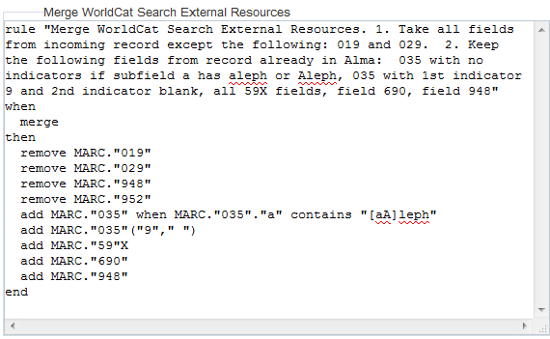
Sample merge routine for import from search external resource
Here is the merge rule in this example:

Slide 26
Sample merge routine for import from search external resource
Here is the merge rule in this example:
rule "Merge WorldCat Search External Resources"
when
merge
then
remove MARC."019"
remove MARC."029"
remove MARC."948"
remove MARC."952"
add MARC."035" when MARC."035"."a" contains "[aA]leph"
add MARC."035"("9"," ")
add MARC."59"X
add MARC."690"
add MARC."948"
end
All merge routines will have this
These will be removed from incoming record (the new record will be created without these fields)
These will be “saved” in existing record in Alma (added from existing to new record)

Slide 27
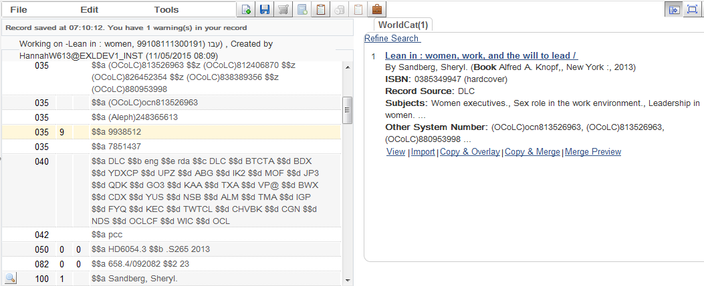
Sample merge routine for import from search external resource
Here are the records side by side
First we will click “View” to compare the records

Slide 28
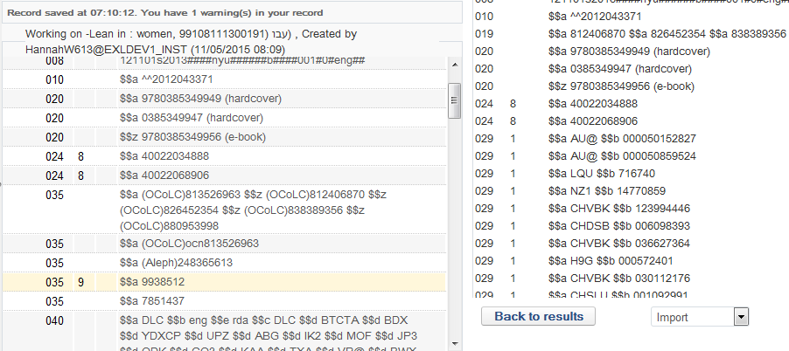
Sample merge routine for import from search external resource
Here are the records side by side
Alma Record
Incoming Record
The 035 fields with green arrows above in existing record should be saved because they meet the rule criteria. Other 035 fields should be removed.
The 019 and 029 fields should be removed from the incoming record

Slide 29
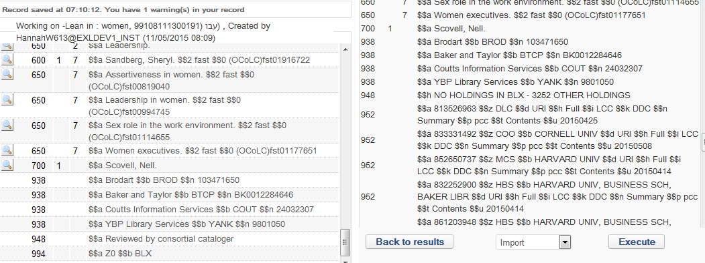
Sample merge routine for import from search external resource
Here are the records side by side
Alma Record
Incoming Record
The 948 in the existing Alma record should be “saved”
The 948 and 952 fields should be removed from the incoming record

Slide 30
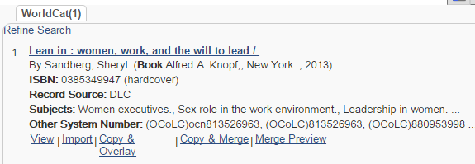
Sample merge routine for import from search external resource
Now we will do “Copy & Merge”

Slide 31
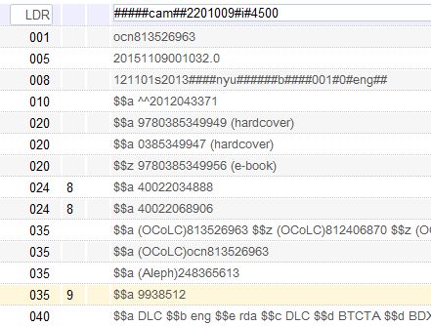
Sample merge routine for import from search external resource
The 019 and 029 fields were not imported with the WorldCat record because of these two lines in the merge routine:
remove MARC."019"
remove MARC."029"

Slide 32
Sample merge routine for import from search external resource
These 035 fields were imported from the WorldCat record because we never stated the following in the merge routine:
remove MARC."035"
These 035 fields were “saved” from the existing record because we stated the following in the merge routine:
add MARC."035" when MARC."035"."a" contains "[aA]leph"
add MARC."035"("9"," ")

Slide 33
Sample merge routine for import from search external resource
This 948 is from the original Alma record because we stated first to remove it from the incoming record and then save it in the Alma record:
remove MARC."948"
add MARC."948"

Slide 34
Sample merge routine for import from search external resource
These 938 fields are from the incoming WorldCat record. We know they are from the incoming WorldCat record because
We never stated as follows which would have removed them from the incoming WorldCat record:
remove MARC."938”
We never stated as follows which would have saved them in the original Alma record (would have added from original Alma record to the new record):
add MARC."938”

Slide 35
Agenda
Introduction
Configuring the merge routine to the type of import
Sample merge routine for import from search external resource
Sample merge routine for import from import profile
Merge two records but keep original 77X fields

Slide 36
Sample merge routine for import from import profile
The merge rule in this example is designed to do as follows:
Use the following from the input file and not from existing record: 600, 610, 611, 630, 650, 651.
Keep all 650 fields from existing record and add 650 with 2nd indicator 7 from input file.
Add 690 from input file and also have the 690 from the existing record.

Slide 37
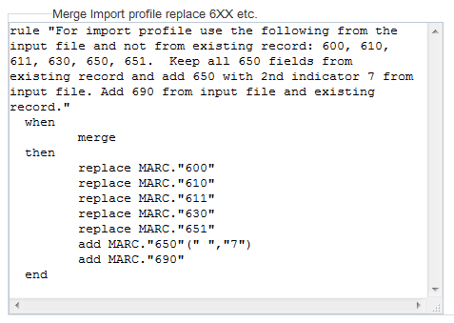
Sample merge routine for import from import profile
Here is the rule:

Slide 38
Sample merge routine for import from import profile
Here is the rule:
rule "For import profile use the following from the input file and not from existing record: 600, 610, 611, 630, 650, 651. Keep all 650 fields from existing record and add 650 with 2nd indicator 7 from input file. Add 690 from input file and existing record."
when
merge
then
replace MARC."600"
replace MARC."610"
replace MARC."611"
replace MARC."630"
replace MARC."651"
add MARC."650"(" ","7")
add MARC."690"
end

Slide 39
Sample merge routine for import from import profile
Here is a partial screenshot of the record already in Alma (This example has ‘Other System Number’ 810117730):

Slide 40
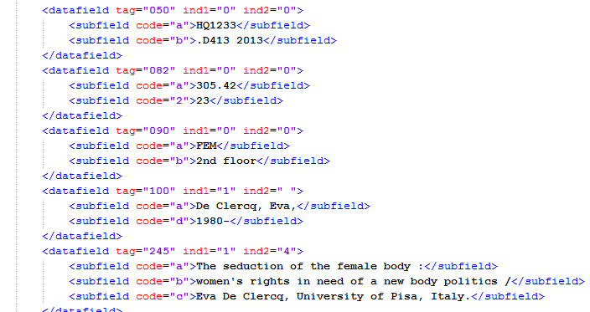
Sample merge routine for import from import profile
Here is a partial screenshot of the record in the input file
Part 1 of 2
Classification fields

Slide 41
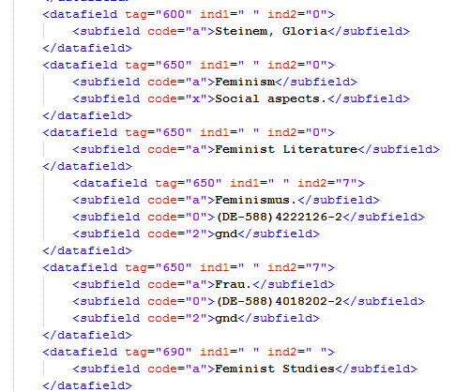
Sample merge routine for import from import profile
Here is a partial screenshot of the record in the input file
Part 2 of 2
6XX fields

Slide 42
Sample merge routine for import from import profile
The record is imported via an import profile

Slide 43
Sample merge routine for import from import profile
Here is the new record
The 096 of the original Alma record remains and the 090 of the input file does not get added because we never stated: add MARC."090"

Slide 44
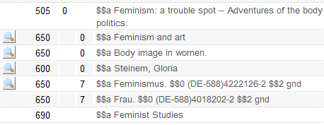
Sample merge routine for import from import profile
Here is the new record
The original 600 from the Alma record with “Watson, Emma” was replaced with the 600 from the input file because we stated: replace MARC."600"
These 650s are from the original record in Alma. The 650 with “Feminist Literature” was not added from the input file because we did not state either of these two lines: replace MARC."650"
add MARC."650"
The only 650 fields which were added from the input file have 2nd indicator 7 because we have this line:
add MARC."650"(" ","7")
The only 690 was added from the input file because we have this line:
add MARC."690”

Slide 45
Agenda
Introduction
Configuring the merge routine to the type of import
Sample merge routine for import from search external resource
Sample merge routine for import from import profile
Merge two records but keep original 77X fields

Slide 46
Merge two records but keep original 77X fields
In this example we will merge two records and
Keep the original 77X fields in the record which already exists in the repository
Not use the 77X fields from the WorldCat record
Keep both repository 6XX fields and WorldCat 6XX fields
Add all other additional fields which are in the WorldCat record and not in the repository record
Here is the rule, called “Replace all fields except the 77X fields”
rule "Replace all fields except 77X fields"
when
merge
then
remove MARC."77X"
replace MARC.XXX excluding "6XX,77X"
end

Slide 47
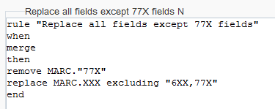
Merge two records but keep original 77X fields
Here is the rule in the metadata editor

Slide 48
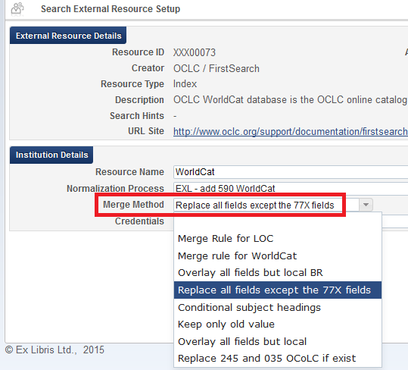
Merge two records but keep original 77X fields
Inside the WorldCat external search resource we choose this merge rule so it will be used when merging a repository record with a WorldCat record:

Slide 49
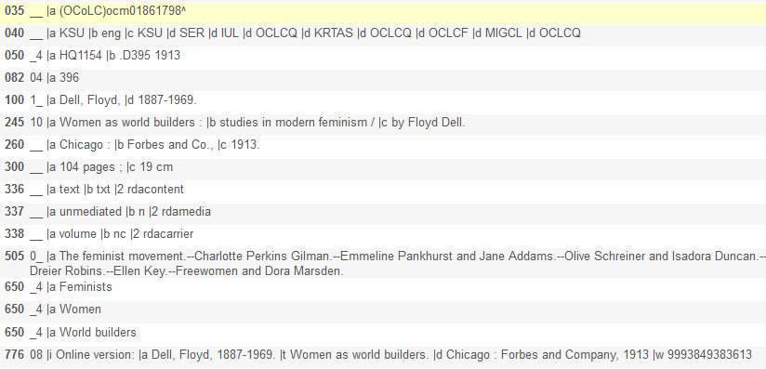
Merge two records but keep original 77X fields
Here is title “Women as world builders : $$b studies in modern feminism” already in the repository with a 776 field

Slide 50
Merge two records but keep original 77X fields
Searching WorldCat we find a matching record.
The matching record in WorldCat
Also has a 776 field.
The WorldCat 776 field has $$w (OCoLC)647686383
The repository record has 776 $$w 9993849383613
Has different 650 fields
The WorldCat record has two 650 0 fields and two 650 7 fields
The repository record has three 650 4 fields
Has an 856 field
The repository record has no 856 field

Slide 51
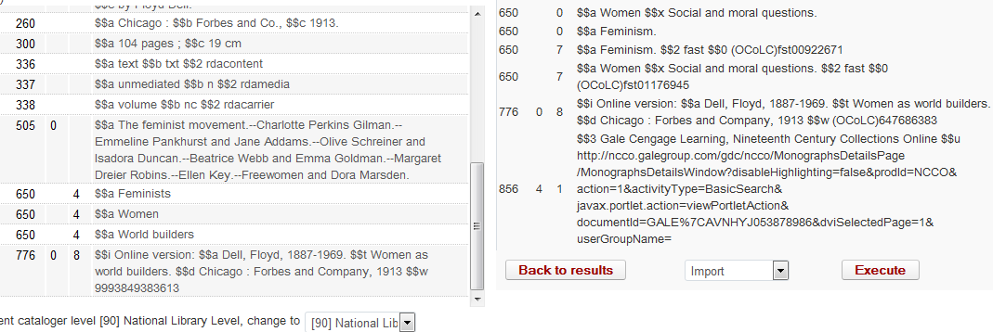
Merge two records but keep original 77X fields
Repository record
WorldCat record

Slide 52
Merge two records but keep original 77X fields
Now we will do “Merge Preview to see the results”
From “View” mode of the WorldCat record
From search results

Slide 53
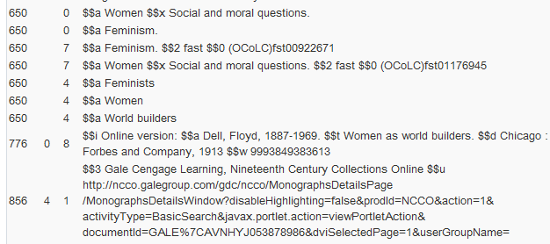
Merge two records but keep original 77X fields
Successful results
650 fields from both the repository record and the WorldCat record
776 from repository record is kept. 776 from WorldCat is not imported
856 from WorldCat is imported. There was no 856 in the repository record

Slide 54
THANK YOU
Yoel.Kortick@exlibrisgroup.com

