Slide 1
Routing lists in Alma
Yoel Kortick Senior Librarian
http://gwk.udk-berlin.de/wp-content/uploads/2012/11/TU-Universitaetsbibliothek.jpg

Slide 2
Routing lists
It is often the case that serial issues need to be “routed” to various users, in a specific order, when they are received.
While this may also be the case for monographs or other “one-time” type orders, it is more typical for serial issues.
When a serial issue needs to be routed to various users when it is received, the POL should have the checkbox “Routing during Receiving” checked. The “Routing during Receiving checkbox” is in the “Additional” section of the POL

Slide 3
Routing lists
The “Routing during Receiving checkbox” indicates that when an item is received for the POL (selecting Actions > Receive) then a message will display indicating that the order is marked for routing.
Typically after being informed that the order is marked for routing the receiving operator will print the interested users list.
To print a list of interested users (for PO lines that are Marked for Routing), select “Actions > Print Interested Users List” for the relevant PO line

Slide 4
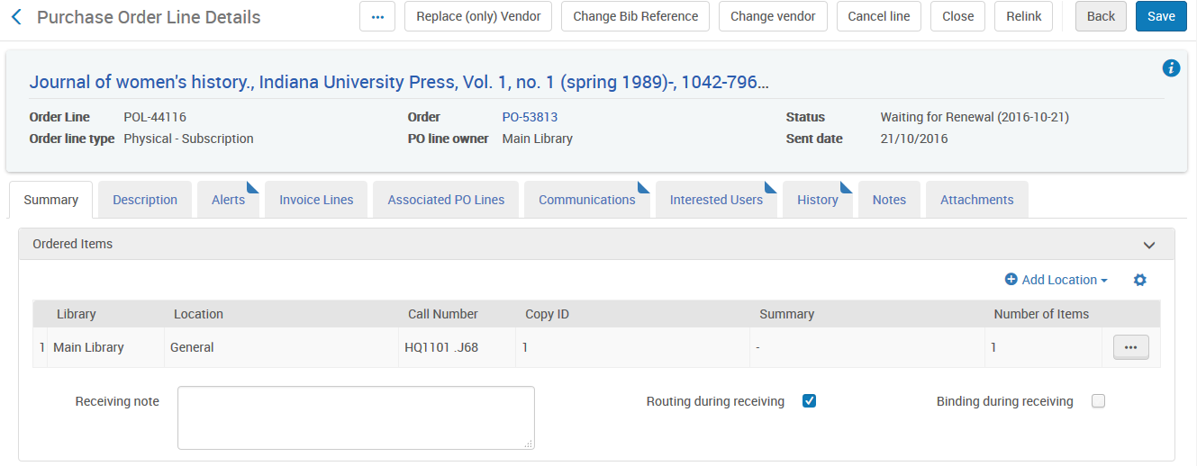
Routing lists
This is POL-44116 for serial title “Journal of women's history”. It contains an indication that it needs to be “Routed during receiving”

Slide 5
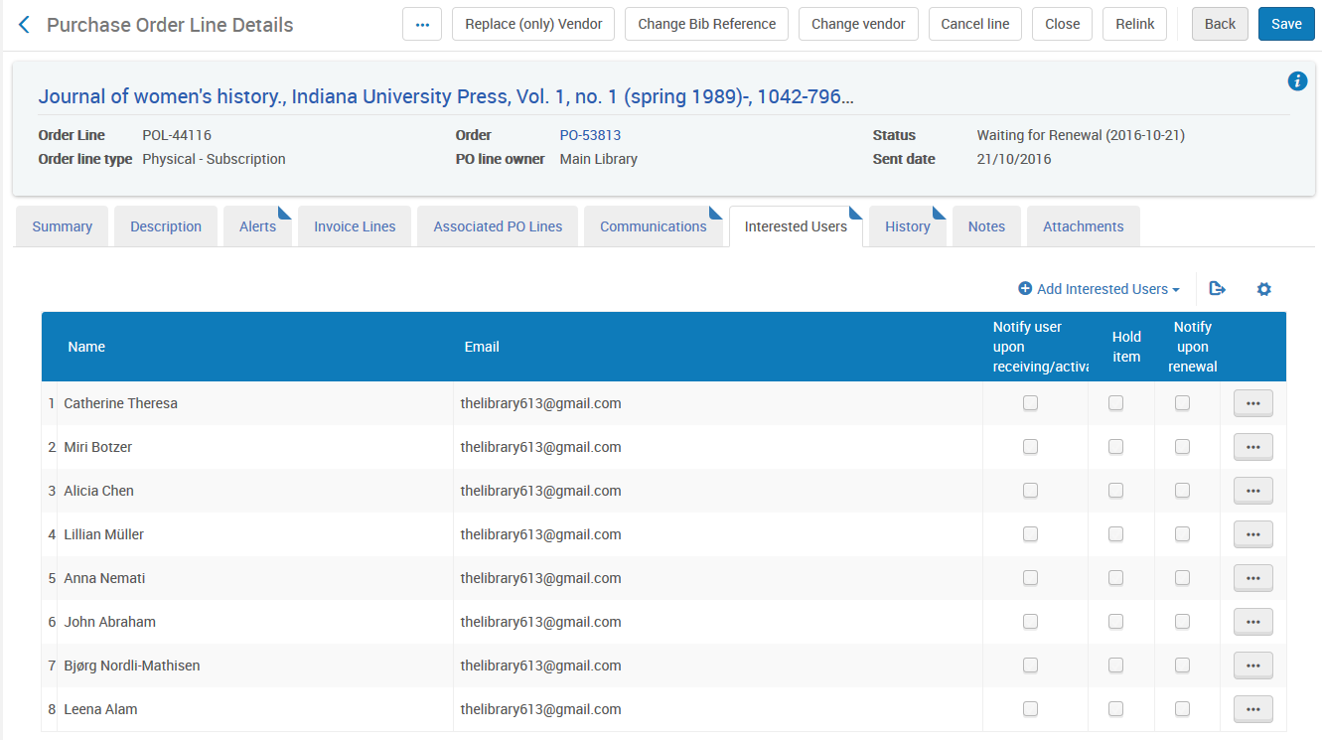
Routing lists
There are 8 interested users

Slide 6
Routing lists
We will now do “Actions > Receive” from the receiving workbench for POL-44116 title “Journal of women's history”.

Slide 7
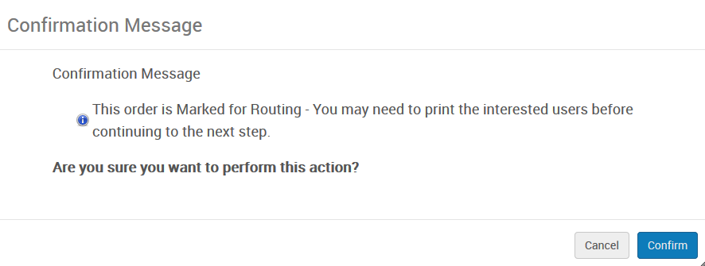
Routing lists
Now the staff user receives the following message:
“Cancel” will cancel the receiving process. The staff user may wish to print the list before receiving the item.
“Confirm” will continue the receiving process.

Slide 8
Routing lists
To print the routing list we will choose “Print interested users list” for the specific POL

Slide 9
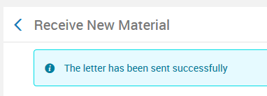
Routing lists
A message appears that the letter has been sent successfully
It is sent to the printer defined for the desk where the staff user is located.

Slide 10
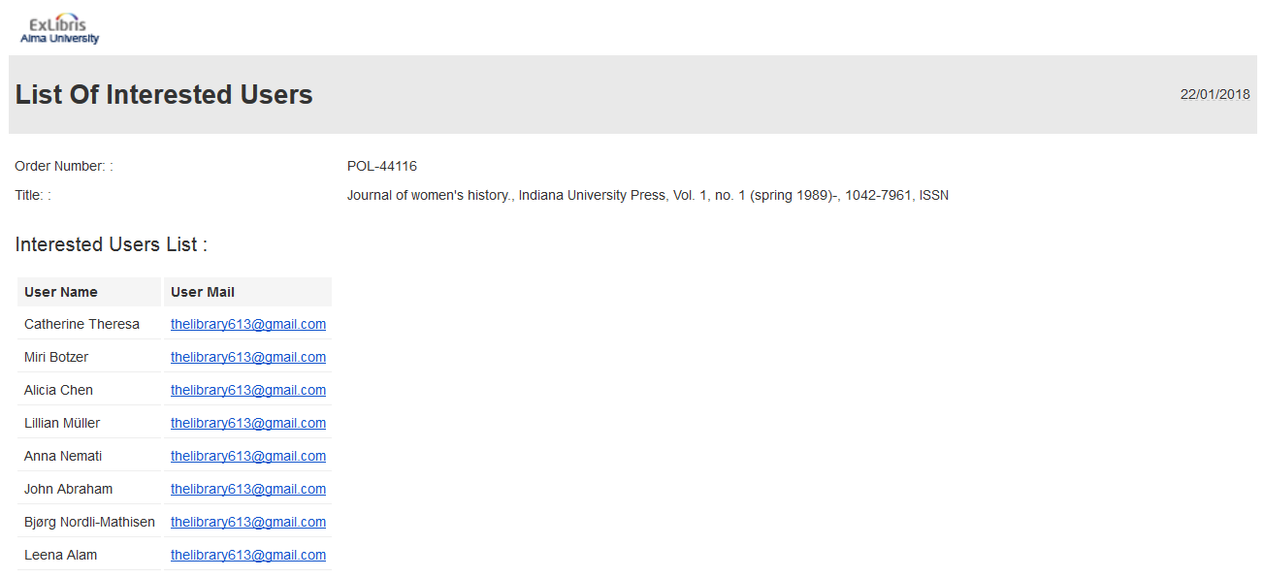
Routing lists
The list is printed and typically inserted in the serial issue as it goes from user to user

Slide 11
Thank you
Yoel Kortick Senior Librarian
http://israelvalley.s3-eu-west-1.amazonaws.com/files/000/011/391/original/big-data.png?1406714586

