Slide 1
Automated Fulfillment Network
Moshe Shechter | Alma Product Manager

Slide 2
The following slides present a process for an automated fulfillment network.
The features described in these slides are available as of June 2017

Slide 3
Concepts
Configuration
Workflow

Slide 4
Concepts

Slide 5
Concepts
The Automated Fulfillment Network is based on the following concepts
The patron places a resource sharing request
Patron does not have to select the potential lender
The patron request form is the same form as the classic Alma resource sharing request form
The request is placed from a Network Zone search scope, either in Alma or in Primo
The pickup location options include libraries at all of the other fulfillment network members
The request is forwarded to the fulfillment network member via the normal rota mechanism on the borrower side
Once the request is forwarded to the fulfillment network partner, it is handled as a regular hold request on the lender side

Slide 6
Concepts
The Automated Fulfillment Network is based on the following concepts
The fulfillment network members are defined as resource sharing partners, and use locate profiles
If the lender fails to fulfill the request, it is forwarded to the next partner in the rota, as a standard resource sharing request
The rota may be hybrid, i.e. include both fulfillment network partners and classic resource sharing (ILL) partners

Slide 7
Configuration

Slide 8
Fulfillment Network
The basic setup of a fulfillment network (i.e. list of fulfillment network members) is required for the process to work
In addition, the workflow is based on a shared discovery, i.e. a Network Zone Primo search scope or a Primo shared by multiple institutions that is achieved by any other type of Primo configuration.
The request must be placed from that shared discovery

Slide 9
Partners
When the institution is defined as a Fulfillment Network member, it will have an option to define partners with the type ‘Fulfillment Network’

Slide 10
Locate Profile
A special ‘Fulfillment Network’ type –
The requestability check of the profile will not consult the ‘Is Requestable for Resource Sharing’ policy
Rather, it will consult the ‘Is Requestable’ policy

Slide 11
Rota Template
The partner can be added to a rota template, which may be automatically assigned to borrowing requests, as per regular resource sharing configurations

Slide 12
Workflow – Use Case I

Slide 13
User Case I
In this use case, patron from U of W will request a resource that is managed at the Network Zone, and has items at Portland State
The request will be for pick up at Portland State

Slide 14
Primo Search
The patron uses the Primo search to find a resource that is owned by another member in the network. The search was conducted in a shared scope – for example a Network Zone scope
In our example, the patron is logged into Primo at his home institution – U of W
The requesting patron is ‘Demo 1’ – who is a patron at U of W but not at Portland State

Slide 15
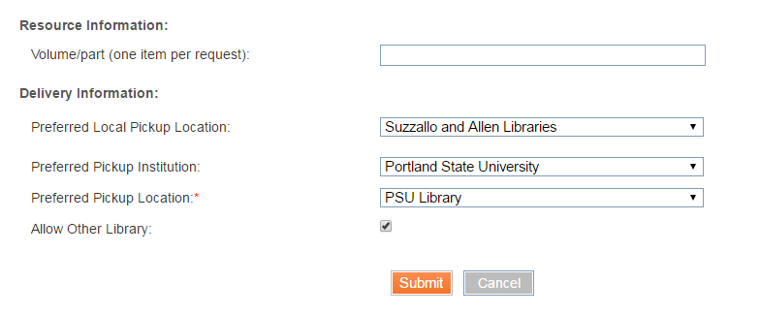
Primo Search
The request form allows a few additional pickup location options
‘Allow Other Library’ means that if the PSU library at Portland State cannot be the pickup location, but another library at Portland State can, then it will be used
The Preferred Pickup may be at any institution’s library
The Preferred Local Pickup is a library at the home institution, to which the item will be sent if the preferred library is not possible

Slide 16
Request is placed – U of W
On the borrower side, we have a new resource sharing request at U of W, with a rota that includes Portland State
The rota includes another ISO partner (PSU), to whom the request will be forwarded if the fulfillment network request fails

Slide 17
Request is placed – U of W
Note that if the pickup location is not the home institution, Alma will automatically manipulate the rota so that partners that can fulfill at the preferred pickup location will be pushed up. For example:
If the preferred pickup location is the PSU Library at Portland State then the partner record for the PSU Library at Portland State will be pushed up the rota.
The reason is that this partner is likely to be able to fulfill the request at the preferred pickup location, while requiring minimal transit logistics
The Portland State/PSU Library partner will be identified by
The partner institution code being the Portland State code
The partner holdings information being the PSU Library code

Slide 18
Request is placed – U of W
Note that if the pickup location is not the home institution, Alma will automatically manipulate the rota. The order of preference will be:
Partners at the library of the pickup location (their Holdings Code is the preferred pickup location’s Holdings Code)
Partners at the campus of the pickup location (their Holdings Code is the preferred pickup location campus’ Holdings Code)
Partners at the institution of the pickup location (their Institution Code is the preferred pickup institution’s code)
Other Fulfillment Network partners that have a ‘Deliver To’ relation with the preferred pickup institution
Other members, as organized on the rota template

Slide 19
Request is Managed – Portland State
The linked account has been created for patron Demo1 at Portland State, and a hold request has been created

Slide 20
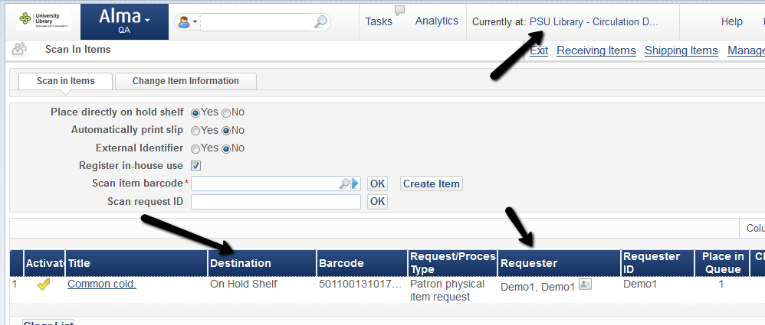
Request is Managed – Portland State
Item is picked off the shelf and put on hold shelf at PSU library

Slide 21
Request – U of W
When the request is placed on the hold shelf by Portland State, it is considered complete at U of W

Slide 22
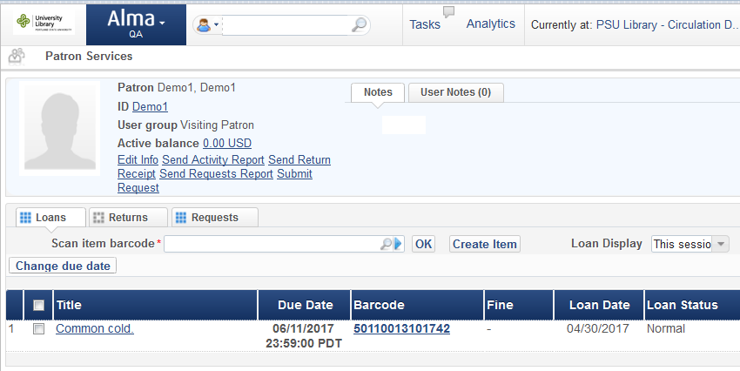
Loan Management - Portland State
The rest of the process is a fulfillment network loan. Portland state will loan the item to the U of W patron

Slide 23
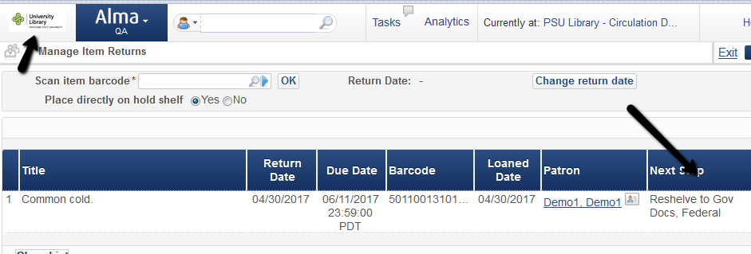
Loan Management - Portland State
The item return will have it reshelved

Slide 24
Workflow – Use Case II

Slide 25
User Case II
In this use case, patron from U of W will request a resource that is managed at the Network Zone, and has items at Portland State
The request will be for pick up at U of W

Slide 26
Primo Search
The patron uses the Primo search to find a resource that is owned by another member in the network. The search was conducted in a shared scope – for example a Network Zone scope
In our example, the patron is logged into Primo at his home institution – U of W
The requesting patron is ‘Demo 2’ – who is a patron at U of W but not at Portland State

Slide 27
Primo Search
The request form will be used to request pickup at a library of the home institution – U of W

Slide 28
Request is placed – U of W
On the borrower side, we have a new resource sharing request at U of W, with a rota that includes Portland State
The rota includes another ISO partner (PSU), to whom the request will be forwarded if the fulfillment network request fails

Slide 29
Request is Managed – Portland State
The linked account has been created for patron Demo2 at Portland State, and a hold request has been created

Slide 30
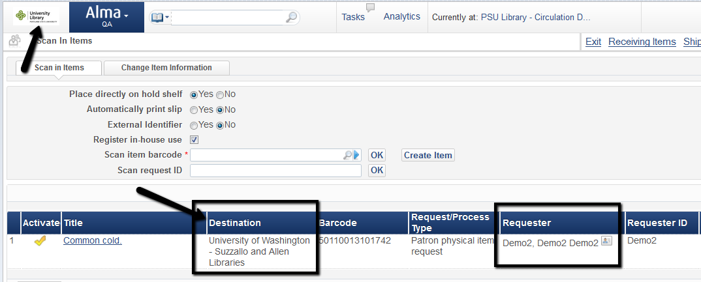
Request is Managed – Portland State
When the item is picked off the shelf and wanded in, it is put in transit to the pickup location at U of W

Slide 31
Request is Managed – U of W
When request is received at U of W, it is put on hold shelf

Slide 32
Request is Managed – U of W
Once requested item is on hold shelf, the borrowing request is considered completed

Slide 33
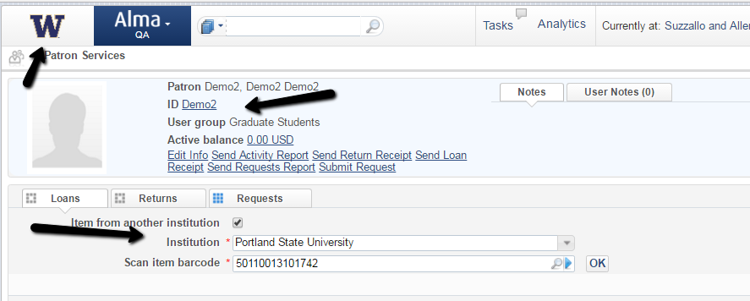
Loan is Managed – U of W
The item is then loaned to the U of W patron

Slide 34
Loan is Managed – U of W
The item is then returned by the U of W patron

Slide 35
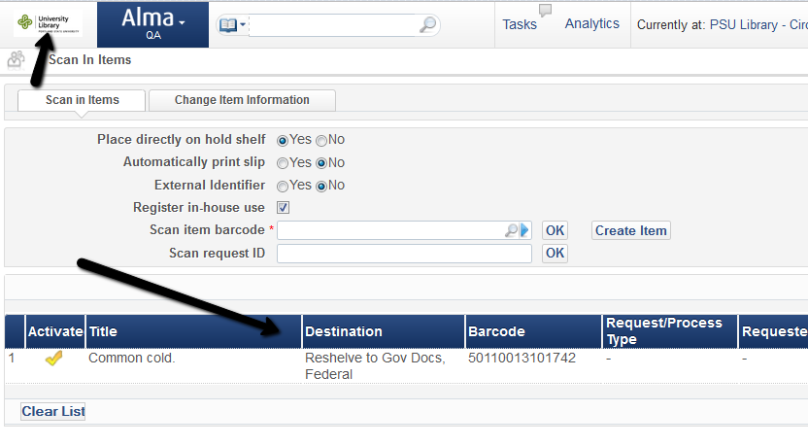
Loan is Managed – Portland State
Item is received back at Portland State and is reshelved

Slide 36
Workflow – Use Case III

Slide 37
User Case III
In this use case, patron from U of W will request a resource that is managed at the Network Zone, and has items at Portland State
The request will be rejected by Portland State, and will continue on in the rota to next partners

Slide 38
Placing the Request
The request will be placed as in the previous use cases, and created as a hold request at Portland State
On the borrower side (U of W), the request is a resource sharing request that has been sent to the Portland State Fulfillment Network Partner

Slide 39
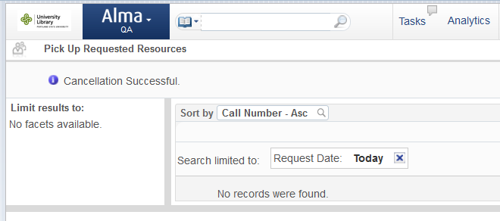
Rejecting the Request
On the Lender side (Portland State) the request is a hold request
The staff at Portland State may decide to cancel the request (for example because the item is not on the shelf)

Slide 40
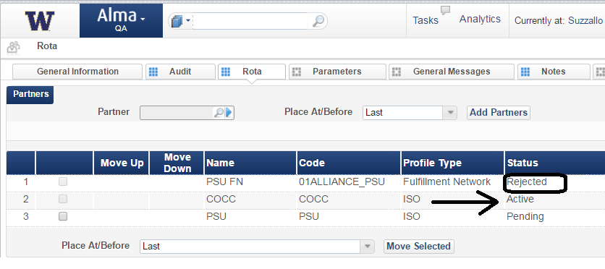
Rota is Activated
This will cause the rota on the borrower side to move on to the next partner in the rota, which may be another fulfillment network partner, or an ISO partner

Slide 41
Rota is Activated
This will cause the rota on the borrower side to move on to the next partner in the rota, which may be another fulfillment network partner, or an ISO partner
The request will be fulfilled by another partner on the rota !

Slide 42
Moshe.shechter@exlibrisgroup.com

