Slide 1
Funds in Resource Sharing

Slide 2
Funds in Resource Sharing
As of August 2017, it is possible to link borrowing resource sharing requests to Alma Funds
This enables managing shipping costs using Alma’s funds management tools

Slide 3
Configurations

Slide 4
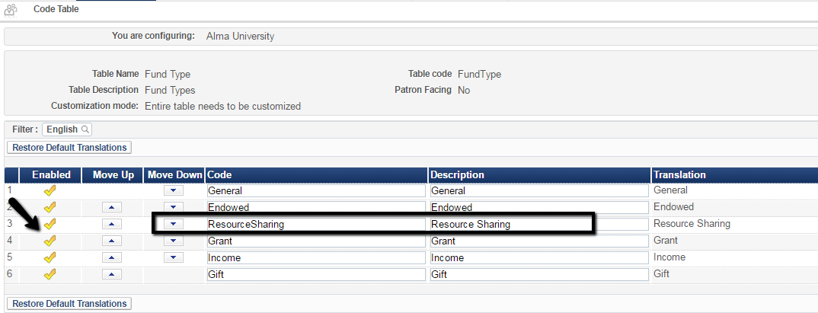
Configurations
The Fund Types code table should enable the ‘Resource Sharing’ Fund type. This fund type is disabled by default

Slide 5
Configurations
Create your resource sharing ledger and fund. The fund will be of type ‘Resource Sharing’
Ledger
Fund

Slide 6
Configurations
No change in fund and ledger management
The Fund should be allocated sums, just like any regular fund
Standard rules, such as ‘Overencumbrance allowed’ and ‘Overexpenditure limit sum’

Slide 7
Workflow - Encumbrance

Slide 8
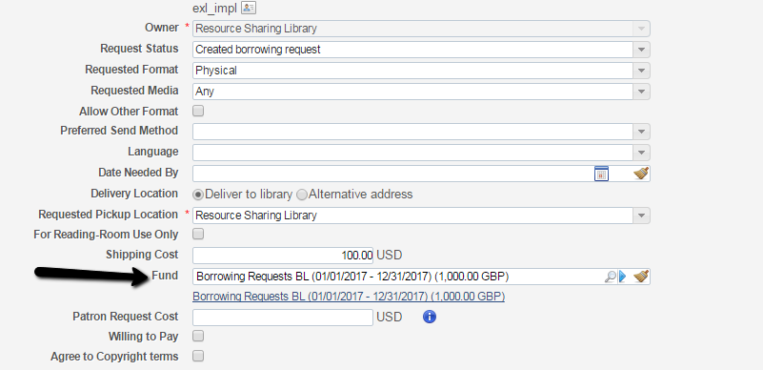
Workflow - Encumbrance
When creating a request (in Alma), or editing an existing request, there is an option to set a fund for the request

Slide 9
Workflow - Encumbrance
The list of funds to select from are funds that match all of the below criteria:
Funds are of type ‘Resource Sharing’
Funds belong to the active fiscal year

Slide 10
Workflow - Encumbrance
In addition, funds will appear :
If the funds’ ‘Available For’ is the institution
Or
If the funds’ ‘Available For’ matches the resource sharing library of the borrowing request

Slide 11
Workflow - Encumbrance
The request creates an encumbrance on the fund
In my example, the borrower request was with a shipping cost of $100. The fund is in GBP, resulting in an encumbrance of 77 GBP.

Slide 12
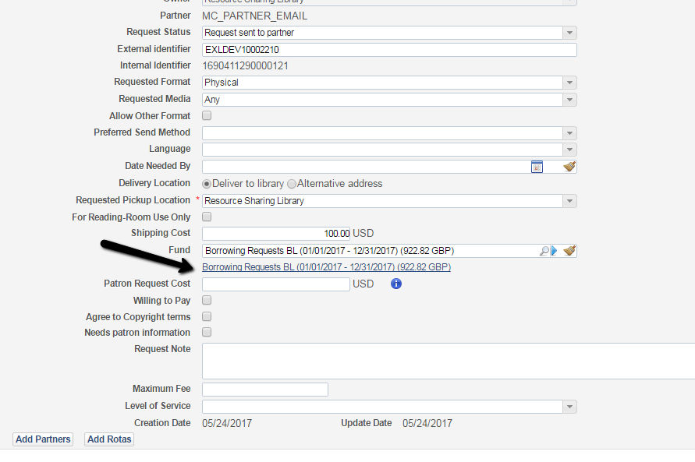
Workflow - Encumbrance
The fund transaction is linkable from the request

Slide 13
Workflow - Encumbrance
The request is linkable from the fund transaction

Slide 14
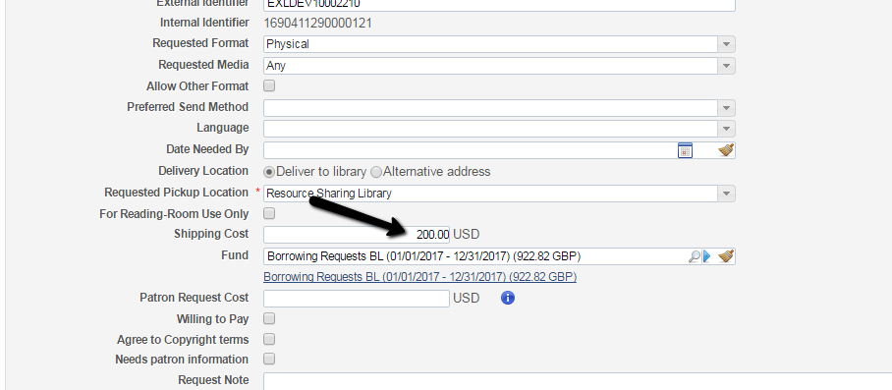
Workflow - Encumbrance
Changing the shipping cost will update the encumbrance

Slide 15
Workflow - Expenditure

Slide 16
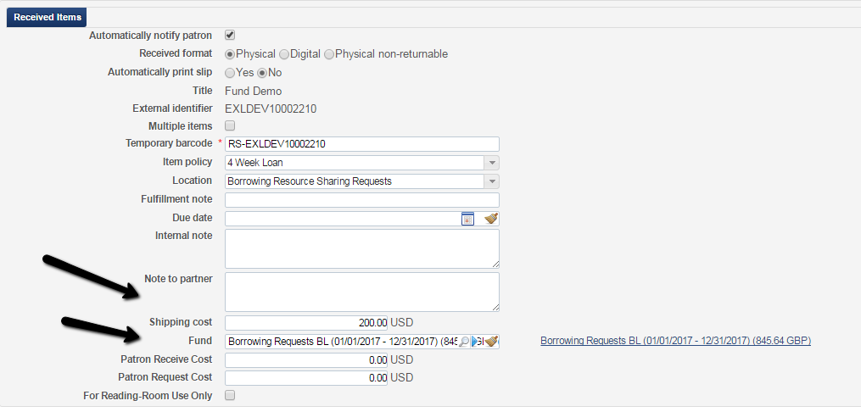
Workflow - Expenditure
For ISO requests, shipping cost may be automatically updated by the lender via the ‘Shipped’ message
It is possible to change the shipping cost and fund at receive time

Slide 17
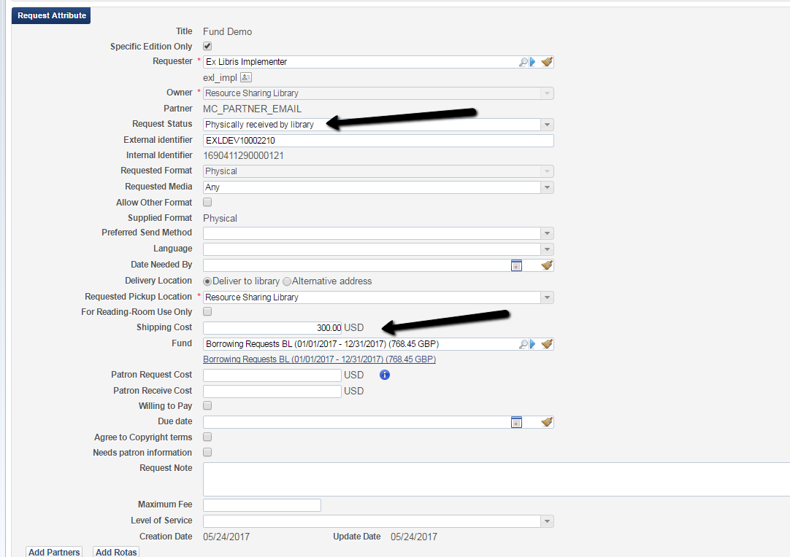
Workflow - Expenditure
It is also possible to change the shipping cost and fund after request is received

Slide 18
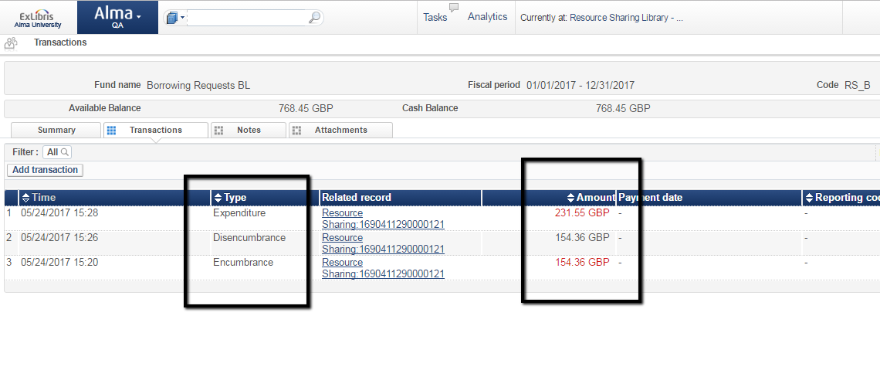
Workflow - Expenditure
After the receive is done:
The a dis-encumbrance is created to balance out the previously created encumbrance
An expenditure is created, as per the shipping cost at receive time

Slide 19
Workflow - Expenditure
It is also possible to edit the cost and fund information from within the Receive Items interface

Slide 20
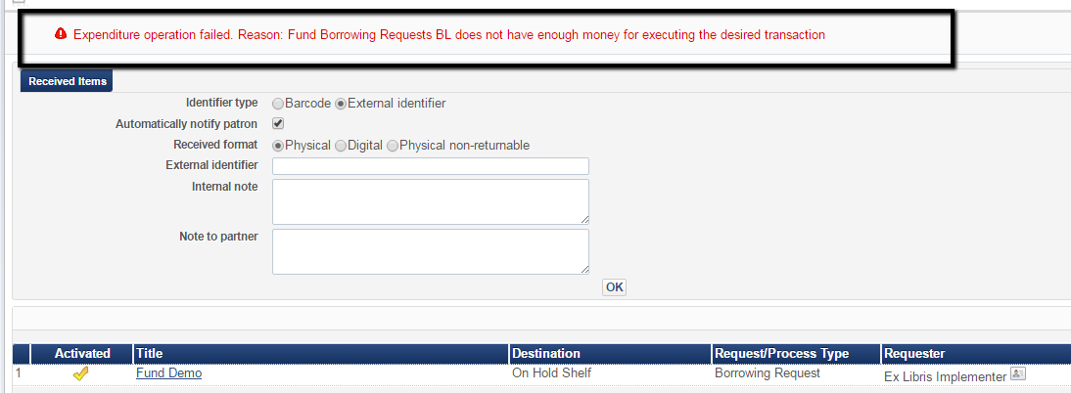
Workflow - Expenditure
If fund is over expended or over encumbered:
A warning will show up.

Slide 21
Workflow - Expenditure
If fund is over expended or over encumbered:
A faceted note will indicate this request in the task list

Slide 22
What Else ?

Slide 23
What Else
A Roll Over process, similar to the PO Line roll over process, manages rolling open resource sharing encumbrances from one fiscal year to the next
Still coming up:
An option to create a report of resource sharing expenditures that were created in a given period of time
An API to allow updating shipping costs from outside of Alma
A row action for shipping cost update
Managing partner currencies
Ability to assign specific Resource Sharing Funds to patrons

Slide 24
Moshe.shechter@exlibrisgroup.com

