Slide 1
RFID In Alma

Slide 2
Configurations

Slide 3
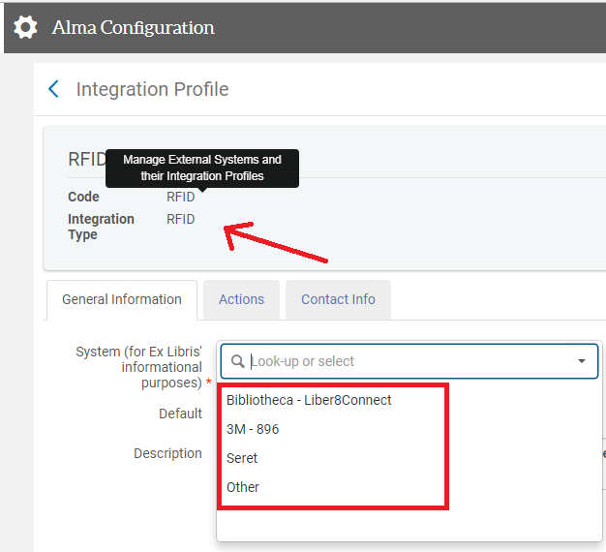
Integration Profile
Get RFID hardware and install the necessary hardware drivers
Create an RFID Integration Profile in Alma
Set the type of RFID system you are using

Slide 4
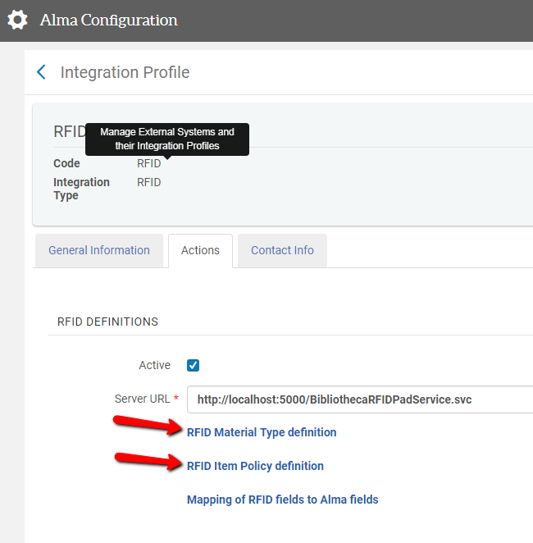
Mappings (1)
From the integration profile, it is possible to define a mapping between the codes used on the RFID tag and the codes used in the Alma inventory. Mapping is possible for:
Material Types
Item Policies

Slide 5
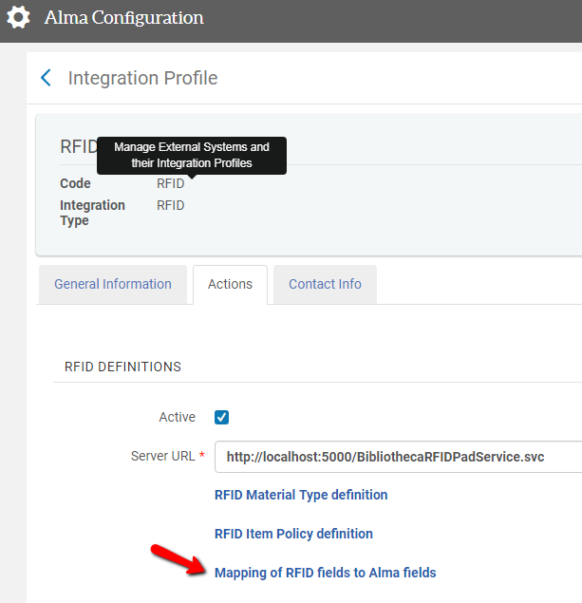
Mappings (1)
It is also possible to map the fields used by the RFID protocol and their mapping to the Alma inventory fields. You should normally not need to worry about this mapping

Slide 6
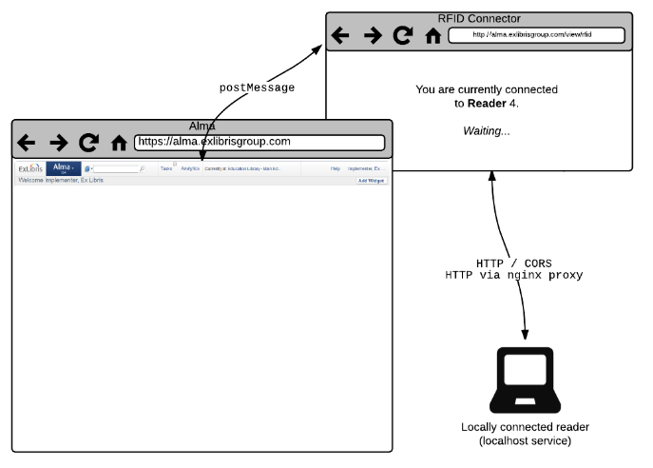
NGINX
Alma communicates with RFID devices that are installed locally on a staff workstation. In order to allow communication between Alma and the locally running RFID software, a proxy should be installed on the workstation.

Slide 7
NGINX
See http://nginx.org/en/ for instructions for the NGINX proxy
Instructions for setting up NGINX can be found at https://developers.exlibrisgroup.com/alma/integrations/rfid

Slide 8
Activate the Profile
You can now activate the RFID profile
Once activated, a pop up will open up. You can minimize it, but not close

Slide 9
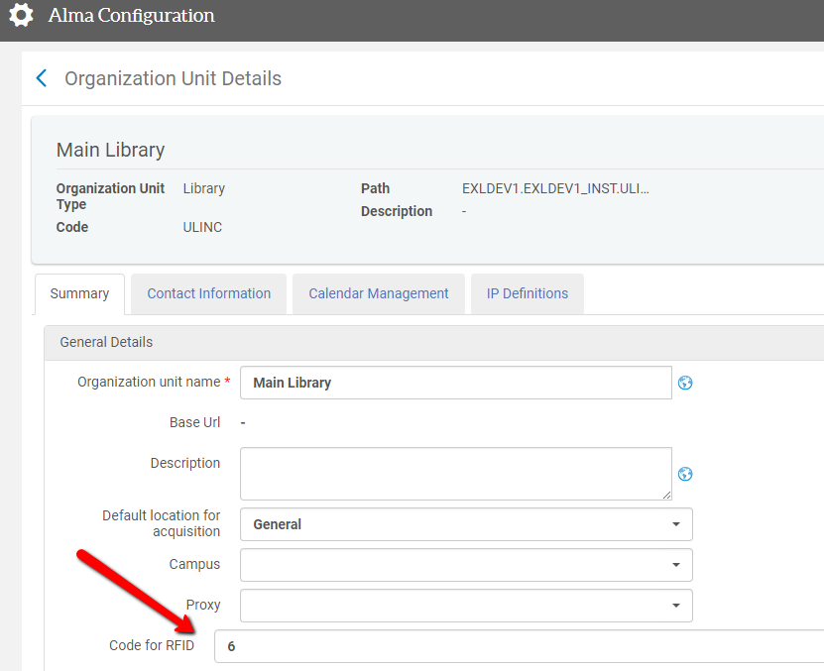
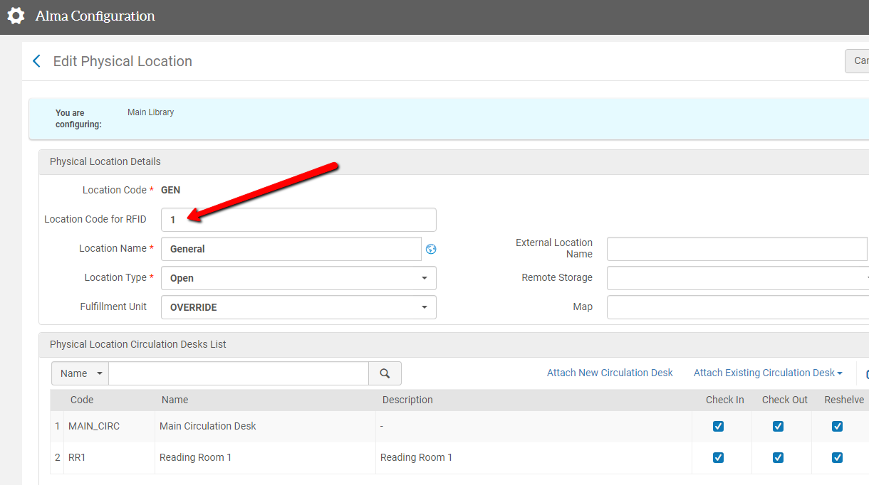
Mappings (2)
It is now possible to map the codes of libraries and locations to the RFID tags’ values

Slide 10
Workflows

Slide 11
Workflows
Persistent search bar
Fulfillment
Manage Patron Services (check-in and check-out)
Return Items
Scan in Items
Resource Management / Acquisition
Physical Item Editor
Quick Cataloging
Receive

Slide 12
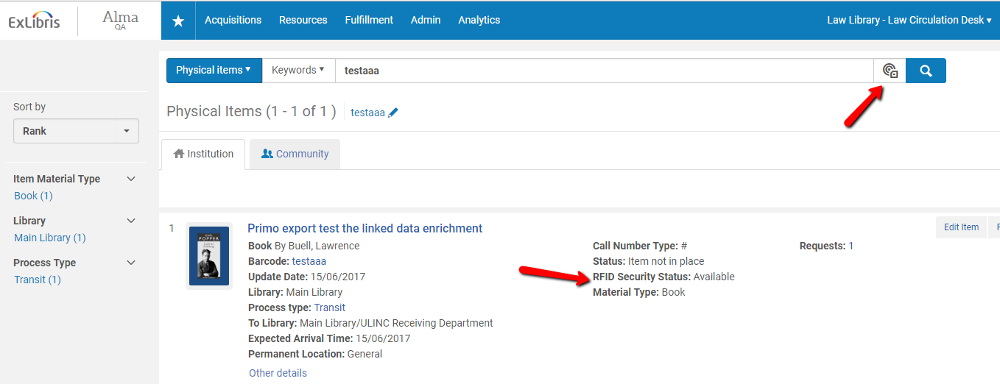
Search
Using the ‘Read RFID’ icon, the RFID tag that is placed near the RFID antenna may be read
The barcode that is read from the tag will be used to fetch the item
Note that the system also shows the security status of the item (i.e. whether the RFID tag shows it is checked out)

Slide 13
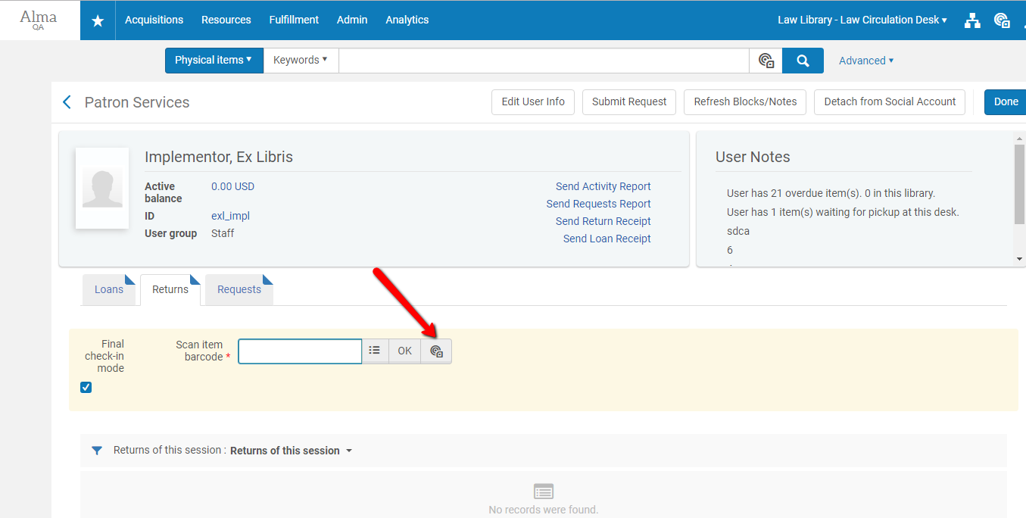
Manage Patron Services
The Check Out\Check Out actions will read the barcode and update the RFID tag

Slide 14
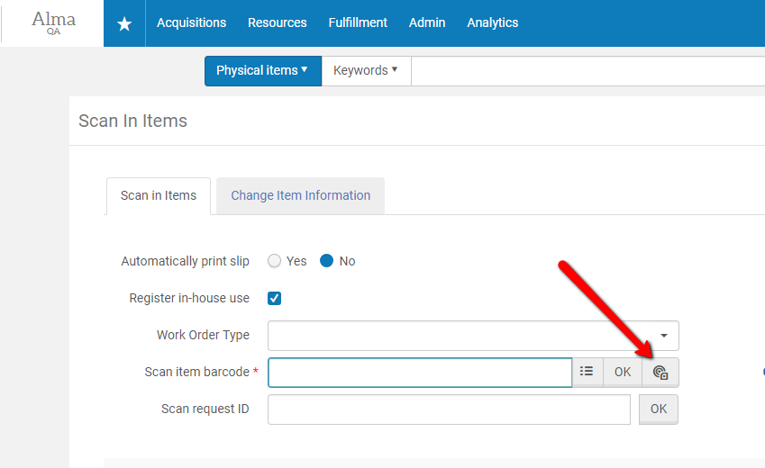
Manage Patron Services
The Check Out\Check Out actions will read the barcode and update the RFID tag

Slide 15
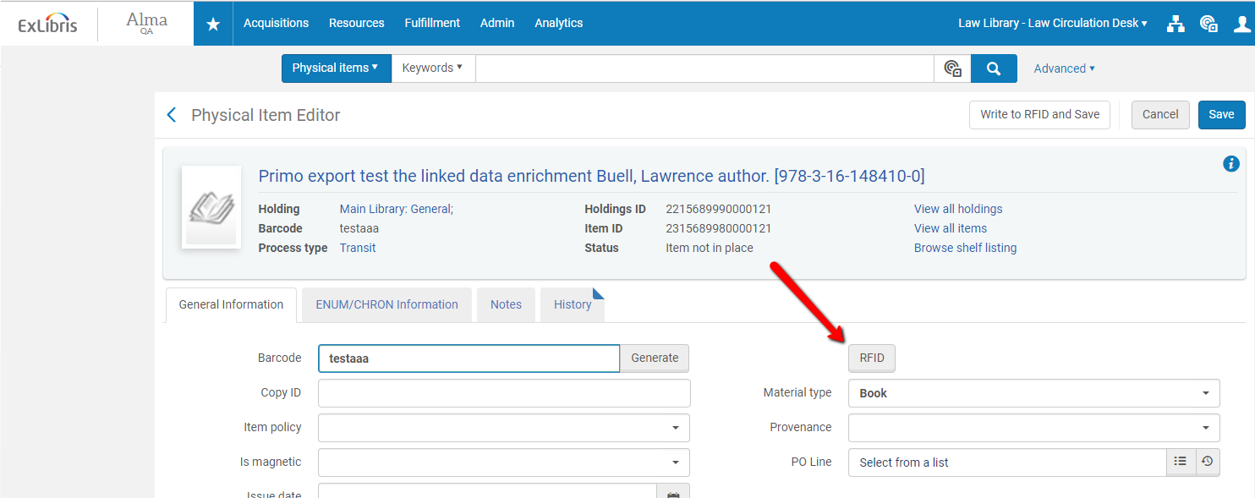
Physical Item Editor
It is possible to read the barcode from the RFID tag

Slide 16
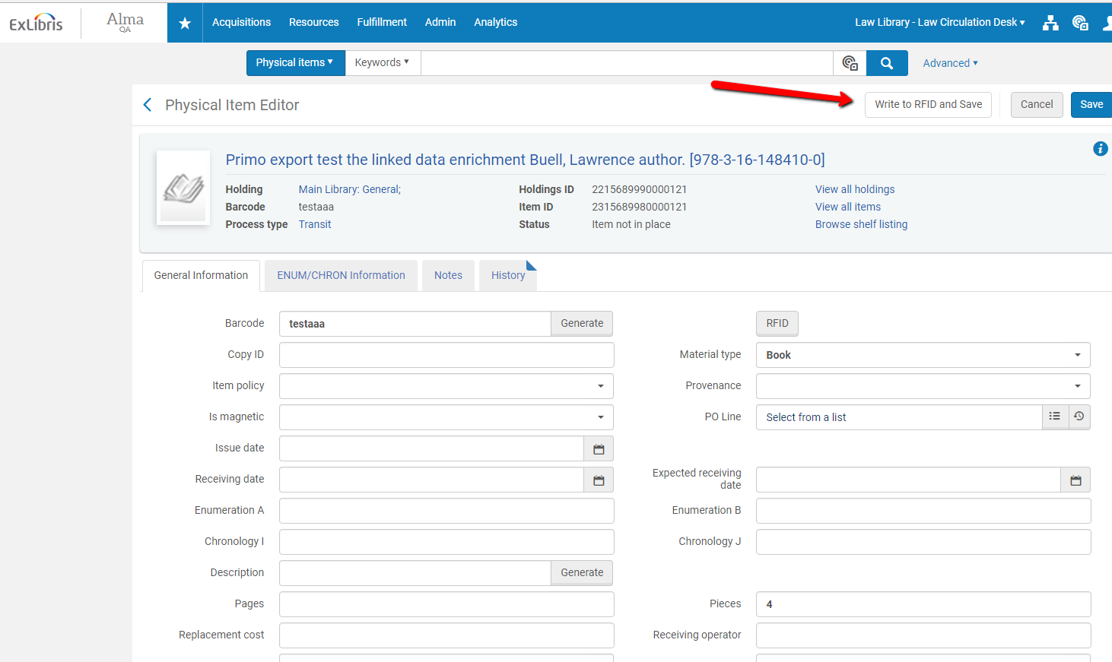
Physical Item Editor
It is possible to write item information on the RFID tag

Slide 17
Quick Cataloging

Slide 18
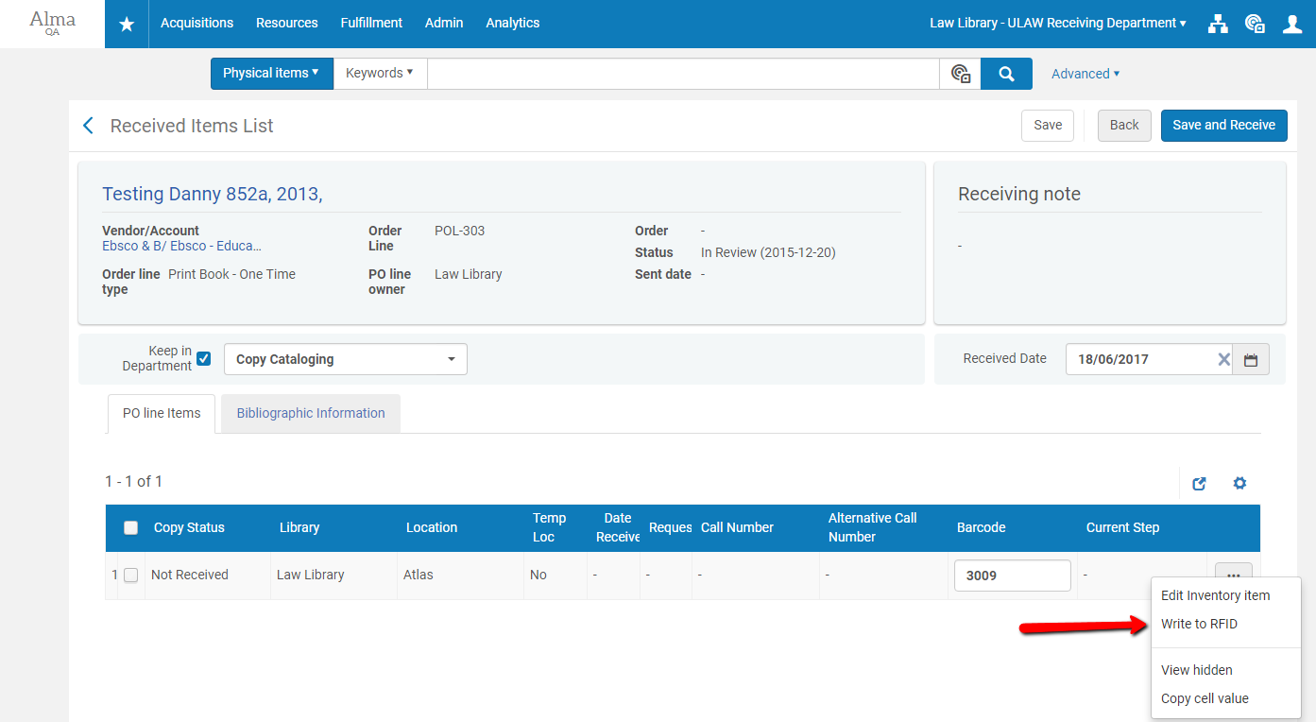
Receive

Slide 19
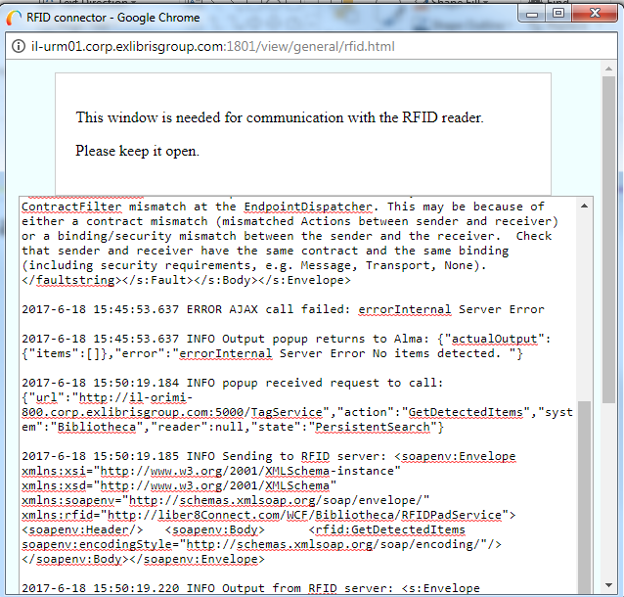
Logs
All actions are logged in the pop up

Slide 20
Links

Slide 21
https://developers.exlibrisgroup.com/alma/integrations/rfid
https://developers.exlibrisgroup.com/alma/integrations/rfid/Information_for_RFID_Vendors
https://knowledge.exlibrisgroup.com/Alma/Product_Documentation/Alma_Online_Help_(English)/Integrations_with_External_Systems/040Fulfillment/080RFID_Support

Slide 22
Thank You
Moshe.shechter@exlibrisgroup.com

