Slide 1
Benchmark Analytics
Yoel Kortick
Senior Librarian
http://israelvalley.s3-eu-west-1.amazonaws.com/files/000/011/391/original/big-data.png?1406714586
http://www.slideteam.net/wp/wp-content/uploads/2015/11/Using-Images-and-Icons-to-Create-Awesome-Agenda-Slides.1.png

Slide 2
Agenda
Introduction
KPI Watchlist
My Trends
Inventory Total
Loans by Month and Requests by Month
Acquisitions - Electronic and Acquisitions - Physical

Slide 3
Introduction
The overall goal and idea of the Benchmark analytics is for the institution to identify
Where in their workflows improvements can be made
Where processes are already at a satisfactory or above satisfactory level.
One way for doing this is to compare KPIs with other institutions
The KPIs can be measured on a monthly or yearly basis. This enables the identification of trends.

Slide 4
Introduction
For example, an institution may see that from the time of ordering physical items until the time the items arrive takes significantly longer than the average for other institutions.
This institution can then drill down to investigate where in the process there may be a problem.
It may be that between the time the order is created until the time it is sent takes too long because the “review” process is taking too long.
It may be that certain vendors are taking an unusually long time to process the orders.
There could also be a problem with the period from when the item arrives to the institution until it arrives to the acquisitions librarian to scan it in.
Benchmark analytics allows the institution to identify these issues

Slide 5
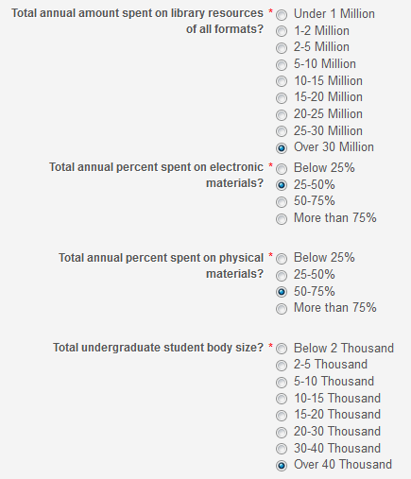
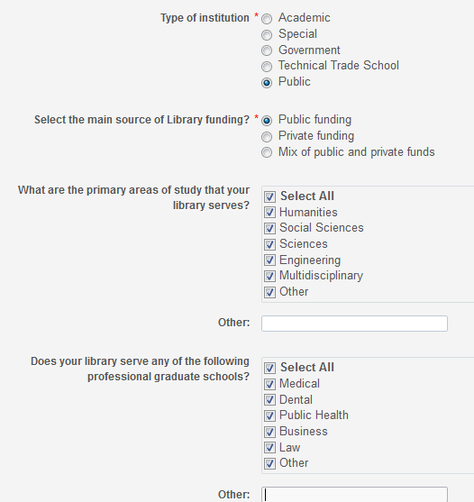
Introduction
As part of the process each institution is defined with a profile so that they can be compared appropriately with other institutions.

Slide 6
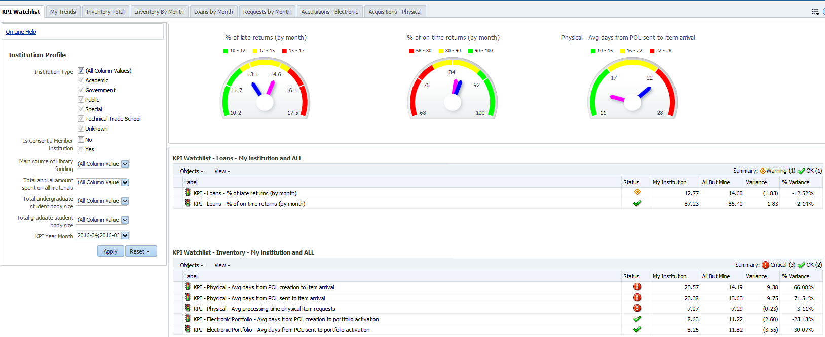
Introduction
The Benchmark Analytics can be easily accessed via an “out of the box” customizable and ready to use KPI dashboard.

Slide 7
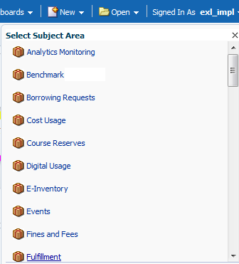
Introduction
The Benchmark Analytics is a subject area in Alma Analytics and, like all other subjects, customized specific reports can be created on demand by each institution.

Slide 8
Agenda
Introduction
KPI Watchlist
My Trends
Inventory Total
Loans by Month and Requests by Month
Acquisitions - Electronic and Acquisitions - Physical

Slide 9
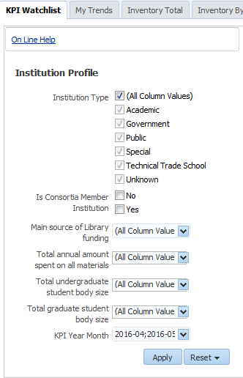
KPI Watchlist
As is the case with all tabs in the KPI Dashboard the comparison to other institutions can be filtered by various criteria.

Slide 10
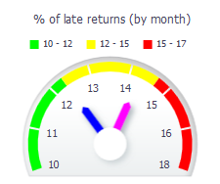
KPI Watchlist
The KPI Watchlist provides a summary of various KPIs which can be seen together.
The gauges quickly inform the user where his institution (blue dial) stands in comparison to other institutions (pink dial)

Slide 11
KPI Watchlist

Slide 12
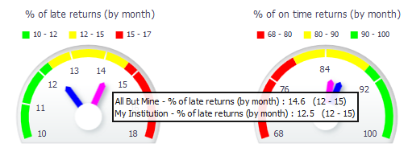
KPI Watchlist
Hovering over the gauge provides further details. When the dial is near the green this is good.
When the dial is near the red this is a warning

Slide 13
KPI Watchlist
The KPI Watchlist also provides the information in tabular form with status indicators of warning, critical and OK

Slide 14
Agenda
Introduction
KPI Watchlist
My Trends
Inventory Total
Loans by Month and Requests by Month
Acquisitions - Electronic and Acquisitions - Physical

Slide 15
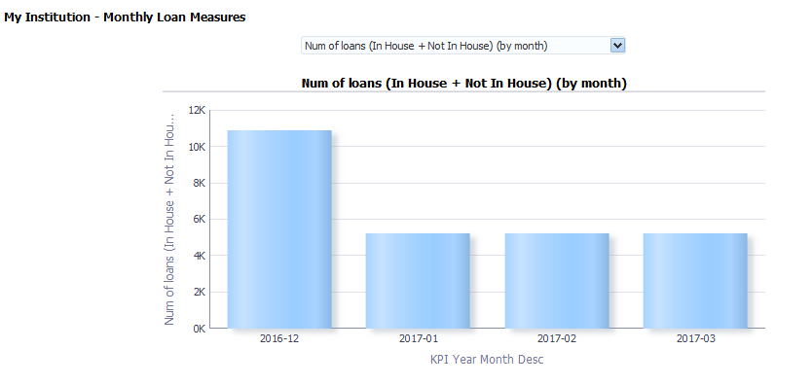
My Trends – Benchmark Analytics
The “My Trends” tab of the dashboard provides the institution with an up close look at his own institution, and may be filtered by time and specific measures.

Slide 16
My Trends – Benchmark Analytics
The “My Trends” currently includes three areas of measurements.
Monthly requests measures
Monthly loan measures
Monthly inventory measures
Each area includes several measures

Slide 17
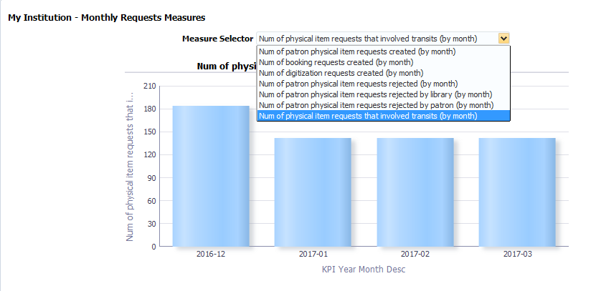
My Trends – Benchmark Analytics

Slide 18
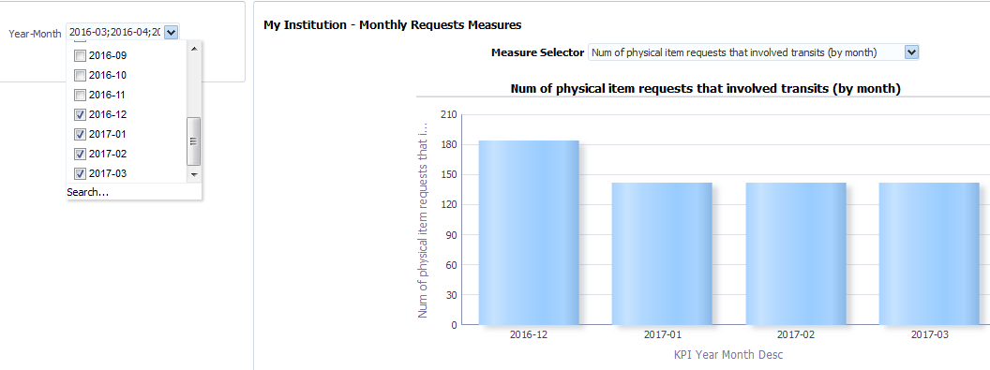
My Trends – Benchmark Analytics
And, of course, each institution can choose the dates for which he wants to see the trends

Slide 19
Agenda
Introduction
KPI Watchlist
My Trends
Inventory Total
Loans by Month and Requests by Month
Acquisitions - Electronic and Acquisitions - Physical

Slide 20
Inventory Total
The Inventory Total tab allows the institution to compare its inventory to other institutions
At the current time this includes:
Number of bibliographic records in repository (total)
Number of electronic collections in repository (total)
Number of electronic portfolios in repository (total)
Number of physical items in repository (total)

Slide 21
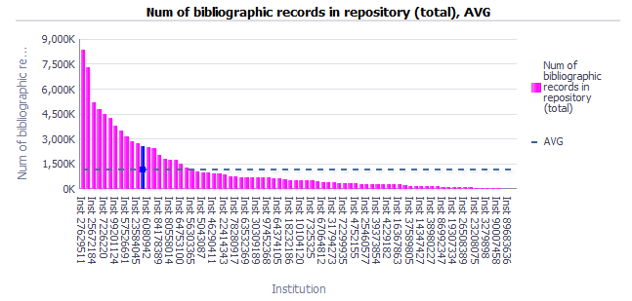
Inventory Total
The dotted line is the average
The blue bar is “my institution”
The pink bars are all other institutions.

Slide 22
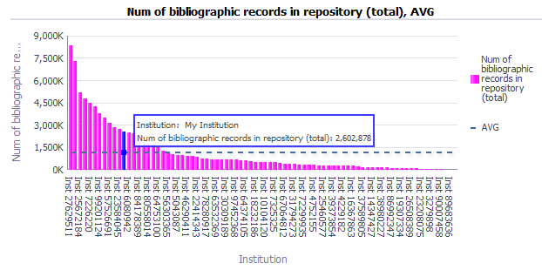
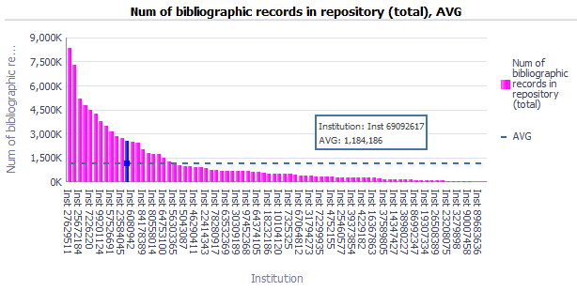
Inventory Total
Hovering over the data provides additional information.

Slide 23
Inventory Total
The data also appears at the top of the dashboard in performance tiles

Slide 24
Inventory Total by month
The Inventory Total by month tab allows the institution to compare what was added to his inventory with other institutions
At the current time this includes:
Number of bibliographic records in repository (by month)
Number of electronic collections in repository (by month)
Number of electronic portfolios in repository (by month)
Number of physical items in repository (by month)

Slide 25
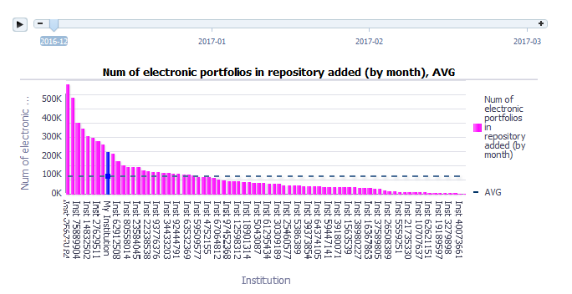
Inventory Total by month
The chosen times appearing can be “played” on the slide bar on top showing the changes over the time period

Slide 26
Inventory Total by month
The data also appears at the top of the dashboard in performance tiles.
Here we have the average amounts added per month for the specified time period

Slide 27
Agenda
Introduction
KPI Watchlist
My Trends
Inventory Total
Loans by Month and Requests by Month
Acquisitions - Electronic and Acquisitions - Physical

Slide 28
Loans by Month
The Loans by Month tab allows the institution to compare its fulfillment loans with other institutions
At the current time this includes:
Number of loans (by month)
Number of late returns (by month)

Slide 29
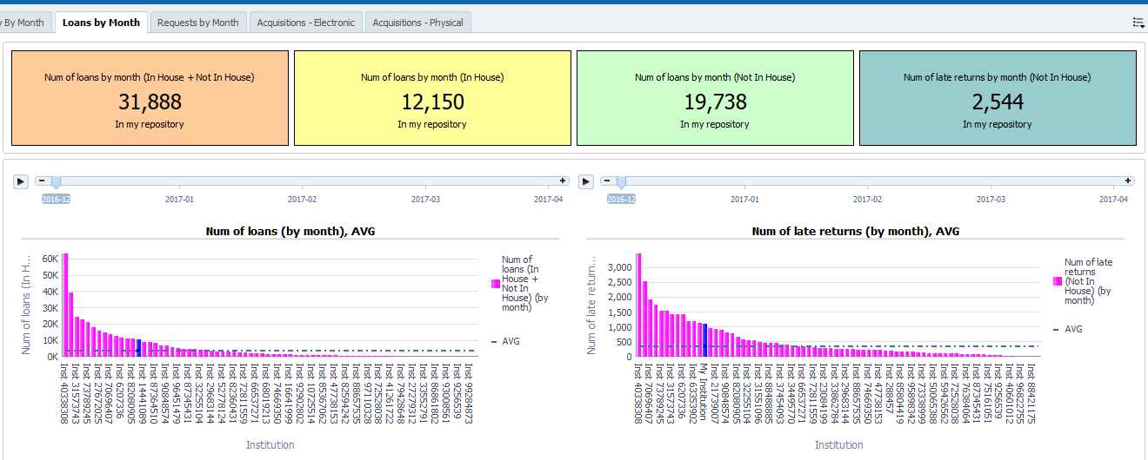
Loans by Month

Slide 30
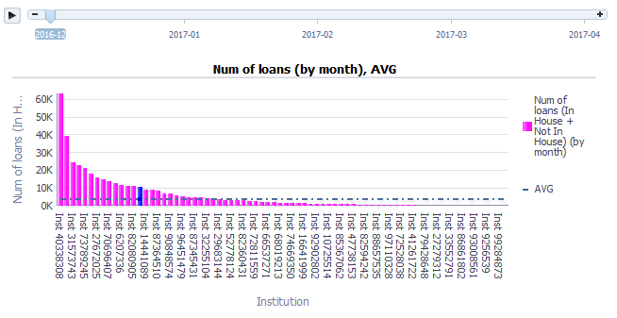
Loans by Month
The chosen times appearing can be “played” on the slide bar on top showing the changes over the time period
Here is the number of loans per month per institution

Slide 31
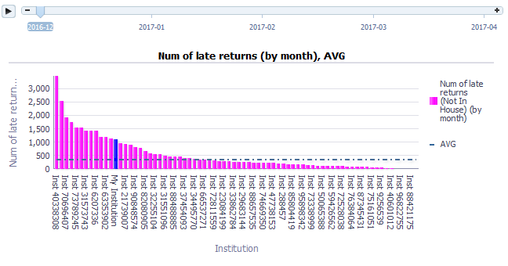
Loans by Month
Here is the number of late returns per month per institution

Slide 32
Loans by Month
The data also appears at the top of the dashboard in performance tiles

Slide 33
Requests by Month
The Requests by Month tab allows the institution to compare its fulfillment requests with other institutions
At the current time this includes:
Number of patron physical item requests created (by month)
A detailed table including
Number of patron physical item requests created (by month)
Number of patron physical item requests rejected (by month)
Number of patron physical item requests rejected by patron (by month)
Number of patron physical item requests rejected by library (by month)

Slide 34
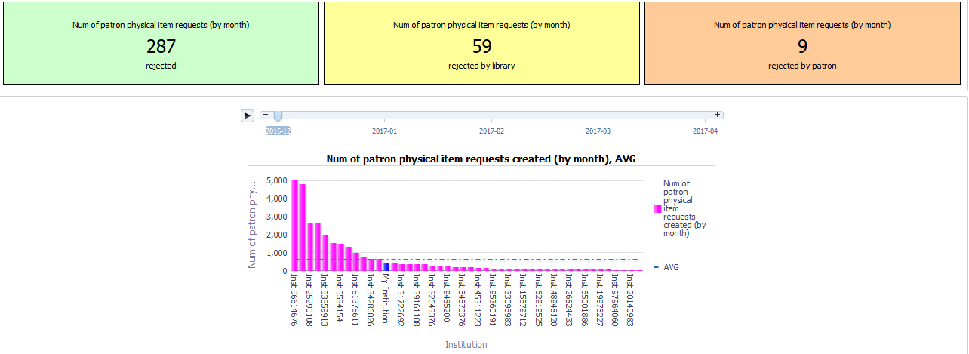
Requests by Month

Slide 35
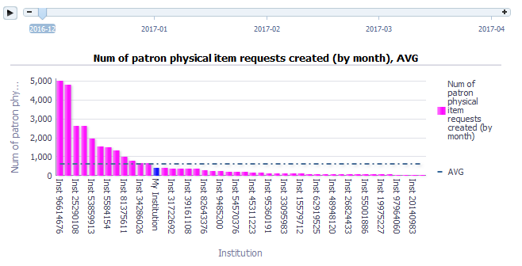
Requests by Month
The chosen times appearing can be “played” on the slide bar on top showing the changes over the time period
Here is the patron physical item requests created per month per institution

Slide 36
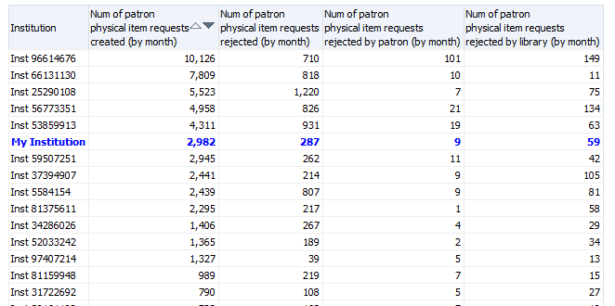
Requests by Month
Here is table showing the data with additional measures

Slide 37
Requests by Month
The data also appears at the top of the dashboard in performance tiles

Slide 38
Agenda
Introduction
KPI Watchlist
My Trends
Inventory Total and Loans by Month and Requests by Month
Loans by Month and Requests by Month
Acquisitions - Electronic and Acquisitions - Physical

Slide 39
Acquisitions - Electronic
The Acquisitions – Electronic tab allows the institution to compare its acquisitions measures regarding electronic collection and portfolios with other institutions
At the current time this includes:
Electronic Portfolio - Avg days from POL creation to portfolio activation

Slide 40
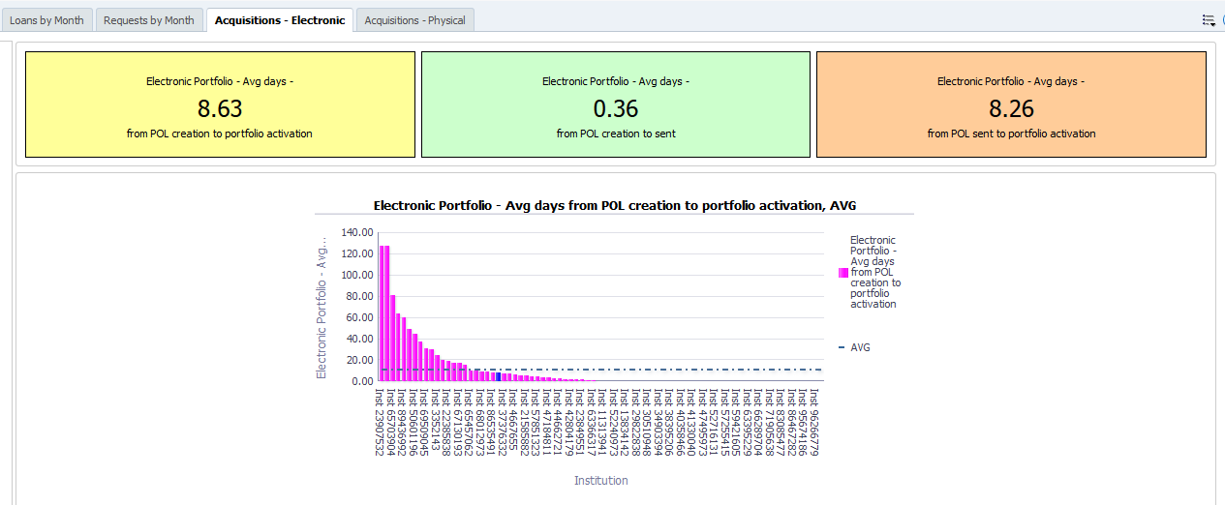
Acquisitions - Electronic

Slide 41
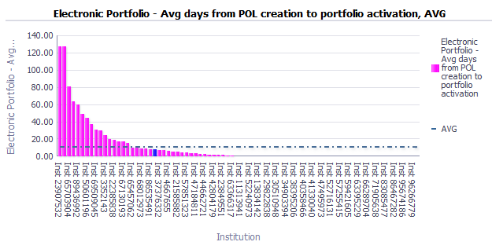
Acquisitions - Electronic
Here the institution can see that regarding the time it takes from ordering electronic inventory to getting it activated he is faster than the average.

Slide 42
Acquisitions - Electronic
The data also appears at the top of the dashboard in performance tiles

Slide 43
Acquisitions - Physical
The Acquisitions – Physical tab allows the institution to compare its acquisitions measures regarding the ordering of physical one-time inventory with other institutions
At the current time this includes:
Physical - Avg days from POL creation to item arrival

Slide 44
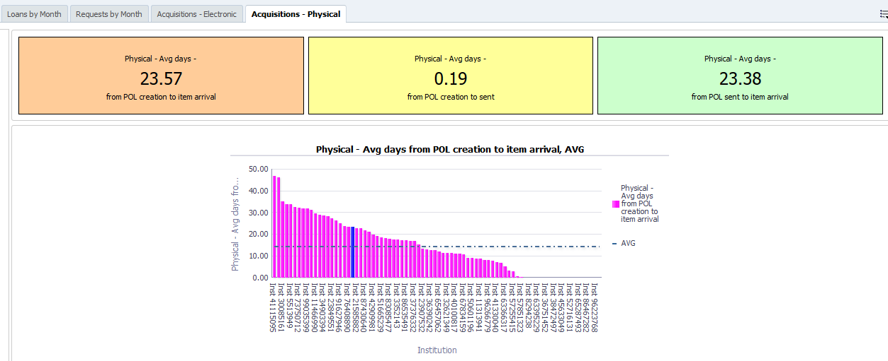
Acquisitions - Physical

Slide 45
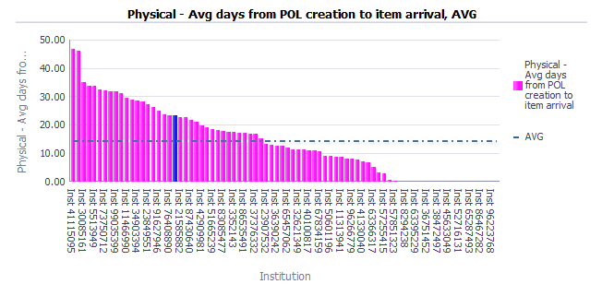
Acquisitions - Physical
Here the institution can see that regarding the time it takes from ordering physical inventory to having it arrive it is much slower than the average.

Slide 46
Acquisitions - Physical
The data also appears at the top of the dashboard in performance tiles

Slide 47
Thank You
http://israelvalley.s3-eu-west-1.amazonaws.com/files/000/011/391/original/big-data.png?1406714586

