Slide 1
The “Relink POL” option
Yoel Kortick
Senior Librarian
Alma Product Management

Slide 2
The “Relink POL” option
The “Relink POL” link changes the actual record to which the POL is linked, including the inventory.
This differs from the “Change Bibliographic Reference” link, because the “Change bibliographic reference link” changes only the description of the POL but remains linked to the same record. This change will not impact the inventory and will only update the PO Line's description

Slide 3
The “Relink POL” option
A typical use case would be:
The order has already been made and sent to the vendor, then the entity to which the bibliographic record relates is changed. Fore example a physical journal might stop publication but be succeeded by another.
Another case might be that an EOD arrives for a single volume within a multi-volume work which is more suitable to link to than the existing link.

Slide 4
The “Relink POL” option
For example here is POL-43721, title “Journal of tribology”, MMSID 9960310600121.

Slide 5
The “Relink POL” option
It is for a serial and already has a holding record and items from a prediction pattern

Slide 6
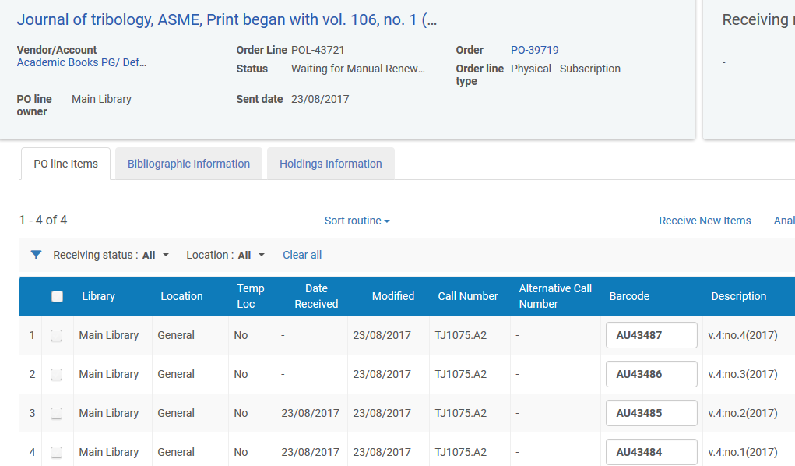
The “Relink POL” option
Two of the four items have already arrived

Slide 7
The “Relink POL” option
The Journal changes it’s name to “The journal of the American Society of Mechanical Engineers”, and now there is a new bibliographic record and MMSID: 99119809400121
The new record has no inventory and no order.

Slide 8
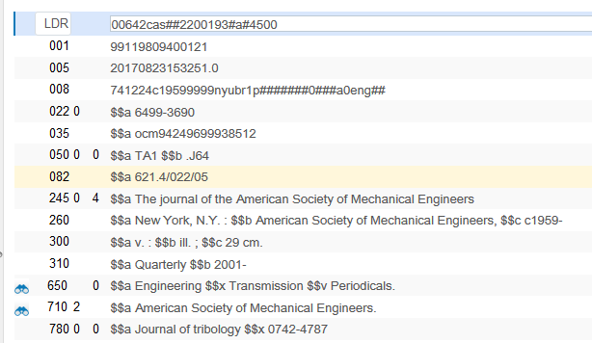
The “Relink POL” option
And by the way the new record is also linked to the previous version of the record with a 780 field
Not directly related to our topic but important to point out

Slide 9
The “Relink POL” option
Here is the link
Not directly related to our topic but important to point out

Slide 10
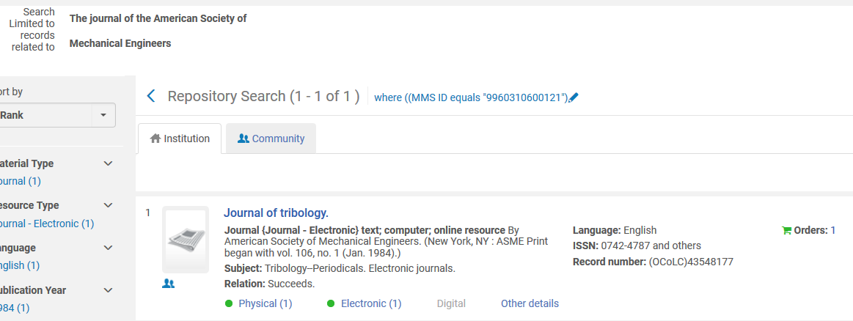
The “Relink POL” option
And it links to the previous version of this journal
Not directly related to our topic but important to point out

Slide 11
The “Relink POL” option
From the order of the “old” or “previous” version of the record we go to the task list

Slide 12
The “Relink POL” option
From the task list we click “Relink”

Slide 13
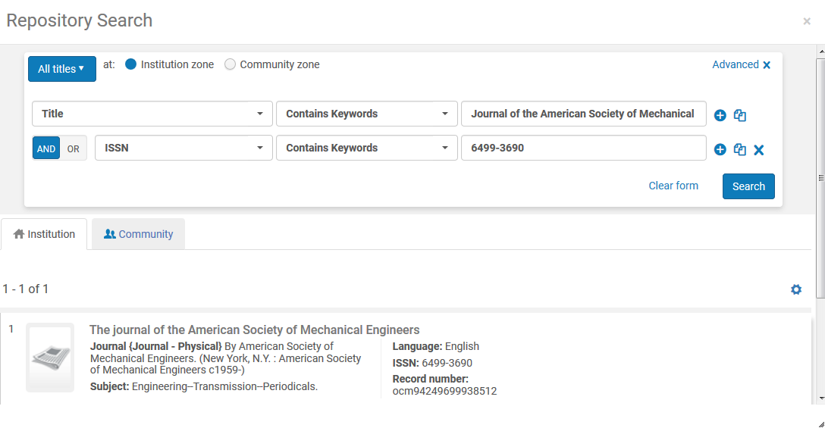
The “Relink POL” option
Search for the record to which we want to relink the order

Slide 14
The “Relink POL” option
Receive confirmation message that the POL will be linked to the new bibliographic record and 1 holdings record will be moved.

Slide 15
“Change Bibliographic Reference” link for POLs
Now the order is on the new record “The journal of the American Society of Mechanical Engineers”

Slide 16
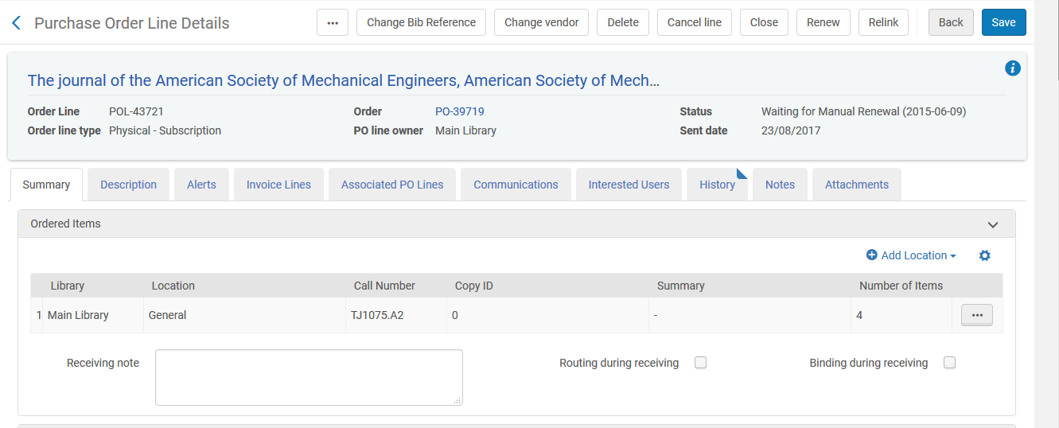
The “Relink POL” option
The holdings record and items form the order are still in the order

Slide 17
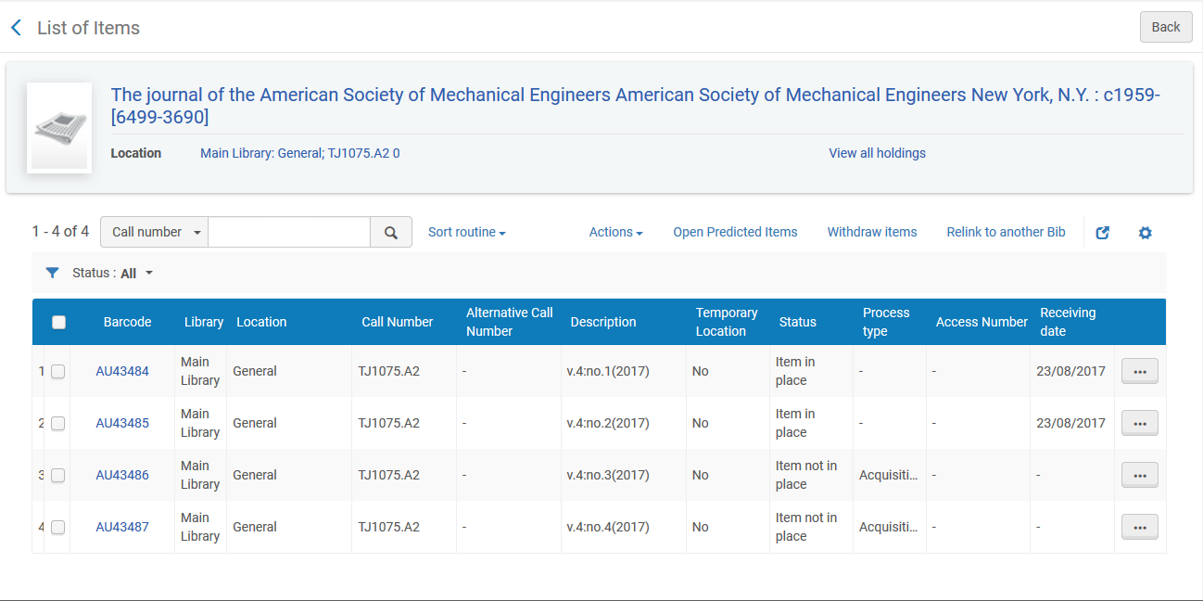
The “Relink POL” option
All inventory has been moved to the new bibliographic record

Slide 18
The “Relink POL” option
The old record “Journal of tribology” no longer has an order

Slide 19
Thank You

