Slide 1
Bound together titles using the 774 field
Yoel Kortick – Senior Librarian

Slide 2
One bibliographic record with multiple 773 host item entry fields
Yoel Kortick – Senior Librarian

Slide 3
Contents
Introduction
Our sample titles
Steps to bind the titles into one volume
Viewing the results
Bound together titles in BIBFRAME

Slide 4
Introduction

Slide 5
Introduction
This document will explain and demonstrate a recommended workflow for cataloguing separate bibliographic titles which become bound together into one physical volume after publication.
Note that there is more than one way to accomplish this task by using 77X fields in Alma.
The workflow described here is a recommended "best practice" workflow though certainly not the only possible workflow.

Slide 6
Introduction
The workflow described here will accomplish two very specific and useful tasks:
Each title in Primo will display as a separate title.
Each separate title within the bound volume will appear as unavailable when the volume is checked out.

Slide 7
Our Sample Titles

Slide 8
Our Sample Titles
These are the three separate titles which are bound together in one physical volume
Title: Das Neue Testament deutsch
System Cont. No.: (DE-599)HEB358836735
MMSID: 9976111300121
Title: Osternacht und Altes Testament
System Cont. No.: (DE-599)DNB990880516
MMSID: 9976111200121
Title: Psalter und Harfe
System Cont. No.: (DE-599)HEB322841348
MMSID: 9976111100121

Slide 9
Our Sample Titles

Slide 10
Steps to bind the titles into one volume

Slide 11
Steps to bind the titles into one volume
Decide which will be the "master title"
This is the title which will get the holdings record, item and 774 fields to link to the other titles
The other titles will not get a holdings record, item or 774 field
On the "master title" add a 774 for each record with which it is bound
In our case it will get two 774 fields, one for each of the other titles with which it is bound
On the "master title" add a holding record and item
On all three records add a 501 "Bound with:" note
Wait for nightly linking job to run

Slide 12
Steps to bind the titles into one volume
We have decided that the "master title" will be:
Title: Das Neue Testament deutsch
System Cont. No.: (DE-599)HEB358836735
MMSID: 9976111300121
So we add 774 fields to it to link to the other two records
We also add a 501 "Bound with" note which includes the other two records

Slide 13
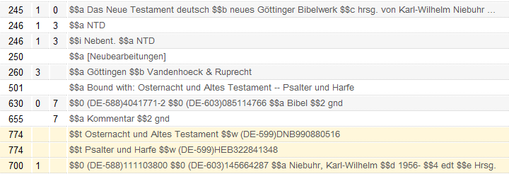
Steps to bind the titles into one volume
The 501 plays no "functional" role in linking the records but may aid in display and conforms to official MARC rules
Here we put the title in subfield t and the system control number in subfield w.
We could instead have put the MMSID in subfield w.
If there was an ISBN or ISSN in the related records then we could have also added the ISBN in subfield z and the ISSN in subfield x

Slide 14
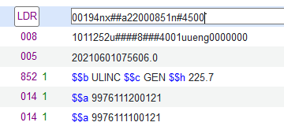
Steps to bind the titles into one volume
We also add a holding record and item to the "master title".
Here is the holding record
The 014 plays no "functional" role in linking the records but may aid in display and conforms to official MARC rules
Here we have linked it to the MMSID of the related records

Slide 15
Steps to bind the titles into one volume
Here is the item
As previously stated only the "master title" gets the holding record and item.

Slide 16
Steps to bind the titles into one volume
Now we will add 501 "Bound with" fields to the other two records. We will not add 774 fields to these two records.
As previously stated these 501 fields have no "functional" value linking the records.
They may aid in display and conform to MARC standards.

Slide 17
Steps to bind the titles into one volume
We then wait for the job "MMS - Build Record Relations" to complete

Slide 18
Viewing the results

Slide 19
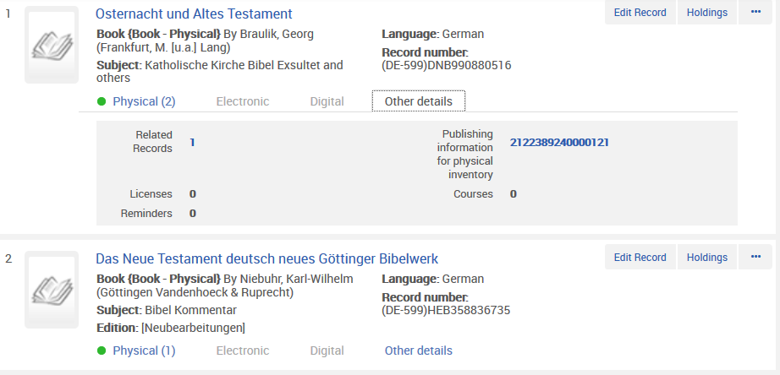
Viewing the results
Searching in Alma for the related records shows the related records with a link to the "Availability of related records"
Here we search for "Osternacht und Altes Testament"

Slide 20
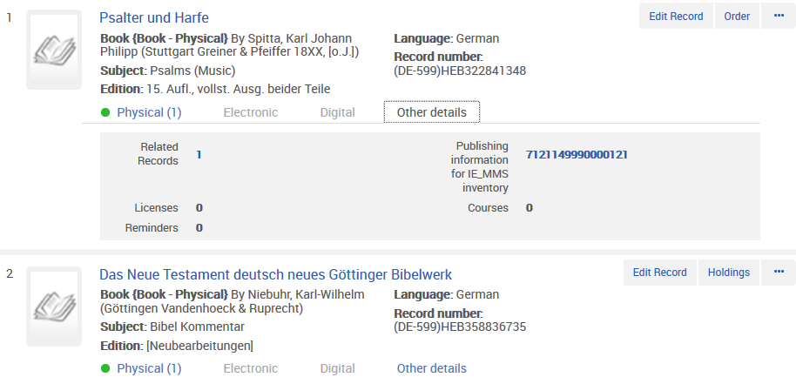
Viewing the results
Searching in Alma for the related records shows the related records with a link to the "Availability of related records"
Here we search for "Psalter und Harfe"

Slide 21
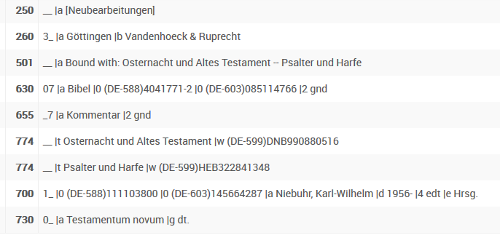
Viewing the results
Title “Das Neue Testament deutsch neues Göttinger Bibelwerk“ has these 774 fields

Slide 22
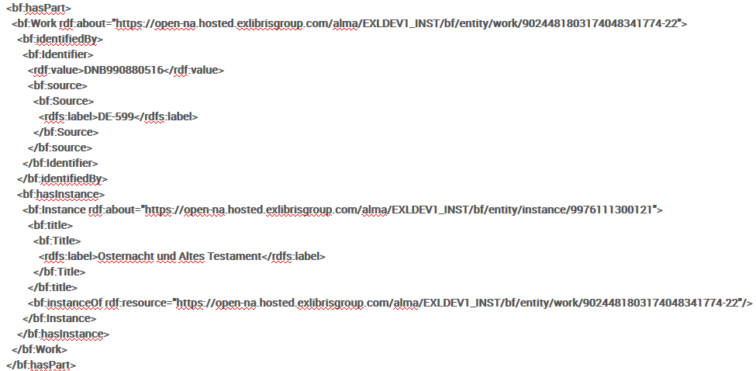
Viewing the results
The they appear as “Bound With” in BIBFRAME
This is for field: 774 |t Osternacht und Altes Testament |w (DE-599)DNB990880516

Slide 23
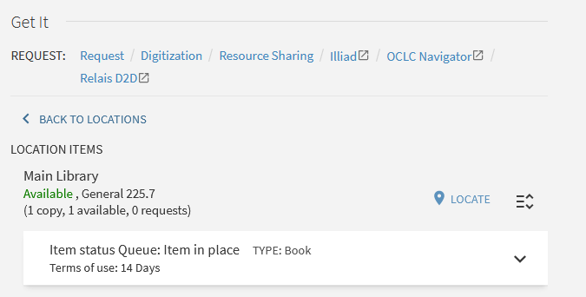
Viewing the results
In Primo here is our "master title" (the one with the 774 fields and holding record and items). The inventory appears

Slide 24
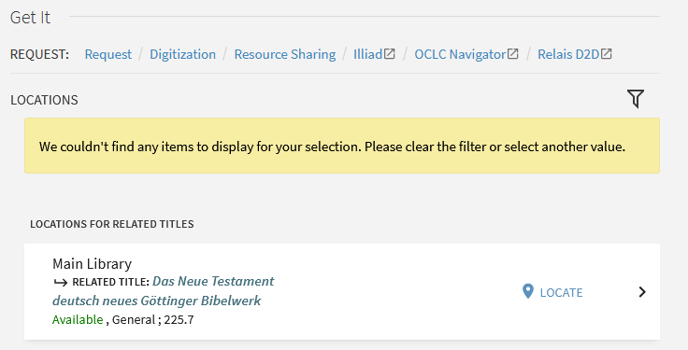
Viewing the results
In Primo here is the first of the two related records which are bound together with the "master title". Here we see the inventory of the related record.

Slide 25
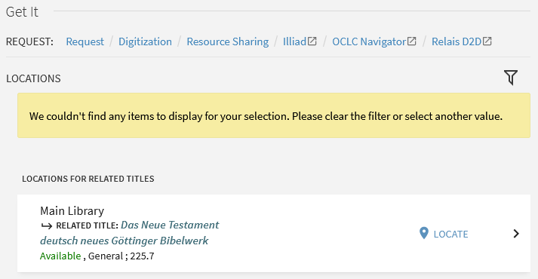
Viewing the results
In Primo here is the second of the two related records which are bound together with the "master title". Here we also see the inventory of the related record

Slide 26
Viewing the results
If the item is on loan then in Primo the fact that it is on loan will be evident in both
The related records which are bound together with the "master title"
The "master title".

Slide 27
Bound together titles in BIBFRAME

Slide 28
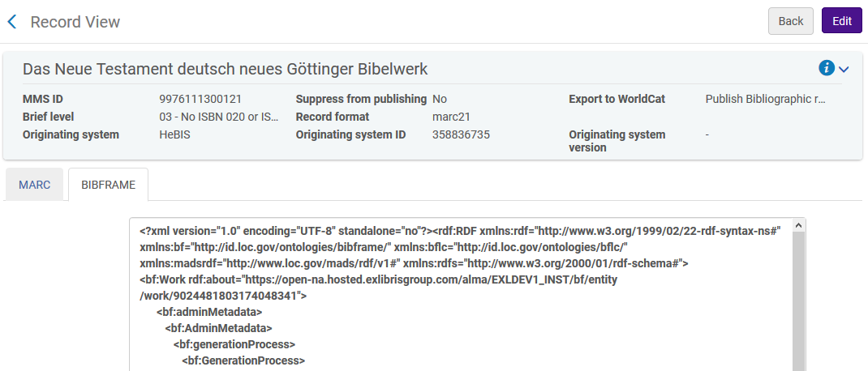
Bound together titles in BIBFRAME
We will now look at the BIBRAME for title “Das Neue Testament deutsch” which has the two 774 fields.

Slide 29
Bound together titles in BIBFRAME
Here is part of BIBRAME for title “Das Neue Testament deutsch” which has the two 774 fields. Reference to first 774.
<bf:hasPart>
<bf:Work rdf:about="https://open-na.hosted.exlibrisgroup.com/alma/EXLDEV1_INST/bf/entity/work/9024481803174048341774-22">
<bf:identifiedBy>
<bf:Identifier>
<rdf:value>DNB990880516</rdf:value>
<bf:source>
<bf:Source>
<rdfs:label>DE-599</rdfs:label>
</bf:Source>
</bf:source>
</bf:Identifier>
</bf:identifiedBy>
<bf:hasInstance>
<bf:Instance rdf:about="https://open-na.hosted.exlibrisgroup.com/alma/EXLDEV1_INST/bf/entity/instance/9976111300121">
<bf:title>
<bf:Title>
<rdfs:label>Osternacht und Altes Testament</rdfs:label>
</bf:Title>
</bf:title>
<bf:instanceOf rdf:resource="https://open-na.hosted.exlibrisgroup.com/alma/EXLDEV1_INST/bf/entity/work/9024481803174048341774-22"/>
</bf:Instance>
</bf:hasInstance>
</bf:Work>
</bf:hasPart>

Slide 30
Bound together titles in BIBFRAME
Here is part of BIBRAME for title “Das Neue Testament deutsch” which has the two 774 fields. Reference to second 774.
<bf:hasPart>
<bf:Work rdf:about="https://open-na.hosted.exlibrisgroup.com/alma/EXLDEV1_INST/bf/entity/work/9024481803174048341774-23">
<bf:identifiedBy>
<bf:Identifier>
<rdf:value>HEB322841348</rdf:value>
<bf:source>
<bf:Source>
<rdfs:label>DE-599</rdfs:label>
</bf:Source>
</bf:source>
</bf:Identifier>
</bf:identifiedBy>
<bf:hasInstance>
<bf:Instance rdf:about="https://open-na.hosted.exlibrisgroup.com/alma/EXLDEV1_INST/bf/entity/instance/9976111300121">
<bf:title>
<bf:Title>
<rdfs:label>Psalter und Harfe</rdfs:label>
</bf:Title>
</bf:title>
<bf:instanceOf rdf:resource="https://open-na.hosted.exlibrisgroup.com/alma/EXLDEV1_INST/bf/entity/work/9024481803174048341774-23"/>
</bf:Instance>
</bf:hasInstance>
</bf:Work>
</bf:hasPart>

Slide 31
Bound together titles in BIBFRAME
Here is part of BIBRAME for title “Osternacht und Altes Testament” which is pointed to by a 774.
<bf:hasPart>
<bf:Work rdf:about="https://open-na.hosted.exlibrisgroup.com/alma/EXLDEV1_INST/bf/entity/work/9024481803174048341774-23">
<bf:identifiedBy>
<bf:Identifier>
<rdf:value>HEB322841348</rdf:value>
<bf:source>
<bf:Source>
<rdfs:label>DE-599</rdfs:label>
</bf:Source>
</bf:source>
</bf:Identifier>
</bf:identifiedBy>
<bf:hasInstance>
<bf:Instance rdf:about="https://open-na.hosted.exlibrisgroup.com/alma/EXLDEV1_INST/bf/entity/instance/9976111300121">
<bf:title>
<bf:Title>
<rdfs:label>Psalter und Harfe</rdfs:label>
</bf:Title>
</bf:title>
<bf:instanceOf rdf:resource="https://open-na.hosted.exlibrisgroup.com/alma/EXLDEV1_INST/bf/entity/work/9024481803174048341774-23"/>
</bf:Instance>
</bf:hasInstance>
</bf:Work>
</bf:hasPart>

Slide 32
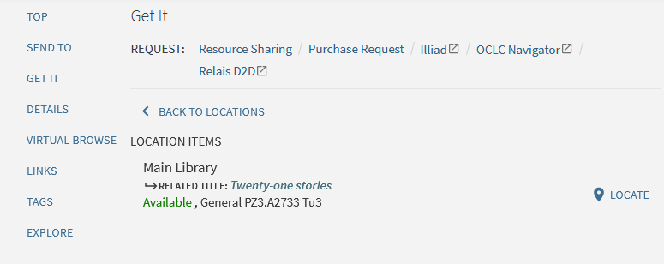
What happens in Primo
After clicking one of the specific items the user sees the item details

Slide 33
xxx@exlibrisgroup.com

