Slide 1
Conditional Hiding of ViewIt/GetIt Services
How to hide ViewIt/GetIt Services using on Display Logic Rules and Electronic Services
Moshe Shechter | Alma Product Manager

Slide 2
Hiding Services Using Display Logic Rules (DLRs)
Display Logic Rules and General Electronic Services are very flexible configuration elements of the services page
In these slides, we will see how it is possible to create flexible services that hide resources based on the discovered resource’s data

Slide 3
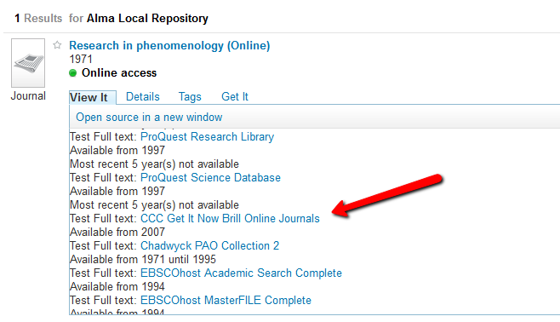
The Goal
Consider the below resource which has been discovered in Primo
The resource has a link to a CCC GetItNow service

Slide 4
The Goal
However, CCC GetItNow services should appear only for article level
In other words, if there is no ISSN/ISBN/DOI and date and starting page data, the link should not appear in the menu.
How can that be configured in Alma ?

Slide 5
The Solution
The solution is based on:
Creating a dummy General Electronic Service that will exist only if the metadata meets the required criteria
Creating a display logic rule that hides CCC GetItNow if the General Electronic Service exists.
Hiding the General Electronic Service unconditionally
The next slides will demonstrate this solution

Slide 6
Step 1 – Create the General Electronic Service (GES)

Slide 7
Step 1 – Create the General Electronic Service (GES) Example 1
In our example, we will create a GES that shows up only if there is a DOI
Of course, this example can be used as a template to add additional conditions such as ‘there is ISSN’ etc.

Slide 8
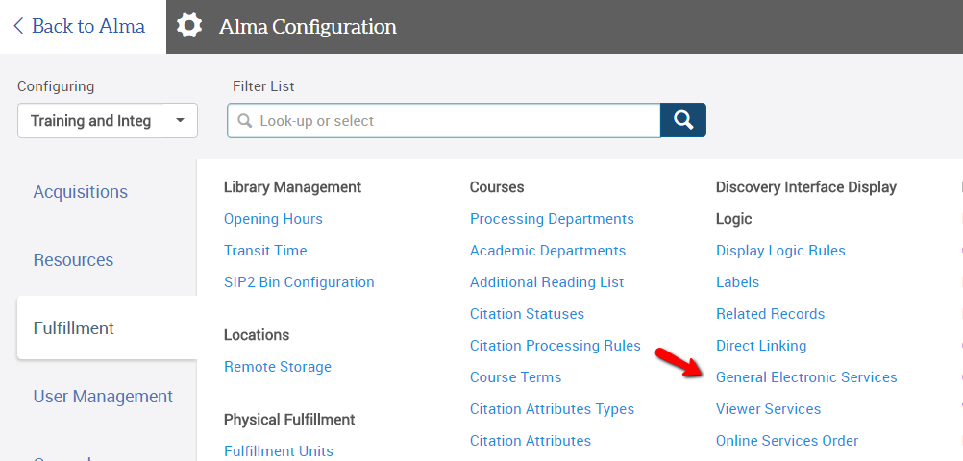
Step 1 – Create the General Electronic Service (GES) Example 1
We will use the Fulfillment Configuration menu to create a General Electronic Service

Slide 9
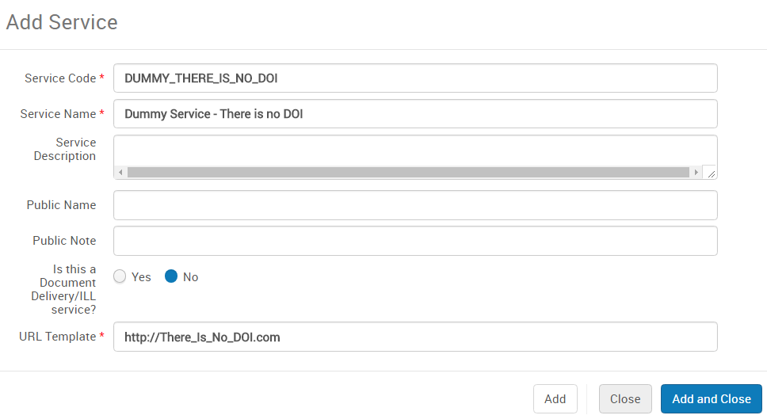
Step 1 – Create the General Electronic Service (GES) Example 1
Being a dummy service, its URL does not really matter, as long as we can easily identify the service

Slide 10
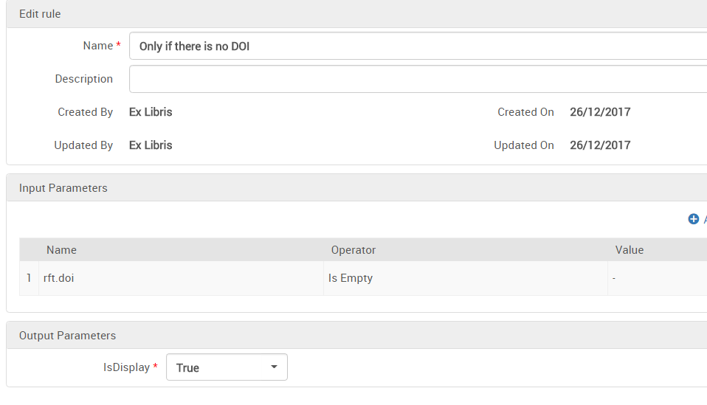
Step 1 – Create the General Electronic Service (GES) Example 1
Let’s add availability rules to the dummy service
This rule means the service will appear only if there is no DOI

Slide 11
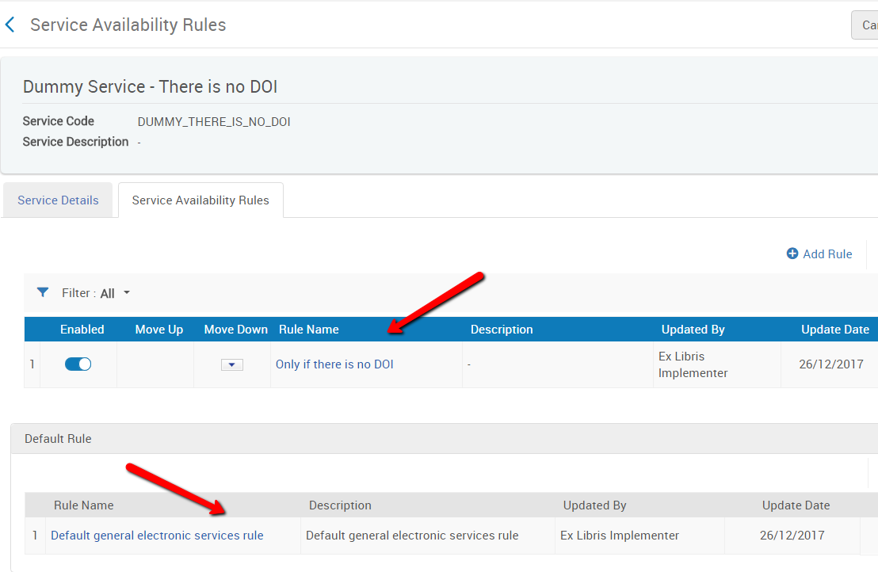
Step 1 – Create the General Electronic Service (GES) Example 1
So, we have configured only one rule for this service that displays the service only if there is no DOI
Together with the default rule, which is set to ‘false’ (i.e. ‘hide’), the service will display only when there is no DOI

Slide 12
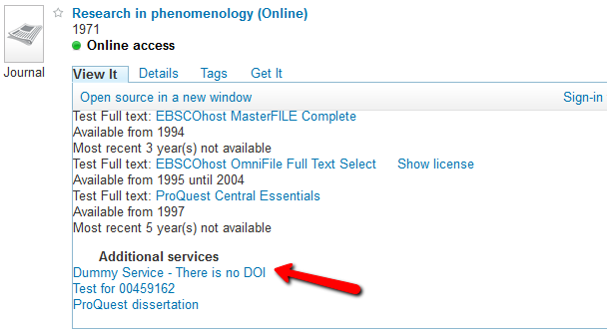
Let’s see how the service works
My current search result shows the service I’ve configured.
This is because it does not have a DOI
We will now add a DOI to see how it effects the service

Slide 13
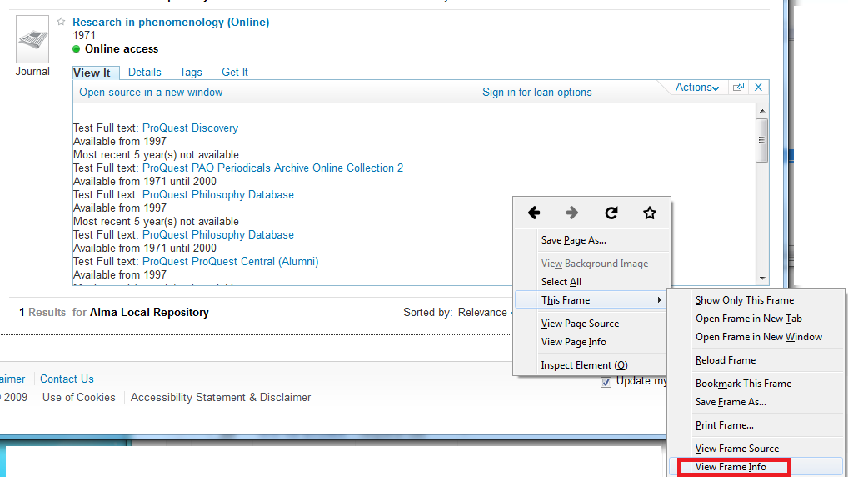
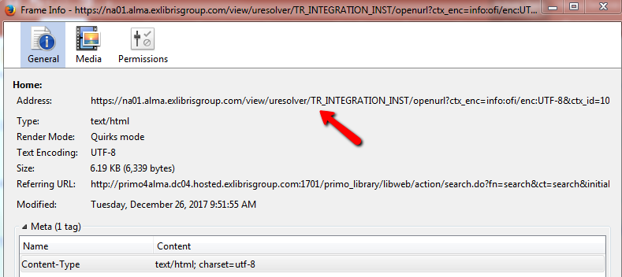
Let’s see how the service works
Let’s grab the services page URL, in order to add a DOI to it

Slide 14
Let’s see how the service works
https://na01.alma.exlibrisgroup.com/view/uresolver/TR_INTEGRATION_INST/openurl?ctx_enc=info:ofi/enc:UTF-8&ctx_id=10_1&ctx_tim=2017-12-26T01%3A43%3A03IST&ctx_ver=Z39.88-2004&url_ctx_fmt=info:ofi/fmt:kev:mtx:ctx&url_ver=Z39.88-2004&rfr_id=info:sid/primo.exlibrisgroup.com-ALMACLOUD&req_id=&rft_dat=ie=TR_INTEGRATION_INST:519502020000561,language=eng,view=ALMACLOUD&svc_dat=cto&u.ignore_date_coverage=true
This is the URL we were using before
This is the URL we will be using now
https://na01.alma.exlibrisgroup.com/view/uresolver/TR_INTEGRATION_INST/openurl?ctx_enc=info:ofi/enc:UTF-8&ctx_id=10_1&ctx_tim=2017-12-26T01%3A43%3A03IST&ctx_ver=Z39.88-2004&url_ctx_fmt=info:ofi/fmt:kev:mtx:ctx&url_ver=Z39.88-2004&rfr_id=info:sid/primo.exlibrisgroup.com-ALMACLOUD&req_id=&rft_dat=ie=TR_INTEGRATION_INST:519502020000561,language=eng,view=ALMACLOUD&svc_dat=cto&u.ignore_date_coverage=true&rft.doi=DOI

Slide 15
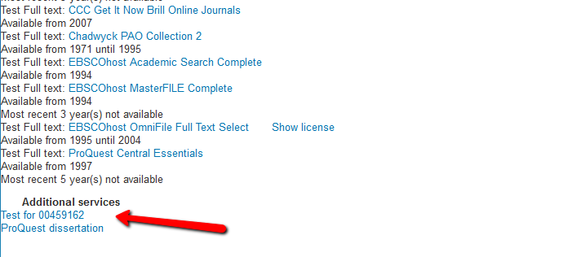
Let’s see how the service works
… and we now don’t see the service I’ve added

Slide 16
Step 2 – Create the Display Logic Rule

Slide 17
Step 2 – Create the Display Logic Rule
We will now create a Display Logic Rule (DLR) that will hide the CCC GetItNow service if the ‘There is no DOI’ service shows up.
This will enable to show the CCC GetItNow service only when there is a DOI

Slide 18
Step 2 – Create the Display Logic Rule

Slide 19
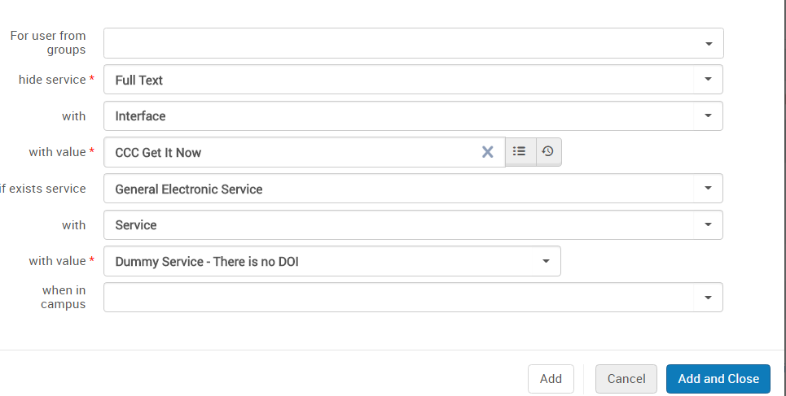
Step 2 – Create the Display Logic Rule
This rule hides the CCC GetItNow services if there is no DOI

Slide 20
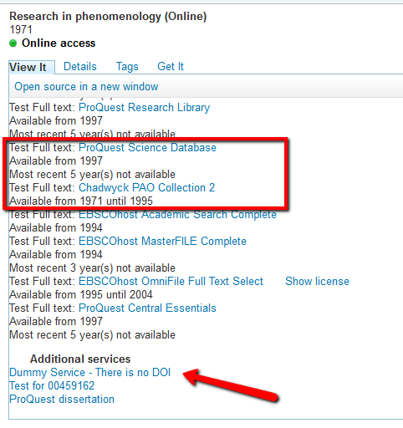
Let’s see how the rule works
This is how the services show up when there is no DOI

Slide 21
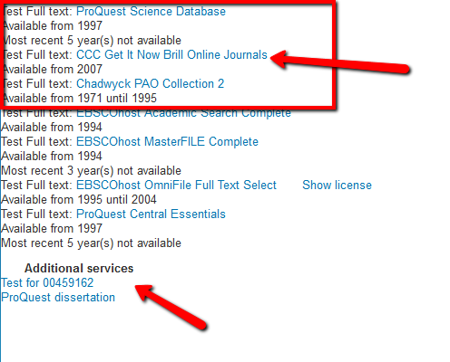
Let’s see how the rule works
… and this is how the services show up when there is a DOI
Notice that now there is a CCC GetItNow service

Slide 22
Step 3 – Hide the Dummy Service

Slide 23
Step 3 – Hide the Dummy Service
Of course, we do not want there to be a ‘Dummy Service - There is no DOI’ service on the services page
We will add a Display Logic Rule to remove the service unconditionally.
Of course, we will add that as the last rule, so that the rule that hides the CCC GetItNow service will run before the service is removed

Slide 24
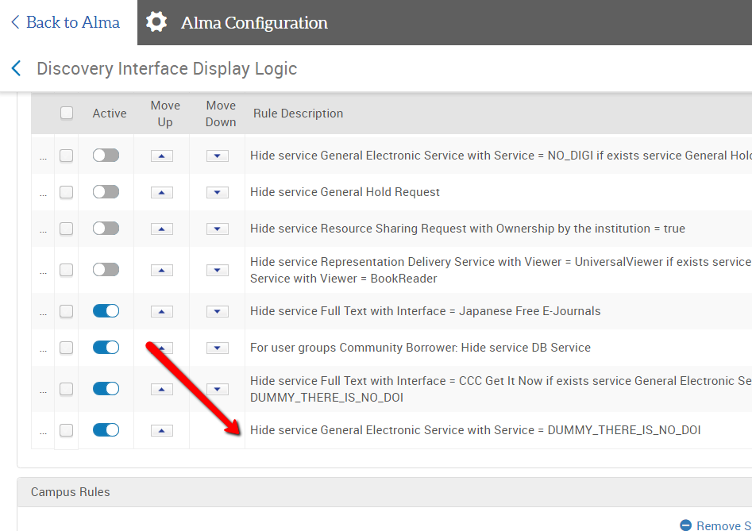
Step 3 – Hide the Dummy Service
This rule hides the Dummy service unconditionally
The rule is last in the Display Logic Rules

Slide 25
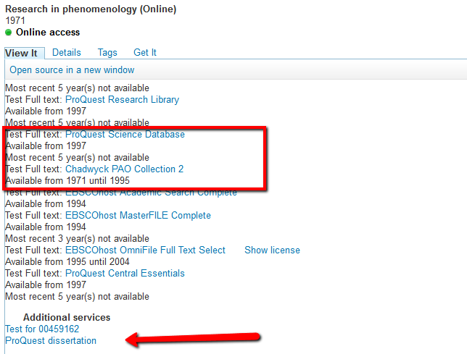
Let’s see how the rule works
Now we have achieved our goal !
CCC GetItNow DOES NOT appear when there is NO DOI

Slide 26
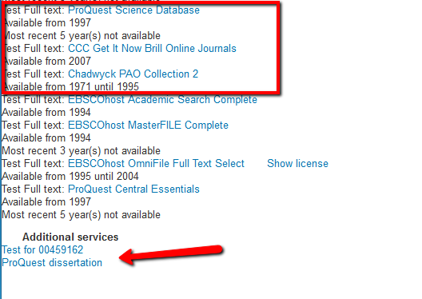
Let’s see how the rule works
Now we have achieved our goal !
CCC GetItNow DOES appear when THERE IS a DOI

Slide 27
Step 1 – Create the General Electronic Service (GES) (another example)

Slide 28
Step 1 – Create the General Electronic Service (GES) Example 2
In the next couple of slides, we’ll see another example of configuring the GES. This time we will make a more complex rule, so that the GES will show up only if there is a DOI OR an ISSN

Slide 29
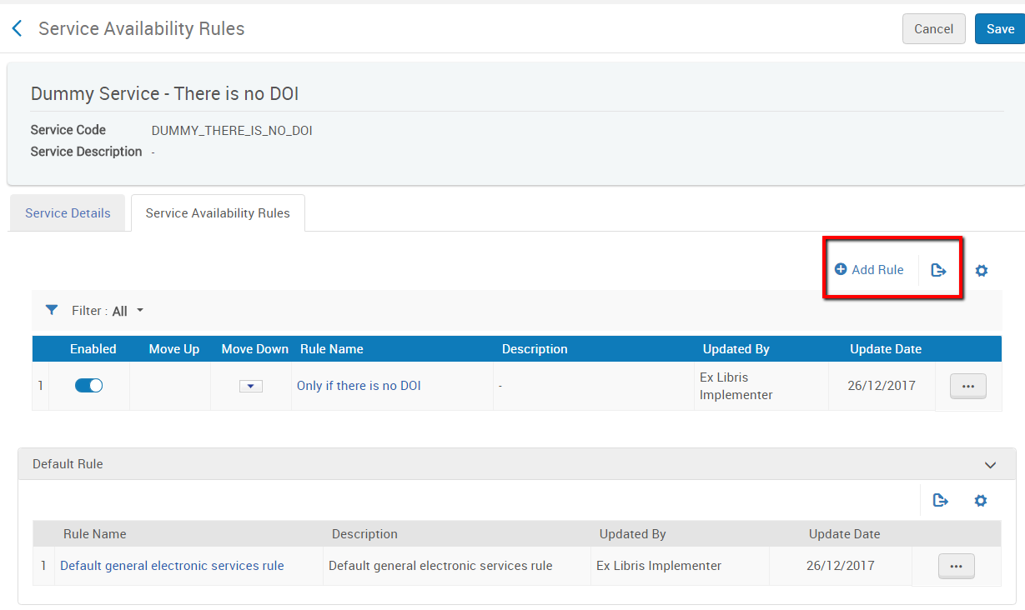
Step 1 – Create the General Electronic Service (GES) Example 2
This is very simple. All we need to do is add a rule to the General Electronic Service we have previously configured

Slide 30
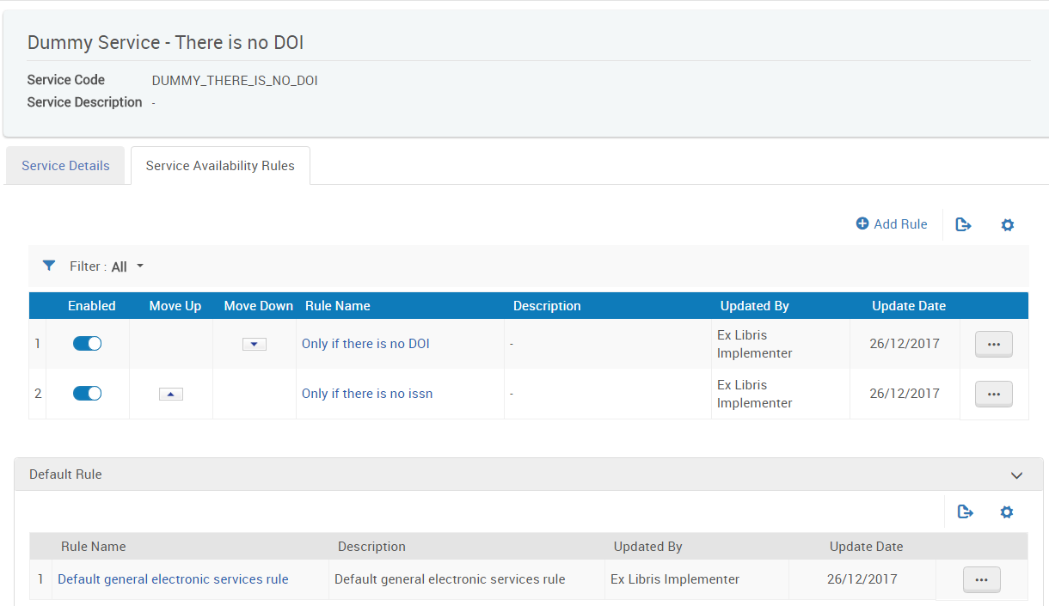
Step 1 – Create the General Electronic Service (GES) Example 2
Having both services configured means that:
The GES will show up only if there is no DOI AND no ISSN
The DLR will therefore hide the CCC GetItNow only if there is neither a DOI nor an ISSN

Slide 31
Thank you
Moshe.shechter@exlibrisgroup.com

