Slide 1
Ex Libris Leganto : Sharing the Love of Reading Lists
An Introduction for Instructors
[Your name]
[Your contact details]

Slide 2
AGENDA
What is Leganto?
Why use Leganto?- Benefits to Instructors and Students
DEMO > Introduction to Leganto for Instructors
A Studen’ts View of Leganto
Analytics
Q&A
Notes:
I would like to lay out our agenda for our time together today. First, I will briefly explain what Leganto is. Next, I will cover why we have chosen to utilize Leganto here on campus and will highlight its benefits to you as instructors and also for your students. We will then move into our live demonstration of Leganto so that you can see it for yourself and get a basic understanding of how to use Leganto. Next, we will take a quick look at some of the analytics and reports that can be pulled for you that illustrate the usage of your course reading list materials. Finally, I will show you what your students will see when they go into your course reading lists that have been created using Leganto, and then we will wrap up with Q&A. Does this sound like a good agenda to everyone?

Slide 3
What is Leganto?
Leganto allows you to easily build comprehensive resource lists and delivers them directly into your course site, as well as providing library support to ensure content is available and accessible to students whenever they need it.
Notes:
Leganto is a new tool that enables you to easily create and share course reading lists that maximizes your library’s existing subscriptions to save the organization and students money while also making copyright clearance simpler. Leganto helps instructors build reading lists that are relevant, easily accessible to students, and interactive.

Slide 4
Easy to create, share and re-use resources lists
Options for in-app collaboration with the library, other instructors, and students about your course resources
Insight into usage and resource optimization – use data and feedback to increase student engagement and success
Library supports fulfillment, making sure your selected resources are always available to students
For Instructors
Notes:
Very easy to use, re-use, and duplicate – Leganto is easy to use. It is simple to search for materials, share information with librarians and your students, and to duplicate readings and reading lists. Leganto has exclusive features that allow you to add materials from basically any resource – hard copy books, online journals, your own PDFs, and YouTube videos are just a few examples.
Easy collaboration with the library, other instructors, and students – Leganto allows you to easily search for and find materials to add to your reading lists – and with the simple click of a button, those materials that require processing assistance, such as copyright clearance or a physical hard copy reserve in the library, will be sent to the library for processing. Additionally, you can easily collaborate with other instructors and your students.
Insight into usage – Analytics and reports can be pulled easily to show the level of usage of your reading list materials and can also help with resource optimization – together, the library and instructors can make sure that the library has the resources available to give the most value possible to your students.
Automates copyright clearance – Importantly, Leganto will give immediate copyright clearance for many materials that you wish to use as part of your course. This will protect you and our institution from embarrassing, expensive, and illegal copyright violations.

Slide 5
Easy to see exactly what instructors expect you to read, watch and listen to for each course
Directly connected to course sites with no additional sign on needed
Low cost to access or use resources through support by library for subscribed and open access resources
When purchases needed, students choose when and what to buy
For Students
Notes:
Leganto for Instructors PowerPoint Slide 5 - Benefits of Leganto for Students – You’ll use this slide to discuss the benefits of Leganto to students. Please feel free to modify these bullet points as needed for your specific institution; you know your individual needs best.
Easy to use – This is often an undergraduate’s first experience with scholarly materials and a university library, and Leganto makes it easy for students to find and access what they need.
They get their reading lists directly through their courses – Leganto provides seamless integration with our LMS and is accessible via mobile devices – no additional log-in credentials needed. Most of the time, students won’t even realize that they are using a tool called Leganto because they will simply click a link to access a reading via the LMS.
Saves them money by maximizing library and open content – When you create your reading lists in Leganto, you will be able to utilize resources for which the library has an existing subscription and also incorporate open web content. This can result in a great cost savings to your students, and we all know how critical learning affordability is to our students.
Flexibility around what they purchase and when – When you use Leganto to create your readings lists, your students can purchase one reading at a time or all readings at the same time; Leganto is flexible and can assist them with their budgets.

Slide 6
Let’s Look at Leganto!
Notes:
Leganto for Instructors PowerPoint Slide 6 – Live Demonstration
You have now set the stage for what Leganto is, why it is of value for instructors and their students, and are ready to show Leganto live.
Now, let’s take a look at Leganto from the perspective of an instructor wishing to create a course reading list. We will take a look at analytics and a student’s view of Leganto later.

Slide 7
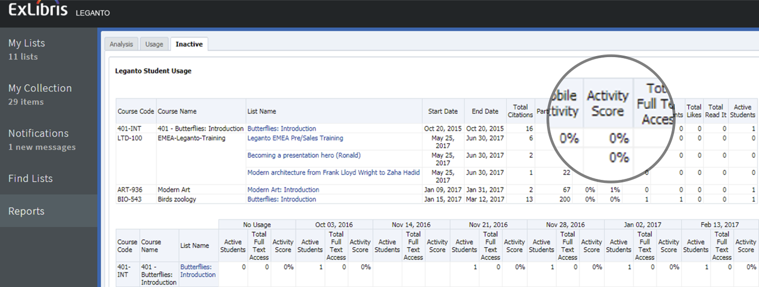
Leganto Analytics
Notes:
Move back to the Leganto for Instructors PowerPoint Slides 7 & 8 - Discuss Analytics – You’ll use these two slides to discuss and show analytics that may be pulled for instructors. You will point out a few analytics that you think will be compelling – such as, number of participants and active students. Please note that the slides may not show heavy usage because they are merely a sample; they are meant to be illustrative only. You could also use only one of these two slides if time is a factor.
As an instructor, you can see how your reading list is being used, which articles people read and commented on, and engage with your students, but you may also want to adjust your reading list for next year based on this info.
2. Here you can see usage info, but Librarians will also be able to get insight into costs for courses, and be able to pull data on the most expensive readings that the library doesn’t subscribe to, or journal titles that the library doesn’t subscribe to with the most readings, or even the most expensive courses or most expensive instructors.
Benefits of Analytics:
• Insight into usage for instructors and library
• Optimize collection development
• Highlight the value of the library collection

Slide 8
Watch Here: https://youtu.be/LbgpVANlfJI
Notes:
Slide 9 - Questions & Answers – You’ll use this slide for Q&A and any follow-up necessary based on your presentation.
I hope I’ve given you an excellent overview of Leganto and how and why you should use it in all of your courses going forward. Your library is here to help. Now, I would like to open the floor for any questions you may have.
As a follow-up to today’s session, I will be emailing you a list of resources available to assist you with using Leganto. These materials include PDFs and short video tutorials. And, as always, the library is here to assist you as well. We think you will find great value in using Leganto for your course reading lists and are excited to help you get started.

