Slide 1
Pivot Funding – Searching, Sharing, Tracking, and Tagging

Slide 2
Today’s Agenda
Overview of Pivot Funding
Pivot funding search options:
Quick Search
Sponsor Search
Advanced Search
Sharing, Tagging, Saving searches and individual opportunities

Slide 3
Pivot Funding Overview
Pivot Funding is the most comprehensive source of Funding available on the Web
A global database, packed with 26,000 records of funding opportunities worth an estimated $33 billion
Multi-Disciplinary in scope
All categories of sponsors, public and private
Over 11,500 national and international sponsors including government agencies, private foundations, corporations, non-profit organizations, etc.
Funding for many purposes: grants, fellowships, capital improvements, travel, visiting professors, training, and more
Pivot Funding is edited daily by a group of editors. Not by a machine!

Slide 4
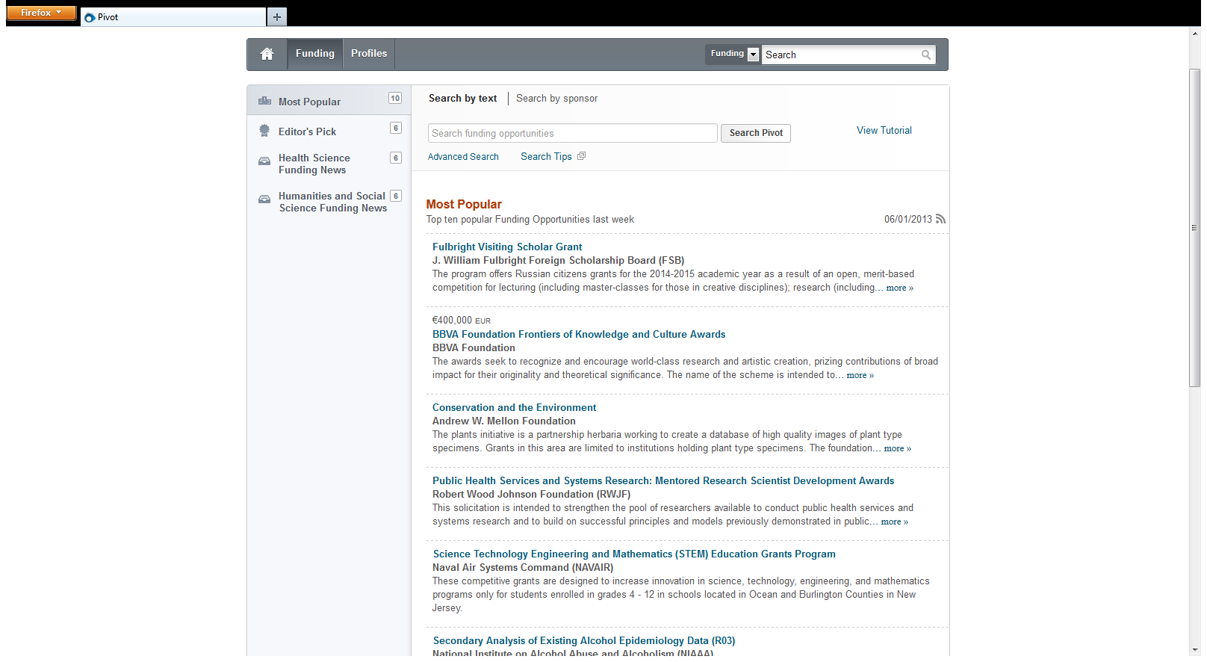
Let’s take a look…

Slide 5
Help with Pivot
Help and FAQs available by clicking the Help button within your Pivot account
Upcoming webinars and recorded sessions are also available in the Help area of your Pivot account or directly at www.proquest.com/go/webinars-pivotusers
Videos are available with in the various sections of Pivot or at You Tube: www.youtube.com/proquestpivot
Pivot Tech Support is available
Eastern Time Zone:
Monday – Thursday: 8:00 am – 11:00 pm ET
Friday: 8:00 am – 8:00 pm ET
Saturday: Email only
Sunday: 2:00 pm – 11:00 pm ET
email: pivot.support@proquest.com
phone: +1. 800-521-0600 ext. 74440 or +1.734-997-4440
Thank you!

