Slide 1
CUSTOMIZING THIS SLIDE PRESENTATION
Throughout we call it “Leganto” but you may have re-branded it – please make sure to replace all of that language throughout
A sample script is in the presenter notes. You’re encouraged to adjust to sound natural to your style and to the terminology most suitable for your audience (e.g. “LMS” to “Blackboard”)
Slide 3 contains screenshots from our demo Canvas environment – please update for your own LMS version and display
If your configuration requires the instructor to activate or install the LTI link before they can connect to Leganto be prepared to address that as well – you don’t want them to try to find it but give up because it’s not installed by default.
Slide 8 has placeholders for your links to more training and information
Slide 10 might require the most customization depending on how you’ve set up your course creation options
Slide 11 contains a screenshot that shows the Primo scopes dropdown in search – you may wish to replace this with one that shows your own Primo scopes
ABOUT THIS PRESENTATION
Slides 2-8 constitute a 5 minute introductory tour of Leganto based on a sample list.
Slides 10-14 are included in case you have the opportunity to go a little deeper into the list creation process (15 minutes or so).
For more detailed training please consult the other materials in the Campus Engagement toolkit, or those developed by your library.
Delete this slide once you’ve customized your own presentation

Slide 2
Leganto gives you -
All Materials in One Stop
Easy to Create & Modify Lists
Student Engagement Opportunities
Library Support & Collaboration
Next Term? Ready to go!
Include all kinds of material types from all sources in one list – easy for students to find right from your course site!
Search the library collection, add from web content and upload our own files.
Organize your list for structure & context.
See where students are engaging with your choices and, if you like, enable discussions & let them suggest additional content.
We help you make sure materials are made available to students at no or low cost & that there are no access restrictions or broken links.
Create your list now, then easily duplicate it next term making any adjustments you like.
Notes:
I’m excited to be able to introduce you to Leganto, our new tool for creating reading lists. I’ll just spend a few minutes with you today giving you a tour of how a list looks and works in Leganto. Then, when you have more time, you can let me know and we can arrange training or simply go ahead and dive in yourself.
This tool allows faculty and librarians to work together to create reading lists containing a wide array of resources, such as library holdings, websites, and videos. It makes it simple for your students to get access to those materials and have them all presented in a single list. You’ll see indications of their activity and be able to get reports on how much they’re interacting with the list.

Slide 3
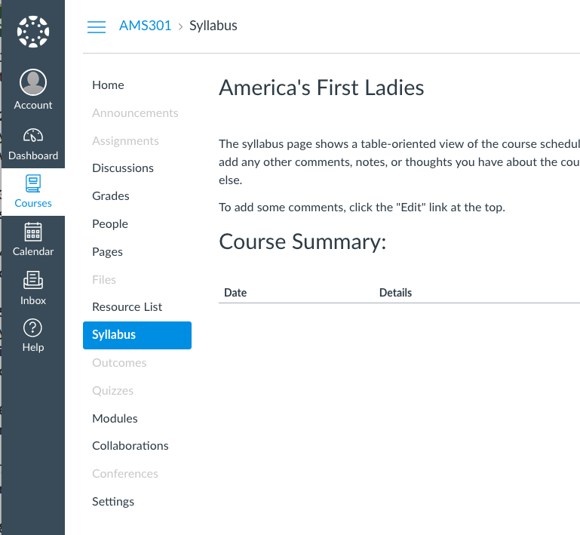
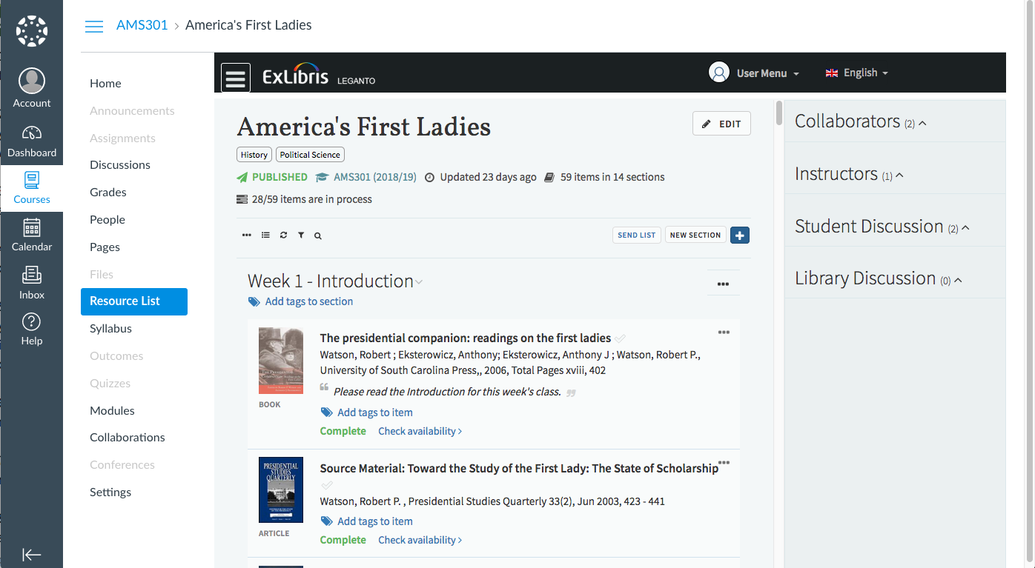
Notes:
Because Leganto is integrated with our LMS, you’ll just click on the link for it in the menu to get started—it’s seamless; you won’t need separate log-in information—and neither will your students. They will access in the same way, but they will only see the finished reading list you’ve created. Further, students love being able to access all of their readings in one place, especially from any mobile device.
You can add other instructors or even library staff as collaborators to help you build and manage the list.

Slide 4
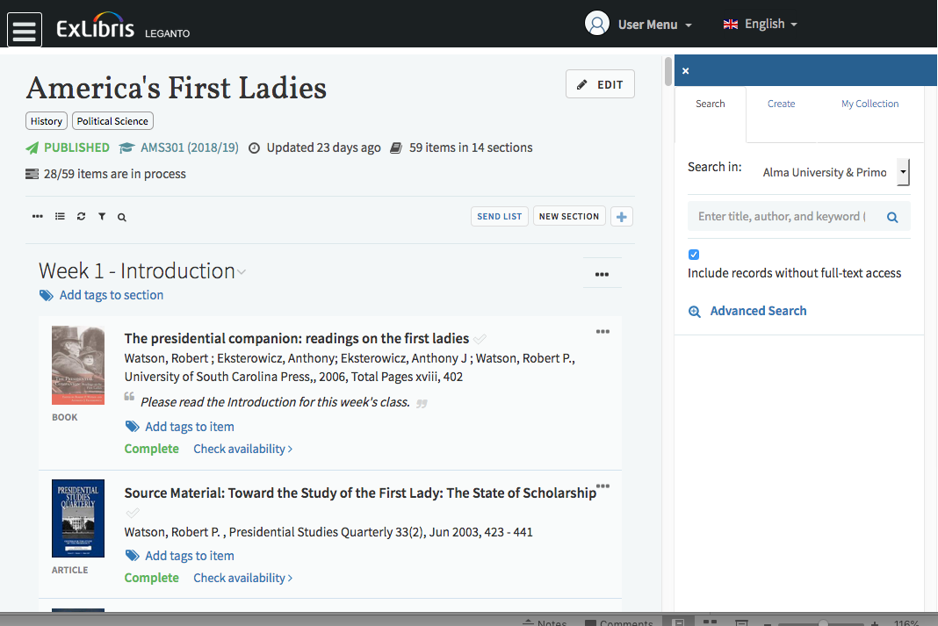
ADDING ITEMS TO YOUR LIST
Search library collections
Upload your own documents
Create and add from your own collection
Notes:
There are a number of ways to add items to the list. The + symbol opens a panel to the right where you can search the library collections and central academic database index. You can also upload our own documents or add individual citations. Or you can build your own collection of materials and then drag and drop them into various lists as needed.
Leganto also has a bookmark tool called Cite It that lets you add items from around the web – Google Scholar, popular websites, Amazon or video sites like You Tube or TED talks. While you’re out just learning about your areas of interest you might find something you’ll want to put on your list – Cite It makes it simple to collect those items and ideas.

Slide 5
ORGANIZING YOUR LIST
Create sections
Include notes
Add tags
Notes:
Leganto lets you organize your list into sections. As the course progresses, this can help your students know what to read when.
You can provide further context with notes and tags and even section descriptions. Leganto really lets you craft the list as you see fit to help students work through your materials.

Slide 6
WORKING WITH THE LIBRARY
Done? Send the list to the library!
We ensure resources are ready for students
When the library’s done: Publish the list to your students
Notes:
Leganto is designed for us each to do what we do best: for you to select the right materials and for us to make sure they’re available when needed. So once you’ve compiled your list, you’ll send it to us to work on.
We then bring in the resources we can to support your choices. We’ll let you know when it’s done and the final step would be to publish it to your LMS and make it visible to students.

Slide 7
STUDENTS’ VIEW
The availability information is provided by the library.
There may be more than one source they can select from.
Items in our print collection will show library location and check out status.
Notes:
You can check out the students’ view of in a “Student View,” or you can see how students are interacting with your reading lists in a report. While your course is running, you can come back to the list and get a quick set of stats - # of likes, # of read its and any favorites right on the screen as well.
Students see the same list, but of course with fewer options, and click into each item to see where they can access the content. As much as possible, we’ll make resources available online and they can click through to access them. No more proxy link making!
In other cases the material might be available in print and that will show here as well – they can see the library location and whether the material is currently on the shelf or checked out.

Slide 8
There’s lots more but that can wait.
Get Started
You can access Leganto today from your course site and start building your list. We’re here to help.
Or, send me your reading list and we’ll build it for you!
Learn More
Sign up for training:
[url for training workshop]
Read more:
[url for training materials]
Watch videos:
[url to training videos]
Notes:
There’s lots more we can show you about Leganto but I wanted to give you a quick taste. I hope you’ll use it for your class. We can set up your list for you if you send it to me; otherwise, you can just click through in the LMS and get started on it yourself.
We’re always here to help and more training is available too. Thanks for taking the time with me today!

Slide 9
DEEP DIVES: How To: Start a List and Add Readings

Slide 10
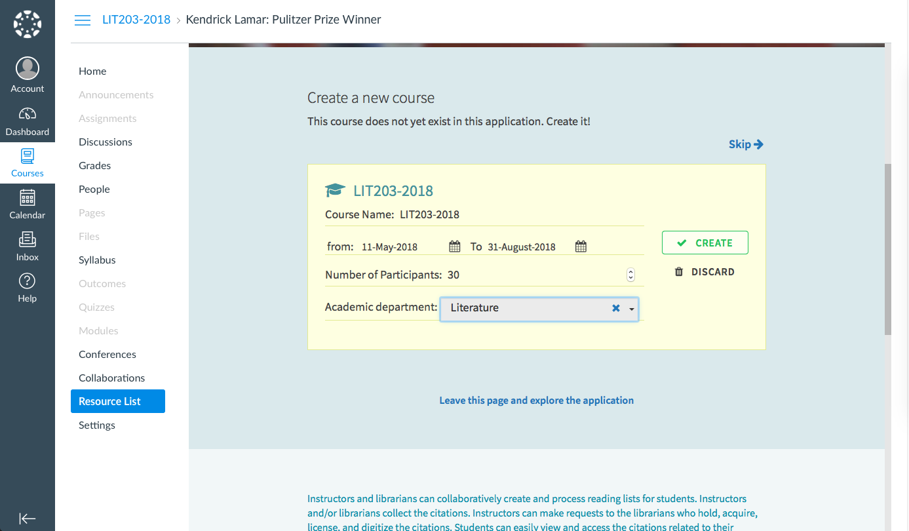
On your first entry to Leganto, you’ll be prompted to provide some information to get your course set up and a reading list started.
Your next screen will contain templates we’ve created to help you get started organizing your list. Choose one or use the Blank list.

Slide 11
DEEP DIVE:
USING SEARCH
1: Open the side panel
4: See instantly if this is available in our library
2: Enter search terms
3: Filter by material type (if you like)
5: Drag the reading(s) you want into your list

Slide 12
1: Open the side panel
DEEP DIVE:
UPLOAD A FILE
or
ADD A CITATION
2: Click on the Create tab
5: Scroll down the upload panel. If you have the file, upload it here.
3: Select the material type – the fields will change
6: Click Add to put it on the list
4: Enter the citation details

Slide 13
DEEP DIVE:
USING ‘CITE IT!’
Install the Tool
1: Click on your name
2: Select Cite It!
3: Drag the Cite It! button to your bookmarks toolbar

Slide 14
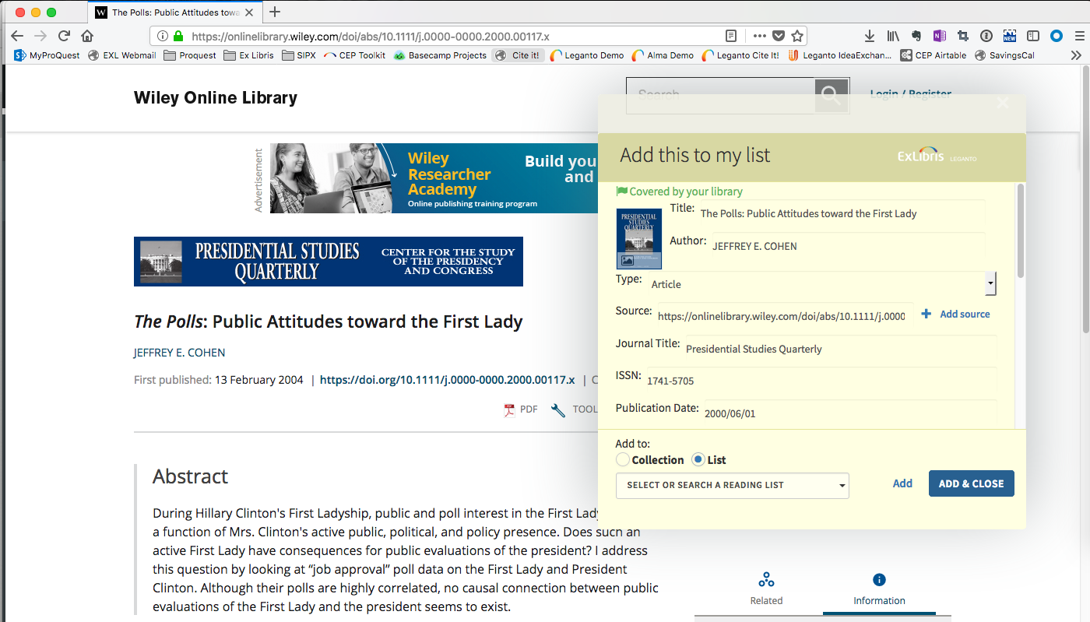
You’re on the web or searching other databases and want to add a resource to your list? Cite It!
DEEP DIVE:
USING ‘CITE IT!’
Collect Resources
1: Click on the Cite It! bookmark
2: See instantly if this resource is available in our library
3: Add it directly to your list or collect for later.

