Slide 1
Configuring and using the Accession Number and Inventory Number
Yoel Kortick. Senior Librarian
https://www.wisegeek.com/what-are-online-surveys.htm
https://images.wisegeek.com/woman-looking-over-shoulder-at-computer.jpg

Slide 2
Contents
Introduction
The accession number
The inventory number
Number four
Number five
Number six

Slide 3
Introduction
Before beginning to explain the configuration and use of the accession number and the inventory number we will state from the outset as follows, in order to clarify the issue:
The accession number is part of the holdings record
The inventory number is part of the physical item.
The accession number and inventory number are two separate entities not dependent on each other.

Slide 4
Introduction – accession numbers
Accession Numbers
It is possible to configure Alma so that accession numbers in holdings records will be automatically generated.
The accession number can be useful in identifying particular holdings records or groups of holdings records.
For example, you can use a prefix that includes the year the resource is acquired or a specific location.

Slide 5
Introduction – accession numbers
Accession Numbers
The accession number includes a counter which by default begins at 1. It increases by 1 each time a new accession number is generated.
After you the accession number is configured, the number is generated in the MD Editor for a holdings record by selecting Tools > MARC 21 Holdings > Generate Accession Number.

Slide 6
Introduction – inventory numbers
Inventory Numbers
It is possible to define multiple number sequences that can be applies to physical items.
This feature provides libraries with the ability to comply with inventory control regulations by providing an additional, unique inventory number for each physical item.

Slide 7
Introduction – inventory numbers
Inventory Numbers
Each sequence may include a prefix.
The sequence can be configured to start at any number
The total length of the prefix + number can also be configured.
In this way the inventory numbers can be used for filtering purposes when creating Analytics reports.

Slide 8
Contents
Introduction
The accession number
The inventory number
Number four
Number five
Number six

Slide 9
The accession number
The accession number sequence can be defined at
The institution level
The library level
The library + location level
In order to implement institution-level sequencing configurations for holdings records the parameter holdings_accession_number_generation_extended should be set to true. (Configuration > Resources > General > Other settings)

Slide 10
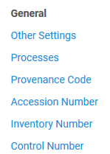
The accession number
In order to create a new accession number go to “Configuration > Resources > General > Accession Number” and select “Create a New Sequence”

Slide 11
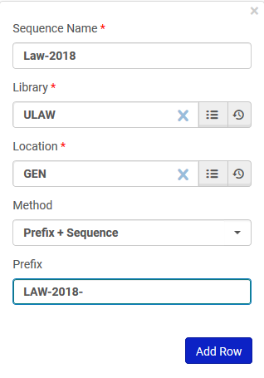
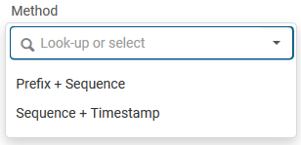
The accession number
Here we have created an accession number for holdings records of the Law library General location.
We have chosen to use “Method” “Prefix + Sequence” and the prefix is “LAW-2018”
The other “Method” we could have chosen is to use a sequence and timestamp

Slide 12
The accession number
After the accession number parameters are defined we can set the sequence to something different than the default “1”
Here we define it to start at 613

Slide 13
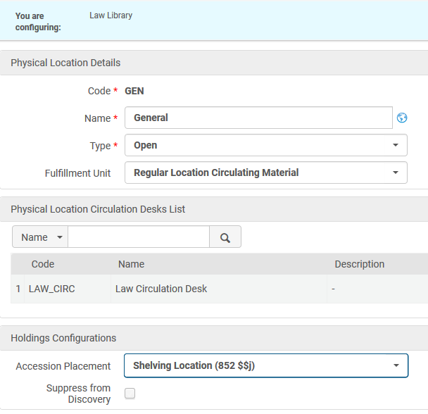
The accession number
In order to have the automatically generated accession number indexed and searchable in the repository it must be assigned to a MARC field.
Here is the location “General” which is part of the Law library.
Under “Configuration > General > Select Library > Locations > Physical Locations” the accession number is defined to go to 852 subfield j.

Slide 14
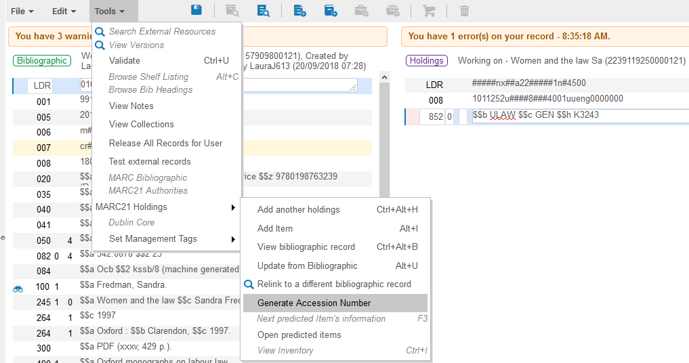
The accession number
Now we will generate an accession number for this holdings record. It is in library “Law” and location “General”

Slide 15
The accession number
The accession number is created (in subfield j because that is what we previously defined). It is LAW-2018-613.

Slide 16
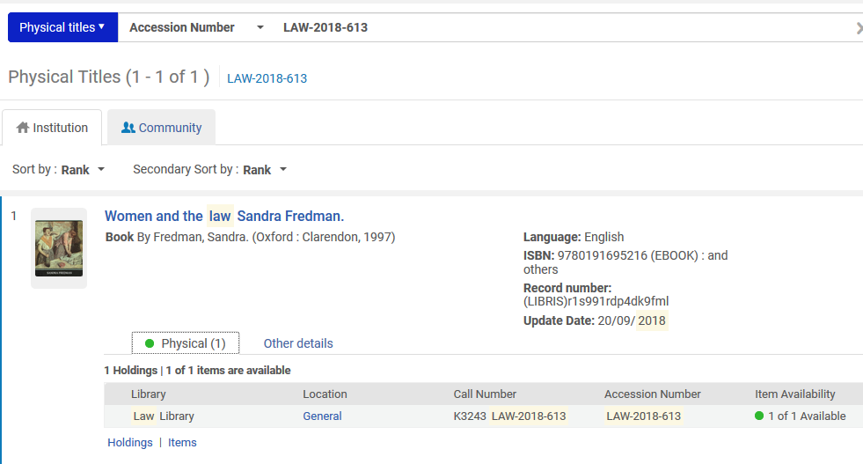
The accession number
The record can be retrieved via the accession number

Slide 17
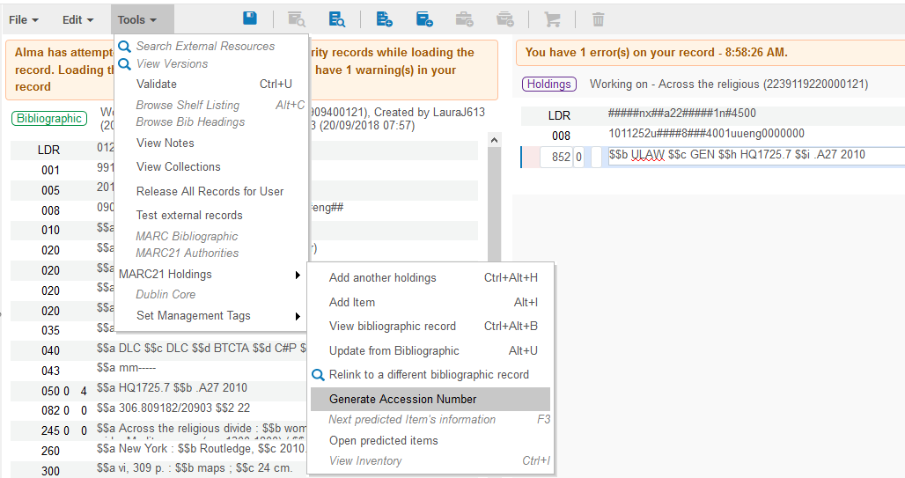
The accession number
Now we will generate another accession number for Law library General location

Slide 18
The accession number
The sequence has gone from 613 to 614. Now the inventory number is LAW-2018-614.

Slide 19
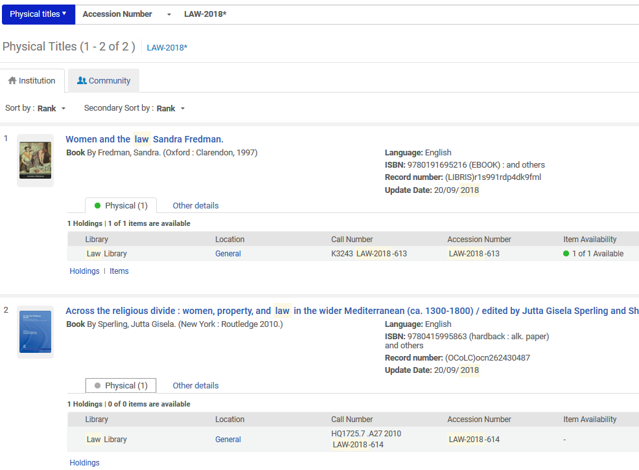
The accession number
Using a wildcard in the search all accession numbers beginning with LAW-2018 can be retrieved.

Slide 20
Contents
Introduction
The accession number
The inventory number
Number four
Number five
Number six

Slide 21
The inventory number
It is possible to configure multiple number sequences which can be applied to physical items.
This feature provides libraries with the ability to comply with inventory control regulations by providing an additional, unique inventory number for each physical item.

Slide 22
The inventory number
Each sequence may include a prefix.
The sequence can be configured to start at any number, and the total length of the prefix + the number can also be configured.
This enables the institution to use the numbers for filtering purposes when creating Analytics reports.

Slide 23
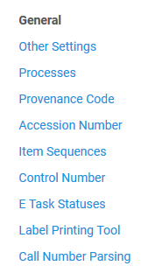
The inventory number
In order to create a new inventory number go to “Configuration > Resources > General > Item Sequences” and select “Create a New Sequence”

Slide 24
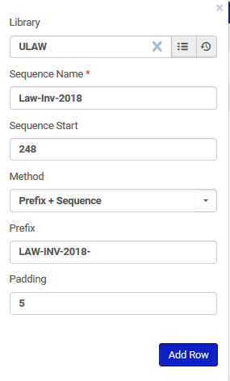
The inventory number
Here we have created an inventory number for items in the Law library.
The prefix is “LAW-INV-2018-”
The sequence is 248
The padding is 5, and we will see how this affects the number later

Slide 25
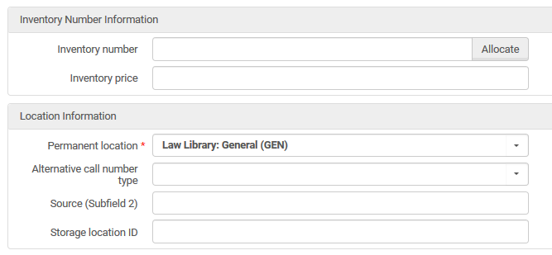
The inventory number
In the physical item editor we will allocate an inventory number for an item in the Law Library

Slide 26
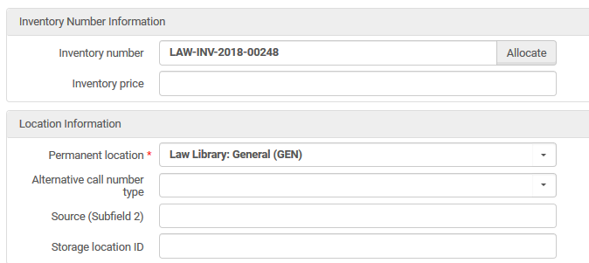
The inventory number
The item is given inventory number ‘LAW-INV-2018-00248’

Slide 27
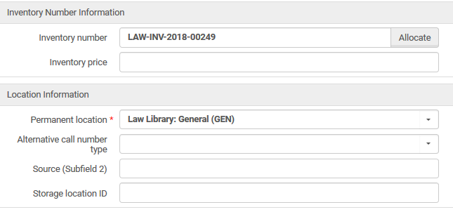
The inventory number
The next item in the Law library which is given an inventory number gets ‘LAW-INV-2018-00249’

Slide 28
The inventory number
The reason the inventory numbers are ‘LAW-INV-2018-00248’ and ‘LAW-INV-2018-00249’ is because:
We stated the prefix is “LAW-INV-2018-”
The sequence starts at 248
The padding is 5
In order to make “248” and “249” be 5 positions it gets “padded” with two leading zeroes so all together it is 5 digits long.

Slide 29
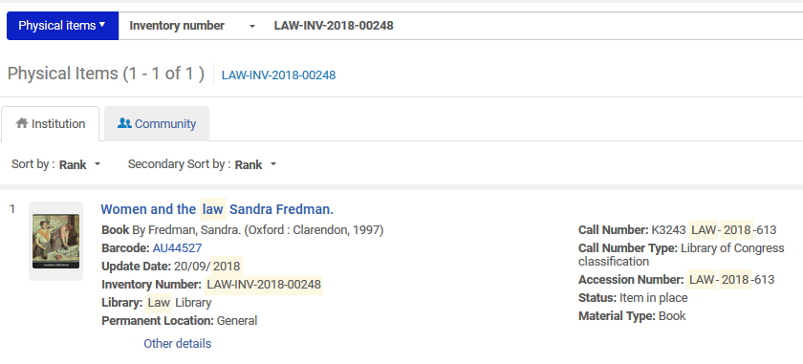
The inventory number
The records can be retrieved via the inventory number.
Here is Inventory number LAW-INV-2018-00248

Slide 30
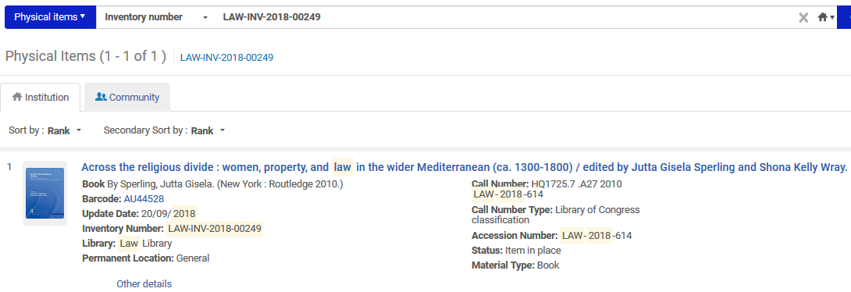
The inventory number
The records can be retrieved via the inventory number.
Here is Inventory number LAW-INV-2018-00249

Slide 31
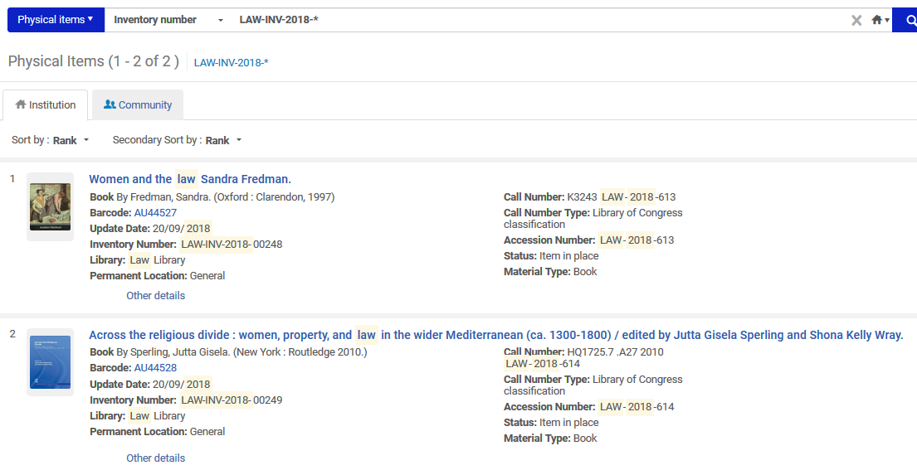
The inventory number
Using a wildcard in the search all inventory numbers beginning with LAW-INV-2018 can be retrieved.

