Slide 1
Including local parameter fields (local fields) in Alma Analytics
Yoel Kortick. Senior Librarian

Slide 2
Contents
Introduction
Defining the fields
The sample records
The results in analytics
text five
text six

Slide 3
Introduction
In addition to the many bibliographic and holdings fields which are already included in Alma Analytics it is possible to also add:
Up to ten additional fields to the “Bibliographic Details” folder
Up to ten additional fields to the “Holding Details” folder
The fields which the institution adds to the “Bibliographic Details” and / or “Holding Details” folder are called “local_param” fields.
These local_param fields do not have to include a “9” in any of the positions.

Slide 4
Contents
Introduction
Defining the fields
The sample records
The results in analytics
text five
text six

Slide 5
Defining the fields
In order for your institution to have the local_param fields you must open a Sales Force Case and request from support to add the fields.

Slide 6
Defining the fields
As we can see in this example, some of the fields do have a “9” and some of the fields do not have a “9”
Dear Alma support:
Please add local_param fields to analytics for my institution as follows:
Bibliographic fields: 901,940,145,222,613,213
Holding: fields: 123,456,780,613,924,326

Slide 7
Defining the fields
In the next two slides we will see that the following has been defined for this specific institution:
Local Bibliographic fields for analytics:
Local_parameter_1 932
Local_parameter_2 938
Local_parameter_3 940
Local_parameter_4 982
Local_parameter_5 984
Local_parameter_6 927
Local_parameter_7 981
Local Holdings fields for analytics
Local_parameter_1 866
Local_parameter_2 852
Local_parameter_3 970
Local_parameter_4 971

Slide 8
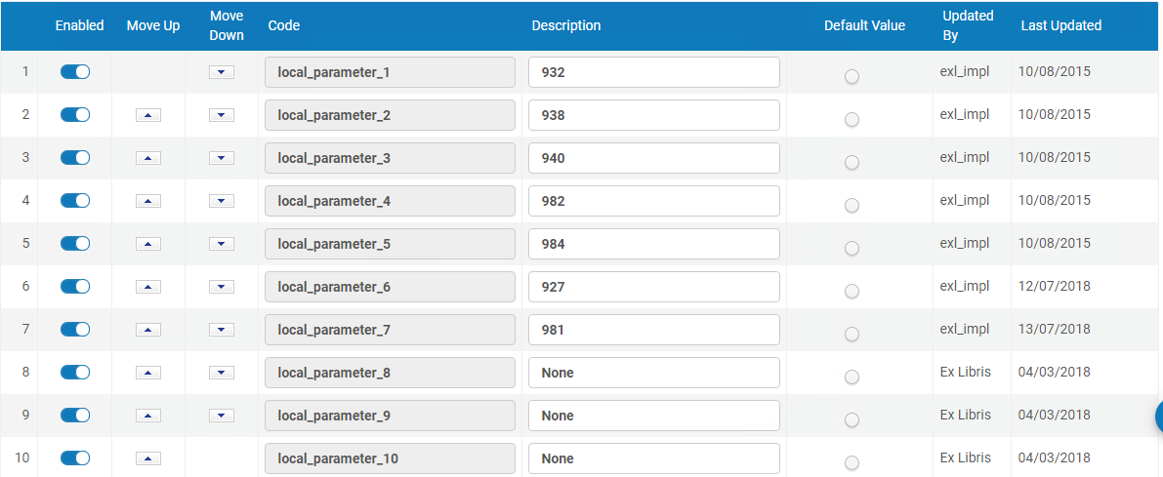
Defining the fields
Ex Libris makes the appropriate definitions in code table ‘Local Parameters for Reports’ and runs appropriate indexing.
Bibliographic fields:

Slide 9
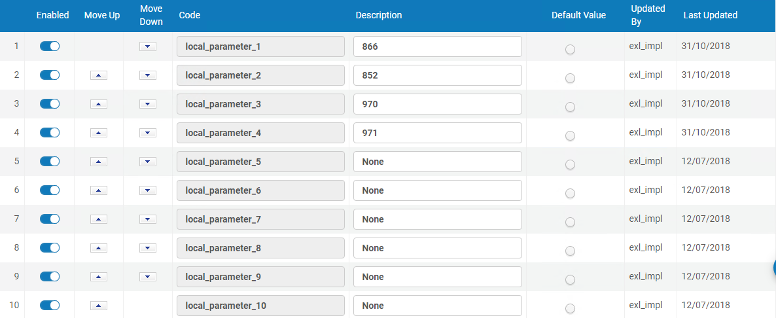
Defining the fields
Ex Libris makes the appropriate definitions in code table ‘Holding Local Parameters for Reports’ and runs appropriate indexing.
Holdings fields:

Slide 10
Contents
Introduction
Defining the fields
The sample records
The results in analytics
text five
text six

Slide 11
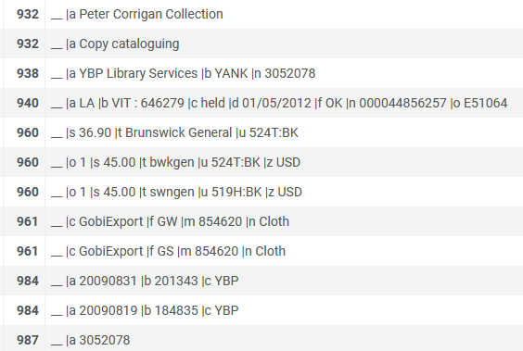
The sample records
Here is bibliographic record MMSID 999640900001341 with local fields
Fields defined as local_param fields are in red squares

Slide 12
The sample records
Here is holdings record ID 22100310020001341 with local fields
Fields defined as local_param fields are in red squares

Slide 13
Contents
Introduction
Defining the fields
The sample records
The results in analytics
text five
text six

Slide 14
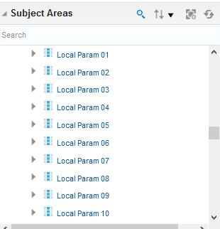
The results in analytics
Here are the bibliographic record local_param fields (shared folder “Bibliographic details)

Slide 15
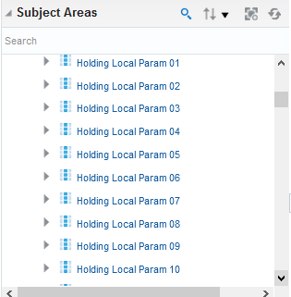
The results in analytics
Here are the holdings record local_param fields (here we are looking in the physical items subject area)

Slide 16
The results in analytics
Here is the bibliographic record in analytics with local parameter fields

Slide 17
The results in analytics
Here is the holdings record in analytics with local parameter fields

Slide 18
The results in analytics
Here is the bibliographic record in Alma and in analytics

Slide 19
The results in analytics
Here is the holdings record in Alma and in analytics

Slide 20
The results in analytics
Note: In the examples used here the local fields were “sent to” analytics without the subfield delimiters.
It is also possible to include the subfield delimiters the analytics local fields.
This can be done by specifying to Ex Libris support, via a salesforce case, that this is desired.

