Slide 1
Displaying holdings record fields in the Primo Get It locations
Yoel Kortick. Senior Librarian

Slide 2
Contents
I | Introduction
II | The configuration
III | Sample holdings records and their appearance in Primo – Example One
IV | Sample holdings records and their appearance in Primo – Example Two
V | Sample holdings records and their appearance in Primo – Example Three

Slide 3
Introduction
The holdings records often contain very useful information for the end user.
This information may
Enable the user to learn more about the resource
Aid the user in physically finding the resource
Therefore Alma has a method to display the holdings record fields to the end user.
Via this method each institution can choose which fields and subfields will appear to the end user and in what order.

Slide 4
Contents
I | Introduction
II | The configuration
III | Sample holdings records and their appearance in Primo – Example One
IV | Sample holdings records and their appearance in Primo – Example Two
V | Sample holdings records and their appearance in Primo – Example Three

Slide 5
The configuration
The configuration for displaying the holdings record fields is done via the tables
Holdings Display Labels
Holdings Display Configuration
See also
Primo GetIt documentation
Configuring Holdings Display Labels
Both tables are accessible from
For Primo VE: Configuration > Discovery > GetIt Configuration
For not Primo VE: Configuration > Fulfillment > Discovery Interface Display Logic
In order for the tables "Holdings Display Labels" and "Holdings Display Configuration" to be used the parameter "uresolver_enable_getit_holding_configuration" must be defined to "true"
The parameter uresolver_enable_getit_holding_configuration is accessible via "Configuration > Fulfillment > General > Other settings"

Slide 6
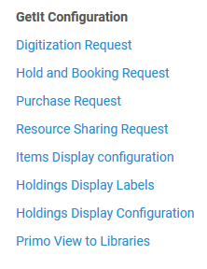
The configuration

Slide 7
The configuration
The table "Holdings Display Labels" defines the name and order of the holdings record field, as well as the translations for the labels.
It does not define what field and subfields are associated with the label name (more on that in a moment).
The code of the holdings display label can be a logical name or a MARC code.
In the example on the next slide the codes for the labels is the MARC field from which the relevant subfields will come. This is just for organizational purposes and has no effect in functionality. It could also be text.

Slide 8
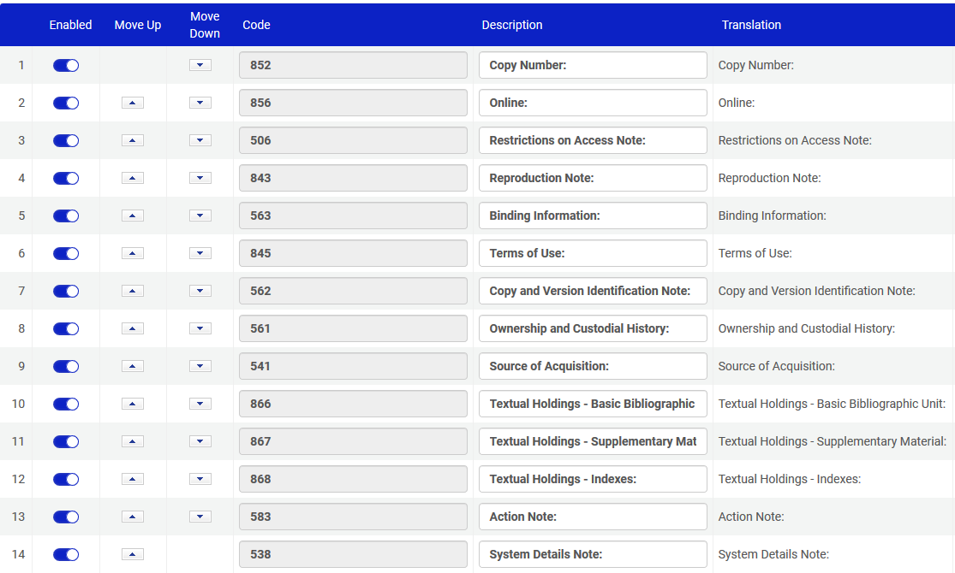
The configuration
Holdings Display Labels

Slide 9
The configuration
The table "Holdings Display Configuration" defines the field and subfields which display for the label.
For example, in the next slide it is defined that:
Field 563 subfields a,3,u will display for "Binding Information"
Field 541 subfields a,b,c,d will display for "Source of Acquisition"
Field 561 subfields a,3,u will display for "Ownership and Custodial History"
Field 562 subfields a,b,c,d,e will display for "Copy and Version Identification Note"
Field 852 subfield t will display for "Copy Number"
Field 856 subfields 3,u,7,z will display for "Online"
Field 506 subfields 3,a,b,c,d,e,u will display for "Restriction on Access Note"
Field 843 subfields 3,a,b,c,d,e,f,m,n will display for "Reproduction Note"
Field 845 subfields a,b,c,d will display for "Terms of Use"
Etc.
Etc.
Etc.

Slide 10
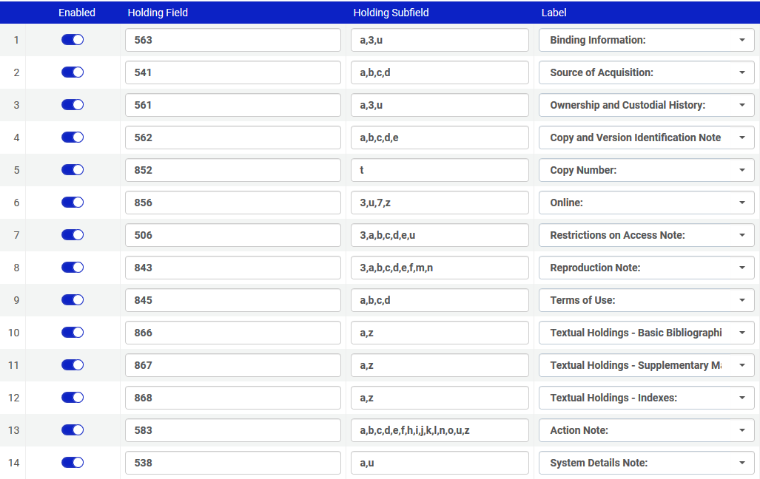
The configuration
Holdings Display Configuration

Slide 11
Contents
I | Introduction
II | The configuration
III | Sample holdings records and their appearance in Primo – Example One
IV | Sample holdings records and their appearance in Primo – Example Two
V | Sample holdings records and their appearance in Primo – Example Three

Slide 12
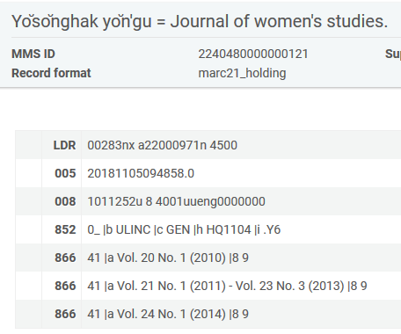
Sample holdings records and their appearance in Primo – example one
Here is the holdings record for title "Yŏsŏnghak yŏn'gu = Journal of women's studies".
It contains field 866, which is defined as "Textual Holdings - Basic Bibliographic Unit"

Slide 13
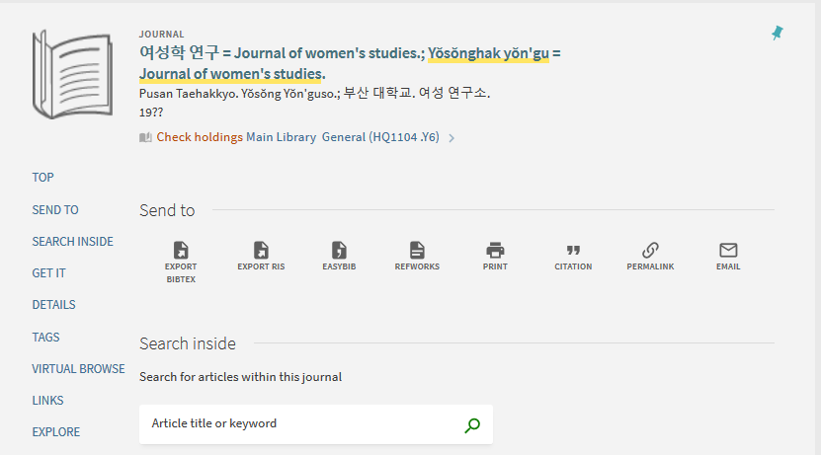
Sample holdings records and their appearance in Primo – example one
In Primo we click the availability link

Slide 14
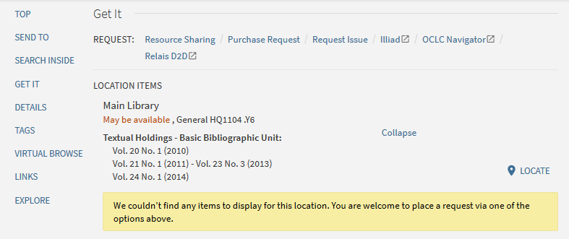
Sample holdings records and their appearance in Primo – example one
The "Textual Holdings – Basic Bibliographic Unit" appears as defined with the contents of 866 subfield a
Above it states "… May be available …" and "… couldn’t find any items" because in this example there is a holdings record but no items.

Slide 15
Sample holdings records and their appearance in Primo – example one
Here is the field which appears after clicking "Expand" each of the fields we defined in "Holdings Display Labels" and "Holdings Display Configuration" appears.

Slide 16
Contents
I | Introduction
II | The configuration
III | Sample holdings records and their appearance in Primo – Example One
IV | Sample holdings records and their appearance in Primo – Example Two
V | Sample holdings records and their appearance in Primo – Example Three

Slide 17
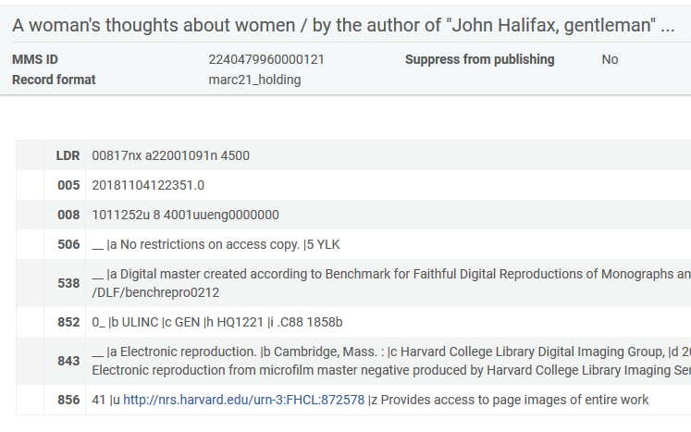
Sample holdings records and their appearance in Primo – example two
Here is the holdings record for title "A woman's thoughts about women".
It contains fields
506 which is defined as "Restrictions on Access Note"
538 which is defined as "Actions Note"
843 which is defined as "Reproduction Note"
856 which is defined as "Online"

Slide 18
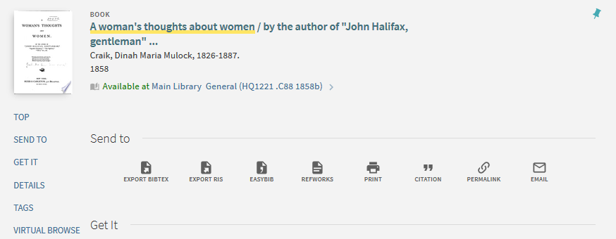
Sample holdings records and their appearance in Primo – example two
In Primo we click the availability link

Slide 19
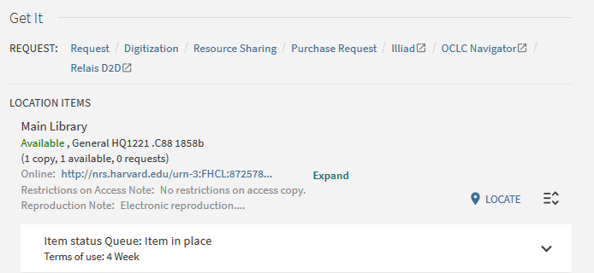
Sample holdings records and their appearance in Primo – example two
The holdings record fields appear in "collapsed" form, as will happen when there are "many" fields to display. We will click "Expand".

Slide 20
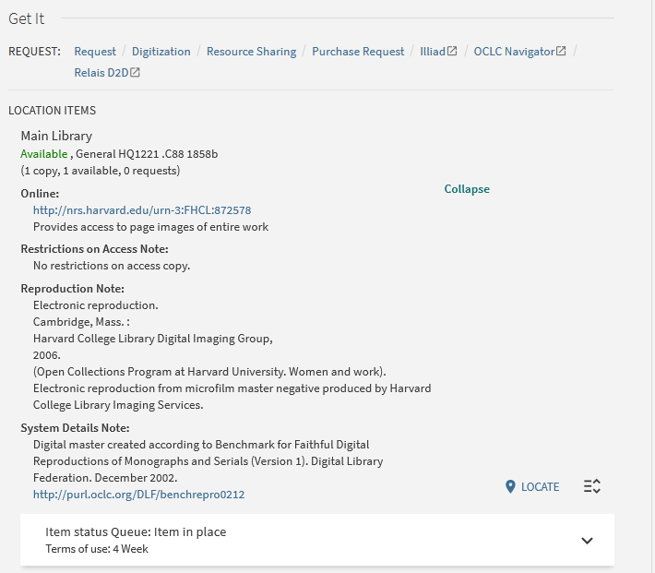
Sample holdings records and their appearance in Primo – example two
After clicking "Expand" each of the fields we defined in "Holdings Display Labels" and "Holdings Display Configuration" appears.

Slide 21
Sample holdings records and their appearance in Primo – example two
Here are the fields which appeared after clicking "Expand" each of the fields we defined in "Holdings Display Labels" and "Holdings Display Configuration" appears.

Slide 22
Contents
I | Introduction
II | The configuration
III | Sample holdings records and their appearance in Primo – Example One
IV | Sample holdings records and their appearance in Primo – Example Two
V | Sample holdings records and their appearance in Primo – Example Three

Slide 23
Sample holdings records and their appearance in Primo – example three
Here are two holdings records for title "Mr. William Shakespeares comedies, histories, & tragedies. : $$b Published according to the true originall copies".
Each has a different call number (shelfmark) in 852 $$h
Arch. G. c.7
Arch. G. c.8
Each holdings record has 1 item

Slide 24
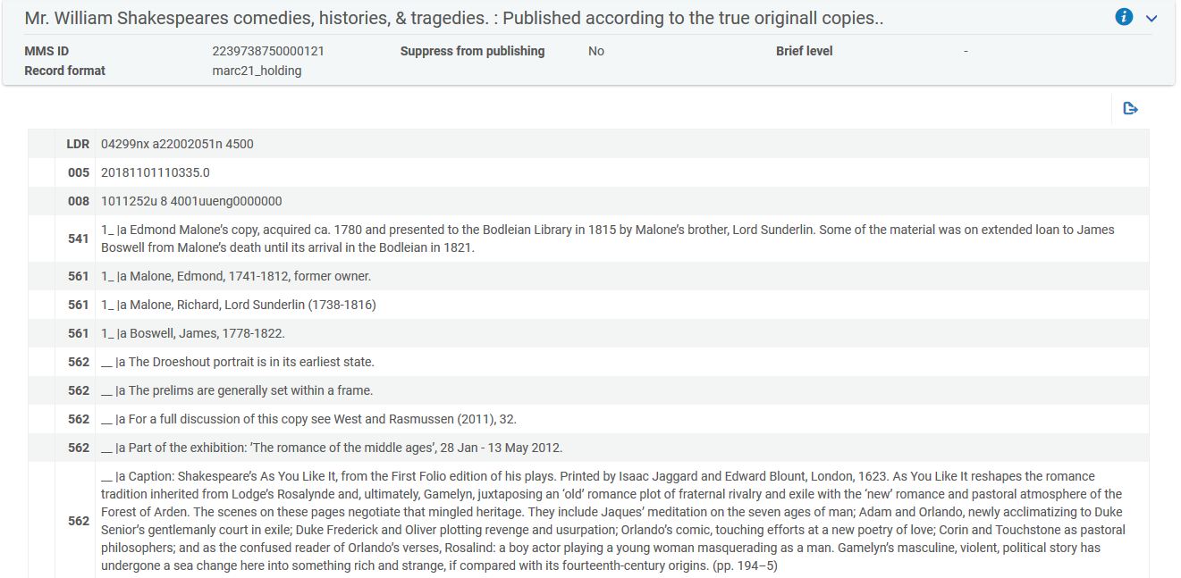
Sample holdings records and their appearance in Primo – example three
Here is the holdings record which has the Call Number Arch. G. c.8
This is the beginning of the holdings record

Slide 25
Sample holdings records and their appearance in Primo – example three
Here is the holdings record which has the Call Number Arch. G. c.8
This is the end of the holdings record

Slide 26
Sample holdings records and their appearance in Primo – example three
In Primo we click the availability link

Slide 27
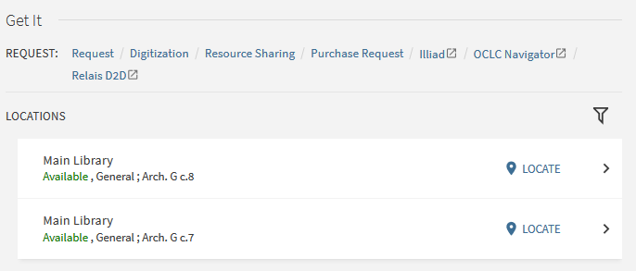
Sample holdings records and their appearance in Primo – example three
Now we will click to view the holdings record with call number Arch. G c.8

Slide 28
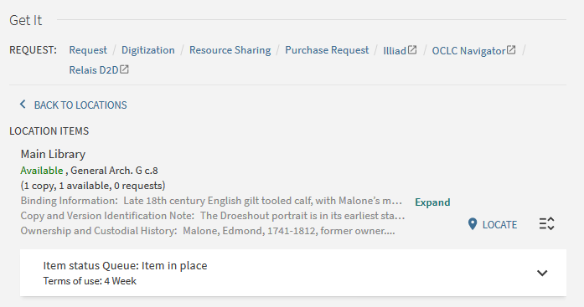
Sample holdings records and their appearance in Primo – example three
The holdings record fields appear in "collapsed" form, as will happen when there are "many" fields to display. We will click "expand".

Slide 29
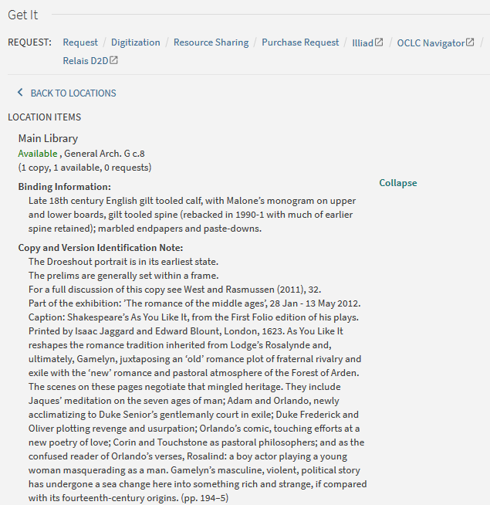
Sample holdings records and their appearance in Primo – example three
After clicking "Expand" each of the fields we defined in "Holdings Display Labels" and "Holdings Display Configuration" appears.
This is the beginning of the holdings record

Slide 30
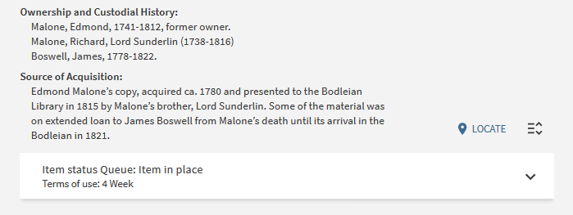
Sample holdings records and their appearance in Primo – example three
After clicking "Expand" each of the fields we defined in "Holdings Display Labels" and "Holdings Display Configuration" appears.
This is the end of the holdings record

Slide 31
Sample holdings records and their appearance in Primo – example three
Here are the fields which appear After clicking "Expand" each of the fields we defined in "Holdings Display Labels" and "Holdings Display Configuration" appears.

