Slide 1
British Library Document Supply Service (BLDSS) API

Slide 2
Agenda
  What is BLDSS and what are its APIs ?
  What are the benefits of using this service ?
  Configuring use of the BLDSS APIs
  BLDSS based workflow
  Some troubleshooting tips

Slide 3
  What is BLDSS and what are its APIs ?

Slide 4
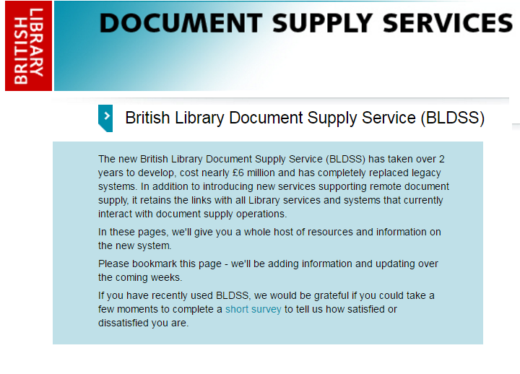
BLDSS

Slide 5
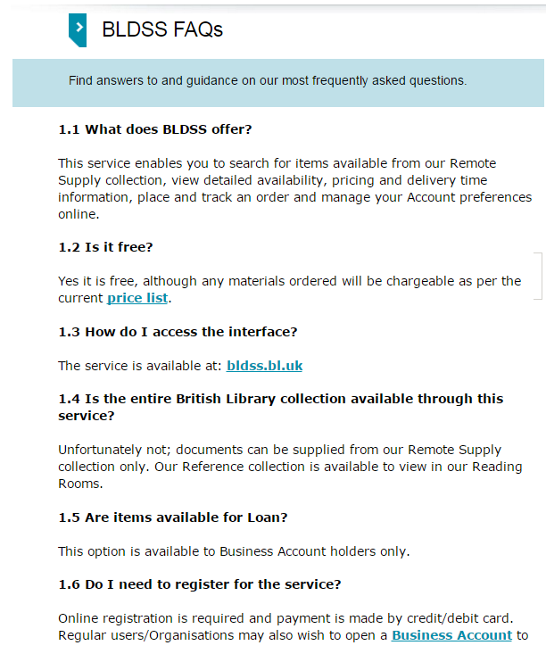
BLDSS

Slide 6
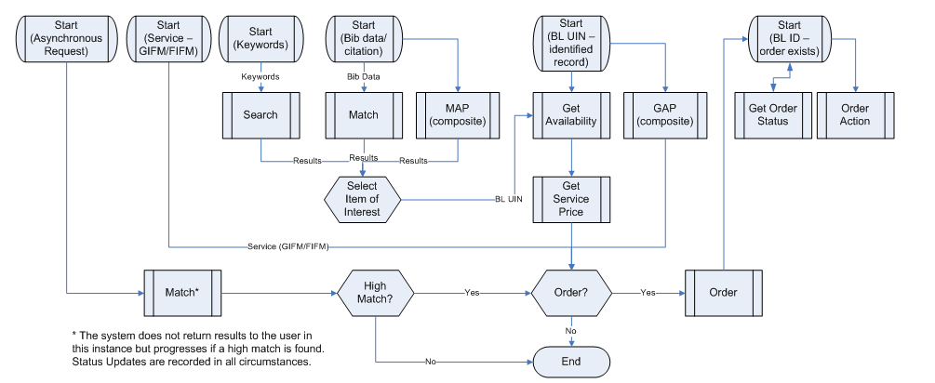
BLDSS APIs
The APIs allow implementing the full discovery and delivery process via API, including elements such as retrieving pricing options and service options

Slide 7
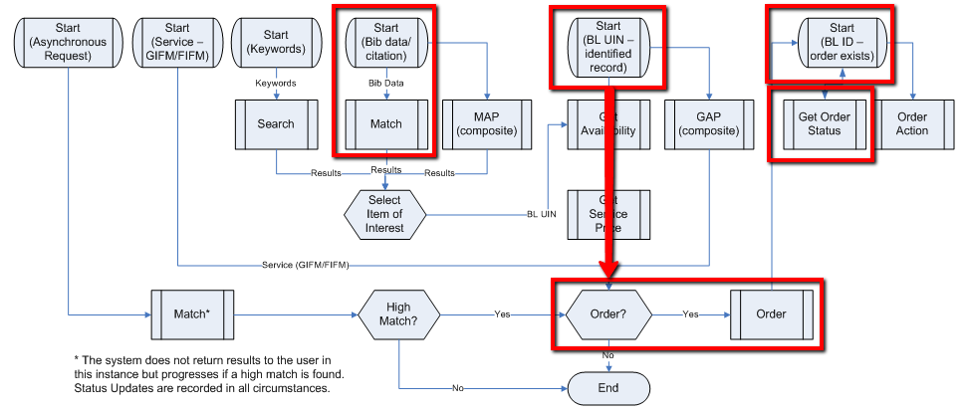
BLDSS APIs
In Alma, we have used the APIs to implement a P2P workflow with BLDSS similar to the one that is used with other protocols (ISO,NCIP P2P)

Slide 8
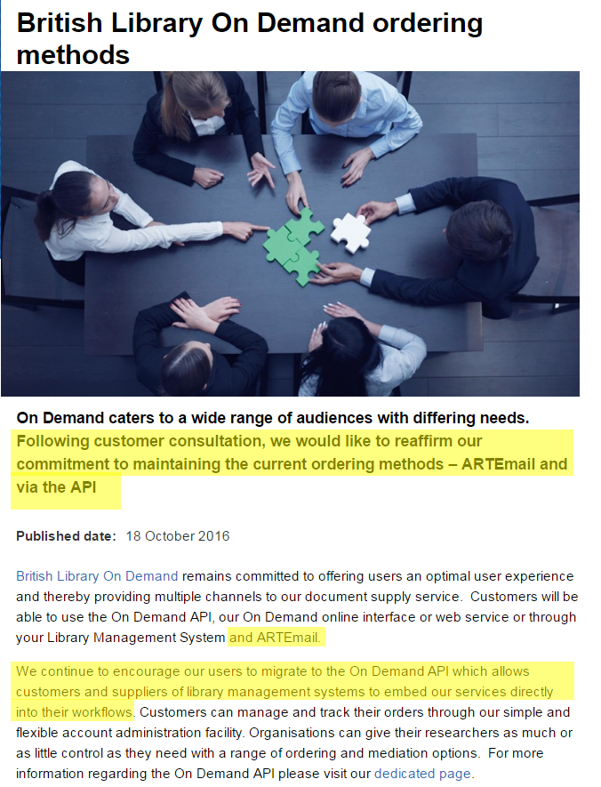
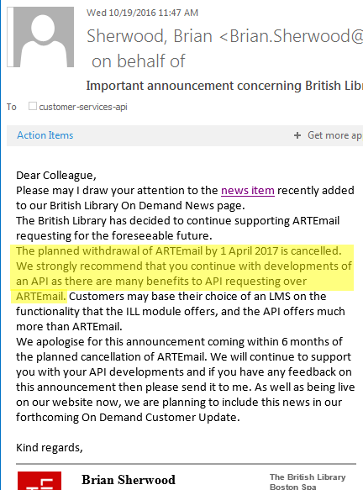
BLDSS APIs

Slide 9
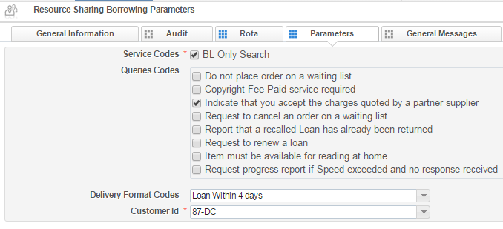
The Benefits
ARTEmail is a very manual process:
  Staff need to manually process every request in order to send it

Slide 10
The Benefits
ARTEmail is a very manual process:
  Locate process is done outside of the system
  Feedback from the BL is received as emails, and need to be manually updated into the system

Slide 11




The Benefits
For example, consider the following ARTEmail workflow
1. Place Request
5. Cancel
2. Search BL
3. Set Request Attributes
4. Send
6. Cancel

Slide 12
The Benefits
By contrast, consider the following BLDSS API workflow
1. Place Request
5. Cancel
2. Search BL
3. Set Request Attributes
4. Send
6. Cancel

Slide 13


The Benefits
For example, consider the following ARTEMail workflow
3. Process Renewal
1. Renew
2. Look at email

Slide 14
The Benefits
By contrast, consider the following BLDSS API workflow
3. Process Renewal
1. Renew
2. Look at email

Slide 15
  Configuring use of the BLDSS APIs

Slide 16
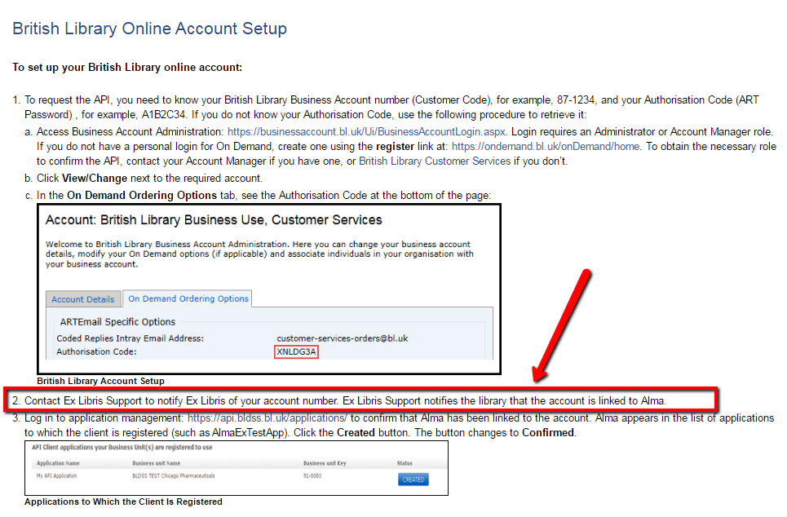
Configuring BLDSS
The first step is to set up the BLDSS account with the BL
This step requires involvement of Ex Libris staff

Slide 17
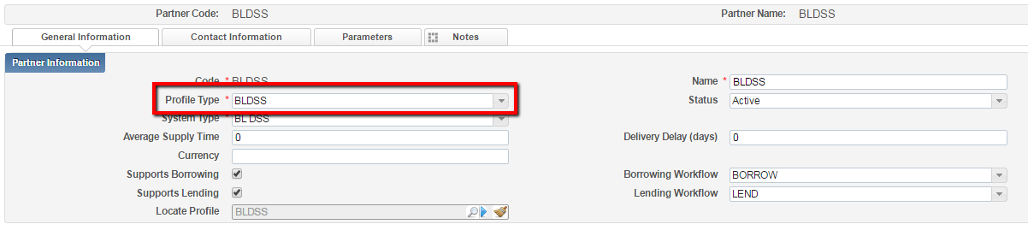
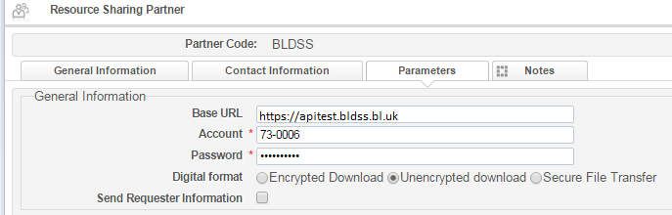
Partner Record
https://api.bldss.bl.uk/api
Real URL
Test URL
Information obtained when setting up BLDSS at BL site

Slide 18
Partner Record
Using the ‘Allow Asynchronous Request’ attribute will allow you to send requests without first locating the resource at BL using the locate process.
If used, Alma will use a BL record ID if the locate process finds one, but will send the request metadata without an ID if the locate does not find a single match. The partner will not be removed from the rota by the locate process.

Slide 19
Partner Record
During testing, you can use the generic test account, using the below credentials.
Account: 73-0006
Password: API6789364
Base URL: https://apitest.bldss.bl.uk

Slide 20
Partner Record
When switching to work in production, change the URL to https://api.bldss.bl.uk, and use your BL account code and password.
Make sure to follow the steps documented in the below on line help link when switching to the production account.
https://knowledge.exlibrisgroup.com/Alma/Product_Documentation/Alma_Online_Help_(English)/Integrations_with_External_Systems/040Fulfillment/020Resource_Sharing_Partners/British_Library_Document_Supply_Service_(BLDSS)

Slide 21
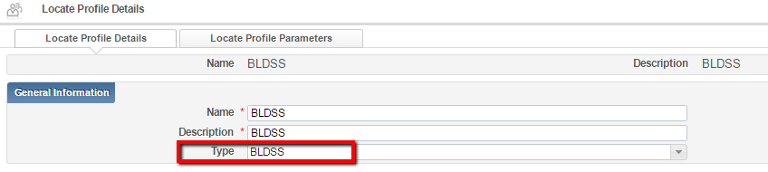
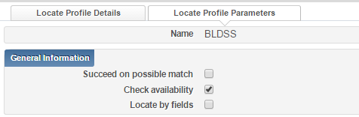
Locate Profile
Of course, partner record should be linked to the locate profile …

Slide 22
  BLDSS Based Workflow

Slide 23
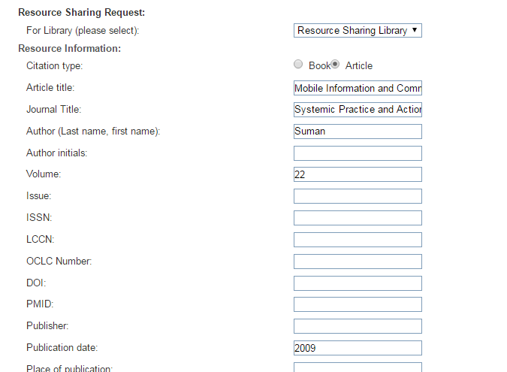
Request Submitted in Primo

Slide 24
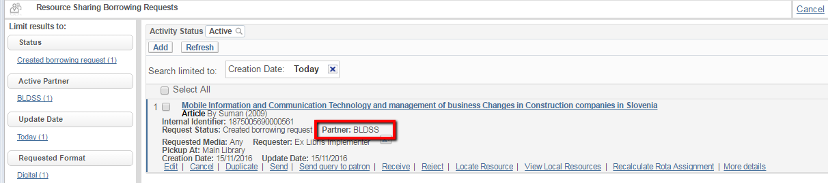
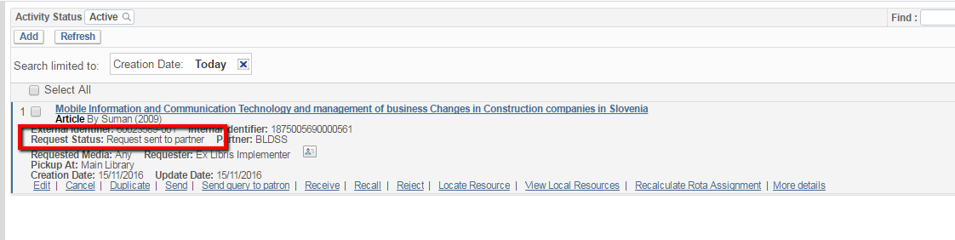
BLDSS Partner added
… as per rota assignment rules
…locate runs, and request is sent
… Automatically !

Slide 25
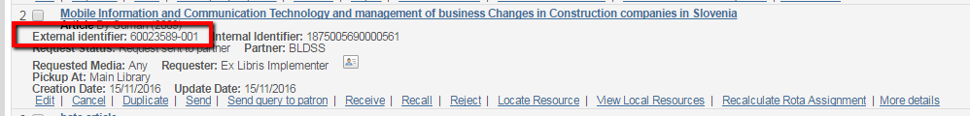
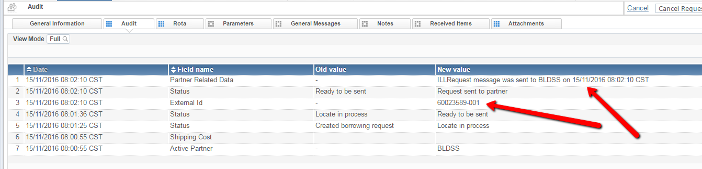
Audit
BL Id is assigned

Slide 26
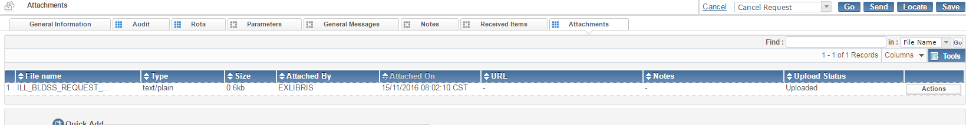
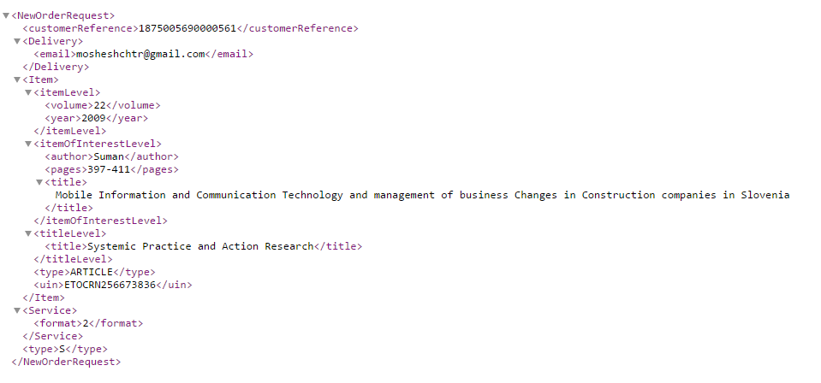
Audit
… and message is saved

Slide 27
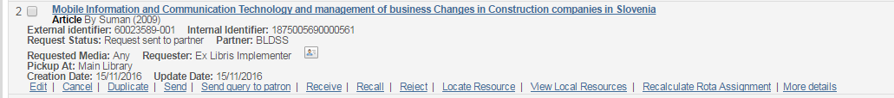
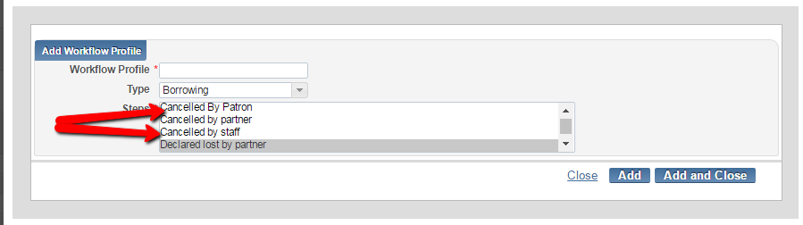
Cancel
Patron (from Primo) or staff (from Alma) can cancel the request.
The option to cancel is setup by workflow profile rules, separately for Primo or for Alma

Slide 28
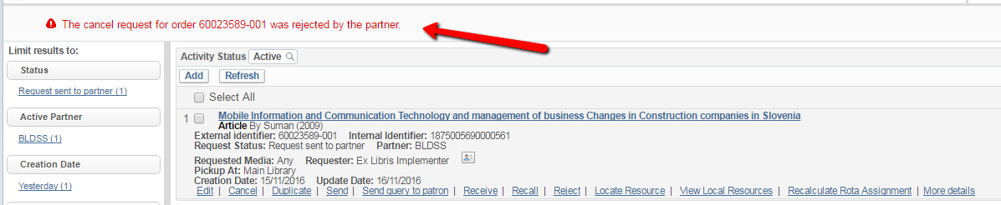
Cancel
It is up to BL to approve or reject the cancellation attempt

Slide 29
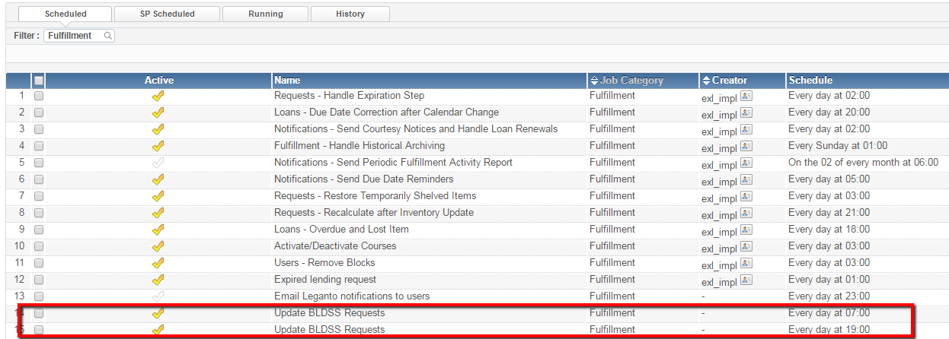
Events
A job (Update BLDSS Requests) polls BL for update on active requests
The job needs to be activated to BLDSS users, and can be activate to run eight times a day

Slide 30
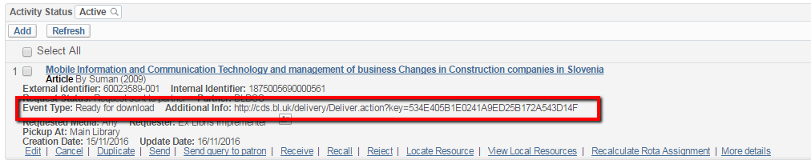
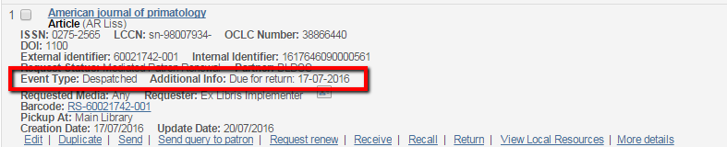
Events
BL updates Alma with:
Event Type
Additional Information
List of events and additional info can be found at http://apitest.bldss.bl.uk/docs/guide/appendix.html#events

Slide 31
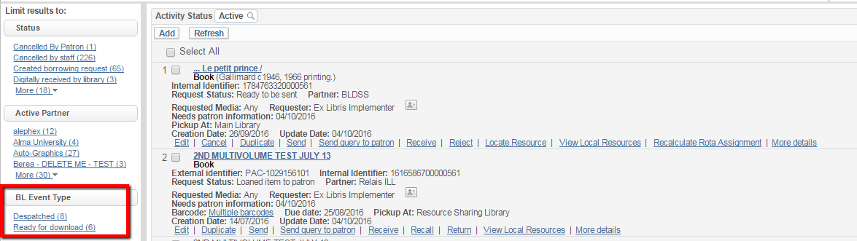
Events
New facets can be used to track updated requests

Slide 32
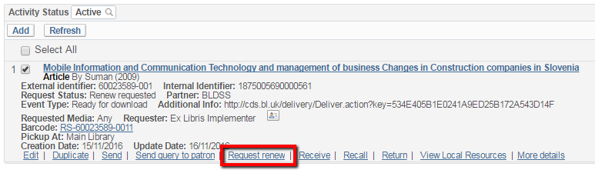
Events
In case of a ‘Unable to fulfil’ event, the request will be considered rejected
In case of a ‘Item renewed’ event the request will be considered ‘Renew Requested’.
  Library should then use the ‘Request Renew’ option to actually renew, based on the reported renew date
  Then, library should manually change the status so that it can distinguish between already handled requests and those waiting for processing

Slide 33
  Some troubleshooting tips

Slide 34
Q: I've just started testing this and am getting the same message 'Request not sent -- mandatory field is missing: country' even though I have input the country.
A:Looking at the request, I see that it is owned by the Interlending and Document Supply Library but it has no country code in its address. The API requires the address of the library that is sending the message.

Slide 35
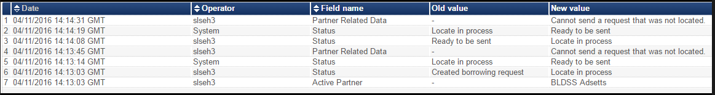
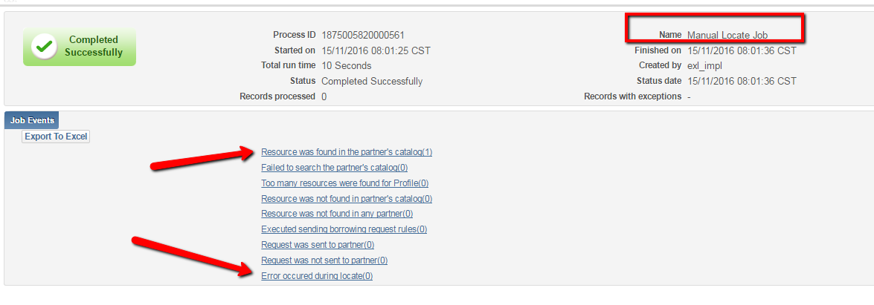
Q: I am receiving the 'Cannot send a request that was not located‘
A: Take a look at the history of the locate actions. It may indicate that the system failed connecting to the BLDSS server. Technical failure to run a locate is ignored by the system, so that it is considered a successful locate. However, because the bldss api mandates a record id that has not been successfully obtained by the API, the send action failed. I suggest re-running a locate and re-attempting the send.

Slide 36
A: The API keeps failing !
Q: This may be a connectivity problem. We (Ex Libris) can change the timeout of the API. That may improve the success rate of the API.

Slide 37
Thank You!
Moshe.shechter@exlibrisgroup.com

