Slide 1
Purchase Requests in Alma
Yoel Kortick
Senior Librarian

Slide 2
Agenda
Introduction
Creating the Purchase Request in Primo
Creating the Purchase Request in Alma
Managing Purchase Requests
PO Line Types for POLs created from Purchase Requests
Reporting on Purchase Requests in Alma Analytics

Slide 3
Introduction

Slide 4
Introduction
In addition to the information here see also Purchase Requests
Purchase requests are used to request that a library purchase a resource.
The purchase request can be created by
Librarians using Alma
Instructors or patrons using Primo or Leganto

Slide 5
Introduction
Purchase requests may be created, for example, for
Something brand new which will have either physical or electronic inventory
Something for which the library has one type of inventory and there is a desire to purchase a different type of inventory
Something for which there is a physical item, but another physical item is needed

Slide 6
Introduction
The purchase request in Alma can be created by the staff user
For themselves
On behalf of another user

Slide 7
Introduction
Roles
Function | Role
Create request from Alma/Primo with the user as the requester | Any role
Create request from Alma on behalf of another user: (the right to perform this task can also be enabled for other users by Ex Libris customer support) | Purchase Request Operator/Manager
Create request from reading list (when enabled by Ex Libris for your institution) | Course Reserves Operator/Manager
Manage requests | Purchase Request Operator, Purchase Request Manager
Purchase Request Operator + Purchase Request Operator Extended or Purchase Request Manager + Purchase Request Operator Extended | Delete rejected requests
Purchase Request Manager | Assign requests

Slide 8
Creating the Purchase Request in Primo

Slide 9
Creating the Purchase Request in Primo
A "Purchase request" link can appear in Primo as a service (in the GetIt or ViewIt tab).
As is the case with other services, it can be hidden from groups of users via the Display Logic Rules.
This service is initially hidden from users by default with the rule "Hide Service Purchase Request".

Slide 10
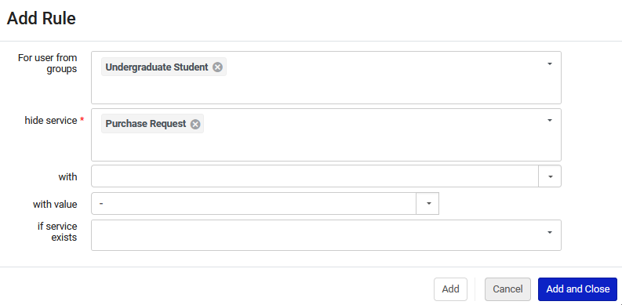
Creating the Purchase Request in Primo
Discovery Interface Display Logic Rules are accessed at "Configuration > Fulfillment > Discovery Interface Display Logic > Display Logic Rules"
This for example would hide the service "Purchase Requests" from undergraduates.

Slide 11
Creating the Purchase Request in Primo
In the example we will see here user Aniko Ezsias will log into Primo and create two purchase requests
First example: She searches for and finds a record, there is one item and it is on loan, she makes a purchase request for additional inventory
Second example: She searches for and does not find a bibliographic record. She then searches for it via the citation linker and from results of citation linker creates a purchase request.

Slide 12
Creating the Purchase Request in Primo – example one of two
User Aniko Eszias logs into Primo, searches for "Gloria Steinem Feminist Extraordinaire" and sees it is not available.

Slide 13
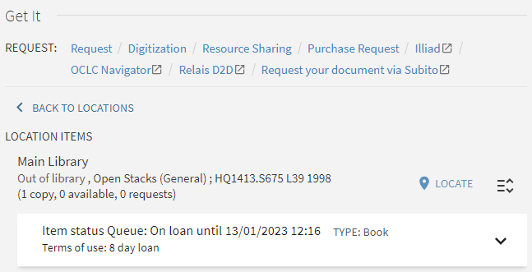
Creating the Purchase Request in Primo – example one of two
Aniko sees that there is one copy on loan and wants to suggest to the library to order another physical copy or an electronic version.
She clicks "Purchase Request".

Slide 14
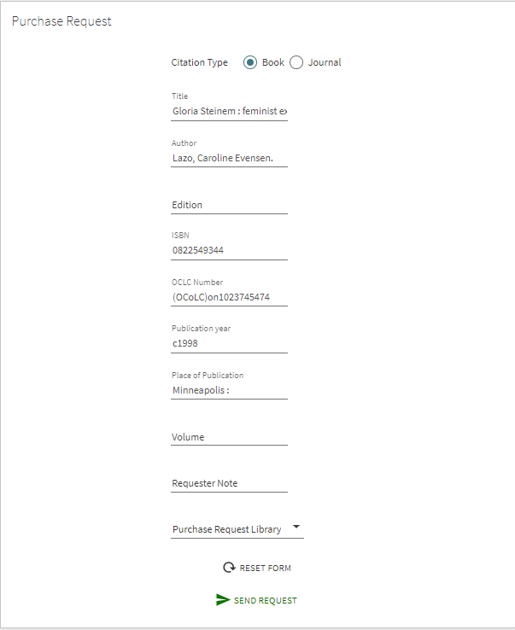
Creating the Purchase Request in Primo – example one of two
The purchase request form fills in automatically from the bibliographic record and she clicks "Send Request"

Slide 15
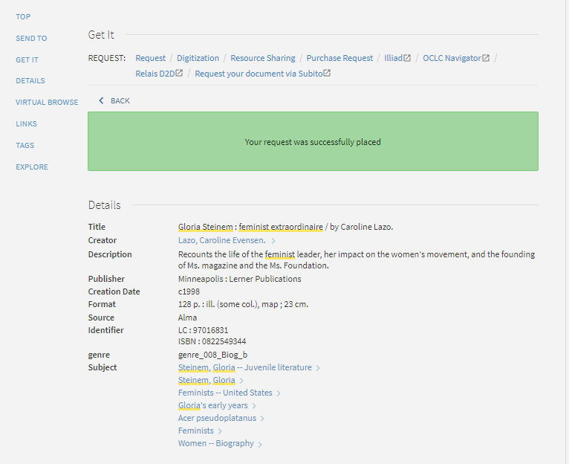
Creating the Purchase Request in Primo – example one of two
The purchase request is created

Slide 16
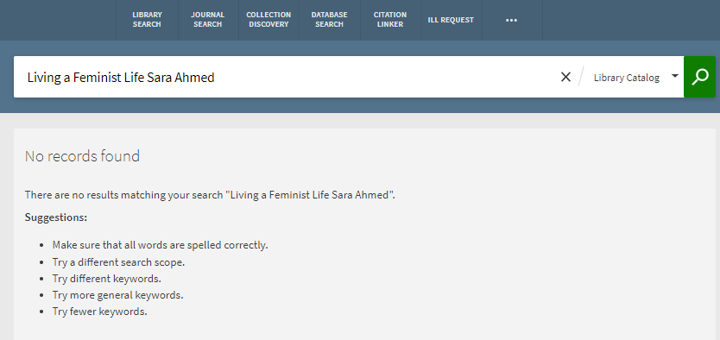
Creating the Purchase Request in Primo – example two of two
Now user Aniko Eszias searches for "Living a Feminist Life" by Sara Ahmed and sees it does not exist. She clicks "Citation Linker".

Slide 17
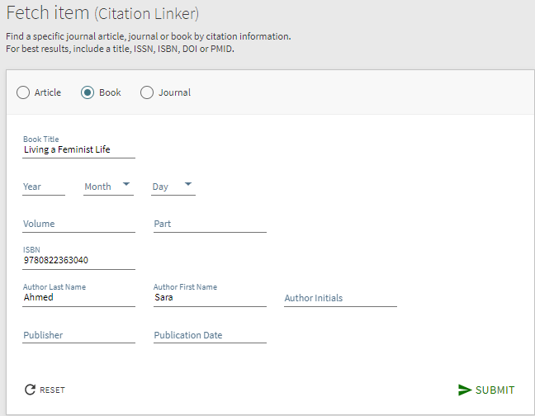
Creating the Purchase Request in Primo – example two of two
She fills in the information (including ISBN 9780822363040) and clicks "Submit"

Slide 18
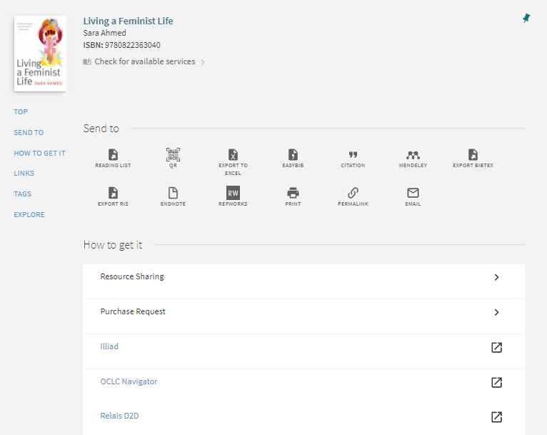
Creating the Purchase Request in Primo – example two of two
From the results Aniko clicks "Purchase Request"

Slide 19
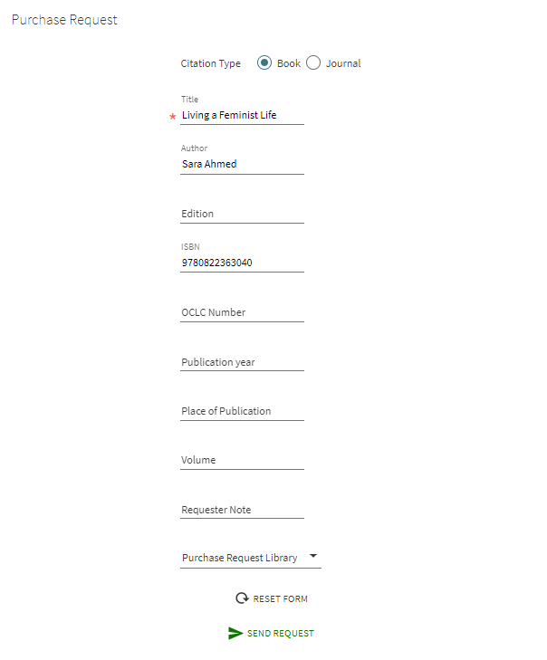
Creating the Purchase Request in Primo – example two of two
And she submits her second purchase request

Slide 20
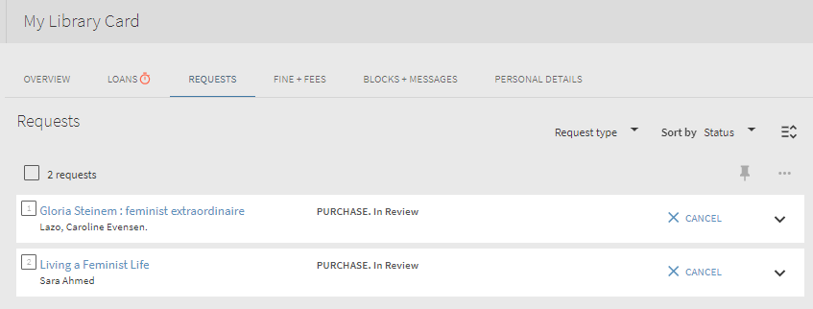
Creating the Purchase Request in Primo – both examples
Aniko can see both of her purchase requests in her library card in Primo

Slide 21
Creating the Purchase Request in Alma

Slide 22
Creating the Purchase Request in Alma
In the example here staff user Laura Jackson will create two purchase requests on behalf of patron Aniko Eszias
First example: Purchase request for electronic inventory for bibliographic record which currently does not exist
Second example: Purchase request for additional physical inventory for bibliographic record already has physical inventory

Slide 23
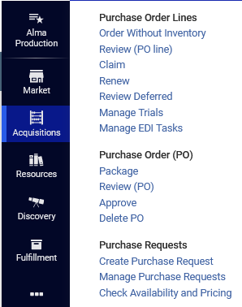
Creating the Purchase Request in Alma
If the staff user has the appropriate roles (as shown in the introduction) then they can create a purchase request in Alma
Staff user Laura Jackson will access the Acquisitions menu

Slide 24
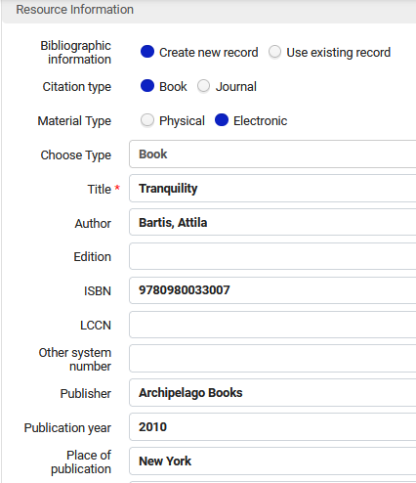
Creating the Purchase Request in Alma – example one of two
Here we have chosen to create a new record of type book
We have filled in known bibliographic information such as title "Tranquility" and author "Bartis, Attila" and ISBN 9780980033007

Slide 25
Creating the Purchase Request in Alma – example one of two
As we will see on the next slide:
In the "Request Attributes" section we define
The requester
Owning Library (optional)
Estimated Cost (optional)
Fund (optional)
Vendor / Account (optional)
Requester Note (optional)

Slide 26
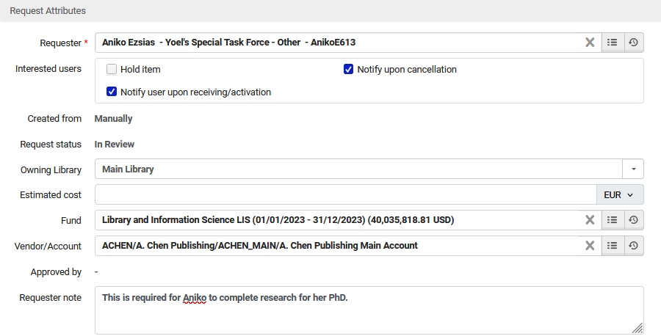
Creating the Purchase Request in Alma – example one of two

Slide 27
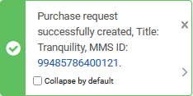
Creating the Purchase Request in Alma – example one of two
We click "Save" and the Purchase Request is created.

Slide 28
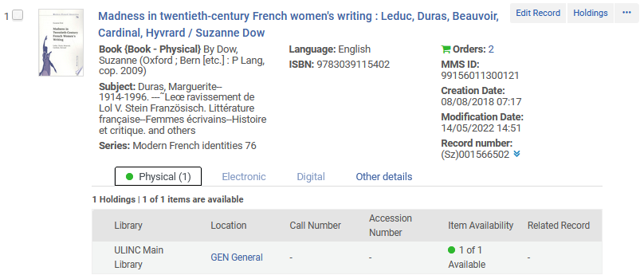
Creating the Purchase Request in Alma – example two of two
Now staff user will create a purchase request for additional inventory for bibliographic record which already has physical inventory.
Title "Madness in twentieth-century French women's writing" exists with one item

Slide 29
Creating the Purchase Request in Alma – example two of two
This time we have chosen "Use existing record" and now we can search for existing record via the pickup list of the title field
Click here to search for the record

Slide 30
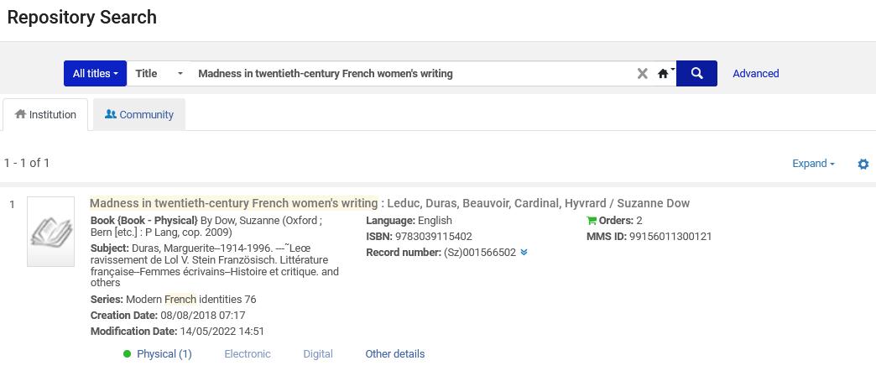
Creating the Purchase Request in Alma – example two of two
Now we search for and select "Madness in twentieth-century French women's writing"

Slide 31
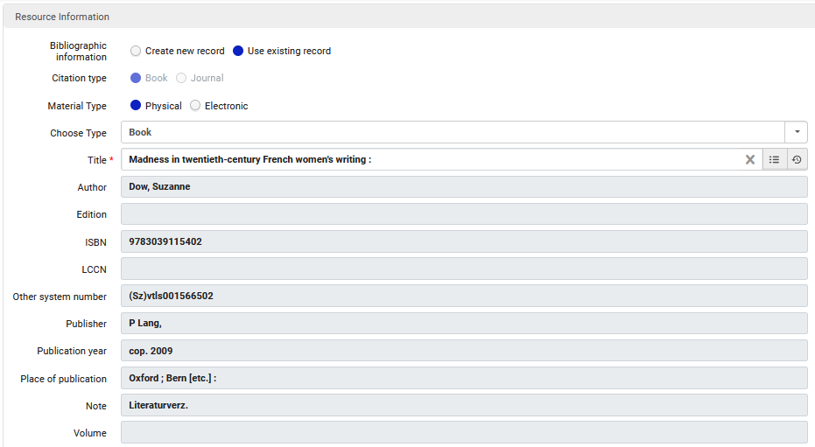
Creating the Purchase Request in Alma – example two of two
The bibliographic information automatically gets filled in from the existing record

Slide 32
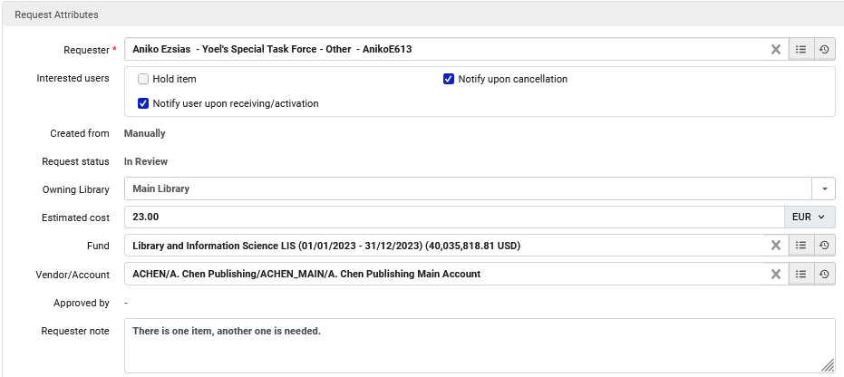
Creating the Purchase Request in Alma – example two of two
The request attributes are filled in the same way as when we made a purchase request for a new bibliographic record

Slide 33
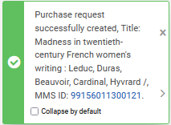
Creating the Purchase Request in Alma – example two of two
We click "Save" and the Purchase Request is created.

Slide 34
Creating the Purchase Request in Alma
All four purchase requests (the 2 created in Primo and the 2 created in Alma) will appear in the "Unassigned" tab of the "Manage Purchase Requests"
More on "Manage Purchase Requests" soon.

Slide 35
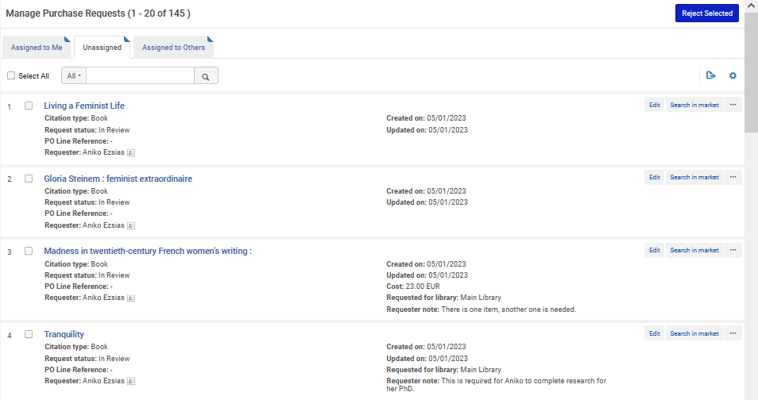
Creating the Purchase Request in Alma
Here are the four purchase requests

Slide 36
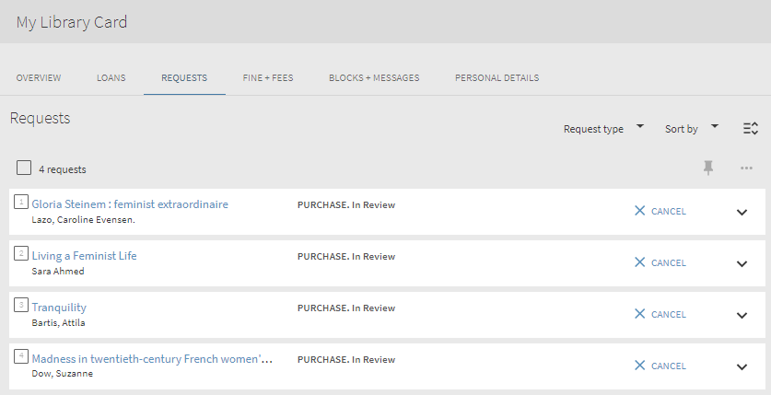
Creating the Purchase Request in Alma
Aniko sees all four purchase requests in her Library Card in Primo

Slide 37
Managing Purchase Requests

Slide 38
Managing Purchase Requests
Acquisitions > Purchase Requests > Manage Purchase Requests

Slide 39
Managing Purchase Requests
The "Manage Purchase Requests" screen allows the user to view pending purchase requests
It is divided into three tabs:
Assigned to you
Unassigned
Assigned to Others
The four Purchase Requests which we recently created will now be in the "Unassigned" tab.
The purchase requests can be faceted by various parameters. In the next slide they are faceted by Requester: Aniko Eszias

Slide 40
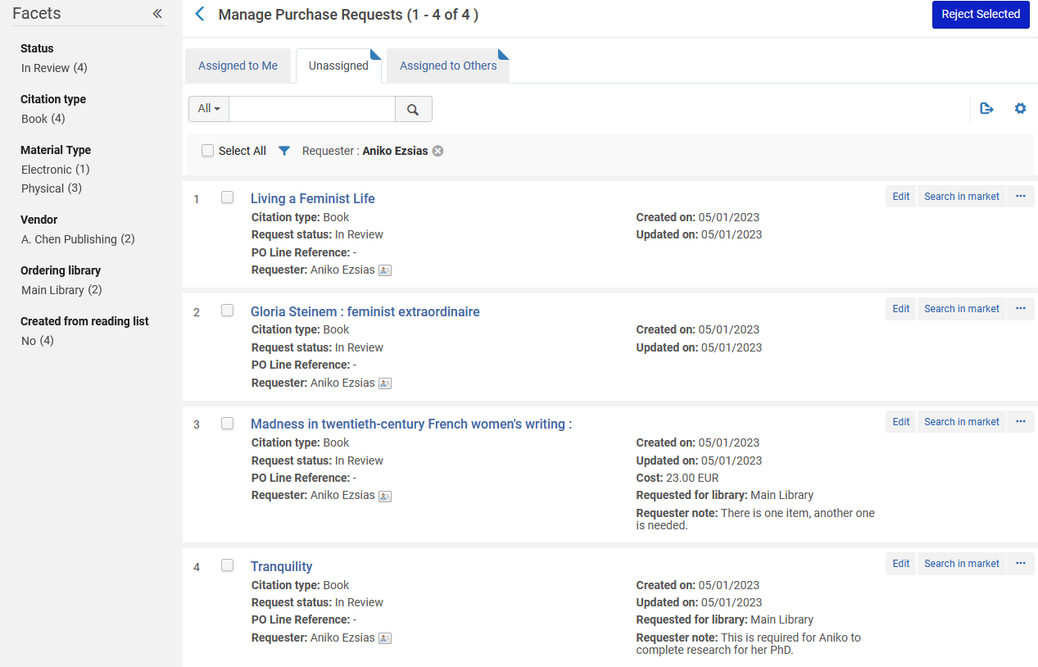
Managing Purchase Requests

Slide 41
Managing Purchase Requests
For each Purchase Request the staff user can
Edit
Approve and Order
Reject
Send query to requester
Assign (to another staff user)
Relink (to a different bibliographic record)
Once a staff user edits or "works on" a purchase request it will automatically be assigned to them. After it is "Approved and Ordered" it goes to the "Unassigned" tab until it will be optionally deleted.

Slide 42
Managing Purchase Requests – example one
Performing actions on a Purchase Requests

Slide 43
Managing Purchase Requests – example one
We will now click "Edit" for "Living a Feminist Life"

Slide 44
Managing Purchase Requests – example one
Note that this purchase request was created in Primo via the citation linker for a record which does not yet exist. Creating the purchase request also created a bibliographic record with no inventory
Date and time the Purchase Request was created

Slide 45
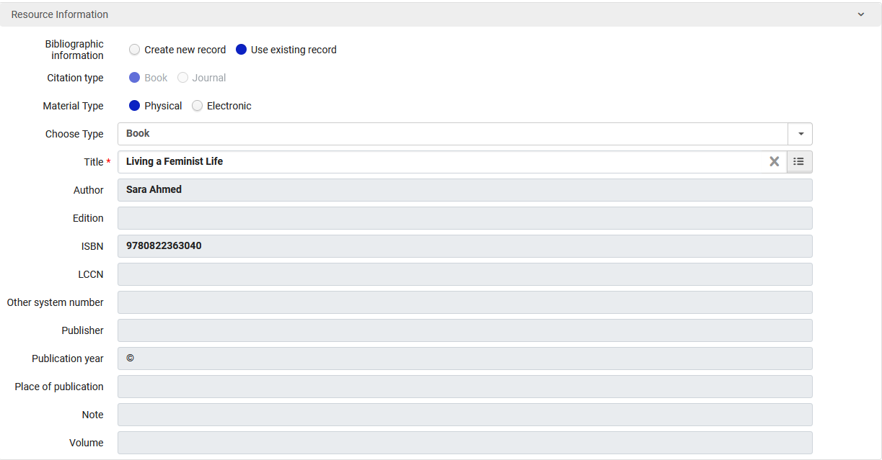
Managing Purchase Requests – example one
After clicking edit we see the resource information
The existing record is being used

Slide 46
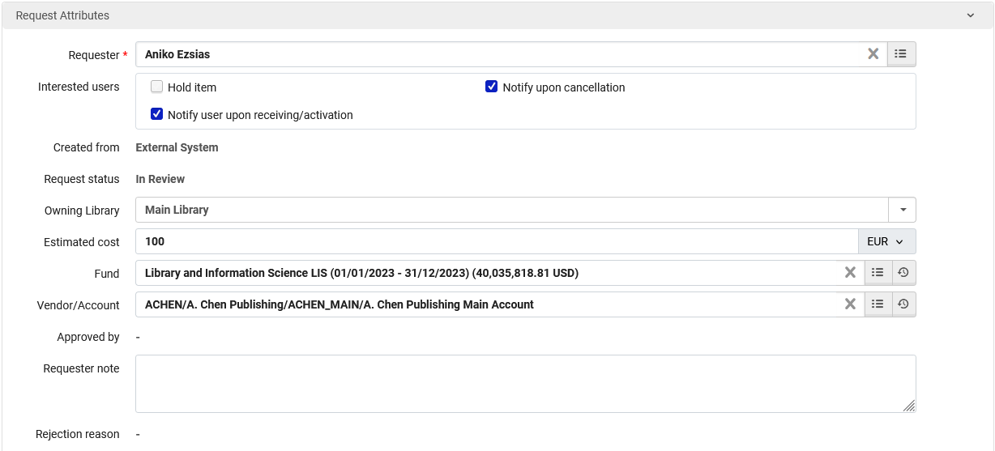
Managing Purchase Requests – example one
We will scroll down and fill in the request attributes.

Slide 47
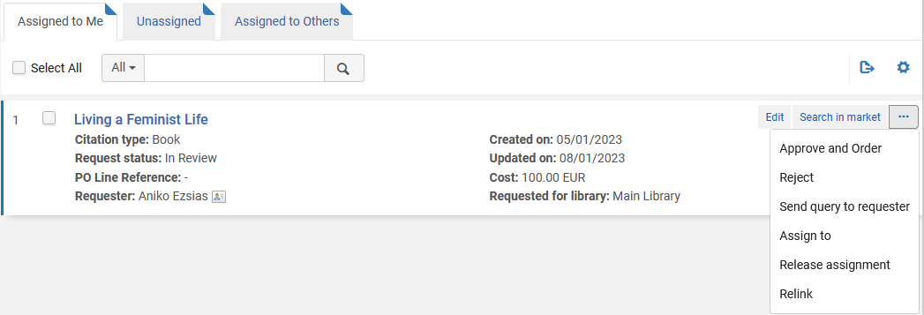
Managing Purchase Requests – example one
The request is now "assigned to me" and I can "Approve and Order"

Slide 48
Managing Purchase Requests – example one
After clicking "Approve and Order" a POL is created

Slide 49
Managing Purchase Requests – example one
Aniko is automatically an "Interested User" in the POL

Slide 50
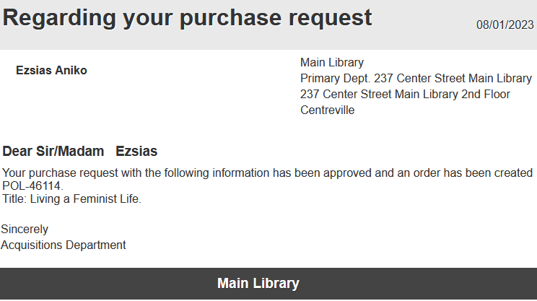
Managing Purchase Requests – example one
Aniko has received a letter that the request was approved, and an order created

Slide 51
Managing Purchase Requests – example two
Now we will click "edit" on the Purchase request for "Madness in twentieth century women’s writing".
This was created from within Alma for an existing record for physical inventory

Slide 52
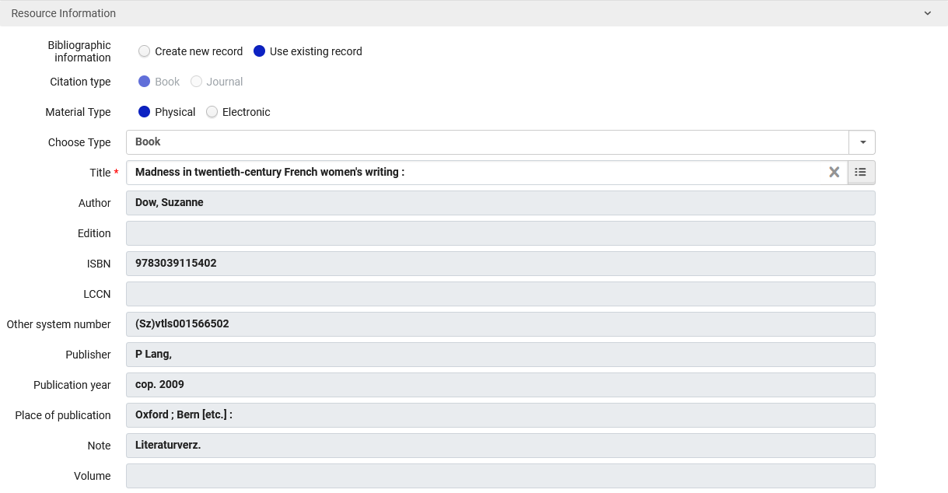
Managing Purchase Requests – example two
This was created from the GetIt tab of an existing record.

Slide 53
Managing Purchase Requests – example two
Format "Physical" is already chosen because it was chosen when the request was made

Slide 54
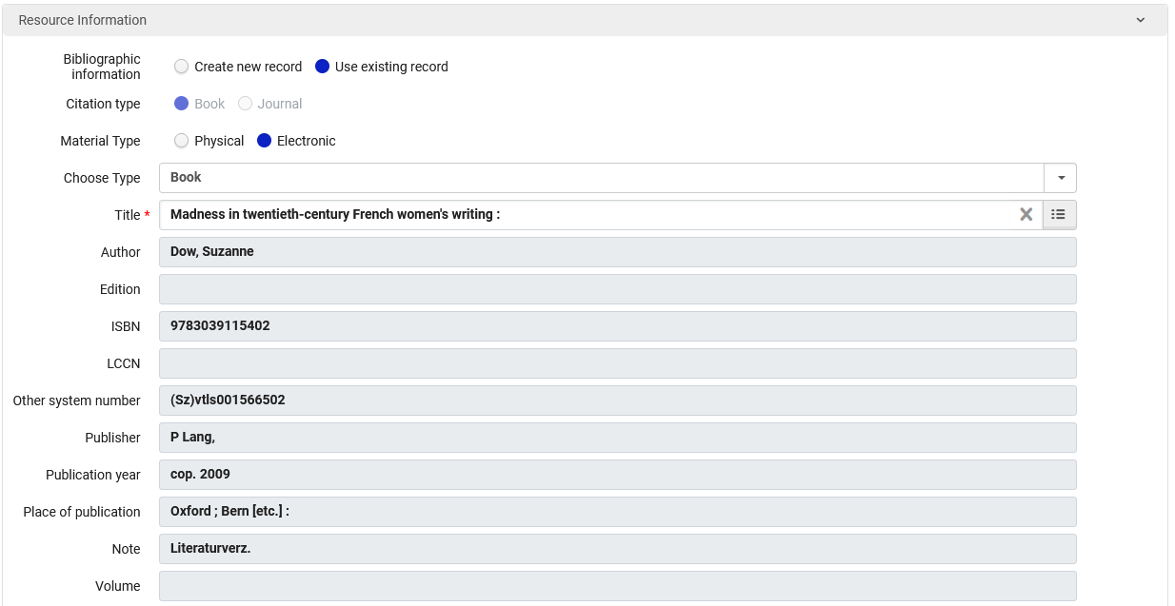
Managing Purchase Requests – example two
We decide to change the format to "Electronic" and leave the rest "as is"

Slide 55
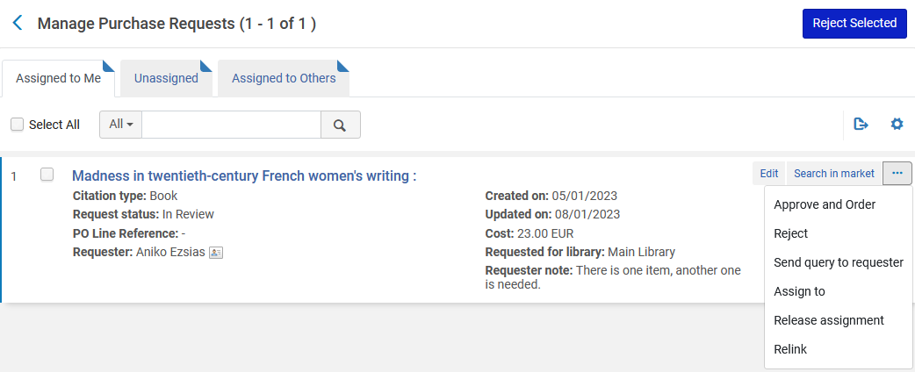
Managing Purchase Requests – example two
It is automatically "Assigned to Me" and I "Approve and Order"

Slide 56
Managing Purchase Requests – example two
The order is created for electronic inventory

Slide 57
Managing Purchase Requests – example two
Aniko is automatically an "Interested User" in the POL

Slide 58
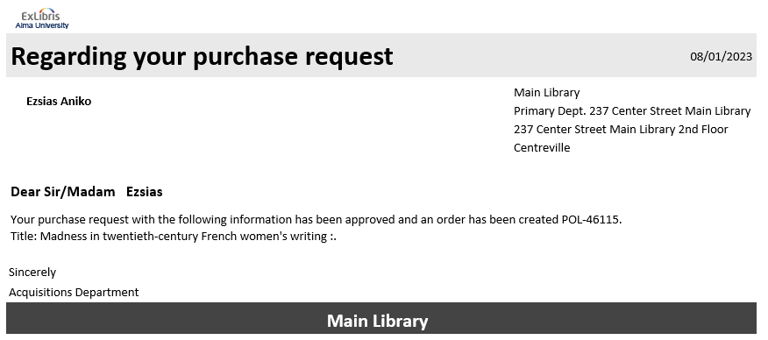
Managing Purchase Requests – example two
Again, Aniko gets a letter

Slide 59
Managing Purchase Requests – example three
Regarding "Tranquility" we have decided to reject it

Slide 60
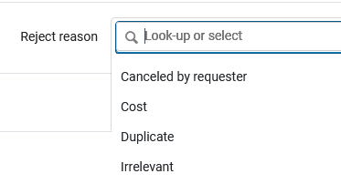
Managing Purchase Requests – example three
We will choose the reason and reject

Slide 61
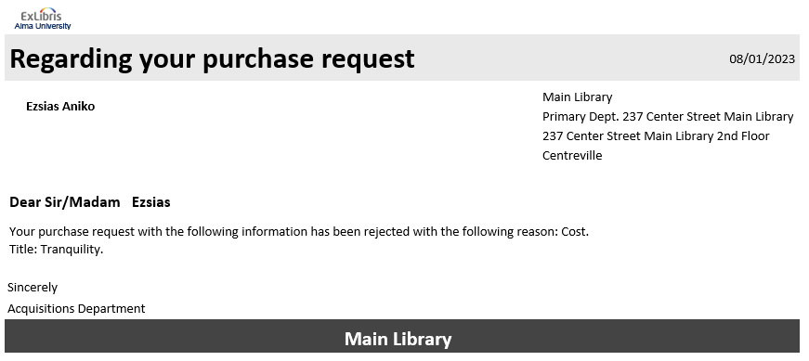
Managing Purchase Requests – example three
Again, Aniko gets a letter

Slide 62
Managing Purchase Requests – example four
We will leave "Gloria Steinem : feminist extraordinaire" in review, and deal with it another time

Slide 63
PO Line Types for POLs created from Purchase Requests

Slide 64
PO Line Types for POLs created from Purchase Requests
If a Purchase Request is created for citation type “Book” and Material Type “Physical” and user does “Approve and Order” then the created POL will have PO line type “Physical - One Time”
If a Purchase Request is created for citation type “Journal” and Material Type “Physical” and user does “Approve and Order” then the created POL will have PO line type “Physical – Subscription”
If a Purchase Request is created for citation type “Book” and Material Type “Electronic” and user does “Approve and Order” then the created POL will have PO Line Type “Electronic Book - One Time”
If a Purchase Request is created for citation type “Journal” and Material Type “Electronic” and user does “Approve and Order” then the created POL will have PO line type “Electronic Journal - Subscription”

Slide 65
Reporting on Purchase Requests in Alma Analytics

Slide 66
Reporting on Purchase Requests in Alma Analytics
For details on using Alma Analytics to report on Purchase Requests see separate presentation: Purchase Requests in Alma Analytics.pptx

