Slide 1
Using API Restriction Profiles
Yoel Kortick
Senior Librarian

Slide 2
Agenda
Introduction | I
The restriction profile | II
Attributing the restriction profile to an API key | III
Testing the restriction profile – Creating a POL | IV
Testing the restriction profile – Retrieving a POL | V
Testing the restriction profile – Retrieving Vendors | VI
Testing the restriction profile – Viewing Funds | VII

Slide 3
Introduction
In addition to this presentation see also Working with API restrictions on the developer network.
Here is the situation the API restrictions comes to solve:
If a vendor has an API key then when he uses that API key it is restricted to one specific institution.
But … there are no other restrictions

Slide 4
Introduction
This means that when not using a restriction profile if vendor X receives an API key he can
Create orders for vendor code Y
Retrieve orders for vendor code Y
Retrieve vendor code Y
See the available balance of all funds

Slide 5
Introduction
Now the vendor and fund can be limited for a specific API key for GET and POST.
To support this capability a restriction profile is created and then associated with the API key.
This is currently relevant for acquisitions APIs for the following areas:
Creating orders for vendors not associated with the restriction profile
Retrieving orders with vendors not associated with the restriction profile
Retrieving vendors not associated with the restriction profile
Seeing available balance of all funds

Slide 6
Agenda
Introduction | I
The restriction profile | II
Attributing the restriction profile to an API key | III
Testing the restriction profile – Creating a POL | IV
Testing the restriction profile – Retrieving a POL | V
Testing the restriction profile – Retrieving Vendors | VI
Testing the restriction profile – Viewing Funds | VII

Slide 7
The restriction profile
To create the API restriction profile go to “Configurations > General > External Systems”
Click “Add Integration Profile” and choose type “API Restrictions”

Slide 8
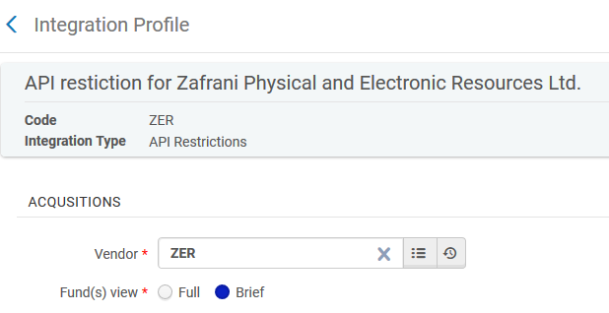
The restriction profile
Choose the vendor and the desired fund(s) view

Slide 9
The restriction profile
Note that in our case we have
Given the restriction profile code ZER
Associate the restriction profile with vendor code ZER
However it is not necessary to give the same code to the restriction profile as the vendor code.
We have done it here merely for organizational purposes.

Slide 10
The restriction profile
Regarding the vendor: This is used when submitting APIs. The specific vendor code used here must be the vendor code used for the API. In our example we used vendor code ZER (Zafrani Physical and Electronic Resources Ltd.). This means that only PO lines with vendor code ZER in the payload will be created. If a different vendor code is in the payload then the PO line will not be created.
Regarding the fund(s) view: This determines whether the GET funds API should return the fund balance. If “Brief” is used then balance will not be returned.

Slide 11
Agenda
Introduction | I
The restriction profile | II
Attributing the restriction profile to an API key | III
Testing the restriction profile – Creating a POL | IV
Testing the restriction profile – Retrieving a POL | V
Testing the restriction profile – Retrieving Vendors | VI
Testing the restriction profile – Viewing Funds | VII

Slide 12
Attributing the restriction profile to an API key
When adding the API key for acquisitions we can add the API restriction profile code to the API.
We will do this now on the next slide

Slide 13
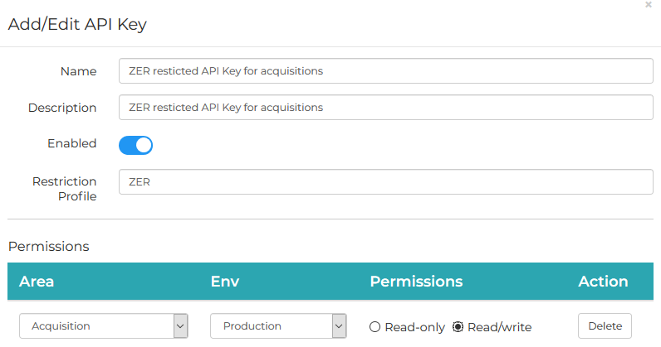
Attributing the restriction profile to an API key

Slide 14
Attributing the restriction profile to an API key
Now when we use this API key we should
Be able to create and retrieve POLs for vendor code ZER (Zafrani Physical and Electronic Resources Ltd.).
Not be able to create and retrieve POLs if the vendor is not ZER (Zafrani Physical and Electronic Resources Ltd.)
Only be able to retrieve vendor which has code ZER
This is because restriction profile ZER uses vendor ZER (Zafrani Physical and Electronic Resources Ltd.).
Not be able to see fund balance
This is because restriction profile ZER has “Fund(s) view” as “Brief”

Slide 15
Agenda
Introduction | I
The restriction profile | II
Attributing the restriction profile to an API key | III
Testing the restriction profile – Creating a POL | IV
Testing the restriction profile – Retrieving a POL | V
Testing the restriction profile – Retrieving Vendors | VI
Testing the restriction profile – Viewing Funds | VII

Slide 16
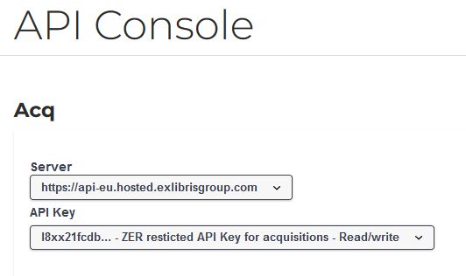
Testing the restriction profile – Creating a POL
We will use the API key with restriction profile ZER to create (POST) a POL

Slide 17
Testing the restriction profile – Creating a POL
In this example we will see that when using an API connected to the restriction profile which has vendor ZER
We can create a POL if the vendor of the POL is ZER
We cannot create a POL if the vendor of the POL is not ZER.
Thus we are restricted to use a specific vendor for POL creation.

Slide 18
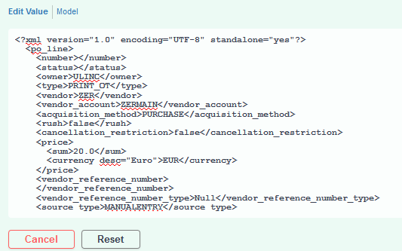
Testing the restriction profile – Creating a POL
The payload has vendor code ZER

Slide 19
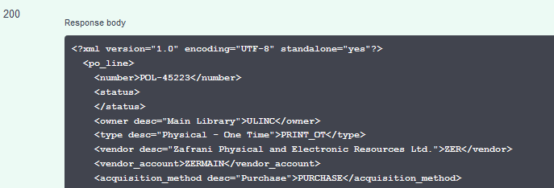
Testing the restriction profile – Creating a POL
A new POL is successfully created

Slide 20
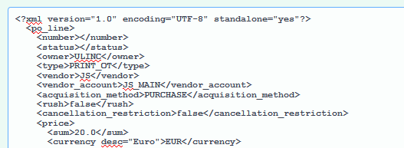
Testing the restriction profile – Creating a POL
Now we will use the same API key to create (POST) an order for a different vendor

Slide 21
Testing the restriction profile – Creating a POL
The POL is not created.
A message is returned "The received vendor does not match the API restrictions profile ZER".

Slide 22
Agenda
Introduction | I
The restriction profile | II
Attributing the restriction profile to an API key | III
Testing the restriction profile – Creating a POL | IV
Testing the restriction profile – Retrieving a POL | V
Testing the restriction profile – Retrieving Vendors | VI
Testing the restriction profile – Viewing Funds | VII

Slide 23
Testing the restriction profile – Retrieving a POL
In this example we will see that when using an API connected to the restriction profile which has vendor ZER
We can retrieve a POL if the code of the vendor of the POL is ZER
We cannot retrieve a POL if the code of the vendor of the POL is not ZER.
Thus we are restricted to retrieve a POL according to the vendor vendor

Slide 24
Testing the restriction profile – Retrieving a POL
Now we will try to retrieve POL-45228 which has vendor with code JS.
We will use the API key connected to restriction profile ZER (which is also connected to vendor ZER). We cannot retrieve the POL

Slide 25
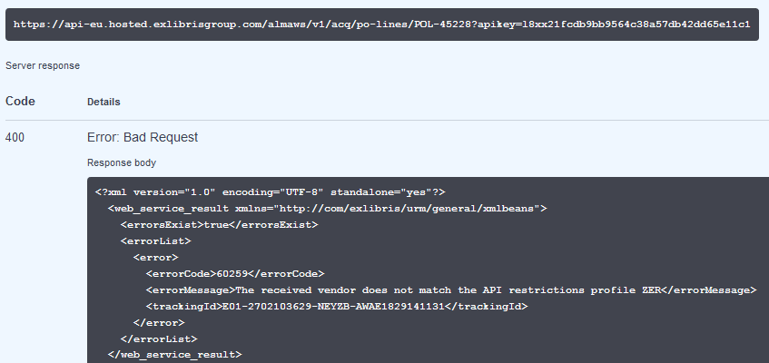
Testing the restriction profile – Retrieving a POL

Slide 26
Testing the restriction profile – Retrieving a POL
Now we will try to retrieve POL-45228 which has vendor with code ZER.
We will use the API key connected to restriction profile ZER (which is also connected to vendor ZER). We cannot retrieve the POL

Slide 27
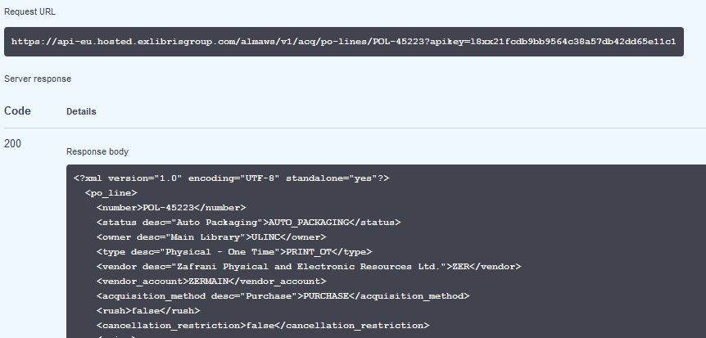
Testing the restriction profile – Retrieving a POL
Success

Slide 28
Agenda
Introduction | I
The restriction profile | II
Attributing the restriction profile to an API key | III
Testing the restriction profile – Creating a POL | IV
Testing the restriction profile – Retrieving a POL | V
Testing the restriction profile – Retrieving Vendors | VI
Testing the restriction profile – Viewing Funds | VII

Slide 29
Testing the restriction profile – Retrieving Vendors
In this example we will see that when using an API connected to the restriction profile which has vendor ZER
We can retrieve a vendor if the code of the vendor is ZER
We cannot retrieve a vendor if the code of the vendor is not ZER.
Thus we are restricted to retrieve a specific vendor

Slide 30
Testing the restriction profile – Retrieving Vendors
If we try to retrieve a vendor which is not code ZER then we get the message “The received vendor does not match the API restrictions profile ZER”
On the next slide a user uses the API key connected to restriction profile ZER
He tried to retrieve (GET) vendor JS.

Slide 31
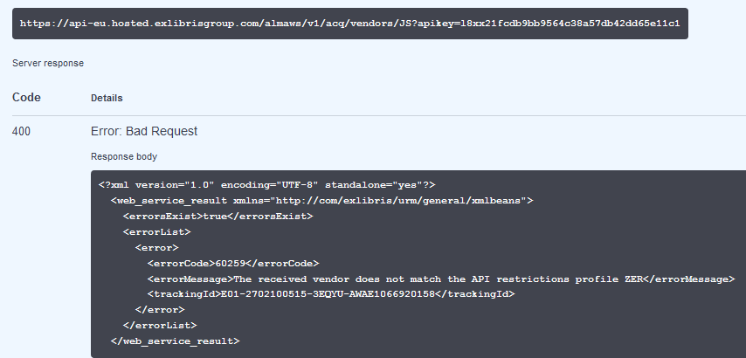
Testing the restriction profile – Retrieving Vendors
GET vendor JS
Receive message

Slide 32
Testing the restriction profile – Retrieving Vendors
Now we will try to retrieve the vendor ZER. This is the vendor associated with the restriction profile.
The user uses the API key connected to restriction profile ZER
He is successful

Slide 33
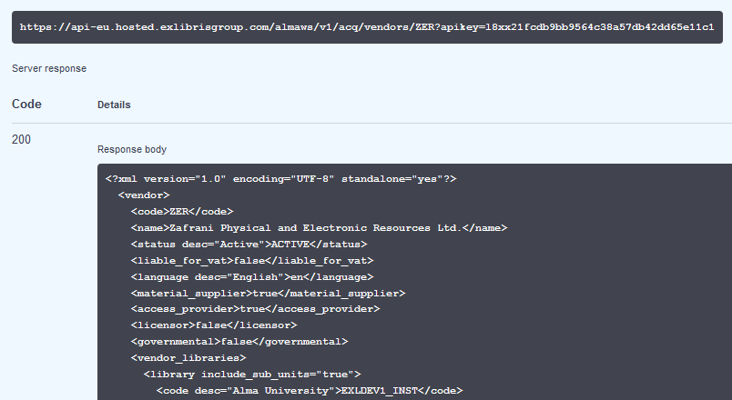
Testing the restriction profile – Retrieving Vendors
GET vendor ZER
Successfully retrieve the vendor

Slide 34
Agenda
Introduction | I
The restriction profile | II
Attributing the restriction profile to an API key | III
Testing the restriction profile – Creating a POL | IV
Testing the restriction profile – Retrieving a POL | V
Testing the restriction profile – Retrieving Vendors | VI
Testing the restriction profile – Viewing Funds | VII

Slide 35
Testing the restriction profile – Viewing Funds
In this example we will see that when using an API connected to the restriction profile which has “Fund(s) view” = brief
We cannot see the “available balance” of any fund
Thus we are restricted to view “available balance” when retrieving a fund.

Slide 36
Testing the restriction profile – Viewing Funds
Now we will try to retrieve the fund with ID 5408323390000121 and use the API key connected to restriction profile ZER
This is the case even when using the parameter view=full

Slide 37
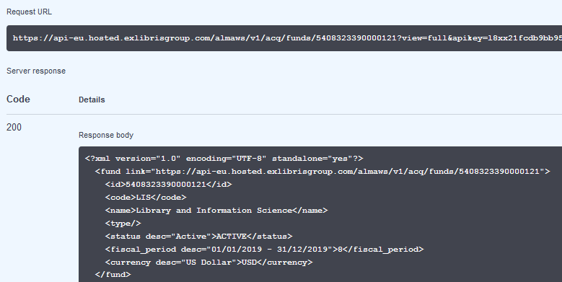
Testing the restriction profile – Viewing Funds
We do not see the available balance

Slide 38
Testing the restriction profile – Viewing Funds
Now we will do the same thing with an API key which is not connected to restriction profile ZER

Slide 39
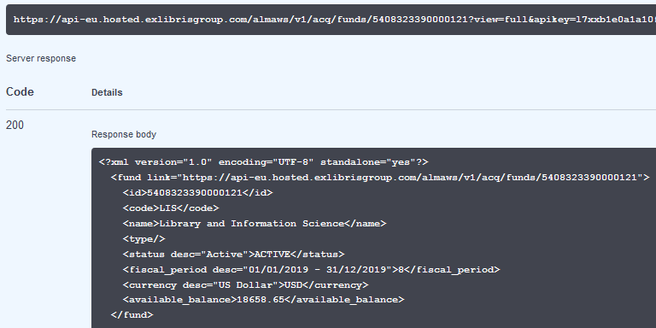
Testing the restriction profile – Viewing Funds
We do see the available balance

