Slide 1
How to edit and change a default Alma Analytics dashboard using the copy folder method
Yoel Kortick – Senior Librarian

Slide 2
Contents
The question
The six steps
The results

Slide 3
The question

Slide 4
The question
How can I edit the Fulfillment Dashboard so it separates between "In House" and "Not In House" loans?

Slide 5
The six steps

Slide 6
The six steps
Any Alma Analytics report (or dashboard or prompt) which is under the "Alma" folder cannot be edited in the "Alma" folder.
All entities under the "Alma" folder are provided by Ex Libris as default reports and cannot be changed in the "Alma" folder.
The "Alma" folder is "read only".
They can be copied elsewhere and then changed.
For an explanation of the directory structure see: Analytics Folders

Slide 7
The six steps
Six steps:
Copy the folder which contains the default dashboard
Paste the copied folder wherever you desire
Run the dashboard from this "local directory" location and see the report or reports we want to change
Do "Edit Dashboard"
Click "edit analysis" on the report then edit and save it in the "local directory" location
Edit the dashboard to point to the new report instead of the default report

Slide 8
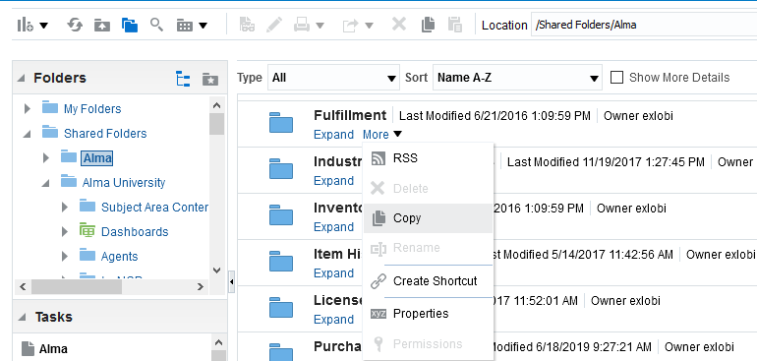
The six steps. Step One
Copy the folder which contains the default dashboard:

Slide 9
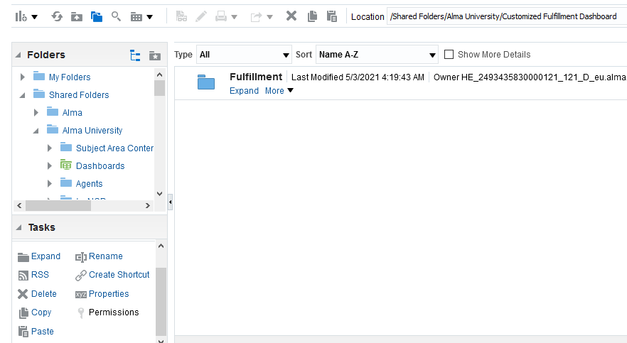
The six steps. Step Two
Paste the copied folder wherever you desire
Pasted to folder "/Shared/Alma University/Customized Fulfillment Dashboard".
"Alma University" is the name of the institution.

Slide 10
The six steps. Step Two
Now we have a copy of the default dashboard in a folder where we can edit it. We also have the reports of the dashboard.

Slide 11
The six steps. Step Three
Run the dashboard from this "local directory" location and see the report we want to change

Slide 12
The six steps. Step Three
Here is the report we want to change
Instead of one column with "Loans (In House + Not In House) we want to separate this into two columns

Slide 13
The six steps. Step Four
From this tab of the dashboard we choose "edit dashboard"

Slide 14
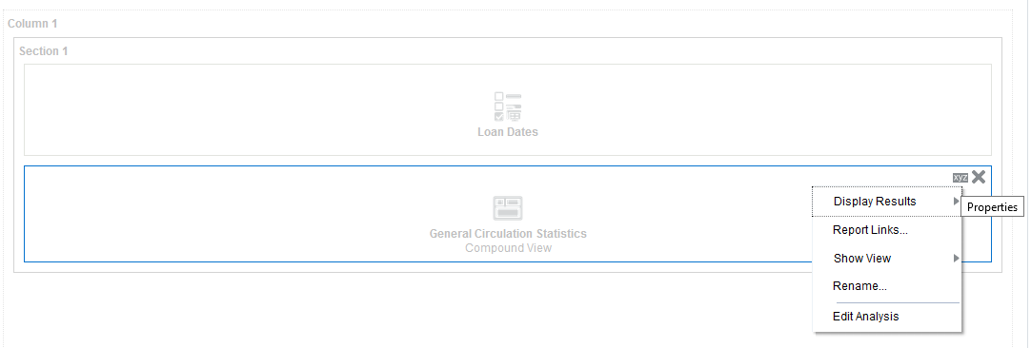
The six steps. Step Five
Now we will click "edit analysis" on the report

Slide 15
The six steps. Step Five
Now edit the report
Add these
Delete this

Slide 16
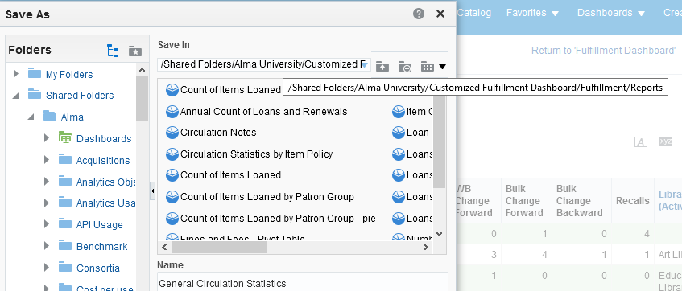
The six steps. Step Five
After making sure it works as desired save it in the local folder directory

Slide 17
The six steps. Step Six
Now we need to edit the dashboard to point to the new report.
The dashboard is in a local folder but it is still "pointing to" the reports under the Alma folder.

Slide 18
The six steps. Step Six
Delete the link to the old report

Slide 19
The six steps. Step Six
Navigate to the new report and drag into the dashboard

Slide 20
The six steps. Step Six
Save the newly edited dashboard

Slide 21
The results

Slide 22
The results
Now we have the customized dashboard with Loans separated into two separate columns of "in house" and "not in house".

Slide 23
xxx@exlibrisgroup.com

