Slide 1
Ex Libris collaboration with the community in developing Alma Analytics
Yoel Kortick. Senior Librarian

Slide 2
Introduction
Ideas Exchange
NERS
The "Electronic Inventory Usage and Cost Per Use" user group
The "Analytics Working Group Evidence Documents"
The "COUNTER Version 5 in Alma and Alma Analytics" user group

Slide 3
Introduction
The Alma Roadmap for Alma Analytics is heavily influenced by a strong collaboration with the community.
Alma Product Management believes that by collaborating with the community we can drive Alma Analytics to best meet the needs of the Alma users.
This presentation will give a few examples of how this collaboration is done.

Slide 4
Introduction
We will focus on:
Ideas Exchange
NERS
The "Analytics Working Group Evidence Documents"
The "Electronic Inventory Usage and Cost Per Use" user group
The "COUNTER Version 5 in Alma and Alma Analytics" user group

Slide 5
Ideas Exchange

Slide 6
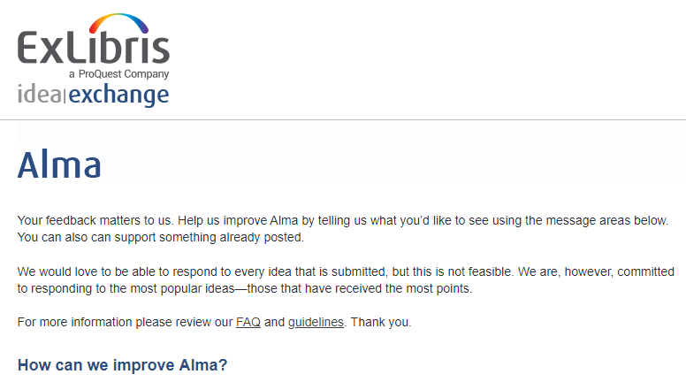
Ideas Exchange
Among the many ideas submitted to ideas exchange are issues dealing with Alma Analytics.
Here are 8 analytics developments from the ideas exchange over the last year.

Slide 7
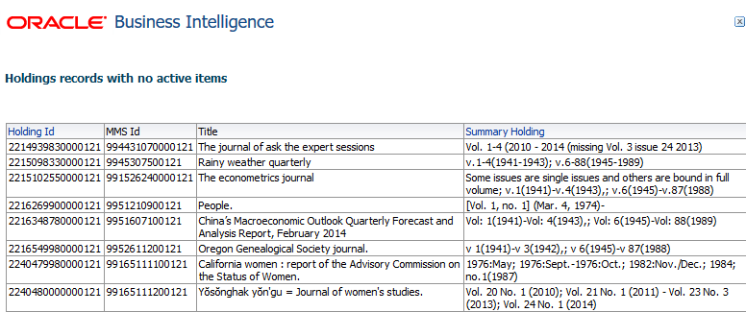
Ideas Exchange
Completed May 2018 release

Slide 8
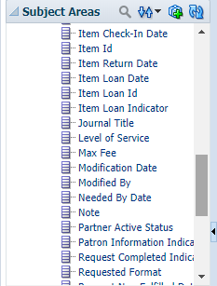
Ideas Exchange
Completed Nov. 2018 release

Slide 9
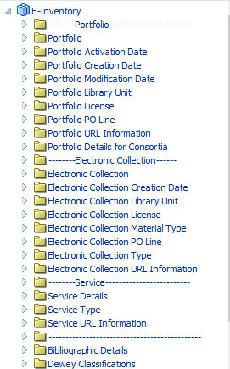
Ideas Exchange
Completed Dec. 2018 release
9

Slide 10
Ideas Exchange
Completed Dec. 2018 release

Slide 11
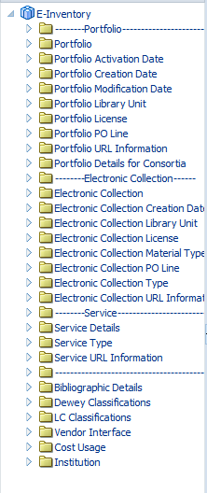
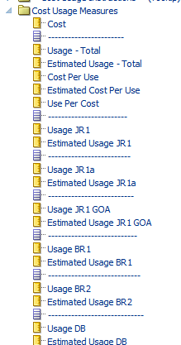
Ideas Exchange
Completed Feb. 2019 release

Slide 12
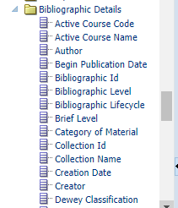
Ideas Exchange
Completed Mar. 2019 release

Slide 13
Ideas Exchange
Planned for Jul. 2019 release

Slide 14
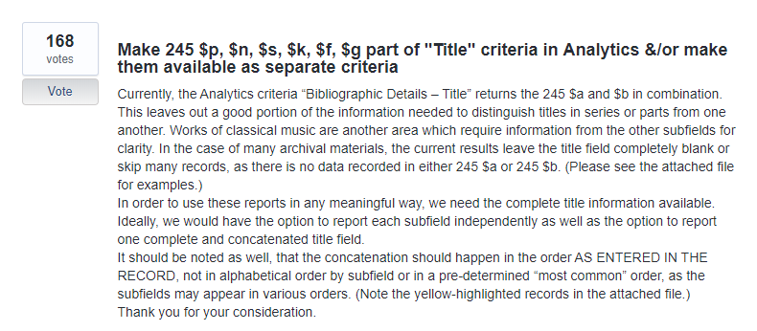
Ideas Exchange
Planned for Aug. 2019 release

Slide 15
NERS

Slide 16
NERS

Slide 17
NERS
NERS request ID 5254 "Perpetual access indication and coverage on portfolio level". Done in Dec. 2018

Slide 18
NERS
NERS request ID 5619
Tentatively planned for 2020 - did not reach minimum top 20 votes
Create a new field from 035 based on contents of prefix and call it "OCLC Number"
It will include only 035 (regardless of indicators). It will include only subfield a which includes one of the following prefixes and that prefix will be included as part of the field:
(OCLC)
(OCoLC)
(ocm)
(ocn)
(on)
OCLC
OCoLC
ocm
ocn
on

Slide 19
Electronic Inventory Usage and Cost Per Use

Slide 20
Electronic Inventory Usage and Cost Per Use
This group is a focal point for all developments regarding the addition of the Cost Usage to the E-Inventory subject area.
This feature was rolled out in Feb. 2019 in states "Under Construction" and is still being developed.

Slide 21
Electronic Inventory Usage and Cost Per Use
Some of the institutions
Belgium - KU Leuven
Germany - Freie Universität Berlin
Norway - UiO University of Oslo
UK – University of Sheffield
USA – Harvard University
USA – UT Dallas
USA – Boston College
USA - University of Minnesota
USA – Northeastern University
USA – Brandeis University

Slide 22
Electronic Inventory Usage and Cost Per Use
This group has been shown developments throughout the entire process and the valuable feedback has been incorporated into the official version.
At the current time this group is checking the initial version of the documentation for this new feature.
We are still rolling out a key part of this development, COUNTER platform matching via a new field, and the group is an integral part of this development.

Slide 23
Analytics Working Group Evidence Documents

Slide 24
Analytics Working Group Evidence Documents
The Analytics Working Group has compiled evidence documents detailing issues and use cases for Alma, Primo, Leganto and Summon Analytics.
Ex Libris meets monthly with a sub-group from the Analytics Working Group to go over the issues and determine next steps. In the interim period discussions are continued via Basecamp.
The Analytics Working Group also documents the issues and next steps in the Ex Libris Community Knowledge Center.
Useful Links: Analytics Working Group: https://igelu.org/products/analytics
Ex Libris Community Knowledge Center: https://knowledge.exlibrisgroup.com/Cross_Product/Knowledge_Articles/Customer_contribution_on_the_CKC
Analytics Discussion List: https://exlibrisusers.org/listinfo/analytics

Slide 25
Analytics Working Group Evidence Documents
This is a group of participants including Alma Users from a wide geographic spectrum as well as library type. Here are some of the institutions:
Australia – State Library of Queensland
Canada – Memorial University of Newfoundland
Germany - Freie Universität Berlin
Israel – The Weizmann Institute
UK - University of Edinburgh
USA – Harvard University
USA – University Iowa
USA – California State University, Fullerton
USA – Northwestern University
USA – University of Minnesota
USA – UT Dallas
USA – Marist College
USA – Boston College

Slide 26
Analytics Working Group Evidence Documents
Topics discussed in the most recent meetings:
Changing the date dimensions in the various subject areas in Alma, Primo and Leganto to be uniform and include all options
Improvements for Primo Analytics, for example making all dates uniform (addressed above) and resolving issues with referrer data
Resolving random analytics time-outs in Alma
Adding the MARC 008 and Leader to Alma Analytics
Adding loan counts for items while on reading lists to several subject areas including Leganto Student Usage, Course Reserves and Fulfillment

Slide 27
COUNTER Version 5 in Alma and Alma Analytics

Slide 28
COUNTER Version 5 in Alma and Alma Analytics
This group will be early testers as the COUNTER version 5 is rolled out in H2 2019.

Slide 29
COUNTER Version 5 in Alma and Alma Analytics
Some of the institutions:
University of Queensland
UT Dallas
University of Auckland
The University of Adelaide
Northeastern University
RMIT University
Monash University

Slide 30
Yoel.Kortick@exlibrisgroup.com

