Slide 1
How to use a normalization rule when importing records in an import profile
Yoel Kortick. Senior Librarian

Slide 2
Introduction
Creating the normalization rule
Adding the normalization rule to a process
Add normalization process to an import profile
Testing the normalization process in an import profile

Slide 3
Introduction
There are cases where institutions import records from “another” catalog and want to edit the record as it is imported.
In this way the record will be imported from the external file with local changes, such as the removal, addition or changing of fields.
For example on the next slide we have file for title “Une Femme” and it has 245 with first indicator 1 and second indicator is empty. It also has 008 pos. 35-37 “fre” meaning it is language French.
The second indicator should be 4. We can make a normalization rule to check the second indicators and fix them during import.

Slide 4
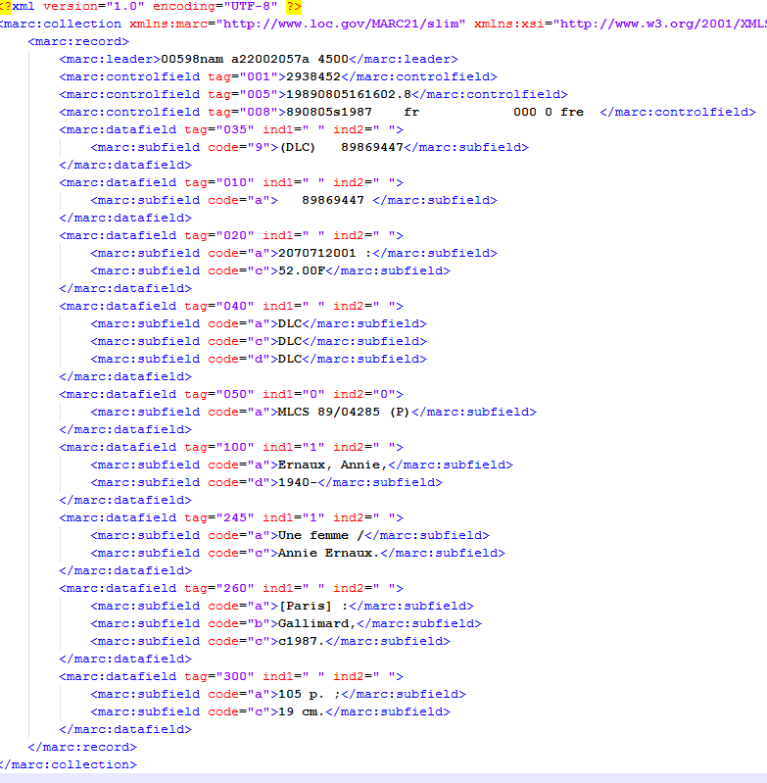
Introduction
Language code in 008 is “fre”
245 2nd indicator is empty.
Text starts with “Une”

Slide 5
Introduction
We can check and fix the 245 second indicators during import as follows:
Create a normalization rule which does the desired change
Put the normalization rule in a normalization process
Add the process to the import profile

Slide 6
Creating the normalization rule

Slide 7
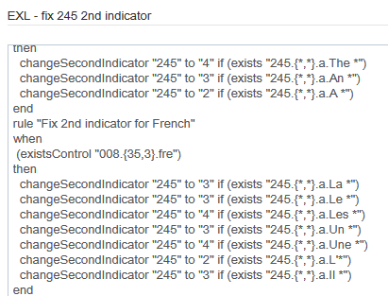
Creating the normalization rule
Our normalization rule “EXL – fix 245 2nd indicator” should fix this (should change it and make 2nd indicator 4):

Slide 8
Adding the normalization rule to a process

Slide 9
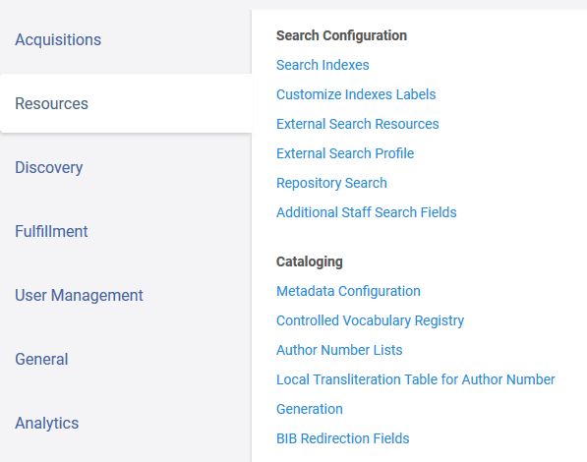
Adding the normalization rule to a process
The normalization rule we created is called “EXL – fix 245 2nd indicator”
Now we make a normalization process which uses this normalization rule.
Configuration > Resources > Cataloging > Metadata Configuration

Slide 10
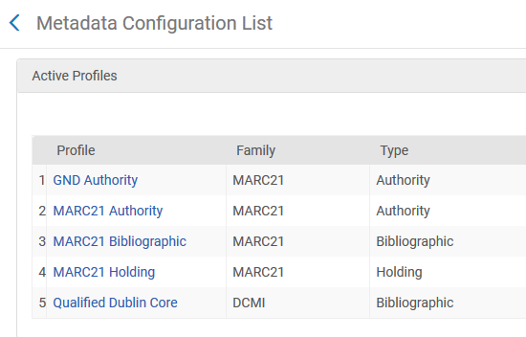
Adding the normalization rule to a process
Choose “MARC21 Bibliographic”

Slide 11
Adding the normalization rule to a process
In “Normalization Process” tab click “Add a Process”

Slide 12
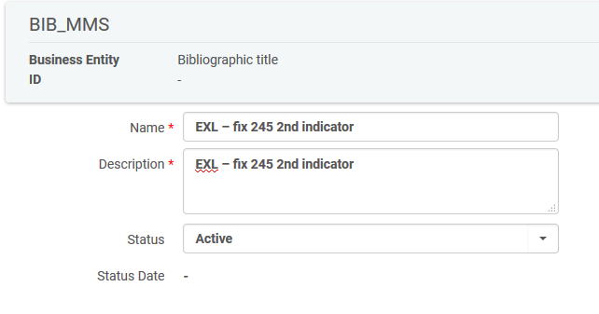
Adding the normalization rule to a process
Call the Normalization Process whatever you want and click “Next”.
Here we called it “EXL – fix 245 2nd indicator”.
We are making the process have the same name as the rule which it will use. This is not mandatory but done here for "organizational" purposes.

Slide 13
Adding the normalization rule to a process
Click “Add Tasks” and choose MarcDroolNormalization
Click “Next”

Slide 14
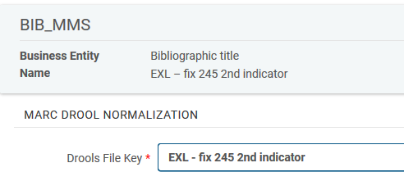
Adding the normalization rule to a process
Choose the specific normalization rule.
The normalization rule we will choose is "EXL – fix 245 2nd indicator" which we looked at a short time ago.
The process can now be used throughout the various places in Alma where normalization processes are used.

Slide 15
Adding the normalization rule to a process
The new normalization process has been added

Slide 16
Add normalization process to an import profile

Slide 17
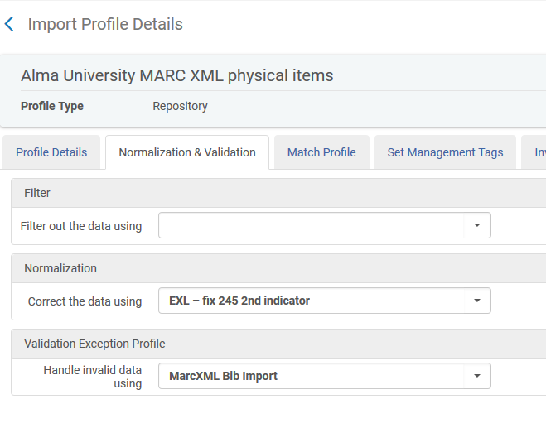
Add normalization process to an import profile
The import profile will use the normalization process “EXL – fix 245 2nd indicator”

Slide 18
Testing the normalization process in an import profile

Slide 19
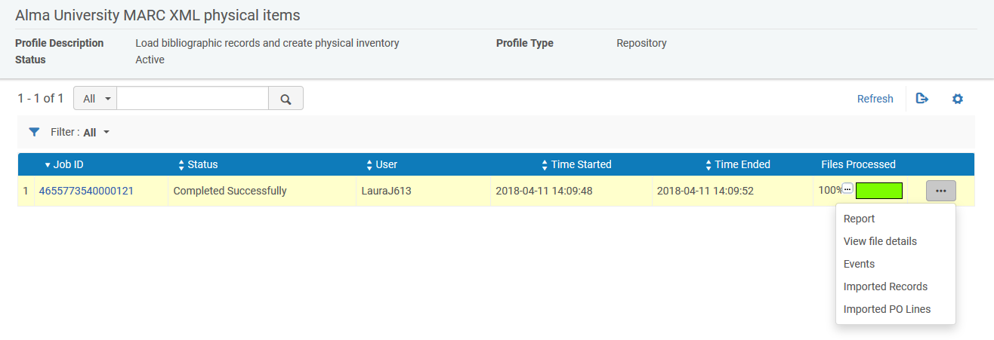
Testing the normalization process in an import profile
The record has been imported and we will view it

Slide 20
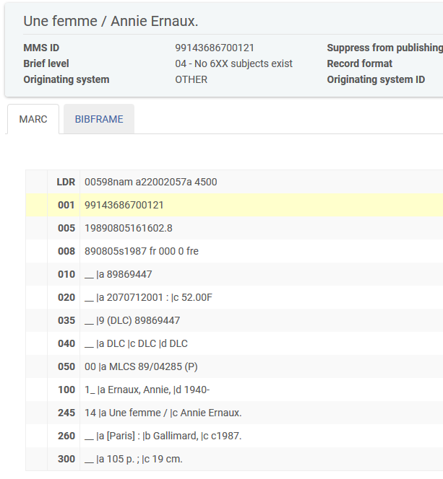
Testing the normalization process in an import profile
The record was changed (2nd indicator was added) as per the normalization rule

Slide 21
Yoel.Kortick@exlibrisgroup.com

