Slide 1
Brief records level functionality in Alma
Yoel Kortick. Senior Librarian

Slide 2
Introduction
Sample brief level rules explained
Determining if the record is brief
Updating the brief level of records retroactively
Giving names to brief levels and searching by brief level

Slide 3
Introduction
Via the “brief level rules” it is possible to define up to ten levels of briefness for bibliographic records.
This may be useful for various activities such as determining
Which bibliographic records should and should not get merged / overlaid during import
What level of briefness should be considered “brief” for the purposes of an alert during POL creation
Which bibliographic records should be “flagged” as needing additional enrichment.

Slide 4
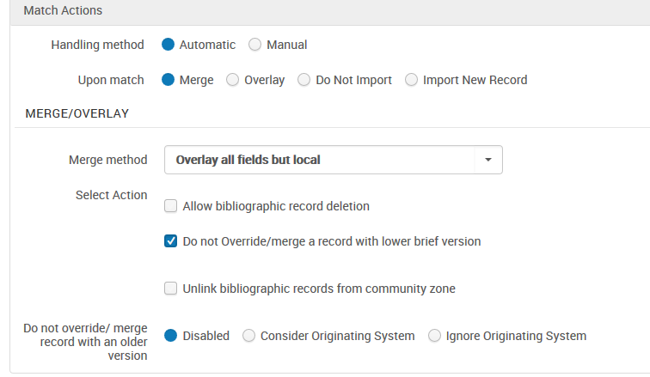
Introduction
Here for example we can use the brief level in the import profile
Which bibliographic records should and should not get merged / overlaid during import

Slide 5
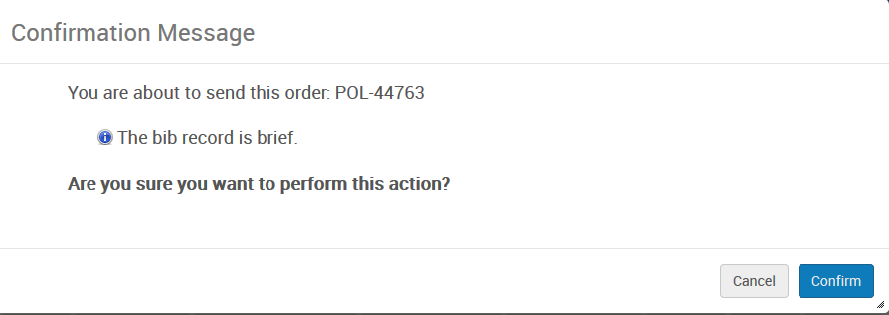
Introduction
Here for example we can use the brief level (resource management configuration > other settings) when creating an order
Bibliographic records with this level and lower will be flagged as brief

Slide 6
Introduction
Here for example we can use the brief level when performing a repository search.
Bibliographic records with this level and lower may be retrieved as a set to be “enriched”
If the brief level rule configuration changes then the job “Identifying Brief Level” should be run on the existing records.

Slide 7
Introduction
One of the motivations for the development of the “brief level” is to conform to various localized MARC rules.
For example OCLC has expanded the traditional MARC values of LDR position 17 to include additional levels of briefness.

Slide 8
Introduction
These are levels as defined by MARC at http://www.loc.gov/marc/bibliographic/bdleader.html

Slide 9
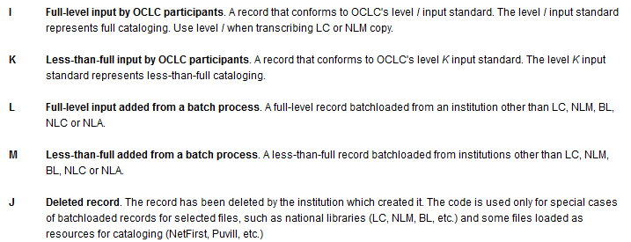
Introduction
OCLC defined additional levels of briefness at http://www.oclc.org/bibformats/en/fixedfield/elvl.html
These 5 levels do not exist in the standard MARC definitions above

Slide 10
Sample brief level rules explained

Slide 11
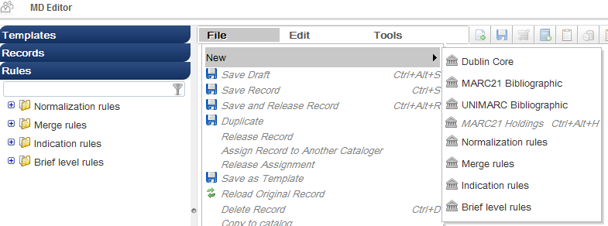
Sample brief level rules explained
The brief level rules are created and maintained in a manner similar to the normalization, indication and merge rules.
The higher the level means the more full the record. Level 10 is a fuller record than level 9.

Slide 12
Sample brief level rules explained
The brief level rule used by the institution is defined at “Resource management configuration menu > catalog > metadata configuration > marc21 bibliographic [or other bibliographic profile] > other settings“
For example here the brief rule used by the institution is “BriefBasedOnLDR”

Slide 13
Sample brief level rules explained
We will now look at two sample brief level rules.
The first rule determines the brief level based on the contents of the LDR position 17 as used by Library of Congress at http://www.loc.gov/marc/bibliographic/bdleader.html and as used by OCLC at http://www.oclc.org/bibformats/en/fixedfield/elvl.html
The second rule determines the brief level based on the presence of or lack of specific fields in the record, as well as blanks in control fields

Slide 14
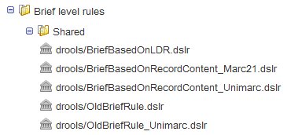
Sample brief level rules explained - “BriefBasedOnLDR”
Both of these rules are supplied “Out of the box”
They may be changed as needed locally by each institution, and also used as a basis for new rules.

Slide 15
Sample brief level rules explained - “BriefBasedOnLDR”
The rule which determines the brief level based on LDR position 17 and appears in Alma as an “out of the box” rule is called “BriefBasedOnLDR”

Slide 16
Sample brief level rules explained - “BriefBasedOnLDR”
rule "Brief 01"
when
(existsControl "LDR.{17,1}.5")
then
set brief_level."01"
end
rule "Brief 02"
when
(existsControl "LDR.{17,1}.3")
then
set brief_level."02"
end
Part 1 of 6 - rule based on LDR

Slide 17
Sample brief level rules explained - “BriefBasedOnLDR”
rule "Brief 03"
when
(existsControl "LDR.{17,1}.J") OR
(existsControl "LDR.{17,1}.j")
then
set brief_level."03"
end
rule "Brief 04"
when
(existsControl "LDR.{17,1}.7")
then
set brief_level."04"
end
Part 2 of 6 - rule based on LDR

Slide 18
Sample brief level rules explained - “BriefBasedOnLDR”
rule "Brief 05"
when
(existsControl "LDR.{17,1}.2")
then
set brief_level."05"
end
rule "Brief 06"
when
(existsControl "LDR.{17,1}.M") OR
(existsControl "LDR.{17,1}.m")
then
set brief_level."06"
end
Part 3 of 6 - rule based on LDR

Slide 19
Sample brief level rules explained - “BriefBasedOnLDR”
rule "Brief 07"
when
(existsControl "LDR.{17,1}.K") OR
(existsControl "LDR.{17,1}.k")
then
set brief_level."07"
end
rule "Brief 08"
when
(existsControl "LDR.{17,1}.8")
then
set brief_level."08"
end
Part 4 of 6 - rule based on LDR

Slide 20
Sample brief level rules explained - “BriefBasedOnLDR”
rule "Brief 09"
when
(existsControl "LDR.{17,1}.4")
then
set brief_level."09"
end
rule "Brief 10"
when
((existsControl "LDR.{17,1}.1") OR (existsControl "LDR.{17,1}.L") OR (existsControl "LDR.{17,1}.I") OR (existsControl "LDR.{17,1}. ") OR (existsControl "LDR.{17,1}.l") OR (existsControl "LDR.{17,1}.i"))
then
set brief_level."10"
end
Part 5 of 6 - rule based on LDR

Slide 21
Sample brief level rules explained - “BriefBasedOnLDR”
rule "set default"
priority 1
when
TRUE
then
set brief_level."01"
end
Part 6 of 6 - rule based on LDR
This is the “catch all” used when all other conditions are not met

Slide 22
Sample brief level rules explained - “BriefBasedOnLDR”
This part of the rule states for example that if LDR pos. 17 is one of the following then the level should be “10”:
1
L
I (pipe)
Blank
l (lowercase L)
i
rule "Brief 10"
when
((existsControl "LDR.{17,1}.1") OR (existsControl "LDR.{17,1}.L") OR (existsControl "LDR.{17,1}.I") OR (existsControl "LDR.{17,1}. ") OR (existsControl "LDR.{17,1}.l") OR (existsControl "LDR.{17,1}.i"))
then
set brief_level."10"
end

Slide 23
Sample brief level rules explained - “BriefBasedOnLDR”
This part of the rule states for example that
if LDR pos. 17 is 4 then the record is level 9
if LDR pos. 17 is 8 then the record is level 8
rule "Brief 08"
when
(existsControl "LDR.{17,1}.8")
then
set brief_level."08"
end
rule "Brief 09"
when
(existsControl "LDR.{17,1}.4")
then
set brief_level."09"
end

Slide 24
Sample brief level rules explained - “BriefBasedOnLDR”
This part of the rule appears at the very bottom (which means it occurs first) and states that the level is 01.
That means that it “starts at” 01 in the rule and unless it meets the conditions of another part of the rule then it will stay at 01
rule "set default"
when
TRUE
then
set brief_level."01"
end

Slide 25
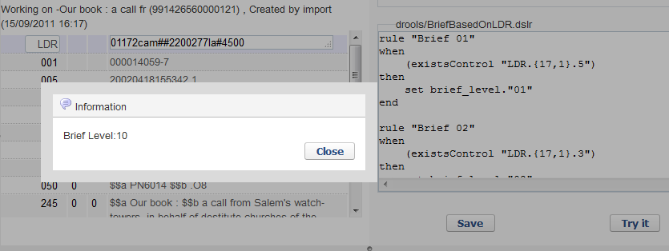
Sample brief level rules explained - “BriefBasedOnLDR”
For example this record has a pipe in position 17 of the LDR. We test the rule and the level is 10
rule "Brief 10"
when
((existsControl "LDR.{17,1}.1") OR (existsControl "LDR.{17,1}.L") OR (existsControl "LDR.{17,1}.I") OR (existsControl "LDR.{17,1}. ") OR (existsControl "LDR.{17,1}.l") OR (existsControl "LDR.{17,1}.i"))
then
set brief_level."10"
end
25

Slide 26
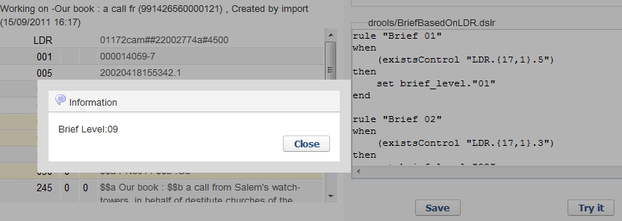
Sample brief level rules explained - “BriefBasedOnLDR”
If the record has a “4” in position 17 of the LDR then the level is 09
rule "Brief 09"
when
(existsControl "LDR.{17,1}.4")
then
set brief_level."09"
end

Slide 27
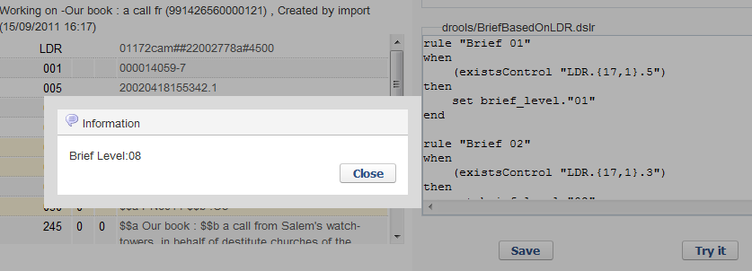
Sample brief level rules explained - “BriefBasedOnLDR”
If the record has a “8” in position 17 of the LDR then the level is 08
rule "Brief 08"
when
(existsControl "LDR.{17,1}.8")
then
set brief_level."08"
end

Slide 28
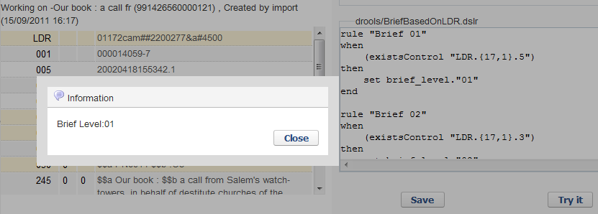
Sample brief level rules explained - “BriefBasedOnLDR”
If the record has a “&” in position 17 of the LDR then the level is 01.
The reason this happens is because the first thing the rule does it set the level to 01, and then the “&” was not defined anywhere else in the rule so the level stayed at 01.

Slide 29
Sample brief level rules explained - “Brief Based On Record Content”
Now the institution changes the rule it is using to be “EXL – Brief Based On Record Content”

Slide 30
Sample brief level rules explained - “Brief Based On Record Content”
rule "Brief 01"
when
not exists "245.a.*"
then
set brief_level."01"
end
rule "Brief 02"
when
not exists "050.a.*" AND not exists "082.a.*"
then
set brief_level."02"
end
Part 1 of 4 - rule based on fields present and not present

Slide 31
Sample brief level rules explained - “Brief Based On Record Content”
rule "Brief 03"
when
not exists "020.a.*" AND not exists "022.a.*"
then
set brief_level."03"
End
rule "Brief 04"
when
not exists "6**.a.*"
then
set brief_level."04"
end
Part 2 of 4 - rule based on fields present and not present

Slide 32
Sample brief level rules explained - “Brief Based On Record Content”
rule "Brief 05"
when
existsControl "008.{35,3}. "
then
set brief_level."05"
end
rule "Brief 06"
when
existsControl "008.{7,4}. "
then
set brief_level."06"
end
Part 3 of 4 - rule based on fields present and not present

Slide 33
Sample brief level rules explained - “Brief Based On Record Content”
rule "Brief 07"
when
not exists "260.a.*" AND not exists "264.a.*"
then
set brief_level."07"
end
rule "set default"
when
TRUE
then
set brief_level."10"
end
Part 4 of 4 - rule based on fields present and not present

Slide 34
Sample brief level rules explained - “Brief Based On Record Content”
This part of the rule states for example that if there are no 6XX fields (subjects) then the record is level 04
rule "Brief 04"
when
not exists "6**.a.*"
then
set brief_level."04"
end

Slide 35
Sample brief level rules explained - “Brief Based On Record Content”
This part of the rule states that is there is no ISBN (020) or ISSN (022) then the record is level 03
rule "Brief 03"
when
not exists "020.a.*" AND not exists "022.a.*"
then
set brief_level."03"
end

Slide 36
Sample brief level rules explained - “Brief Based On Record Content”
This part of the rule states that if there is no classification number (050 or 082) then the record will be level 02
rule "Brief 02"
when
not exists "050.a.*" AND not exists "082.a.*"
then
set brief_level."02"
end

Slide 37
Sample brief level rules explained - “Brief Based On Record Content”
This part of the rule states that if there is no title (245) then the record will be level 01.
rule "Brief 01"
when
not exists "245.a.*"
then
set brief_level."01"
end

Slide 38
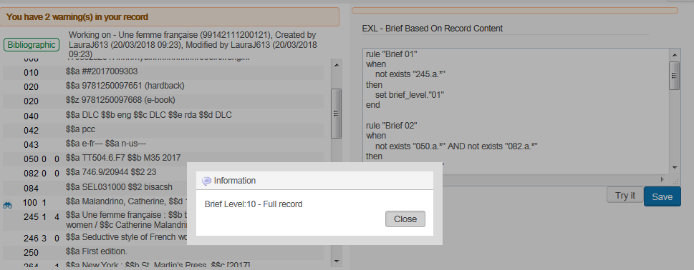
Sample brief level rules explained - “Brief Based On Record Content”
For example this record has a 6XX, 020 and 082. It is level 10. It states “Brief Level 10 – Full record

Slide 39
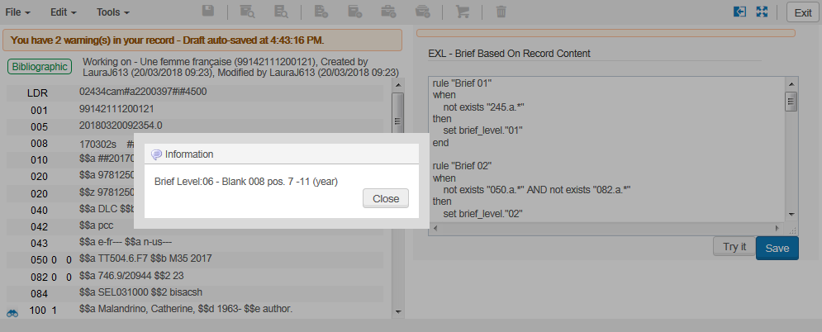
Sample brief level rules explained - “Brief Based On Record Content”
If we remove the year from 008 pos. 7-11 it gets level 06. It states “Brief Level 06 – Blank 008 pos. 7-11 (year)

Slide 40
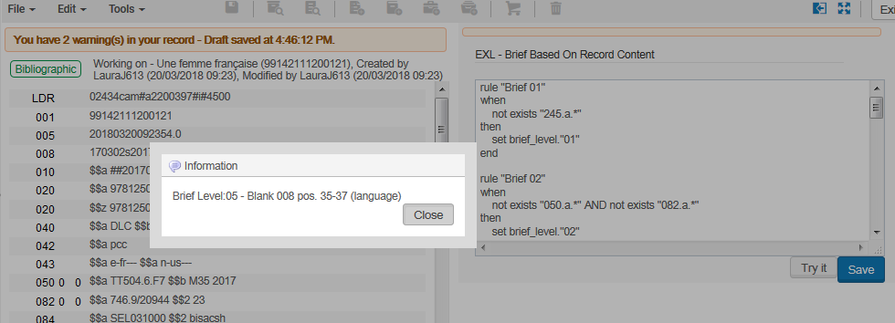
Sample brief level rules explained - “Brief Based On Record Content”
If we remove the language from 008 pos. 35-37 it gets level 05. It states “Brief Level 05 – Blank 008 pos. 35-37 (language)

Slide 41
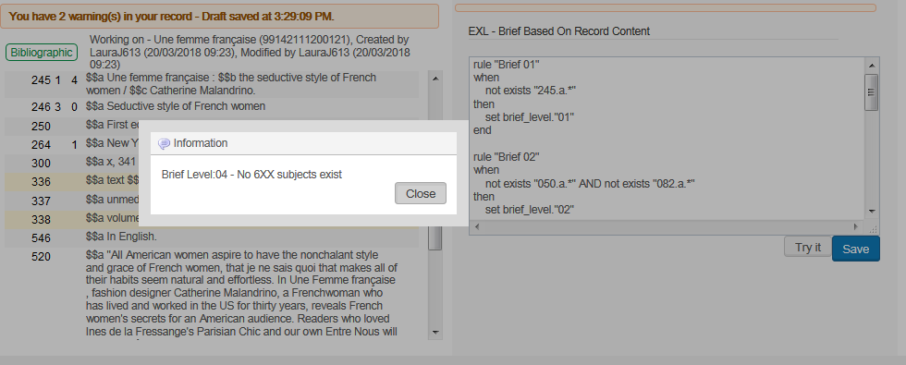
Sample brief level rules explained - “Brief Based On Record Content”
If we remove the 6XX it gets level 04. It states “Brief Level 04 – No 6XX subjects exist

Slide 42
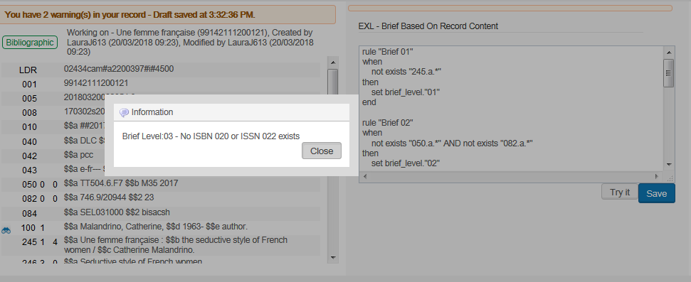
Sample brief level rules explained - “Brief Based On Record Content”
If we remove the 020 it gets level 03. It states “No ISBN 020 or ISSN 022 exists”

Slide 43
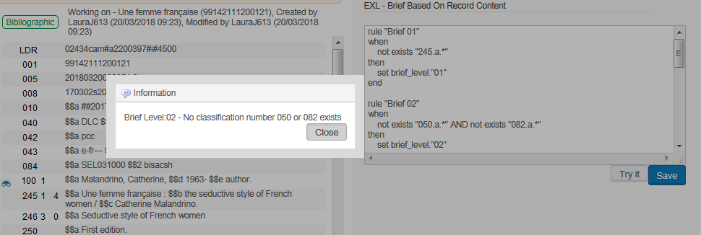
Sample brief level rules explained - “Brief Based On Record Content”
If we remove the 050 and 082 it gets level 02. It states “No classification number 050 or 082 exists”.

Slide 44
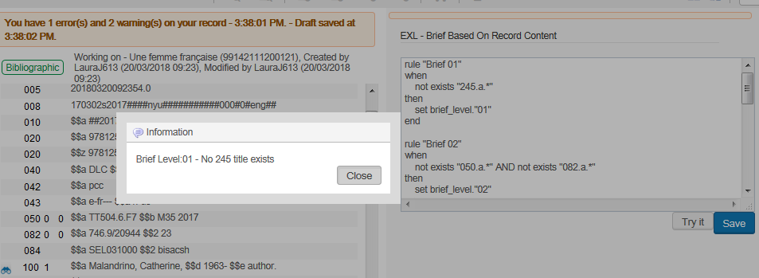
Sample brief level rules explained - “Brief Based On Record Content”
If we remove the 245 it gets level 01. It states “No 245 title exists”.

Slide 45
Determining if the record is brief

Slide 46
Determining if the record is brief
In addition to determining the level of the briefness, it is possible to determine if the record is “brief” (what level makes it brief).
This is used, for example, when an order is created.
Any record which is equal to or less than the brief_level value is considered brief
The brief_level value is defined in “Resource management configuration menu > general > other settings > brief_level”

Slide 47
Determining if the record is brief
Any record which has brief_level 02 or less will be considered brief

Slide 48
Determining if the record is brief
If you do not want any records to be considered brief then set the brief_level to 00.
No records will be brief_level 00 or less so therefore there will be no brief records.
No record will be 00 or lower and therefore no record will be brief

Slide 49
Determining if the record is brief
We will do an example now where brief_level is set to 02

Slide 50
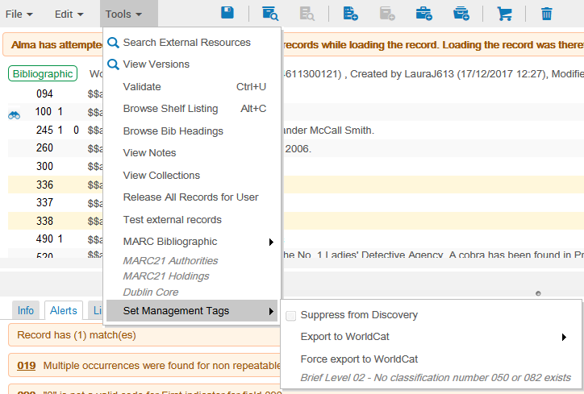
Determining if the record is brief
Here we have a record which is level 02.
Thus it should be considered brief (02 and lower is brief).

Slide 51
Determining if the record is brief
We create an order for this record and it is considered brief
Message when saving order
Message when viewing order

Slide 52
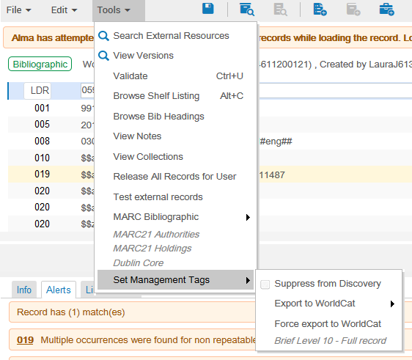
Determining if the record is brief
Here we have a record which is level 10.
Thus it should not be considered brief (02 and lower is brief).

Slide 53
Determining if the record is brief
It is not considered brief
No alert when saving or viewing order that it is brief

Slide 54
Updating the brief level of records retroactively

Slide 55
Updating the brief level of records retroactively
After performing one of the following two actions the existing records will not get the brief level changed accordingly until the job “identifying brief level” is run:
Changing the default brief level rule defined in the bibliographic profile “other settings”
Editing the content of the existing brief level rule defined in the bibliographic profile “other settings”
55

Slide 56
Updating the brief level of records retroactively
The job “identifying brief level” works on a set of records.
Thus this job could potentially be run on the entire repository

Slide 57
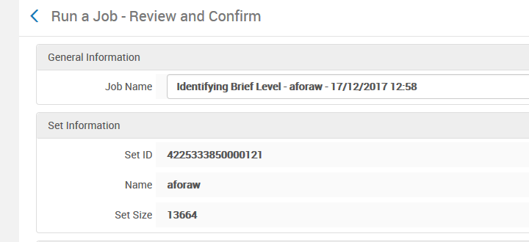
Updating the brief level of records retroactively
When the job completes all records in the set will have the correct level according to the updated brief level rule

Slide 58
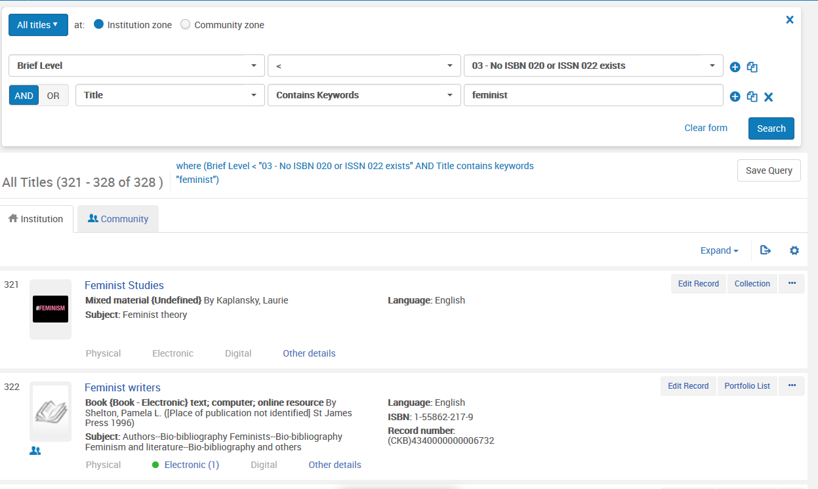
Updating the brief level of records retroactively
It will then be possible to properly retrieve records by brief level

Slide 59
Updating the brief level of records retroactively
And it will also be possible to configure import profiles to use merge routines and overlay rules to properly be configured according to brief level

Slide 60
Giving names to brief levels and searching by brief level

Slide 61
Giving names to brief levels and searching by brief level
Until now we have seen that the brief levels are all identified with numeric values.
It is also possible to apply logical names to these numeric values.
This is done via the table “Brief Levels” accessible in the “general” section of the resource management configuration menu.

Slide 62
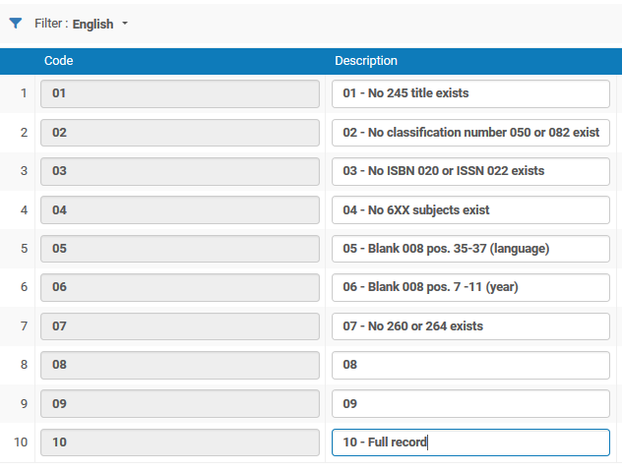
Giving names to brief levels and searching by brief level
Here we have defined the levels according to the definitions in the rule we saw called “Brief Based On Record Content”

Slide 63
Giving names to brief levels and searching by brief level
To be able to search by brief level you should define “mms_briefLevel” as “true” for either “Simple Search” or “Advanced Search”.
This is defined in Configuration > Resources > Search Configuration > Search Indexes .
Here it is defined as true” for “Advanced Search”

Slide 64
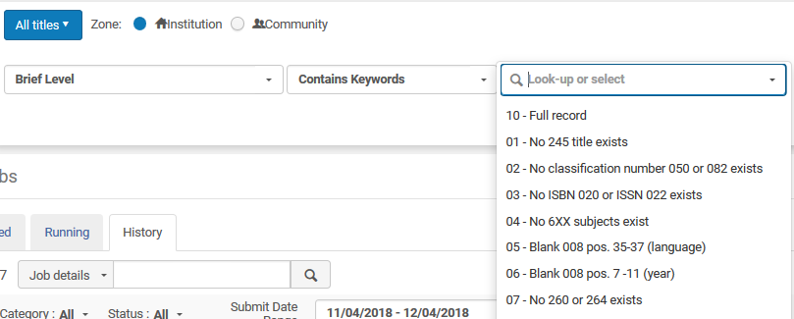
Giving names to brief levels and searching by brief level
You can then search by brief level in the repository search. The names here come from the names defined previously via the table “Brief Levels” accessible in the “general” section of the resource management configuration menu.
A logical name for the levels instead of just numeric values

Slide 65
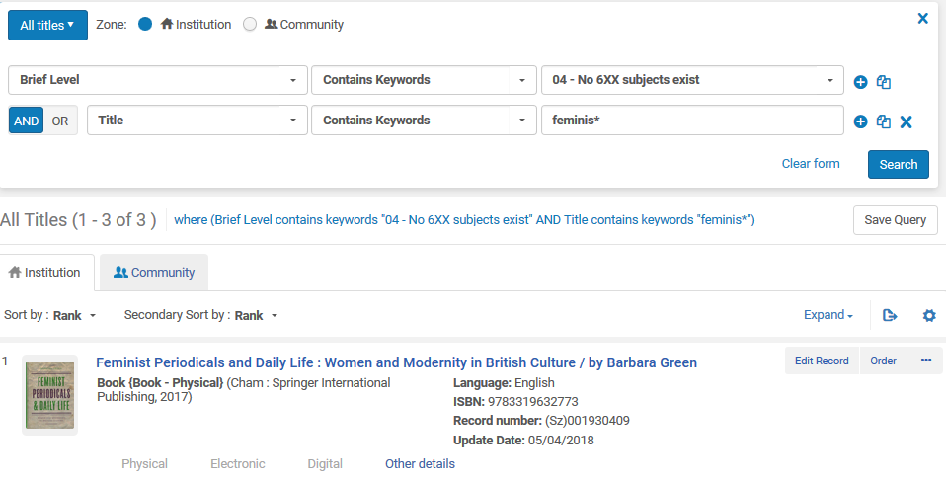
Giving names to brief levels and searching by brief level
Here we search for all records with keyword like “feminis*” in the title and no 6XX subject exists.

Slide 66
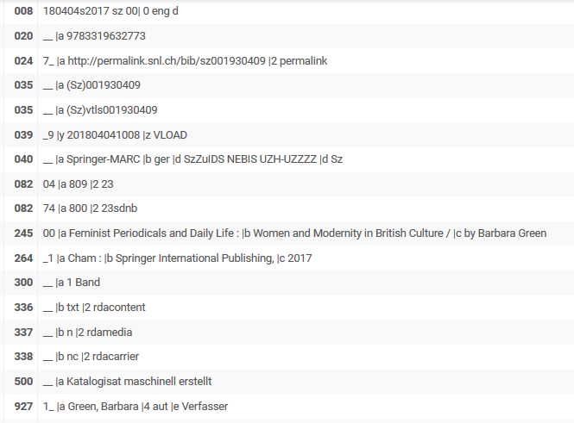
Giving names to brief levels and searching by brief level
This is the first record which was retrieved.
It has feminis* in the title and no 6XX field.

Slide 67
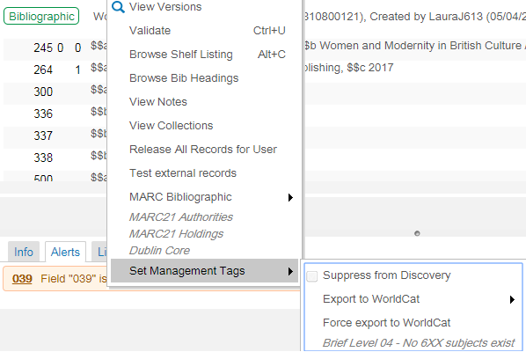
Giving names to brief levels and searching by brief level
The text of the brief level also appears in the metadata editor for the record

Slide 68
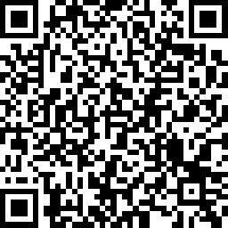
We value your feedback! Please complete the session survey in the schedule section of the app.

Slide 69
Yoel.Kortick@exlibrisgroup.com

