Slide 1
Bound together titles using the 773 field
Yoel Kortick – Senior Librarian

Slide 2
One bibliographic record with multiple 773 host item entry fields
Yoel Kortick – Senior Librarian

Slide 3
Contents
Introduction
Our sample titles
Steps to bind the titles into one volume
Viewing the results in Alma
Viewing the results in Primo
Viewing the results in BIBFRAME

Slide 4
Introduction

Slide 5
Introduction
Introductory Note:
The methodology described here for “Bound together titles” can also be used for other cases where, for whatever reason, one barcode will belong to multiple bibliographic records.
In the example here barcode AU44928 belongs to both of the following bibliographic records:
Title: "Readings from the Holy Scriptures / prepared for use of Jewish personnel of the Army of the United States".
MMSID: 99165511200121
Title: "Prayer book: abridged for Jews in the Armed Forces of the United States".
MMSID: 99165510900121

Slide 6
Introduction
This document will explain and demonstrate a recommended workflow for cataloguing separate bibliographic titles which become bound together into one physical volume after publication.
Note that there is more than one way to accomplish this task by using 77X fields in Alma.
The workflow described here is a recommended "best practice" workflow though certainly not the only possible workflow.

Slide 7
Introduction
The workflow described here will accomplish two very specific and useful tasks:
Each title in Primo will display as a separate title.
Each separate title within the bound volume will appear as unavailable when the volume is checked out.

Slide 8
Our Sample Titles

Slide 9
Our Sample Titles
These are two separate titles which are bound together in one physical volume
Title: "Readings from the Holy Scriptures / prepared for use of Jewish personnel of the Army of the United States".
System Cont. No.: 16385958
MMSID: 99165511200121
Title: "Prayer book: abridged for Jews in the Armed Forces of the United States".
System Cont. No.: 16080397
MMSID: 99165510900121

Slide 10
Our Sample Titles

Slide 11
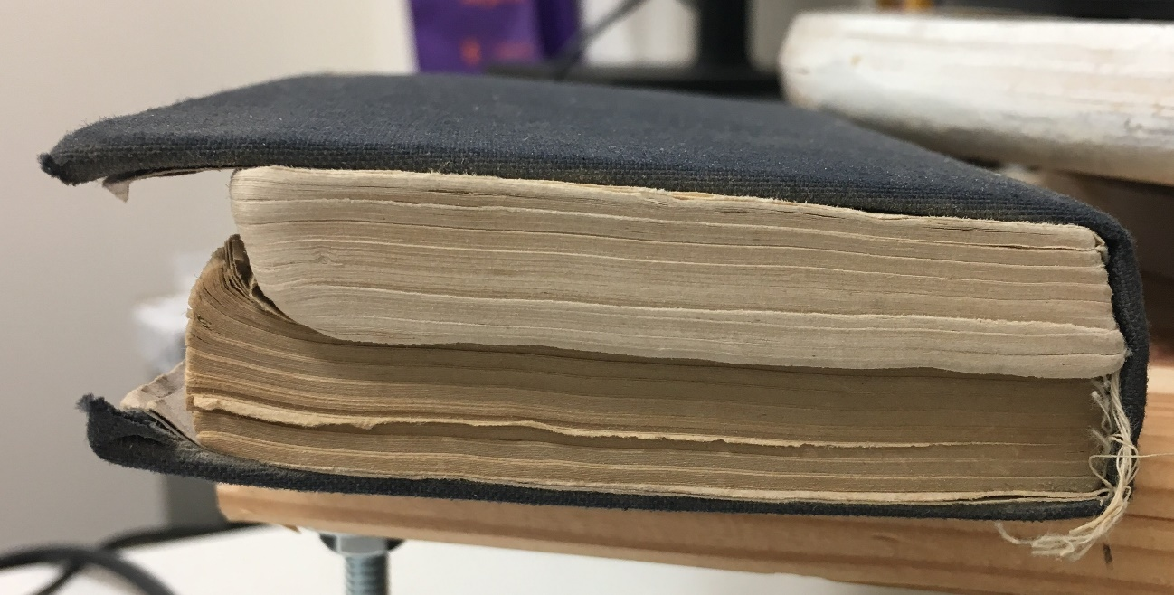
Our Sample Titles
Here is the bound volume.
It is possible to see here that two distinct works have been bound together

Slide 12
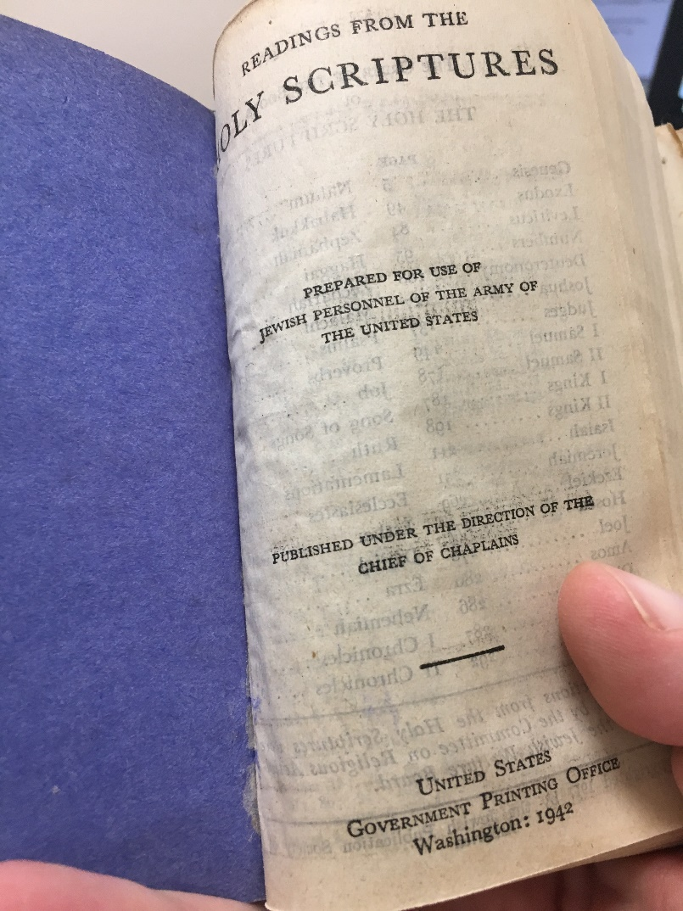
Our Sample Titles
Here is title "Readings from the Holy Scriptures / prepared for use of Jewish personnel of the Army of the United States".

Slide 13
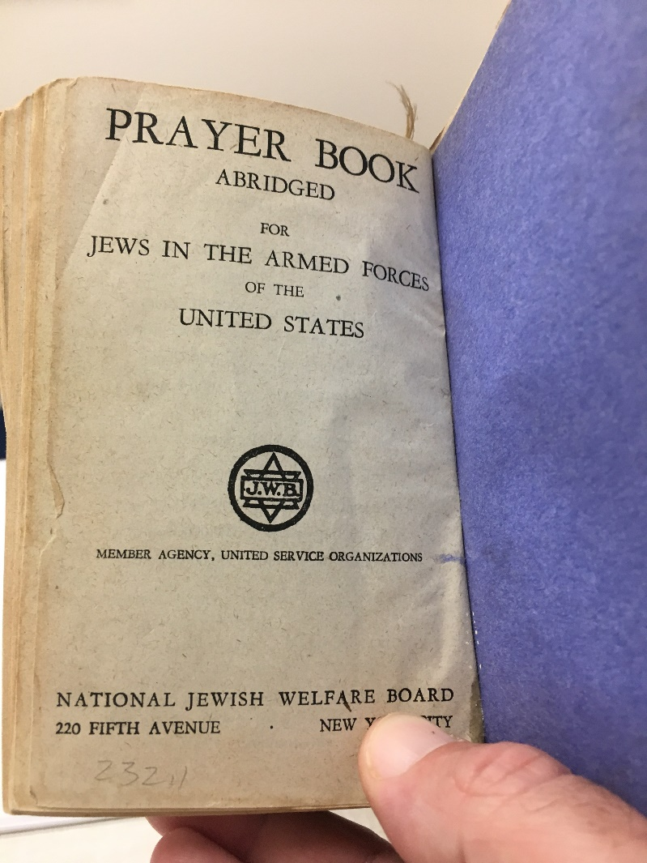
Our Sample Titles
Here is title "Prayer book: abridged for Jews in the Armed Forces of the United States".

Slide 14
Steps to bind the titles into one volume

Slide 15
Steps to bind the titles into one volume
Decide which will be the "master title"
This is the title which will get the holdings record and item
The other title will not get a holdings record or item. It will get a 773 linking to the title and item of the "master title“
On both records add a 501 "Bound with:" note
Wait for linking job to run

Slide 16
Steps to bind the titles into one volume
We have decided that the "master title" will be:
Title: Readings from the Holy Scriptures
System Cont. No.: 16385958
MMSID: 99165511200121
So we add a holdings record and item to this title
We add a 773 field to "Prayer book abridged" to link to this record.
We also add a 501 "Bound with" note which includes the other record

Slide 17
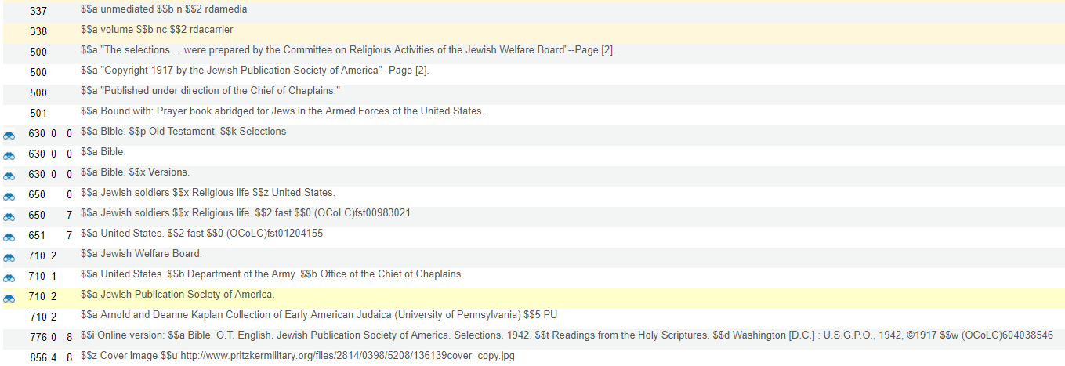
Steps to bind the titles into one volume
The 501 plays no "functional" role in linking the records but may aid in display and conforms to official MARC rules
Title: Readings from the Holy Scriptures
Note that our title "Readings from the Holy Scriptures" also has a 776 field linking to an online version.
This is "by chance" and has nothing to do with the bound items..

Slide 18
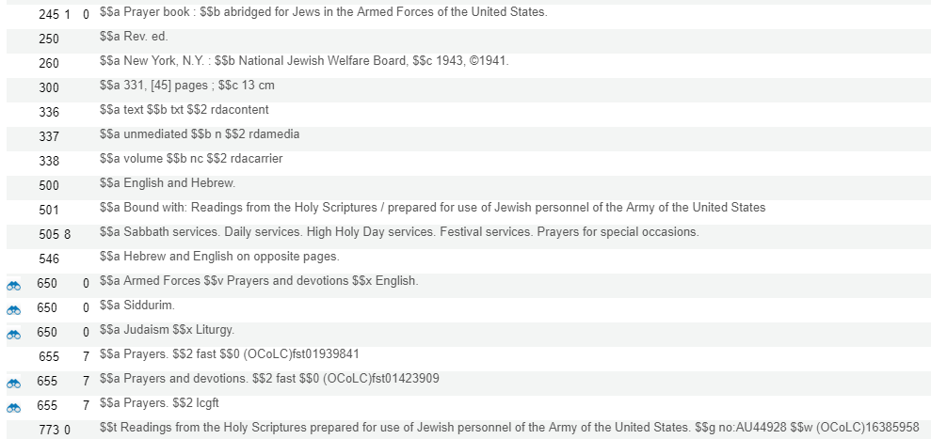
Steps to bind the titles into one volume
The 501 plays no "functional" role in linking the records but may aid in display and conforms to official MARC rules
Title: Prayer book: abridged …
Here we put the system control number in subfield w.
We could instead have put the MMSID in subfield w.
If there was an ISBN or ISSN in the related records then we could have also added the ISBN in subfield z and the ISSN in subfield x
There is also a link to the item via subfield g and the barcode preceded by "no:"

Slide 19
Steps to bind the titles into one volume
We also add
A 014 to the holding record of the "master title".
An Item to this holding record
The 014 plays no "functional" role in linking the records but may aid in display and conforms to official MARC rules.
Here we have linked it to the MMSID of the related record.

Slide 20
Steps to bind the titles into one volume
Here is the item
As previously stated only the "master title" gets the holding record and item.
The 773 of "Prayer book: abridged …" has $$g no:AU44928 to link to this item

Slide 21
Steps to bind the titles into one volume
Now we will add 501 "Bound with" field to the other record "Prayer book: abridged …".
As previously stated these 501 fields have no "functional" value linking the records.
They may aid in display and conform to MARC standards.

Slide 22
Steps to bind the titles into one volume
We then wait for the job "MMS - Build Record Relations" to complete

Slide 23
Viewing the results in Alma

Slide 24
Viewing the results in Alma
Searching in Alma for the related records shows the related records with a link to the "Availability of related records"
Here we search for "Prayer book: abridged …"

Slide 25
Viewing the results in Alma
Note that "Prayer book : abridged ..." has a "physical" link and a holdings record.
But … it is actually the holdings record of the linked item

Slide 26
Viewing the results in Alma
Searching in Alma for the related records shows the related records with a link to the "Availability of related records"
Here we search for "Readings from the Holy Scriptures"
There are two related records here:
One from the 773 of the bound item
One from the 776 for the online version

Slide 27
Viewing the results in Alma
If we click the "Related Records" link from "Prayer Book: abridged …" …
Click here

Slide 28
Viewing the results in Alma
Then we get to the related record "Readings from the Holy Scriptures"

Slide 29
Viewing the results in Alma
If we click the "Related Records" link from "Readings from the Holy Scriptures" …
Click here

Slide 30
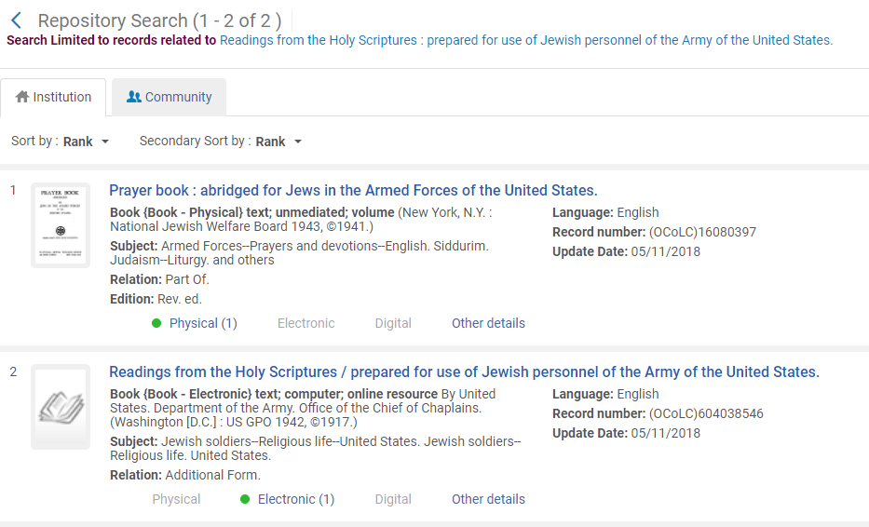
Viewing the results in Alma
Then we get to the related record "Readings from the Holy Scriptures " (from the 773) and we also get the online version (from the 776 of the physical version).

Slide 31
Viewing the results in Primo

Slide 32
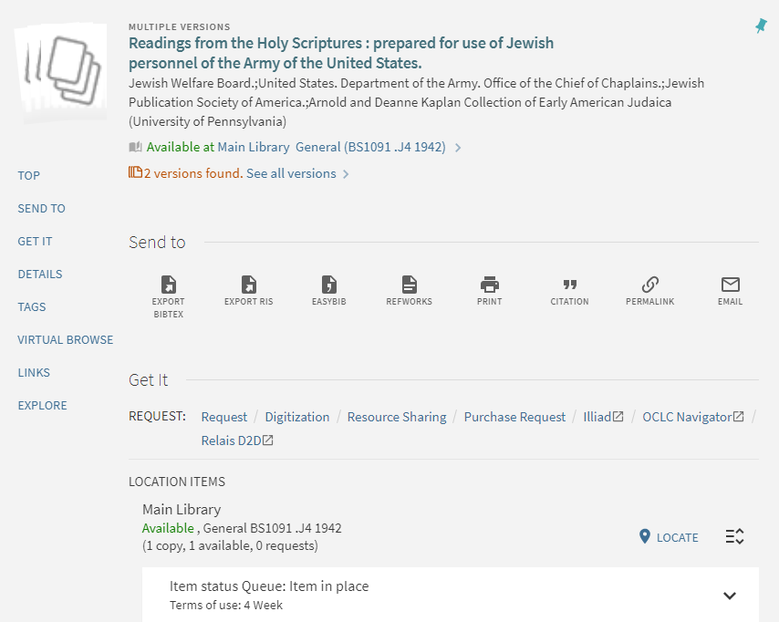
Viewing the results in Primo
In Primo here is our "master title" (the one with the holdings record and items). The inventory appears and we see that there are two versions (physical and electronic from the 776)

Slide 33
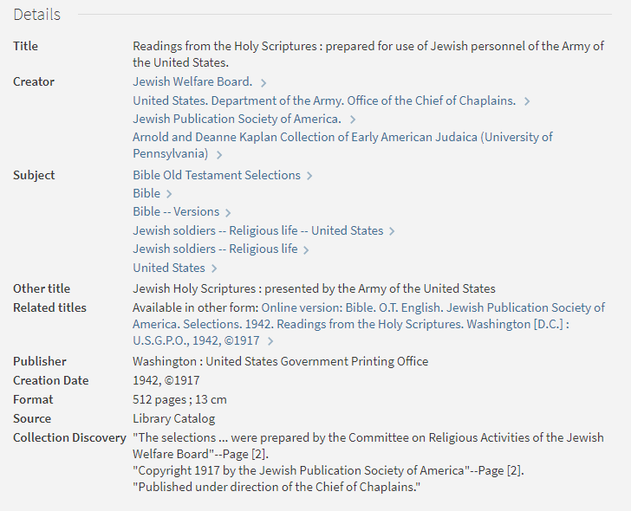
Viewing the results in Primo
In the Primo details for "Readings from the holy scriptures" we see a link online title

Slide 34
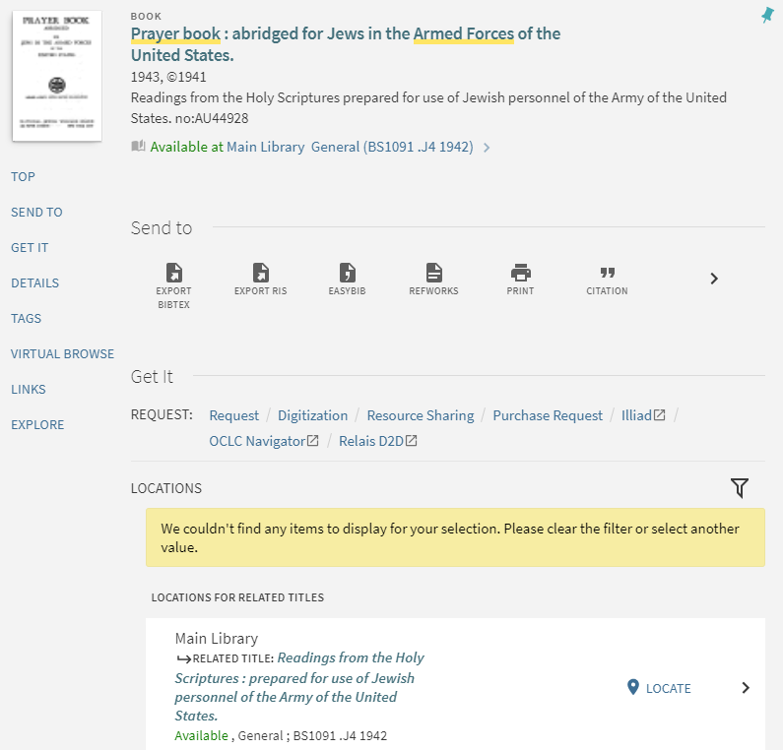
Viewing the results in Primo
In Primo here is the related record which has the 773 but no holdings record or item of its own. Here we see the inventory of the related record

Slide 35
Viewing the results in BIBFRAME

Slide 36
Viewing the results in BIBFRAME
We will now look at the BIBRAME for title "Readings from the Holy Scriptures" which has a holdings record, item and 776 to online version.

Slide 37
Viewing the results in BIBFRAME
Here is part of BIBRAME for title "Readings from the Holy Scriptures"
<bflc:relationship>
<bflc:Relationship>
<bflc:relation>
<bflc:Relation>
<rdfs:label>Online version</rdfs:label>
</bflc:Relation>
</bflc:relation>
<bf:relatedTo rdf:resource="https://open-na.hosted.exlibrisgroup.com/alma/EXLDEV1_INST/bf/entity/instance/99165511200121"/>
</bflc:Relationship>
</bflc:relationship>

Slide 38
Viewing the results in BIBFRAME
We will now look at the BIBRAME for title "Prayer book abridged …" which has no holdings record or item, and does have a 773 pointing to another record and item.

Slide 39
Viewing the results in BIBFRAME
<bf:partOf>
<bf:Work rdf:about="https://open-na.hosted.exlibrisgroup.com/alma/EXLDEV1_INST/bf/entity/work/9012104262824155989773-35">
<bf:identifiedBy>
<bf:Identifier>
<rdf:value>16385958</rdf:value>
<bf:source>
<bf:Source>
<rdfs:label>OCoLC</rdfs:label>
</bf:Source>
</bf:source>
</bf:Identifier>
</bf:identifiedBy>
<bf:hasInstance>
<bf:Instance rdf:about="https://open-na.hosted.exlibrisgroup.com/alma/EXLDEV1_INST/bf/entity/instance/99165510900121">
<bf:part>no:AU44928</bf:part>
<bf:title>
<bf:Title>
<rdfs:label>Readings from the Holy Scriptures prepared for use of Jewish personnel of the Army of the United States.</rdfs:label>
</bf:Title>
</bf:title>
<bf:instanceOf rdf:resource="https://open-na.hosted.exlibrisgroup.com/alma/EXLDEV1_INST/bf/entity/work/9012104262824155989773-35"/>
</bf:Instance>
</bf:hasInstance>
</bf:Work>
</bf:partOf>
Here is part of BIBRAME for title "Prayer book abridged …"

Slide 40
xxx@exlibrisgroup.com

