Slide 1
Managing Sets and running Jobs
Callie Mendoza, Technical Support Team Lead
Yaala Ariel-Joel, Technical Support Analyst

Slide 2
Welcome and Introductions
Callie Mendoza
Alma NA Support Tier 2 Team Lead
Started with Ex Libris in October 2014
MLIS from Dominican University
Yaala Ariel-Joel
Working in Ex Libris support for multiple years, and products
Was a reference librarian in several special libraries
On my spare time, enjoy hiking

Slide 3
Agenda
Agenda
An Introduction to Sets
Creating and Editing Sets
Set Manipulation
Running jobs on sets of data
Restoring a job
Documentation, blogs, knowledge articles

Slide 4
1. An introduction to sets

Slide 5
What are search queries and sets?
A set is a group of entities with a common value– such as items, users, PO Lines.
Sets may be used to:
Manage data directly (view or edit the records one by one).
Manage the data by running a job (e.g. publish records, edit in bulk, notify users).

Slide 6
Types of Sets
Logical – A saved search query, which runs every time the set is referenced.
Set content is dynamic - results reflect information currently in the repository.
Notes:
Note about Itemized – can create a set of deleted items. Sometimes a job using an itemized set will return errors, this is generally due to deleted records in the set.

Slide 7
Types of Sets
Itemized – Individual items, selected or uploaded by the user.
Set content is static – members can be added or removed manually.
Deleted records are retained behind the scenes even if the record is no longer found in the repository.
Notes:
Note about Itemized – can create a set of deleted items. Sometimes a job using an itemized set will return errors, this is generally due to deleted records in the set.

Slide 8
Itemized - Fulfillment Sets
Create itemized physical item sets based on their loan status
Fulfillment > Advanced Tools > Create Fulfillment Sets

Slide 9
Manage Sets
Set Tabs:
My Sets – Your saved search queries, both private and public
Public Sets – All users' saved queries that are not marked private
All Sets – All queries
Notes:
The All Sets tab is available only to a Repository Manager. This role is also required in order to edit public sets.
Itemized sets may include references to deleted records. Deleted records do not appear in repository searches or in normalization jobs. Using itemized sets, you can perform operations on deleted records, such as republishing them to Primo.
There are no limits on the number of records that can be included in a set.

Slide 10
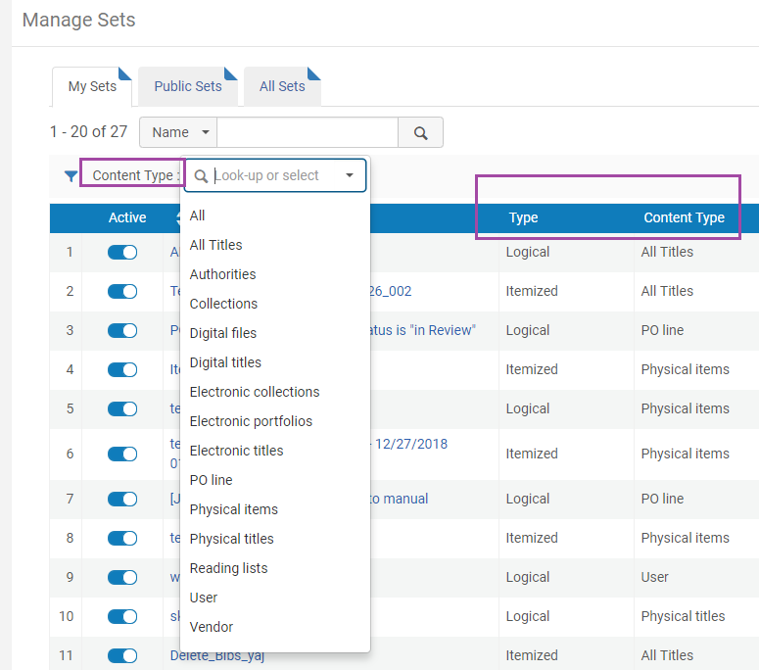
Set Content Types
Resource Management sets
Titles, Authorities, Collections,
Inventory: Digital/Electronic/Physical
Acquisition sets
PO Lines, or Vendors
User sets
Reading List Sets

Slide 11
2. Creating and editing Sets

Slide 12
How to create a set? Add Set via a Wizard
“Add Set” from: Manage Sets
Choose if Logical, or Itemized

Slide 13
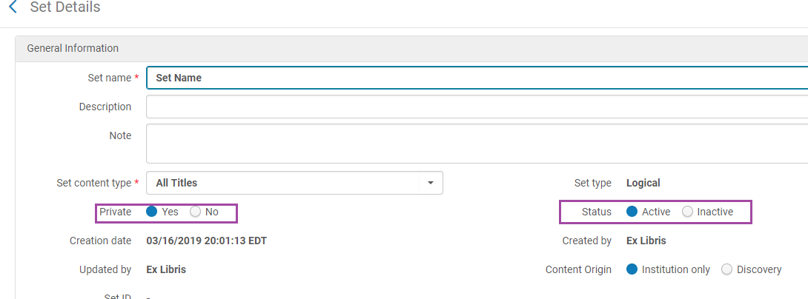
Add Set – Logical or Itemized?
The set name cannot contain special characters (for example: &, #, $, %).

Slide 14
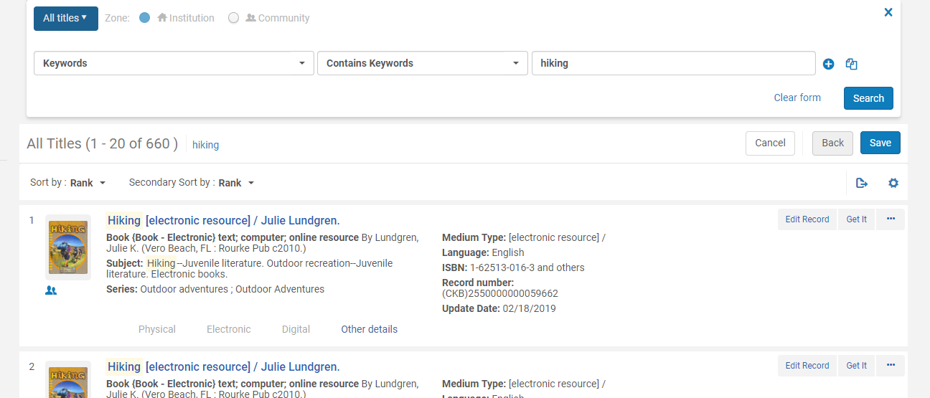
Add Set – Logical, From Search

Slide 15
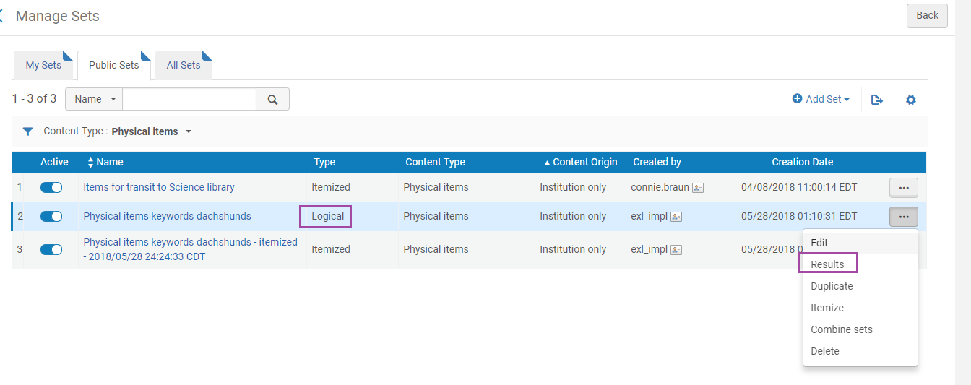
Logical Set – view Results (modify search terms & save)

Slide 16
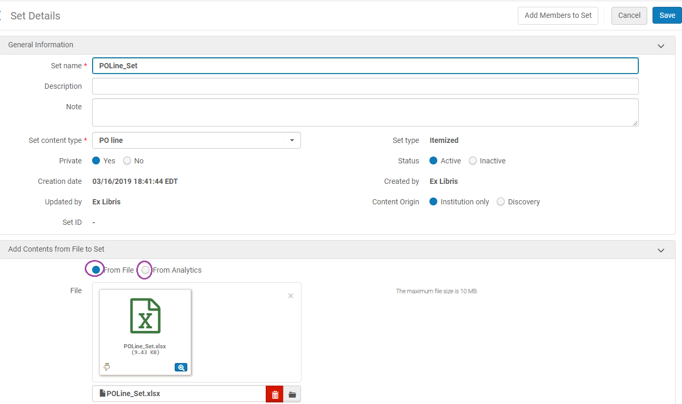
Add Set - Itemized
From Excel or Analytics
First, “Save”. Later, can edit and “Add Members to Set”.

Slide 17
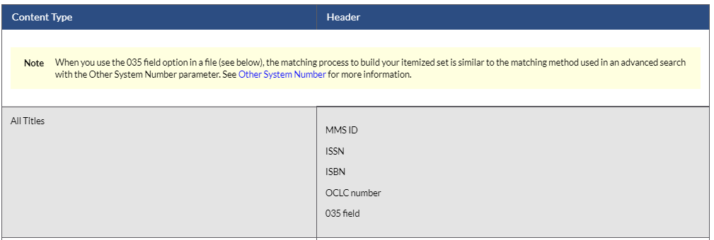
Add Set – Itemized, input file
Use a text file (.txt or .csv) or Excel file (.xls or .xlsx).
Have correct header. Consult the Online Help: https://knowledge.exlibrisgroup.com/Alma/Product_Documentation/010Alma_Online_Help_(English)/050Administration/070Managing_Jobs/060Managing_Search_Queries_and_Sets
Only the first column (which has valid header) – is read.

Slide 18
Add Set – Itemized: error is received with information regarding supported IDs

Slide 19
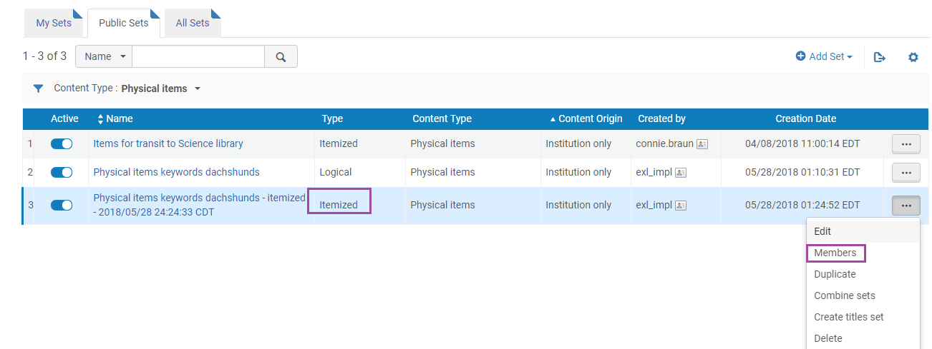
Itemized Set – View Members

Slide 20
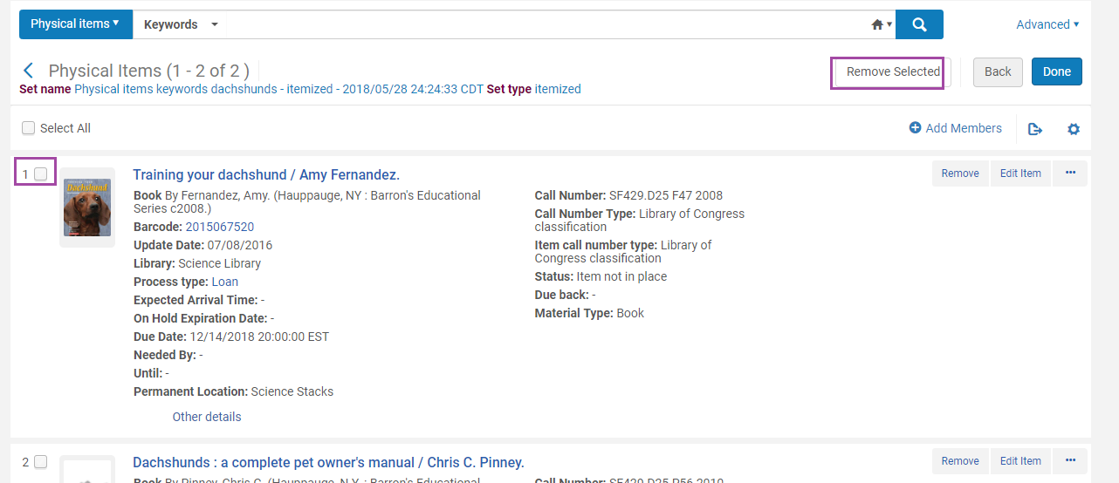
Itemized Set – Removed Selected

Slide 21
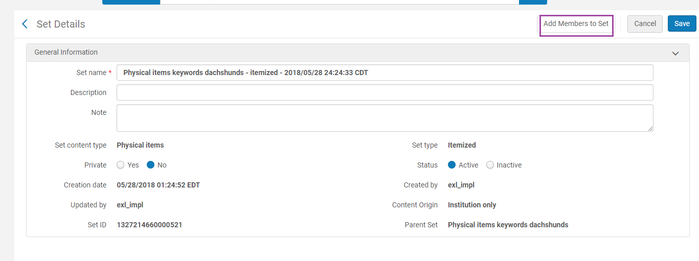
Itemized Set – Edit and Add Members to Set

Slide 22
3. Set manipulation

Slide 23
Converting Logical Sets to Itemized Sets
You can convert a logical set to an itemized set.

Slide 24
Converting Logical Sets to Itemized Sets

Slide 25
Combining Sets
Sets must be the same type
The combined set is an itemized set.

Slide 26
Combining Sets
And – Include only the members in common between the two sets in the new combined set.
Not – Include only the members that are in the first set and not in the second set in the new combined set.
Or – Include all of the members in both of the sets in the new combined set.

Slide 27
Set A – 246 records
Set B – 3,129 records

Slide 28
Combining Sets - AND
Notes:
AND – create a set only of what these sets have in common

Slide 29
Combining Sets

Slide 30
Combining Sets

Slide 31
Combining Sets - NOT
Notes:
Not – Include only the members that are in the first set and not in the second set in the new combined set.
Cats set had 246 – now less since the BIG titles have been removed

Slide 32
Combining Sets - OR
Notes:
Or – Include all of the members in both of the sets in the new combined set.
246 + 3,129

Slide 33
Filtering Sets
Relevant only for Resource Management content types
Filter set content based on fields that are not indexed/searchable
Uses Indication Rules

Slide 34
Creating Indication Rules

Slide 35
Creating Indication Rules
Notes:
The Private and Shared options determine in which folders the indication rule is saved.

Slide 36
Creating Indication Rules
When (<conditions on MARC record>) then Action1 Action2 if condition Action3 End
Notes:
“When” must be the only word in the first line. The condition must be placed on a separate line.
Multiple Boolean Operators can be used but it will degrade the performance
No more than 200 Boolean operators.

Slide 37
Creating Indication Rules
when ((exists '074’) OR (exists ‘086’))
then
set indication."true" end

Slide 38
Creating Indication Rules
Notes:
Click to show error

Slide 39
Creating Indication Rules
Notes:
Click to show error

Slide 40
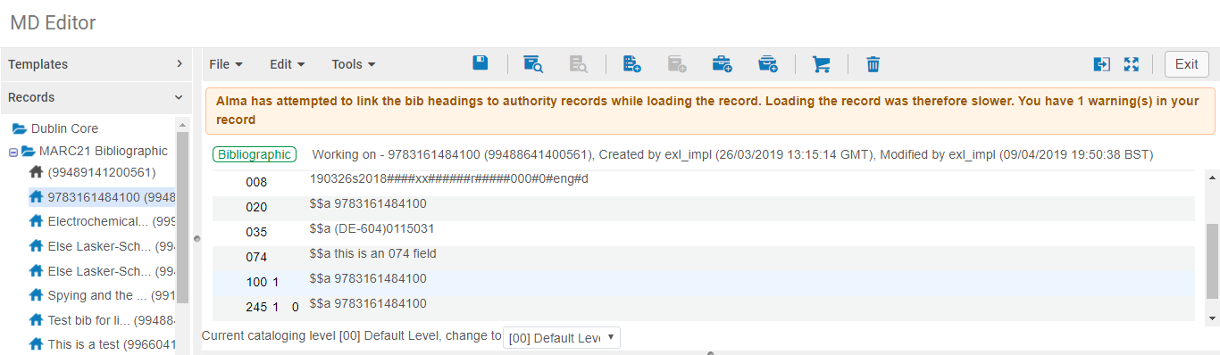
Testing Indication Rules
Notes:
Open record
Open Split screen
Click to show arrow

Slide 41
Testing Indication Rules
Notes:
Open record
Open Split screen
Click to show arrow

Slide 42
Testing Indication Rules
Notes:
TRY IT
Click to show arrow

Slide 43
Testing Indication Rules

Slide 44
Using Indication Rules

Slide 45
Using Indication Rules

Slide 46
Using Indication Rules

Slide 47
Using Indication Rules

Slide 48
Using Indication Rules

Slide 49
Agenda
Agenda
An Introduction to Sets
Creating and Editing Sets
Set Manipulation
Running jobs on sets of data
Restoring a job
Documentation, blogs, knowledge articles

Slide 50
Running a set based job
Delete Bibliographic Records
Delete all local bibs without inventory created before January 2014
Notes:
68 – different jobs using sets

Slide 51
Running a set based job
Notes:
Click for run a job

Slide 52
Running a set based job

Slide 53
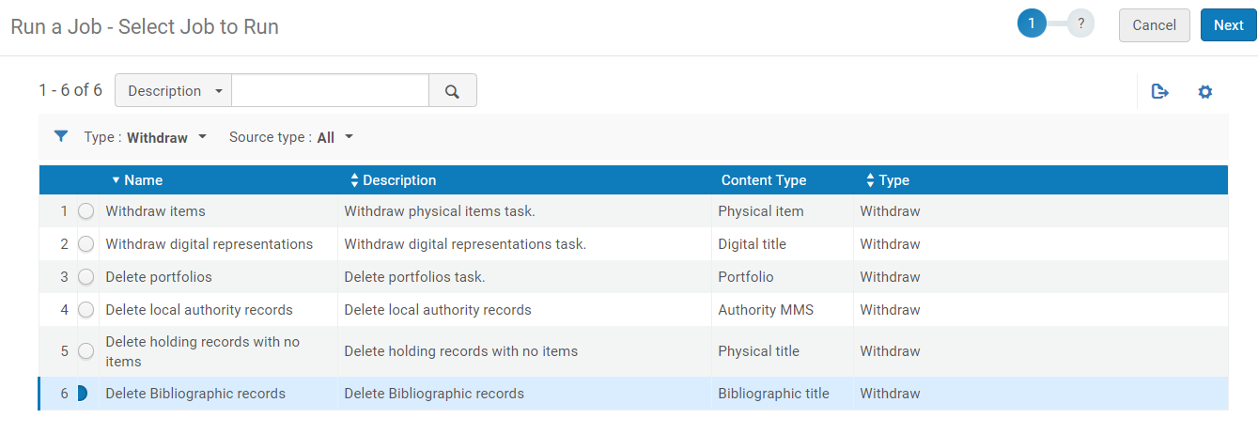
Running a set based job

Slide 54
Running a set based job

Slide 55
Running a set based job

Slide 56
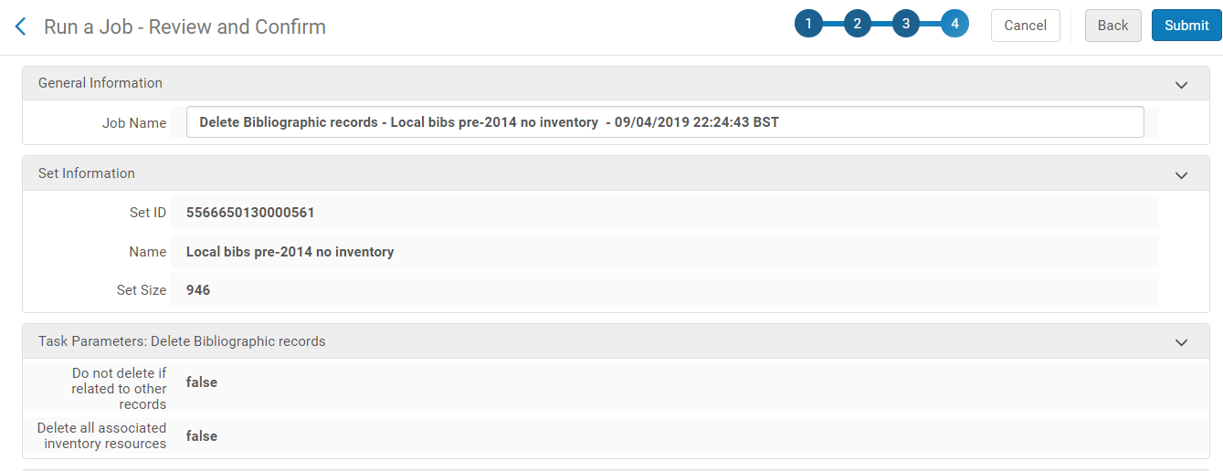
Running a set based job

Slide 57
Running a set based job

Slide 58
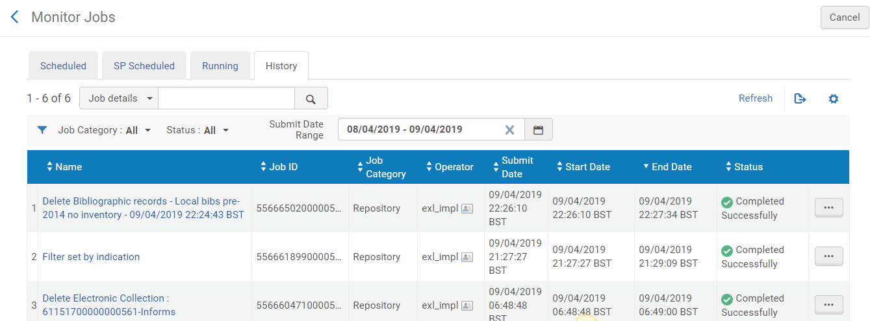
Running a set based job

Slide 59
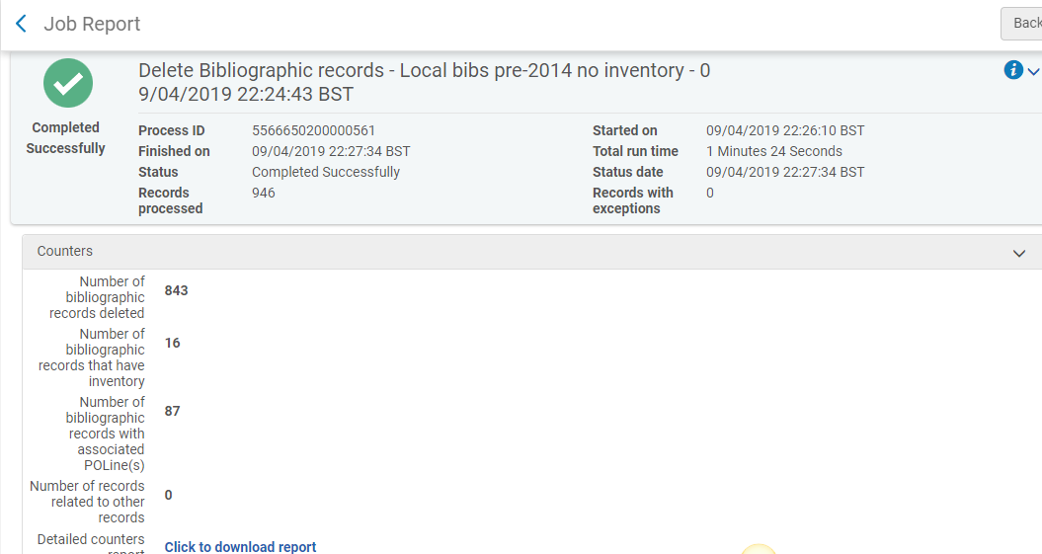
Running a set based job

Slide 60
Running a set based job

Slide 61
4. Restoring a Job

Slide 62
Restoring a job
You can restore records that were removed or changed by the following jobs:
Withdraw items
Delete portfolios
Delete bibliographic records
KORMARC/MARC 21/UNIMARC normalization
Change holdings information
Authorities-preferred term correction
You can restore up to 5000 records.
Notes:
This includes any related records. For example, holdings and item records are counted separately when restoring their bibliographic record.
Support can restore a job that is larger than 5000

Slide 63
Restoring a job
Resources > Advanced Tools > Restore Jobs
Notes:
This includes any related records. For example, holdings and item records are counted separately when restoring their bibliographic record.
Support can restore a job that is larger than 5000

Slide 64
Restoring a job
Notes:
This includes any related records. For example, holdings and item records are counted separately when restoring their bibliographic record.
Support can restore a job that is larger than 5000

Slide 65
Restoring a job
Notes:
This includes any related records. For example, holdings and item records are counted separately when restoring their bibliographic record.
Support can restore a job that is larger than 5000

Slide 66
Restoring a job

Slide 68
Other Tips and Tricks

Slide 69
Normalization Jobs

Slide 70
Normalization Jobs

Slide 71
Normalization Jobs

Slide 72
Normalization Jobs

Slide 73
Normalization Jobs

Slide 74
Normalization Jobs

Slide 75
Normalization Jobs

Slide 76
Normalization Jobs

Slide 77
Normalization Jobs

Slide 78
Normalization Jobs

Slide 79
Normalization Jobs

Slide 80
Normalization Jobs

Slide 81
Normalization Jobs

Slide 82
Export Jobs
Notes:
Get information you can’t extract from the export to excel in the repository search.
Export URLs
In order to perform periodic validation tests to find broken links and fix them, you can export the following from Alma:
Logical sets and itemized sets
Static URLs and dynamic URLs
URLs from electronic collection level sets
URLs from portfolio level sets
URLs from the 856 $u (repeatable) in bibliographic records
With a file of exported URLs, it is possible to test the URLs using third-party, external link checkers such as LinkChecker (https://wummel.github.io/linkchecker/). To support these third-party options, both the CVS and HTML export output formats are provided.

Slide 83
Publishing

Slide 84
Information Update
Notes:
Move electronic portfolio information – Let’s say you have portfolios that are local and you want to use CZ portfolios instead BUT you don’t want to lose your POL info
Create physical item move requests – If anyone out there is using dummy patrons (RS) this might be a better way! You create a location for those items and move them into the closed location instead of checking them out to a patron

Slide 85
Documentation, articles, blogs

Slide 86
Next Steps and Resources
Online Help:
Managing Search Queries and Sets:
https://knowledge.exlibrisgroup.com/Alma/Product_Documentation/010Alma_Online_Help_(English)/050Administration/070Managing_Jobs/060Managing_Search_Queries_and_Sets
Running Manual Jobs on Defined Sets:
https://knowledge.exlibrisgroup.com/Alma/Product_Documentation/010Alma_Online_Help_(English)/050Administration/070Managing_Jobs/020Running_Manual_Jobs_on_Defined_Sets
Jobs with more detailed documentation:
https://knowledge.exlibrisgroup.com/Alma/Product_Documentation/010Alma_Online_Help_(English)/050Administration/070Managing_Jobs/040Viewing_Running_Jobs#Job_Types_with_Their_Own_Management_Pages

Slide 87
Next Steps and Resources
Blogs, e.g. on the Developer Network:
Laura Guy, Alma – RAPID OAI Setup and Configuration
https://developers.exlibrisgroup.com/blog/Alma-RAPID-OAI-Setup-and-Configuration
Andy Tang, Delete Marc records from Marc file by using 035 field list file
https://developers.exlibrisgroup.com/blog/delete-marc-records-from-marc-file-by-using-035-field-list-file/
Laura Guy, Adding Springshare Libguide Discovery to Primo VE
https://developers.exlibrisgroup.com/blog/adding-springshare-libguide-discovery-to-primo-ve/

Slide 88
Next Steps and Resources
Knowledge Articles (randomly selected):
How to link local portfolios (standalones) to the Community Zone:
https://knowledge.exlibrisgroup.com/Alma/Knowledge_Articles/How_to_link_local_portfolios_(standalones)_to_the_Community_Zone
Batch delete Process Type "Technical - Migration", or putting items in place in bulk: https://knowledge.exlibrisgroup.com/Alma/Knowledge_Articles/Items_not_in_place_(not_available)_-_how_to_fix_in_bulkbatch%3F
Create an itemized Users set based on Analytics
https://knowledge.exlibrisgroup.com/Alma/Knowledge_Articles/Create_Users_Set_for_expired_patrons_based_on_Analytics
How to Bulk Change PO Line Status?
https://knowledge.exlibrisgroup.com/Alma/Knowledge_Articles/How_to_Bulk_Change_PO_Line_Status%3F

Slide 89
Thank you!

Slide 90
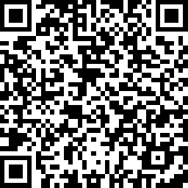
We value your feedback! Please complete the session survey in the schedule section of the app.

