Slide 1
Prediction Patterns and Summary Holdings
Knowledge Days 2019

Slide 2
Welcome
Callie.Mendoza@exlibrisgroup.com
Team Lead for NA Alma Support Tier 2
Started at Ex libris in October 2014
MLIS from Dominican University

Slide 3
Setting up Prediction Patterns
Opening Predicted Items
Receiving (check-in)
Normalization Tasks for Holdings Records
Summary Holding Example when Prediction Pattern is used
Summary Holding Example without Prediction Pattern

Slide 4
Prediction Patterns Introduction
In order for prediction patterns to be used there must be:
An acquisitions order
An 853/4/5 captions and pattern field in the holding record
Information registered in the ‘Next predicted item’s information’

Slide 5
Prediction Patterns Introduction
The acquisitions order is needed because information must be taken from the vendor
For example the issue’s “Expected Date of Arrival” will be taken from a combination of
The vendor “Subscription interval” in the order record
The “issue date” of the expected issue
Expected date of arrival = ‘issue date’ + ‘Subscription Interval’

Slide 6
Prediction Patterns Introduction
The 853/4/5 captions and pattern field in the holding record is needed because this is where information such as publication frequency and publication dates will be taken from.
The captions and pattern field must reside in the holding record which is associated with the specific order
The “Next predicted item’s information“ is needed because this will determine the dates for the start and remainder of the specific issue cycle

Slide 7
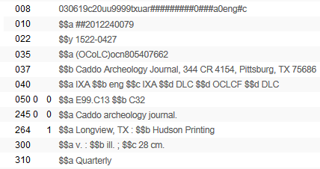
Prediction Pattern
We have bibliographic record MMSID 99137610800121
Title “Caddoan archeology journal”
This is a quarterly journal

Slide 8
Prediction Pattern
Notes:
Library makes purchase order line POL-44785 for this record
It will begin with: Volume 12 Issue 1 Year 2018
The order is made using vendor ‘J and S Ltd.’
The “Subscription interval” is “30”

Slide 9
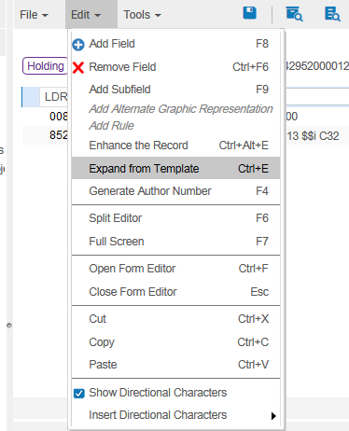
Prediction Pattern
Notes:
In the holding record (which gets created automatically when the order is created) the librarian adds field 853 for a quarterly journal.
The librarian can use a predefined template when adding field 853, and make only the necessary changes if needed.

Slide 10
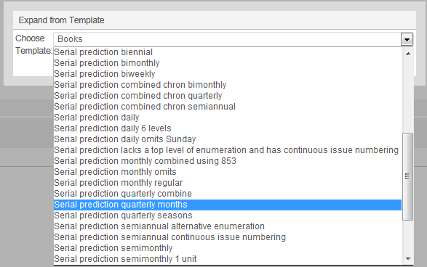
Prediction Pattern
Notes:
‘Out of the box’ there are many prediction patterns – one for nearly every possible situation. These contain 853 captions and pattern fields as well as 590 note fields.
We will choose ‘Serial prediction quarterly months’

Slide 11
Prediction Pattern
Notes:
The 853 (and 590) get added to the holding record from the template
The 853 captions and pattern field contains standard MARC information
$$a Prefix for enumeration a -- $$b prefix for enumeration b -- $$u shows that this is 4 times a year
$$v Numbering continuity, the r means the issue repeats each cycle --- $$i enumeration i (it will appear in parentheses)-- $$j chronology j –
$$w Frequency q=quarterly -- $$8 Field link and sequence number

Slide 12
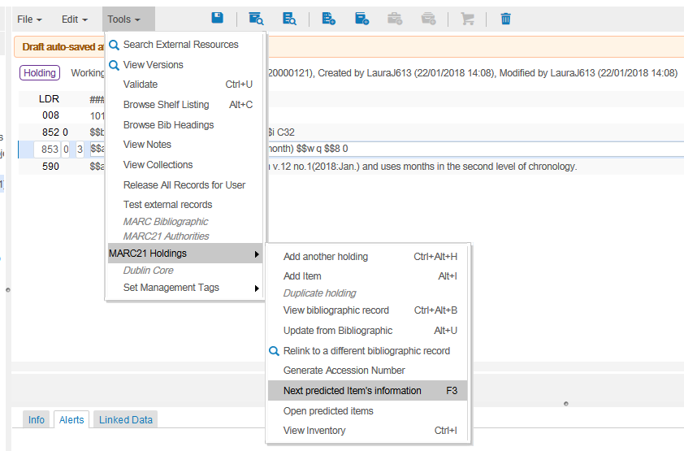
Prediction Pattern
Notes:
Put cursor on 853 field and choose ‘Tools > Marc21 Holdings > Next predicted item’s information’

Slide 13
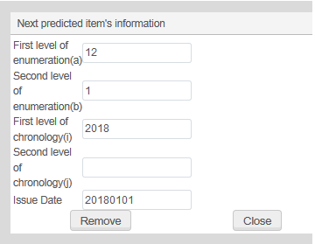
Prediction Pattern
Starts with Vol. 12 Issue 1 Year 2018. First issue date is Jan.01 2018

Slide 14
Prediction Pattern
The issue dates of the predicted items must be within this range
Notes:
In order for the predication pattern mechanism to work the ‘issue date’ of the expected items must be within the range of the subscription ‘from’ date and subscription ‘to’ date within the order.

Slide 15
Prediction Pattern
Link to the Next predicted item’s information
Notes:
After the next predicted item’s information has been entered the 853 field will have a link to this information

Slide 16
Setting up Prediction Patterns
Opening Predicted Items
Receiving (check-in)
Normalization Tasks for Holdings Records
Summary Holding Example when Prediction Pattern is used
Summary Holding Example without Prediction Pattern

Slide 17
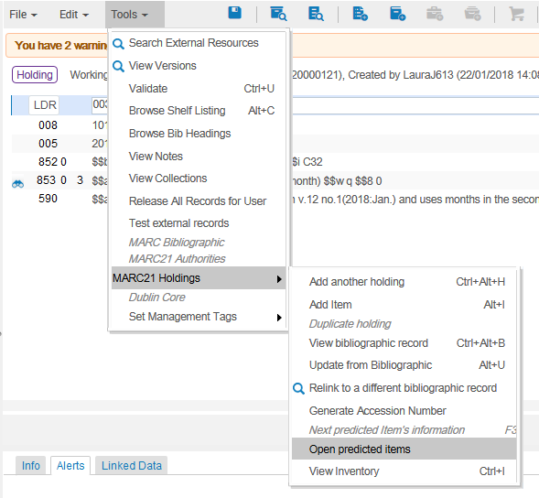
Opening the predicted items

Slide 18
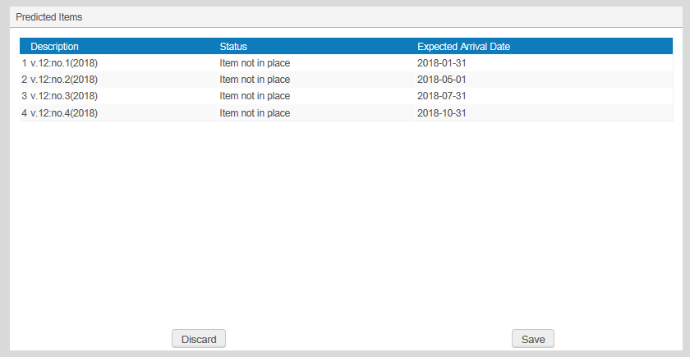
Opening the predicted items
Notes:
Description – This information appears in accordance with the 853 field: $$a v. $$b no. $$i (year)
Status – Item not in place b/c they have not been received
Expected Arrival Date - The expected arrival date is the ‘Issue date’ + the ‘Subscription Interval’ (click to reveal)
The first ‘issue date’ was 20180101 and the order ‘subscription interval’ was ‘30’ therefore the first expected arrival date is 20180131 (which is 20180101 + 30)
853 subfield u had ‘4’ and subfield w had ‘q’ so it is quarterly with 4 issues per cycle: therefore ~90 days between each issue

Slide 19
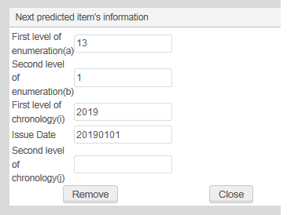
Opening the predicted items
After the cycle of issues is opened the ‘Next predicted item’s information’ automatically ‘jumps’ to the next cycle
Notes:
Now it is Volume 13 year 2019. Previously it was volume 12 year 2018..

Slide 20
Receiving (check-in)
Notes:
All four predicted items of the cycle have been created with no receiving date (because they have not yet been received)

Slide 21
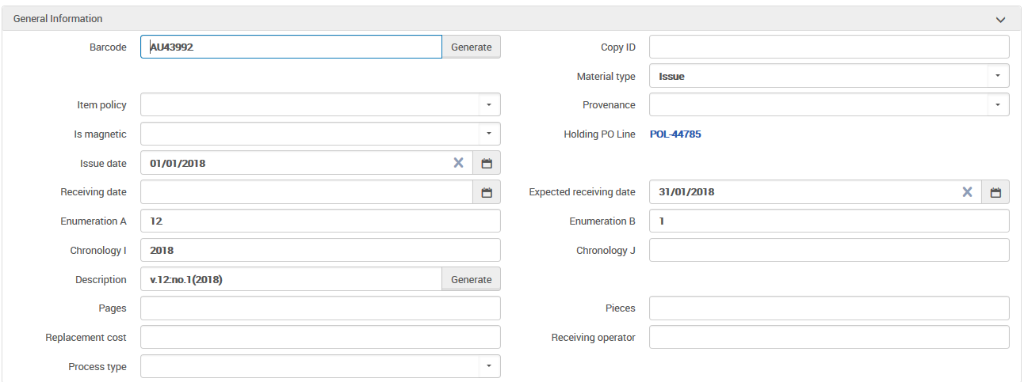
Receiving (check-in)
Notes:
Each item has an expected receiving date
The description (as previously stated) is in accordance with 853 pattern field

Slide 22
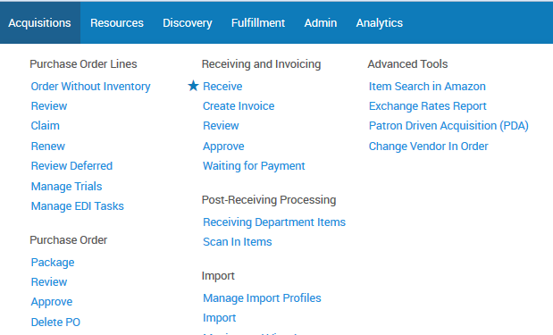
Receiving (check-in)
Notes:
The staff user is at the acquisitions department (or a circulation desk which is defined to also function as an acquisitions desk) and does “Acquisitions > Receiving and Invoicing > Receive”

Slide 23
Receiving (check-in)
In the receiving workbench we retrieve the journal

Slide 24
Receiving (check-in)
We will choose “Actions > Manage Items”

Slide 25
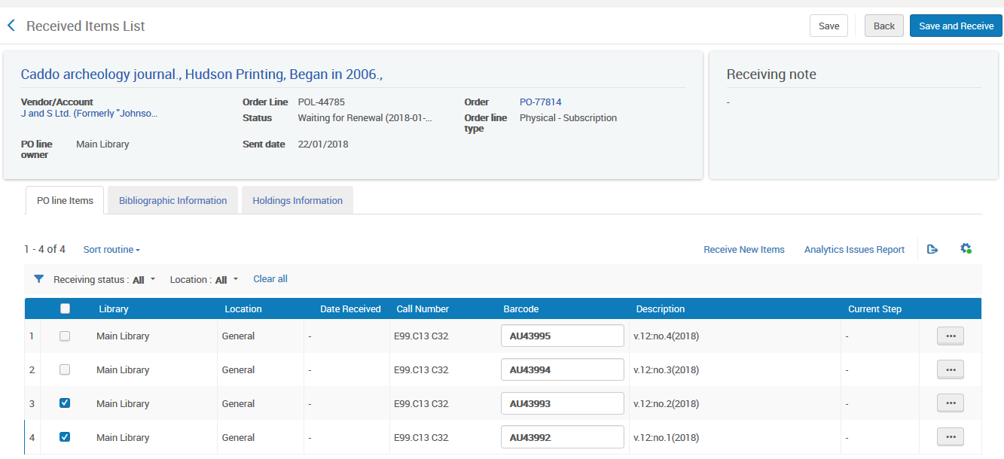
Receiving (check-in)
Notes:
Now we receive the items.
We can click the checkbox(es) on the left and then click “Save and Receive” or we can do “Actions > Receive” per item
We will now receive Volume 12 numbers 1 and 2

Slide 26
Receiving (check-in)
Notes:
The user now sees which items have already arrived and which items have not yet arrived

Slide 27
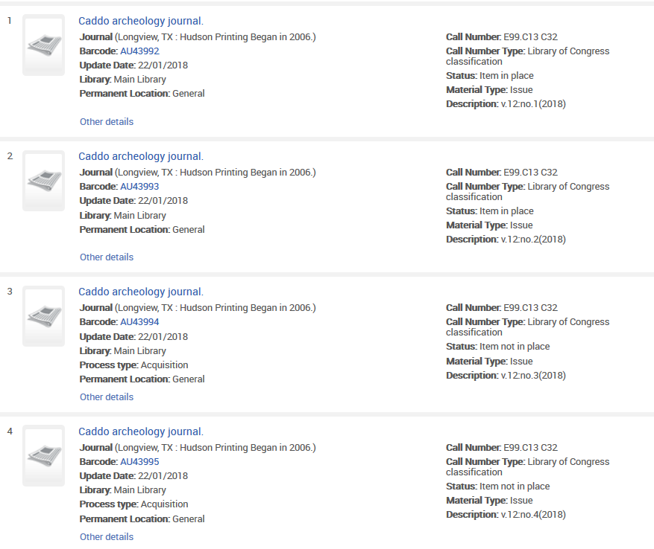
Receiving (check-in)
Notes:
When doing a physical item search we see that Vol. 12 issues 1-2 are in place but issues 3-4 are not in place (not arrived)

Slide 28
Receiving (check-in)
Notes:
When we did “Receive” the items immediately became “in place”. We could have set it up so that the items would have remained in the acquisitions department for further processing until scanning them into the circulation desk.

Slide 29
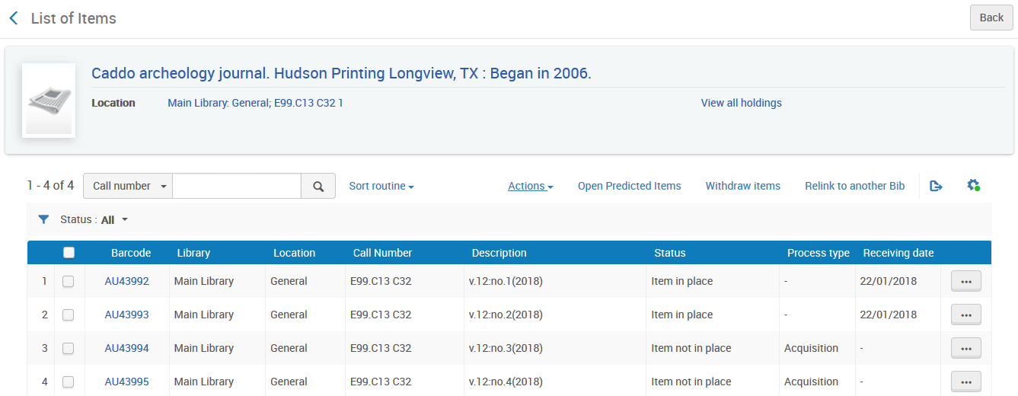
Receiving (check-in)
Notes:
We can also see from the items list what has and has not arrived.
We will click here now to open the next cycle of predicted items

Slide 30
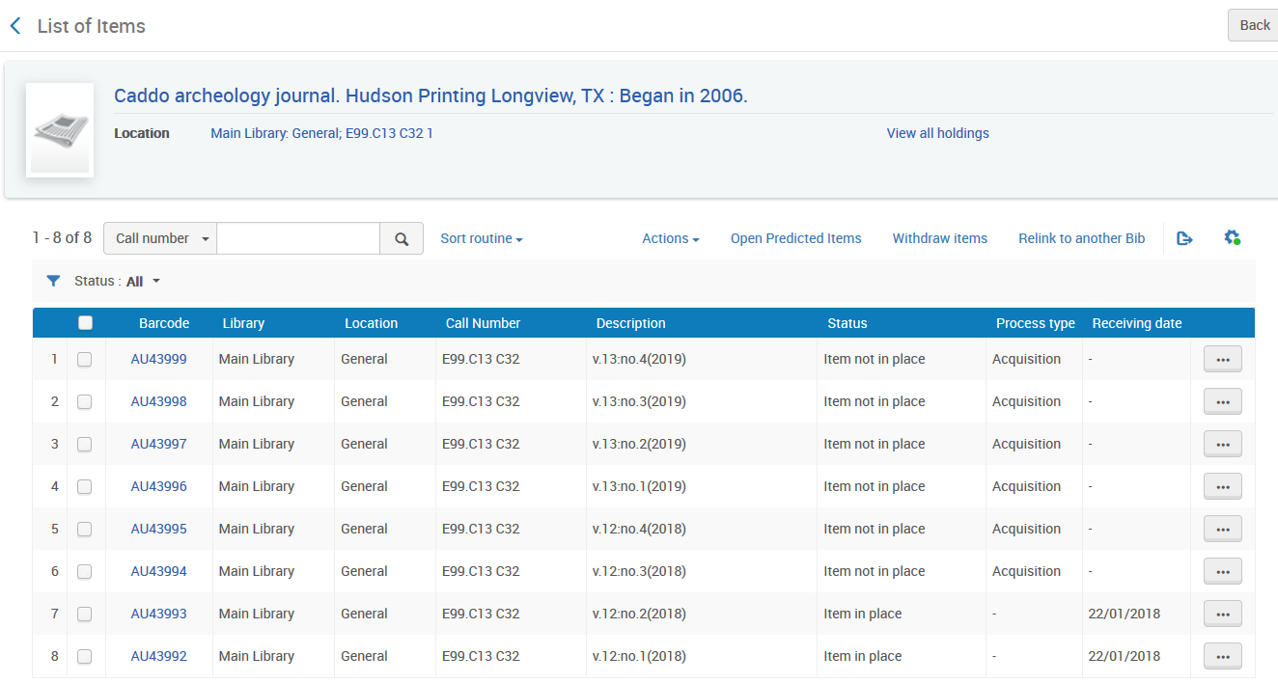
Receiving (check-in)
Notes:
The next cycle

Slide 31
Setting up Prediction Patterns
Opening Predicted Items
Receiving (check-in)
Normalization Tasks for Holdings Records
Summary Holding Example when Prediction Pattern is used
Summary Holding Example without Prediction Pattern

Slide 32
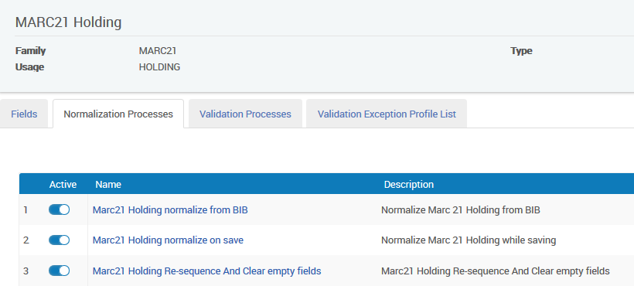
Normalization Tasks for Holdings Records
32
Notes:
By default Alma provides a set of rules which occur when a holdings record is saved.
These may be viewed at Resource Management Configuration Menu > Cataloging > Metadata Configuration > Marc 21 Holding > Normalization > Marc21 Holding normalize on save

Slide 33
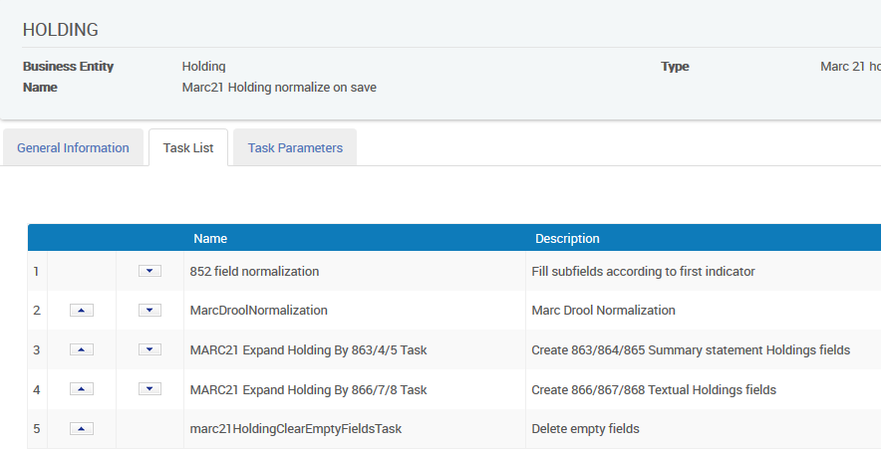
Normalization Tasks for Holdings Records
33
Notes:
In the “Task List” tab which we will show here we can see the following five tasks:
852 field normalization
MarcDroolNormalization
MARC21 Expand Holding By 863/4/5 Task
MARC21 Expand Holding By 866/7/8 Task
marc21HoldingClearEmptyFieldsTask
The order of the tasks in the task list, is very important and it is recommended that these three appear in the following order:
MarcDroolNormalization
MARC21 Expand Holding By 863/4/5 Task
MARC21 Expand Holding By 866/7/8 Task
The order is important because as we will see:
“MarcDroolNormalization” will remove previous 863/4/5/6/7/8 fields before creating new “up-to-date” ones
“MARC21 Expand Holding By 863/4/5 Task” will create the 863/4/5 fields that will subsequently be used by “MARC21 Expand Holding By 866/7/8 Task”
Because “MARC21 Expand Holding By 866/7/8 Task” uses the results of “MARC21 Expand Holding By 863/4/5 Task” it should appear after “MARC21 Expand Holding By 863/4/5 Task”

Slide 34
Normalization Tasks for Holdings Records
rule "delete 863 4 5 6 7 8 if it does not have subfield 8 9" when (TRUE) then removeField "863" if (not exists "866.8.9") removeField "864" if (not exists "867.8.9") removeField "865" if (not exists "868.8.9") removeField "866" if (not exists "866.8.9") removeField "867" if (not exists "867.8.9") removeField "868" if (not exists "868.8.9") end
34
Notes:
In the “Task List” tab which we will show here we can see the following five tasks:
852 field normalization
MarcDroolNormalization
MARC21 Expand Holding By 863/4/5 Task
MARC21 Expand Holding By 866/7/8 Task
marc21HoldingClearEmptyFieldsTask
The order of the tasks in the task list, is very important and it is recommended that these three appear in the following order:
MarcDroolNormalization
MARC21 Expand Holding By 863/4/5 Task
MARC21 Expand Holding By 866/7/8 Task
The order is important because as we will see:
“MarcDroolNormalization” will remove previous 863/4/5/6/7/8 fields before creating new “up-to-date” ones
“MARC21 Expand Holding By 863/4/5 Task” will create the 863/4/5 fields that will subsequently be used by “MARC21 Expand Holding By 866/7/8 Task”
Because “MARC21 Expand Holding By 866/7/8 Task” uses the results of “MARC21 Expand Holding By 863/4/5 Task” it should appear after “MARC21 Expand Holding By 863/4/5 Task”

Slide 35
Connection between item and holdings record
35
Notes:
The MARC21 Expand Holding By 866/7/8 Task procedure will automatically create the 866/867/868 fields.
The 866/867/868 are the ‘Textual Holdings’ fields (arrow)
The 866/867/868 fields are created from the 853/854/855 and 863/864/865 linked fields. (arrow x2)
The 863/864/865 fields will be created from the actual existence of the arrived items.
This will be done for the arrived items which have a link to the 853/4/5 field of the holdings record
If the item is created from a prediction pattern then the link to the 853/4/5 field of the holdings record is made automatically.
If the item is not made from a prediction pattern then item “pattern type” and “linking number” should be updated manually.

Slide 36
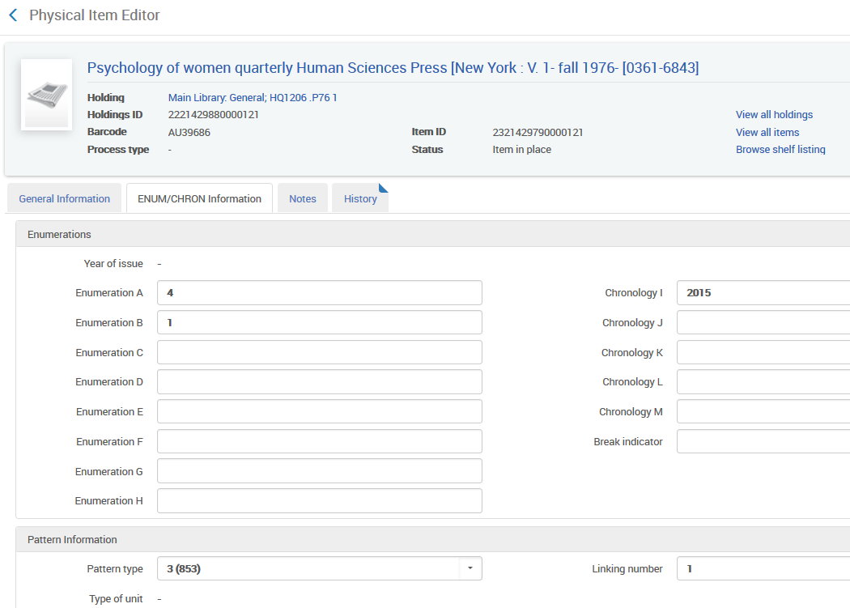
36

Slide 37
37

Slide 38
Setting up Prediction Patterns
Opening Predicted Items
Receiving (check-in)
Normalization Tasks for Holdings Records
Summary Holding Example when Prediction Pattern is used
Summary Holding Example without Prediction Pattern

Slide 39
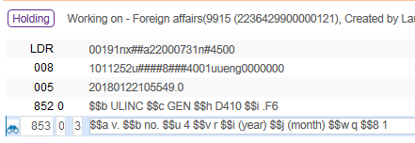
Example when Prediction Pattern is used
In our case we have an acquisitions order (POL-44783) for MMSID 991527300000121 ISBN 0015-7120 which is the “Foreign Affairs” journal.
Inside the holdings record we create a prediction pattern 853 field
39

Slide 40
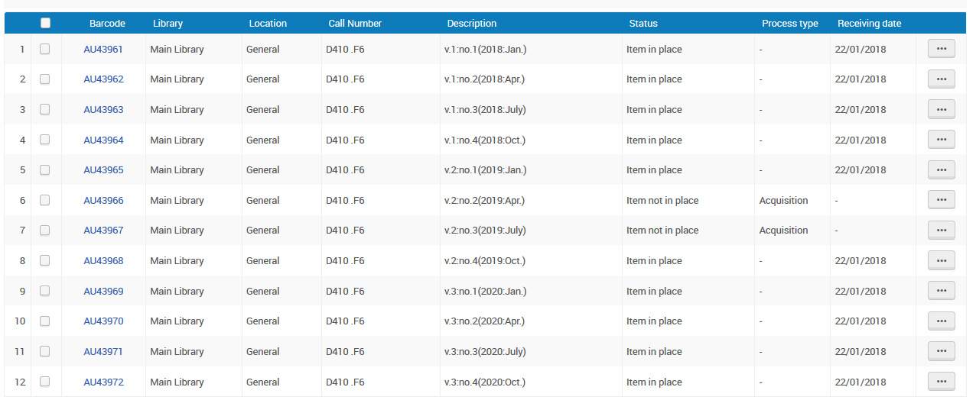
Example when Prediction Pattern is used
40
Notes:
In our specific situation:
Vol. 1 2018 issues 1-4 have all arrived. It is a complete volume.
Vol. 2 2019 issues 1 and 4 have arrived. Issues 2 and 3 are missing. It is not a complete volume.
Vol. 3 2020 issues 1-4 have arrived. It is a complete volume.
So we have 10 issues.
All is complete for Vol. 1-3 except for issues 2 and 3 of Vol. 2 from 2019.
Vol. 2 issues 2-3 missing. They have no receiving date, they are “not in place” and have Process Type “Acquisition”

Slide 41
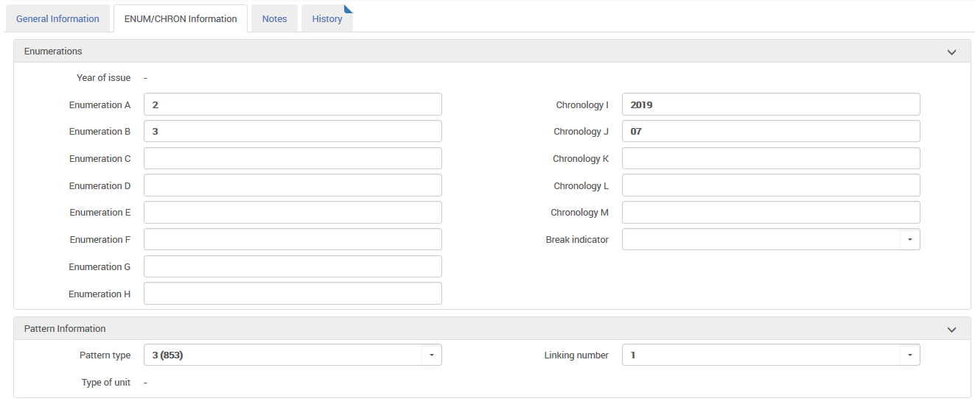
Example when Prediction Pattern is used
41
Notes:
Because we used the prediction pattern to create the items each item is automatically linked to the relevant 85X field of the holdings record

Slide 42
The 863/4/5 and the 866/7/8 tasks
“MARC21 Expand Holding By 863/4/5 Task” creates a 863/4/5 based on the existence and arrival of linked items.
We already saw that we have items linked to the holdings record. The items are Vol. 1-3 issues 1-4 of each volume except for issues 2-3 of volume 2
“MARC21 Expand Holding By 866/7/8 Task” uses the combination of the 853/4/5 and 863/4/5 to create a 866/7/8 summary holdings field
42

Slide 43
The 863/4/5 and the 866/7/8 tasks
Therefore when we save the holdings record we expect that:
“MARC21 Expand Holding By 863/4/5 Task” will look at which items arrived and create an 863/4/5 field from the items
“MARC21 Expand Holding By 866/7/8 Task” create new 866/7/8 fields from a combination of the new 863/4/5 fields created above and the existing 853/4/5 fields.
43

Slide 44
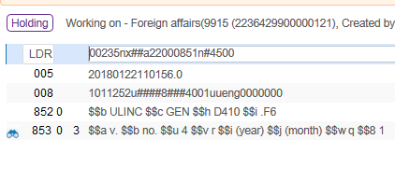
The 863/4/5 and the 866/7/8 tasks
Here is the holdings record before saving
There are no 863/4/5 or 866/7/8 fields
44

Slide 45
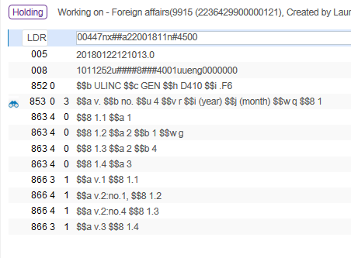
The 863/4/5 and the 866/7/8 tasks
Now we save the holdings record:
These 863 and 866 fields are created automatically!
45

Slide 46
The 863/4/5 and the 866/7/8 tasks
created from MARC21 Expand Holding By 863/4/5 Task after saving record
created from the 863 fields via the MARC21 Expand Holding By 866/7/8 Task after saving record
46

Slide 47
Vol. 1 complete
Vol. 2 issue 1 with gap after it subfield w with “g”
Vol. 2 issue 4
Vol. 3 complete
47
Notes:
First the 863 fields were created from the actual physical items.
Alma saw which items existed and were linked to the holdings record and made relevant 863 fields

Slide 48
Vol. 1 complete
Vol. 2 issue 1
Vol. 2 issue 4
Vol. 3 complete
48
Notes:
Next the 866 fields are created from the 863 fields. The 853 field was also used, for example to know to put “v.” as prefix to volume and “no.” as prefix to issue

Slide 49
Recreating the 863/4/5 and the 866/7/8 fields

Slide 50
Recreating the 863/4/5 and the 866/7/8 fields
Every time a record is saved a new 863/4/5 will be created (if “Marc21 Holding normalize on save” process has “MARC21 Expand Holding By 866/7/8 Task” )
But, we really do not want multiple 863/4/5 fields. We want just one per set of issues which have no gap.
We want the existing 866/7/8 fields to be removed when we save a record so that new ones can be built according to the up-to-date new 863/4/5 fields.
Therefore we make a normalization rule which will first delete the existing 863/4/5/6/7/8 fields.
50

Slide 51
Recreating the 863/4/5 and the 866/7/8 fields
Here is a sample rule. We do not however delete all 863/4/5/6/7/8/9. We delete only those without a 9 in subfield 8 because we may have “local” 86X fields
rule "delete 863 4 5 6 7 8 if it does not have subfield 8 9"
when
(TRUE)
then
removeField "863" if (not exists "866.8.9")
removeField "864" if (not exists "867.8.9")
removeField "865" if (not exists "868.8.9")
removeField "866" if (not exists "866.8.9")
removeField "867" if (not exists "867.8.9")
removeField "868" if (not exists "868.8.9")
end
This will prevent local fields from getting deleted
51

Slide 52
52
Notes:
The rule (which we called “delete 863 4 5 6 7 8 if it does not have subfield 8 9”) is then added to the “Marc21 Holding normalize on save”.

Slide 53
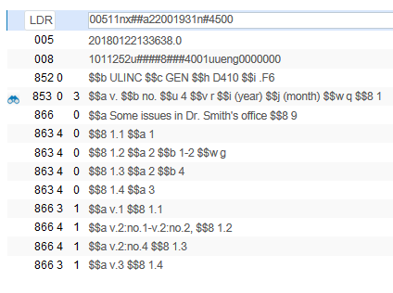
Recreating the 863/4/5 and the 866/7/8 fields
53
Notes:
We still have the local 866 (b/c our rule said if there is a 866 with subfield $8 9 don’t delete
863 For Vol. 2 is updated to now have issue 2 noted, see that the gap remains b/c we are still missing issue 3
866 was created to show we have vol 2 issues 1-2

Slide 54
Now, for example, Vol. 2 issue 2 arrives
54
Notes:
Remember we had a gap!

Slide 55
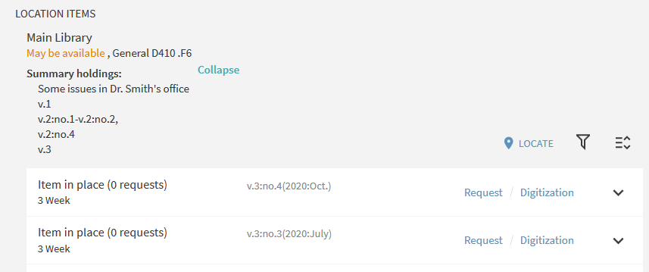
Viewing the summary holding in Primo
55
Notes:
When the end user views the record in Primo he now does not need to scroll through what can often be a long list of items to see if the item(s) he needs are present.
He can instead view the summary holdings record in the GetIt tab
The actual display of the 866/7/8 field in Primo depends on local customizations and thus differs from library to library

Slide 56
What happens if you aren’t using prediction patterns?

Slide 57
The example when not using a prediction pattern
Serial “Thoreau journal quarterly”.
It has no acquisitions order or prediction pattern
It has a holding record with an 853 as follows:
57

Slide 58
The example here not using a prediction pattern
We can still use the summary task previously show as long as these 3 requirements are met:
A receiving date
Pattern type
Linking number
58

Slide 59
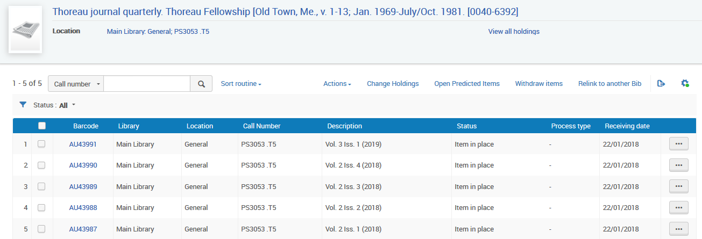
The example here not using a prediction pattern
59
Notes:
Vol 2 issues 1-4
Vol 3 issue 1
Are all received

Slide 60
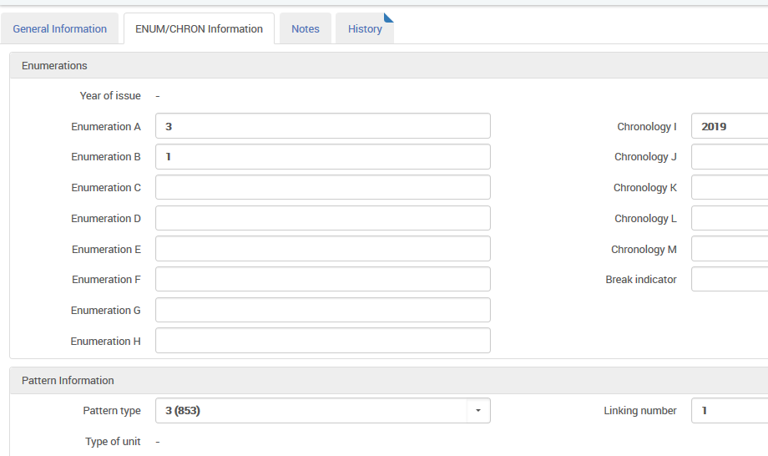
The example here not using a prediction pattern
60
Notes:
#2 – we have a pattern type
#3 – we have a linking number
And they match with the 853 field of the holding record

Slide 61
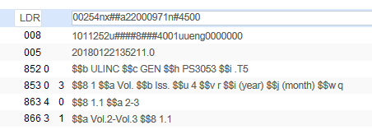
The example here not using a prediction pattern
When the holding record is saved the 863 and 866 is automatically created
61

Slide 62
Viewing the summary holding in Primo
62

Slide 63
Callie.mendoza@exlibrisgroup.com

Slide 64
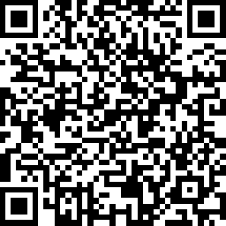
We value your feedback! Please complete the session survey in the schedule section of the app.

