Slide 1
Advanced Analytics – Fulfillment
Connie Braun and Dominic Doneux

Slide 2
First Steps
Add a sub-folder in your institutional folder to hold the analyses we will create
If more than one person from your institution is participating in today’s training, determine a naming convention (e.g. initials or name to start each saved analysis name)

Slide 3
Loans Overdue Between Seven and 14 Days
Loans and Renewals Snapshot
Patrons with Active Blocks and Without Fines or Fees
Fines and Fees Aging Report

Slide 4
All Loans that are Overdue by Seven or More Days

Slide 5
Introduction
Looking to create an analysis that shows all items overdue between seven and 14 days
Should be a “rolling” interval, so always looking at reasonably current information

Slide 6
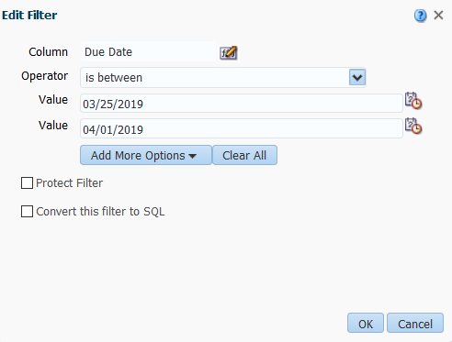
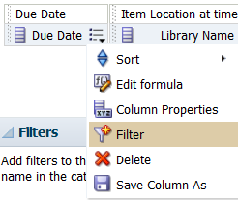
Add Columns and Initial Filter for Due Date

Slide 7
What the Analysis Looks Like

Slide 8
View the Results

Slide 9
Loans Overdue Between Seven and 14 Days
Save the Analysis!

Slide 10
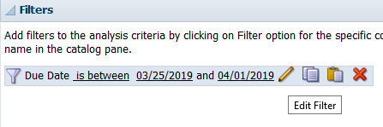
Edit the Filter for Due Date

Slide 11
More on Filter for Due Date
"Due Date"."Due Date" BETWEEN TIMESTAMPADD(SQL_TSI_DAY, -14, CURRENT_DATE) AND TIMESTAMPADD(SQL_TSI_DAY, -7, CURRENT_DATE)

Slide 12
How the Analysis Looks Now

Slide 13
View the Results

Slide 14
Loans Overdue Between Seven and 14 Days
Save the Analysis!

Slide 15
Loans Overdue Between Seven and 14 Days
What else might be useful in this analysis?

Slide 16
Loans and Renewals Snapshot

Slide 17
Introduction
We want to create a “snapshot” report showing how many loans and renewals there were during a specific period of time
We want to count the loans and renewals separately
We want to be able to easily update this report with different periods of time

Slide 18
Introduction
To measure loans and renewals separately we will use the FILTER function instead of filters
To make the report easy to update we will use a prompt and presentation variables
But first, why is this not possible with regular filters?

Slide 19
A First Attempt With Filters

Slide 20
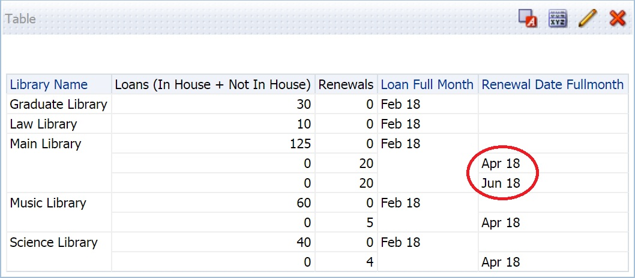
A First Attempt With Filters
Renewals after Feb 18 are being counted
Renewals for items loaned before Feb 18 are not being counted

Slide 21
A First Attempt With Filters

Slide 22
A First Attempt With Filters
Only returns items loaned AND renewed in a single month

Slide 23
A First Attempt With Filters

Slide 24
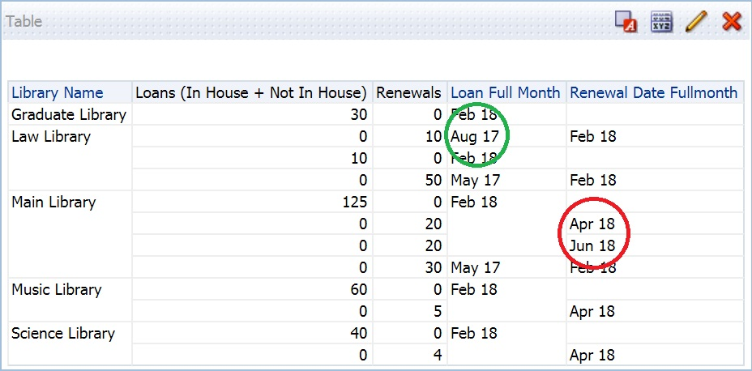
A First Attempt With Filters
Renewals for items loaned before Feb 18 are being counted
Renewals after February 18 still counted

Slide 25
Loans and Renewals Snapshot
Save the Analysis!

Slide 26
Replacing Filters with FILTER Function

Slide 27
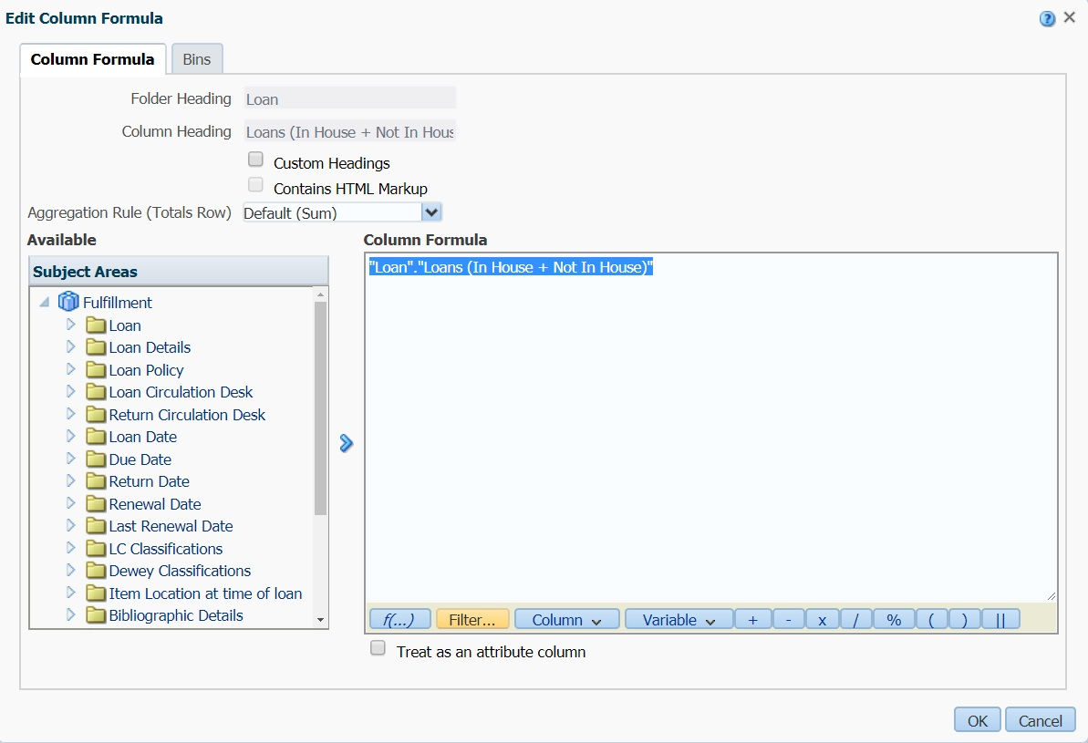
Replacing Filters with FILTER Function

Slide 28
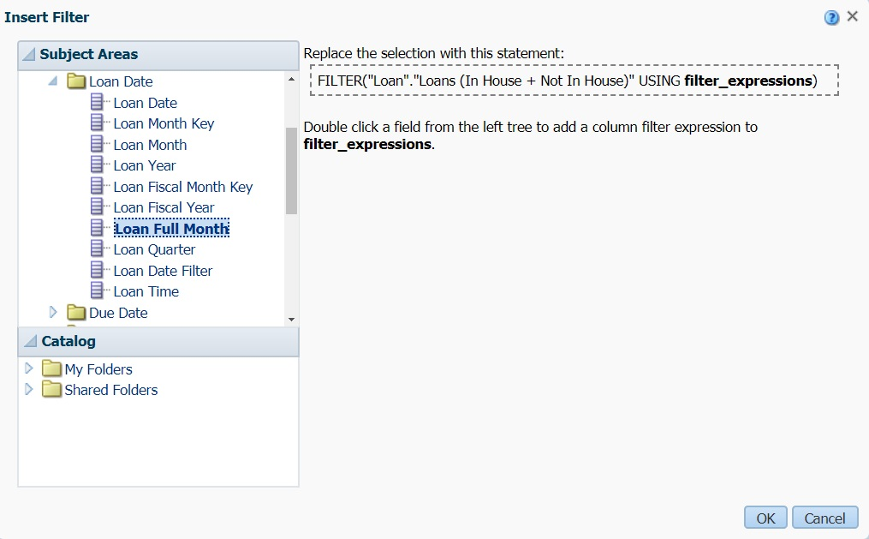
Replacing Filters with FILTER Function
Double Click

Slide 29
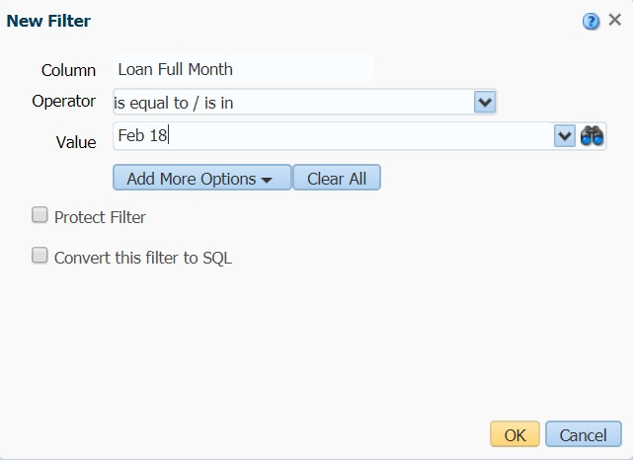
Replacing Filters with FILTER Function

Slide 30
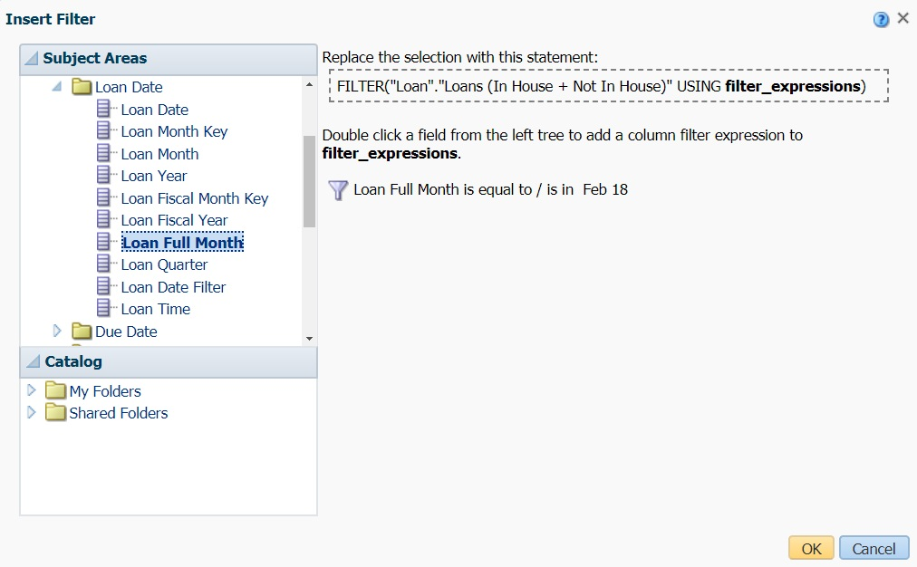
Replacing Filters with FILTER Function

Slide 31
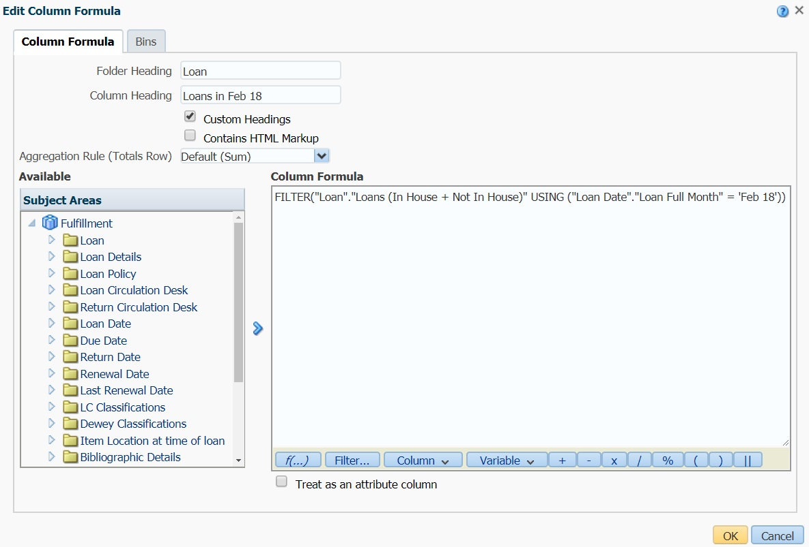
Replacing Filters with FILTER Function

Slide 32
Replacing Filters with FILTER Function

Slide 33
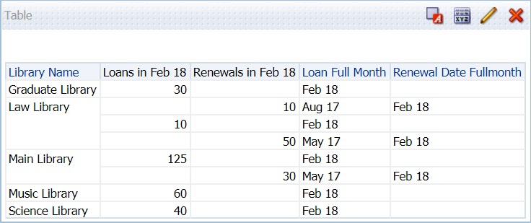
Replacing Filters with FILTER Function
Only loans or renewals that occurred in February 2018 counted!

Slide 34
Loans and Renewals Snapshot
Save the Analysis!

Slide 35
Using Presentation Variables
What if we want to choose another time period?
Our report has two fields, two custom column headers and two filters to update…
Using presentation variables and a prompt we can change the time period in one step!

Slide 36
Using Presentation Variables

Slide 37
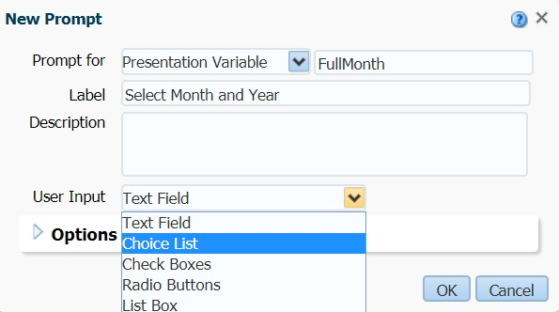
Using Presentation Variables

Slide 38
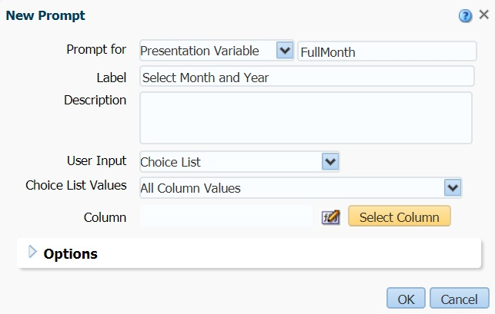
Using Presentation Variables

Slide 39
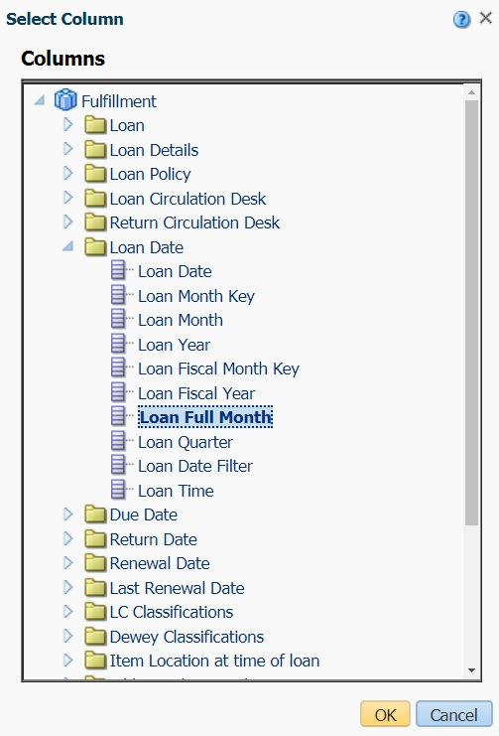
Using Presentation Variables

Slide 40
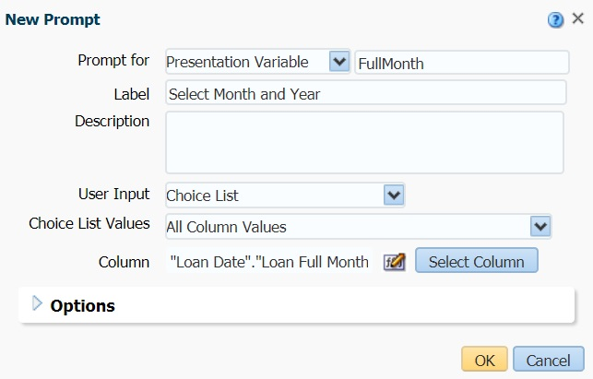
Using Presentation Variables

Slide 41
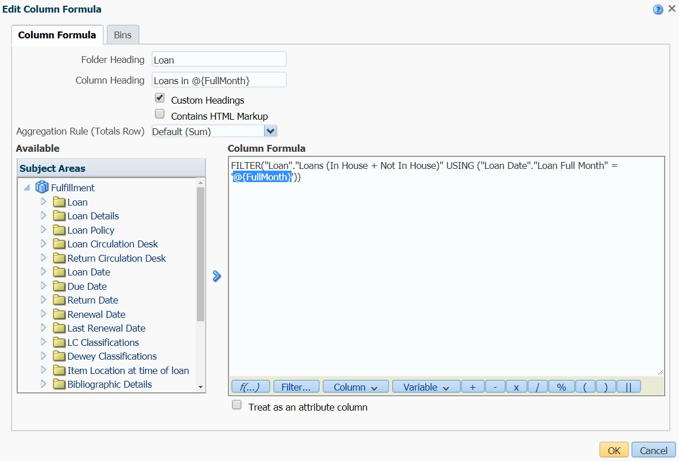
Using Presentation Variables
Replace all instances of “Feb 18” with @{FullMonth}

Slide 42
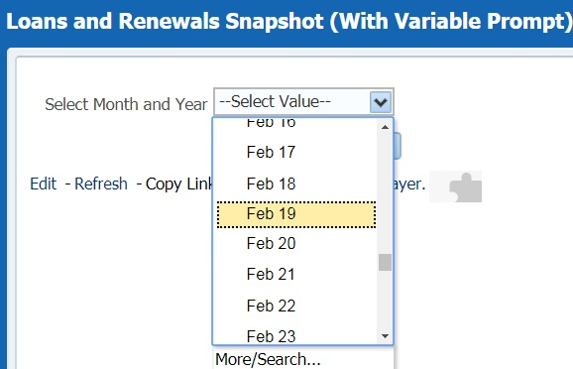
Using Presentation Variables

Slide 43
Using Presentation Variables
With one prompt we updated two fields, two column headers and two filters at once!

Slide 44
Loans and Renewals Snapshot
Save the Analysis!

Slide 45
Patrons with Active Blocks and Without Fines or Fees

Slide 46
Introduction
Want to identify patrons that are actively blocked from using the library for reasons other than fines or fees
Should include Last and First Name, Primary Identifier, Block Status and proof that there is no cash balance
This analysis uses two queries, the primary analysis retrieving data from the sub-query

Slide 47
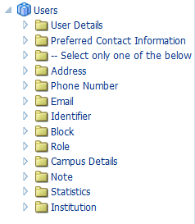
Users Subject Area

Slide 48
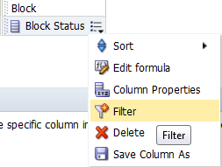
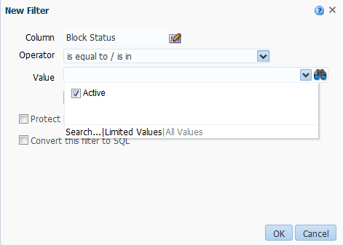
Adding a Filter to the Block Status Column

Slide 49
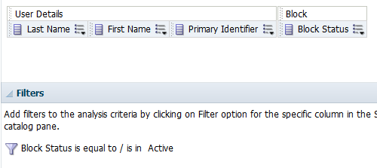
Here is Our Analysis

Slide 50
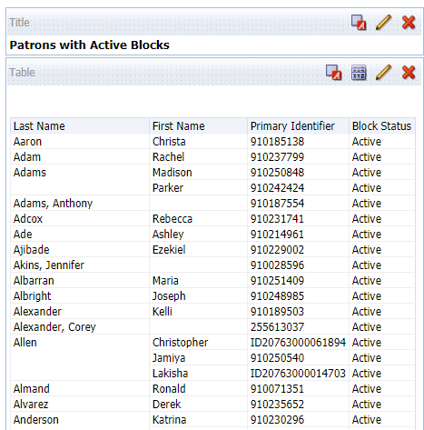
View the Results

Slide 51
Patrons with Active Blocks
Save the Analysis!

Slide 52
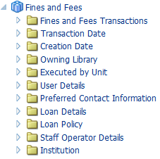
Fines and Fees Subject Area

Slide 53
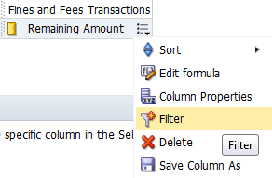
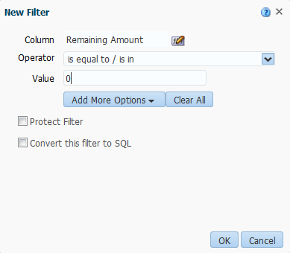
Apply a Filter to the Remaining Amount Column

Slide 54
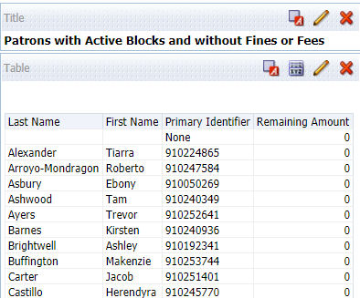
View the Results

Slide 55
Patrons with Active Blocks
Save the Analysis!

Slide 56
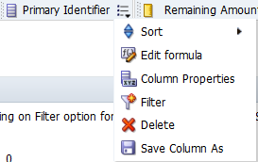
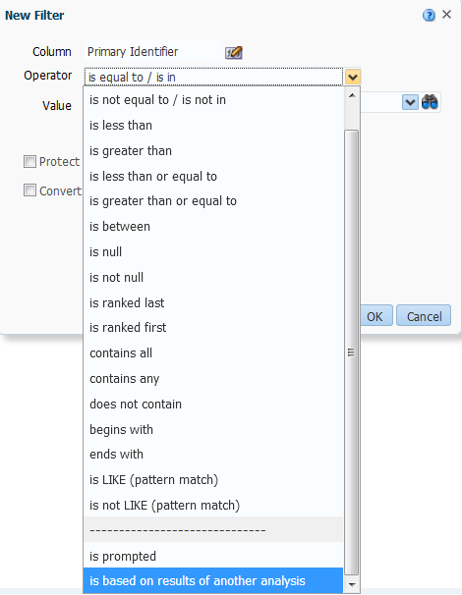
Apply Another Filter, Primary Identifier Column

Slide 57
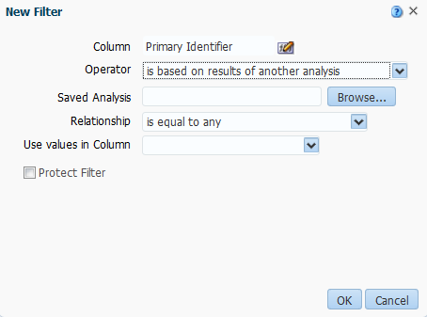
Click on the Browse Button…

Slide 58
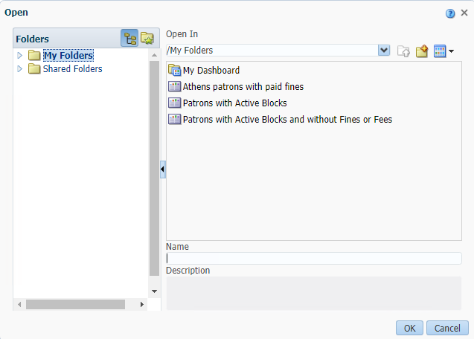
…and Navigate to the First Analysis We Created

Slide 59
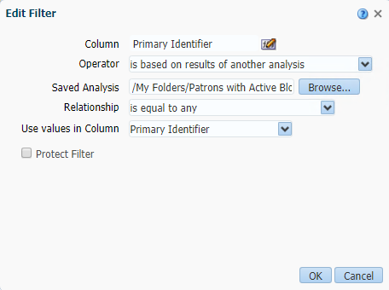
See the Path to the Other Analysis

Slide 60
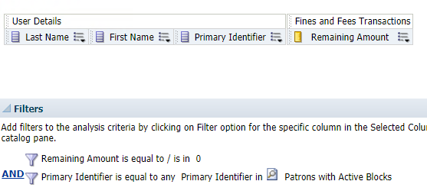
Review the Criteria

Slide 61
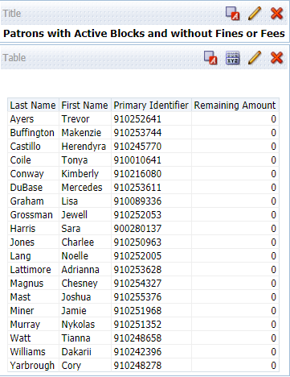
View the Results

Slide 62
Patrons with Active Blocks
Save the Analysis!

Slide 63
Fines and Fees Aging Report

Slide 64
Introduction
Looking for a report that shows aging of fines and fees in defined numbers of days
We tried adding an Advanced SQL filter and received errors
What do we do?

Slide 65
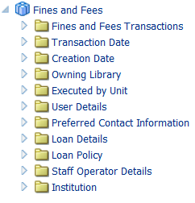
Fines and Fees Subject Area

Slide 66
Fines and Fees Aging
Save the Analysis!

Slide 67
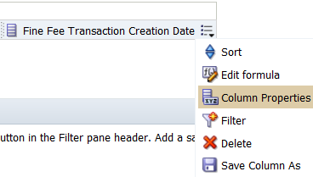
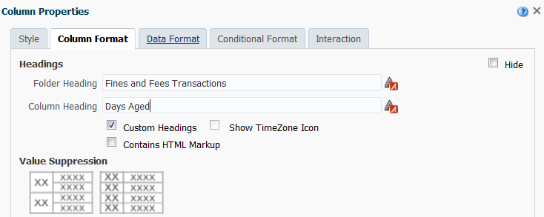
Modify the Column Heading

Slide 68
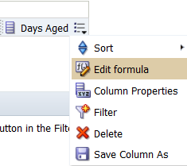
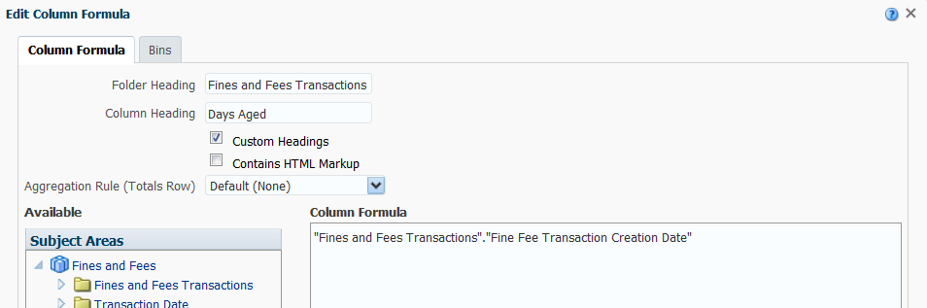
Edit the Formula for Fine Fee Transaction Creation Date

Slide 69
Change the Column Formula Statement

Slide 70
Fines and Fees Aging
Save the Analysis!

Slide 71
Edit the Formula Again, Going to Bins Tab

Slide 72
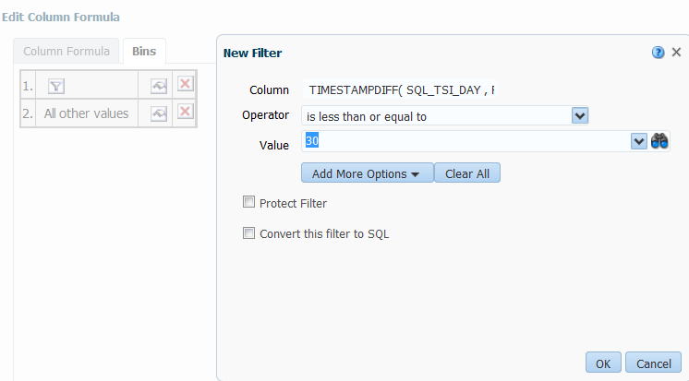
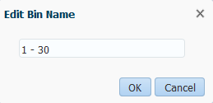
Add Bins

Slide 73
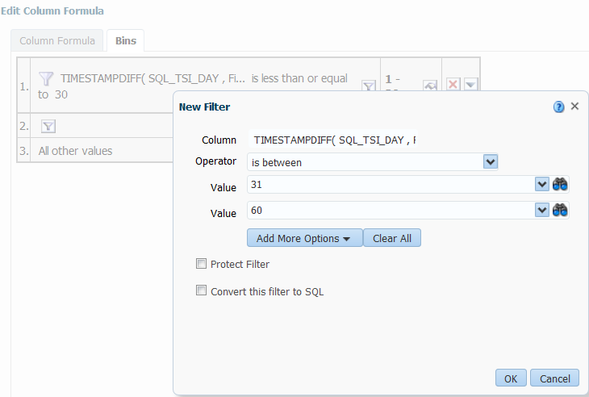
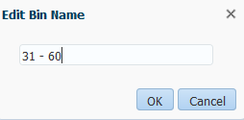
Add Bins

Slide 74
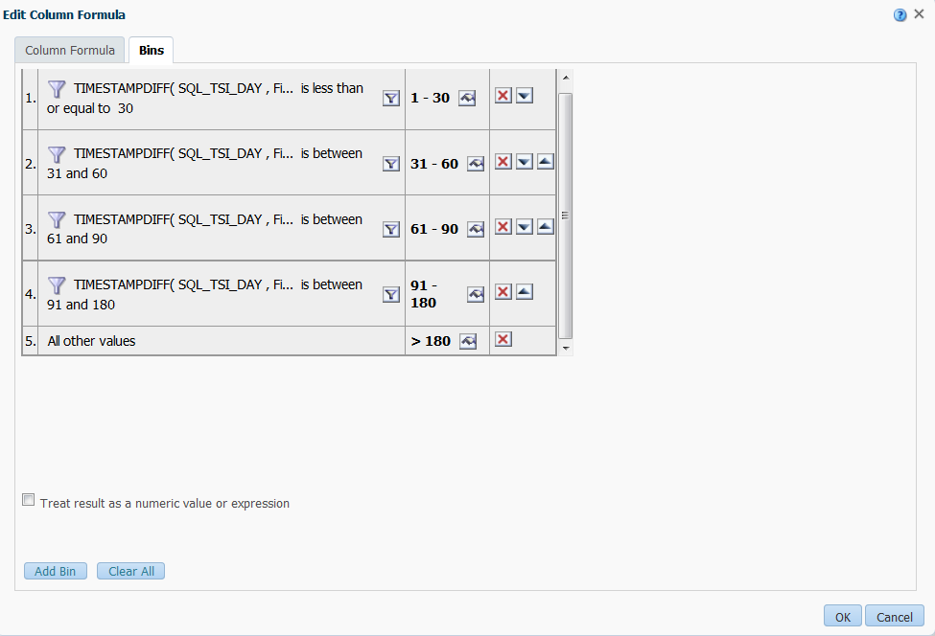
Bins Added

Slide 75
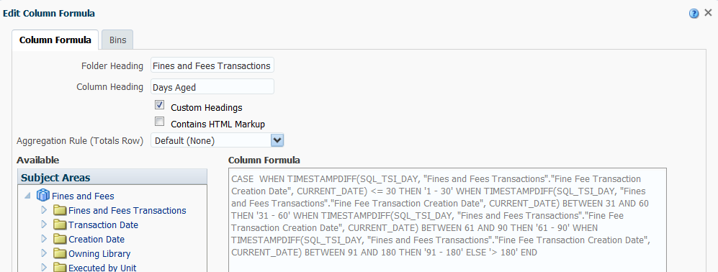
Return to Column Formula Tab to See Update

Slide 76
Fines and Fees Aging
Save the Analysis!

Slide 77
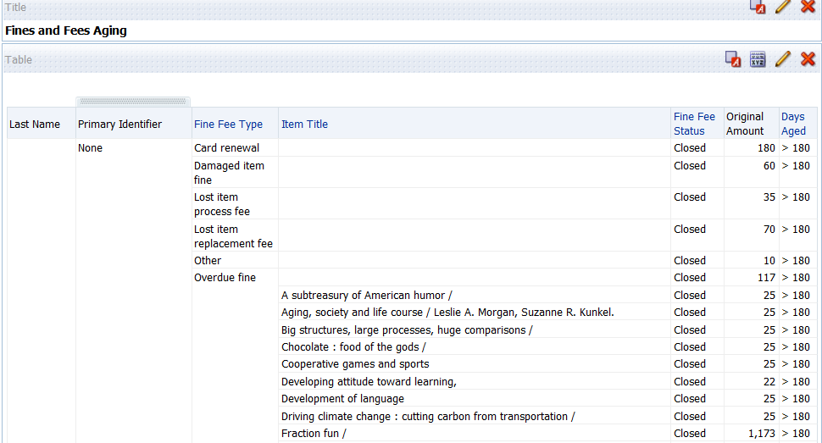
View the Results

Slide 78
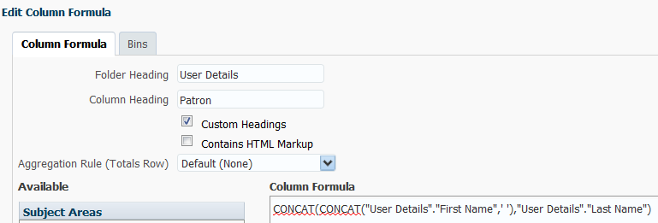
Concatenate Names
CONCAT(CONCAT("User Details"."First Name",' '),"User Details"."Last Name")

Slide 79
Fines and Fees Aging
Save the Analysis!

Slide 80
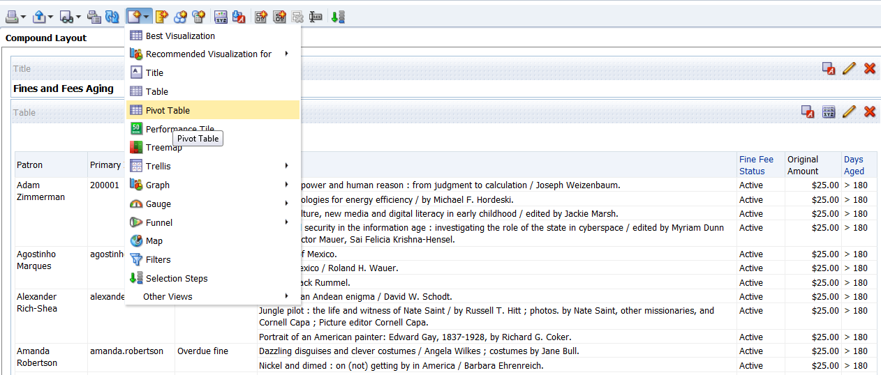
View the Results and Add a Pivot Table View

Slide 81
Pivot Table View

Slide 82
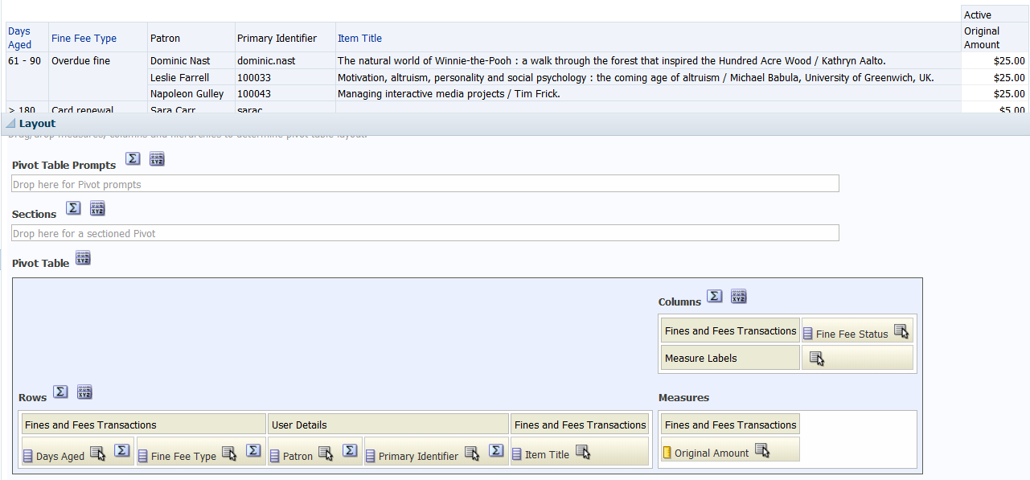
Move Columns
Move the Fine Fee Status column from Columns to Rows. Move the Days Aged from Rows to Columns.

Slide 83
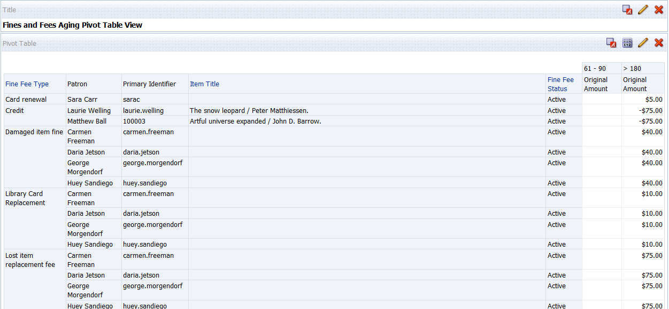
View the Results

Slide 84
Fines and Fees Aging
Save the Analysis!

Slide 85
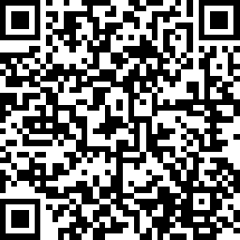
We value your feedback! Please complete the session survey in the schedule section of the app.

Slide 86
Thank you!

