Slide 1
Display Configuration in Primo VE
Clarice Shin
Vladimir Bludyrev

Slide 2
Introduction
Vlad
  Senior Technical Support Analyst
  Cross-product specialist (Primo and SFX)
  MLIS (Simmons College)
Clarice
  Joined Ex Libris in 2017
  Primo and Primo VE
  MLIS (University of Illinois Urbana Champaign)

Slide 3
Session Description
Introduction to Display Configuration:
Views
Search Profiles and Search Results
Brief and Full Display
Resource Types
Notes:
Question for the Audience:
Who has worked with non Primo VE , Primo? This presentation is geared more towards users who have never used Primo previously. This will also useful for people who would like to see the differences between Primo and Primo Ve.
In this session we will introduce you how to configure Display in Primo VE. The definition of Display will be narrow, not UI customization. We will be talking about the configuration about the view from start to finish.
Go through list!!

Slide 4
Objectives
By the end of this session you will :
Learn how to add a View in Primo VE
Understand the relationship between Back Office and Front End display
Learn how to configure Brief and Full Display
Learn how to add custom Resource Types
Notes:
By the end of this session, you will be familiar what is a view and how to add a new view. You will understand changes in the back office and how that affects the front end. You will also learn how to configure all aspects of a view, including search results, brief/full display. At the end will talk about how to add custom resource types

Slide 5
Adding a View
Search Profiles and Results
Brief Display Configuration
Full Record Display Configuration
Custom Resource Types
Notes:
First we will dive into adding a view, we will be sending a good amount of time on adding a view. We will be discussing Search Profile and Results and Brief Display Configuration. We will go into more depth for the Full Record Display Configuration for an extended amount of time. We will also touch upon Custom Resource Types.

Slide 6
Adding a View

Slide 7
Views
What End Users see in Discovery UI
Based on Institution / Campus / Library / User Group
Changes can be tested immideately
Assigned Role: Discovery - Admin
Notes:
What is a View?
A View is everything that your end user will see in your discovery interface. This is what your users will see coming from your library home page, google scholar, or a third party source.
A view is considered to be everything that the end user sees when the access the Primo search page. The view is not limited to just the limited to the look and feel (branding) but all of the search behaviors, search results behaviors, and the way that records appear in the search results.
A view can be restricted to different entities in Alma, institution, campus, user groups etc. whatever definitions you would like to use to group your users. One of the advantages to Primo Ve, you can view your changes immediately. You can add test views even in your Production environment if you would like to test a quick change, or would like to see what a configuration change would look like. As long as your have the role of Discovery –Admin in your Role Assignment

Slide 8
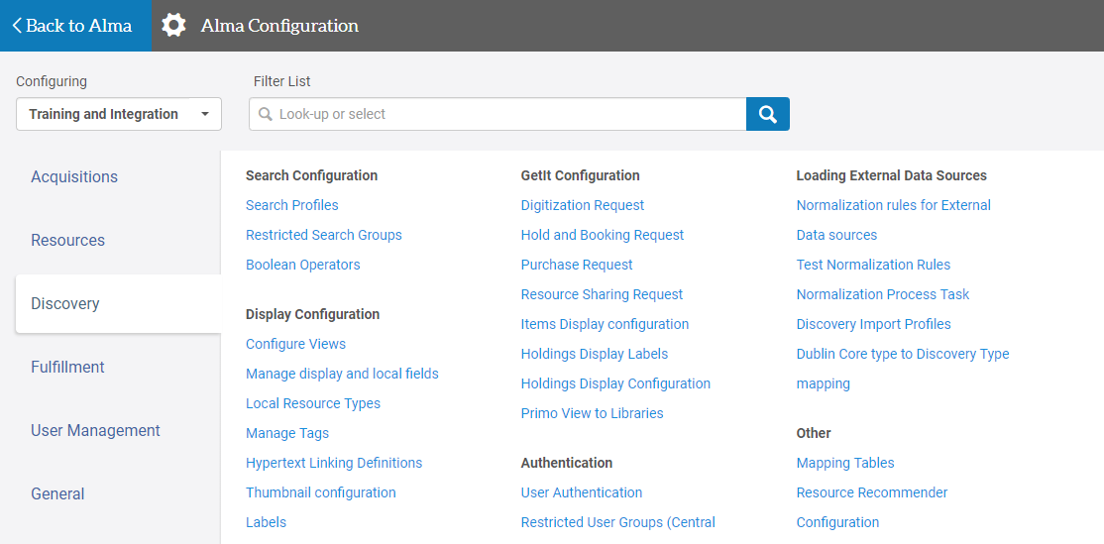
Views

Slide 9
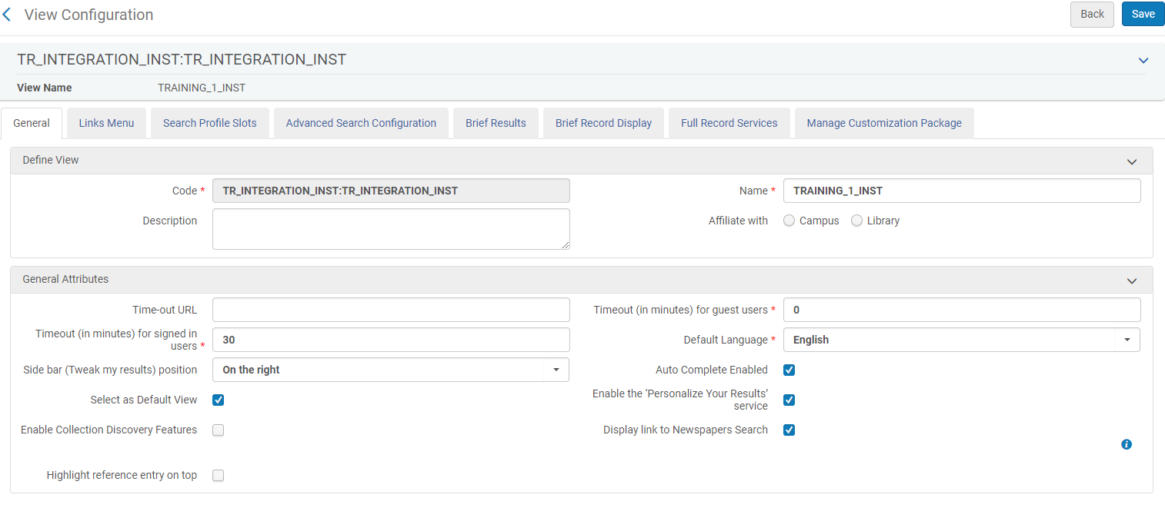
Views
Alma Configuration > Discovery > Display Configuration > Configure Views > General
Notes:
Code: in URL
We will be starting with the General Tab. Here you will create the name and code for your specific view. The code will be in your Primo VE url. In the URL it will be vid = code. So in this case it will be vid = example.
In the general tab, this is also where you can configure your timeout settings, like the url and time limit in minutes for signed in and guest users. I would like to point out the side bar, the default is on the right but we have noticed that people prefer the side bar to be on the left. We will be touching on the side bar later in the presentation when talking about facets.
I would like to point out “Highlight reference entry on top” setting. This is a newer feature in a previous release. When selected, your view will display a short topic overview which comes from a Primo Central collection that you have activated. Currently the only Primo Central collections that are being used are, Credo, Encyclopedia Britannica, Gale Virtual Reference Library, Worldbook, Netadvance, and Wikipedia.

Slide 10
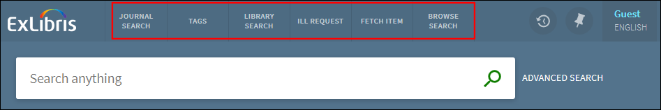
Views: Links Menu
Six default links:
More links can be added and reordered – no limit
Notes:
The next tab is the links menu. The links menu controls the links menu on the top of your Primo VE banner. Typically there are 6 links on the top banner, it depends on the width of your browser. There can be possibly be more, but if you continue to add custom links then the rest of the links will be hidden by an ellipse symbol. There is no limit otherwise as to how many links can be added.
The screen shots above shows the links that are predefined by Primo VE by default.

Slide 11
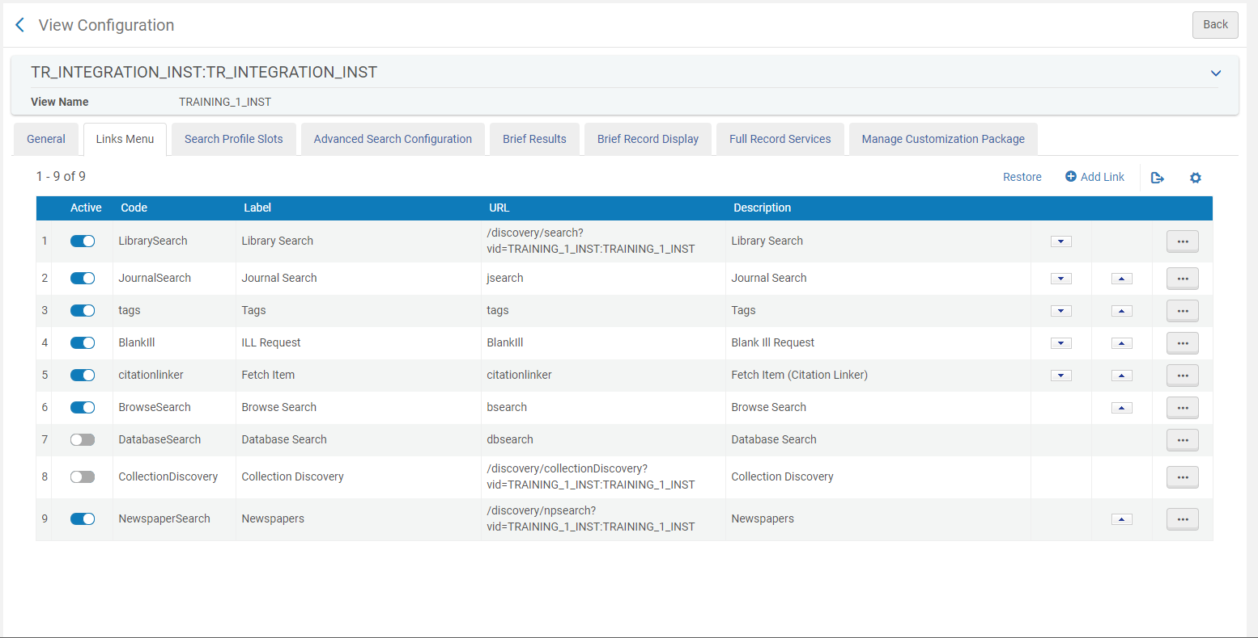

Views: Links Menu
Alma Configuration > Discovery > Display Configuration > Configure Views> Links
Notes:
Main Menu Link up top
Deactivate Links
Add your own Links
Links to your library website
Libguides

Slide 12
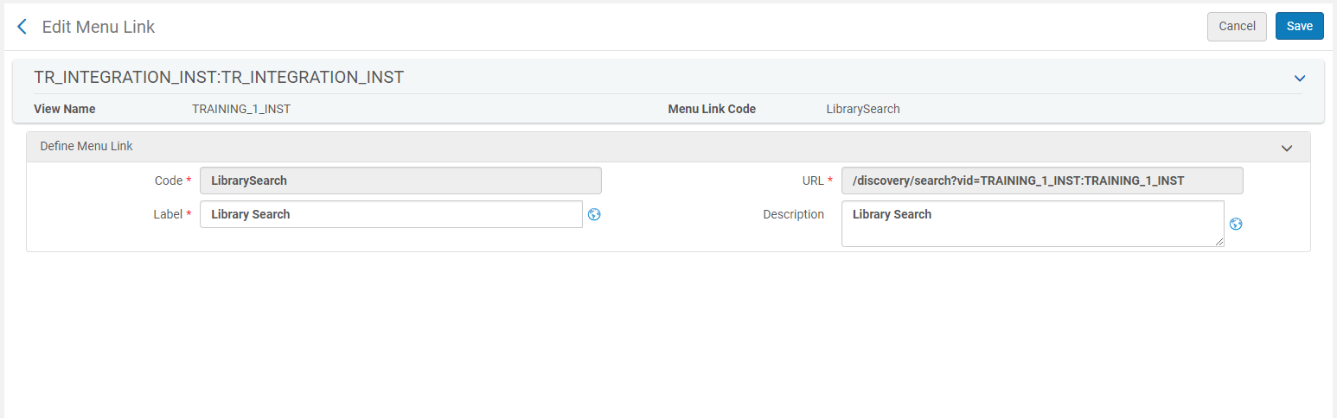
Views: Editing Links
Alma Configuration > Discovery > Display Configuration > Configure Views> Links
Notes:
Here is the screen when you click on the edit.
This is where you want to change the code or the label and URL
OTB options will have a unique url like you see in this example, however custom ones can be added as well like a specific link to your libguides or your own a-z journal list.
OTB links will stay on the same page and Custom ones will open into a separate page

Slide 13
Search Profiles

Slide 14
Views: Search Profiles Slots
Groups of Records = Scopes
Configuration Menu > Discovery > Search Configuration > Search Profiles
Can be locally added and customized
Documentation on Search Profiles and Scopes
Notes:
Further information on how to configure what goes inside the search profile slots
We are going to move on to the next tab, which is configuring search profiles. Search Profiles are configured to search previously defined groups of records which are called scopes. Scopes are configured in Discovery > Search Configuration > Search Profiles. We will not be discussing on how to configure search scopes in this presesntation but we have added a link to the documentation which will explain the process further.

Slide 15
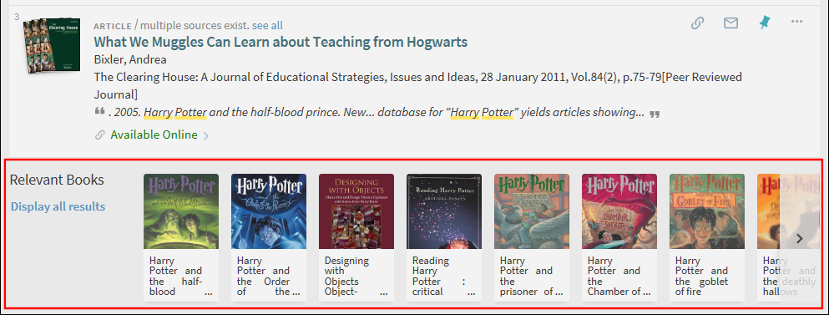
Views: Search Profiles
Types of Profiles: Local Data, Central Index, Blended, Other.
Featured Results: supplemental results from a different profile – horizontal scrollbar
Notes:
Further information on how to configure what goes inside the search profile slots
The enabled featured results is an option at the bottom of your search profile configuration page. It presents a list of relevant results from a different search profile. If a user a searching local data, in the featured results bar you can see results from your Primo Central scope or vice versa.

Slide 16
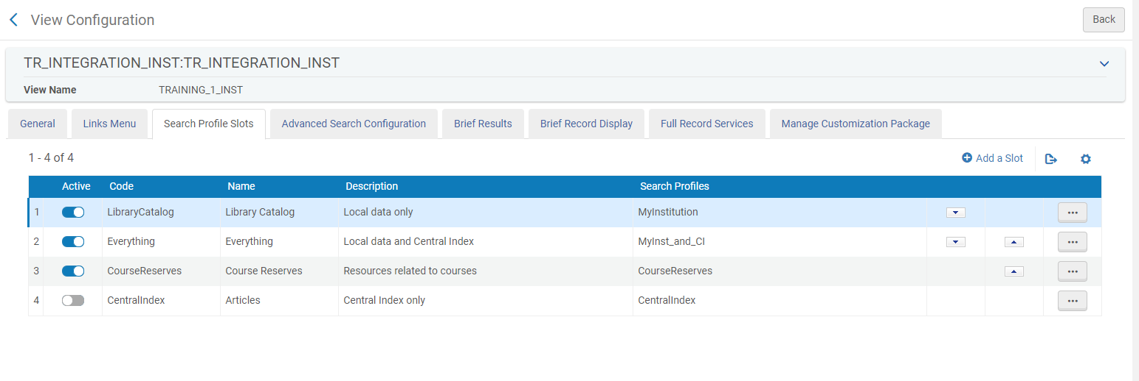
Views: Search Profile Slots
Alma Configuration > Discovery > Display Configuration > Configure Views> Search Profile Slots
Notes:
Search Scopes in Front End
Search profiles slots tab included the search profiles that were already defined or new ones that you have created. Typically OTB profiles that may have been created during your implementation are searching your… examples.

Slide 17
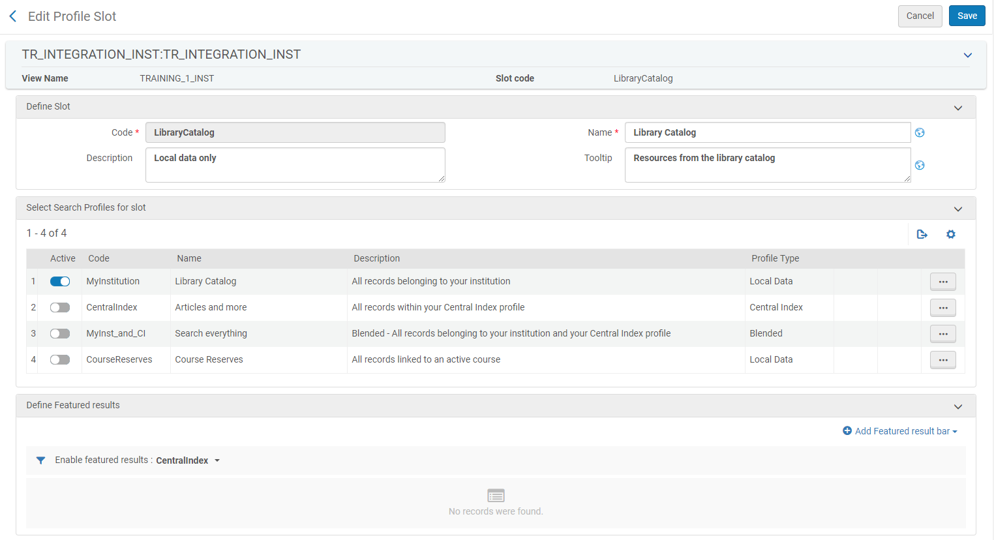

Views: Edit Search Profile Slots
Notes:
Editing for the search profiles are search configuration
When clicking the edit, you can choose which scopes are active for the slots. You cannot edit what is inside the search scope only what is inside the slot.

Slide 18
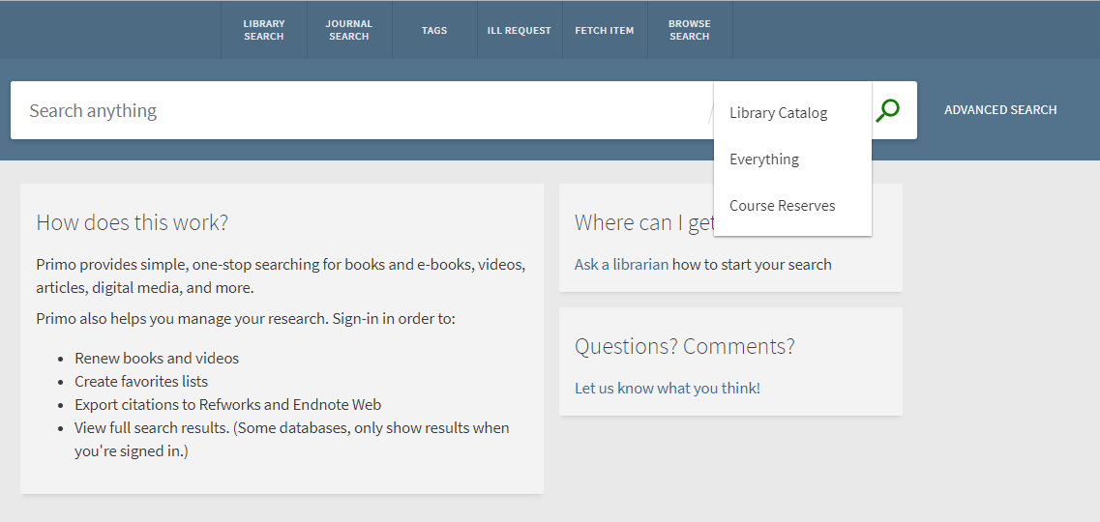
Search Profile Slots

Slide 19
Views: Advanced Search
Indexes - Search Field list
Resource Types – Material Type list
Languages – Language list
Can be added to existing search slots
ALL = all search slots
ALL_NOT_CR = all except course reserves
Notes:
Advanced Search is the next tab in your view configuration menu. There are 3 main sections that you can configure – Indexes, Resource Types, and Languages. You can create the same type of configuration for all of your search slots, specific slots, or all except course reserves

Slide 20
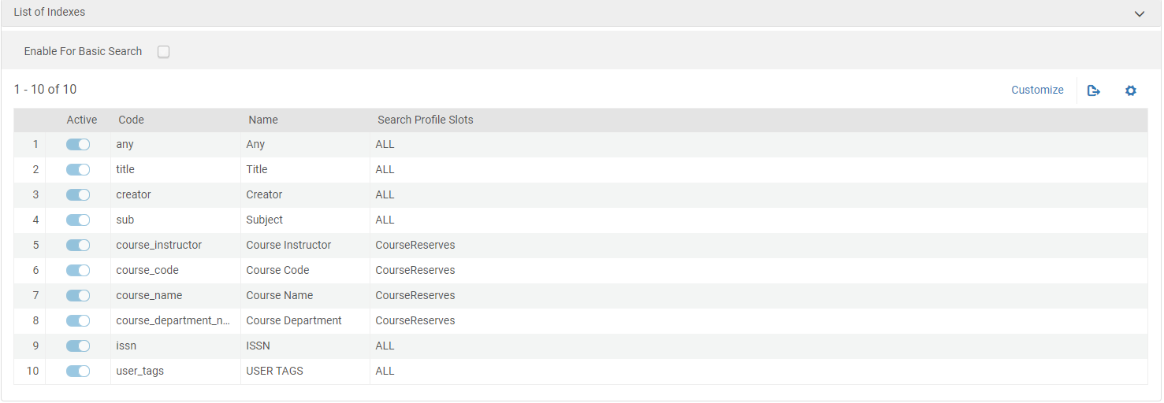
Views: Advanced Search Indexes
Alma Configuration > Discovery > Display Configuration > Configure Views>
Advanced Search Configuration
Notes:
Indexes are search fields that you can add to the Advanced Search options - they are predefined in a drop-down list. Indexes are searchable fields in a record that have been Normalized by sets of Norm Rules either for external data, Alma data, or Primo Central data.

Slide 21
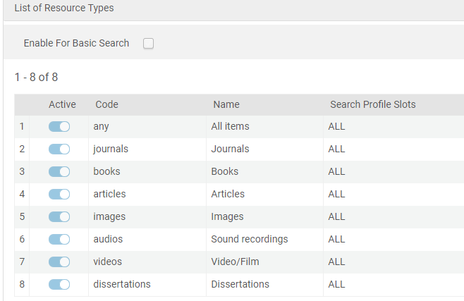
Views: Advanced Search Resource types
Alma Configuration > Discovery > Display Configuration > Configure Views>
Advanced Search Configuration
Notes:
The basic concept for indexes also applies to resource types. Resource types can appear as Facets in your search results, and are also determined by Normalization rules.

Slide 22
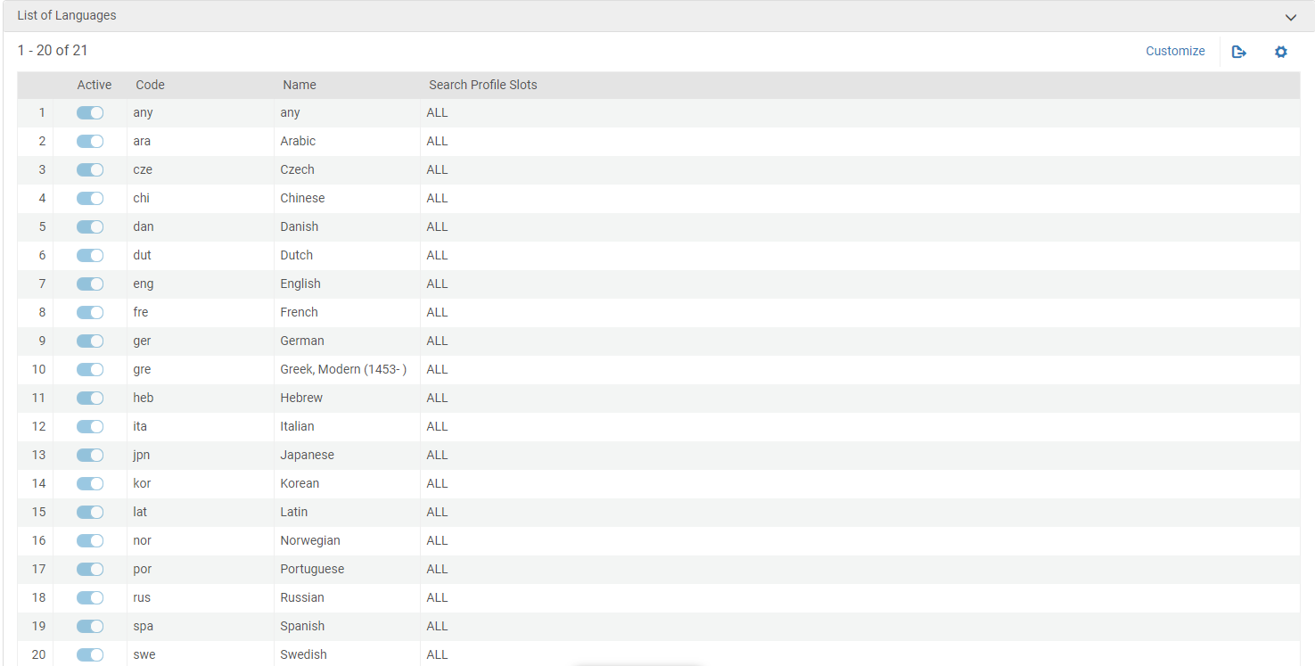
Views: Advanced Search Languages
Alma Configuration > Discovery > Display Configuration > Configure Views>
Advanced Search Configuration
Notes:
Languages are similar to resource types, some are pre-defined out of the box, adding a new Language would also go through a Normalization process.

Slide 23
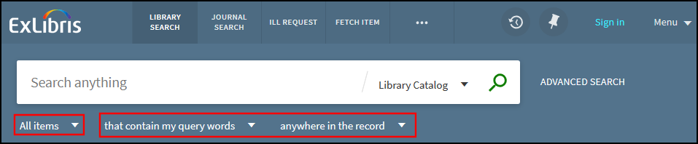
Views: Advanced Search Filters for Basic Search
Resource Type - types defined in Advanced Search
Search Type – contains, exact, begins with
Search Field – fields defined in Advanced search
Notes:
The above Resource Type and Search field configurations can also be set up for Basic Search using the “Enable for Basic Search
checkbox.

Slide 24
Views: Labels
Text the users see in Primo VE View
Configured in Discovery Code Tables : Configuration Menu > Discovery > Display Configuration > Label
Documentation on labels
Notes:
Labels are the text that users see in the Primo Front End. Most of text that’s visible in the Primo Front End is controlled by the Label code tables in Display Configuration -> Labels section. Customizing labels is relatively straight forward as long as you know which label code is responsible for which bit of text.
Some of the text on the initial Primo search page is configured by the UI Customization package, which is discussed in the presentation by Jean.

Slide 25
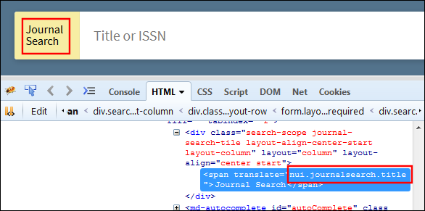
Views Label Codes
Can be found in Primo VE source code:
Notes:
Here’s how you can find the label code – right click on the area in Primo Front end you want to customize, select “Inspect Element”, and then the “HTML” tab. See the <span_translate> tag around the text element that you would to change, and then look up the lable code in the the Back Office code table.

Slide 26
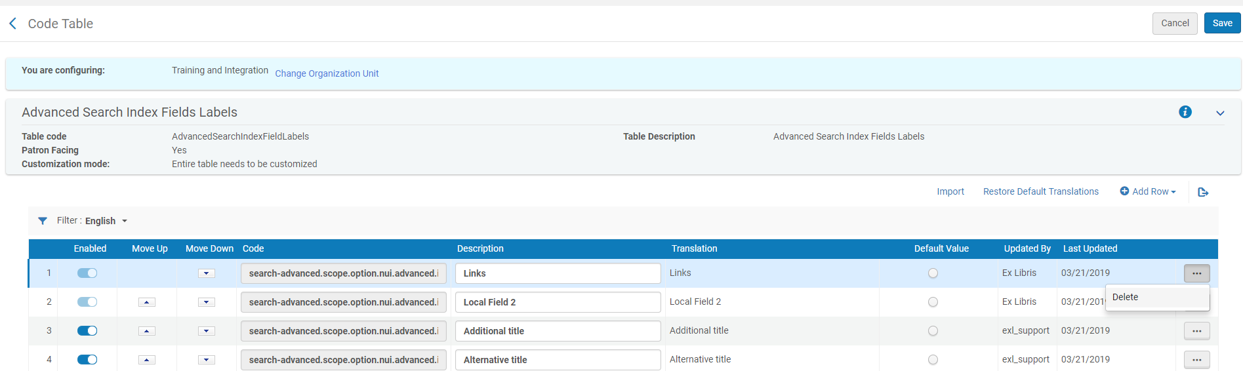
Labels Configuration
Alma Configuration > Display Configuration > Labels > Advanced Search index Field Labels
Notes:
<Change screenshot to include search bar. >! Here’s an example of the code – the Description field is the actual text that you will be changing. You will potentially return to the Labels configuration many times, depending on which text you would like to customize.

Slide 27
Live Demo
Labels
  Using inspect
  Looking up label in Code Table

Slide 28
Brief Results

Slide 29
Brief Results
Facets – results filter by metadata
Sorting (ranking) - relevance, date, title, author
Dedup – duplicates displayed as single record
FRBR – Grouping by Functional Requirements for Bibliographic Records principles
Notes:
We are continuing to go deeper in to the views and we will be discussing Brief Results. Brief Results is what appears in Primo VE after executing a search. Besides the records itself there are 4 other configurations for the results page.
Facets are what appear on the side of the records. They take the metadata from the records displayed and show the corresponding filters.
Sorting or Ranking of the records. There are some configuration options in Primo VE. Sorting and Ranking take different aspects of the records such as date, title, and author. Relevancy ranking uses an algorithm to determine how the weight of the record.
Dedup –ed records are duplicate records that are displayed as a single record.
FRBR-ed records are versions of records that are grouped together. In Primo they will have an indication of “multiple versions”

Slide 30
Brief Results : Facets
Values to Display – number of values without expanding facet
Sort – by Size or Alphanumeric
Local fields can be added as Facets
Notes:
Additionally you can configure the number of values for each facet that can be displayed before the facet needs to be expanded.
Sorting by size meaning putting the facets with the most results at the top. Sorting by Alphanumeric is sorting alphabetically.
Local fields which we will cover later on in the presentation can also be added as facets.

Slide 31
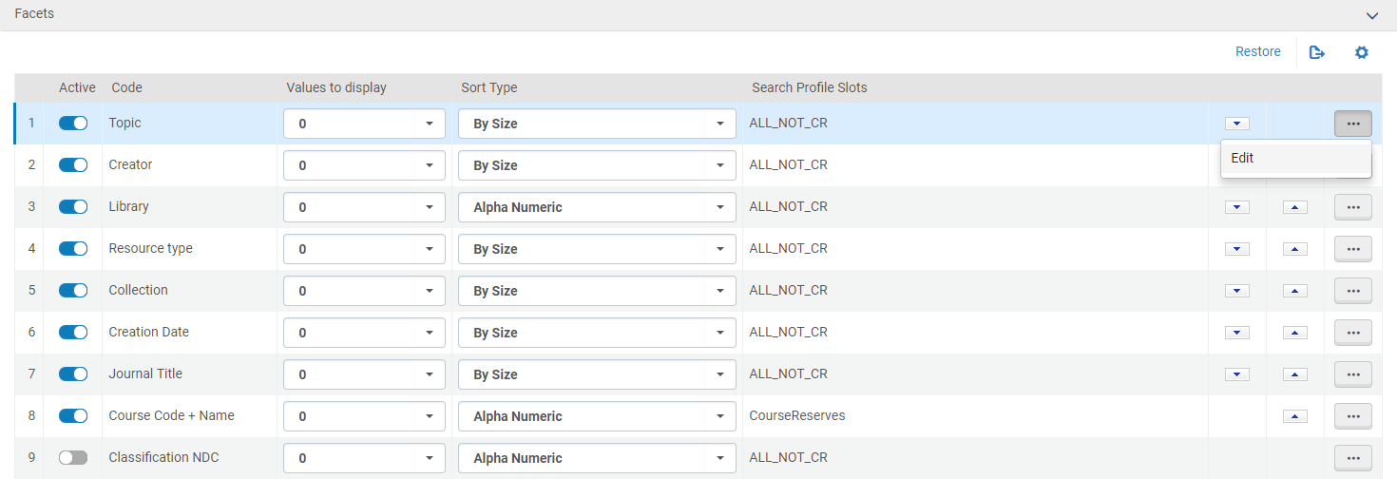
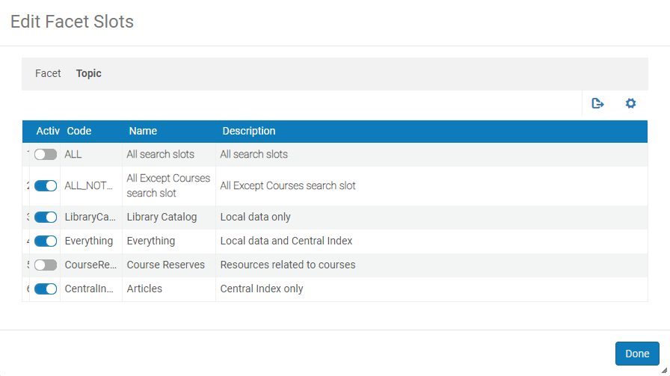
Brief Results: Facet
Alma Configuration > Discovery > Display Configuration > Configure Views> Brief Results
Notes:
In the Views menu, you can
Activate or deactivate a facet
change the order of the facets
as well as which facet are used with each search profile.

Slide 32
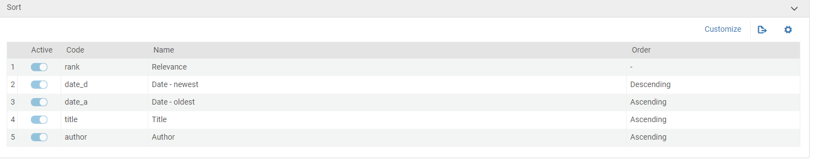
Brief Results: Sort order
Alma Configuration > Discovery > Display Configuration > Configure Views> Brief Results
Notes:
This is the sort order menu of the search results. You can configure how each search result will be sorted and which order.

Slide 33
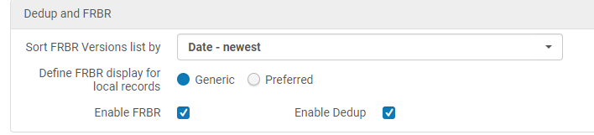
Brief Results: Dedup/FRBR
Alma Configuration > Discovery > Display Configuration > Configure Views> Brief Results
Notes:
ADD SCREENSHOT
The Dedup/FRBR section allows you to enable to disable FRBR and DEDUP for ALL records. Also can choose which record, generic or preferred is displayed in the brief results. You can also sort the FRBR list by Date, Title, Author but most users choose Date-newest

Slide 34
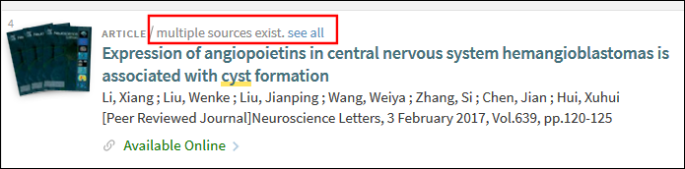
Brief Results: FRBR configuration
Preferred = Dynamically selected among FRBR group
Generic = Place holder, does not include availability status
Dedup/FRBR analysis tool
Records can be suppressed from Dedup/FRBR
Notes:
The choice between Generic or Preferred record will determine how the FRBR records group will be visible to the users in the result list. Preferred record is dynamically selected among the FRBR group based on an algorithm. The preferred record is the highest ranked record from the results set. From the preferred record, the system displays a link to the additional records in the group. Preferred record deliver for single record not goup
The generic record is a place holder record. It contains metadata from the FRBR group but does not contain any specific information like availability. We generally recommend choosing the preferred record.
Groups of records or individual records can be suppressed from Dedup/FRBR. This can be accomplished by running a job in Alma. We have included documentation on how to do suppress dedup/frbr.
The analysis tool is used to determine why records are grouped together. You can see a breakdown of the fields and how they are or are not matching. It can be used for troubleshooting in case if you believe that the records are being grouped incorrectly. Information from the analysis can be helpful when reporting issues with grouped records.

Slide 35
Live Demo
Dedup/FRBR Analysis tool

Slide 36
Brief Record

Slide 37
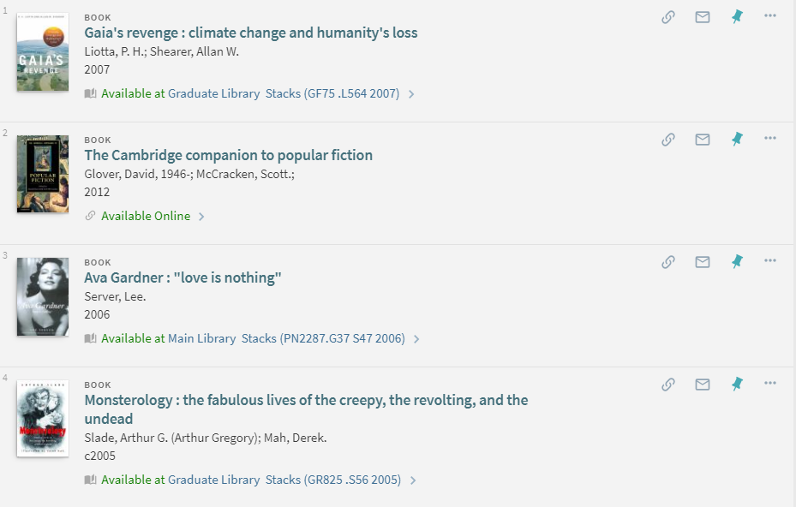
Brief Display
Notes:
This is the Brief Display it contains the most essential metadata for the record as well as the availability status and several actions.
First is the Display line and second the actions

Slide 38
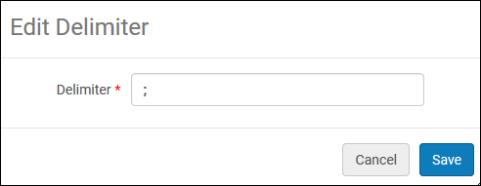
Brief Record : Display Lines
4 lines maximum, multiple data fields per line
Data fields on each line separated by delimiter
Local fields can be added to display lines
Notes:
The brief record can have the maximum of 4 lines. But there can be multiple data fields on each line. You can separate the data fields by delimiters such as a semi colon.
The same local fields that can be added as facets can be added to the brief record display lines. We will talk about creating local fields in the full record section of the presentation.

Slide 39
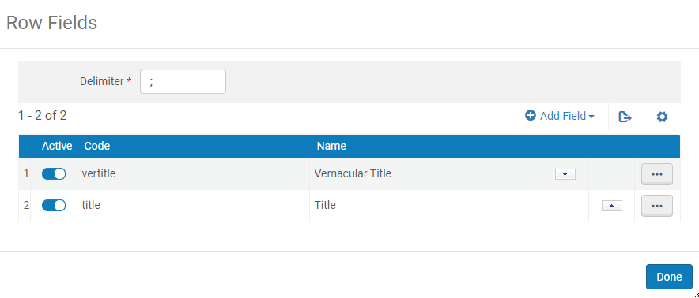
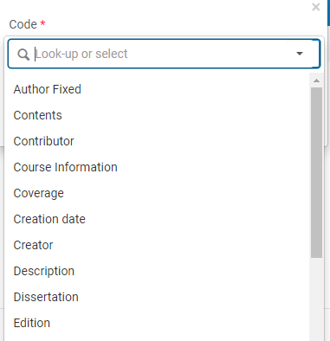
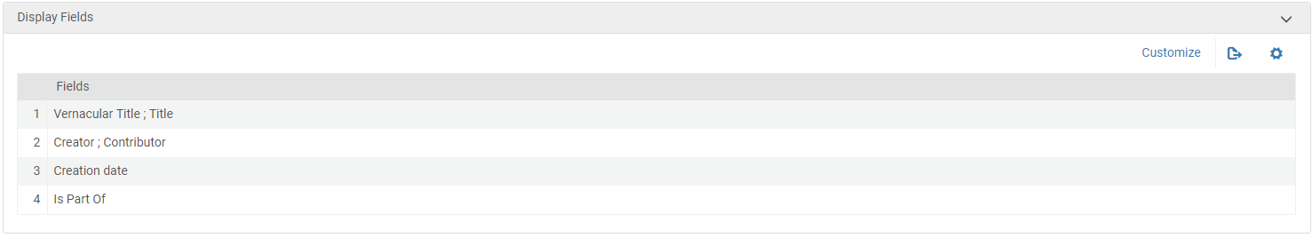
Brief Record
Notes:
You can edit each of the 4 display fields and add multiple rows fields to each one. You can add a field from a drop down list that will include your out of the box and locally created fields.

Slide 40
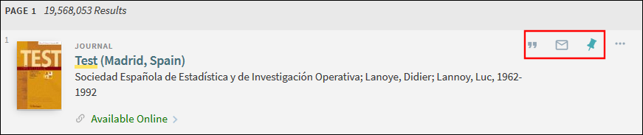
Brief Record : Actions
E-Shelf, Email, Permalink, Print, Export, RIS
Up to 3 actions can display "Up Front" (e-shelf, email, and citation are default)
Same Action configuration for both Brief and Full display
Notes:
The actions are different ways for the user to interact with the citation. The actions are, E-Shelf (favorites), Email, Permalink, Print, Export, RIS. Up to 3 actions can be displayed in the brief display. The same actions configuration will be configured for the brief and full display. More actions can be selected for the Full display.

Slide 41
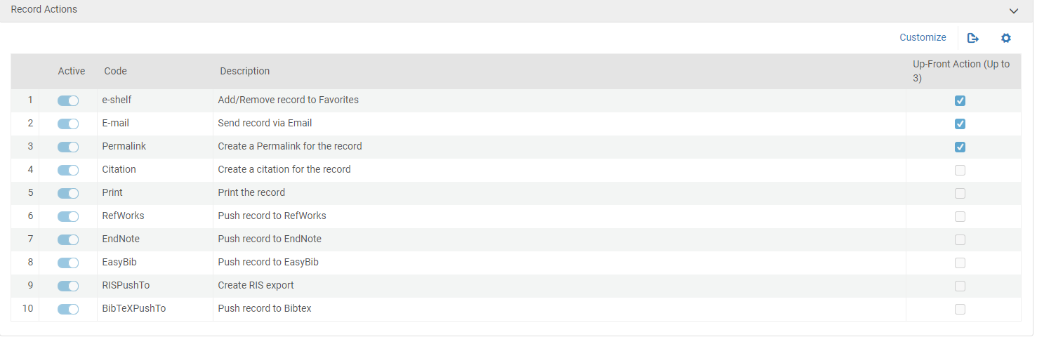
Brief Record
Notes:
Here is the menu for the record actions. As you can see you can choose which actions are up front. You can also activate or deactivate which actions will display in the full display. The customize button allows you to change the order of the actions.

Slide 42
Full Record Display

Slide 43
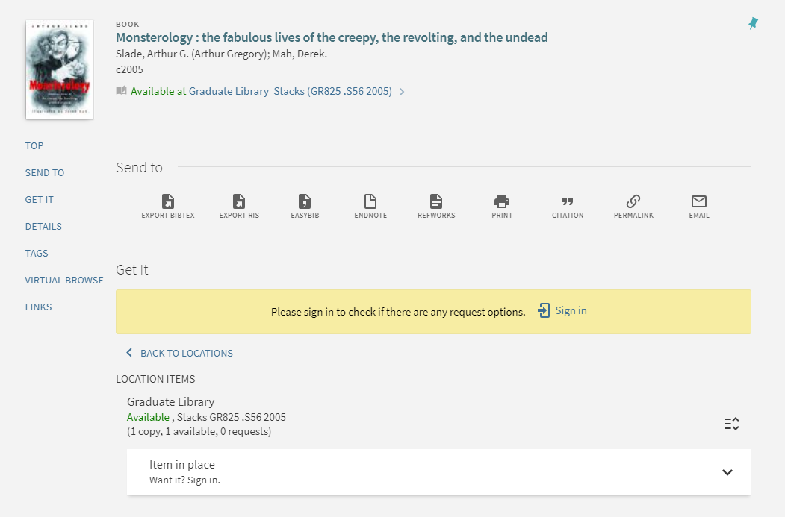
Full Record: Custom Holdings Display Field
Notes:
We will now discuss different configuration options for the Full Record. We will start by discussing the Holdings Display Field. The highlighted section of the full record is where you can add your own Holdings Display Fields.

Slide 44
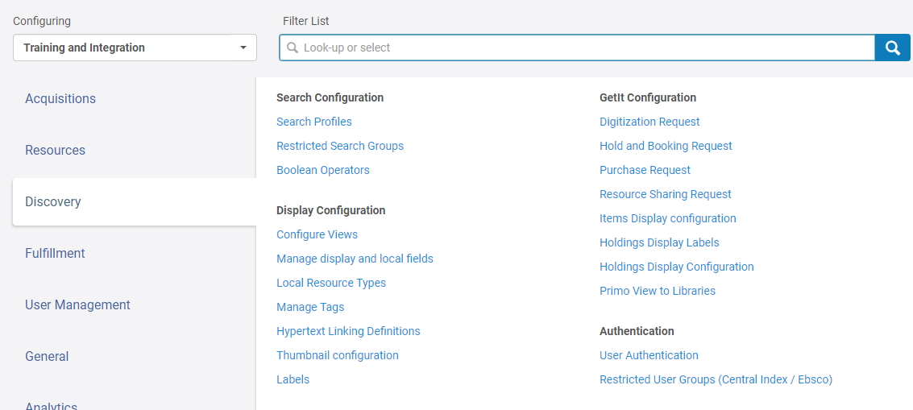
Configuration: Custom Holding Display
Notes:
This is the section in the Back Office where you will want to configure the Holdings Display Labels or code table and Holdings Display Configuration or mapping table.

Slide 45
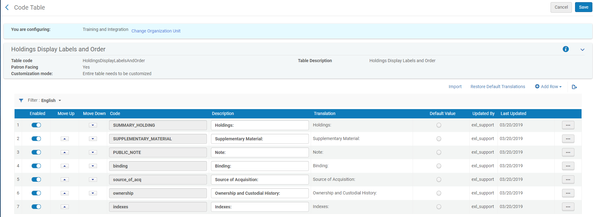
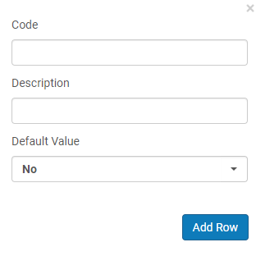
Configuration: Holding Display Label Code Table
Alma Configuration > Discovery > GetIt Configuration> Holdings Display Labels
Notes:
Here in the Holding Display Label Code table you can add a new row with your own custom code and description. The code will be used in the Holding Display Configuration Mapping table the description is what will be shown in your front end. Code needs to be alpha numerica no spaves
After filling out the code and description, click add row and then save.

Slide 46
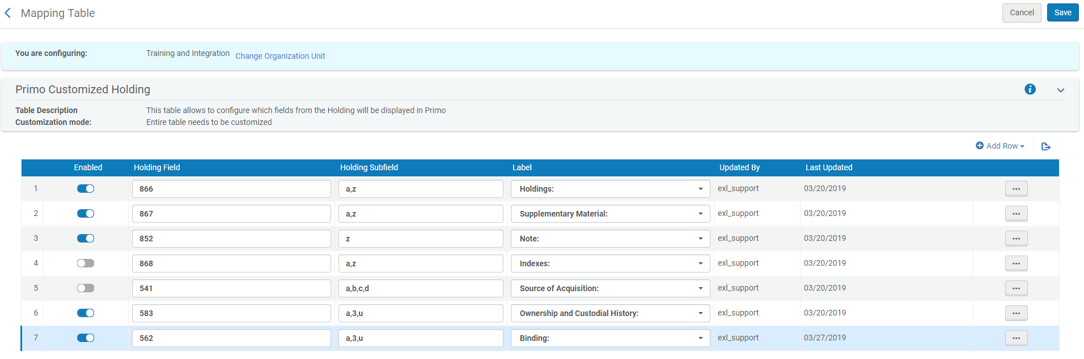
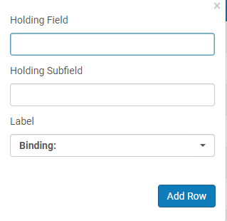
Configuration: Holdings Display Configuration Mapping Table
Alma Configuration > Discovery > GetIt Configuration> Holdings Display Configuration
Notes:
Here in the Holdings Display Configuration mapping table, you will also want to click add row. In the Holding field add the corresponding holdings field such as 583 or 562 and also the subfield. Choose the label that you have created or a out of the box label. Click add row and save.

Slide 47
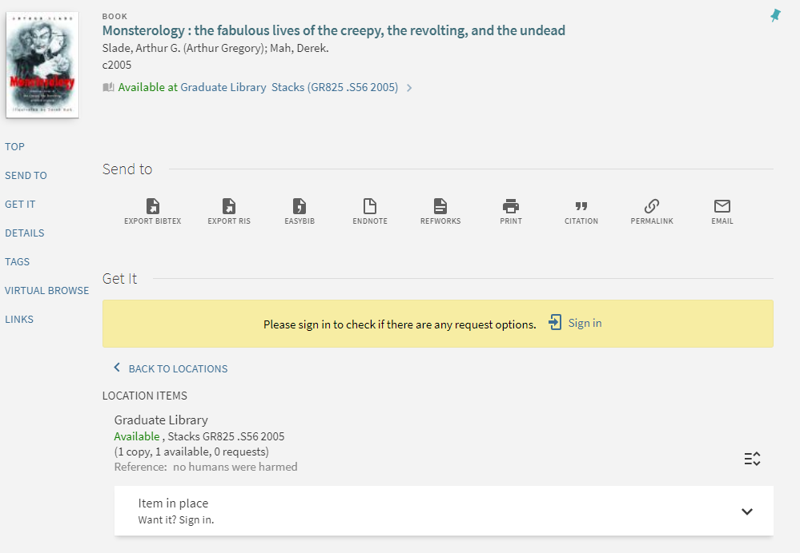
Custom Holdings Display: End Result
Notes:
Then after saving you should be able to see your new custom Holdings display field. In this case, I created Reference: and the text in the record is no humans were harmed.

Slide 48
Display Fields vs Local Fields
Display Fields
  Out of the Box fields that are editable
  Display Rules
Local Fields
  Create unique ones for your institution
  Tool for display and search
Notes:
Display fields are out of the box fields that you can edit. You can change the normalization rules of these fields to grab the correct metadata in your own records if it is not already doing so. The display rules in the presentation are a list of the normalization rules for display so you can see how the rules are behaving with the records.
Local fields can be created unique for your own institution. Local fields as we have mentioned throughout the presentation are not just for the full display. They are a tool that can be used for search, facets, and display lines in the brief record.
The syntax of normalization rules was discussed in an earlier session presented Jonathan Dror. If you missed this session you can view the presentation after.

Slide 49
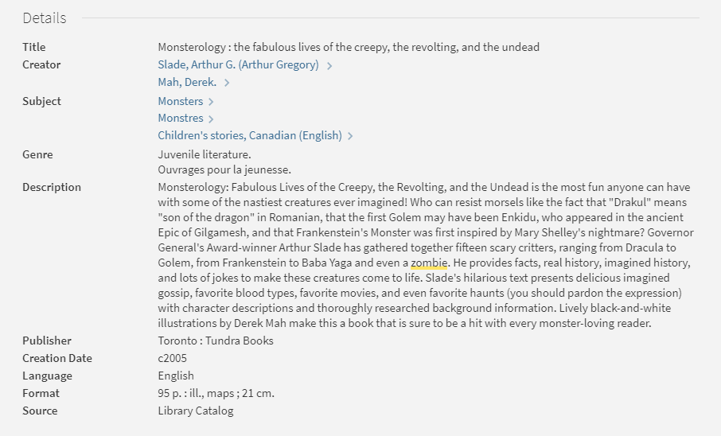
Full Record: Details
Notes:
This is the details section of the full record. These field are generated out of the box and have their own set of normalization rules. You can edit the out of the box normalization rules to edit the out of the box fields.

Slide 50
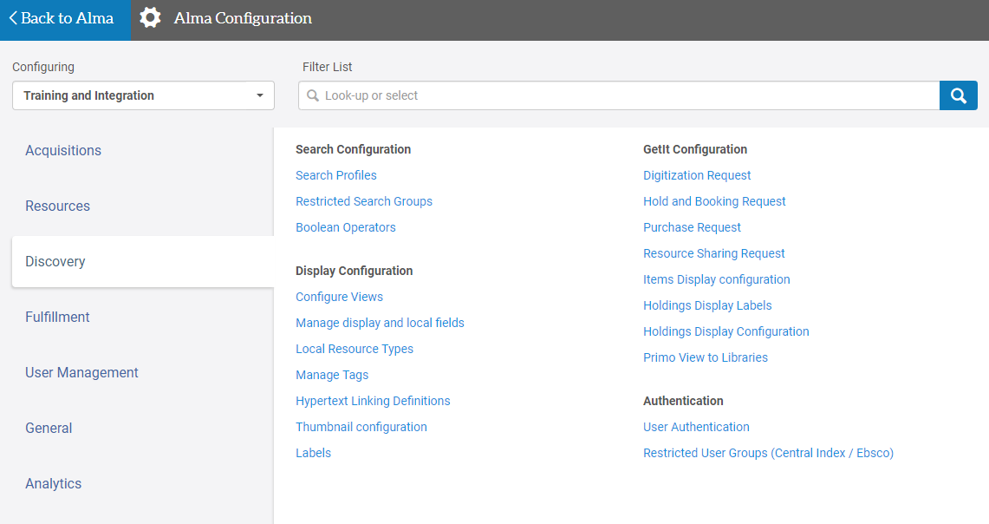
Configuration: Display Fields
Alma Configuration > Discovery > Display Configuration> Manage display and local fields
Notes:
Here is where you will configure the display and local fields.

Slide 51
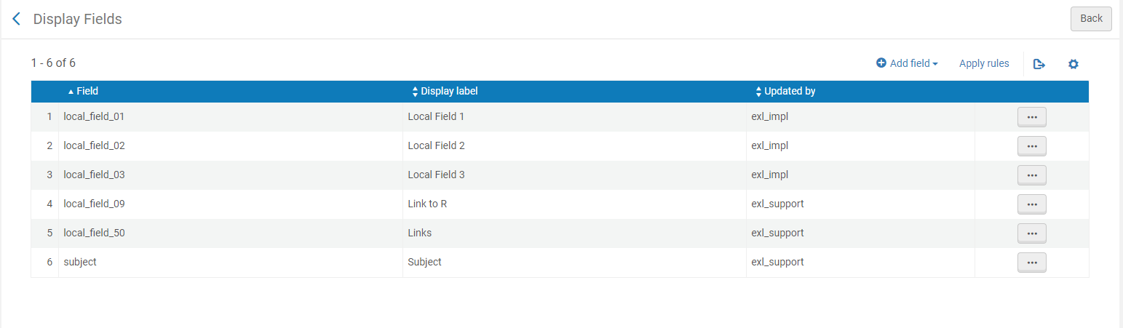

Configuration: Display Fields
Alma Configuration > Discovery > Display Configuration> Manage display and local fields
Notes:
To edit a display field. First choose add field, then choose add display field

Slide 52
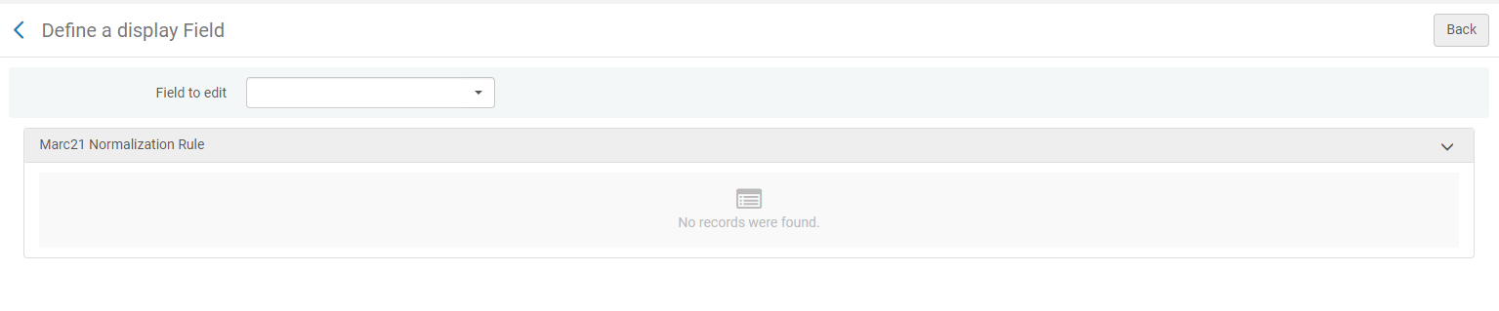
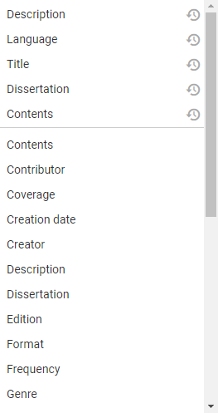
Configuration: Display Fields
Notes:
Next to the field selection, there will be a dropdown menu of all of the out of the box fields that you can edit.

Slide 53
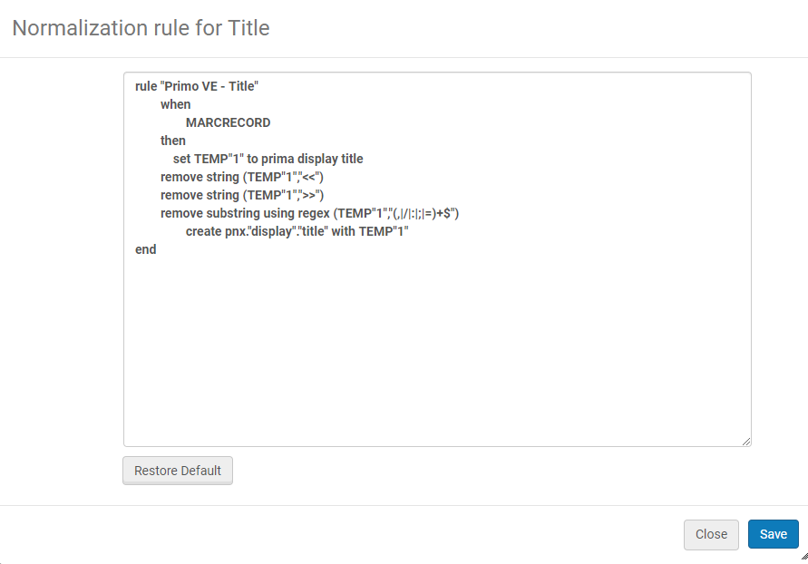
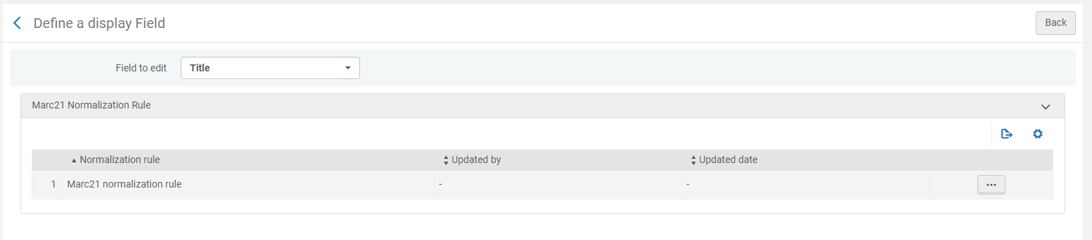
Configuration: Display Fields
Notes:
Choose which field you will like to edit, in this case we chose title. Click on the elipses menu and edit your normalization rule and the click save.

Slide 54
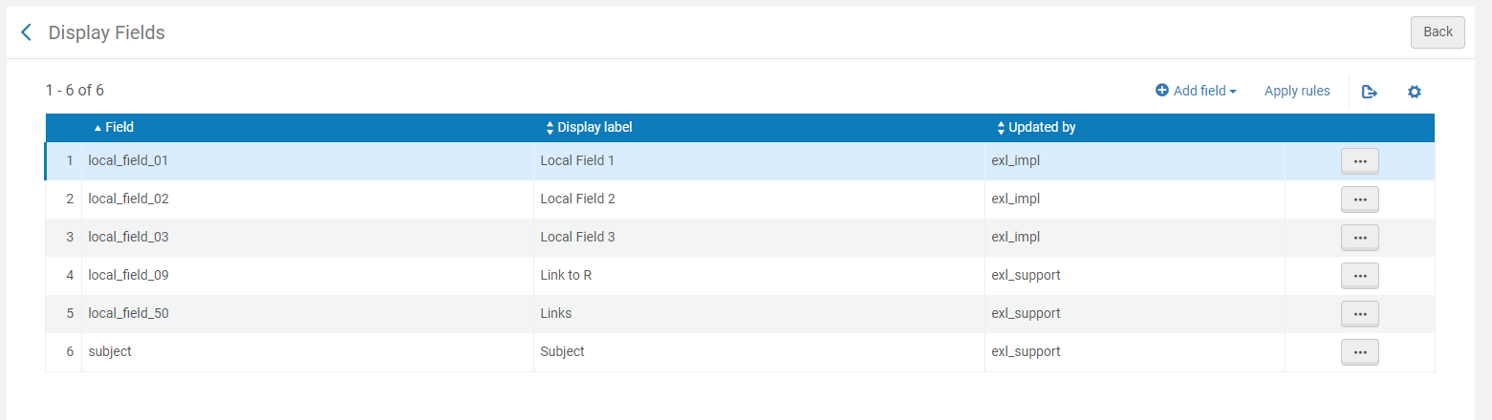
Remember!
Notes:
After you will go back to the display fields and remember to choose apply rules. If you do not then your changes will not appear in the front end.

Slide 55
Configuration: Local Fields
Alma Configuration > Discovery > Display Configuration> Manage display and local fields
Notes:
The local fields configuration is very similar to display fields. You will again choose, add field, then add local field.

Slide 56
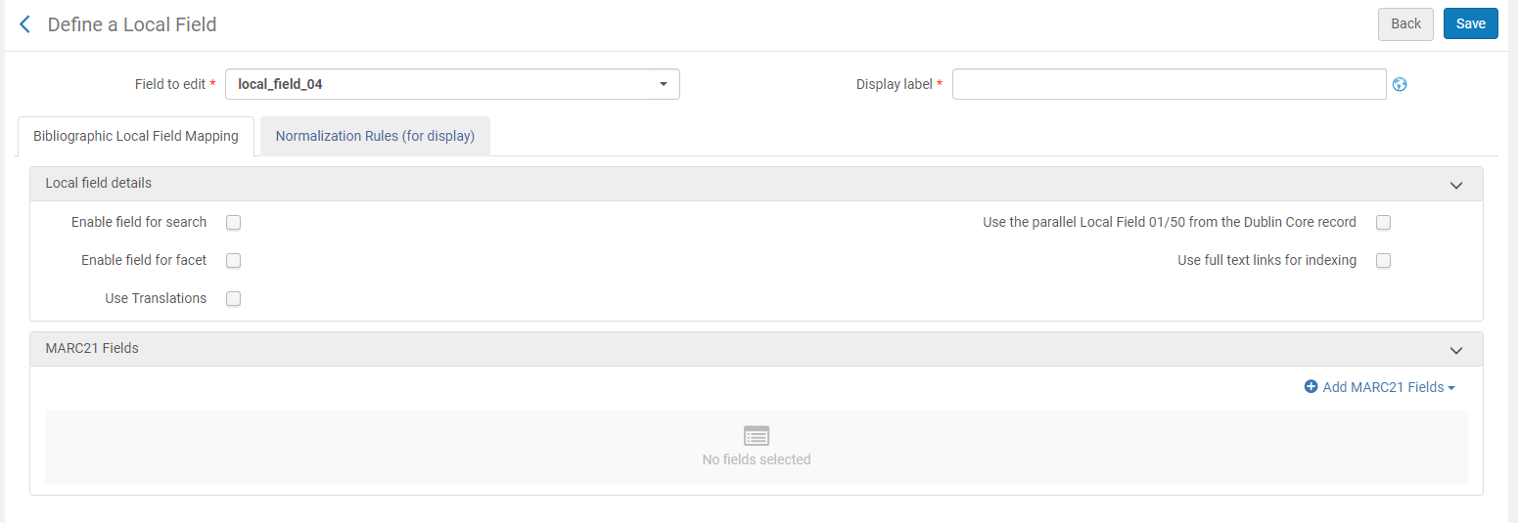
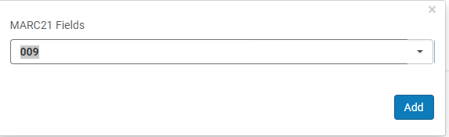
Configuration: Local Fields
Notes:
Here is where the process is different to display fields. Alma will choose the next available field so in our case it is local_field_4. You will then choose a display label, this is the label that will be in the front end.
The check boxes are what we were discussing before in our presentation. Here is where you can enable the fields to be searched, or to be a filtered as a facet in the results page. This adds them to the drop down
This is where you can add which MARC fields will be mapped to the local field.
Click save.

Slide 57
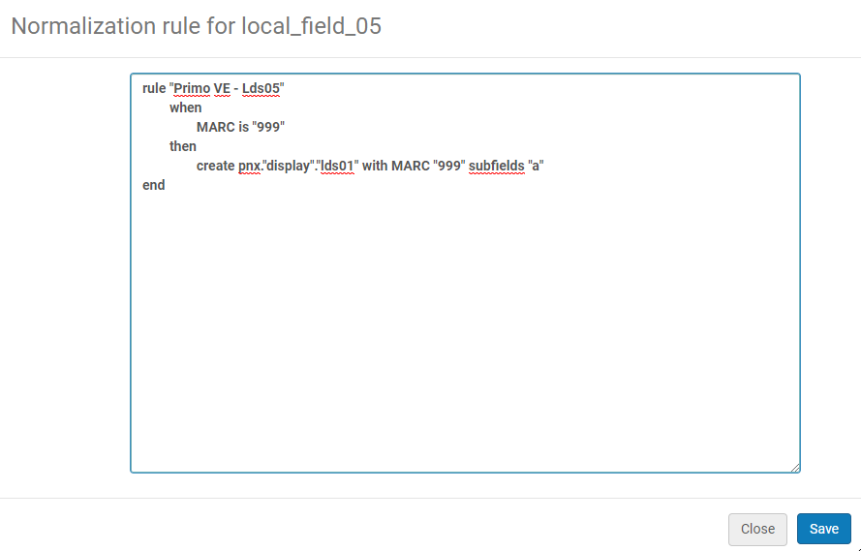
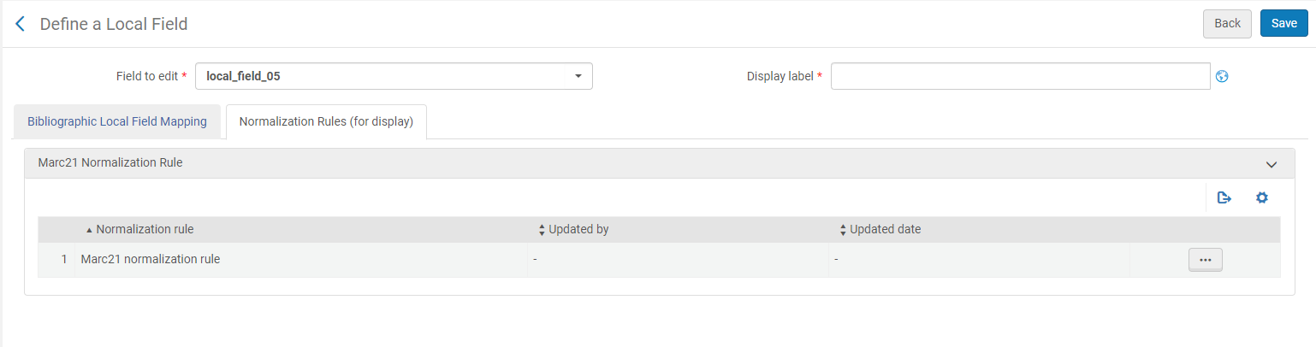
Configuration: Local Fields

Slide 58
Important!
Notes:
Then click apply rules! This is very important to see the changes in the front end.
IF WE HAVE TIME LOCAL FIELDS

Slide 59
Local Resource Types & Tags

Slide 60
Local Resource Types
Maximum of 20
Configuration Menu > Discovery > Display Configuration > Local Resource Types
mapped from Marc or Dublin Core fields/subfields
Run Recalculate Local Resource Types Job (Admin > Manage Jobs and Sets > Run a Job) on a set of relevant records
Notes:
Resource Types are defined by out of the box Normalization rules that take metadata from the Marc or Dublin Core core record.
You can also add local resource types, a maximum of 20.
Local Resource types are configured in the Discovery Display Configuration.
After creating a local resource type of your choice, you will need to run a Recalculate Local Resource Type job on a set of records you would like to display as that type.

Slide 61
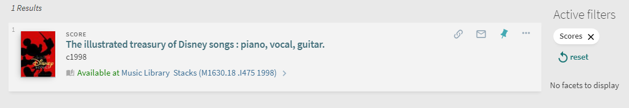
Configuration Local Resource Types
Plural label = Facets / Advanced Search
Singular label = Record brief display
Regular expression mapping: <field> $<subfield>), MARC fixed field (00X), LDR
Notes:
In the Local Resource type configuration, you can add how the type would display in plural (Facets or Advanced Search field), for example : Vinyl Records , or how the type would display in singular (Brief Record), for example : Vinyl Record
To extract the relevant metadata for the resource type, you can either use the entire Marc Field / Subfield, or use regular expression mapping with field/subfield, fixed fields such as 008, or the leader field.

Slide 62
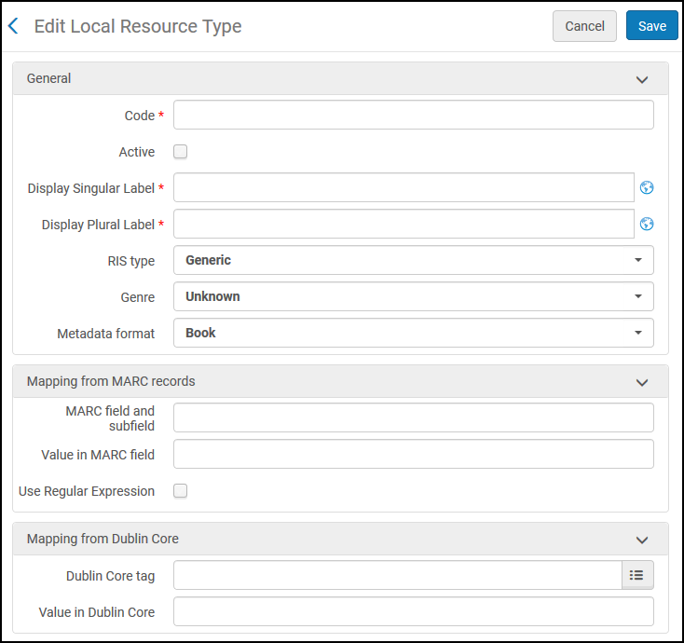
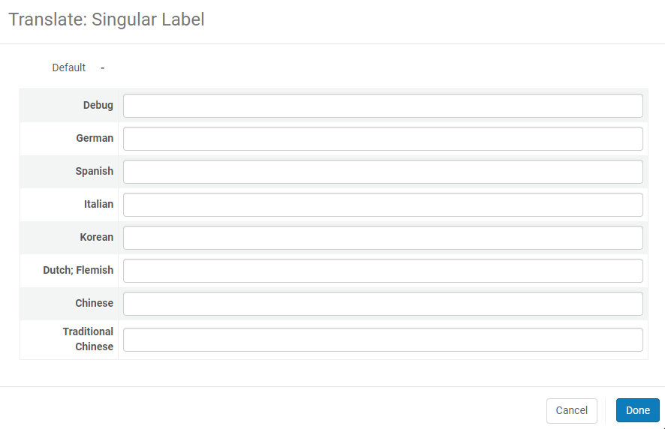
Configuration: Local Resource Types
Alma Configuration > Discovery > Display Configuration> Local Resource Types

Slide 63
Marc Field mapping
No Regular expression (Marc & DC) = matching values separated by semicolon:
exa;ex;Examination paper
Regular expression (Marc only) = specify to extract data from field
^.{32}[aoc].*
Notes:
Here are examples of mapping without a regular expression, and with a regular expression.
Regular expressions can only be used with Marc Records.
Mapping without a regular expression take matching values separated by Semicolon (as an OR statement).
Mapping with Regular expressions take metadata from certain positions in a particular field.

Slide 64
Managing Tags
Tags added by Primo VE Users can be viewed in Configuration Menu > Discovery > Display Configuration > Manage Tags
Tags can be deleted for any reason by Alma user with Discovery – Admin role

Slide 65
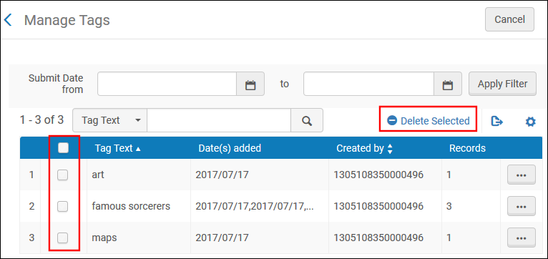
Managing Tags

Slide 66
Questions?

Slide 67
Thank You

Slide 68


We value your feedback!
Please complete the session survey in the schedule section of the app.

