Slide 1

Integrating Alma with Self-Check Out Machines
Ben Grimshaw, PMP
Project Manager

Slide 2
Welcome and Introductions
Ben Grimshaw
  I was one of the first four Alma support analysts in North America
  I’ve worked in the Profession Services department since 2016 working with customers implementing Alma.
  In my spare time you can probably find me attending a rock, blues or jazz concert in Chicago.
  Fun fact: I attended elementary school 7 miles east of this hotel.

Slide 3
Session Objectives
Session Description:
This session will review the technical requirements and configuration options available for using self-checkout machines with Alma. You’ll leave this session with an checklist of how to get started and a template for troubleshooting technical issues.
Session Objective(s):
  By the end of this session, you will know, understand and/or be able to:
    Required hardware and software to use self-check machines with Alma
    Default configurations that need to be updated
    Troubleshooting steps and what information you should share with Support Analysts or your implementation team.

Slide 4
When to integrate self-check?
Installing Stunnel
Configuring Stunnel
Configuring integration profile in Alma
Troubleshooting guidelines
Information to share with support or implementation teams

Slide 5
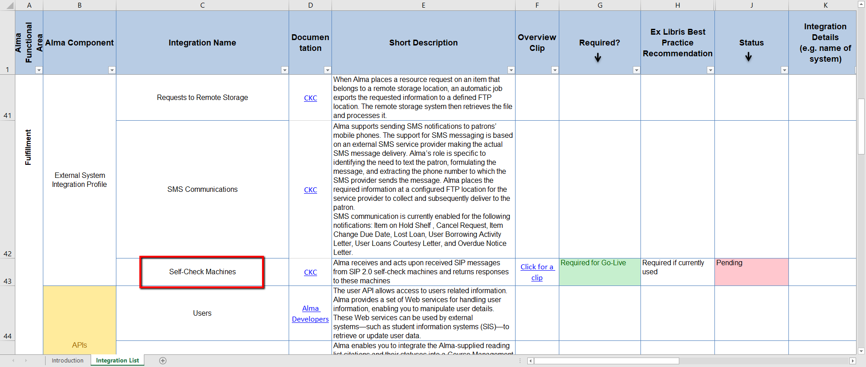
The first time Ex Libris will ask you about self-check:
Notes:
3rd party integrations form.

Slide 6
When can Self-Check be configured
Any time after test load delivery.
You need your production environment to set up your certificate to communicate between Alma and the Stunnel Server.
Always consider the hardware you’ll use and impact to patron services to prevent frustration.
Implementing after go-live is certainly possible with considerations we’ll discuss today.

Slide 7
When to integrate self-check?
Installing Stunnel
Configuring Stunnel
Configuring integration profile in Alma
Troubleshooting guidelines
Information to share with support or implementation teams

Slide 8
Stunnel considerations
Stunnel is free open source software used to encrypt the circulation transactions to protect patron information. https://developers.exlibrisgroup.com/alma/integrations/stunnel
Compatible with Windows, MAC, Linux and other operating systems should be installed on a machine that is “always on.”
Has been successfully run on desktop machines but consider hosting on a server for greater stability if this is an option.

Slide 9
Single or Multiple installation?
It is possible to have a single stunnel instance serving multiple integration points. Considerations to keep in mind while deciding on multiple or single stunnel installations:
Pro: Avoiding single point of failure. Separate log files for make it easier to track down connectivity problems
Con: Need to configure/maintain/upgrade multiple instances.

Slide 10
Steps to install Stunnel
1. Select a server or workstation and install Stunnel
2. Set Stunnel as a service/daemon.
3. Obtain the Alma certificate.
4. Update the configuration file.
5. Test.
https://developers.exlibrisgroup.com/alma/integrations/stunnel/

Slide 11
When to integrate self-check?
Installing Stunnel
Configuring Stunnel
Configuring integration profile in Alma
Troubleshooting guidelines
Information to share with support or implementation teams

Slide 12
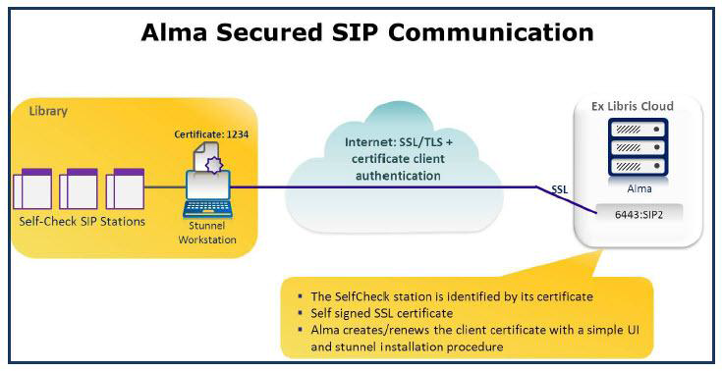
Stunnel’s role in communication with Alma

Slide 13
.conf file example
; **************************************************************************
; * Global options *
; ************************************************************************** ;
; Debugging stuff (may useful for troubleshooting)
debug = 7
output = stunnel.log ;
;Disable FIPS mode to allow non-approved protocols and algorithms
fips = no
;**************************************************************************
; * Service defaults may also be specified in individual service sections *
; **************************************************************************
; Disable support for insecure SSLv2 protocol
options = NO_SSLv2
[Integration Profile 1]
key = [certificate file name]
cert = [certificate file name]
client = yes
accept = 5001 Local port definition
connect = [Alma domain]:6443 example: na06.alma.exlibrisgroup.com:6443
TIMEOUTclose = 0
TIMEOUTconnect = 200
TIMEOUTidle = 86400
[Integration Profile 2 ] if using installation for multiple service points

Slide 14
Multiple integration points on a single Stunnel instance
[ CIRC WEST]
key = shelfcheckcw.pem
cert = shelfcheckcw.pem
client = yes
accept = 5001
connect = na05.alma.exlibrisgroup.com:6443
TIMEOUTclose = 0
TIMEOUTconnect = 200
[READING ROOM]
key = shelfcheckrr.pem
cert = shelfcheckcwrr.pem
client = yes
accept = 5002
connect = na05.alma.exlibrisgroup.com:6443
TIMEOUTclose = 0
TIMEOUTconnect = 200
[CIRC EAST]
key = shelfcheckce.pem
cert = shelfcheckce.pem
client = yes
accept = 5003
connect = na05.alma.exlibrisgroup.com:6443
TIMEOUTclose = 0
TIMEOUTconnect = 200
[COMPUTER LAB]
key = shelfcheckcl.pem
cert = shelfcheckccl.pem
client = yes
accept = 5004
connect = na05.alma.exlibrisgroup.com:6443
TIMEOUTclose = 0
TIMEOUTconnect = 200

Slide 15
When to integrate self-check?
Installing Stunnel
Configuring Stunnel
Configuring integration profile in Alma
Troubleshooting guidelines
Information to share with support or implementation teams

Slide 16
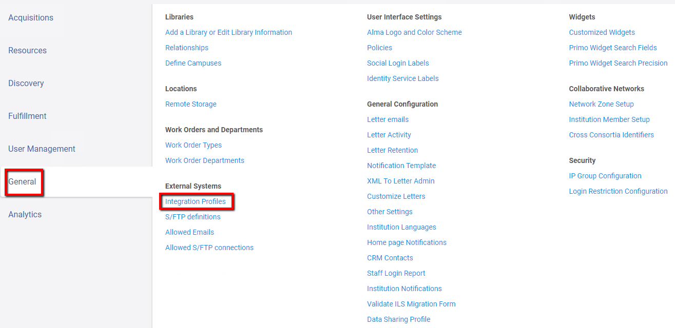
General Configuration Menu > External Systems> Integration Profiles

Slide 17
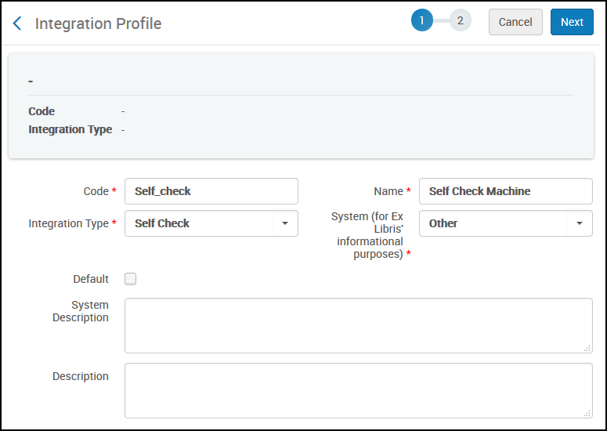
Add Self-Check integration profile

Slide 18
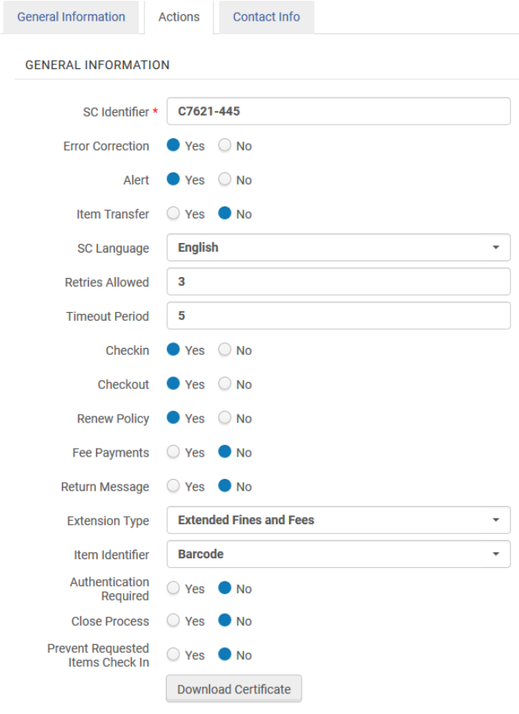
Typical Configuration:
Always keep your self-check machine’s configuration settings and compare them against the defined behaviors in Alma. (example: Self-Check Machine is set to not send a check digit but Alma is configured with Error Correction on).

Slide 19
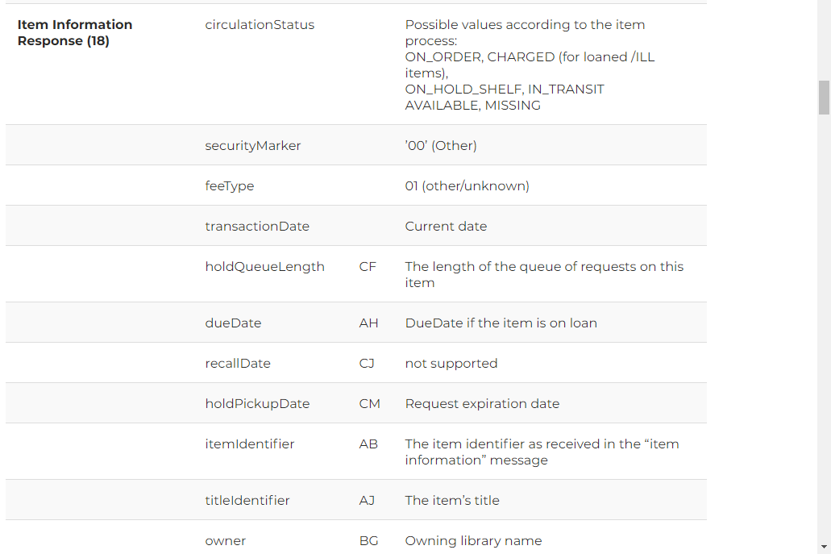
Supported SIP2 messages
Supported messages are listed in the developers network: https://developers.exlibrisgroup.com/alma/integrations/selfcheck/sip2/

Slide 20
New feature: Extended Fines and Fees
The following fields will be added for each open charge in the Patron Information Response message and Fee paid response message:
EB – Barcode of the item that is linked to the charge (such as for an overdue/lost item)
ET – Title of the item that is linked to the charge
EC – Cash transaction type code
ED – Cash transaction type description
EF – Sum
EK – Fee ID
BZ – Payment transaction number
Note: Please make sure that the self check machine supports this option as well and share any supporting documentation in your Salesforce case.

Slide 21
Most common error:
Time and date formats misaligned between Stunnel system, Self-Check machine and Alma.
Alma Parameters:
1. use_time_format_with_time_zone_in_self_check
2. system_time_format
3. Time zone

Slide 22
When to integrate self-check?
Installing Stunnel
Configuring Stunnel
Configuring integration profile in Alma
Troubleshooting guidelines
Information to share with support or implementation teams

Slide 23
Basic Troubleshooting guidelines
Confirm Stunnel Service is running
Confirm certificates are not expired
Compare current configuration to a record of configuration when service was successfully configured and working
Check for errors specific to your self check machine model or configuration differences from Alma configuration
Check logs for error messages

Slide 24
When to integrate self-check?
Installing Stunnel
Configuring Stunnel
Configuring integration profile in Alma
Troubleshooting guidelines
Information to share with support or implementation teams

Slide 25
What to include in any self check support ticket
.conf file
Stunnel Error logs
Self-Check Error Log
Need to not only check .conf file is set up correctly but this can also be used to confirm what we see in logs.
This allows us to see what is communicated between Stunnel and Alma. Always share an example barcode and identifier.
Providing the model number and error logs from the machine allow us to search for similar cases from other institutions.
Context
Integration Profile
Does anything still work?
Has self-check worked before? Are you setting it up for the first time?
If you have multiple integration profiles configured are all of them failing?
Example: New loans work but renewals do not?

Slide 26
Next Steps and Resources
Documentation
  Alma Integration Profile
  Developer Network Self-Check
Additional resources:
  Blog Articles on Developer Network from specific customers
  https://developers.exlibrisgroup.com/alma/integrations/stunnel/
  https://el-una.org/about/mailing-lists/alma-mailing-lists/ (ALMA-L)
  2019 Knowledge Days Seminar Presentations

Slide 27
Session Objectives: Any questions?
    Required hardware and software to use self-check machines with Alma
    Default configurations that need to be updated
    Troubleshooting steps and what information you should share with Support Analysts or your implementation team.

Slide 28

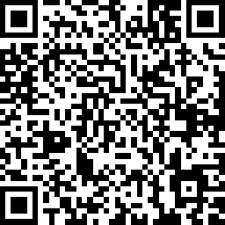
We value your feedback!
Please complete the session survey in the schedule section of the app.

