Slide 1
What’s Wrong With This Link?
Troubleshooting Common Linking Issues
Vladimir Buldyrev | Senior Technical Support Analyst
Jack Boettcher| Senior Technical Product Analyst

Slide 2
Welcome and Introductions
Vlad Buldyrev – Senior Technical Product Analyst
  Cross-product link specialist (focusing on SFX & Primo)
  MLIS (Simmons College)
Jack Boettcher – Senior Technical Product Analyst
  Cross-product link specialist
  MLIS (University of Texas)

Slide 3
Session Objectives
Session Description:
This session examines full-text availability and delivery across Primo, Alma, SFX, Summon, and 360 Link. It will provide troubleshooting steps for some of the most common issues with linking to full-text content
Session Objective(s):
  By the end of this sessions you will know, understand and/or be able to:
    Understand the concepts behind OpenURL and Link Resolving
    Understand the interaction between Ex Libris products from a linking perspective
    Submit linking-related Support cases with the most helpful information
    Perform basic troubleshooting for linking issues

Slide 4
Target Audience
New and experienced customers
Digital/electronic resources librarians
Anyone who deals with reporting broken links to support

Slide 5
Introduction & Concepts
Putting it all Together
Troubleshooting
Common Linking Issues
Next Steps, Support Resources and Feedback

Slide 6
Introduction & Concepts

Slide 7
Introduction & Concepts
PCI & Summon Indexes
Availability
Delivery

Slide 8
Introduction – Primo Central Index
Centralized index
Based on Primo / VE platform
Data is Harvested from content providers
Growing Number of records as collections are added
Offered as a service to all Primo / Alma customers at the institutional level

Slide 9
Availability process – Primo Central
Primo queries PCI Activations
Checks Alma holdings file
Availability is determined!

Slide 10
Availability and Delivery Methods – Primo Central
Holdings File
Availability based on holdings file
Delivery via link resolver
Link to Resource
Availability based on the presence of a static link in the record
Delivery via static link in record

Slide 11
Introduction – Summon Index
Centralized Index
Data harvested from content providers
Content providers not configured at collection level
Available for Summon/360 as well as Alma with Summon

Slide 12
Availability and delivery process - Summon
360 KB queried
Returns availability info to Summon
Displays in Summon as FT or citation

Slide 13
Related Documentation
Primo Central Indexing
Registering Institutions for Primo Central Index
Type of Links
Activate Resources in the Primo Central Wizard
Configuring Primo Central to Use the Institutional Holdings File

Slide 14
Putting it all Together

Slide 15
Putting it all Together
Activation
Holdings file creation
Full text!

Slide 16
Components in context
Index
Link resolver
Discovery
Interface
Vendor Data

Slide 17
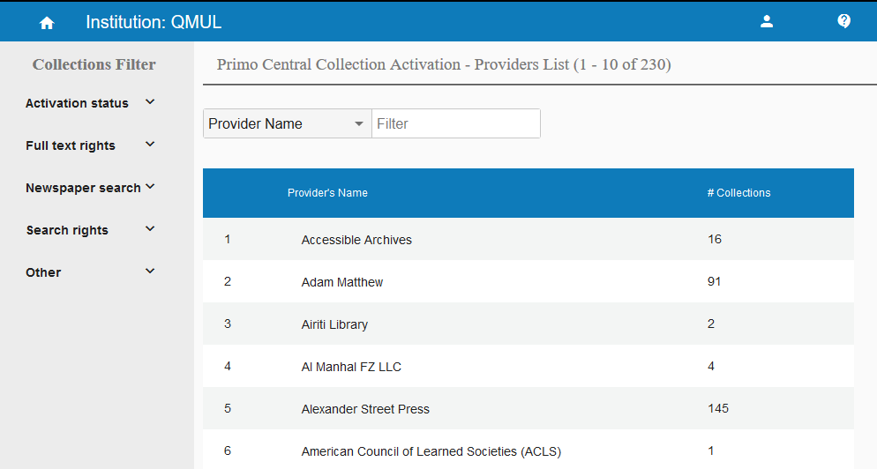
Step 1: Activate the collection in Primo Central

Slide 18
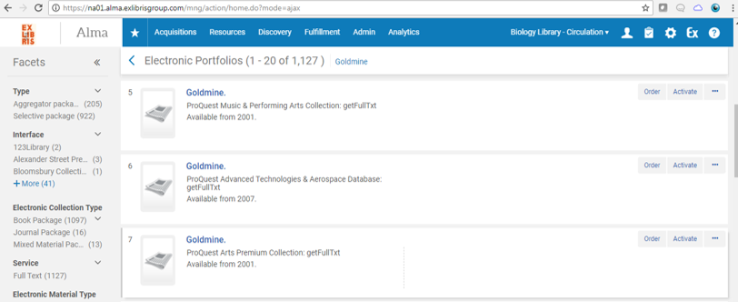
Step 2: Activate the resource in Community Zone / KB
Primo Central harvests activation changes once a week
Makes records from newly activated collections discoverable in Primo

Slide 19
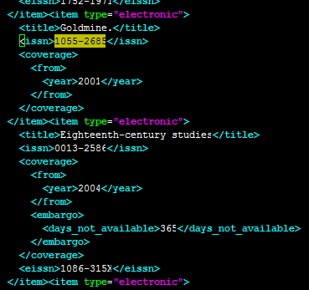
Coverage information added to holdings file (Alma/SFX)
<item type="electronic">
<title>Goldmine.</title>
<issn>1055-2685</issn>
<coverage>
<from>
<year>2001</year>
</from>
</coverage>
</item>
Primo Central sets availability indicator to “full-text available” or “no full-text” based on holdings file

Slide 20
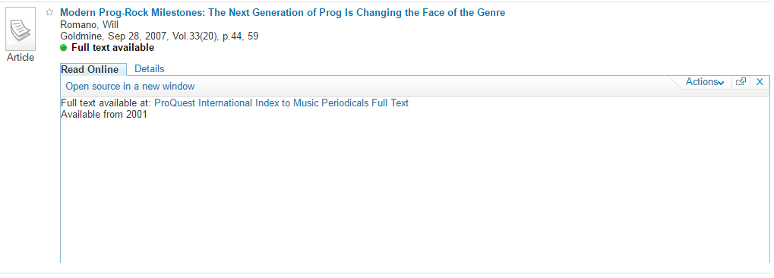
Discovery and Delivery
Articles from this journal now display in discovery UI
Link resolver delivers a link to full text

Slide 21


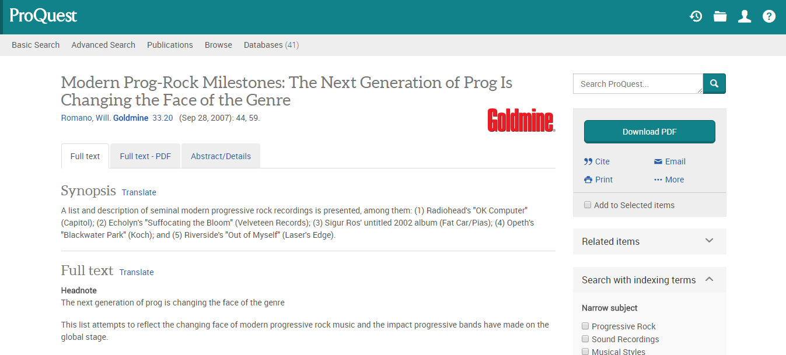
Profit!!!!
OpenURL debug shows the correct target was found
Full text delivery achieved!

Slide 22
Link Resolver Menu
Link Resolver Menu
OpenURL template
Record metadata

Slide 23
Delivery
OpenURL request sent to link resolver
Link resolver validates OpenURL metadata and returns full text links
Debugging functions used for troubleshooting

Slide 24
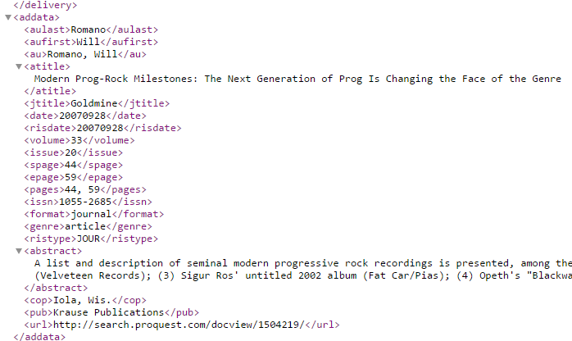
PNX Sections: Addata
Contains the metadata used to populate the openURL
Incorrect metadata in <addata> can cause many linking problems

Slide 25
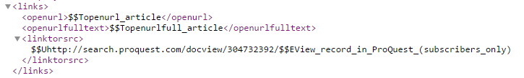
Link to Resource <linktorsrc> Method
Simpler method of linking
Used when vendor metadata does not include unique identifiers such as ISSN, ISBN, or when the collection has no portfolios
If static <linktorsrc> URL is present in the PNX, the availability indicator in Primo with show “full text available”

Slide 26
Related Documentation
Activating Alma Portfolios - checklist
01 KB Manager: Activating Resources
Publishing Electronic Holdings to Primo Central

Slide 27
Troubleshooting

Slide 28
Troubleshooting
What Support needs
URL structure
PNX and Context Object
Debugging

Slide 29
Information our Support Team needs
THE OPENURL
Primo/Summon permalink or citation
Front end logins (proxy, Primo)
Back end logins (SFX, Primo BO)

Slide 30
How to get the OpenURL?
Primo old and new UI
360 Link
https://knowledge.exlibrisgroup.com/Alma/Knowledge_Articles/How_to_extract_OpenURL_from_a_Primo_Central_Alma_and_other_sources

Slide 31
How to get the OpenURL for Primo VE?
For Primo VE, the OpenURL is not directly available
The Display CTO (context object) option can be used for debugging
https://knowledge.exlibrisgroup.com/Alma/Product_Documentation/010Alma_Online_Help_(English)/040Resource_Management/050Inventory/020Managing_Electronic_Resources#Step+2+-+Primo+VE

Slide 32
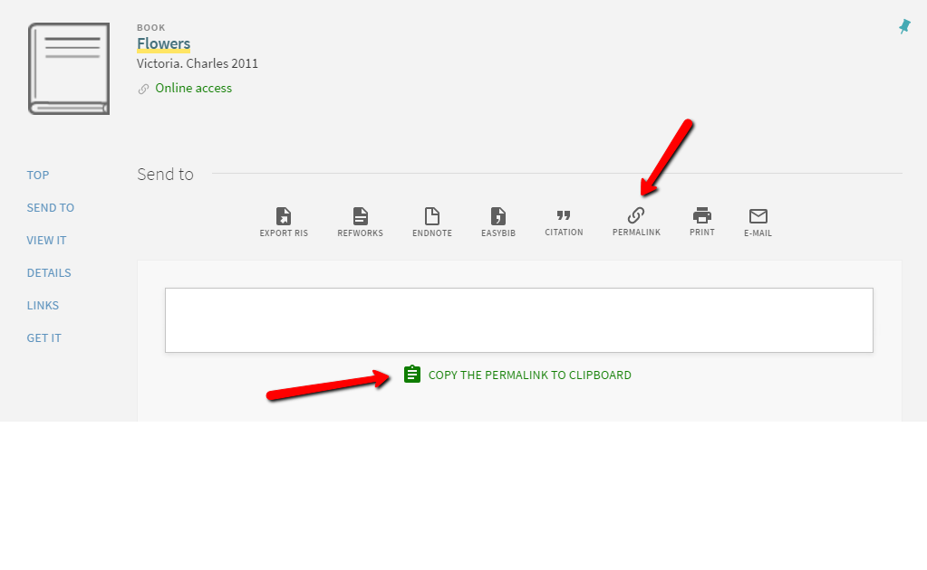
How to Get Primo permalink

Slide 33
OpenURL 0.1 (360, SFX)
    http://qk8mu7jr6k.search.serialssolutions.com/
      ?genre=article
      &issn=02534126
      &title=Journal of Earth System Science
      &volume=125
      &issue=1
      &date=20160201
      &atitle=Century scale climate change in the central highlands of Sri Lanka
      &spage=75
      &pages=75-84
      &au=Silva, J De
      &sid=EBSCO:Academic OneFile
Base URL
Citation
Metadata
SID (source ID)

Slide 34
OpenURL 1.0 (Alma, SFX, 360)
http://na01.alma.exlibrisgroup.com/view/uresolver/01CALS_USM/openurl?ctx_enc=info:ofi/enc:UTF-8&ctx_id=10_1&ctx_tim=2016-03-02T12%3A42%3A43IST&ctx_ver=Z39.88-2004&url_ctx_fmt=info:ofi/fmt:kev:mtx:ctx&url_ver=Z39.88-2004&rfr_id=info:sid/primo.exlibrisgroup.com-gale_hrca
&req_id=&rft_val_fmt=info:ofi/fmt:kev:mtx:&rft.aucorp=&rft.date=19980930&rft.volume=117&rft.spage=A1&rft.issn=0458-3035&rft.pub=Los%20Angeles%20Times&
rft.place=&rft.series=&rft.stitle=
&rft.bici=&rft_id=info:bibcode/&rft_id=info:hdl/&rft_id=info:lccn/&rft_id=info:oclcnum/&rft_id=info:pmid/&rft_id=info:eric/((addata/eric}}&rft_dat=%3Cgale_hrca%3E21216876%3C/gale_hrca%3E,language=eng,view=&svc_dat=viewit&env_type=test&req.skin=csusm_uresolver
Base URL
SID (source ID)
Citation
Metadata

Slide 35
Target URL Example
http://www.ajcn.org/cgi/content/fulltext/71/6/1525
ParseParam
(TargetService or
ObjectPortfolio)
Citation / OpenURL metadata
TargetParser Linking Syntax

Slide 36
context_object / Display CTO (Alma)
Essential starting point in link troubleshooting
OpenURL metadata + CKB augmentation
Found in debugging code of each Link Resolver Menu, or in displayCTO debugger for Primo VE
Includes OpenURL itself

Slide 37
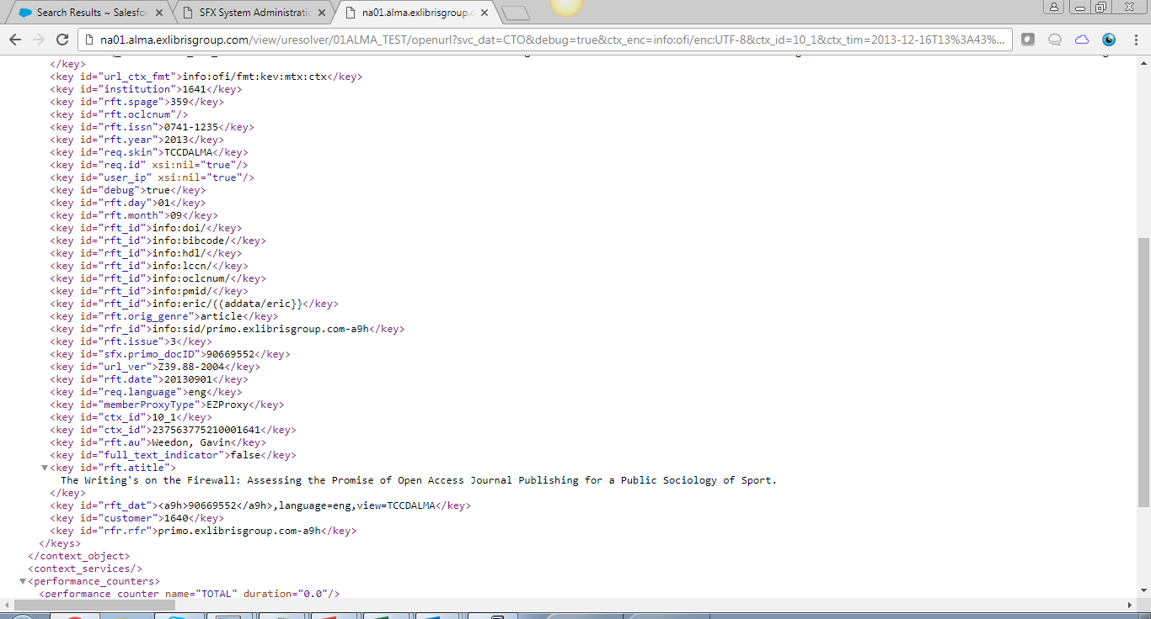
CTO example

Slide 38
Link Resolver Menu Debugging
Insert: svc_dat=CTO&debug=true& into OpenURL after the first question mark
Provides information on:
Matching with Alma IZ records
Service, parsers and parse parameters
Target URLs
Reasons for filtering:
“Available for”
“Date Filter”
“Display Logic”

Slide 39
Alma Link Resolver Debugging Examples
Date Filter :
<key id="character_set">null</key>
<key id="interface_name">OCLC</key>
<key id="Is_free">0</key>
<key id="Filtered">true</key>
<key id="Filter reason">Date Filter</key>
<key id=“Availability">Available from 1999 until 2007 volume: 254 issue: 52.</key></keys>
Target URL:
<target_url>http://www.tandfonline.com/doi/abs/10.1080/00940771.2012.11461</target_url>
<is_error>false</is_error>
<error_code>null</error_code>
Target URL error:
<target_url>null</target_url>
<is_error>true</is_error><
error_code>200606</error_code>

Slide 40
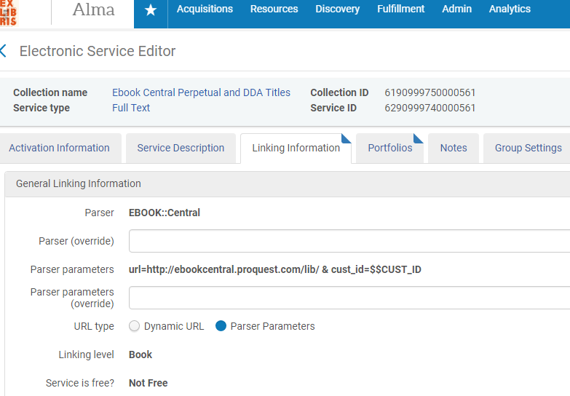
Linking Level - Alma

Slide 41
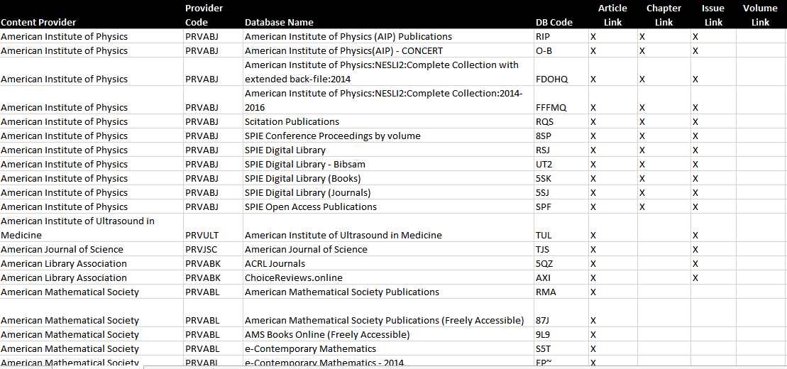
Linking Level – 360 Link

Slide 42
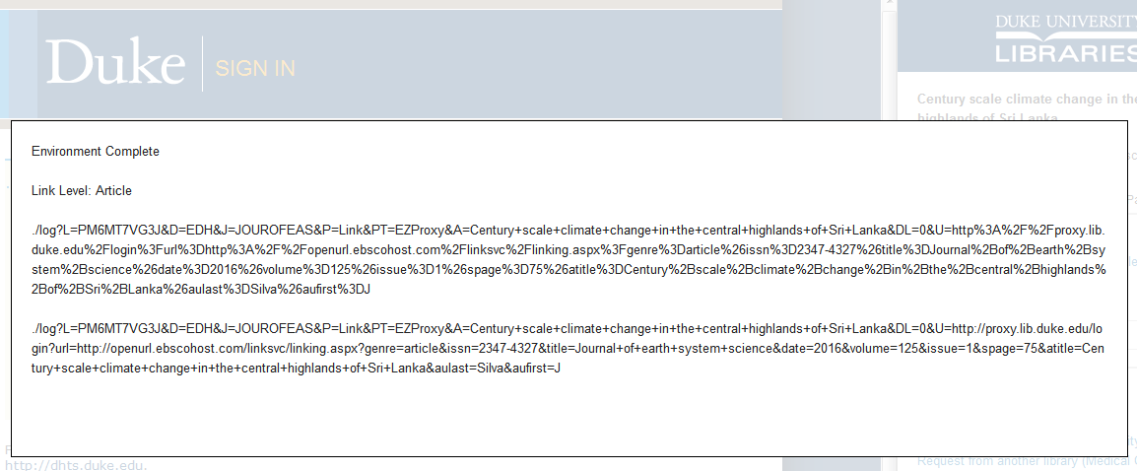
Target Link Troubleshooting (360 Link) – Ctrl + period!

Slide 43
Related Documentation
Alma Link Resolver
How To Report Full Text Linking and Availability Problems to Support
Turn on Debugging mode to view Target URLs
04 Basic Troubleshooting
360 Link: Available Target Linking Syntaxes (“Linkers”)
Databases that need additional configuration (360/Summon, Alma)

Slide 44
Common Linking Issues

Slide 45
What’s wrong with this link?
Proxy Auth
Inaccurate metadata
Metadata mismatch
Parser or syntax bug

Slide 46
Proxy/Authentication issues
Configuration
URL in proxy config table?
IP on file?
Unique IDs
Check L/P parameters (Alma)
LocIDs (Gale)
Site ID (Ebook Central)
Accessible w/o proxy?

Slide 47
Metadata Issues – Types of problems
Parser or syntax bug – parser not passing expected info to ctx_object or target.
Linking syntax Change – vendor unexpectedly changed syntax, SFX KB Software/360 Linkers not yet updated.
Metadata mismatch between vendors – OpenURL metadata is inaccurate, insufficient or different from target metadata

Slide 48
Metadata Issues – Which problem?
Compare OpenURL and ctx_object
does ctx_object contain OpenURL metadata?
If not, either source parser issue or invalid OpenURL format .
Compare ctx_object and Target URL
– does Target URL contain the correct ctx_object metadata?
If not, possible target parser issue.
Tip: Use OpenURL decryptor tool such as:
http://meyerweb.com/eric/tools/dencoder/

Slide 49
Metadata Issues – Which problem?
Check the Target Database and try to find the article
– does the indexed article title, year, volume, issue, and start page match that Link Resolver is sending in Target URL?
If not, possible metadata mismatch– contact vendors, ask our Data Services team or 360/Summon support.
Is the linking syntax totally different from the target URL?
If yes, possible syntax change – contact ExLibris Data Services, SFX KB Team, or 360/Summon support

Slide 50
Example A: Incorrect metadata in record and openURL
This journal is in the Free E-Journals collection. Articles prior to 1999 cannot be found in Primo:
"Dining at the Great House: Food and Drink in the Time of Jane Austen"
Persuasions: Journal of the Jane Austen Society of North America, 1990 Dec. 16, Vol. 12, pp. 88-98.
Record id: mla1990033307

Slide 51
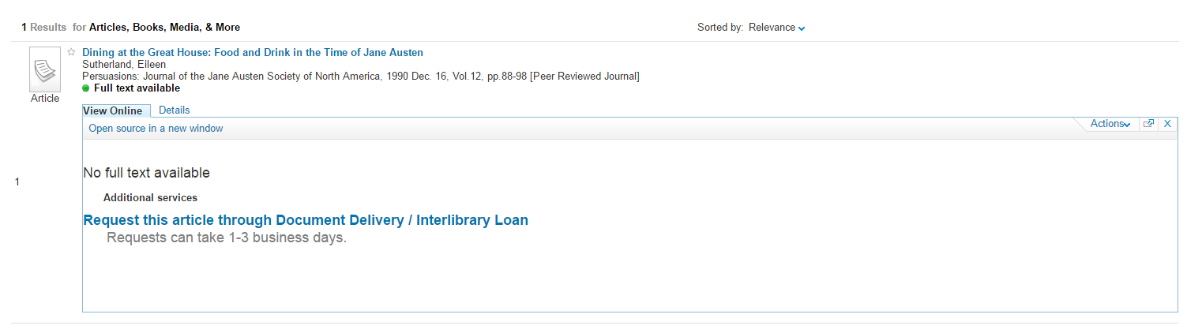
Link Resolver View
Full text indicator (correct) but no full text available

Slide 52
First Step: check the holdings file to confirm access
item type="electronic">
<title>Persuasions.</title>
<issn>0821-0314</issn>
<coverage>
<from>
<year>2000</year>
</from>
</coverage>
<coverage>
<from>
<year>1980</year>
</from>
<to>
<year>1993</year>
</to>
</coverage>

Slide 53
Background
The Jane Austen society publishes two journals under the name Persuasions, and each has different content. One is print format (but also available to view online) and the other is online-only.
Print:
Persuasions: The Jane Austen Journal
http://www.jasna.org/persuasions/printed/index.html
(ISSN 0821-0314)
Online:
Persuasions: The Jane Austen Journal On-Line
http://www.jasna.org/persuasions/on-line/index.html
(ISSN 1559-7520)

Slide 54
Problem
For records from this journal, the Primo Central records incorrectly assign the print journal EISSN for the online-only journal which is not correct.
The availability indicator is correct, but the incorrect EISSN prevents any targets from displaying.

Slide 55
openURL (incorrect)
http://il-kblwe01:3410/support1?ctx_ver=Z39.88-2004&ctx_enc=info:ofi/enc:UTF-8&ctx_tim=2016-04-25T20%3A12%3A25IST&url_ver=Z39.88-2004&url_ctx_fmt=infofi/fmt:kev:mtx:ctx&rfr_id=info:sid/primo.exlibrisgroup.com:primo3-Article-mla&rft_val_fmt=info:ofi/fmt:kev:mtx:journal&rft.genre=article&rft.atitle=Dining+at+the+Great+House%3A+Food+and+Drink+in+the+Time+of+Jane+Austen&rft.jtitle=Persuasions%3A+Journal+of+the+Jane+Austen+Society+of+North+America&rft.btitle=&rft.aulast=&rft.auinit=&rft.auinit1=&rft.auinitm=&rft.ausuffix=&rft.au=Sutherland%2C+Eileen&rft.aucorp=&rft.date=1990&rft.volume=12&rft.issue=&rft.part=&rft.quarter=&rft.ssn=&rft.spage=88&rft.epage=98&rft.pages=&rft.artnum=&rft.issn=0821-0314&rft.eissn=1559-7520&rft.isbn=&rft.sici=&rft.coden=&rft_id=info:doi/&rft.object_id=&svc_val_fmt=info:ofi/fmt:kev:mtx:sch_svc&rft_dat=%3Cmla%3E1990033307%3C/mla%3E%3Cgrp_id%3E-8877744002640852565%3C/grp_id%3E%3Coa%3E%3C/oa%3E&rft.eisbn=&rft_id=info:oai/&req.language=eng

Slide 56
openURL (corrected)
http://il-kblwe01:3410/support1?ctx_ver=Z39.88-2004&ctx_enc=info:ofi/enc:UTF-8&ctx_tim=2016-04-25T20%3A12%3A25IST&url_ver=Z39.88-2004&url_ctx_fmt=infofi/fmt:kev:mtx:ctx&rfr_id=info:sid/primo.exlibrisgroup.com:primo3-Article-mla&rft_val_fmt=info:ofi/fmt:kev:mtx:journal&rft.genre=article&rft.atitle=Dining+at+the+Great+House%3A+Food+and+Drink+in+the+Time+of+Jane+Austen&rft.jtitle=Persuasions%3A+Journal+of+the+Jane+Austen+Society+of+North+America&rft.btitle=&rft.aulast=&rft.auinit=&rft.auinit1=&rft.auinitm=&rft.ausuffix=&rft.au=Sutherland%2C+Eileen&rft.aucorp=&rft.date=1990&rft.volume=12&rft.issue=&rft.part=&rft.quarter=&rft.ssn=&rft.spage=88&rft.epage=98&rft.pages=&rft.artnum=&rft.issn=0821-0314&rft.eissn=0821-6314&rft.isbn=&rft.sici=&rft.coden=&rft_id=info:doi/&rft.object_id=&svc_val_fmt=info:ofi/fmt:kev:mtx:sch_svc&rft_dat=%3Cmla%3E1990033307%3C/mla%3E%3Cgrp_id%3E-8877744002640852565%3C/grp_id%3E%3Coa%3E%3C/oa%3E&rft.eisbn=&rft_id=info:oai/&req.language=eng

Slide 57
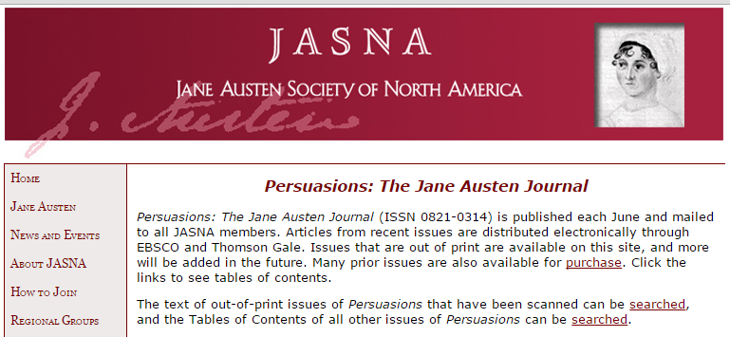
Resolution
The corrected openURL displays a target and directs to the correct URL:
http://www.jasna.org/persuasions/printed/index.html

Slide 58
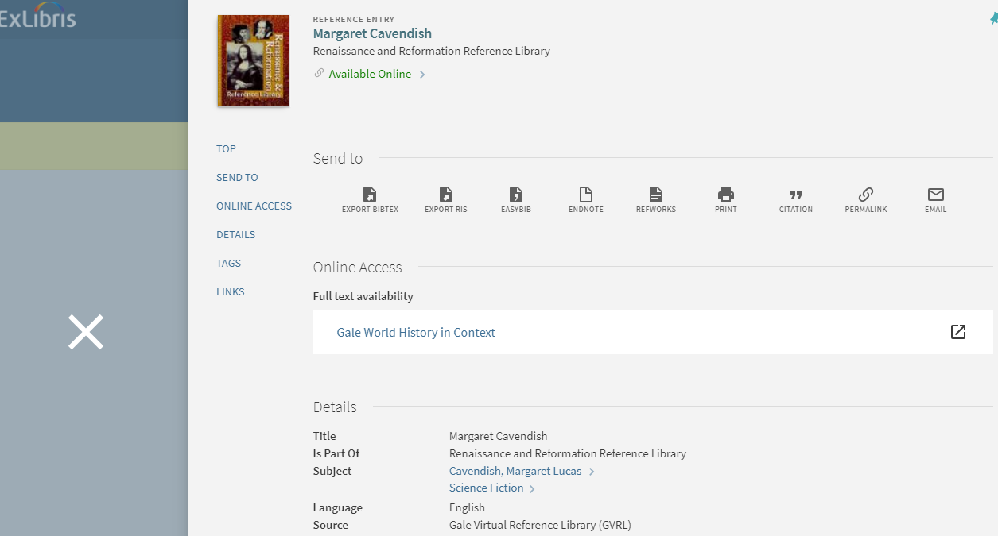
Example B: Parser Problem (Primo VE)

Slide 59
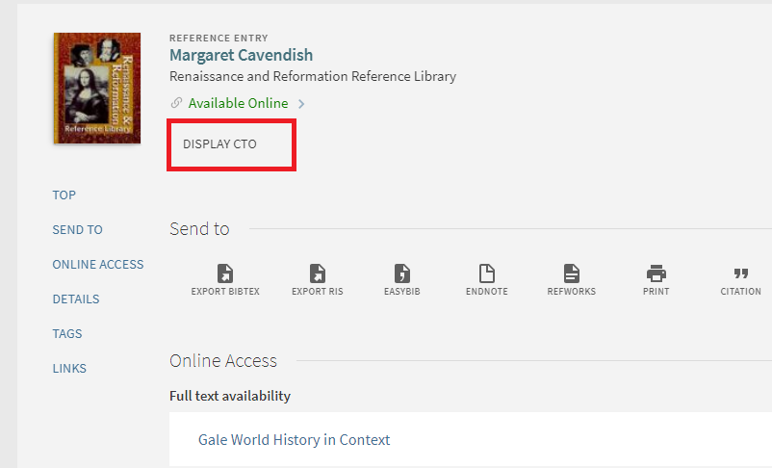
Use the displayCTO debugger to view the context_object

Slide 60
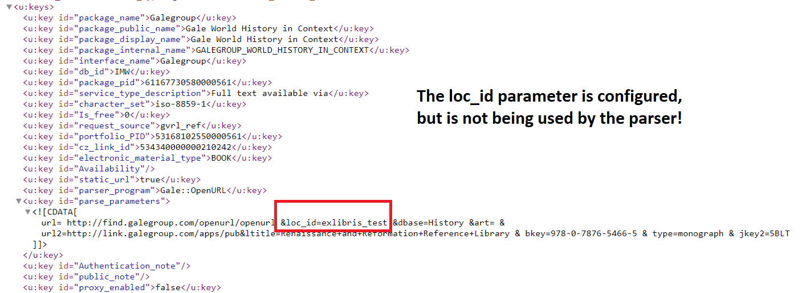
Find target URL in CTO

Slide 61
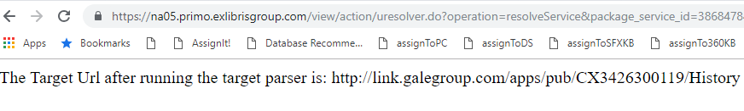
&debug=true
While the OpenURL is not exposed in Primo VE, you can copy the link address of the URL in the View It menu, and add ‘&debug=true’
This will reveal the target link generated by Alma Link Resolver

Slide 62
Parser problem with Gale::OpenURL
We determined that the Location ID linking parameter (loc_id) configured on the Service was not being used by the parser in one particular scenario (direct link with Gale ID).
The issue was forwarded to the Data Services Team to review the parser.

Slide 63

Example C : Metadata mismatch

Slide 64
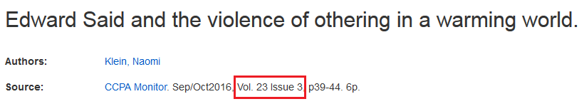
Example C : Metadata Mismatch

Slide 65
Fetch Type Linking – EBSCO API
Introduced in 2016 after consultation with EBSCO
XML request sent to EBSCO instead of a metadata URL
API returns either no result, or direct article link with EBSCO article number.
May improve some linking issues, but not metadata conflicts/mismatches
Available in both SFX and Alma, easy to activate/deactivate
Fetch Type Linking – EBSCO API

Slide 66
Fetch Type Linking - DOI
DOI = Digital Object Identifier
Publishers assign a number to a particular article (instead of metadata)
CrossRef keeps track of DOI numbers and associated metadata
If a publisher does not support a deep article-level linking syntax, link resolvers use:
  - CrossRef reverse-lookup services (enrichment)
  - DOI for article-level linking

Slide 67
DOI Linking problems – what to do?
DOIs are unique, not context-sensitive
Resolve a DOIs at CrossRef website:
https://www.doi.org/
Report Incorrect DOIs to CrossRef:
http://www.crossref.org/DOIComplaint/
Disable CrossRef on TS level (if persistent problems with target).
Note: This will not solve the problem completely, as OpenURL DOIs will still be used.
Some Services allow CrossRef exceptions in parse_param:
exception=noDOI
DOI Linking problems – what to do?

Slide 68
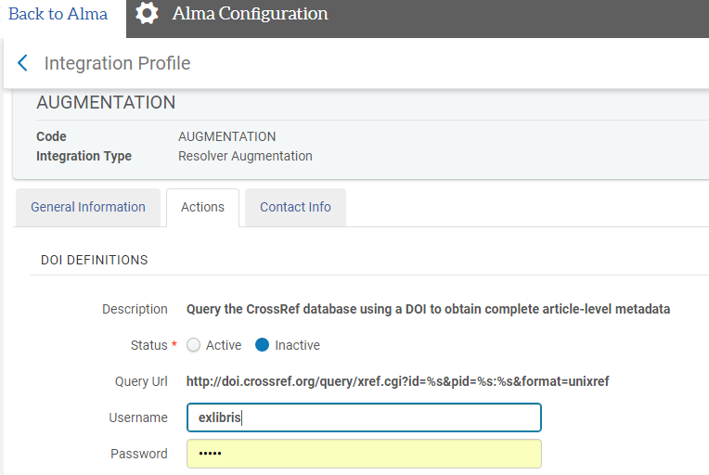
DOI Linking problems – what to do?
Advanced Configuration -> General -> External Systems -> Augmentation Profiles -> Resolver Augmentation

Slide 69
Related Documentation
Setup of CrossRef (DOI)
Common linking problems
Configuring Ebsco API
what is &exception=noDOI

Slide 70
Next Steps and Resources
Our KB team’s publisher relations group
exlibrisdataservices@exlibrisgroup.com
Benjamin.Johnson@proquest.com
If vendors have questions or want to communicate new linking syntax
Additional support resources from Ex Libris:
  Idea Exchange – ideas.exlibrisgroup.com
  Developer Network – developers.exlibrisgroup.com
  2019 Knowledge Days Seminar Presentations

Slide 71
Questions?

Slide 72

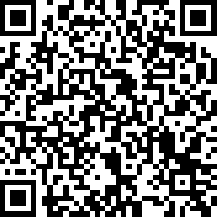
We value your feedback!
Please complete the session survey in the schedule section of the app.

