Slide 1
Demystifying Analytics in Alma
Interpreting Alma Analytics for Library Decision Making
Matt Warnock, Customer Success Manager

Slide 2
Matt Warnock, Customer Success Manager

Slide 3
Alma Analytics Basics
How and Why of Analytics
The Story in the Data
Suggestions for Getting Started
Notes:
https://developers.exlibrisgroup.com/blog/Tableau-Web-Data-Connector-for-Ex-Libris-Analytics/

Slide 4
Alma Analytics Basics

Slide 5
More than Just Reporting
Alma Analytics is more than just a reporting tool.
Alma Analytics is a business intelligence tool that can be used to interpret and communicate meaningful patterns and trends of data.
These patterns and trends and then be applied towards effective decision making.
In this presentation we’ll look at the hows and whys of decision making as well as a few cases where evidence-based decisions can be made.

Slide 6
Alma Analytics in a Nutshell
What are Analytics?
Built on Oracle Business Intelligence
What can you do?
Build, customize, and run reports on your Alma instance
Who can create reports?
Anyone with the Design Analytics role
Accessing Analytics
Alma > Analytics > Design Analytics
Notes:
Also used by Primo and Summon

Slide 7
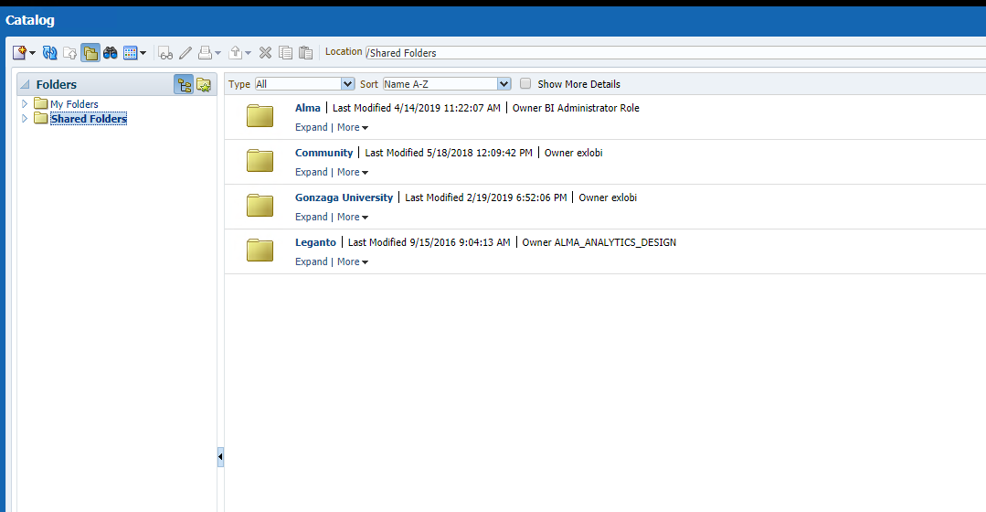
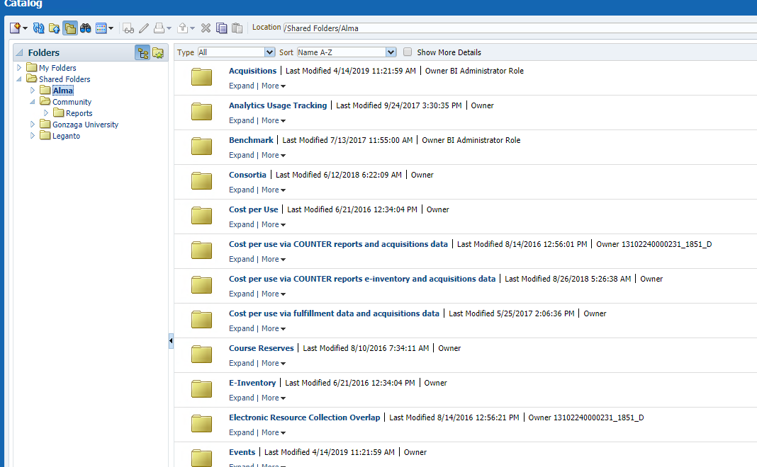
Analytics Examples
Notes:
There are many out of the box reports available, plus many more reports created & shared by Alma users globally. Oftentimes, if there’s a report you need, an Alma user somewhere has created a report you can use. I was working with a group of libraries that needed to do some annual reporting, but couldn’t find the report they needed in the various reports that were available out of the box, but when we looked for those reports in the community folders we found at least 75 possible reports. The Community reports use the parameters of the individual that created them with the data of the library that is accessing them, so there isn’t any cross-pollination of the creator’s data with your own.

Slide 8

Data Frequency
Data extracted by Alma 24 hours after previous extract*
Data collated and inserted into OBI in nightly process
Institutions use OBI to analyze and report on data
* Time of the last extract can be found under the Analytics drop down in the Alma navigation bar.

Slide 9
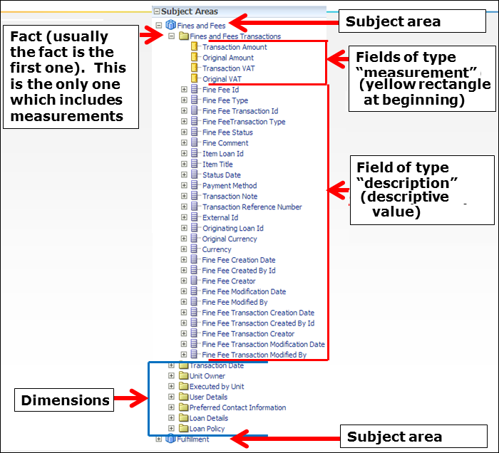
Analytics Data Breakdown
Notes:
Brief run through of these measurements/dimensions.
I know it can be intimidating in the beginning to look at these reports and try to play around with things, but I think it’s important to note that the worst thing that’s going to happen is you create a report that doesn’t work. The things you create in Alma Analytics don’t affect the underlying data. Analytics is a separate system that the data is exported to and the process only goes one way.

Slide 10
Analytics General Terminology
Term | Description
Subject Area | Data organized into different areas, such as Funds Expenditures, Fulfillment, Users, Fines and Fees, and Physical Items. Subject areas contain folders, measurement columns, attribute columns, and hierarchical columns.
Fact | Consists of the measurements, metrics, or facts related to a business process and contains the core part of the subject area.
Measurement Column | A column of data in subject areas that holds a simple list of data values that can change or can be counted or aggregated in some way.
Description Column | A column in subject areas that holds a flat list of values that are also known as members.
Dimensions | Tables that contain descriptive attributes that are typically textual fields or discrete numbers behaving like text, eg. Library Code, Vendor Name, Loan Date.

Slide 11
Alma Analytics Subject Areas
So Many Subject Areas!
Analytics Usage Tracking | Benchmark | Borrowing Requests
Cost Usage | Course Reserves | Digital Inventory
Digital Usage | E-Inventory | Events
Fines and Fees | Fulfillment | Funds Expenditure
Leganto Institutional Student Use | Leganto Instructor Use | Leganto Student Use
Lending Requests | Licenses | Link Resolver Usage
Physical Items | Physical Items Historic Events | Requests
Titles | Usage Date | Users
Notes:
Originally, I had 3 separate slides that listed each of these subject areas with a couple of words about each, but I knew that my director would say there were too many words on too many slides, so I cut back. I won’t go through each of these, but you can see there are a lot of areas to poke around in and a lot of potential information about Alma available to you. For comparison, Primo Analytics has 8 subject areas and Summon Analytics has 6.

Slide 12
The Decision Making Process

Slide 13
Business Practices for Analytics Use
Why look at Analytics?
  Enables long-term planning
  Provides more confidence on dealing with uncertainty despite a flood of information
Provide objective goals with figures and evidence
Reveal relationships between different parts of the library
Continuous improvement, what is working and what isn’t?
Know what you want to measure to manage the numbers, don’t let the numbers do the managing for you
Before you start digging into statistics, know what you want to ask of the data.
Notes:
https://smallbusiness.chron.com/importance-statistics-management-decision-making-4589.html
https://www.quora.com/How-is-statistics-used-in-business-decision-making
What are the subject areas for Alma Analytics? Know what data is available to pull from.
https://simplyeducate.me/2012/12/02/the-role-of-statistics-in-decision-making/
https://www.abs.gov.au/ausstats/abs@.nsf/lookup/1500.0chapter42010

Slide 14
More than just Numbers
Just having access to numbers isn’t enough for the decision making process.
It is necessary to access, understand, analyze, and communicate the information.
A little statistical literacy helps in understanding the numbers available in Alma Analytics.
  This falls into 3 categories: Data Awareness, Understanding of Statistical Concepts, and Communication

Slide 15
Data Awareness
Data is there to help us make decisions, and data awareness helps us select data that provides accurate answers to our questions.
  Looking at Alma Analytics for making decisions starts with the data need. Here are some questions to consider:
    What topic or subject area you are interested in?
    What are you trying to figure out?
    What is the timeframe of what you’re trying to count?
Notes:
https://www.abs.gov.au/ausstats/abs@.nsf/lookup/1500.0chapter62010
What types of data are available in Alma Analytics

Slide 16
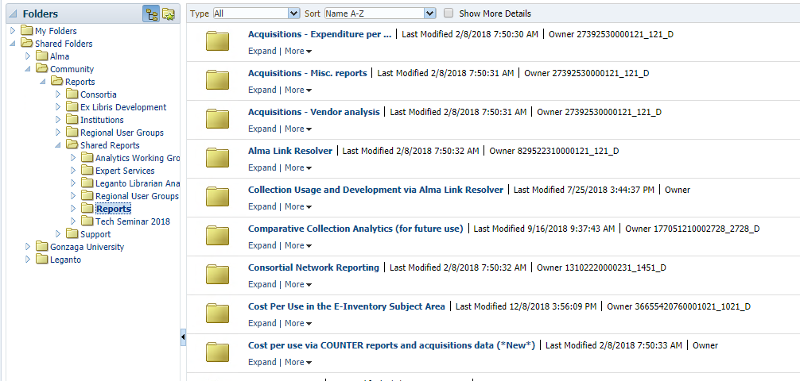
Data Awareness
What is the right report?
Once your information need has been identified, what report(s) are you going to use?
Notes:
As I mentioned before, there are a lot of out of the box reports, as well as a plethora of shared reports and the ability to create your own custom reports.
https://www.abs.gov.au/ausstats/abs@.nsf/lookup/1500.0chapter62010
What types of data are available in Alma Analytics

Slide 17
Knowing is Half the Battle
What issues or questions do you require information about?
What are your objectives and expectations?
How do the results of your analysis of Alma Analytics compare to your objectives and expectations?
Review, always review. Alma Analytics is collecting new data all the time for you to evaluate at the necessary intervals.
Notes:
The more of an idea you have of what you need going in, the better off you’ll be when trying to get answers from the data.

Slide 18
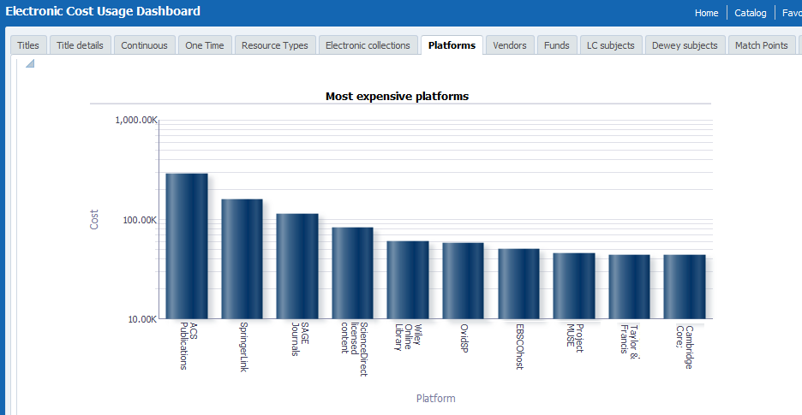
Communicate, Communicate, Communicate!
How are you communicating this information and your decisions to your colleagues and those that you report to?
Tables and graphs make the data easy to digest…but you need the numbers to back up your conclusions just in case
Notes:
It’s unlikely that you’ll need to be an Analytics expert, but it’s a good idea to be familiar with everything you have to present. The graph displayed on this slide is an easily digestible chunk of information that doesn’t take a lot of explanation, but can be very effective in getting your point across.
How will you present the information to make your case for a course of action? How do you get to the decision making process? There are stages for that.

Slide 19
Stages of Decision Making – The What
What is the issue at hand, and what are you trying to accomplish with it?
  Are you trying to make a case for increasing a certain type of spending?
  Are you trying to justify a bigger staffing budget for the service desks?
  Are you trying to decide what parts or how much of the physical collection to weed?
Notes:
This all may seem pretty straightforward, but it’s a good way to break down the issue at hand into manageable chunks that can be dealt with in pieces rather than trying to tackle the whole issue at once.
The first phase involves identifying and understanding the issue at hand. Statistics can assist policy makers to identify existing economic, social or environmental issues that need addressing. For example, statistical analysis could identify issues concerning the aging of the population or the implications of rising inflation. They are also vital for developing a better understanding of the issue by analysing trends over time, or patterns in the data.
https://www.abs.gov.au/ausstats/abs@.nsf/lookup/1500.0chapter42010
https://www.abs.gov.au/ausstats/abs@.nsf/lookup/1500.0chapter52010

Slide 20
Stages of Decision Making – Digging In
You’ve identified the issue at hand, but now what?
  Now you need to find the extent of the issue and determine how urgently you need to address it.
  Analytics highlight the relevance and severity of your issue in numerical terms and help you develop programs to address this as quickly as possible.
  Set up S.M.A.R.T. goals for what you want to accomplish.
Notes:
SMART = Specific, Measurable, Achievable, Relevant, and Time-bound
Statistics provide a valuable source of evidence to support the initiation of new policy or the alteration of an existing policy or program. Once an issue has been identified, it is then necessary to analyse the extent of the issue, and determine what urgency there is for the issue to be addressed. Statistics can highlight the relevance and severity of the issue in numerical terms, and thus demonstrate the importance of developing policy or programs to address the issue as quickly as possible.

Slide 21
Stages of Decision Making – Responding
Now that you have an issue to consider, how do you respond?
  This is where you carefully consider the information you have before you.
  Communicate with the key stakeholders on the issue to establish an understanding of the problem and the available information.
  Create clearly defined aims and goals with quantifiable indicators for your desired outcome.
  Benchmarks should be set up to check in a regular intervals to evaluate the outcomes of your decision.
Notes:
Once an issue has been identified and recognised as an important policy issue, it is then necessary to determine the best way to respond. This stage requires careful and rigorous statistical analysis and thorough consultation with key stakeholders to establish a clear understanding of the true extent of the problem. This will help to determine the most appropriate policy or program options to address the issue, and the best strategy for implementing these. During this stage, clearly defined aims and goals should be developed with quantifiable indicators for measuring success. Benchmarks should also be established to ensure that progress is measurable following the implementation of the policy/program.

Slide 22
Stages of Decision Making – Rinse and Repeat
Your decision and the library’s action doesn’t mean the process is over.
It is important to check your data to reevaluate your decision at regular intervals to ensure you don’t have to make further adjustments.
Not only can you decide if your decision was effective, but you might find areas for further improvement.
Eventually…you start the process over again.
Notes:
The policy process does not end once the policy/program is up and running. It is essential that the progress of a policy/program is regularly monitored and evaluated to ensure it is effective. An evaluation of the success of the policy/ program in quantifiable terms can be measured against benchmarks which were established at an earlier stage to accurately measure progress. This enables an assessment to be made as to whether the policy is meeting initial aims and objectives, as well as providing insight and identification of areas that require improvement. The process should then be repeated, by beginning the cycle again.

Slide 23
The Story in the Data
Notes:
At some point in your life, you might be encountering stressful situations that require you to make a choice. How will you be able to make informed and objective decisions?
The use of statistical tools may help you in this situation. It will help you reduce the uncertainty associated with decision-making that can affect your way of life. It reduces the guesswork related to decision making.
https://www.abs.gov.au/ausstats/abs@.nsf/lookup/1500.0chapter42010
Statistics can also aid the decision making process by enabling us to establish numerical benchmarks and monitor and evaluate the progress of our policy or program.
Statistics can be used to inform decision making throughout the different stages of the policy-making process. The following framework has been adapted from different approaches to the policy making cycle

Slide 24
The Story in your Data
What stories do you need to tell about the health and activity of the library with Analytics?
Who needs to see the information?
What are they most interested in?
Notes:
When I worked as a Circ. Manager at a public library, the story that my department told was in check ins, check outs, and the number of people coming through the door. I also helped tell the story of other departments in tracking how many checkouts were coming from which areas.
Who are you showing the data to and what are they most interested in seeing? If you have to report to the AUL what are they going to want to know about the library? If you’re building a report for the Dean of the university, what are they going to want to see? How can you best capture what the library is doing and it’s importance for the university?

Slide 25
Getting Started
How many use analytics on a regular basis?
Taking steps to make analytics easily accessible
  Widgets for quick visual access
  Scheduling reports and dashboards for more in-depth review

Slide 26
How much is too much?
How often do you need to look at analytics?
  Most reports are updated daily
  How often do you need to check statistics? Monthly? Quarterly?
  How often are you reporting on library activities to someone else?

Slide 27
Suggestions for Getting Started
Notes:
Now we’ll look at a few examples of reports that are available in Alma Analytics already that may give you some insights into library functions. These report can be tweaked and edited to suit your purposes and saved to your institutional folders to be accessed whenever you want.

Slide 28
Staffing by Need
How does circulation activity fluctuate from day-to-day or throughout the day?
  Are you desks properly staffed to meet the needs of your patrons during peak times?
Are your resources distributed properly?
Example Reports: Number of loans/day at the circ desk & Number of loans/hour at the circ desk
Notes:
Coming from a circulation background, making sure the desk is covered by the right amount of staff at the right times is something I’m familiar with. Unfortunately for me, the systems I had to use when I was in circ didn’t provide me with this robust of a data platform. When I started in Circ we were using Dynix classic and I had to print our monthly stats on green bar paper and 10-key everything into a spreadsheet.

Slide 29
Number of Loans/Day of Week at Circ. Desk
The report: “Number of loans by day of week at circulation desk”
Located in the Community folder > /shared/Community/Reports/Shared Reports/Reports/Fulfillment - Misc. reports
Useful to allocate staff at different days of the week to different circulation desks.
By knowing which desks have the most activity at which hours staff can be maximized by having more staff at busy desks and less staff at slower desks at the appropriate times.
Notes:
The report we’re going to look at first is…
It’s in the community folder of Alma Analytics…

Slide 30
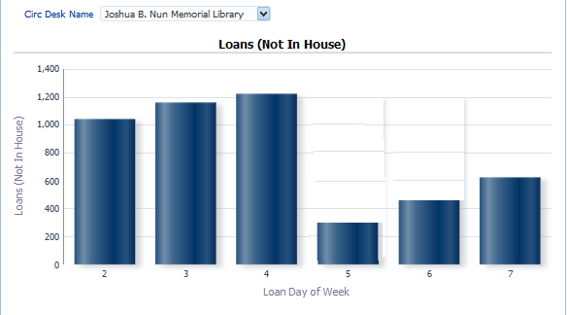
Number of Loans/Day of Week at Circ. Desk
The results include both a table and a bar graph. Here is the graph.
The bar graph works with a prompt and here the “Joshua B. Nun Memorial Library” was chosen
Day of Loan. 1 = Sunday, 2 = Monday, etc.

Slide 31
Number of Loans/Day of Week at Circ. Desk
In the graph on the previous slide we have evidence to make a decision that the majority of staff should be at the desk on Monday, Tuesday and Wednesday.
If until now the library has been evenly distributing an even amount of employees during each weekday then now the staff can be redistributed by “busy days” so their time can be used more effectively.

Slide 32
Number of Loans/Hour at Circ. Desk
The report: “Number of loans by hour at circulation desk”
Located in the Community folder > /shared/Community/Reports/Shared Reports/Reports/Fulfillment - Misc. reports
Useful to allocate staff at different times of the day to different circulation desks.
By knowing which desks have the most activity at which days of the week staff can be maximized by having more staff at busy desks and less staff at slower desks at the appropriate times.
Notes:
If we combine the information from the previous report with this next one, you get an even clearer picture of what’s going on at the circ desk. The next report is…
It is also located in the Community folder…

Slide 33
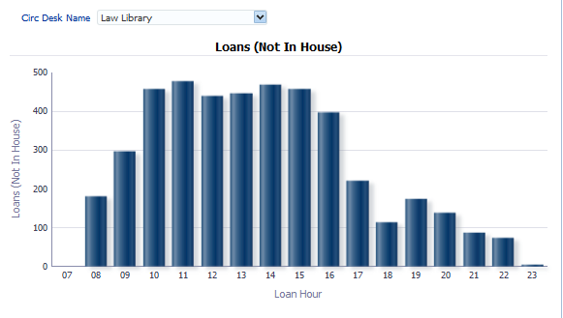
Number of Loans/Hour at Circ. Desk
The results include both a table and a bar graph. Here is the graph.
The bar graph works with a prompt and here the “Law Library” was chosen
Hour of loan

Slide 34
Number of Loans/Hour at Circ. Desk
In the graph on the previous slide we have evidence to make a decision that the majority of staff should be at the desk during the hours of 10:00 – 4:00.
If until now the library has been evenly distributing an even amount of employees during all times of the day during library open hours then now the staff can be redistributed by “busy hours” so their time can be used more effectively.
Notes:
With this information, you can plan appropriately for staffing at peak times, but also make a plan for other activities for staff to handle during off-peak times. When I was at the University of Chicago we used the off peak hours to scan materials for document delivery and audit the items stored in the automated storage system.

Slide 35
Collection Management
There are many reports that can answer questions about the library’s collections, their use, their costs, etc.
These reports can give you come insight into how your collection development strategies may need to be adjusted.
Example Reports: Electronic Acquisitions and Benchmark Analytics, Use of eResources for Collection Development, Physical Item Use for Weeding, & Most Used Physical Items for Collection Development
Notes:
Next we’ll look at a couple of reports that can help you make decisions about your collections.

Slide 36
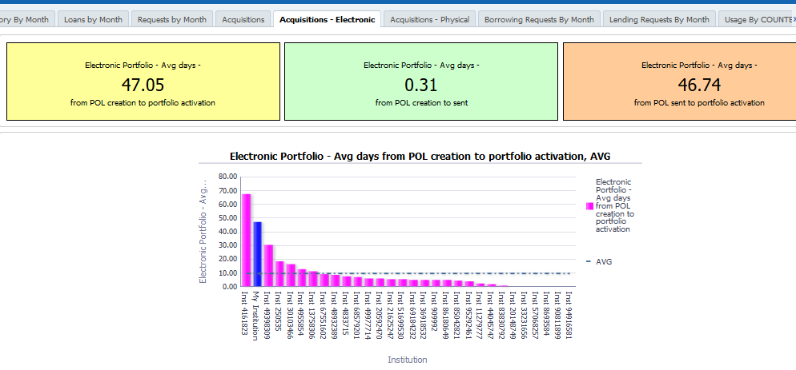
Electronic Acquisitions and Benchmark Analytics
Now we will look at the “Acquisitions – Electronic” tab of the “KPI Dashboard” located at /shared/Alma/Benchmark/Dashboards
36
Notes:
The Benchmark analytics subject area is especially useful in comparing the performance of your library to similar libraries. If you’re not sure where you may or may not need to reevaluate the processes and practices of the library, this is a good place to start. Benchmark Analytics cover several measurements, including Inventory KPIs, Acquisitions KPIs, Fulfillment KPIs for Requests and Loans, Resource Sharing KPIs for borrowing and lending requests, and Usage KPIs through COUNTER reports.
Some of the questions that can be investigated with these reports include: What is the average time of my institution from when an order is sent until the eResource is activated compared to other institutions? What is the average time for a physical item hold request to be processed compared to other institutions? What is the percent of loans that were returned late compared to other institutions?

Slide 37
Electronic Acquisitions and Benchmark Analytics
The information in this tab is useful for determining if there should be changes in the acquisitions workflow for electronic resources.
As with all tabs of the benchmark analytics, each institution can compare various KPIs between their institution and other similar institutions.

Slide 38
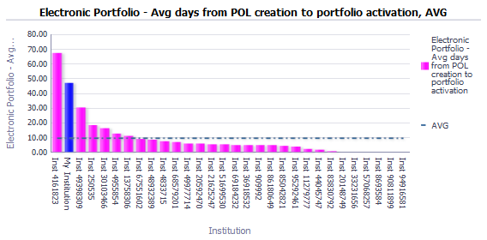
Electronic Acquisitions and Benchmark Analytics
This is the measure of the institution (blue bar) against all other institutions (pink bars) for time from creating an order for an electronic resource until the electronic resource is activated. The average is the blue dotted line.
Notes:
This graph shows the average days from the purchase order line creation to portfolio creation for electronic portfolios and compares them to other institutions. The dashed blue line shows the average length of time that it takes to go through this process, and gives a sampling of the time it takes other institutions to go through this process. In this example, the blue bar second from the left represents the library that is pulling the report. From this, we can clearly see that the library in question is well above the average in the time that it takes them to go from PO lines to portfolio activation. This is a case where you might want to evaluate the work that is going on in the library, take a step back to really follow your processes, and see where you might be able to make improvements.

Slide 39
Electronic Acquisitions and Benchmark Analytics
We can see from the previous slide that the time from order creation to resource activation is significantly higher in the institution than the average of all other institutions.
This evidence may be used to investigate, among other factors, the following:
  Perhaps the vendors being used need to be reevaluated
  The internal processes for activating the resources may need to be checked.
  The POL approval rules perhaps should be changed.
Notes:
Next we’ll look at an example of a report that looks at eResource usage.

Slide 40
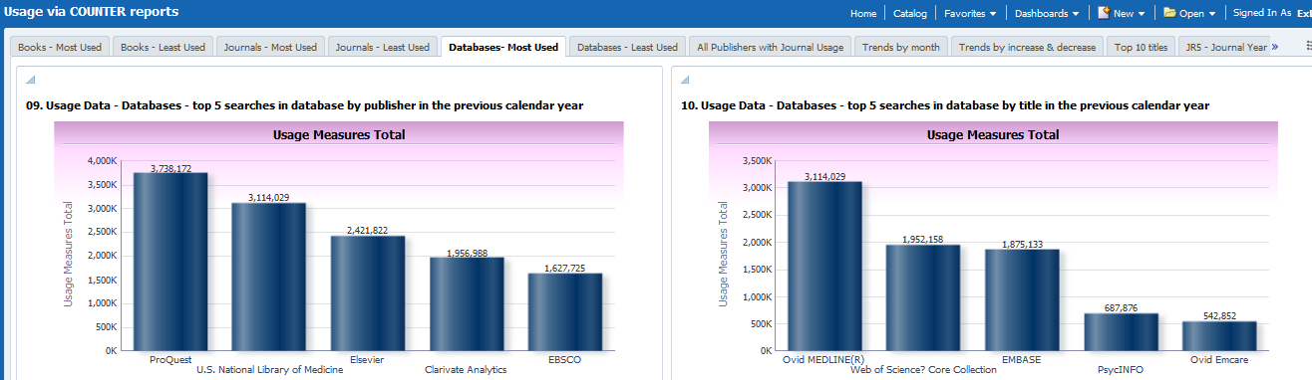
Use of eResources for Collection Development
We will now look at the “Databases most used” tab of the “Usage via COUNTER Reports” dashboard at /shared/Alma/Usage via COUNTER reports/Dashboards. We will look at the graphs by publisher.

Slide 41
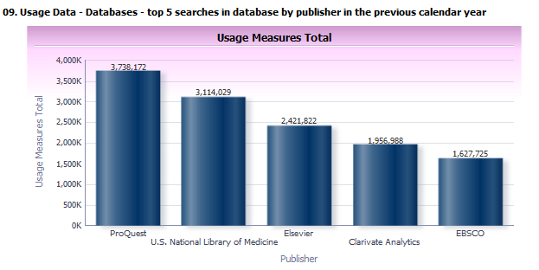
Use of eResources for Collection Development
Here are the publishers of databases which have the most searches in the previous calendar year

Slide 42
Use of eResources for Collection Development
The institution can use this evidence and determine that because these are publishers for whom the databases are most used then perhaps they should continue to be ordered.
This of course will influence collection development.
This data can further be combined not only with usage but also with “Cost per Use.” This too can be done with a default “out of the box” dashboard.
Notes:
Next we’ll look at a couple of reports that track the use of physical materials.

Slide 43
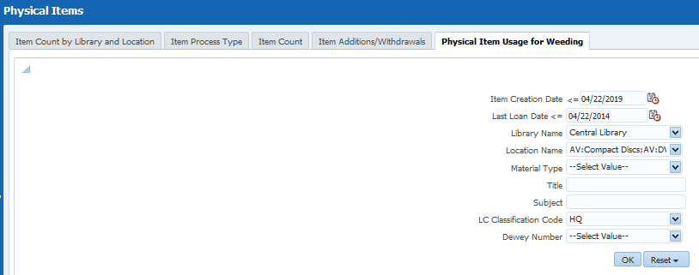
Physical Item Usage for Weeding
We will now look at the “Physical item usage for weeding” tab of the “Physical Items” dashboard at /shared/Alma/Inventory/Dashboards

Slide 44
Physical Item Usage for Weeding
The report produced here is useful for weeding. It is possible to take a call number classification code and find out which physical items have been in the library more than X years and never loaned in more than Y years.
These items can then be weeded from the library or moved to remote storage.
This can save valuable physical space in the library.
Notes:
I know many of the libraries I talk to have had to evaluate their physical collection usage and make decisions on what to keep or put into storage as more and more of the space in the library is taken up for studying and collaboration instead of housing books. While I was at the University of Chicago the library made an initial evaluation of what was being put into storage, but over time had to reevaluate and expand the scope of what they were willing to take off of the shelves to make room for more people space in the library.

Slide 45
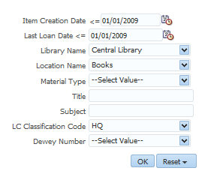
Physical Item Usage for Weeding
Here we retrieve all items which:
Were created over ten years ago
Have not been loaned in the last ten years
Are in the Central Library in the Books location
Have LC Classification Code HQ

Slide 46
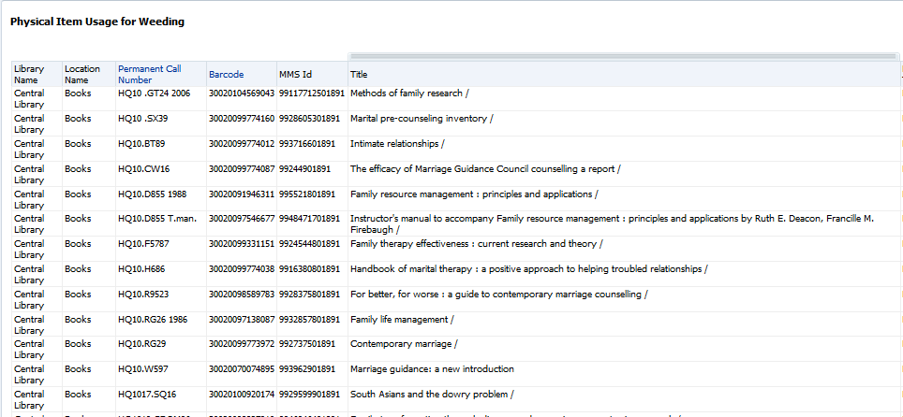
Physical Item Usage for Weeding
Results

Slide 47
Physical Item Usage for Weeding
In the list on the previous slide we have evidence to make a decision that these items can likely be weeded or removed to remote storage.
We have evidence that these items have been in the library at least ten years and never loaned in at least ten years. Unless there are “extenuating circumstances” they can probably be removed.
In this way valuable space in the library can be used for something else.

Slide 48
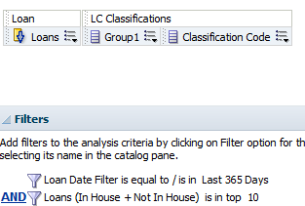
Most Used Items for Collection Development
We will now look at a custom made report showing which LC subjects are most used in the institution by looking at how many items of records with a specific LC subject area were loaned in the last year.
Here is the criteria tab of the report in the fulfillment subject area.
Number of loans sorted descending
Top ten LC subjects and corresponding number of loans in the last 365 days

Slide 49
Most Used Items for Collection Development
On the next slide we see the results.
We see for example that “Commerce”, “Internal Medicine” and “Psychology” are very used subjects.
Thus regarding collection development, and also taking into account other factors, the institution may decide that these subjects should be a significant part of the future purchased materials.

Slide 50
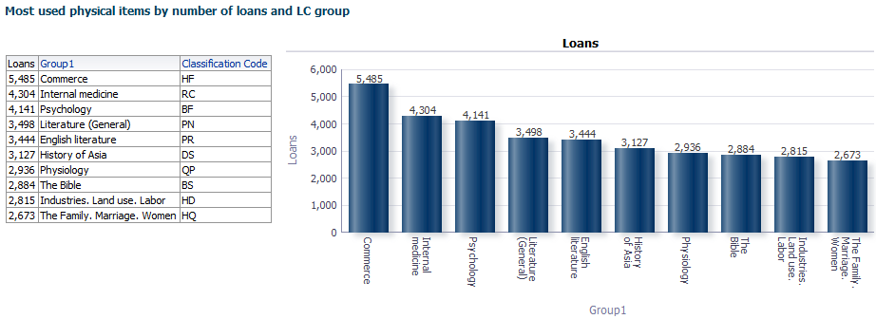
Most Used Items for Collection Development

Slide 51
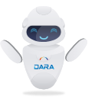
Other Analytics Tools
Primo and Summon Analytics show how your users interact with discovery
The new DARA tool can help make recommendations for maximizing configuration options.
Notes:
https://www.researchgate.net/publication/264848111_ELEMENTS_OF_STATISTICAL_DECISION_MAKING
https://www.abs.gov.au/ausstats/abs@.nsf/lookup/1500.0chapter82010
https://www.aclweb.org/anthology/W97-1005
https://www.americanexpress.com/en-us/business/trends-and-insights/articles/the-role-of-statistics-in-business-decision-making/

Slide 52
Additional Information
Alma Analytics and Evidence Based Decision Making
Analytics Benchmark subject area
A guide for using statistics for evidence based policy, 2010

Slide 53
Thank you!
Matt Warnock
matthew.Warnock@exlibrisgroup.com

Slide 54
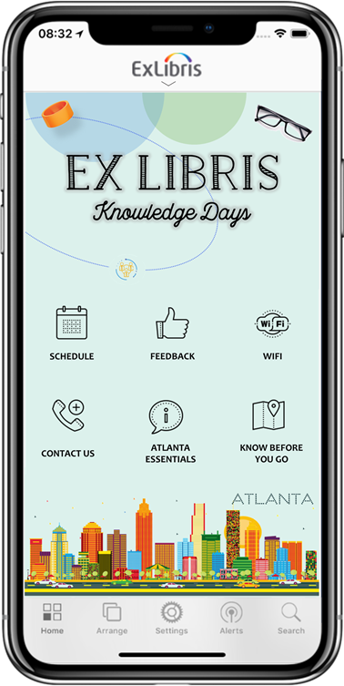
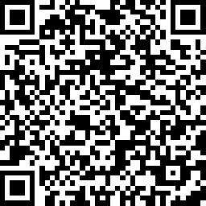
We value your feedback!
Please complete the session survey in the schedule section of the app.

