Slide 1
Optimize and Streamline Alma Workflows
Megan Drake

Slide 2
Welcome and Introductions
Megan Drake
MLS, 2005
Four years at Ex Libris
Consulting Services Manager
Expert Services, Special Projects, Functional Workshops
Previously Senior Implementation Consultant
Alma & Primo
Consortial Implementations
Systems & Applications Librarian at Pacific University
Orbis Cascade Alliance member
Heavily involved in SILS Project
Pacific first to go live in first cohort

Slide 3
Session Objectives
Session Description:
Have you been live on Alma for a while? Wondering what you can easily do to optimize your use of Alma? In this session, we will highlight configuration tweaks and Analytics reports across Acquisitions, Cataloging, ERM, and Fulfillment that you can use to begin to streamline your configurations and workflows.
Session Objective(s):
By the end of this session, you will know, understand and/or be able to:
Optimize and streamline Alma configurations across functional areas

Slide 4
Configuration Optimizations
Acquisitions
Electronic Resources Management
Cataloging
Fulfillment
Analytics Reports – Expert Services
Expert Services

Slide 5
Configuration Optimizations
Acquisitions
Electronic Resources Management
Cataloging
Fulfillment
Analytics Reports – Expert Services
Expert Services

Slide 6
Acquisitions Optimizations

Slide 7
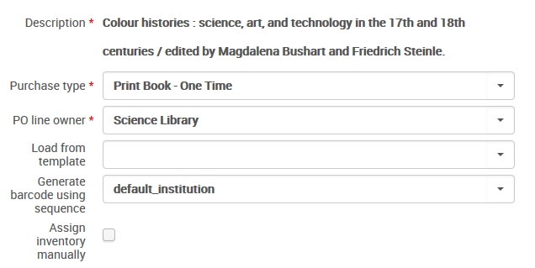
Purchase Type
Purchase type defines:
Inventory format
Physical
Electronic
Continuity
One-time
Continuous
Standing
Acquisition/item material type
Notes:
It is important to note that when you start the purchasing workflow by creating a Purchase Order line, the first thing you choose is the Purchase Type.
In this screenshot, we are creating a PO line with the purchase type of Print Book - One Time. The purchase type defines two things:
the inventory type that Alma will automatically create (e.g., physical or electronic inventory; in this case it is physical inventory), and
the continuity (e.g., is it a one-time order, is it a continuous order such as a subscription, or is it a standing order)
Once you choose the Purchase Type, you cannot change it later on. This is because the continuity and inventory type that are defined in the Purchase Type are core to the data structure of the purchase order line and most of the options for the downstream workflows are defined by the inventory type and continuity.
For example, if I create physical inventory (Print Book in this example), it will trigger Receiving workflows. If I create electronic inventory, it will trigger activation workflows. If it is a one-time order, it will remain open until it is received and paid for. If it is a continuous order (for example, a subscription), it will remain open until it is canceled.
The PO line also defines the acquisitions material type which, unlike the purchase type, can be changed later on.
It’s important to keep this in mind when you are creating purchase order lines. Additionally, if you are in implementation, take a good look at your migrated data and ensure that that continuity and inventory type migrated correctly.

Slide 8
Purchase Type

Slide 9
Purchase Type

Slide 10
Purchase Type

Slide 11
Purchase Type

Slide 12
Purchase Type

Slide 13
Purchase Type

Slide 14
Recommended Purchase Types to Retain
Physical
Physical – Subscription
Physical – One Time
Physical – Standing Order Monograph
Electronic
Electronic Collection – Subscription
Electronic Collection – One Time
Electronic Title – Subscription
Electronic Title – One Time
Electronic Title – Standing Order
Non-Inventory
Access Service – Subscription
Other Service – One Time

Slide 15
Order Line Templates
Create templates for:
Common combinations of vendor / fund / location
Moving the ERM order process to ERM specialists
Moving the Gift order process to Cataloging

Slide 16
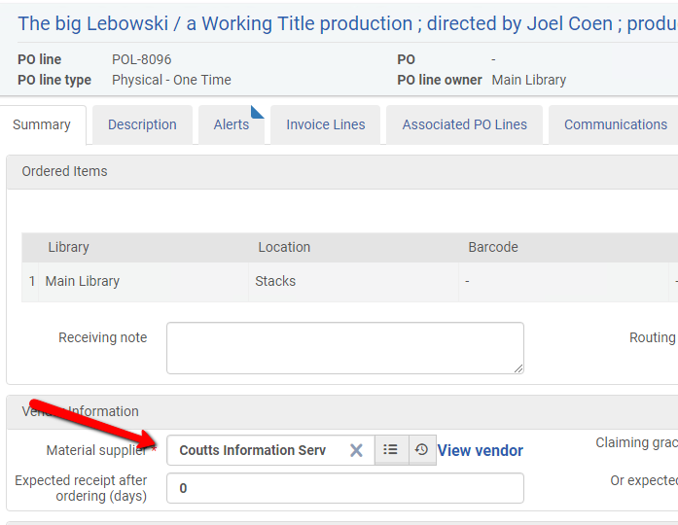
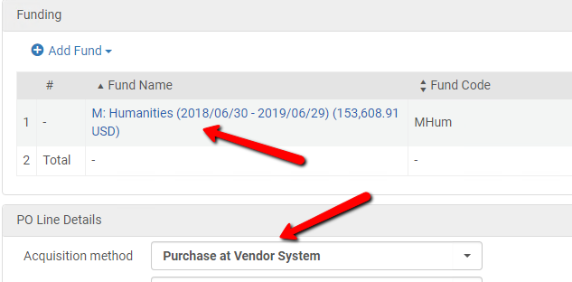
Order Line Templates

Slide 17
Order Line Templates

Slide 18
Order Line Templates

Slide 19
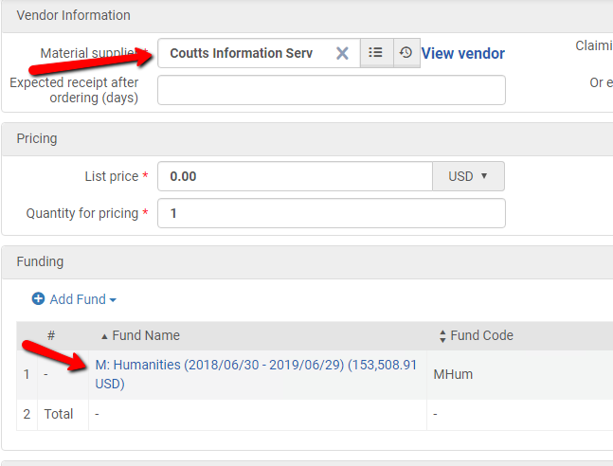
Order Line Templates

Slide 20
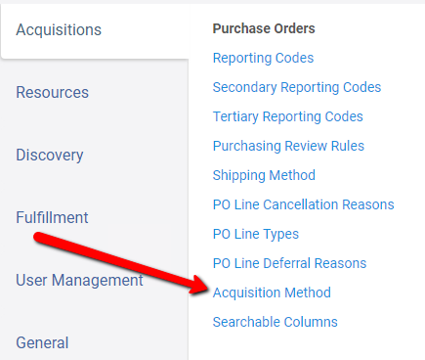
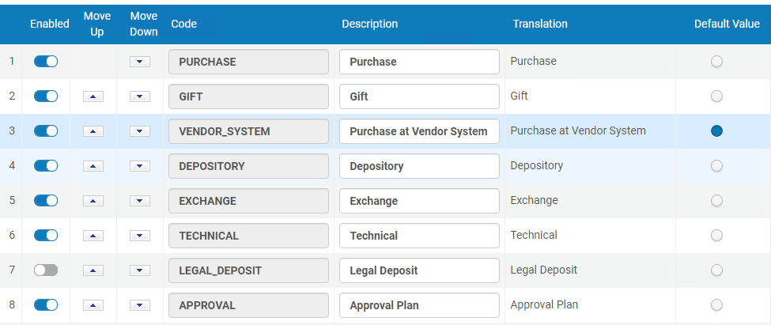
Acquisition Method

Slide 21
Recommended Acquisition Method to retain
Purchase at Vendor System (Default)
Approval
Gift
Technical

Slide 22
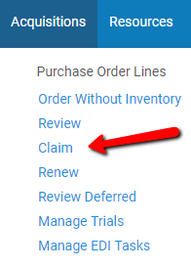
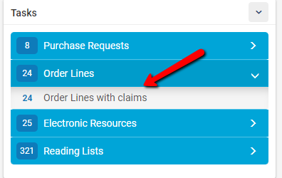
Claiming Task List

Slide 23
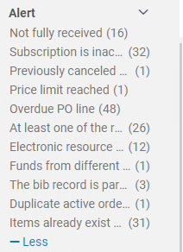
Claiming Task List
Claims are created when
Materials are not received by the expected receiving date
Electronic resources are not activated by the expected activation date
Claims are often inadvertently created during the early days after Go Live when workflows are still being solidified
Notes:
\

Slide 24
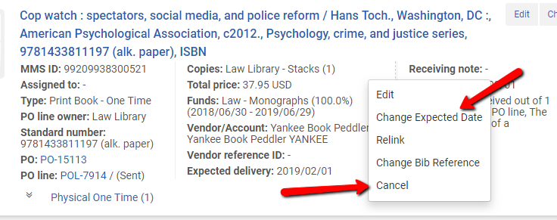
Claiming Task List

Slide 25
Resource Management Optimizations

Slide 26
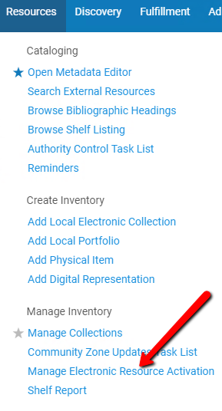
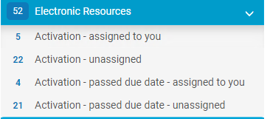
Activation Task List

Slide 27
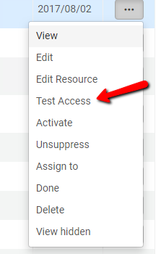
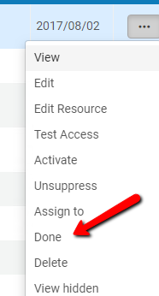
Activation Task List
Often cluttered due to workflow issues at Go Live
Close all old task list items after ensuring that the resource is activated

Slide 28
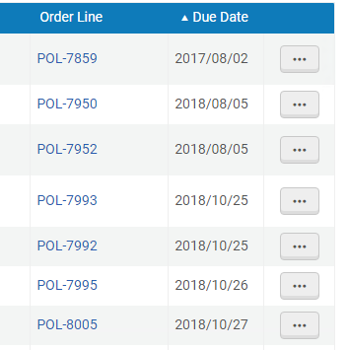
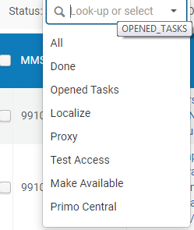
Activation Task List
Delete activation task list items that are old by filtering status date to earliest.
As you work through the cleanups, change the filter to the most recent date and use statuses to filter by the needed activation work.

Slide 29
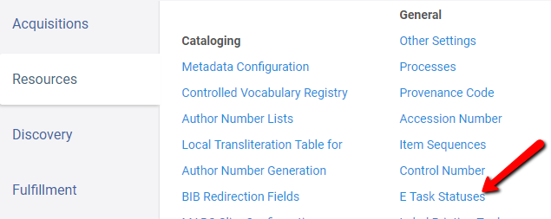
Activation Task List

Slide 30
Activation Task List

Slide 31
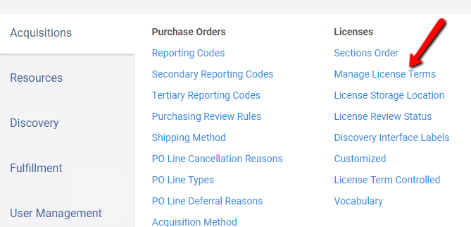
Licenses

Slide 32
Licenses
Agree as a group what should be tracked with licenses
Hide the terms that are not included in the agreed upon list

Slide 33
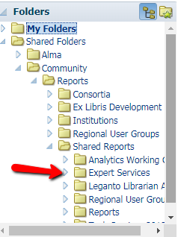
Item Material Types

Slide 34
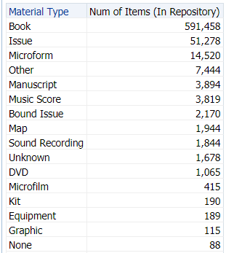
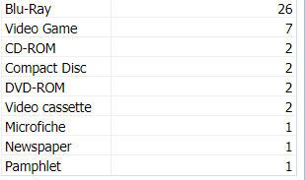
Item Material Types

Slide 35
Item Material Types
Determine which material types will be used.
Create sets of the items with deprecated material types and change the material type in bulk

Slide 36
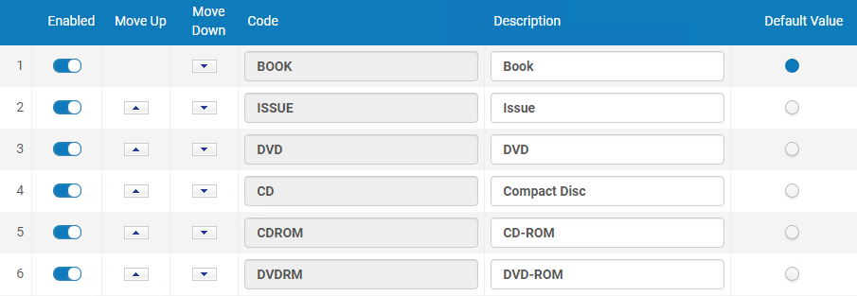
Item Material Types
Disable the deprecated material types so they cannot be used

Slide 37
Fulfillment Optimizations

Slide 38
Request Monitoring

Slide 39
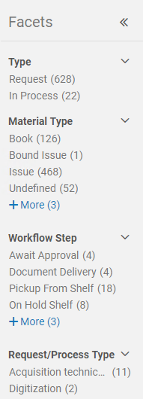
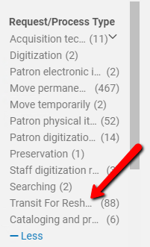
Request Monitoring – Lost in Transit

Slide 40
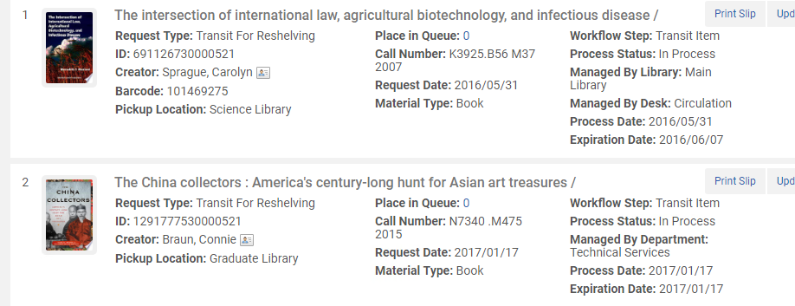
Request Monitoring – Lost in Transit

Slide 41
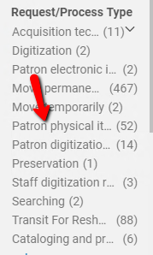
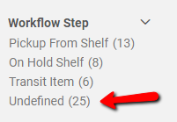
Request Monitoring – Aged Physical Item Requests

Slide 42
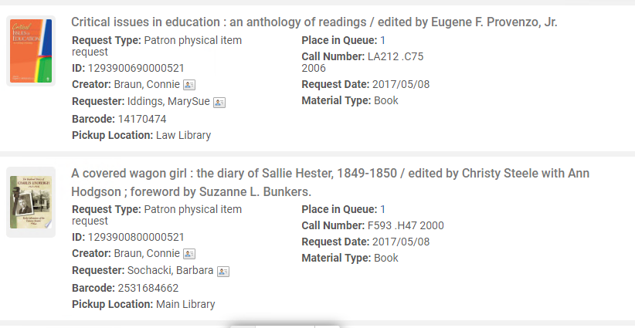
Request Monitoring – Aged Physical Item Requests

Slide 43
Request Monitoring – Aged Physical Item Requests

Slide 44
Request Monitoring – Aged Physical Item Requests

Slide 45
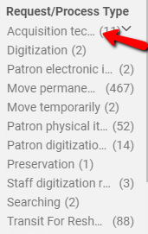
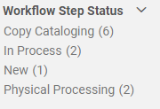
Request Monitoring – Cataloging Backlog

Slide 46
Work Orders
Where do people do the work?
Do materials need to transit between buildings or floors?
Do the same people do different types of work that are all managed by work orders?

Slide 47
Work Orders
Where do people do the work? – In one location
Do materials need to transit between buildings or floors? – No
Do the same people do different types of work that are all managed by work orders? – Yes
Use statuses for different types of work within the OTB Acquisitions Work Order

Slide 48
Work Orders
Where do people do the work? – In multiple locations
Do materials need to transit between buildings or floors? – Yes
Do the same people do different types of work that are all managed by work orders? – No
Create different work order departments for the disparate locations where work is performed

Slide 49
Lost / Missing Workflows
Create a new work order called “Search.”
Attach to the circulation desk used by the staff who will be performing the work (via the relevant circ desk configuration).
Create statuses of “First,” “Second,” “Third,” and “Reacquire.”
These will sort alphabetically so using a number in the code is suggested.

Slide 50
Lost / Missing Workflows
After a search, work from the “items in department” list to select all items in each status and increment them as follows:
Select all items with a status of “Third” and update the status to “Reacquire”
Select all “Second” items and update to “Third”
Select all “First” items and update to “Second”
The order is important to avoid rolling items on the first search through each subsequent status as part of the same process.
When items are flagged for reacquisition, queue an acquisitions technical services work order and complete the search work order.

Slide 51
Lost / Missing Workflows
Items in missing status are actionable
Create scheduled analytics report of items in missing status
Missing items are moved into the Search Work Order department and the missing status is cleared

Slide 52
Configuration Optimizations
Acquisitions
Electronic Resources Management
Cataloging
Fulfillment
Analytics Reports – Expert Services
Expert Services

Slide 53
Expert Services folder

Slide 54
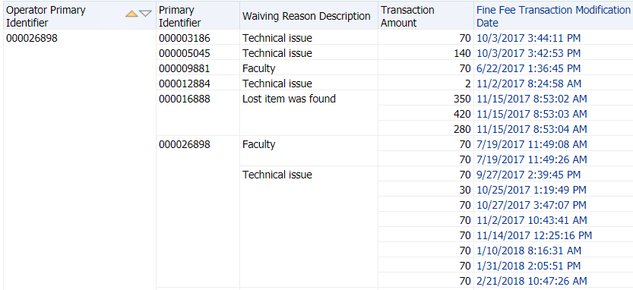
Expert Services folder

Slide 55
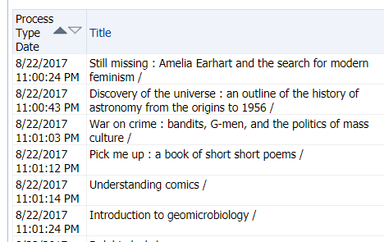
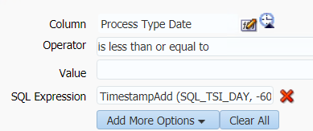
Expert Services folder

Slide 56
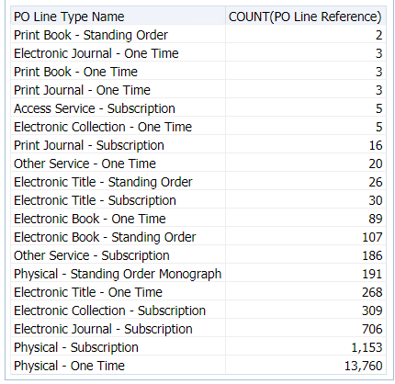
Expert Services folder

Slide 57
Configuration Optimizations
Acquisitions
Electronic Resources Management
Cataloging
Fulfillment
Analytics Reports – Expert Services
Expert Services

Slide 58
Expert Services
Optimize
Identify new ways to streamline your use of Ex Libris systems. A consultant will perform an onsite analysis of current workflows in one functional area, make recommendations, and configure the system, and train staff.
Extend
Set up new system functionality. A consultant will configure the system and train staff in new workflows and administration.
Analyze
Write custom reports in Alma Analytics. A consultant will understand the questions to answer, then deliver reports and visualizations.
Educate
Customized training sessions. An Ex Libris consultant will work to identify the functional areas requiring training and design training sessions targeted to your specific needs.

Slide 59
Optimize Service
Review
Understand current workflows, processes, and assets
Manage staff expectations
Set agenda for onsite visit
Optimize
Discussions of workflows and best practices
Demonstrations and trainings on workflows and configuration
Engagement summary
Activities and training performed
Configurations performed and recommended

Slide 60
Extend Service
Planning
Clarify intended outcomes
Review requirements and current workflows
Consultation and configuration
System configuration
Training on workflows and administration of the new function
Engagement summary
Activities and new features implemented
Configurations made during the project
Follow-up to monitor progress

Slide 61
Analyze
Planning
Planning and scoping with subject area experts
Subject area and specific questions to answer or monitor
Context, intended usage and target audience
Building reports
Criteria, results, visualizations, and dissemination options
Review report and tune results based on feedback

Slide 62
Educate
Planning
Planning and scoping with project manager
Subject area(s) and specific questions to answer
Context and target audience
Training delivery
Demonstrations and training on workflows and configurations

Slide 63
Questions?

Slide 64
Next Steps and Resources
Additional support resources from Ex Libris:
Idea Exchange – ideas.exlibrisgroup.com
Developer Network – developers.exlibrisgroup.com
2019 Knowledge Days Seminar Presentations

Slide 65
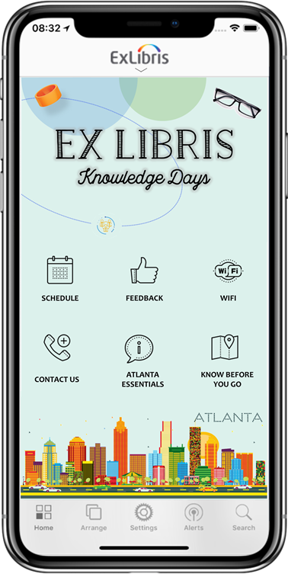
We value your feedback! Please complete the session survey in the schedule section of the app.
Notes:
TUESDAY

