Slide 1
Advanced Analytics – Acquisitions
Connie Braun and Dominic Doneux

Slide 2
First Steps
If not already done, add a sub-folder in your institutional folder to hold the analyses we will create
If more than one person from your institution is participating in today’s training, determine a naming convention (e.g. initials or name to start each saved analysis name)

Slide 3
New Titles Received in the Past Month
Budget Summary
Cost Changes of Subscriptions Over Time

Slide 4
New Titles Received in the Past Month

Slide 5
Introduction
Library liaisons would like a monthly report of physical titles added to the library’s collections
Should be subdivided by Reporting Code which is based on academic departments
Should not include journals

Slide 6
Add Columns from Physical Items Subject Area

Slide 7
View Results

Slide 8
Items Received in the Past Month
Save the Analysis!

Slide 9
Add Another Column and a Filter

Slide 10
View the Results

Slide 11
Items Received in the Past Month
Save the Analysis!

Slide 12
Add a Filter for Receiving Date

Slide 13
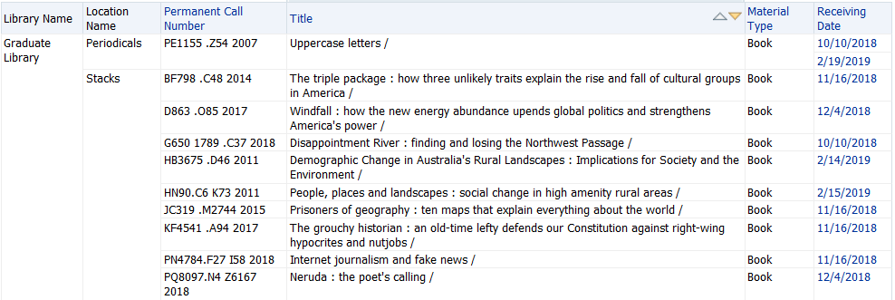
View the Results

Slide 14
Items Received in the Past Month
Save the Analysis!

Slide 15
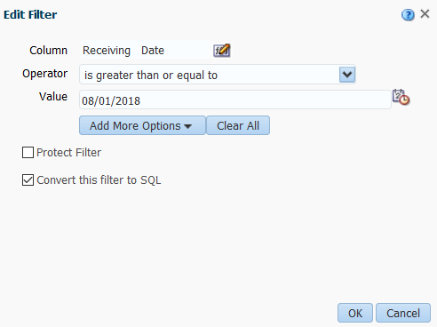
Edit the Receiving Date Filter

Slide 16
Edit the Receiving Date Filter

Slide 17
Revised Analysis

Slide 18
View the Results

Slide 19
Items Received in the Past Month
Save the Analysis!

Slide 20
Items Received in the Past Month
What else might be useful in this analysis?

Slide 21
Budget Summary

Slide 22
Introduction
Would like an overall budget summary that shows the original allocations of funds along with encumbrances and expenditures
A nice addition would be a column showing balance remaining
A further “nice-to-have” is showing percentage relationships between allocations and encumbrances and/or allocations and expenditures

Slide 23
Adding Columns

Slide 24
Editing Column Properties

Slide 25
Customizing Column Headings

Slide 26
Columns Used and Initial Results

Slide 27
Budget Summary
Save the Analysis!

Slide 28
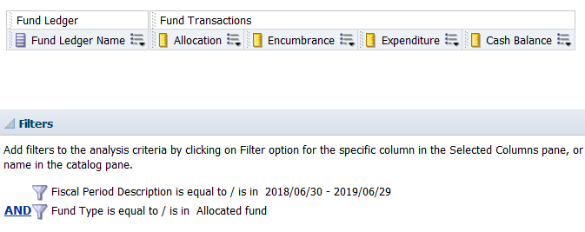
Add Filters for Fiscal Period Description and Fund Type

Slide 29
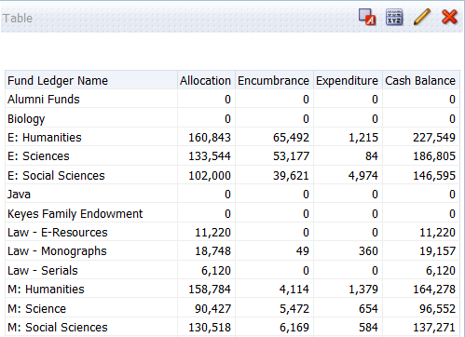
View the Results

Slide 30
Budget Summary
Save the Analysis!

Slide 31
Edit the Formula for the Cash Balance Column

Slide 32
Edit the Formula for the Cash Balance Column
"Fund Transactions"."Transaction Allocation Amount" - ("Fund Transactions"."Transaction Encumbrance Amount" + "Fund Transactions"."Transaction Expenditure Amount")

Slide 33
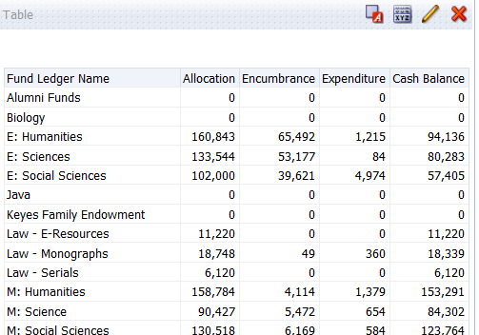
View the Results

Slide 34
Budget Summary
Save the Analysis!

Slide 35
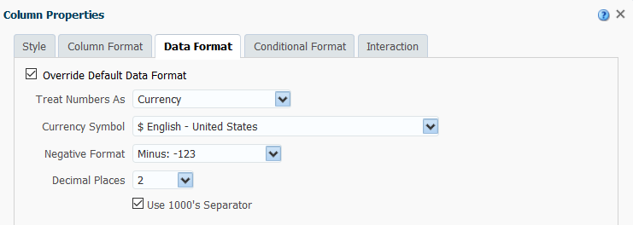
Edit the Column Properties to Show Actual Values

Slide 36
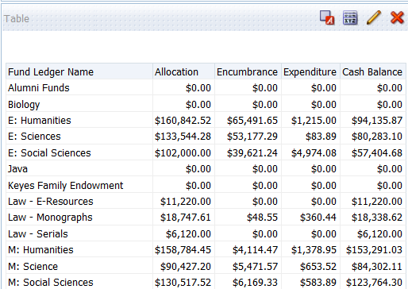
View the Results

Slide 37
Budget Summary
Save the Analysis!

Slide 38
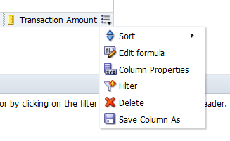
Adding Percentages to the Analysis

Slide 39
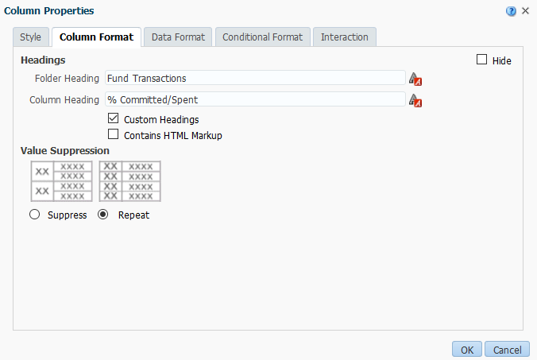
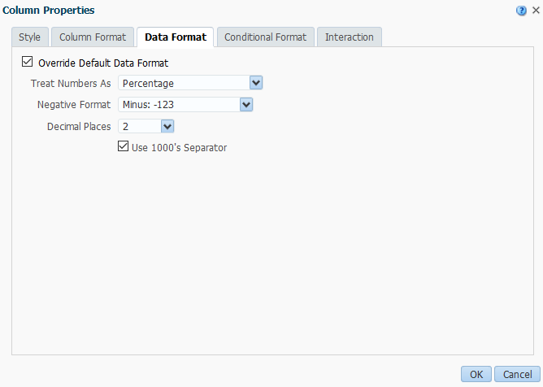
Adding Percentages to the Analysis

Slide 40
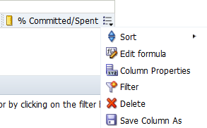
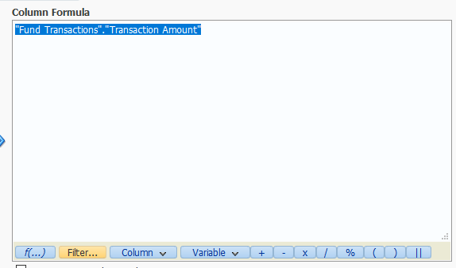
Adding Percentages to the Analysis

Slide 41
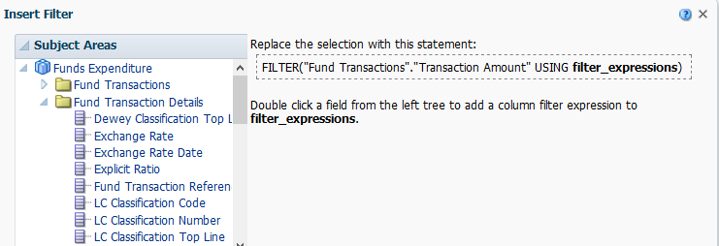
Adding Percentages to the Analysis

Slide 42
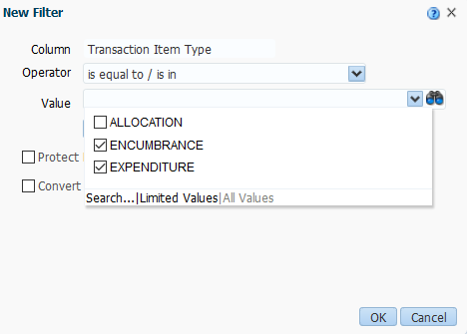
Adding Percentages to the Analysis

Slide 43
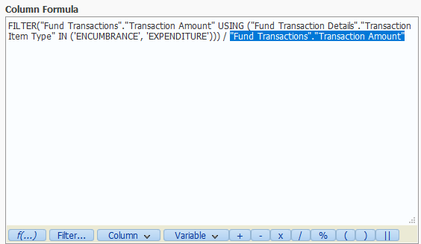
Adding Percentages to the Analysis

Slide 44
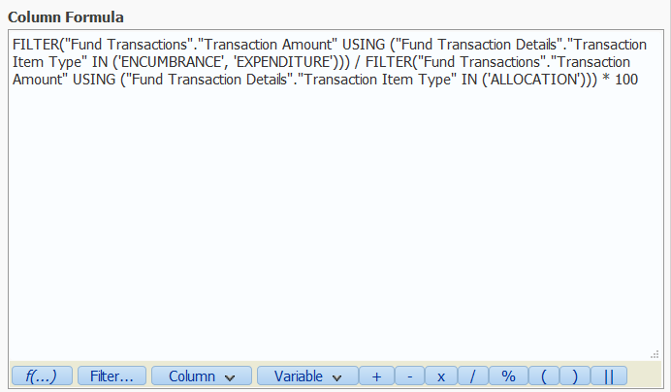
Adding Percentages to the Analysis
FILTER("Fund Transactions"."Transaction Amount" USING ("Fund Transaction Details"."Transaction Item Type" IN ('ENCUMBRANCE', 'EXPENDITURE'))) / FILTER("Fund Transactions"."Transaction Amount" USING ("Fund Transaction Details"."Transaction Item Type" IN ('ALLOCATION'))) * 100

Slide 45
Budget Summary
Save the Analysis!

Slide 46
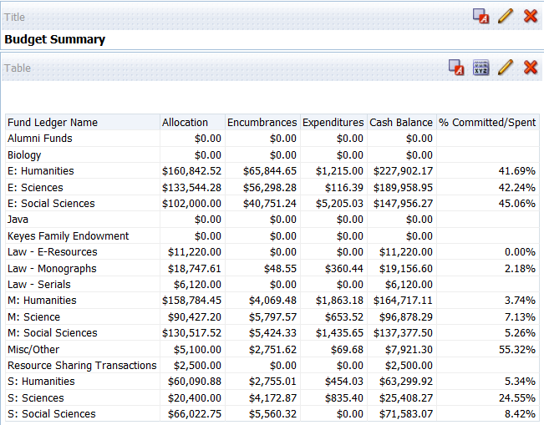
View the Results

Slide 47
Budget Summary
What else might be useful in this analysis?

Slide 48
Cost Changes of Subscriptions Over Time

Slide 49
Introduction
Goal is to see how the cost of subscriptions have changed over the years
Let’s focus on the past five years
Uses a pivot table view to simplify viewing of the data

Slide 50
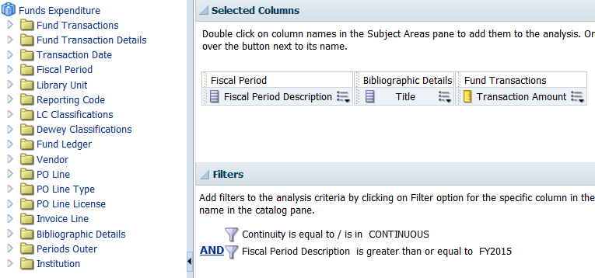
Add Columns and Filters

Slide 51
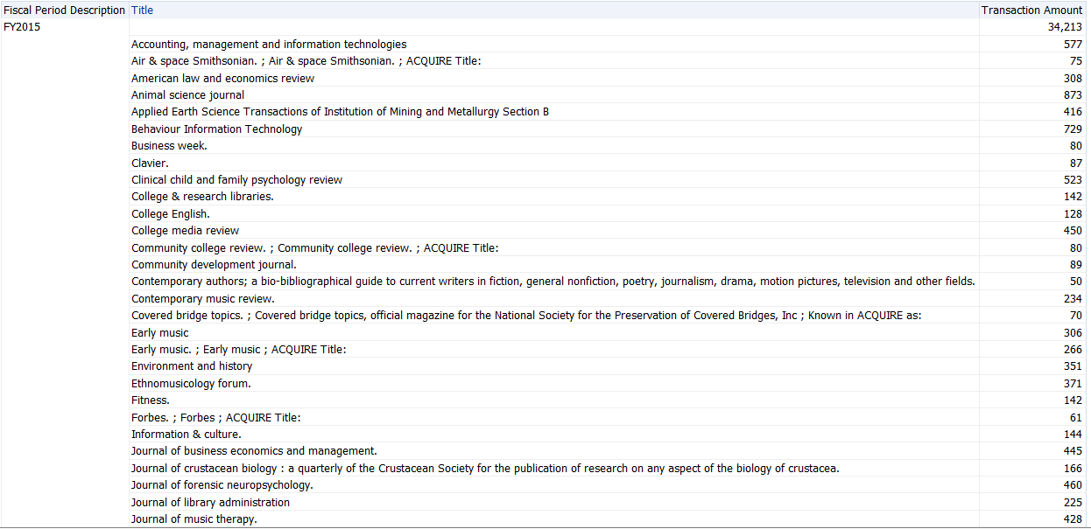
View Results

Slide 52
Subscription Cost Changes
Save the Analysis!

Slide 53
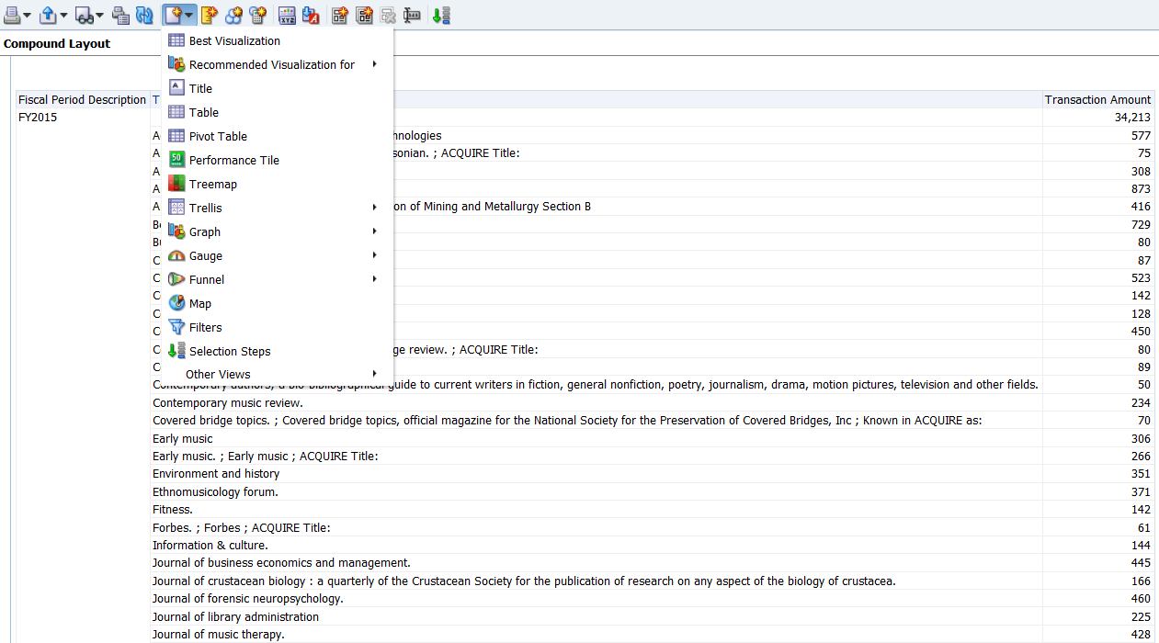
Add a New View for a Pivot Table, Delete Table View

Slide 54
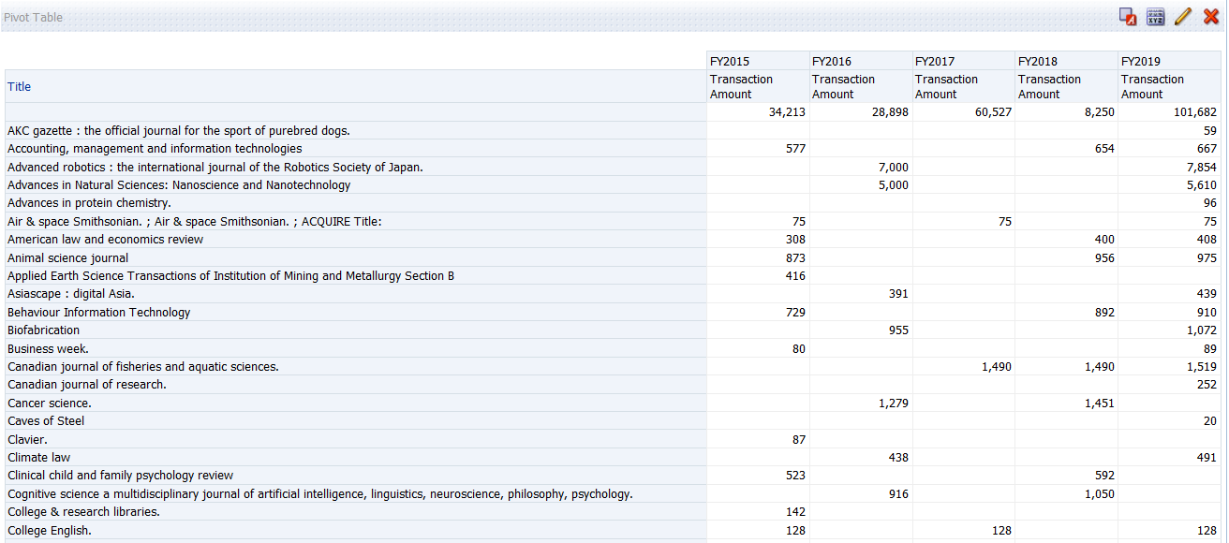
View the Results

Slide 55
Subscription Cost Changes
Save the Analysis!

Slide 56
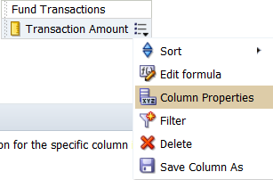
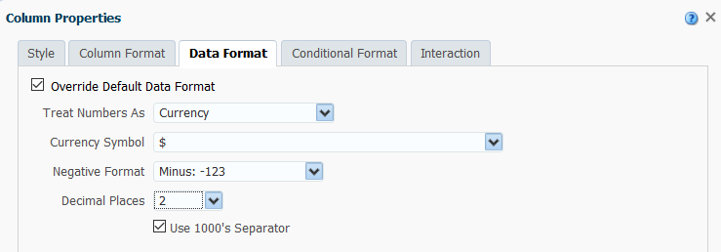
Change to Exact Dollar Values

Slide 57
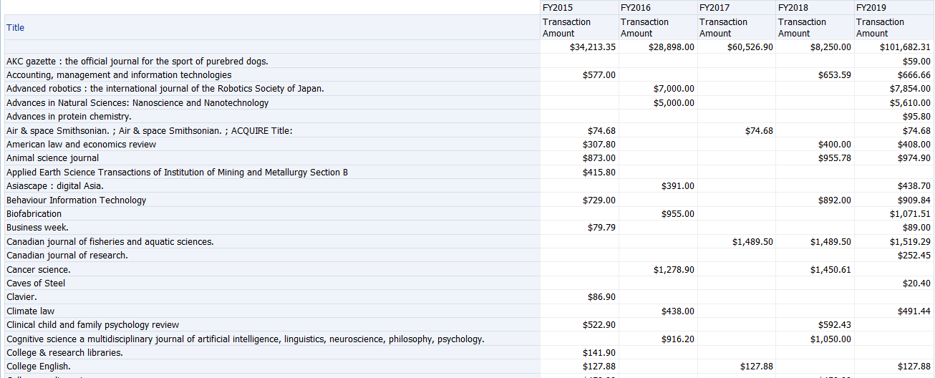
View the Results

Slide 58
Subscription Cost Changes
What else might be useful in this analysis?

Slide 59
We value your feedback! Please complete the session survey in the schedule section of the app.

Slide 60
Thank you!

