Slide 1
Usage and Cost per use in the E-Inventory subject area
Yoel Kortick
Senior Librarian

Slide 2
Agenda
Introduction
Reports and dashboard
Calculation of resource cost
How the match is made
Electronic Cost Usage Dashboard

Slide 3
Introduction

Slide 4
Introduction
This presentation relates to the "Cost Per Use" which is an integral part of the E-Inventory subject area.
A folder called "Cost Usage" exists in the E-Inventory subject area. The subfolders and fields in this folder allow the user to create "Usage" and "Cost per use" reports.
Note that the subfolder also contains a tool tip pop up for additional help.

Slide 5
Introduction
The next slide contains a diagram explaining what is included in the "Cost Usage" folder of the E-Inventory subject area, and how that content it differs from the "Usage Data" subject area.
"Usage Data" subject area = Includes all records which were loaded via COUNTER reports
"Cost Usage" folder of the E-Inventory subject area = Includes all records which were loaded via COUNTER reports and match a record in the repository which has electronic inventory

Slide 6
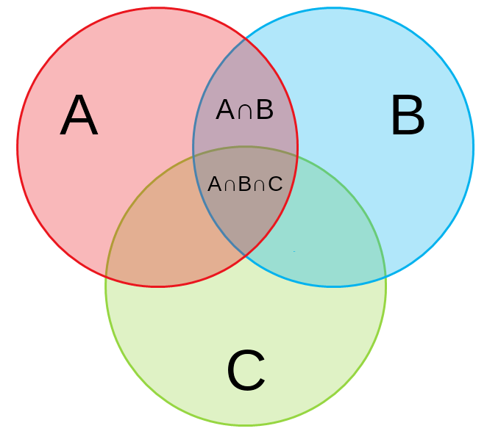
Introduction
Has COUNTER Usage Data and E-Inventory
E-Inventory
Usage Data
A = Everything in the E-Inventory subject area
B = Everything in the Usage Data subject area
C = Everything in the Funds Expenditures subject area
A∩B = Part of Cost Usage folder. Has COUNTER Usage Data and E-Inventory in Alma
A∩B∩C= Part of Cost Usage folder. Has COUNTER Usage Data and E-Inventory in Alma and Expenditure in Alma
Has COUNTER Usage Data and E-Inventory and Expenditure
Funds Expenditures
https://www.mydraw.com/templates-venn-diagram-three-circle-venn-diagram

Slide 7
Introduction
Several default reports exist in the folder /shared/Alma/Cost per use via COUNTER reports e-inventory and acquisitions data/Reports.
A default dashboard with these reports exists under /shared/Alma/Cost per use via COUNTER reports e-inventory and acquisitions data/Dashboards.

Slide 8
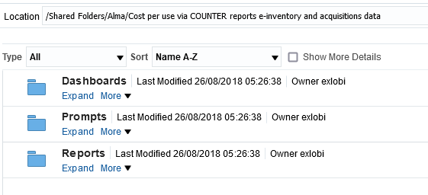
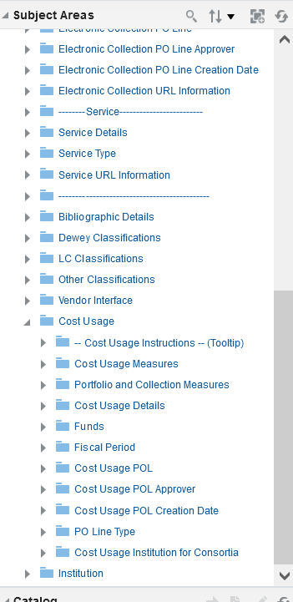
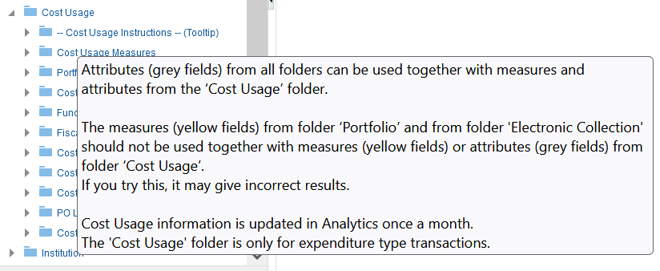
Introduction

Slide 9
Introduction
Via the folder "Cost Per Use" in the E-Inventory subject area it is possible to obtain the following information:
An in-depth analysis of the COUNTER usage for titles in Alma.
Cost Per Use on POLs of type "One Time" as well as type "Continuous".
Cost Per Use for portfolios which are part of a collection but do not necessarily have their own POL. For example, the user can get cost per use for one specific portfolio which is part of a collection, and the collection has a POL but the portfolio does not.

Slide 10
Introduction
Additionally, the user can:
View the match points used when matching the titles from the COUNTER reports to the titles in the Alma E-Inventory subject area.
Get an in-depth breakdown of the COUNTER usage
Include the platforms in the cost per use reports
Include the fund details including the fund fiscal period in the cost per use reports

Slide 11
Introduction
Because the Cost Per Use is an integral part of the E-Inventory subject area all of the following fields and more may be included in the Cost Per Use reports:
The licenses
The LC subjects
The Dewey subjects
The resource types
All fields from the "Bibliographic Details" folder

Slide 12
Reports and dashboard

Slide 13
Reports and dashboard
The default "Electronic Cost Usage Dashboard" is located at "/shared/Alma/Cost per use via COUNTER reports e-inventory and acquisitions data/Dashboards"
The default reports are located at "/shared/Alma/Cost per use via COUNTER reports e-inventory and acquisitions data/Reports"

Slide 14
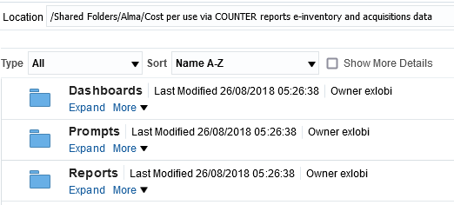
Reports and dashboard

Slide 15
Reports and dashboard
The "Electronic Cost Usage Dashboard" includes the following tabs:
Titles
A prompt by "Fund Fiscal Period Description" and list of
Most used titles
Least used titles
Most expensive titles
Least expensive titles
Title details
A search box criteria for word from title, ISBN and ISSN.
Results are a list of titles including details of cost per use
A link to the view the same title in the usage data subject area

Slide 16
Reports and dashboard
Continuous
A prompt for searching titles with a POL of type "Continuous" by portfolio creation year, minimum cost and minimum usage and a list of titles including details of cost per use
A link to the view the same title in the usage data subject area
One time
Like the "Continuous" tab but searches for titles with a POL of type "One Time"
Resource Types
A prompt by "Fund Fiscal Period Description"
A detailed analysis of the resource types of electronic inventory.
This includes inventory which does and does not necessarily have usage or cost.
There are three pie charts with a detailed explanation.

Slide 17
Reports and dashboard
Electronic Collections
A prompt by "Fund Fiscal Period Description" and list of
A list of Cost Usage By Electronic collections
Platforms
A prompt by "Fund Fiscal Period Description" and list of
Most used platforms
Least used platforms
Most expensive platforms
Least expensive platforms
Vendors
A prompt by "Fund Fiscal Period Description" and list of
Most used vendors
Least used vendors
Most expensive vendors
Least expensive vendors

Slide 18
Reports and dashboard
Funds
A prompt by "Fund Fiscal Period Description" and list of
Most used funds (highest use)
Most effective funds (highest use per cost)
LC Subjects
A prompt by "Fund Fiscal Period Description" and list of
Most used LC Subjects
Least used LC Subjects
Most expensive LC Subjects
Least expensive LC Subjects
Dewey Subjects
A prompt by "Fund Fiscal Period Description" and list of
Most used Dewey Subjects
Least used Dewey Subjects
Most expensive Dewey Subjects
Least expensive Dewey Subjects

Slide 19
Reports and dashboard
Match Points
A prompt by "Fund Fiscal Period Description" and pie charts and a graph explaining if there was a match between the title from the COUNTER report and the title in the Alma E-Inventory and if so according to what criteria
Usage Types
A prompt by "Fund Fiscal Period Description" and pie charts with a detailed analysis of the COUNTER report types in Cost Per Use.

Slide 20
Reports and dashboard
Usage By Title Per Electronic Collections
A prompt by "Fund Fiscal Period Description" and a list of electronic collections with:
Number of titles in the collection
Number of titles in the collection which have usage
Percent of titles which have usage
Cost
Usage
Cost Per Use
Cost per title
Titles with multiple portfolios
Includes prompts by title, subject, classification codes, cost and usage.
Allows for filtering by number of collections per title
Useful for evaluating which collections have a lot of overlap (have a lot of the same titles).

Slide 21
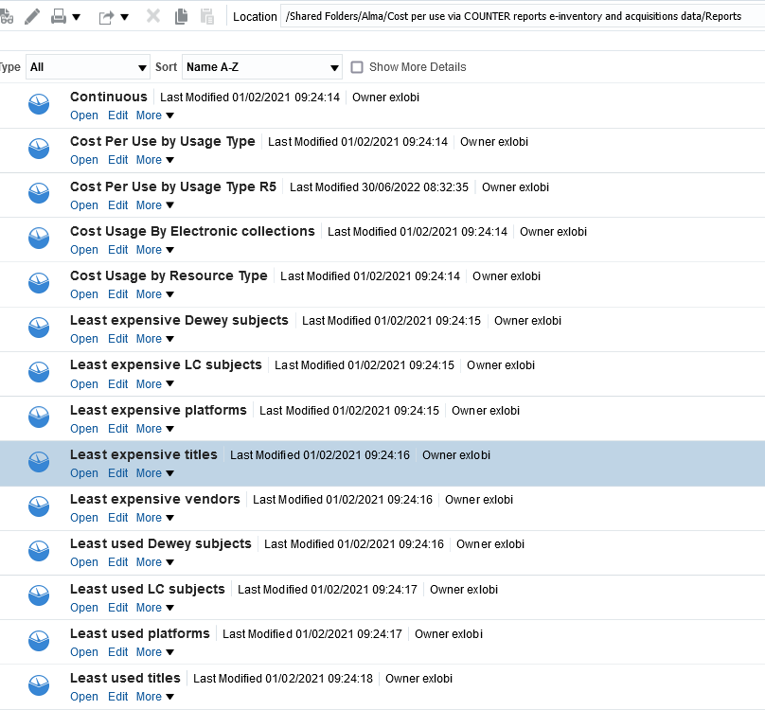
Reports and dashboard
The reports in the dashboard may be edited and saved locally

Slide 22
Calculation of resource cost

Slide 23
Calculation of resource cost
There are four situations in which the cost of an electronic resource must be determined for Alma Analytics cost per use
The resource does not have it’s own POL but rather it is part of an electronic collection which has a POL and the POL is of type Continuous.
The resource does not have it’s own POL but rather it is part of an electronic collection which has a POL and the POL is of type One Time.
The resource does have it’s own POL and the POL is of type Continuous.
The resource does have it’s own POL and the POL is of type One Time.

Slide 24
Calculation of resource cost
For an explanation of each of these situations see:
Alma Analytics – Overview of determining the price for cost per use
Alma Analytics – Determining the price for cost per use for a portfolio which is part of a collection which has a POL of type Continuous
Alma Analytics – Determining the price for cost per use for a portfolio which is part of a collection which has a POL of type One Time
Alma Analytics – Determining the price for cost per use for a portfolio which has its own POL of type Continuous
Alma Analytics – Determining the price for cost per use for a portfolio which has its own POL of type One Time

Slide 25
How the match is made

Slide 26
How the match is made
For details on how the match is made between the resource in the COUNTER report and the resource in Alma see Alma Analytics – Matching the resource from COUNTER report to the resource in Alma for cost per use

Slide 27
Electronic cost usage dashboard

Slide 28
Electronic Cost Usage Dashboard
What follows here are a small sample of some of the many reports available in the "Electronic Cost Usage Dashboard".

Slide 29
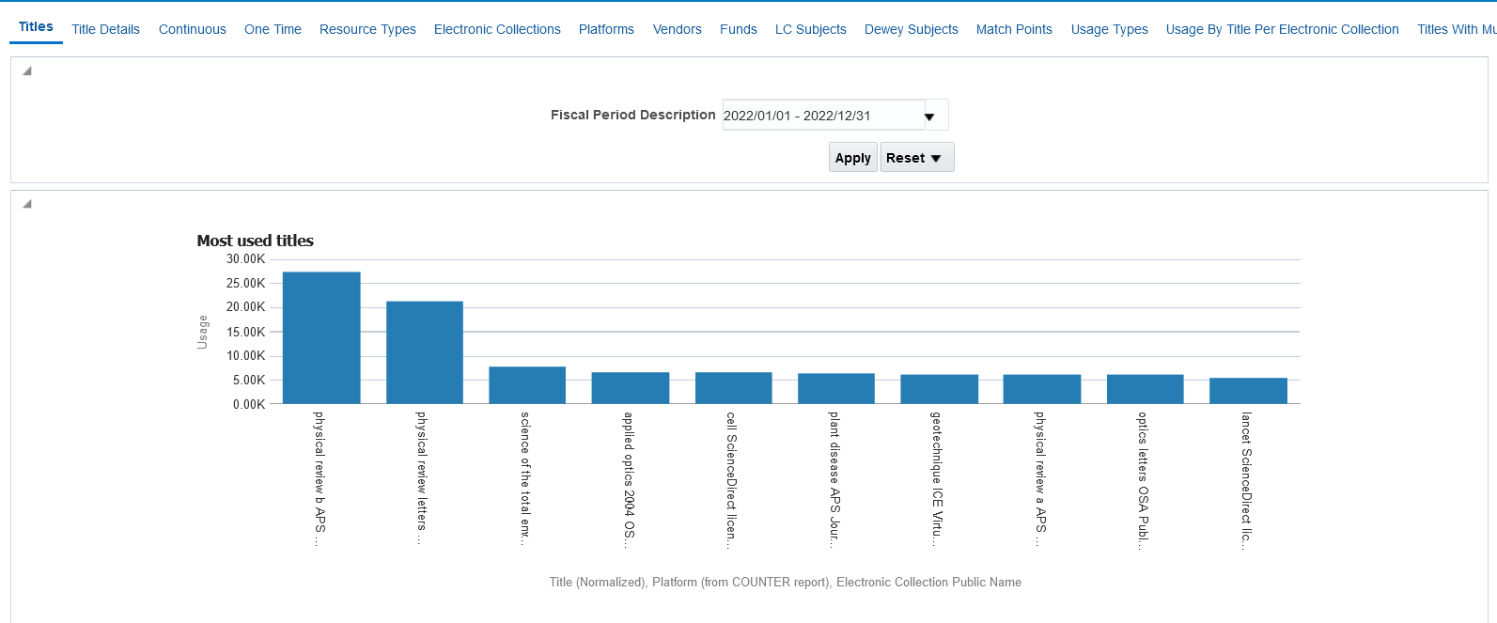
Electronic Cost Usage Dashboard

Slide 30
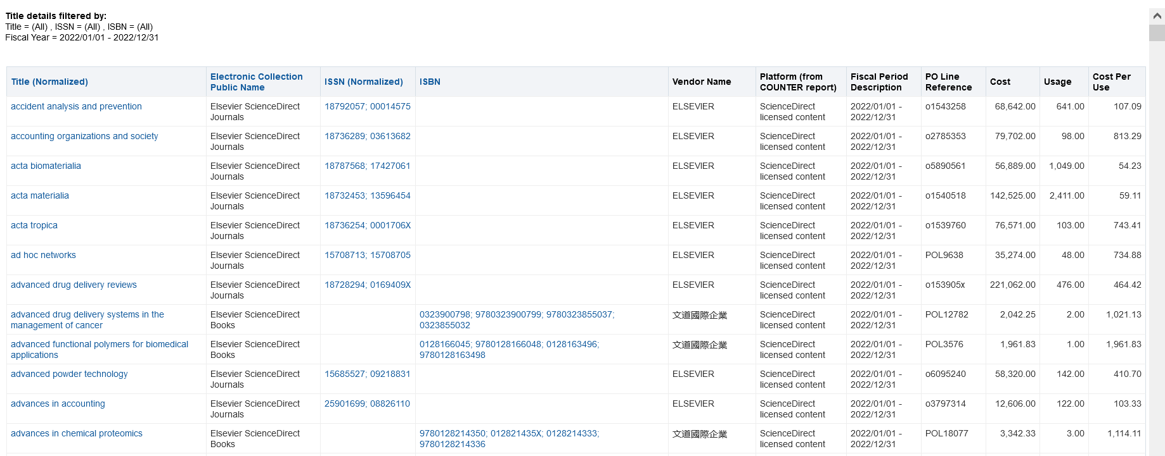
Electronic Cost Usage Dashboard

Slide 31
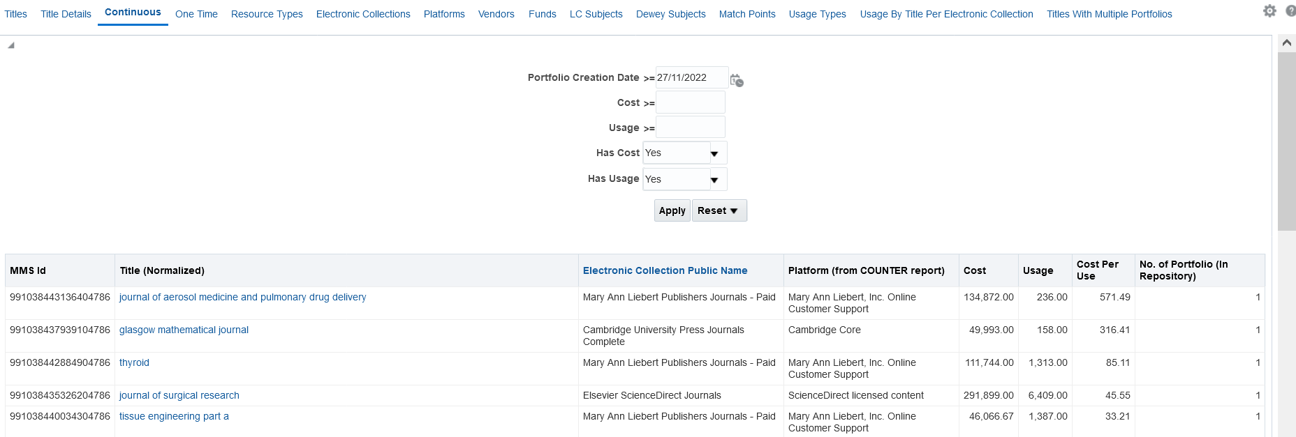
Electronic Cost Usage Dashboard

Slide 32
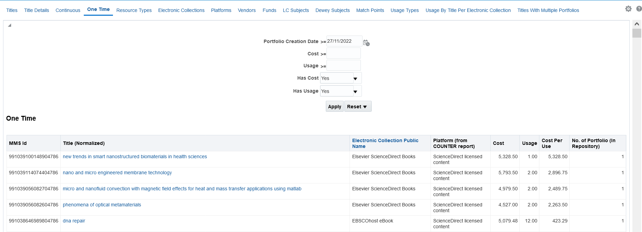
Electronic Cost Usage Dashboard

Slide 33
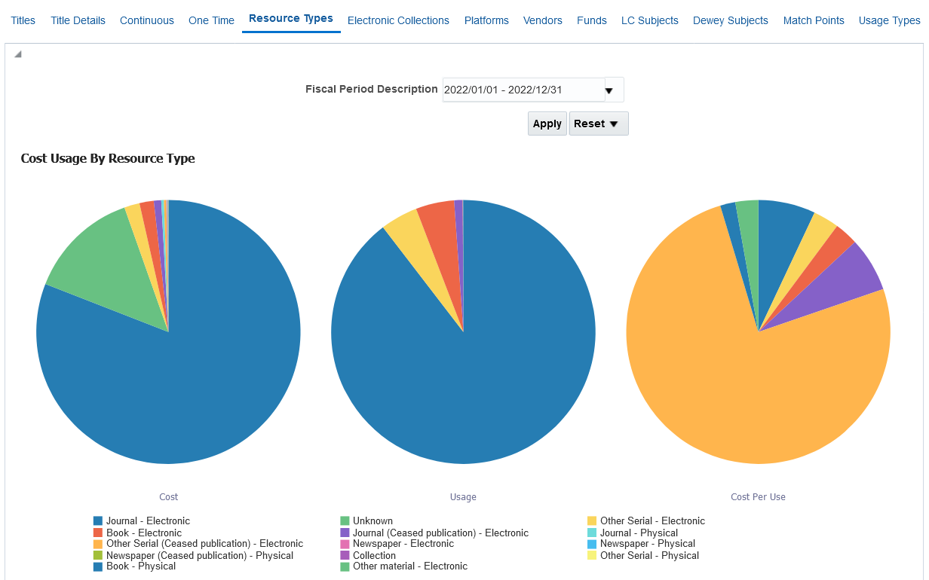
Electronic Cost Usage Dashboard

Slide 34
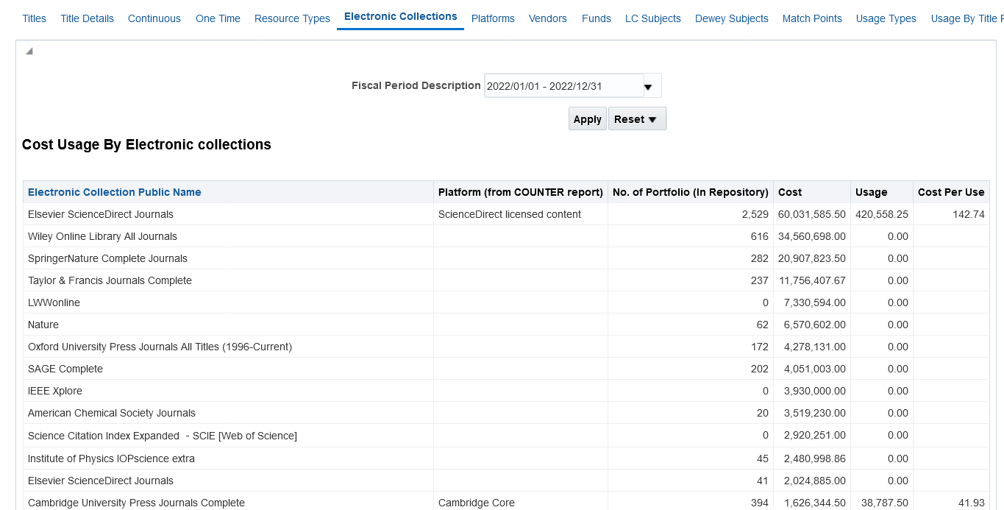
Electronic Cost Usage Dashboard

Slide 35
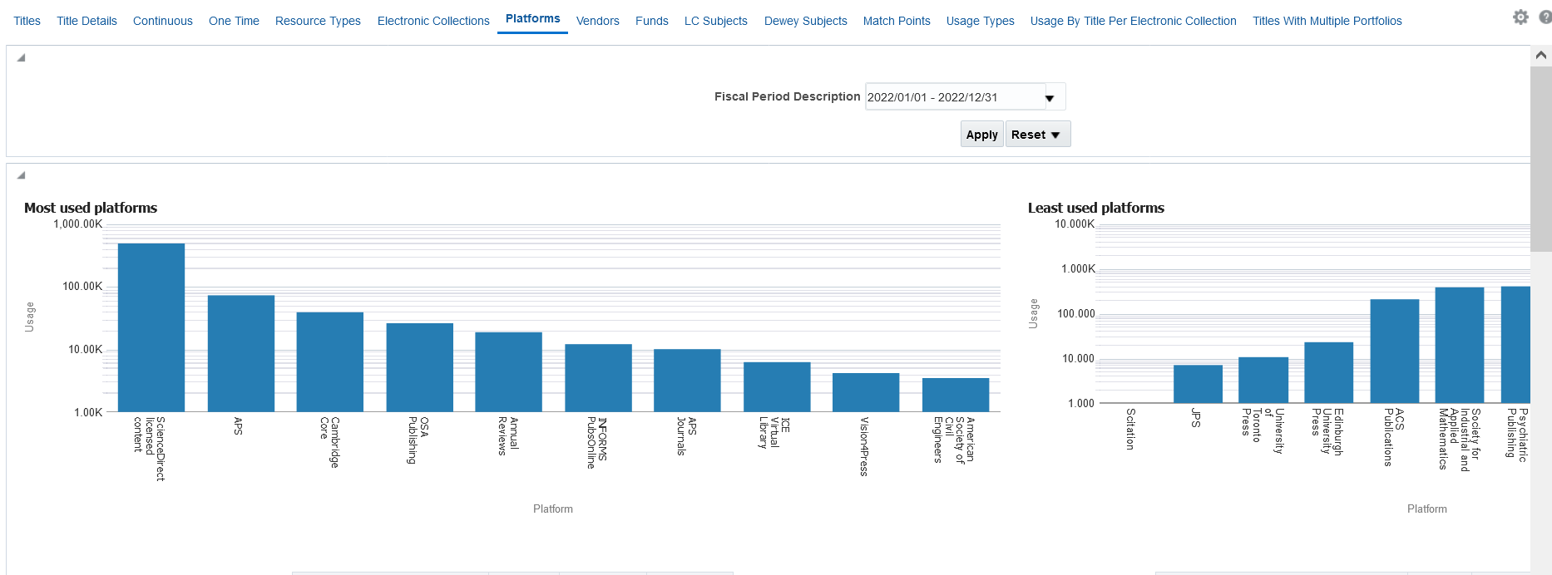
Electronic Cost Usage Dashboard

Slide 36
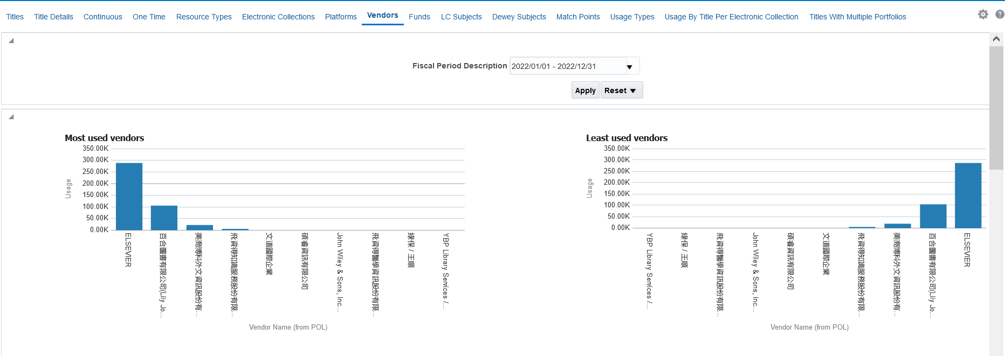
Electronic Cost Usage Dashboard

Slide 37
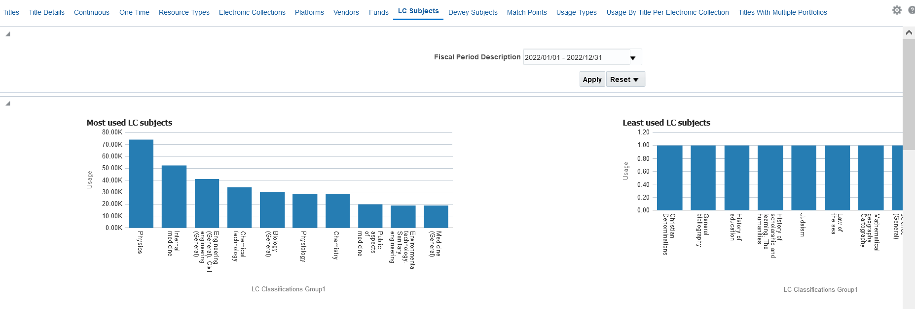
Electronic Cost Usage Dashboard

Slide 38
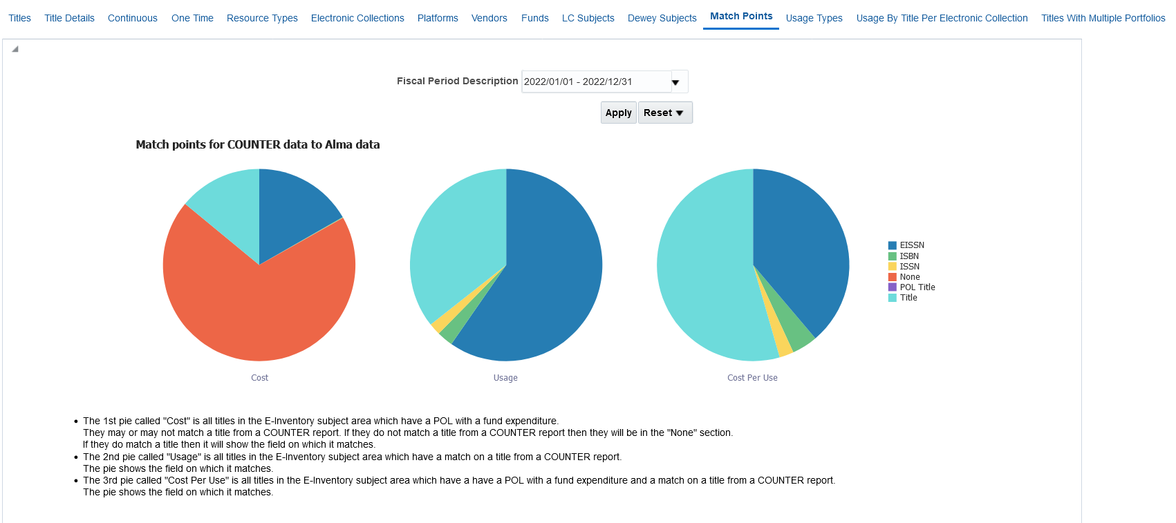
Electronic Cost Usage Dashboard

Slide 39
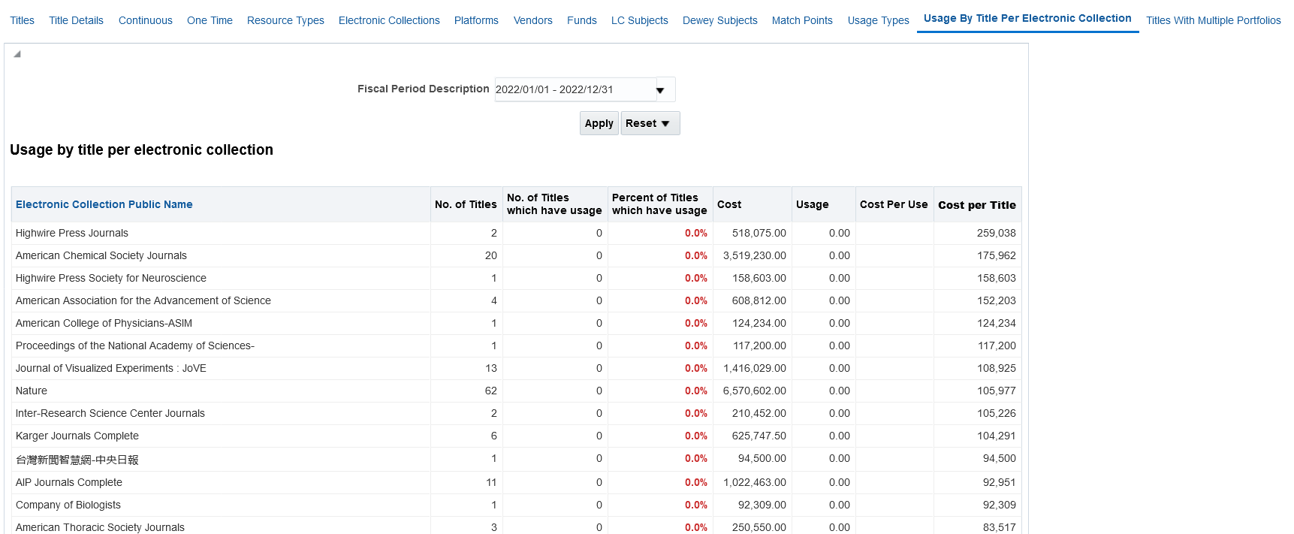
Electronic Cost Usage Dashboard

