Slide 1
Alma support for COUNTER Release 5 status report August 2019
Yoel Kortick. Senior Librarian

Slide 2
Introduction
The User Interface
The COUNTER Release 5 SUSHI account
Multiple report types in the COUNTER Release 5 SUSHI account
COUNTER Release 5 SUSHI harvesting
The "COUNTER Release 5 in Alma and Alma Analytics" user group
FAQ

Slide 3
Introduction
The developments shown here are up to and including the Sept. 2019 Alma release.
It is possible that minor changes will occur from what is shown here and the actual release.

Slide 4
The User Interface

Slide 5
The User Interface
During testing and early release phase all access to COUNTER Release 5 user interface capabilities will be "available" only for institutions for whom a "behind the scenes" parameter has been set to "true".

Slide 6
The User Interface
When adding a SUSHI account the staff user will need to specify if the account will be for COUNTER Release 4 or COUNTER Release 5.
Thus institutions will be able to simultaneously work with both COUNTER Release 4 and COUNTER Release 5.
This of course will be until COUNTER Release 4 support will be phased out at some unspecified future time, by both "the industry" as well as by Alma. At that time COUNTER Release 5 exclusively will be supported.

Slide 7
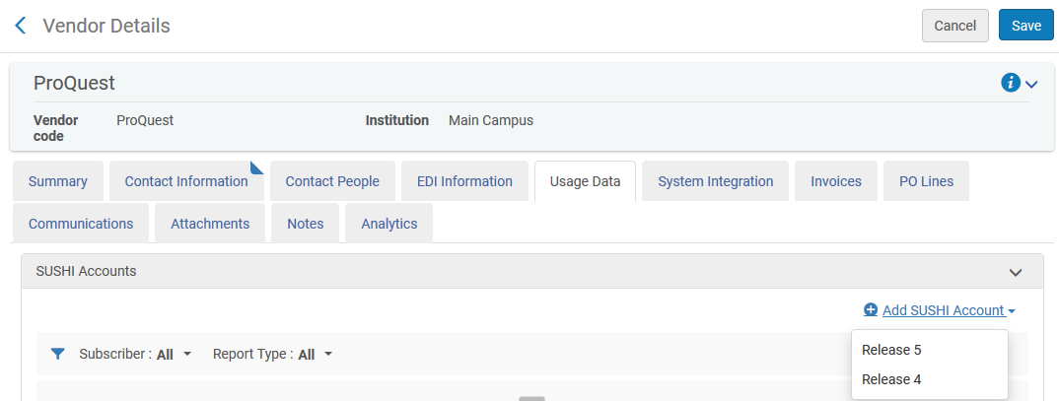
The User Interface
Staff user chooses to which COUNTER release the SUSHI account pertains

Slide 8
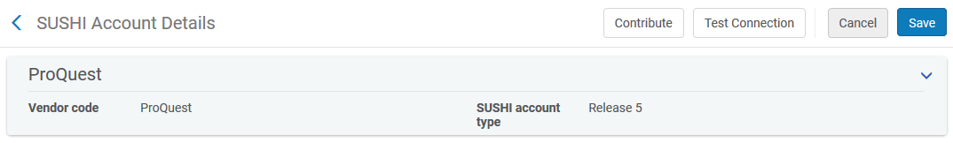
The User Interface
After selecting Release 5 there is an indication of such in the SUSHI account

Slide 9
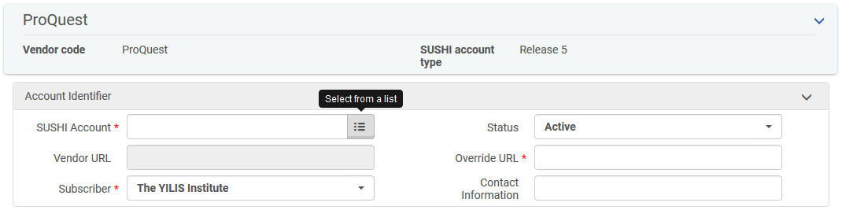
The User Interface
If the SUSHI account is of type "Release 5" then the "pickup list" which copies SUSHI accounts from the CZ will retrieve only SUSHI accounts of type "Release 5" from the CZ.
This will be possible because a new field indicating COUNTER release version has been added to the CZ certified SUSHI vendors.

Slide 10
The COUNTER Release 5 SUSHI account

Slide 11
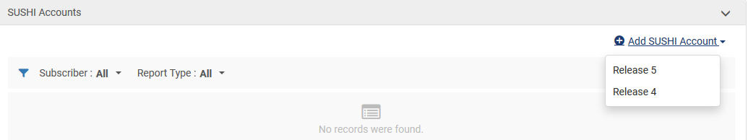
The COUNTER Release 5 SUSHI account
Let’s together now add a COUNTER Release 5 SUSHI account and fill in as follows:
  URL: https://sushi.pre.proquest.com/counter/r5
  Customer ID: 193940613
  API Key: LONS48X3PO0SN4V3613
    API Key is a new field exclusive to COUNTER 5 SUSHI accounts

Slide 12
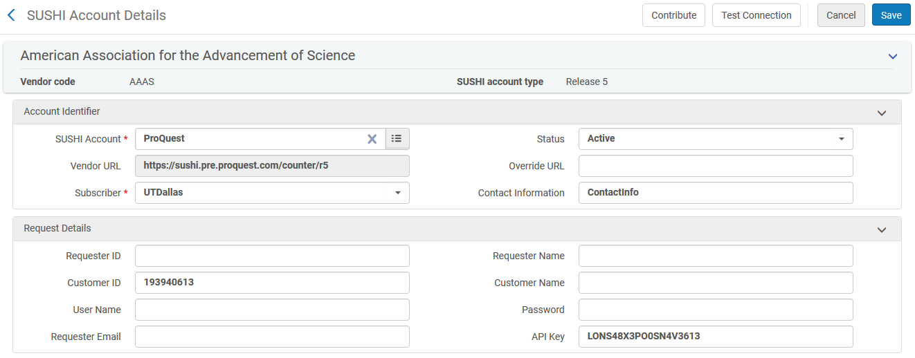
The COUNTER Release 5 SUSHI account
We will test the connection
New field exclusive to COUNTER release 5

Slide 13
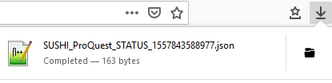
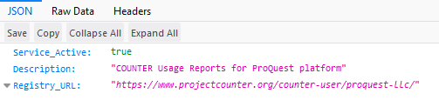
The COUNTER Release 5 SUSHI account
The "Test Connection" for a COUNTER Release 5 SUSHI account returns a json file stating if the service is active.

Slide 14
Multiple report types in the COUNTER Release 5 SUSHI account

Slide 15
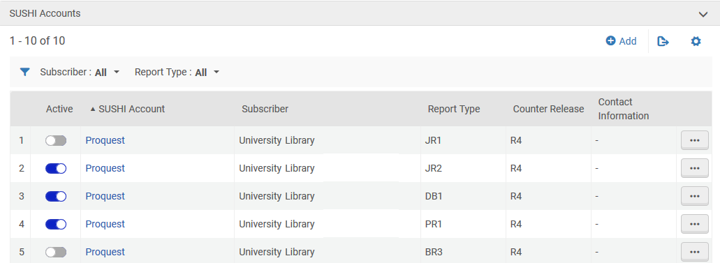
Multiple report types in the COUNTER Release 5 SUSHI account
In COUNTER Release 4 each SUSHI account could have only one report type.
This is the "old" COUNTER release 4

Slide 16
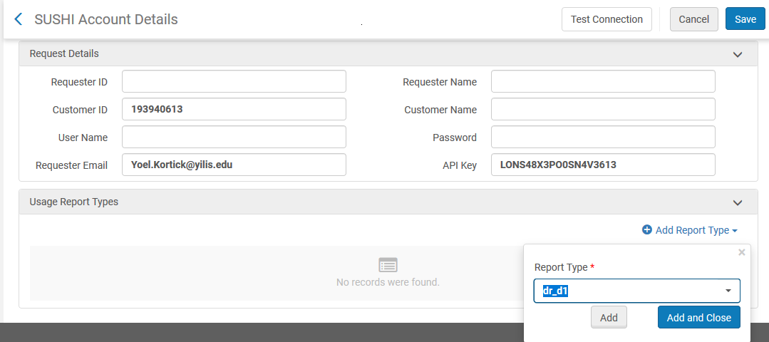
Multiple report types in the COUNTER Release 5 SUSHI account
In COUNTER Release 5 one account can have multiple report types
Multiple report types can be added here

Slide 17
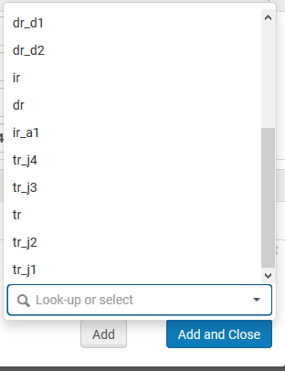
Multiple report types in the COUNTER Release 5 SUSHI account
The various report types can be chosen

Slide 18
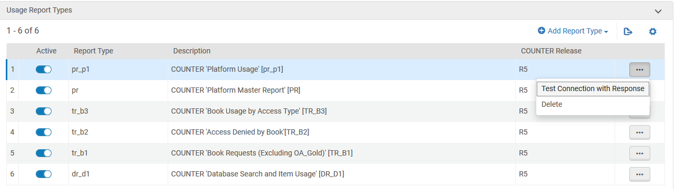
Multiple report types in the COUNTER Release 5 SUSHI account
The various report types of this SUSHI account appear, and the "test connection with response" is done per report type.

Slide 19
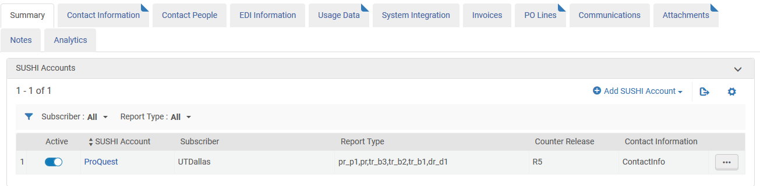
Multiple report types in the COUNTER Release 5 SUSHI account
All report types appear with the account after saving

Slide 20
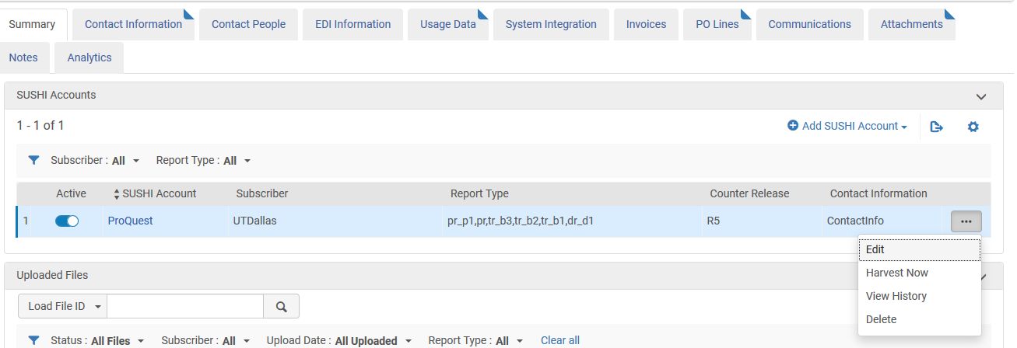
Multiple report types in the COUNTER Release 5 SUSHI account
The Harvest Now option will work on all report types associated with the SUSHI account

Slide 21
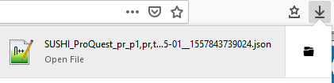
Multiple report types in the COUNTER Release 5 SUSHI account
The "test connection with response" also downloads a json file.

Slide 22
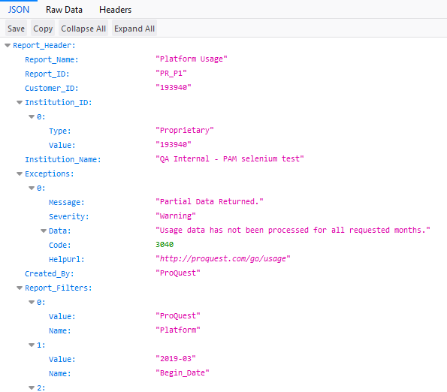
Multiple report types in the COUNTER Release 5 SUSHI account
Here is the json file with information per report type.

Slide 23
COUNTER Release 5 SUSHI Harvesting

Slide 24
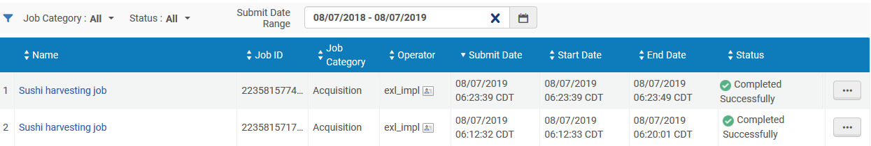
COUNTER Release 5 SUSHI harvesting
Here we have two Harvest reports from SUSHI Harvesting

Slide 25
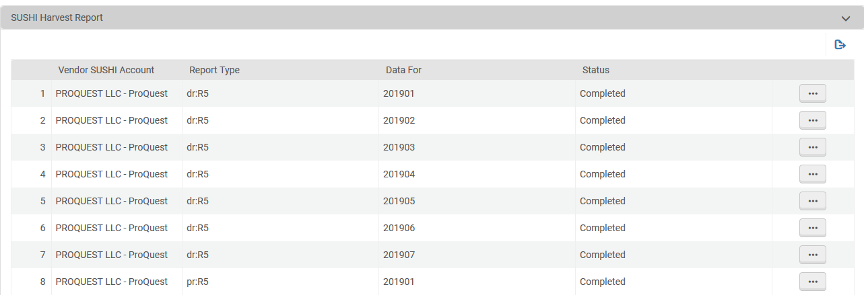
COUNTER Release 5 SUSHI harvesting
The SUSHI Harvest Report we see the usage date and the report type for the account on which the harvesting ran

Slide 26
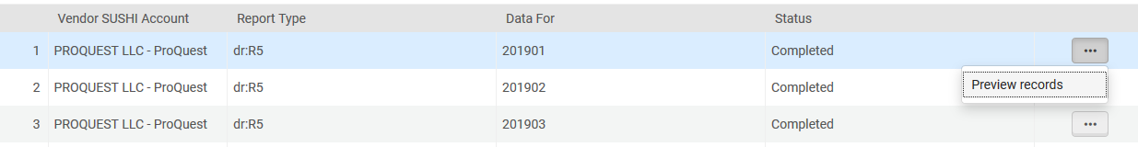
COUNTER Release 5 SUSHI harvesting
Now we will preview records

Slide 27
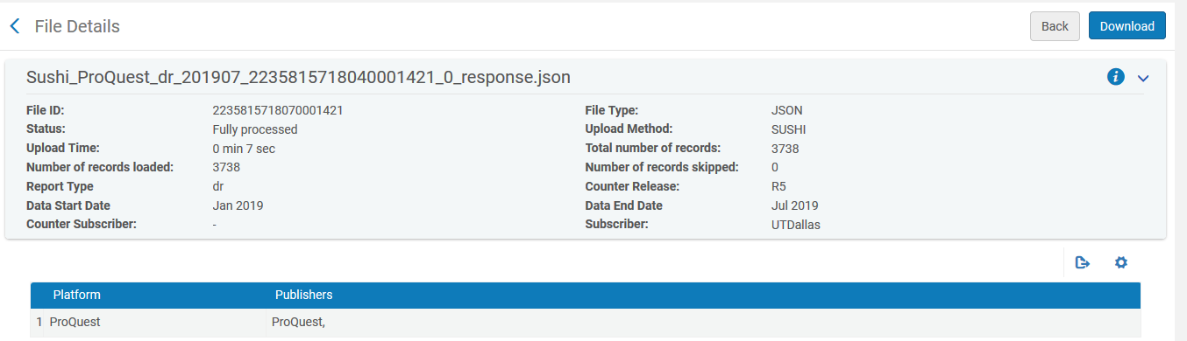
COUNTER Release 5 SUSHI harvesting
We can see the details and also download the COUNTER report

Slide 28
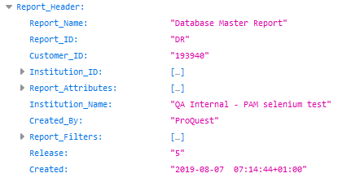
COUNTER Release 5 SUSHI harvesting
Here for example is the header of the report

Slide 29
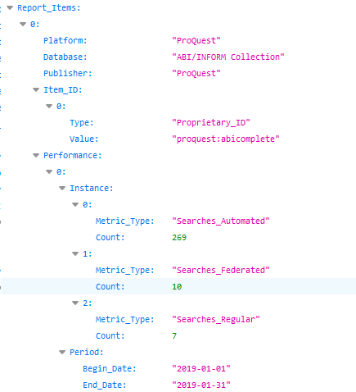
COUNTER Release 5 SUSHI harvesting
Here for example is the beginning of the measures

Slide 30
The COUNTER Release 5 in Alma and Alma Analytics User Group

Slide 31
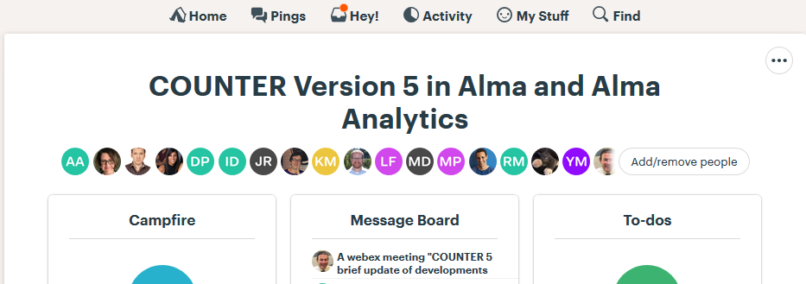
The COUNTER Release 5 in Alma and Alma Analytics User Group
This is a group of early testers with whom Ex Libris consults and provides early access.

Slide 32
The COUNTER Release 5 in Alma and Alma Analytics User Group
Some of the institutions represented in the group:
  University of Queensland
  UT Dallas
  University of Auckland
  The University of Adelaide
  Northeastern University
  RMIT University
  Monash University

Slide 33
FAQ

Slide 34
FAQ
Can you please supply some specific dates for the rollout of COUNTER 5?
The complete rollout plan for COUNTER Release 5 in Alma is available at Managing COUNTER Compliant Usage Data

Slide 35
FAQ
Now that I configured a COUNTER5 SUSHI account, will there be an overlap with my COUNTER 4 account?
COUNTER release 4 and COUNTER release 5 SUSHI accounts for same vendor can work simultaneously. This is because they will in any case use different URLs and COUNTER release 4 and release 5 use different measures which are exposed in Alma Analytics. Note however that not all vendors may simultaneously support both releases.

Slide 36
FAQ
If I delete my existing COUNTER release 4 SUSHI accounts (after I create the COUNTER release 5 accounts for the same vendors) will the data harvested by these release 4 accounts also be deleted?
No. The existence of a COUNTER SUSHI account has no bearing on the existence of data in Alma from harvested reports. Deleting the SUSHI account will not delete the data which was harvested by that SUSHI account.

Slide 37
Yoel

