Slide 1
Upload Electronic Holdings from Elsevier
Yoel Kortick
Senior Librarian

Slide 2
Agenda
Introduction | I
The setup | II
The update from Elsevier | III
Summary | IV

Slide 3
Introduction
In addition to this presentation see also the on line help at Upload Electronic Holdings from Elsevier.
It is possible to both import and continuously update Elsevier electronic holdings by automatically retrieving the institution-specific holdings using an integration profile.
This feature is advantageous because it can replace the manual, multi-step workflow of contacting Elsevier for your specific institutional holdings, converting the provided feed to meet the Portfolio Loader format, and then uploading the holdings using the Portfolio Loader.

Slide 4
Introduction
This feature ensures that your institution-specific electronic holdings for Elsevier collections are up-to-date and reflect your purchases.
To support this capability, the following Elsevier collections that you need to activate are in the Community Zone:
Elsevier ScienceDirect Books Complete
Elsevier ScienceDirect Journals Complete

Slide 5
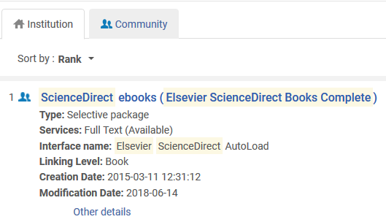
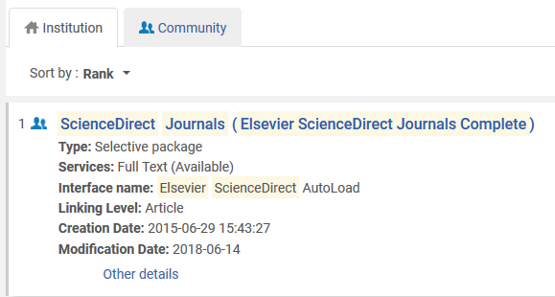
Introduction
Here are the two collections in the institution activated from the community zone.
These are the collections which will be automatically updated via the “Upload Electronic Holdings” integration profile for Elsevier.

Slide 6
Agenda
Introduction | I
The setup | II
The update from Elsevier | III
Summary | IV

Slide 7
The setup
The first step is to obtain from Elsevier an institution token.
This is a token used by Elsevier to identify your institution and thereby provide the holdings files for your institution.
This token will be put into the integration profile.

Slide 8
The setup
The second step is to ensure that the Elsevier collections for which you are updating holdings are active collections in Alma.
For example:

Slide 9
The setup
The third step is to add an integration profile of type “Upload Electronic Holdings” and choose “Elsevier” as the “Provider”.
This is done from the “Profile List” page at “Configuration > General > External Systems > Integration Profiles”

Slide 10
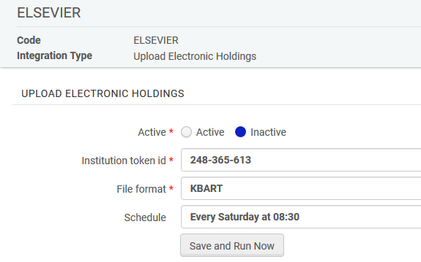
The setup
Fill in the Token ID (which you received from Elsevier), File Format = KBART, and choose scheduling option.

Slide 11
Agenda
Introduction | I
The setup | II
The update from Elsevier | III
Summary | IV

Slide 12
The update from Elsevier
The job “Upload Electronic Holdings” for vendor Elsevier will run as scheduled. In this case, every Saturday at 08:30
If needed the job can also be run manually

Slide 13
The update from Elsevier
Here from the “Monitor Jobs” we see the last two runs of the upload electronic holdings for Elsevier

Slide 14
The update from Elsevier
Let’s take a look at the report for the job run on Jan. 26, 2019.

Slide 15
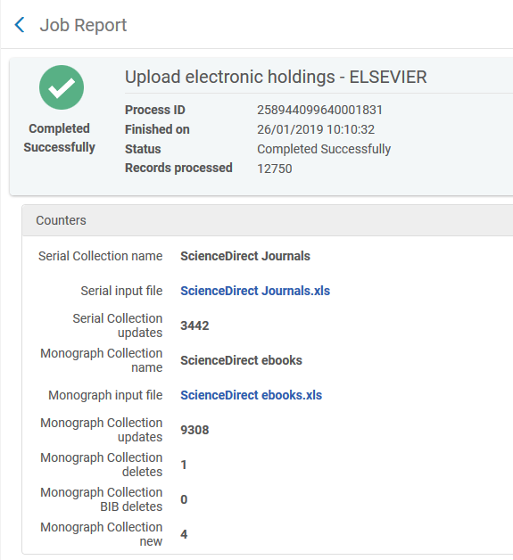
The update from Elsevier
Two KBART files were provided via the job by Elsevier

Slide 16
The update from Elsevier
This is part of the KBART file ScienceDirect Journals.xlsx supplied by Elsevier. Here we see for example that
"Women's Studies International Forum" ISSN 0277-5395 is published from year 1982 vol. 5 iss. 1
"Women's Studies International Quarterly" ISSN 0148-0685 is published from year 1978 vol. 1 to year 1981 vol. 4 iss. 4

Slide 17
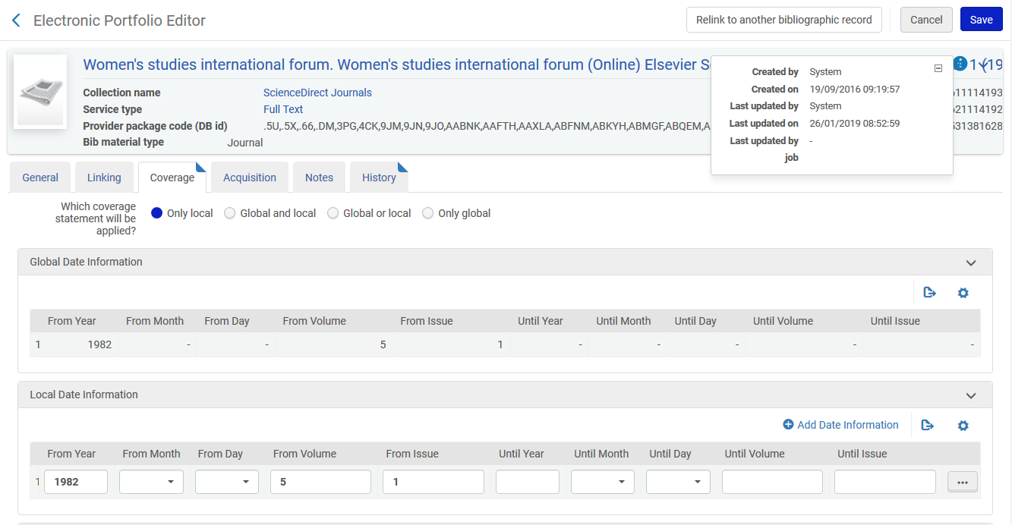
The update from Elsevier
For the first example we see coverage identical to the contents of the KBART file. It was updated by System the day and time that the “Upload Electronic Holdings” from Elsevier ran

Slide 18
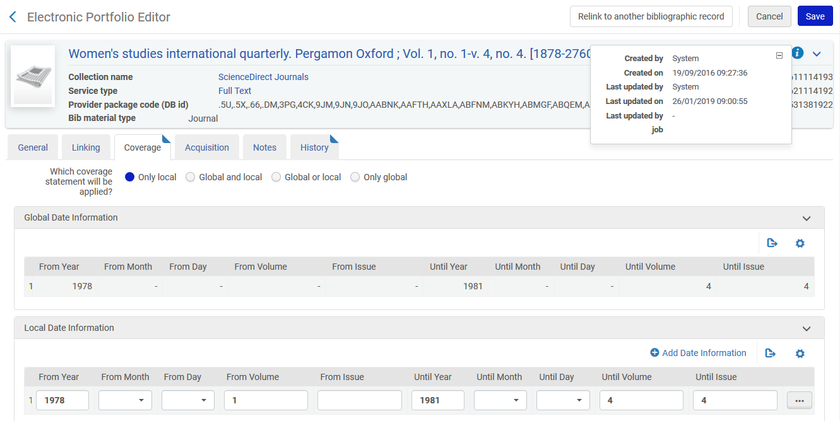
The update from Elsevier
For the second example we see coverage identical to the contents of the KBART file. It was updated by System the day and time that the “Upload Electronic Holdings” from Elsevier ran

Slide 19
Agenda
Introduction | I
The setup | II
The update from Elsevier | III
Summary | IV

Slide 20
Summary
After a simple setup the institution was able to automatically receive files from Elsevier, have them upload to Alma, and update the holdings of the electronic resources.
No manual work was done.
This is a great time saver, replacing the need to get the files from the vendor, make sure they are in proper format, and manually load to Alma.

