Slide 1
Artificial Intelligence in Alma
DARA – Data Analysis Recommendation Assistant
Ex Libris Day - National Chung Hsing University,
Taichung, Taiwan
Yoel Kortick. Senior Librarian

Slide 2
Agenda
Introduction
Types of recommendations
DARA Based on Analytics
Accessing DARA
Filter Recommendations
Link Electronic Resources to the CZ
Automatic Usage Data
Use Electronic Inventory Features
Unavailable Portfolios
Missing Items
High Request Load
Manage Recommendations

Slide 3
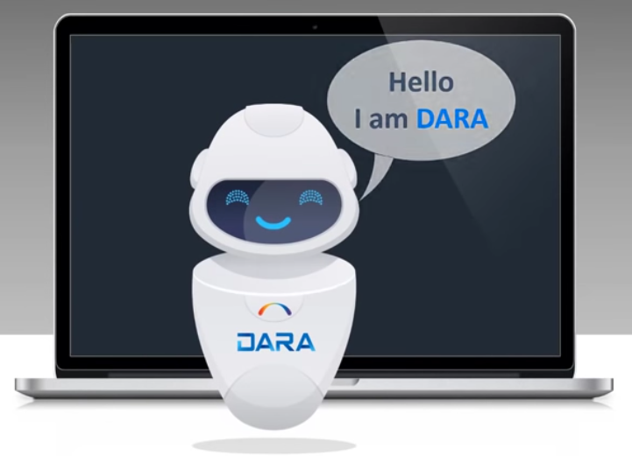
Introduction
DARA is Alma’s Data Analysis Recommendation Assistant

Slide 4
Introduction
DARA uses
AI (Artificial Intelligence)
ML (Machine Learning)
DARA assists the library by
Recommending workflow efficiencies
Suggesting features
Validating configurations.

Slide 5
Agenda
Introduction
Types of recommendations
DARA Based on Analytics
Accessing DARA
Filter Recommendations
Link Electronic Resources to the CZ
Automatic Usage Data
Use Electronic Inventory Features
Unavailable Portfolios
Missing Items
High Request Load
Manage Recommendations

Slide 6
Types of recommendations
Automatic Usage Data DARA identified several instances where you manually uploaded a COUNTER file and suggests that you create a SUSHI account and have the usage information harvested automatically. This is only recommended if DARA knows that other institutions are able to harvest successfully from this vendor.
Load Usage Data DARA identified that your institution does not upload usage data from a vendor even though your institution does have active collections from the vendor. DARA suggests that you create a SUSHI account and have the usage information harvested automatically. This is only recommended if DARA knows that other institutions are able to harvest successfully from this vendor.
Unavailable Portfolios Using an Alma Analytics report, DARA identifies unavailable electronic portfolios and recommends that you activate them. You can customize the report to produce recommendations that better suit the needs of your institution. Note that customizing the report updates recommendations already generated, but does not remove them from the List of Recommendations if they no longer have any unavailable portfolios. To remove a recommendation, select Dismiss.
Validate Order Information for Orders Created by API DARA identifies that although you have the New Order Integration profile configured in your institution, and you have PO lines created by an API, you did not select any of the Validation of Order Information options for the New Order API integration profile. These options prevent the API from creating new orders without proper funding.

Slide 7
Types of recommendations
High Request Load Using an Alma Analytics report, DARA identifies physical items with multiple patron physical requests. Items are included here for which the time until an item became available for this title was relatively long. DARA recommends reviewing the title to potentially reduce the patron waiting time. This might be done by modifying the terms of use for these items, moving them to a short loan location or purchasing additional copies of this title. These options might reduce the time until a requested item becomes available and improve patron satisfaction.
Link Electronic Resources to the CZ DARA identifies electronic portfolios which can be linked to the CZ (based on ISSN/ISBN matching). Linking to the CZ will enable the institution to receive Community Zone updates automatically, without the need to update the portfolios manually. DARA recommends linking these local electronic portfolios to the CZ.
Missing Items Using an Alma Analytics report, DARA identifies items which have been in missing status for a long time. DARA recommends reviewing the item in order to decide how it should be handled: Some institutions create a dedicated work order to try to find the item. If the item is found, remove the "missing" status. If the item is really missing, the institution should consider withdrawing the item.
Use Electronic Inventory Features DARA identifies electronic collections which exist and are not being updated via the “Upload Electronic Holdings” integration profile for ProQuest, OVID, Springer and Elsevier. DARA recommends activating the integration profile so that electronic inventory will be automatically updated.

Slide 8
Agenda
Introduction
Types of recommendations
DARA Based on Analytics
Accessing DARA
Filter Recommendations
Link Electronic Resources to the CZ
Automatic Usage Data
Use Electronic Inventory Features
Unavailable Portfolios
Missing Items
High Request Load
Manage Recommendations

Slide 9
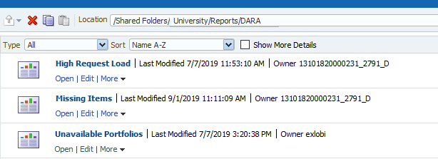
DARA Based on Analytics
The recommendations which use Alma Analytics reports take the reports from the DARA folder under the institutional folder of Alma Analytics.

Slide 10
Agenda
Introduction
Types of recommendations
DARA Based on Analytics
Accessing DARA
Filter Recommendations
Link Electronic Resources to the CZ
Automatic Usage Data
Use Electronic Inventory Features
Unavailable Portfolios
Missing Items
High Request Load
Manage Recommendations

Slide 11
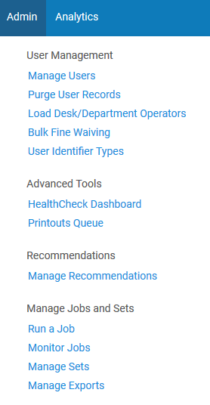
Accessing DARA
DARA can be accessed either via
Menu “Admin > Recommendations > Manage Recommendations”
Icon “View Recommendations”

Slide 12
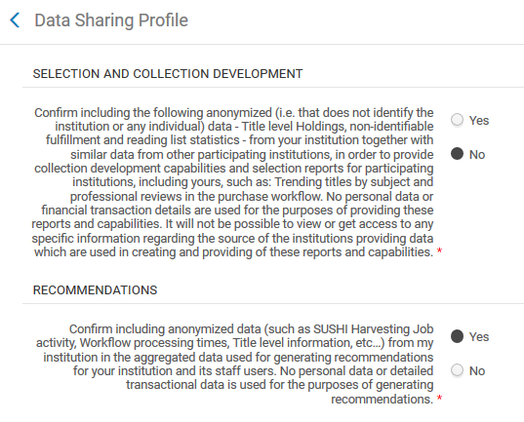
Accessing DARA
DARA is available to institutions with “Yes” specified as such in the Data Sharing Profile

Slide 13
Agenda
Introduction
Types of recommendations
DARA Based on Analytics
Accessing DARA
Filter Recommendations
Link Electronic Resources to the CZ
Automatic Usage Data
Use Electronic Inventory Features
Unavailable Portfolios
Missing Items
High Request Load
Manage Recommendations

Slide 14
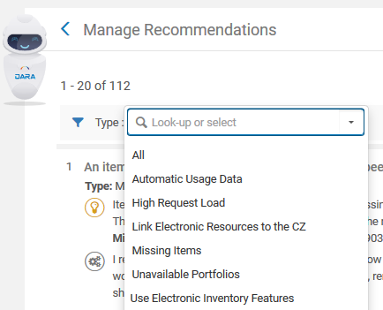
Filter Recommendations
Filter by type

Slide 15
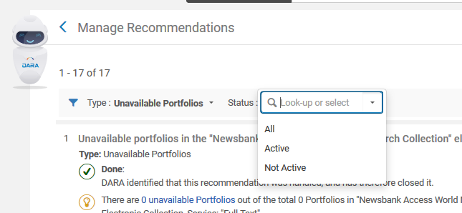
Filter Recommendations
Filter by status

Slide 16
Agenda
Introduction
Types of recommendations
DARA Based on Analytics
Accessing DARA
Filter Recommendations
Link Electronic Resources to the CZ
Automatic Usage Data
Use Electronic Inventory Features
Unavailable Portfolios
Missing Items
High Request Load
Manage Recommendations

Slide 17
For example – Link Electronic Resources to the CZ
Here is a recommendation for “Link Electronic Resources to the CZ”.
DARA identified that the electronic collection IEEE/IET Electronic Library (IEL) Journals” has local portfolios which can be linked to the CZ based on their ISBN or ISSN. This would be more efficient than handling a local portfolio.
We will click “Let’s do it!”

Slide 18
For example – Link Electronic Resources to the CZ
The following explanation appears. We will click “I’m Ready”

Slide 19
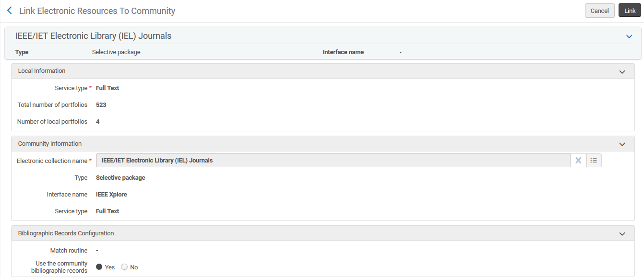
For example – Link Electronic Resources to the CZ
The “Link Electronic Resources To Community” job appears for the electronic collection and the user merely needs to click “Link”

Slide 20
Agenda
Introduction
Types of recommendations
DARA Based on Analytics
Accessing DARA
Filter Recommendations
Link Electronic Resources to the CZ
Automatic Usage Data
Use Electronic Inventory Features
Unavailable Portfolios
Missing Items
High Request Load
Manage Recommendations

Slide 21
For example – Automatic Usage Data
Here is a recommendation for “Automatic Usage Data”.
DARA identified that the institution manually loaded a COUNTER report for a vendor that supports automated SUSHI harvesting.
We will click “Let’s do it!”

Slide 22
For example – Automatic Usage Data
The following explanation appears. We will click “I’m Ready”

Slide 23
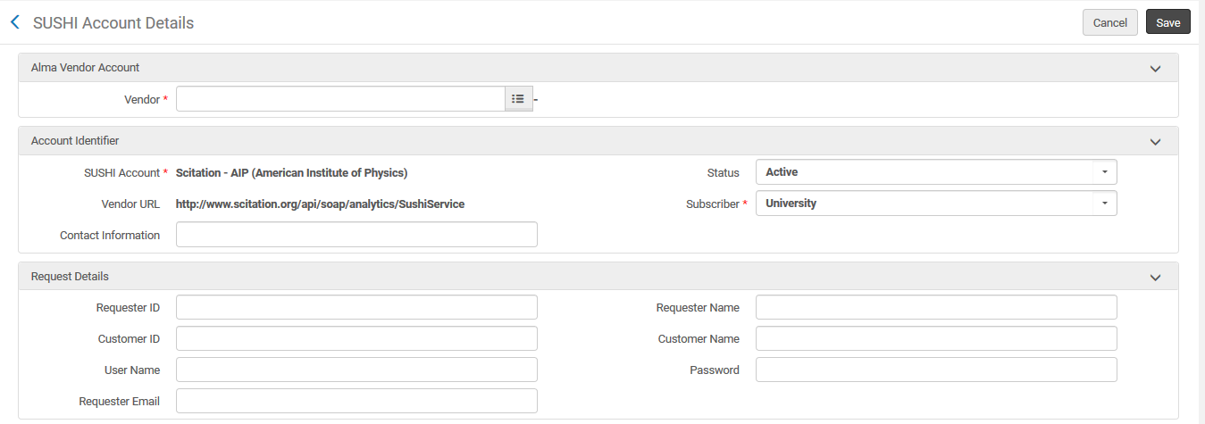
For example – Automatic Usage Data
The SUSHI Account page for the vendor appears and the institution can begin adding details and credentials.

Slide 24
Agenda
Introduction
Types of recommendations
DARA Based on Analytics
Accessing DARA
Filter Recommendations
Link Electronic Resources to the CZ
Automatic Usage Data
Use Electronic Inventory Features
Unavailable Portfolios
Missing Items
High Request Load
Manage Recommendations

Slide 25
For example – Use Electronic Inventory Features
Here is a recommendation for “Use Electronic Inventory Features”.
DARA identified that the institution has an electronic collection for Springer Link but has not created the “Upload Electronic Holdings” Integration Profile for Springer Link.
We will click “Let’s do it!”

Slide 26
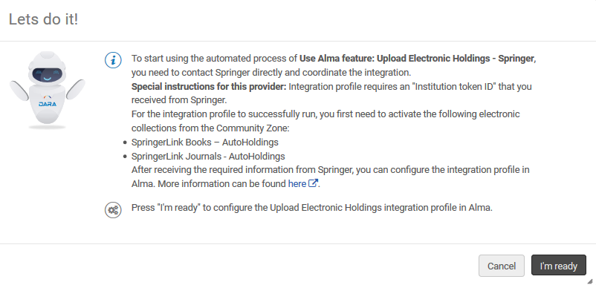
For example – Use Electronic Inventory Features
The following explanation appears. We will click “I’m Ready”

Slide 27
For example – Use Electronic Inventory Features
The user is taken to the Integration profile of type Upload Electronic Holdings” for Springer and merely needs to enter the Institution token ID.

Slide 28
Agenda
Introduction
Types of recommendations
DARA Based on Analytics
Accessing DARA
Filter Recommendations
Link Electronic Resources to the CZ
Automatic Usage Data
Use Electronic Inventory Features
Unavailable Portfolios
Missing Items
High Request Load
Manage Recommendations

Slide 29
For example – Unavailable Portfolios
Here is a recommendation for “Unavailable Portfolios”. DARA identified that the electronic collection “Wiley Online Library” includes 1670 portfolios and 131 of those portfolios are unavailable.
The institution may wish to review these portfolios and activate them so that they will be published to discovery and available to users.
We will click “Let’s do it!”

Slide 30
For example – Unavailable Portfolios
The following explanation appears. We will click “I’m Ready”

Slide 31
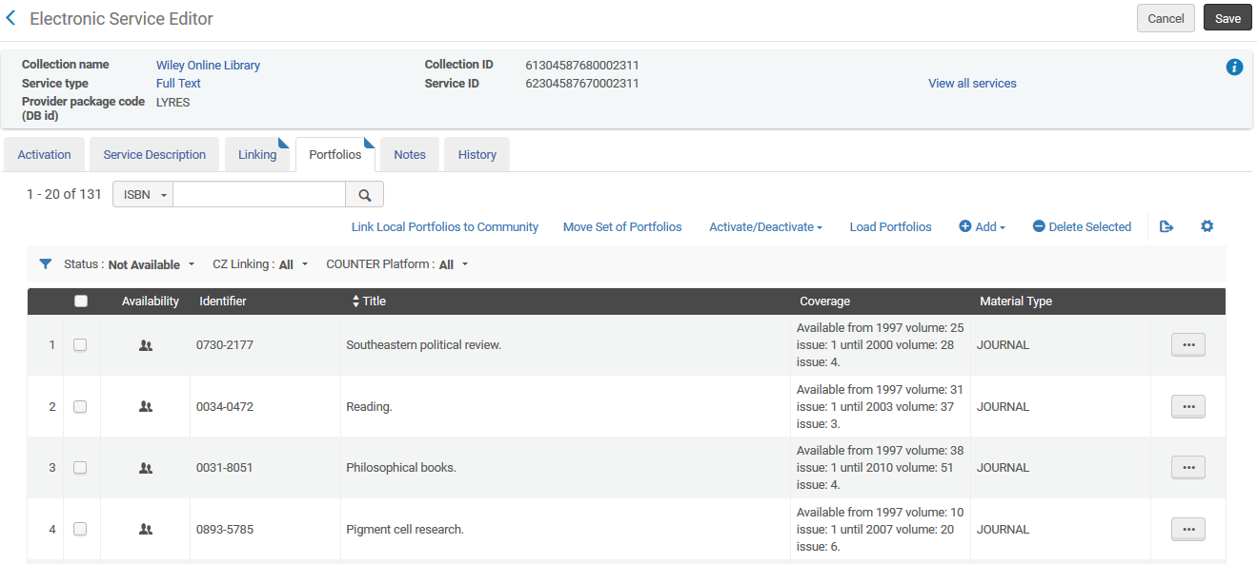
For example – Unavailable Portfolios
The user is taken to the electronic service editor of the collection with the list of unavailable portfolios. For here the user can do as desired with these portfolios (for example activate them)record and can do as desired

Slide 32
Agenda
Introduction
Types of recommendations
DARA Based on Analytics
Accessing DARA
Filter Recommendations
Link Electronic Resources to the CZ
Automatic Usage Data
Use Electronic Inventory Features
Unavailable Portfolios
Missing Items
High Request Load
Manage Recommendations

Slide 33
For example – Missing Items
Here is a recommendation for “Missing Items”.
DARA identified that the institution has an item in status missing for over two years. DARA recommends reviewing the item if found removing the missing status. If the item is really missing the institution may wish to withdraw it from the catalog.
We will click “Let’s do it!”

Slide 34
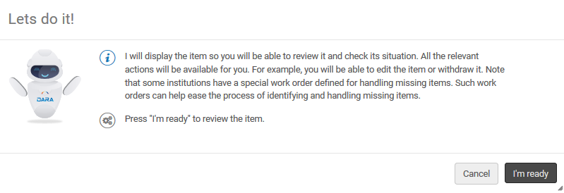
For example – Missing Items
The following explanation appears. We will click “I’m Ready”

Slide 35
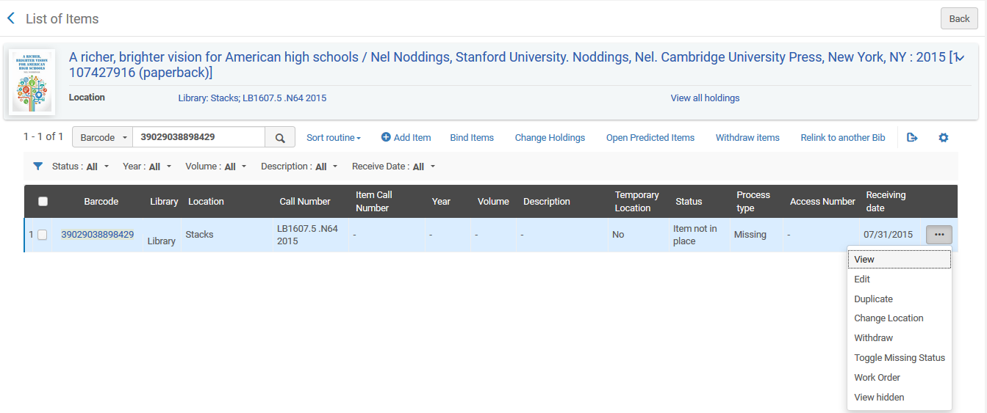
For example – Missing Items
The user is taken to physical item editor and can do as desired
It will also be possible to export these items to a set and to print a list to an Excel sheet

Slide 36
Agenda
Introduction
Types of recommendations
DARA Based on Analytics
Accessing DARA
Filter Recommendations
Link Electronic Resources to the CZ
Automatic Usage Data
Use Electronic Inventory Features
Unavailable Portfolios
Missing Items
High Request Load
Manage Recommendations

Slide 37
For example – High Request Load
Here is a recommendation for “High Request Load”. DARA identified that the institution has a title with 17 requests in the last year and 3 items. The average number of days until it was available for the request was 48.
The institution may wish to modify the terms of use for this item, move it to a short loan location or purchase additional copies of this title
We will click “Let’s do it!”

Slide 38
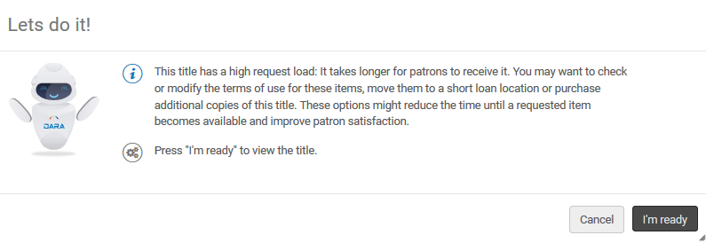
For example – High Request Load
The following explanation appears. We will click “I’m Ready”

Slide 39
For example – High Request Load
The user is taken to the record and can do as desired

Slide 40
Agenda
Introduction
Types of recommendations
DARA Based on Analytics
Accessing DARA
Filter Recommendations
Link Electronic Resources to the CZ
Automatic Usage Data
Use Electronic Inventory Features
Unavailable Portfolios
Missing Items
High Request Load
Manage Recommendations

Slide 41
Manage Recommendations
Select the three dots next to a recommendation to:
Dismiss – dismiss the recommendation if you are not interested in implementing it. It no longer appears for anyone in your institution. Enter a reason to help DARA learn which recommendations are helpful to you.
Mark as Done – indicate that the recommendation was handled and change the status of the recommendation to Not Active if you implement the recommendation without using the Let's do it! button
Edit Notes – add and view notes for the recommendation. Notes can be used to coordinate collaboration on a recommendation between staff members.
Edit Attachments – add and view attachments for the recommendation.

Slide 42
Manage Recommendations
It is possible also to restore a non-active recommendation.
When a recommendation is implemented, expired (not handled for 12 months), or dismissed, it changes to Not Active status. You can restore its status to Active.
To restore a Not Active recommendation to Active:
Filter the recommendations by Not Active status.
Select the three dots and select Restore.
The recommendation's status is now Active.

Slide 43
Manage Recommendations
Active Recommendation (Dismiss, Mark as Done, Let’s do it)
Non-Active Recommendation (Restore)

Slide 44
Yoel.Kortick@exlibrisgroup.com

