Slide 1
RDA, Linked Data and BIBFRAME in Alma
Yoel Kortick
Senior Librarian

Slide 2
Contents
Brief introduction to RDA (and the connection to linked data)
RDA for cataloging and describing records - Media Type
RDA for cataloging and describing records – Abbreviations
RDA and FRBR in Alma (and the connection between RDA and FRBR)
RDA/RDF format in Alma via General Publishing Profile
RDA/RDF format in Alma via job "Export Bibliographic Records"
RDA/RDF format in Alma via APIs
Linked data in the general publishing profile
Linked data in the Alma User Interface
Comparing the Linked Data with the RDA/RDF format
Brief introduction to BIBFRAME (and the connection to linked data)
BIBFRAME in the Alma User Interface
BIBFRAME in the general publishing profile
How and why is this useful to the end user

Slide 3
Introductory comment
The most important and significant part of this presentation is the concluding section: "How and why is this useful to the end user".
The subjects of RDA and Linked Data should not become just an academic exercise in, for example, "how should punctuation appear?" or "why does subfield 0 have a full URL instead of just an identifier?"
The real goal here is: help the end user access the material he or she is looking for and supply additional relevant information.

Slide 4
Brief introduction to RDA (and the connection to linked data)

Slide 5
Brief introduction to RDA (and the connection to linked data)
The purpose of this presentation is not to describe in depth what RDA is, but rather to describe how it has been implemented in Alma. Specifically, we will focus on linked data.
Other sources abound for the reader seeking to gain a more in depth understanding of exactly what RDA is.
In this presentation we will begin to describe what RDA is and include a few specific quotes from various sources.

Slide 6
Brief introduction to RDA (and the connection to linked data)
RDA stands for "Resource Description and Access" and is the title of the standard, that is the successor to AACR2. Resource Description and Access (RDA) is a standard for descriptive cataloging providing instructions and guidelines on formulating bibliographic data. Resource Description & Access (RDA) is a set of cataloging instructions based on FRBR and FRAD, for producing the description and name and title access points representing a resource. RDA offers libraries the potential to change significantly how bibliographic data is created and used.
Resource Description and Access (RDA). Librarianship Studies and Information Technology (accessed Feb. 2020)

Slide 7
Brief introduction to RDA (and the connection to linked data)
RDA is a package of data elements, guidelines, and instructions for creating library and cultural heritage resource metadata that are well-formed according to international models for user-focused linked data applications.
http://www.rda-rsc.org/node/235 (accessed Feb. 2020)

Slide 8
Brief introduction to RDA (and the connection to linked data)
Two Basic Goals of RDA Structure
One goal of RDA is to identify attributes or characteristics of works, expressions, manifestations, items persons, corporate bodies, and families.
The other goal is relating these entities.
Expressing relationships in bibliographic and authority records helps users find what they want and lets users know about other available resources.
https://www.librarianshipstudies.com/2020/02/rda-provides-instructions-for-which-of.html (accessed Feb. 2020)

Slide 9
Brief introduction to RDA (and the connection to linked data)
A little background
RDA was initially released in June 2010.
RDA was implemented in 2013 by the Library of Congress and other major libraries in the United States and Europe.
It was announced as follows: "Changes to MARC21 have been made to accommodate new RDA data elements. Libraries will need to consult with their library system vendor about the vendor's plans to accommodate RDA changes."
Resource Description and Access (RDA). Librarianship Studies and Information Technology

Slide 10
Brief introduction to RDA (and the connection to linked data)
It is possible to divide the RDA into two distinct categories:
RDA for cataloging and describing records
RDA for describing levels of bibliographic data (WEMI - work, expression, manifestation, and item)) and looking at groups of records as the same work (FRBR - Functional Requirements for Bibliographic Records).
Let's first briefly discuss the first category with two examples of how the cataloging has changed.
Then we will move onto the second category in a more in-depth manner.
For in depth details in cataloging changes from AACR2 to RDA see for example RDA Refresher Performance Support: What is Different from AACR2? under Library of Congress RDA Training Materials. (accessed Feb. 2020)

Slide 11
RDA for cataloging and describing records - Media Type

Slide 12
RDA for cataloging and describing records – Media type
One example of RDA for cataloging is that with RDA the GMD 245 subfield h was replaced by the content, media, and carrier terms or codes in fields 336, 337 and 338. Here is the description from OCLC Support and training 245 Title Statement (NR) (accessed Feb. 2020):
See also: "Content, Media, and Carrier (336/337/338) Fields in the Public Display". Journal of Library Metadata. Volume 18, 2018 - Issue 3-4. Lisa Romano. Pages 151-170. (accessed Feb. 2020)

Slide 13
RDA for cataloging and describing records – Media type
Here is (part of) a record before RDA which describes a video recording
Note the 245 subfield h and lack of 336, 337 and 338.
Descriptive information is in the 300 and 500

Slide 14
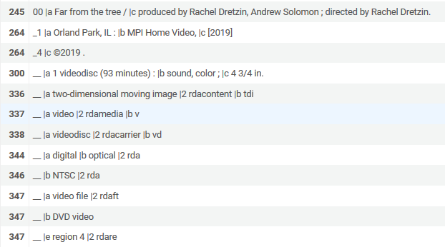
RDA for cataloging and describing records – Media type
Here is (part of) a video recording record after RDA
Note the lack of a 245 subfield h
Descriptive information is in the 336, 337, 338 and 347

Slide 15
RDA for cataloging and describing records – Media type
In Alma the 245 subfield h can be searched in Alma via the "Medium Type"
In Alma the 337 subfield a can be searched in Alma via the "Media Type term"

Slide 16
RDA for cataloging and describing records – Media type
See also: "RDA fields supported in Alma" at Searching in Alma
See also: MARC 21 Bibliographic All Titles Search

Slide 17
RDA for cataloging and describing records - Abbreviations

Slide 18
RDA for cataloging and describing records – Abbreviations
Another example of cataloging changes with RDA deals with abbreviations.
" … AACR2 endeavored to display as much book information as possible in the smallest amount of space, employing abbreviations and prescriptive punctuation. In today's electronic-based library, these space concerns are obsolete, and the focus has shifted to discovery concerns, where abbreviations can impede discovery."
"Resource Description and Access "RDA": New Code for Cataloging". The Serials Librarian
From the Printed Page to the Digital Age. Volume 60, 2011 - Issue 1-4: An Oasis in Shifting Sands: NASIG at 25. Magda El-Sherbini Presenter & Megan Curran Recorder . Pages 7-15. (accessed Feb. 2020)

Slide 19
RDA for cataloging and describing records – Abbreviations
" … As previously noted, many of the rules of AACR2 were based in a card-catalog-centric environment. Abbreviations were employed to save space on the card, and those abbreviations often had Latin roots (for example, et al., s.l., and s.n.) that have little or no meaning to the average patron. In RDA all abbreviations should be spelled out unless abbreviated on a resource, and the terms used should be natural and understandable to patrons and librarians alike. "
"Resource Description and Access "RDA": New Code for Cataloging". The Serials Librarian
From the Printed Page to the Digital Age. Volume 60, 2011 - Issue 1-4: An Oasis in Shifting Sands: NASIG at 25. Magda El-Sherbini Presenter & Megan Curran Recorder . Pages 7-15

Slide 20
RDA for cataloging and describing records – Abbreviations
Example 1 of 3
Here is (part of) a record with pages and illustrations before RDA
Note the "p." for "pages" and "ill." for "illustrations" in field 300 subfields a and b

Slide 21
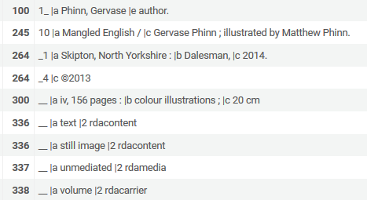
RDA for cataloging and describing records – Abbreviations
Example 1 of 3
Here is (part of) a record with pages and illustrations after RDA
Note the "pages" and "illustrations" in field 300 subfields a and b

Slide 22
RDA for cataloging and describing records – Abbreviations
Example 2 of 3
Here is (part of) a record with no known place of publication before RDA
Note the "[S.l.]." for "Place of Publication" in the 260 subfield a. This is an abbreviation from Latin for "Sine loco" meaning "Without a place".

Slide 23
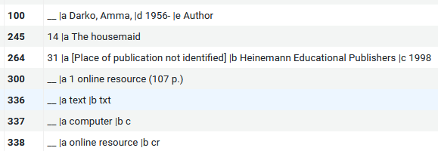
RDA for cataloging and describing records – Abbreviations
Example 2 of 3
Here is (part of) a record with no known place of publication after RDA
Note the "Place of publication not identified" for "Place of Publication" in the 264 subfield a.

Slide 24
RDA for cataloging and describing records – Abbreviations
Example 3 of 3
Here is (part of) a record with no known publisher before RDA
Note the "[S.n.]." for "Publisher" in the 260 subfield b. This is an abbreviation from Latin for "Sine nominee" meaning "without a name".

Slide 25
RDA for cataloging and describing records – Abbreviations
Example 3 of 3
Here is (part of) a record with no known place of publication before RDA
Note the "Unknown publisher" for "Name of producer, publisher, distributor, manufacturer" in the 264 subfield b.

Slide 26
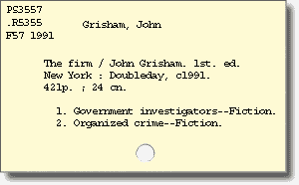
RDA for cataloging and describing records – Abbreviations
Abbreviations were necessary when the card catalog was used in order to get all of the information on the card
https://www.usg.edu/galileo/skills/unit04/primer04_04.phtml

Slide 27
RDA for cataloging and describing records – Abbreviations
https://www.liscafey.com/2015/07/elements-of-catalog-card.html

Slide 28
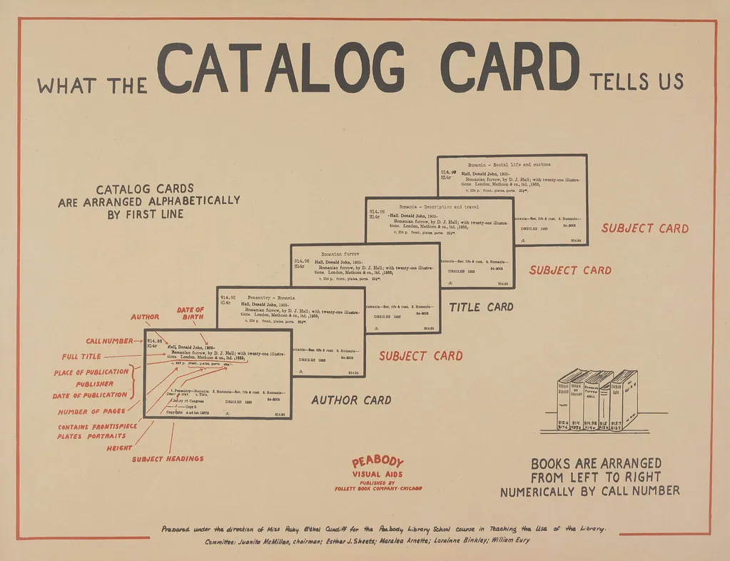
RDA for cataloging and describing records – Abbreviations
https://infomational.com/2011/10/03/content-container-or-concept-what-the-catalog-card-tells-us/

Slide 29
RDA and FRBR in Alma (and the connection between RDA and FRBR)

Slide 30
RDA and FRBR in Alma (and the connection between RDA and FRBR)
" … RDA is not a replacement of MARC; it is a set of guidelines for how to enter data into MARC records. RDA is not in itself intended for display in online catalogs; it is an encoding standard for catalogers. RDA is a set of standardized rules -- FRBR is a conceptual model for how those rules might support enhanced online catalog displays…. Conceptually, FRBR provides relationships between different editions, translations, publications, and formats of the same content."
"RDA and FRBR... Tell me again why I care?". By Heather Powers and Dianne Coan, 03.19.2013. (accessed Feb. 2020)

Slide 31
RDA and FRBR in Alma (and the connection between RDA and FRBR)
In FRBR (Functional Requirements for Bibliographic Records) comprises three groups of entities:
Group 1 entities are work, expression, manifestation, and item (WEMI). They represent the products of intellectual or artistic endeavor.
Group 2 entities are person, family and corporate body, responsible for the custodianship of Group 1’s intellectual or artistic endeavor.
Group 3 entities are subjects of Group 1 or Group 2’s intellectual endeavor, and include concepts, objects, events, places.
Later (slide 44) we will see that RDA in RDF (RDA/RDF) uses these three FRBR groups.
FRBR Entities. Librarianship Studies & Information Technology. (accessed Feb. 2020)

Slide 32
RDA and FRBR in Alma (and the connection between RDA and FRBR)
Alma has a process whereby bibliographic records of the same Work (The "W" in WEMI) are grouped together for display when delivered to the end user in Primo discovery.
The method by which the records in Alma are FRBRized is described in Understanding the Dedup and FRBR Processes (Primo VE).
Let’s look at an example

Slide 33
RDA and FRBR in Alma (and the connection between RDA and FRBR)
Here in Alma we search for creator "Sheryl Sandberg" and get 5 results:

Slide 34
RDA and FRBR in Alma (and the connection between RDA and FRBR)
The 5 results are
"Sheryl Sandberg: Women must learn to "Lean In"" cataloged as a visual material
"Lean in women work and the will to lead" cataloged as a physical book
"Lean in women work and the will to lead" cataloged as an electronic book
"Option B : facing adversity, building resilience, and finding joy" cataloged as a physical book
"Option B : facing adversity, building resilience, and finding joy" cataloged as an electronic book

Slide 35
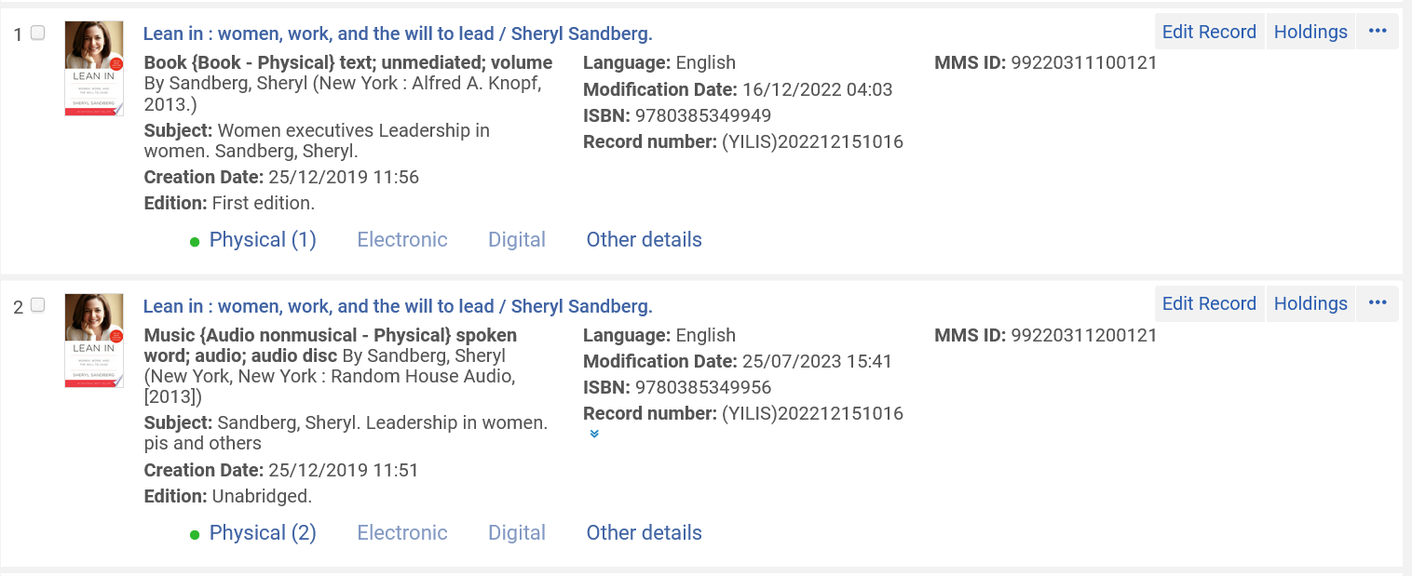
RDA and FRBR in Alma (and the connection between RDA and FRBR)
For example – "Lean in"
Same work different format and edition

Slide 36
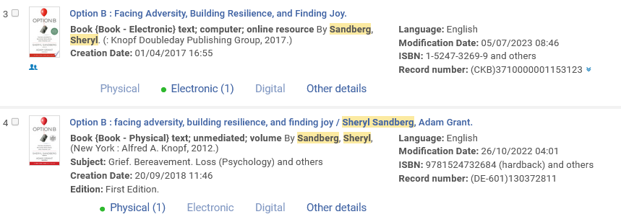
RDA and FRBR in Alma (and the connection between RDA and FRBR)
For example – "Option B"
Same work different format

Slide 37
RDA and FRBR in Alma (and the connection between RDA and FRBR)
We will now see that the same search for creator "Sheryl Sandberg" which gave 5 results in Alma will give 3 results in Primo.
The 5 bibliographic records have become FRBRized into three unique "works" (The "W" of the FRBR WEMI):
The two titles of different formats for "Lean in women work and the will to lead"
The two titles of different formats for "Option B : facing adversity, building resilience, and finding joy "
The one title "Sheryl Sandberg: Women must learn to "Lean In""

Slide 38
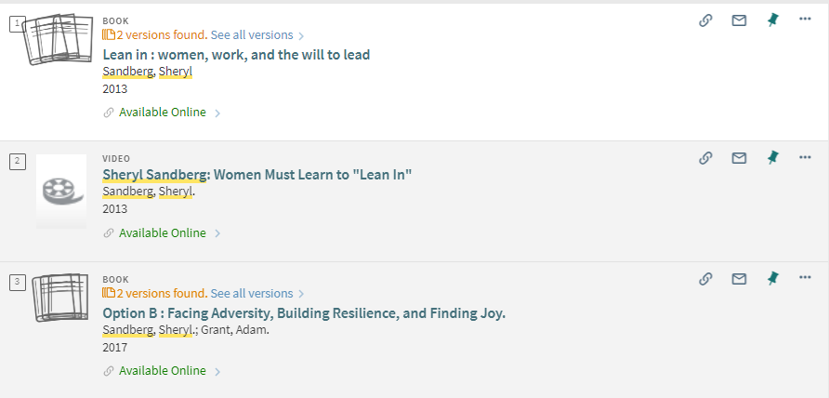
RDA and FRBR in Alma (and the connection between RDA and FRBR)
Links to see all versions of the FRBRized title

Slide 39
RDA and FRBR in Alma (and the connection between RDA and FRBR)
Another example is title "Outrageous acts and everyday rebellions" by Gloria Steinem.
There are two bibliographic records.
One was published in 1983 and is the first edition.
The other was published in 1995 and is the second edition with a new preface and notes by the author.
Both are cataloged as a physical book

Slide 40
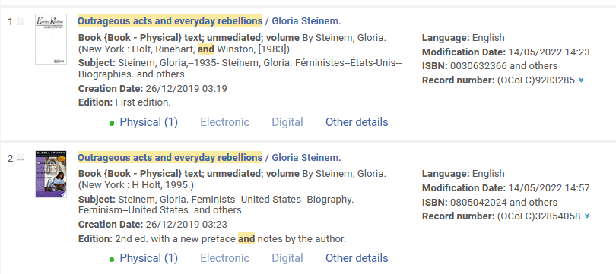
RDA and FRBR in Alma (and the connection between RDA and FRBR)

Slide 41
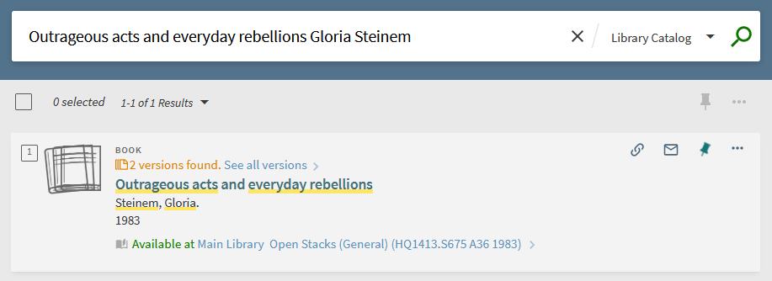
RDA and FRBR in Alma (and the connection between RDA and FRBR)
In Primo the two versions are FRBRized together and the end user can view both versions of desired.

Slide 42
RDA and FRBR in Alma (and the connection between RDA and FRBR)
Note also, as described at Understanding the Dedup and FRBR Processes (Primo VE), institutions can decide not to FRBRize records.
The deactivations of the FRBRization process can be done on the level of the entire Primo view or just for certain records based on rules.

Slide 43
RDA/RDF format in Alma via General Publishing Profile

Slide 44
RDA/RDF format in Alma via General Publishing Profile
Alma can present data in RDA/RDF format (Resource Description and Access / Resource Description Framework) in several ways and places.
RDA in RDF: The definition of RDA in RDF uses three basic components: the FRBR entities (Groups 1, 2, and 3).*
We already saw these groups earlier (slide 31)
* RDA Vocabularies for a Twenty-First-Century Data Environment. Karen Coyle. Page 27 https://journals.ala.org/index.php/ltr/article/download/4672/5544

Slide 45
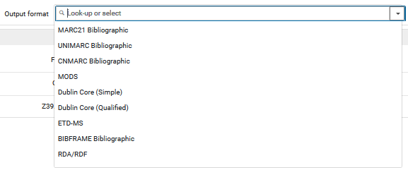
RDA/RDF format in Alma via General Publishing Profile
Let’s first look at the General Publishing Profile
We will choose format RDA/RDF

Slide 46
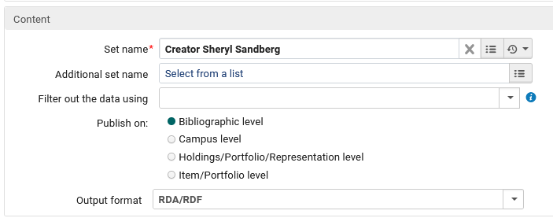
RDA/RDF format in Alma via General Publishing Profile
We will choose a set which we have created containing the 5 records we previously saw with creator "Sheryl Sandberg"

Slide 47
RDA/RDF format in Alma via General Publishing Profile
The output contains 5 cases of "Work", "Expression" and "Manifestation".
There are identical links to the work for
"Lean in women work and the will to lead"
"Option B : facing adversity, building resilience, and finding joy "
There is a single link to the work for
"Sheryl Sandberg: Women must learn to "Lean In""
Here is a sample file (just click the link and it will open in your default program for opening xml): General Publishing Profile Output format RDA RDF.xml
We will now look at parts of this file and links to the "work" from within the file

Slide 48
RDA/RDF format in Alma via General Publishing Profile
There are identical links to the work for "Lean in women work and the will to lead"

Slide 49
RDA/RDF format in Alma via General Publishing Profile
There are two manifestations for the work for "Lean in women work and the will to lead"

Slide 50
RDA/RDF format in Alma via General Publishing Profile
There are identical links to the work for "Option B : facing adversity, building resilience, and finding joy "

Slide 51
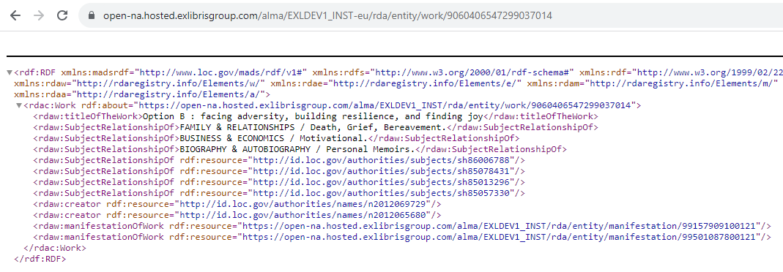
RDA/RDF format in Alma via General Publishing Profile
There are two manifestations for the work for "Option B : facing adversity, building resilience, and finding joy "

Slide 52
RDA/RDF format in Alma via General Publishing Profile
There is one manifestation for the work for "Sheryl Sandberg: Women Must Learn to "Lean In""

Slide 53
RDA/RDF format in Alma via job "Export Bibliographic Records"

Slide 54
RDA/RDF format in Alma via job "Export Bibliographic Records"
The job "Export Bibliographic Records" can also produce a file of records from a set in RDA/RDF format.
The output appears the same as what we have already seen for the general publishing profile, thus no need for additional screenshots of the file or links to it.

Slide 55
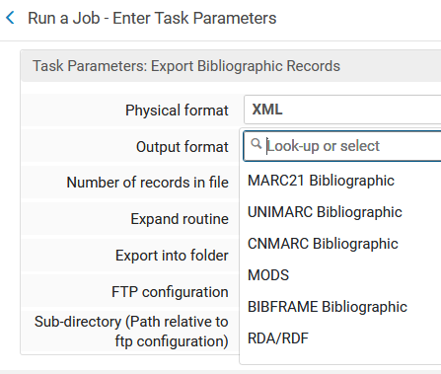
RDA/RDF format in Alma via job "Export Bibliographic Records"

Slide 56
RDA/RDF format in Alma via APIs

Slide 57
RDA/RDF format in Alma via APIs
As explained here it is also possible to use APIs to retrieve a record in RDA/RDF format. 2 APIs are available:
GET manifestation
The API returns 3 levels of the information: Work, Expression and Manifestation. Work and manifestation levels has their own URIs. Includes the Work ID to use the "GET Work" API.
GET work
The API returns Work related fields. In order to know the work id, you should call the GET manifestation API first and retrieve the related Work ID.

Slide 58
RDA/RDF format in Alma via APIs
GET manifestation
https://open-na.hosted.exlibrisgroup.com/alma/<institution code>/rda/entity/manifestation/<mms id>.rdf
For example try this for "Option B : facing adversity, building resilience, and finding joy" (MMSID 99157909100121) https://open-eu.hosted.exlibrisgroup.com/alma/EXLDEV1_INST-eu/rda/entity/manifestation/99157909100121.rdf

Slide 59
RDA/RDF format in Alma via APIs
Now we will use this Work ID 9060406547299037014 for the GET work API

Slide 60
RDA/RDF format in Alma via APIs
GET work
https://open-na.hosted.exlibrisgroup.com/alma/<institution code>/rda/entity/work/<work id>.rdf
For example try this (just copy and paste to your browser) : https://open-eu.hosted.exlibrisgroup.com/alma/EXLDEV1_INST-eu/rda/entity/work/9060406547299037014.rdf

Slide 61
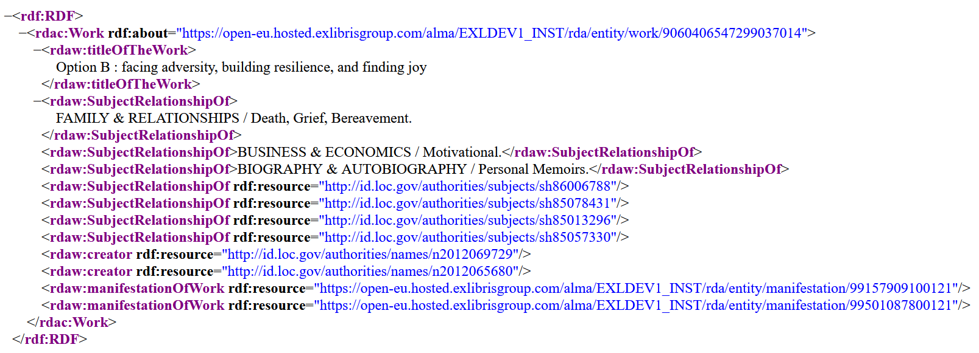
RDA/RDF format in Alma via APIs

Slide 62
Linked data in the general publishing profile

Slide 63
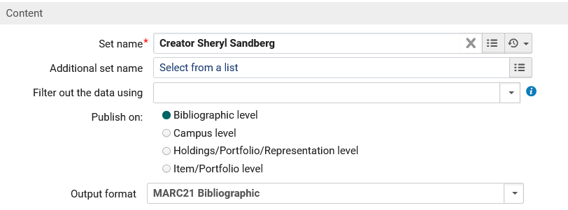
Linked data in the general publishing profile
We will choose a set which we have created containing the records we previously saw with creator "Sheryl Sandberg".
The output format will be "MARC 21 Bibliographic"

Slide 64
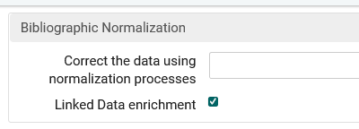
Linked data in the general publishing profile
In the "Bibliographic Normalization" section we will choose "Linked Data enrichment".

Slide 65
Linked data in the general publishing profile
Here is the file with "MARC21 Bibliographic" and "Linked Data enrichment" (just click the link and it will open in your default program for opening xml): : General Publishing Profile Output format MARC21 Bibliographic with Linked Data.xml

Slide 66
Linked data in the general publishing profile

Slide 67
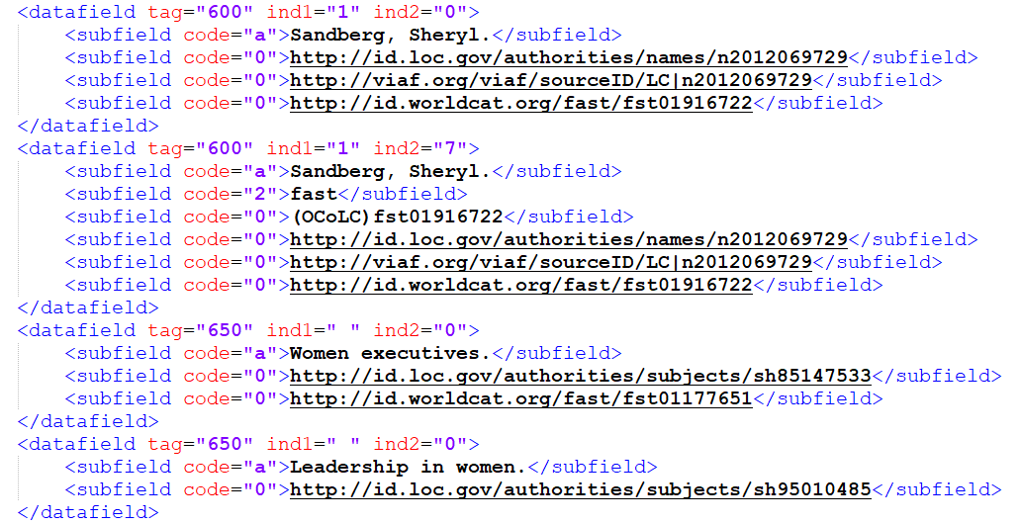
Linked data in the general publishing profile

Slide 68
Linked data in the Alma User Interface

Slide 69
Linked data in the Alma User Interface
Here we have performed a repository search for physical title "Option B : facing adversity, building resilience, and finding joy" and see a link to "Linked Data"

Slide 70
Linked data in the Alma User Interface
Now we see the "Linked Data" and we will click the viaf link for Sheryl Sandberg

Slide 71
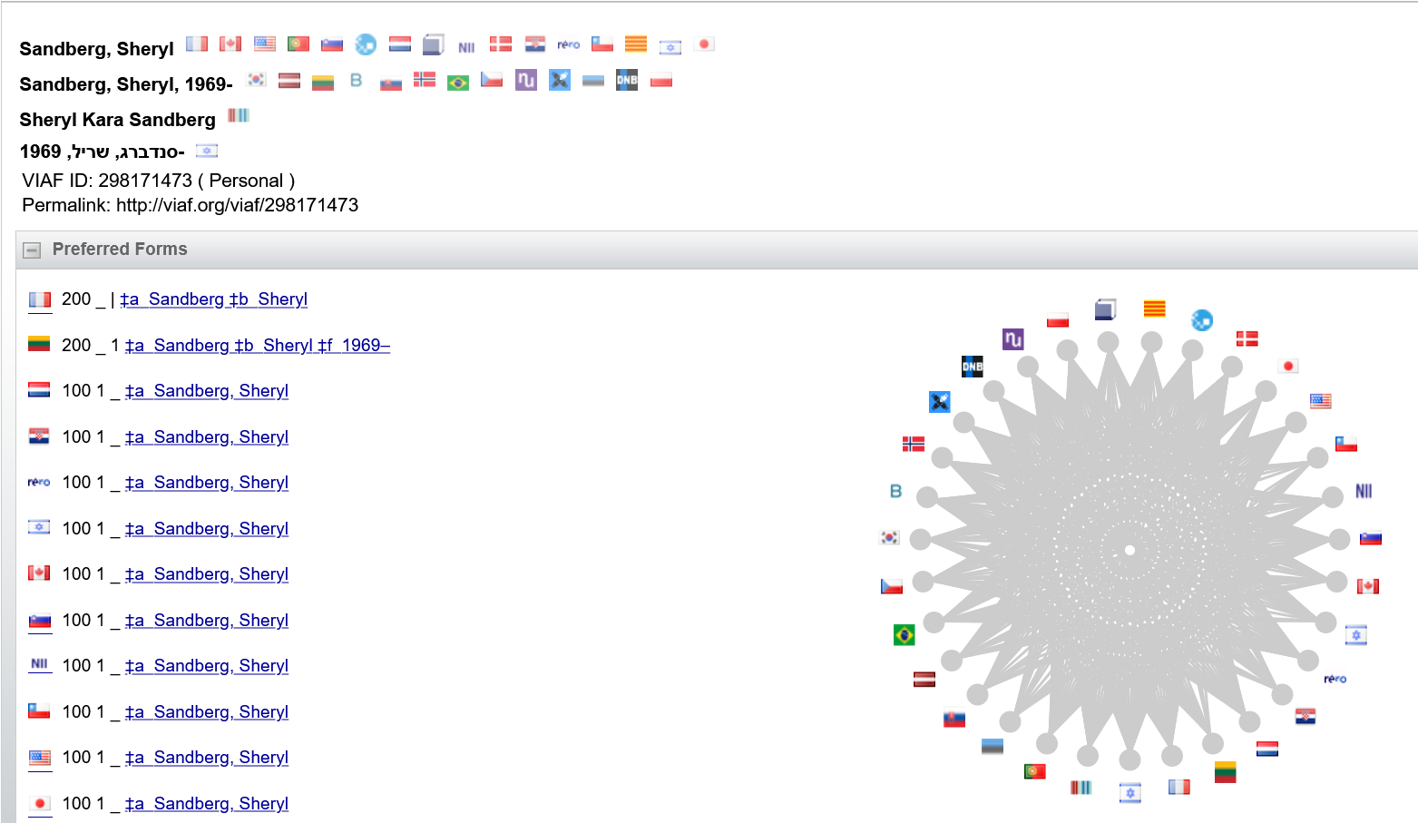
Linked data in the Alma User Interface

Slide 72
Linked data in the Alma User Interface
Now we will click the isbn13 link for 9780525590088

Slide 73
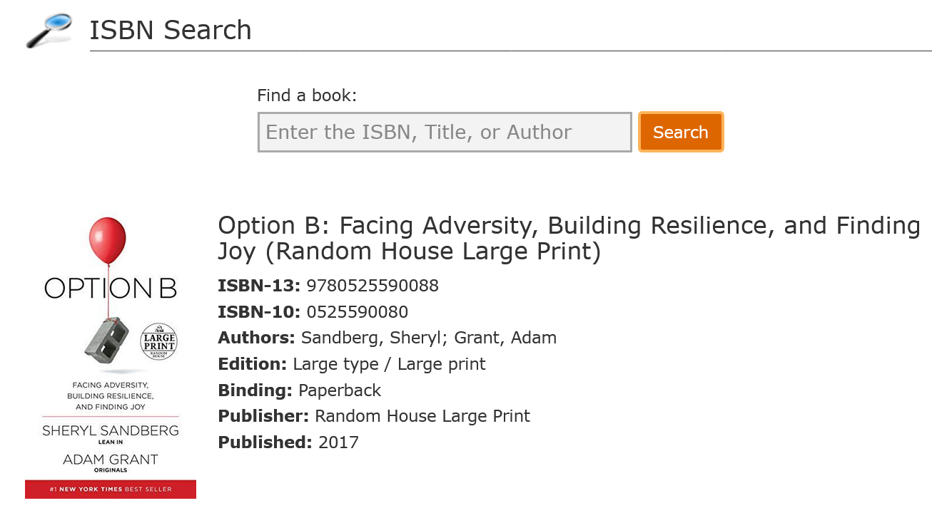
Linked data in the Alma User Interface

Slide 74
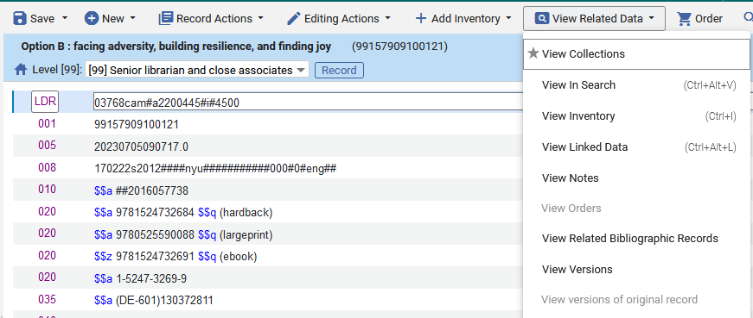
Linked data in the Alma User Interface
We can also see the "Linked Data" in the Metadata Editor

Slide 75
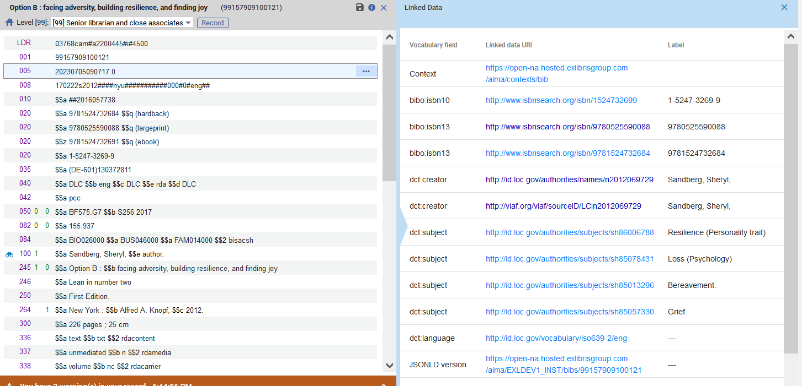
Linked data in the Alma User Interface

Slide 76
Comparing the Linked Data with the RDA/RDF format

Slide 77
Comparing the Linked Data with the RDA/RDF format
Let’s briefly compare what we see
In the RDA/RDF record via https://open-eu.hosted.exlibrisgroup.com/alma/EXLDEV1_INST-eu/rda/entity/manifestation/99157909100121.rdf
In the Linked Data

Slide 78
Comparing the Linked Data with the RDA/RDF format
Full list of linked data for "Option B : facing adversity, building resilience, and finding joy"
Links to
http://www.isbnsearch.org
http://id.loc.gov
http://viaf.org

Slide 79
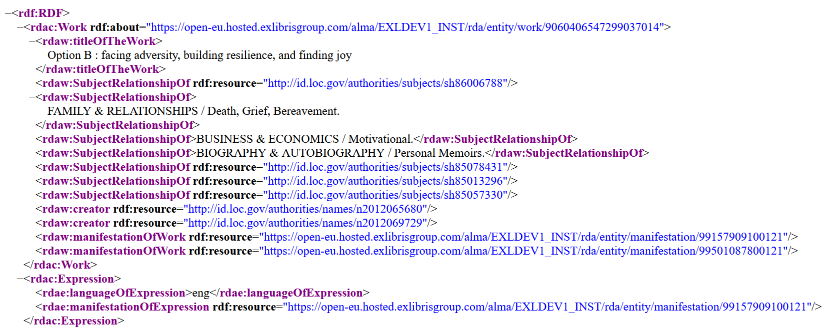
Comparing the Linked Data with the RDA/RDF format
The RDA/RDF record part 1

Slide 80
Comparing the Linked Data with the RDA/RDF format
The RDA/RDF record part 2

Slide 81
Comparing the Linked Data with the RDA/RDF format
The RDA/RDF record
The "Work" section contains the title and links to the authority records according to the vocabulary to which they are linked in the bibliographic record. In the case here it is to http://id.loc.gov/authorities/subjects/ and http://id.loc.gov/authorities/names/ .
The "Manifestation" section contains additional bibliographic information
The Linked Data
Contains the links to the authority records which are also in the "Work" section of the RDA record
Also contains links to other sources such as http://viaf.org/viaf/ and http://www.isbnsearch.org/

Slide 82
Brief introduction to BIBFRAME (and the connection to linked data)

Slide 83
Brief introduction to BIBFRAME (and the connection to linked data)
"BIBFRAME (Bibliographic Framework) is an initiative to evolve bibliographic description standards to a linked data model, in order to make bibliographic information more useful both within and outside the library community."
Library of Congress Overview of the BIBFRAME 2.0 Model

Slide 84
Brief introduction to BIBFRAME (and the connection to linked data)
"BIBFRAME is a web-first Linked Data model intended to make library records accessible to the Web at large. This new initiative serves as the foundation for the future of bibliographic description, both on the web and the broader networked world. BIBFRAME promises to better accommodate RDA and its vocabulary than MARC 21. It is still under experimentation. The library community, specifically catalogers, need to be aware of the development of BIBFRAME and experiment with the BIBFRAME editor."
RDA implementation and the emergence of BIBFRAME. Magda El-Sherbini. LIS.it 9, 1 (January 2018) ISSN: 2038-1026 DOI: 10.4403/jlis.it-12443 (accessed Feb. 2020)

Slide 85
Brief introduction to BIBFRAME (and the connection to linked data)
BIBFRAME 2.0 organizes information into three core levels of abstraction:
Work. The highest level of abstraction, a Work, in the BIBFRAME context, reflects the conceptual essence of the cataloged resource: authors, languages, and what it is about (subjects).
Instance. A Work may have one or more individual, material embodiments, for example, a particular published form. These are Instances of the Work. An Instance reflects information such as its publisher, place and date of publication, and format.
Item. An item is an actual copy (physical or electronic) of an Instance. It reflects information such as its location (physical or virtual), shelf mark, and barcode.
Library of Congress Overview of the BIBFRAME 2.0 Model (accessed Feb. 2020)

Slide 86
BIBFRAME in the general publishing profile

Slide 87
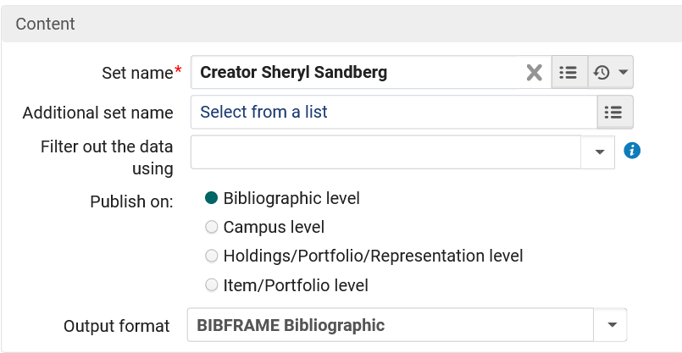
BIBFRAME in the general publishing profile
We will choose a set which we have created containing the 5 records we previously saw with creator "Sheryl Sandberg".
The output format will be "BIBFRAME Bibliographic"

Slide 88
BIBFRAME in the general publishing profile
Here is a sample file (just click the link and it will open in your default program for opening xml): General Publishing Profile Output format BIBFRAME.xml

Slide 89
BIBFRAME in the general publishing profile
With the XML file collapsed we can see all five records, with the Work and Instance of each.

Slide 90
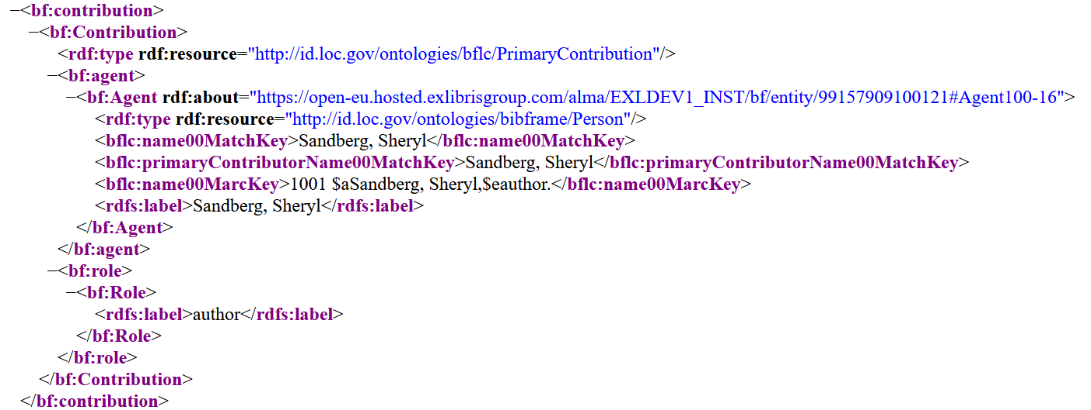
BIBFRAME in the general publishing profile
Here for example is a contribution section from within the Work section for the author
D

Slide 91
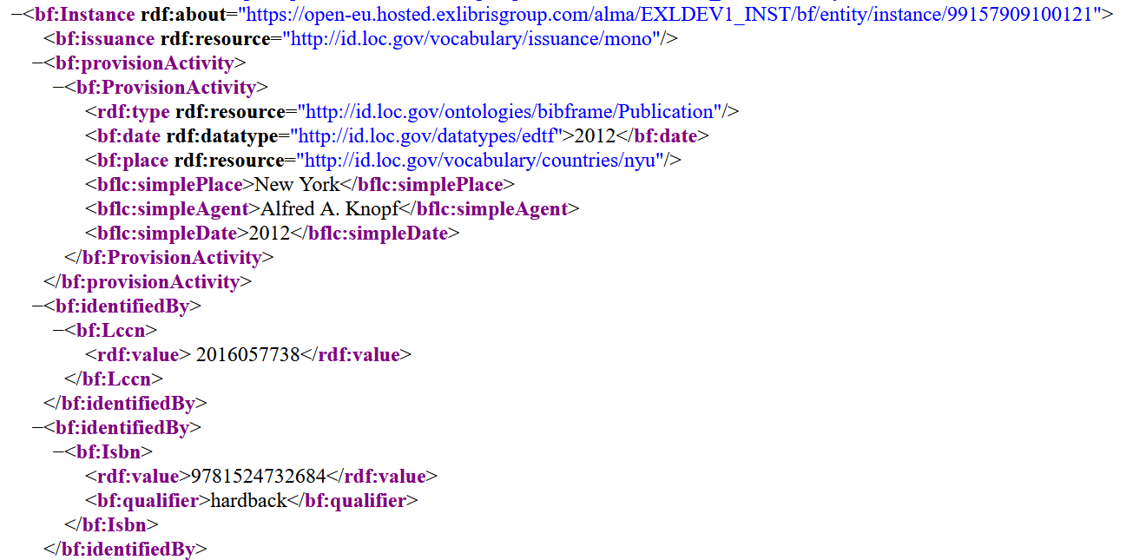
BIBFRAME in the general publishing profile
Here for example part of the Instance section in the Work

Slide 92
BIBFRAME in the Alma user interface

Slide 93
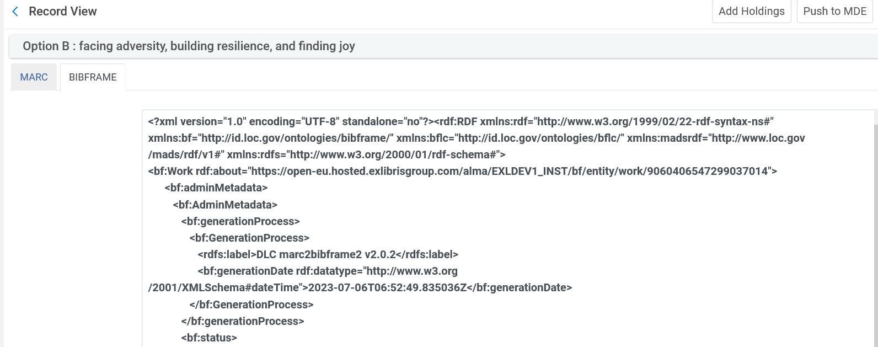
BIBFRAME in the Alma user interface
In the Alma User Interface BIBFRAME for a particular record can be viewed in the "BIBFRAME" tab of the Record View. The format is the same as we saw for the general publishing profile thus additional screenshots are not necessary.

Slide 94
How and why is this useful to the end user

Slide 95
How and why is this useful to the end user
We have already seen that the publishing to Primo can include linked data.
When this is the case, the institution can utilize that linked data in discovery to provide additional information to the end user.

Slide 96
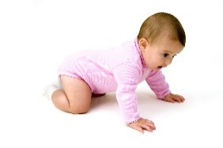
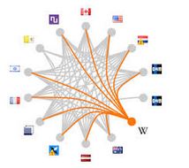
How and why is this useful to the end user
The linked data is typically used as a starting point to "crawl" to additional sources.
In a Linked Data context, ideally one would simply follow the links and "crawl" from one data description to another.
https://www.careerguide.com/blog/wp-content/uploads/2017/10/Data-Career-1.jpg
https://www.pregmed.org/wp-content/uploads/2015/04/A-Crawling-Baby.jpg

Slide 97
How and why is this useful to the end user
We will now look at an example whereby an Alma institution has included the linked data in the discovery results.
Technical aspects are explained in the Tech Blog "Using the linked data integration API to enhance discovery from Steve Meyer of the University of Wisconsin: https://developers.exlibrisgroup.com/blog/Using-the-Linked-Data-Integration-API-to-Enhance-Discovery

Slide 98
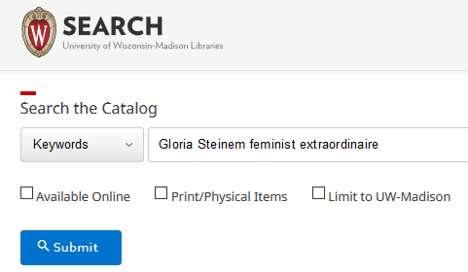
How and why is this useful to the end user
We will search https://search.library.wisc.edu/search/system for title "Gloria Steinem feminist extraordinaire"

Slide 99
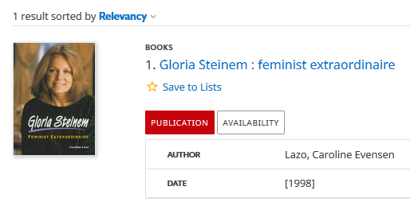
How and why is this useful to the end user
Now from results we will click the title for the "full view"

Slide 100
How and why is this useful to the end user
In lower section of the "full view" in section "Information from the web" we see information from http://dbpedia.org/resource/Gloria_Steinem

Slide 101
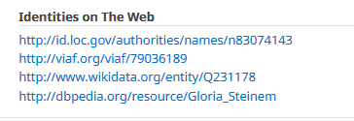
How and why is this useful to the end user
In lower section of the "full view" in section "Information from the web" we also see links to LOC authorities, viaf, Wikipedia and dbpedia

Slide 102
How and why is this useful to the end user
Now we will look at another example from a different Alma Institution: The Hong Kong University of Science and Technology.
The Primo search is at https://julac.hosted.exlibrisgroup.com/primo-explore/search?vid=HKUST
We will search the library catalog for title "Lean in women work and the will to lead"

Slide 103
How and why is this useful to the end user
From the results we will click the title to see the full view

Slide 104
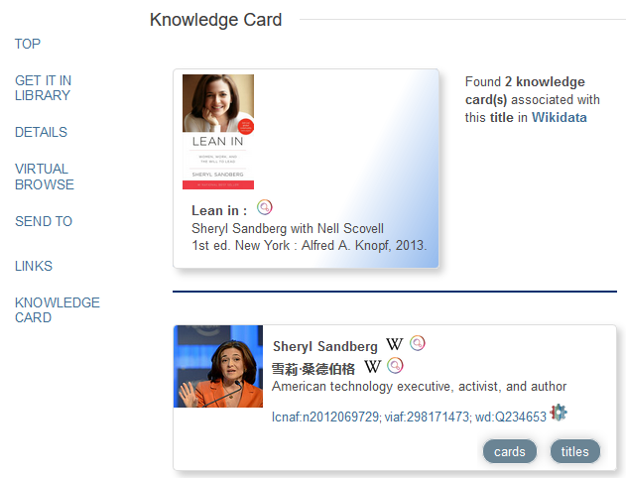
How and why is this useful to the end user
Now we have a link to the "Knowledge Card"
Link to Wikidata
Link to LC Name Authority record
Link to viaf

Slide 105
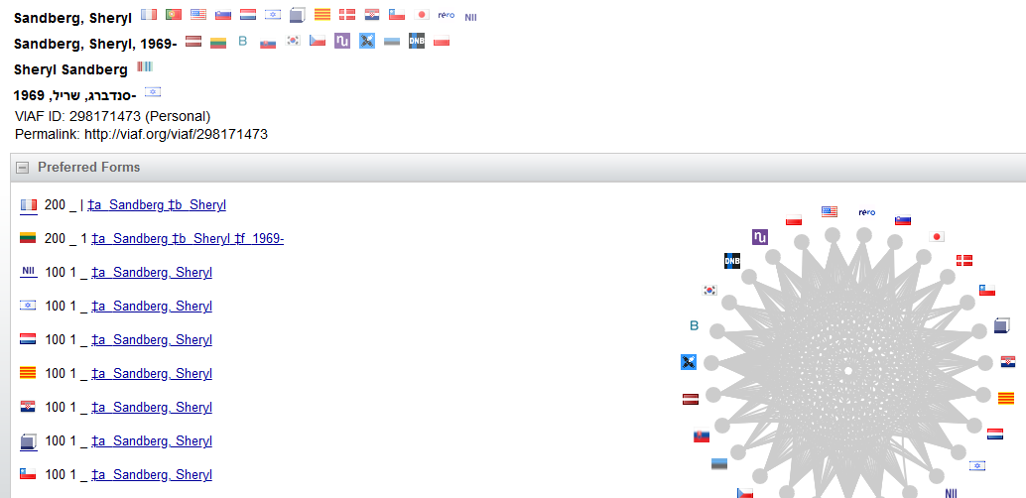
How and why is this useful to the end user
From the discovery results the end user can arrive here (viaf)

Slide 106
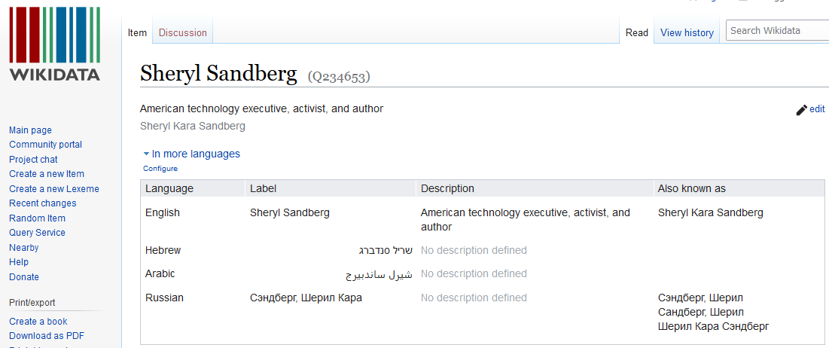
How and why is this useful to the end user
From the discovery results the end user can arrive here (wikidata)

