Slide 1
Support for local extensions for bibliographic records linked to the Alma CZ
Yoel Kortick
Senior Librarian

Slide 2
Introduction
The sample electronic collection and the records
Adding local extensions to the linked CZ records manually
The local extension in Primo
Adding local extensions to the linked CZ records with normalization process
Adding local extensions to the linked CZ records with import profile
Local extensions in published and exported records
Using local extensions with DB Categories

Slide 3
Introduction

Slide 4
Introduction
In this presentation we will show how it is possible to use local extensions with bibliographic records which are linked from the institution to Community Zone.
This is useful because often institutions will want to simultaneously
Take advantage of the rich functionality of the Alma CZ
Use local extensions to provide important additional information to display to library staff and end users
Use local extensions to provide additional index points to end users
Use local extensions to provide additional facets to end users

Slide 5
Introduction
In addition to the material here see also:
Local Extensions for Community Zone Bibliographic Records
Working with Local Extension Fields

Slide 6
The sample electronic collection and the records

Slide 7
The sample electronic collection and the records
The Institution has linked to CZ electronic collection “OECD Science and Information Technology iLibrary” which includes (among others) the following portfolios:
Title “Using knowledge for development”, ISBN 9789264196681
Title “Korea and the knowledge-based economy : making the transition”, ISBN 9789264182981
Title “ICT and learning supporting out-of-school youth and adults”, ISBN 9789264012271

Slide 8
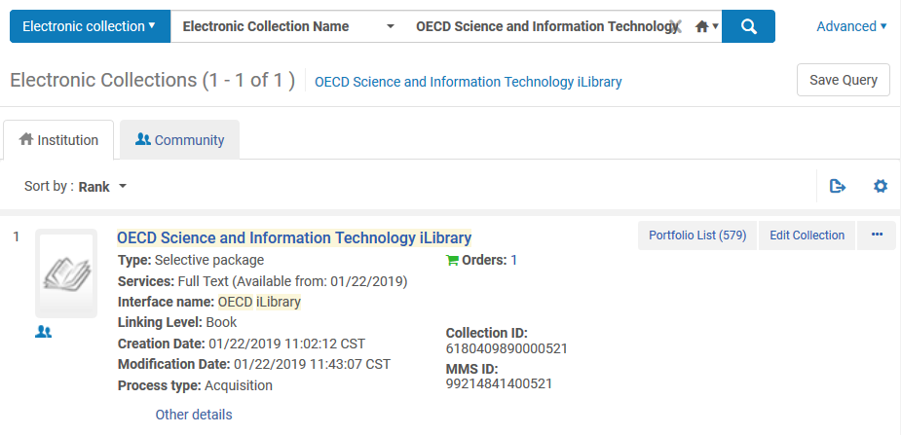
The sample electronic collection and the records
The entire collection is active and linked to the CZ.

Slide 9
The sample electronic collection and the records
First sample record linked to the CZ.

Slide 10
The sample electronic collection and the records
Second sample record linked to the CZ.

Slide 11
The sample electronic collection and the records
Third sample record linked to the CZ.

Slide 12
Adding local extensions to the linked CZ records manually

Slide 13
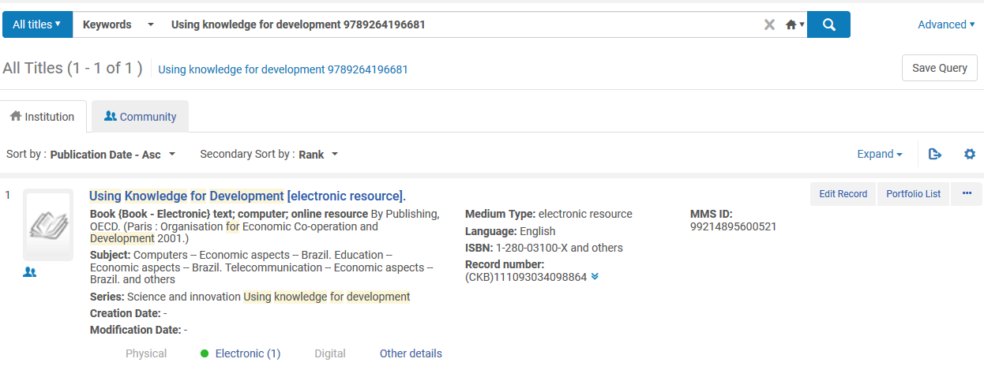
Adding local extensions to the linked CZ records manually
Now we will edit Title “Using knowledge for development”, ISBN 9789264196681

Slide 14
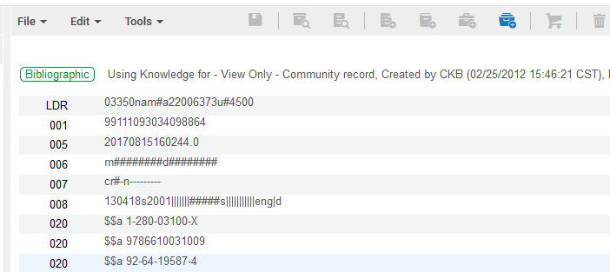
Adding local extensions to the linked CZ records manually
Note that we have a message “View Only – Community Record”

Slide 15
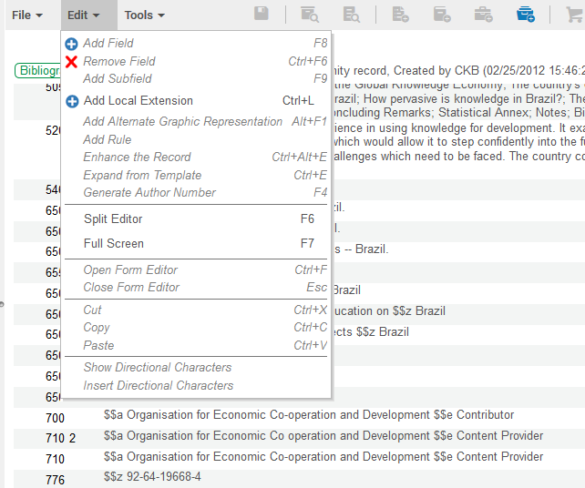
Adding local extensions to the linked CZ records manually
Now we will add one or more local extensions
We will add the following fields:
913 $$a Library and Information Science
948 $$a Meydanovitch, Jonny

Slide 16
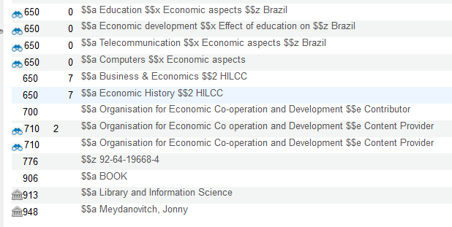
Adding local extensions to the linked CZ records manually
And we have added two local extensions

Slide 17
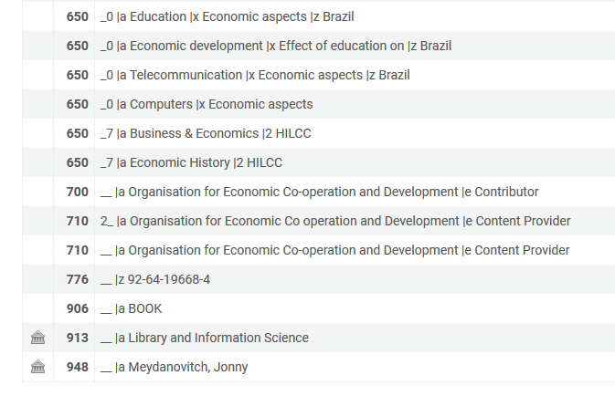
Adding local extensions to the linked CZ records manually
The record in the Alma institution
In Alma search in the institution local extensions will display

Slide 18
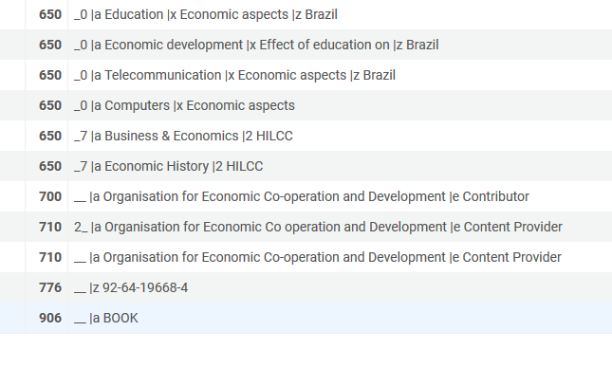
Adding local extensions to the linked CZ records manually
The record in the CZ
No other institution will see the local extensions in the CZ

Slide 19
The local extensions in Primo

Slide 20
The local extensions in Primo
The record in Primo
The local extensions are fully visible for all users of discovery

Slide 21
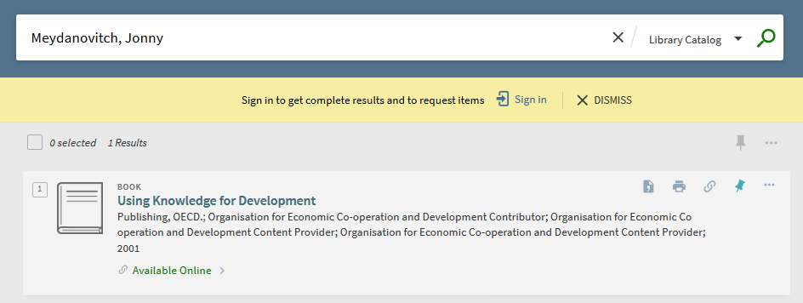
The local extensions in Primo
It is also possible to search Primo by the local extensions

Slide 22
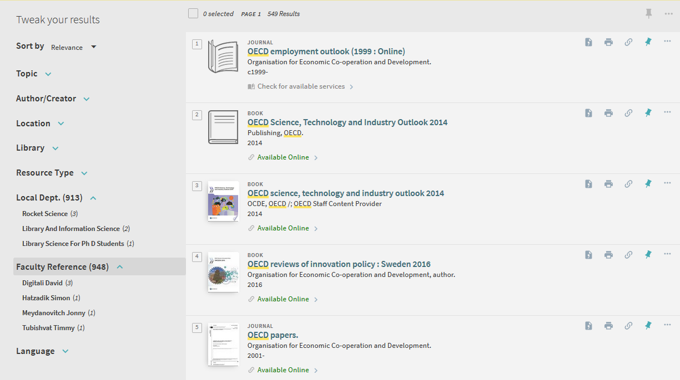
The local extensions in Primo
It is also possible to facet in Primo by the local extensions

Slide 23
Adding local extensions to the linked CZ records with normalization process

Slide 24
Adding local extensions to the linked CZ records with normalization process
This is a normalization rule which will add a 913 field with subfield a “Rocket science”
rule "Add field 913 subfield a as local extension with text Rocket Science"
when
( not exists "913.a.Rocket Science" )
then
addField "913.a.Rocket Science"
addSubField "913.9.local" if ( exists "913.a.Rocket Science" )
end
Subfield 9 with text “local” is used by Alma behind the scenes to designate the field as a local extension. It does not display in Alma or Primo or but appear as part of the MARC record when exported.

Slide 25
Adding local extensions to the linked CZ records with normalization process
This is a normalization rule which will add a 948 field with subfield a “Digitali, David”
rule "Add field 948 subfield a as local extension with text Digitali, David"
when
( not exists "948.a.Digitali, David" )
then
addField "948.a.Digitali, David"
addSubField "948.9.local" if ( exists "948.a.Digitali, David" )
end

Slide 26
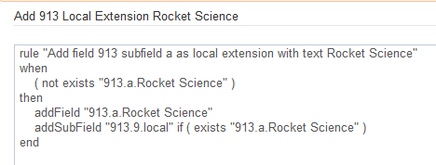
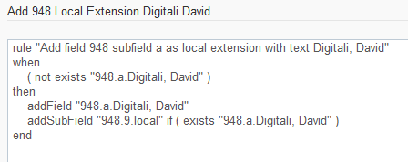
Adding local extensions to the linked CZ records with normalization process
Here are the two rules

Slide 27
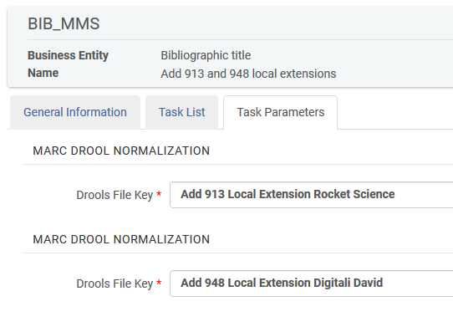
Adding local extensions to the linked CZ records with normalization process
Here is the normalization process with the two rules

Slide 28
Adding local extensions to the linked CZ records with normalization process
Set “Korea economy” includes record “Korea and the knowledge-based economy: making the transition”,. ISBN 9789264182981 which is linked to the CZ

Slide 29
Adding local extensions to the linked CZ records with normalization process
Now we will run the normalization process on the set

Slide 30
Adding local extensions to the linked CZ records with normalization process
Choose the set

Slide 31
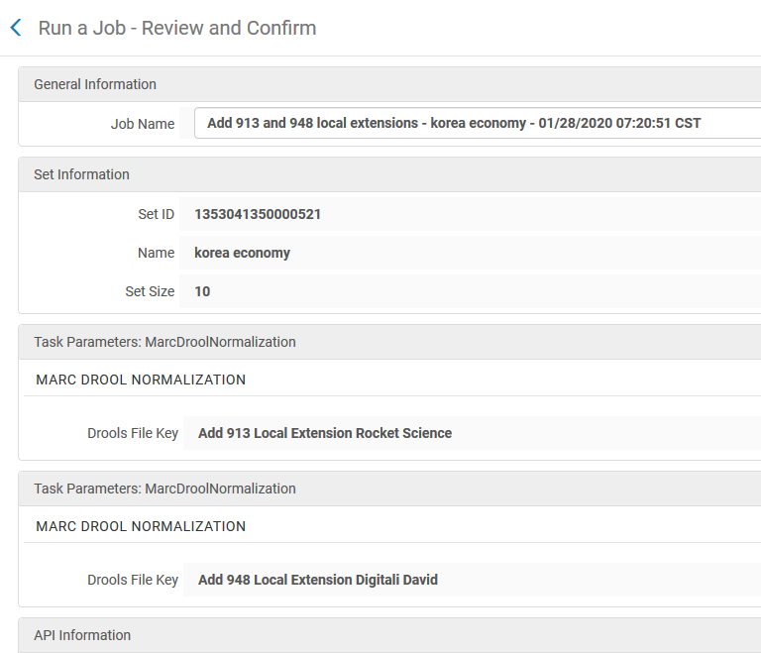
Adding local extensions to the linked CZ records with normalization process
Submit the job

Slide 32
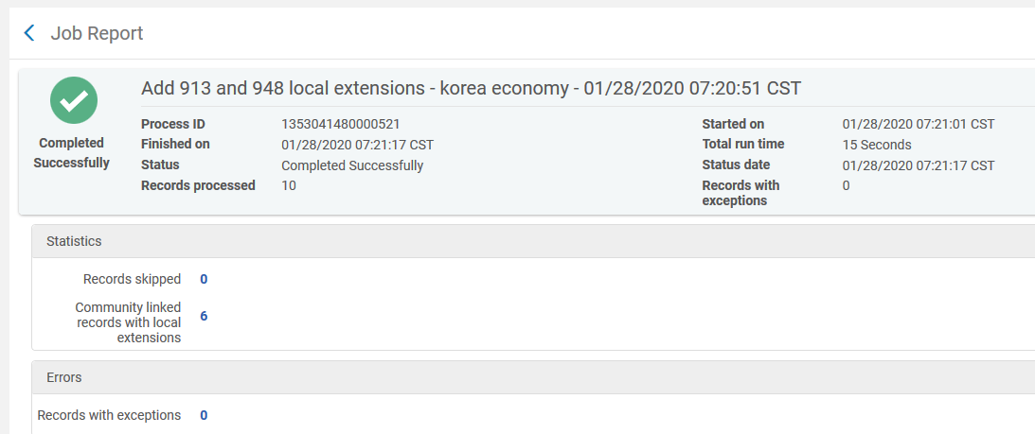
Adding local extensions to the linked CZ records with normalization process
The job completes and indicates that there are community linked records with local extensions

Slide 33
Adding local extensions to the linked CZ records with normalization process
Let’s see what happened to the record linked to the CZ

Slide 34
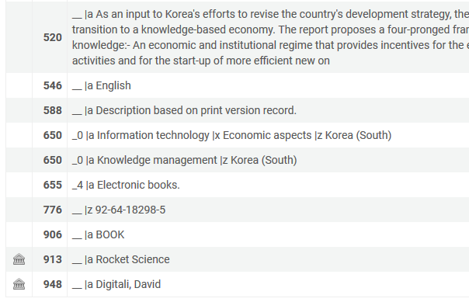
Adding local extensions to the linked CZ records with normalization process
Both local extensions were added

Slide 35
Adding local extensions to the linked CZ records with import profile

Slide 36
Adding local extensions to the linked CZ records with import profile
Here we have an input file of a bibliographic record with local extensions
<?xml version="1.0" encoding="UTF-8"?><collection>
<record>
<leader>01228nam 2200337 a 4500</leader>
<controlfield tag="005">20180322115607.0</controlfield>
<controlfield tag="006">m o d | </controlfield>
<controlfield tag="007">cr -n---------</controlfield>
<controlfield tag="008">061011s2006 fr a ob 000 0 eng d</controlfield>
<datafield tag="035" ind1=" " ind2=" ">
<subfield code="a">(CKB)1000000000227103</subfield>
</datafield>
<datafield tag="245" ind1="0" ind2="0">
<subfield code="a">ICT and learning</subfield>
</datafield>
<datafield tag="913" ind1=" " ind2=" ">
<subfield code="a">Library Science for Ph.D. students</subfield>
<subfield code="9">local</subfield>
</datafield>
<datafield tag="948" ind1=" " ind2=" ">
<subfield code="a">Tubishvat, Timmy</subfield>
<subfield code="9">local</subfield>
</datafield>
</record>
</collection>
Match point to match the CZ record
Local extensions with $$9 local to add to the linked CZ record

Slide 37
Adding local extensions to the linked CZ records with import profile
The input file on the previous slide will add:
Field “Local Dept. (913)” with text “Library Science for Ph.D. students”
Field “Faculty Reference (948)” with text “Tubishvat, Timmy”

Slide 38
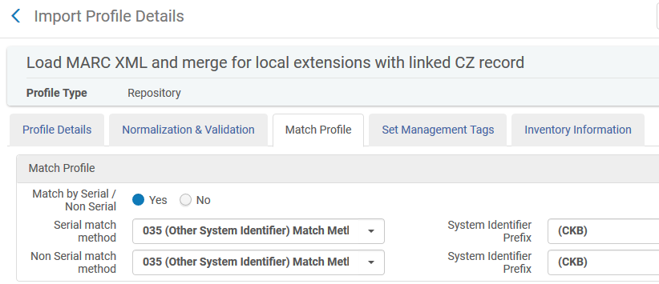
Adding local extensions to the linked CZ records with import profile
The import profile will match on the 035 with prefix (CKB)

Slide 39
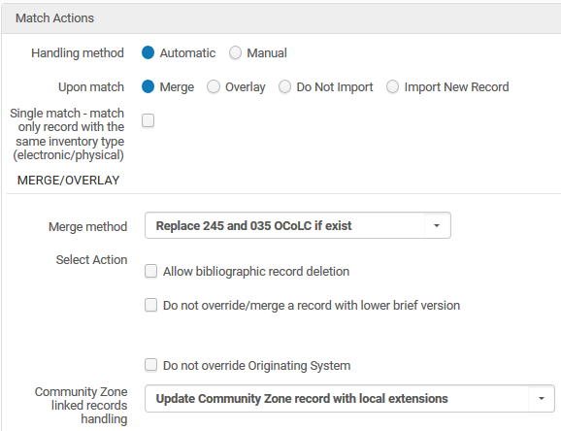
Adding local extensions to the linked CZ records with import profile
The local extensions will be added to the CZ record
A “merge” will occur but only the local extensions will get added. Other fields will not change because it is a CZ record.
Note the field “Community Zone linked records handling”. This will enable the local extensions to get added

Slide 40
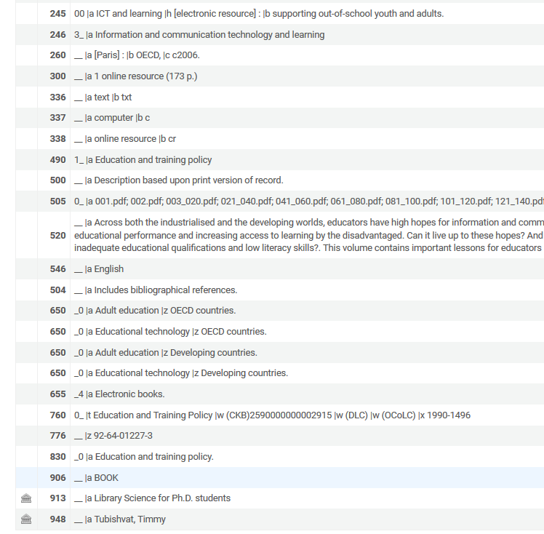
Adding local extensions to the linked CZ records with import profile
The local extensions were added to the CZ record via the import profile

Slide 41
Adding local extensions to the linked CZ records with import profile
The local extensions which were added to the CZ record via the import profile also appear in Primo

Slide 42
Local extensions in published and exported records

Slide 43
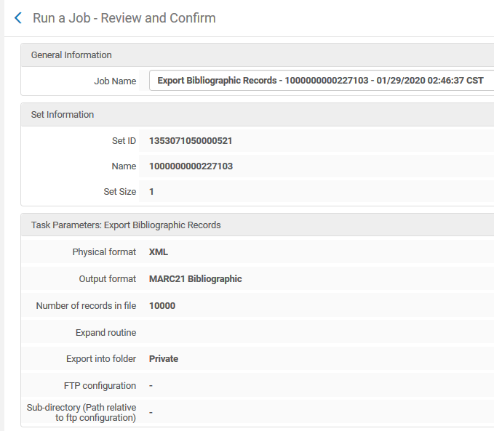
Local extensions in published and exported records
The local extensions for bibliographic records linked to the CZ are also present in the published and exported records.
Here we run the job “Export Bibliographic Records” on a set and export to MARC 21 in XML.
The set contains the records we have used here (they are linked to CZ and contain local extensions).

Slide 44
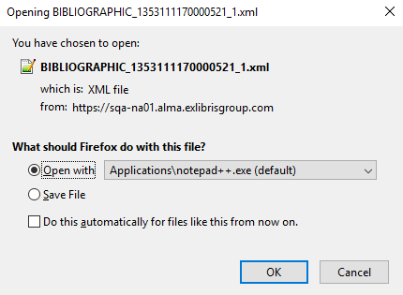
Local extensions in published and exported records
Let’s see the exported records

Slide 45
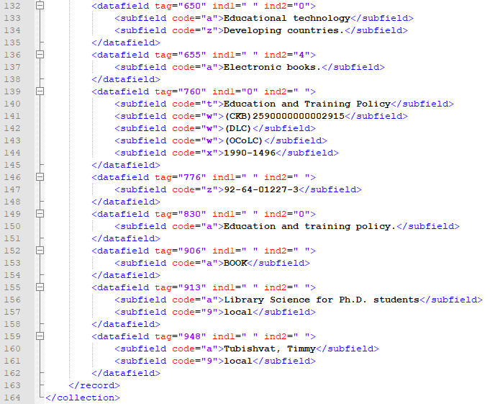
Local extensions in published and exported records
We can see the local extensions

Slide 46
Using local extensions with DB Categories

Slide 47
Using local extensions with DB Categories
It is also possible to use the local extensions with Database Categories, as described at Database Category Configuration .
This means that institutions can use local extensions in bibliographic records that are linked to the CZ in order to build DB categories in Primo.
At “Configuration > Resources > general > Other Settings” we have defined the db_categories_field to be 914

Slide 48
Using local extensions with DB Categories
“ProQuest Dialog” is a database connected to the Community Zone

Slide 49
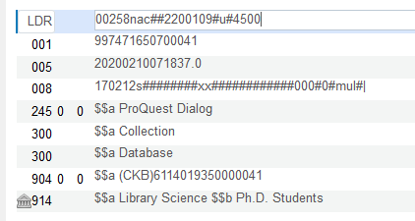
Using local extensions with DB Categories
The bibliographic record associated with this database has a 914 field with $$a Library Science $$b Ph.D. Students

Slide 50
Using local extensions with DB Categories
“Congressional Indexes” is a database connected to the Community Zone

Slide 51
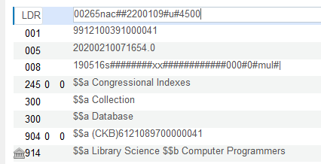
Using local extensions with DB Categories
The bibliographic record associated with this database has a 914 field with $$a Library Science $$b Computer Programmers

Slide 52
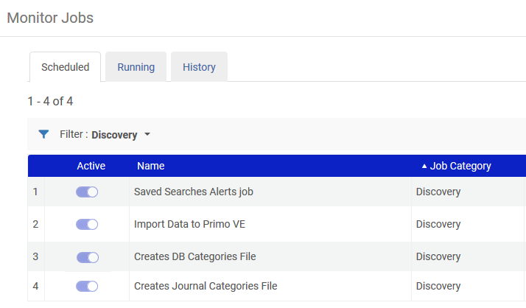
Using local extensions with DB Categories
The regularly scheduled (daily) job “Create DB Categories File” runs

Slide 53
Using local extensions with DB Categories
The job runs and processes records

Slide 54
Using local extensions with DB Categories
Now in Primo after clicking “Database Search” the databases can be searched by category

Slide 55
Using local extensions with DB Categories
Now we have chosen “Library Science > Computer Programmers”

Slide 56
Yoel.Kortick@exlibrisgroup.com

