Slide 1
Balance and remaining funds measures in the “Funds Expenditures” subject area
Yoel Kortick. Senior Librarian

Slide 2
Introduction
Example

Slide 3
Introduction

Slide 4
Introduction
This development for Jan. 2019 has added four new fields to “Funds Expenditures” subject area existing “Fund Transactions” folder:
Cash Balance
Available balance
% remaining (considering expended and encumbered)
% remaining (considering only expended)
By using these new fields, together with the existing fields, institutions can quickly get a more in depth overview of their financial situation.

Slide 5
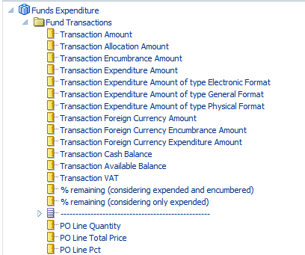
Introduction

Slide 6
Introduction
The idea behind this development was originally inspired by the work done by Mike Rogers of University of Tennessee. We thank Mike for his initiative.
In Community Knowledge Article How to calculate in Analytics the % remaining of a fund considering both expenditures and encumbrances Mike describes how to use a formula to calculate the “% remaining”.
Mike’s idea has now been built into Alma as a pre-made field with no need to manually create the formula. While already developing in this area other fields were also added: transaction cash balance and transaction remaining balance (fields which were in any case being used to create the “% remaining”).

Slide 7
Introduction
A default report is included which uses these fields.
Report Location /shared/Alma/Acquisitions/Reports
Report Name Funds Overview for Fiscal Period
This report is also included in the default Acquisitions Dashboard at /shared/Alma/Acquisitions/Dashboards

Slide 8
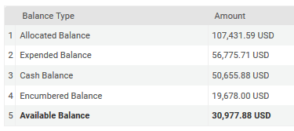
Introduction
With the additions of these fields we have all of the measures which appear in the Alma User Interface in the “Summary” tab

Slide 9
Introduction
Here is an explanation of these fields:
Allocated Balance: What is allocated
Expenditure Balance: What was expended
Cash Balance: Allocated Balance – Expenditure Balance
Encumbered Balance: All transactions which are encumbered
Available Balance: Allocated Balance – Expenditure Balance - Encumbered Balance

Slide 10
Introduction
The Alma UI has these fields and (until now) Alma Analytics did not have these fields:
Cash Balance
Available balance
These fields (until now) did not appear anywhere and now they are in Alma Analytics:
% remaining of a fund considering both expenditures and encumbrances (Available Balance / Allocation)
% remaining of a fund considering only expenditures (Cash Balance / Allocation)

Slide 11
Example

Slide 12
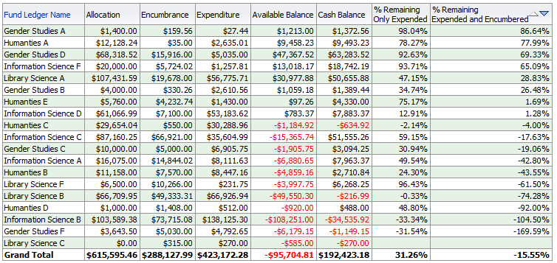
Example
Here is a report which includes all of the measures for allocated funds for FY-2020 sorted ascending by "% remaining (considering only expended)"
On the next slide we will focus on “Library Science A”

Slide 13
Example
Here is Alma Analytics
Cash Balance / Allocation
Available Balance / Allocation
Here is the summary tab of the Alma User Interface

Slide 14
Yoel.Kortick@exlibrisgroup.com

