Slide 1
DARA Identifies Highly Requested Titles
Yoel Kortick
Senior Librarian

Slide 2
Introduction
The default DARA report
Using the DARA recommendation

Slide 3
Introduction
Using an Alma Analytics report, DARA can identify highly requested titles in your institution.
This allows you to take steps to reduce patron waiting time for these items, such as
modifying their terms of use
moving them to a short loan location
purchasing additional copies of the items
This is useful because it can help the library to best utilize resources

Slide 4
The default DARA report

Slide 5
The default DARA report
By default, DARA displays titles with at least 5 requests in the last year with a minimum average waiting time to available of 5 days.
You can customize the report to produce recommendations that better suit the needs of your institution.

Slide 6
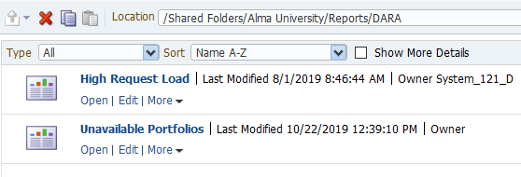
The default DARA report
This is the default report which is used

Slide 7
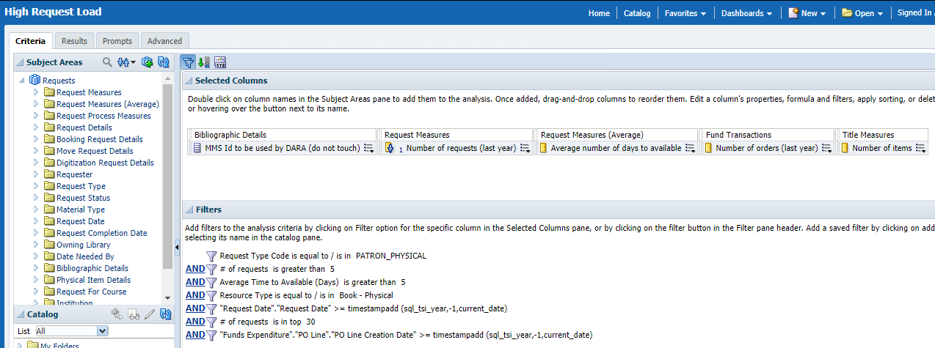
The default DARA report
These are the default filters for the report

Slide 8
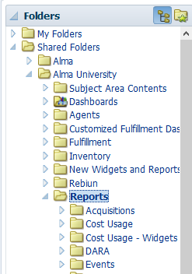
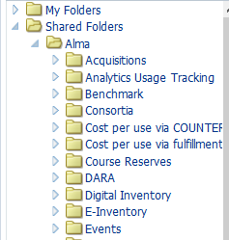
The default DARA report
DARA uses the report under folder “/shared/{Your Institution}/Reports/DARA”
If the report is not located there (for example if someone deleted it) then Alma will copy it from folder “/shared/Alma/DARA” to folder “/shared/{Your Institution}/Reports/DARA”
Therefore when you customize a report it should be customized under folder “/shared/{Your Institution}/Reports/DARA”
Reports used by DARA
Default “out of the box” reports

Slide 9
Using the DARA recommendation

Slide 10
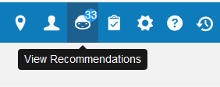
Using the DARA recommendation
Let’s view the recommendations

Slide 11
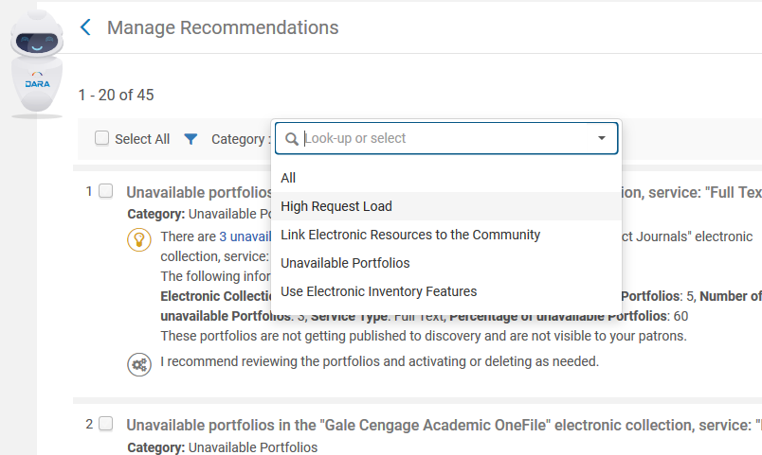
Using the DARA recommendation
And filter by High Request Load

Slide 12
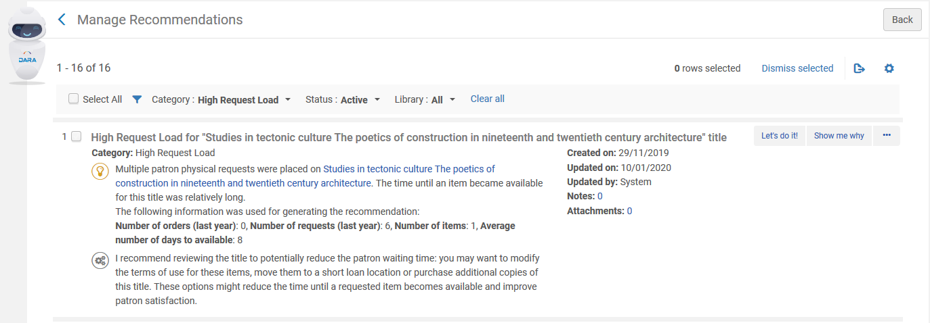
Using the DARA recommendation
We see here for example that there are at 16 items which had at least 5 requests in the last year and a waiting time on average of at least 5 days.
Now we’ll click “Let’s do it!”

Slide 13
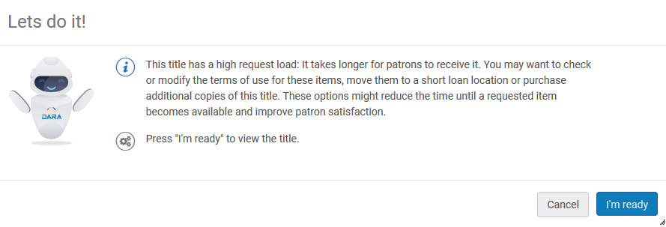
Using the DARA recommendation
And now we’ll click “I’m ready”

Slide 14
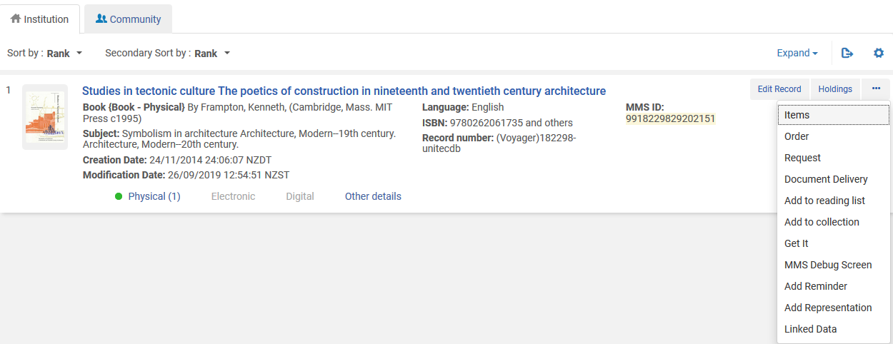
Using the DARA recommendation
We are brought to the bibliographic record of the highly request item and can take further action as desired

Slide 15
Yoel.Kortick@exlibrisgroup.com

