Slide 1
An Overview of Local Authorities in Alma
Yoel Kortick
Senior Librarian

Slide 2
Introduction
Why would we use local authorities?
Example One - New authority record created from scratch
Example Two - Copy from CZ and add non-preferred term
Example Three - Copy similar from CZ and change as needed
Searching for local authorities

Slide 3
Introduction
This presentation will assume that local authorities have already been defined in the institution.
This is a process which is typically done during the implementation phase, though it can also be done at a later stage.
If you need information about defining a new local authority vocabulary see “To create a local authority” at Adding a Local Authority Definition .

Slide 4
Introduction
Note that even after you define a local authority, you will need Ex Libris to define that your institution uses local authorities.
This is explained at Adding a Local Authority Definition
And also at Creating Local Authority Records

Slide 5
Introduction
In this presentation the institution has defined that Library of Congress Names (LCNAMES) and Library of Congress Subjects (LCSH) are defined as local subjects.
This can be seen at ‘Configuration Menu > Resources > Cataloging > Metadata Configuration > See section “Authority Vocabularies”

Slide 6
Introduction
As we will soon see, the fact that an institution uses local authorities does not mean that the institution uses only local authorities.
It is a combination of local authorities and global authorities (from the Community Zone).

Slide 7
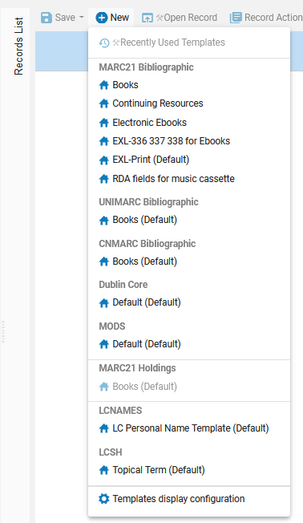
Introduction
If your institution is defined to use local authorities, you will see an option to create a local authority record in the metadata editor. For example:
This institution can create new LCNAMES records and new LCSH records.
If you have local authorities defined and do not see the option here to create the local authorities it is likely because the default templates for those authorities are not defined to appear. See New Metadata Editor - Templates display configuration .

Slide 8
Why would we use local authorities?

Slide 9
Why would we use local authorities?
Local authorities may be used if
None of the many authority vocabularies in the Community Zone meet the needs of the institution.
An authority vocabulary of the Community Zone does meet the needs of the institution but there are some cases where
The institution wishes to change a particular authority heading because they do not like the way it appears or think that an end user will find records more successfully with a different heading.
The institution wants to use a heading which does not exist in the specific authority vocabulary of the Community Zone.

Slide 10
Why would we use local authorities?
When local authority records are used the system first checks the local authorities and if there is a match then the local authority record is used.
If there is no match in the local authorities, then the system will check the global authority records.
Therefore, local authority records can be used to “override” the global authority record

Slide 11
Example One - New authority record created from scratch

Slide 12
Example One - New authority record created from scratch
The institution uses Library of Congress Subject Headings (LCSH) and wants to use subject “Gefilte Fish”.
The cataloger discovers that there is no LCSH for “Gefilte Fish”.
The cataloger therefore decides to create a local authority record for LCSH with heading “Gefilte Fish”.

Slide 13
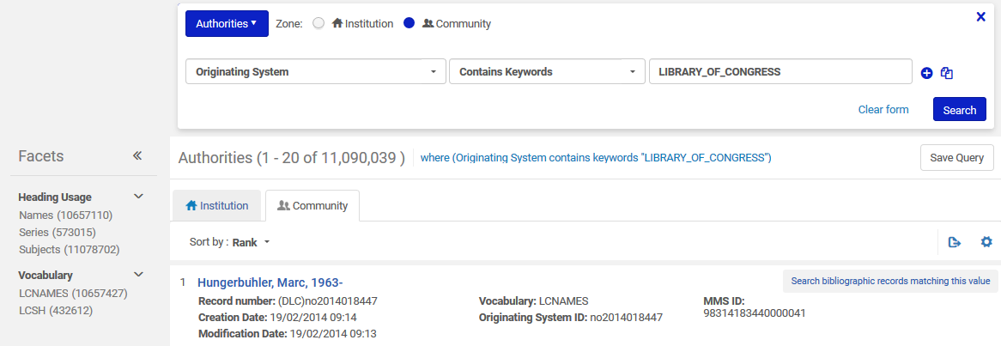
Example One - New authority record created from scratch
Here we see all LC authority records in the Community Zone including both LCSH and LCNAMES

Slide 14
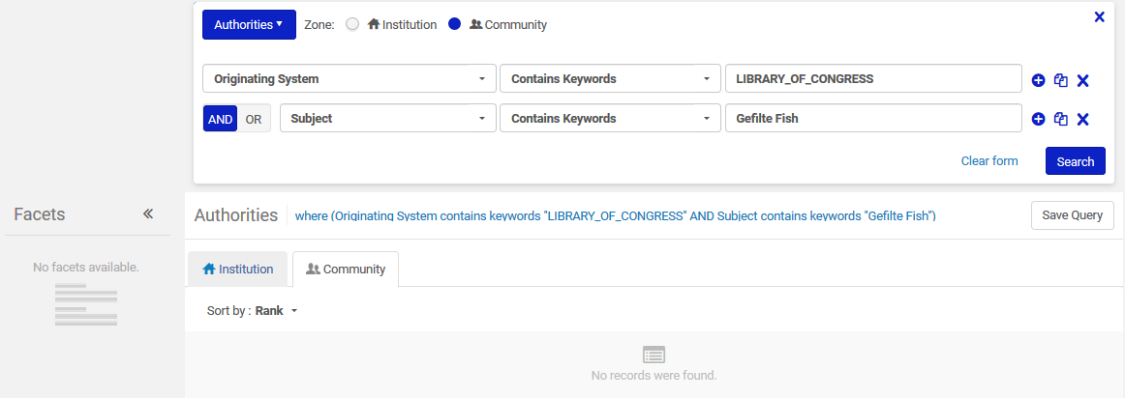
Example One - New authority record created from scratch
There are no LC authority records with subject “Gefilte Fish” in the CZ.

Slide 15
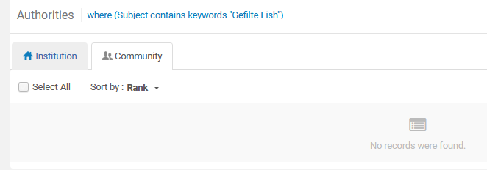
Example One - New authority record created from scratch
There are no authority records with subject “Gefilte Fish” for any vocabularies in the CZ

Slide 16
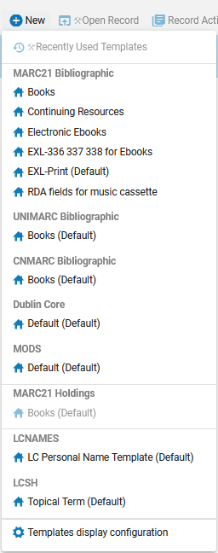
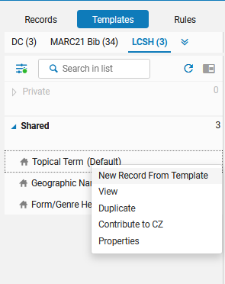
Example One - New authority record created from scratch
Now we will create a local LCSH authority record in the metadata editor
Option 1 from the ‘New’ menu
Option 2 directly from a template

Slide 17
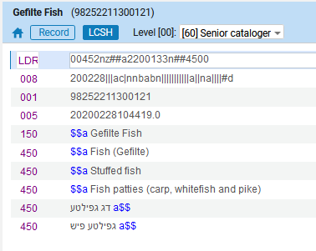
Example One - New authority record created from scratch
Here is our local LCSH authority record

Slide 18
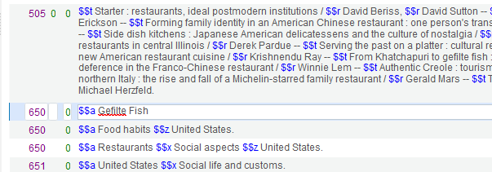
Example One - New authority record created from scratch
In a bibliographic record with title “The restaurants book” we use the heading and then do F3. 2nd indicator is “0” so LCSH will be used.

Slide 19
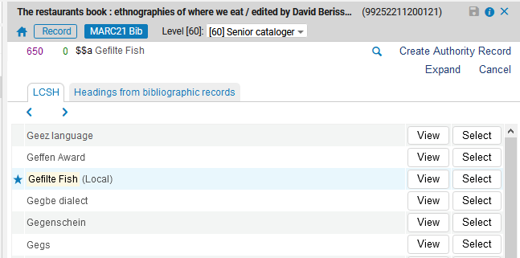
Example One - New authority record created from scratch
We see the authority heading with an indication that it is local, and we select it

Slide 20
Example One - New authority record created from scratch
The subject heading is linked to the local authority record

Slide 21
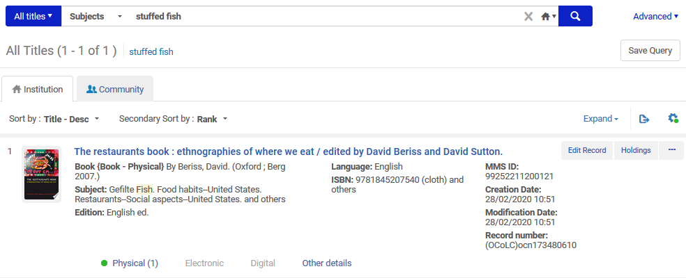
Example One - New authority record created from scratch
The record is retrieved in Alma by a non preferred term of the local authority record

Slide 22
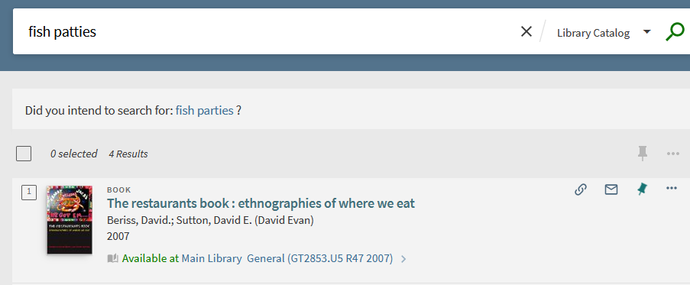
Example One - New authority record created from scratch
The record is retrieved in Primo by a non preferred term of the local authority record

Slide 23
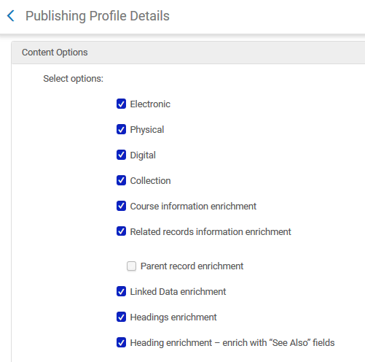
Example One - New authority record created from scratch
The record was found by non-preferred term in Primo because the “Publish bibliographic records to Primo” profile includes headings enrichment
This parameter is relevant for both global and local authority records

Slide 24
Example Two - Copy from CZ and add non-preferred term

Slide 25
Example Two - Copy from CZ and add non-preferred term
The institution uses Library of Congress Subject Headings (LCSH) and wants to have an additional “non-preferred term” for LCSH heading “Cooking (Herring)”
The cataloger wants to add non-preferred term “Schmaltz herring”

Slide 26
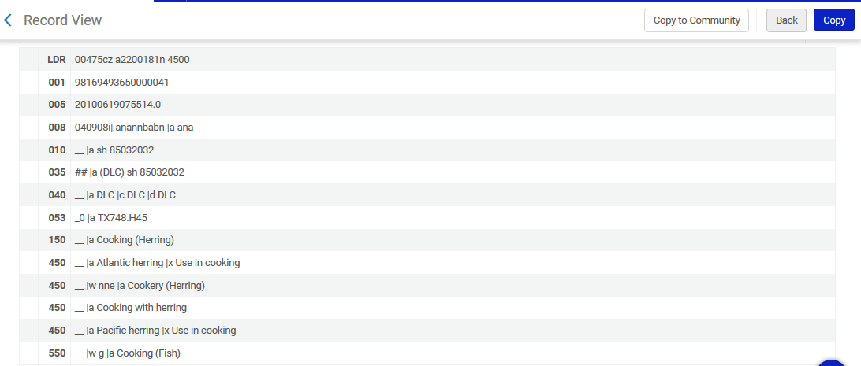
Example Two - Copy from CZ and add non-preferred term
This is the LCSH authority record in the Community Zone
We will copy this record to our institution
There currently is no non-preferred term for “Schmaltz herring” in the CZ

Slide 27
Example Two - Copy from CZ and add non-preferred term
After clicking “Copy” we will leave the default values for the vocabulary code and the originating system.

Slide 28
Example Two - Copy from CZ and add non-preferred term
A new record is created in the institution and we edit it

Slide 29
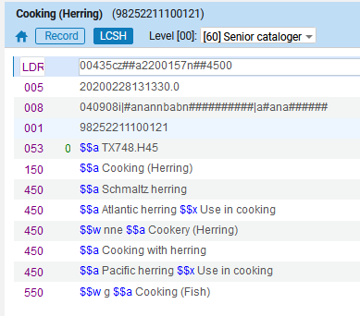
Example Two - Copy from CZ and add non-preferred term
We add our own non-preferred term
This is our new non-preferred term
We will leave the preferred term “Cooking (Herring)”

Slide 30
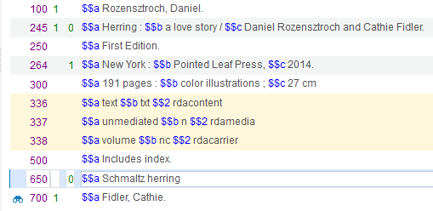
Example Two - Copy from CZ and add non-preferred term
We will now save bibliographic record with title “Herring: a love story” which has the non-preferred term “Schmaltz herring” from the local authority record. We are not clicking F3 to look for a heading, we are just saving the record

Slide 31
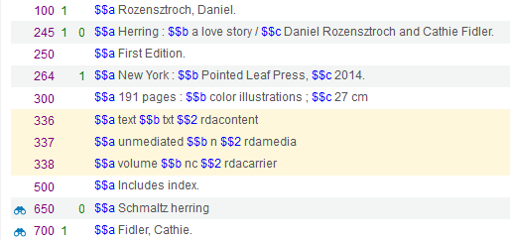
Example Two - Copy from CZ and add non-preferred term
The bibliographic heading links to an authority record and we will click the binoculars

Slide 32
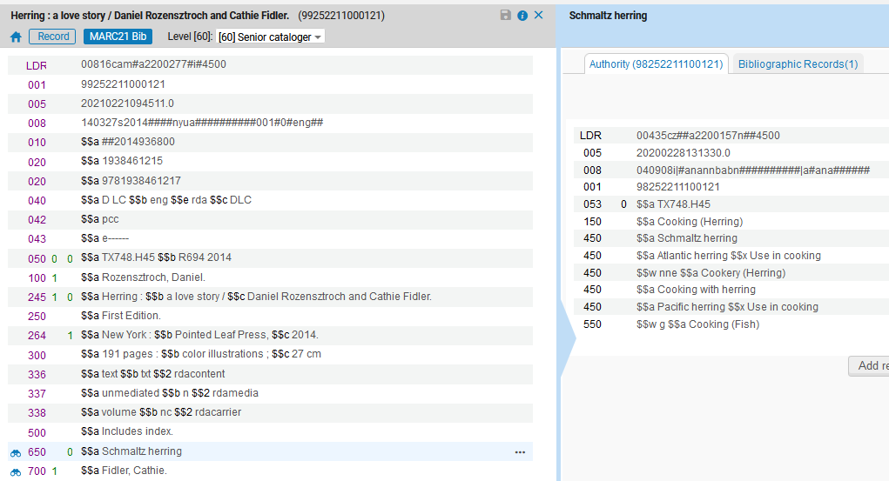
Example Two - Copy from CZ and add non-preferred term
We see that it has linked to the local authority record

Slide 33
Example Two - Copy from CZ and add non-preferred term
The regularly scheduled job “Authorities – Preferred Term Correction” runs

Slide 34
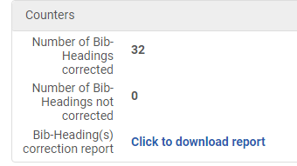
Example Two - Copy from CZ and add non-preferred term
The job report shows that the heading has changed to the preferred term from the non-preferred term which we added

Slide 35
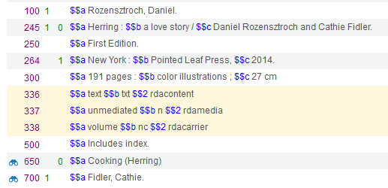
Example Two - Copy from CZ and add non-preferred term
The bibliographic record was updated from non preferred term “Schmaltz herring” to preferred term “Cooking (Herring)

Slide 36
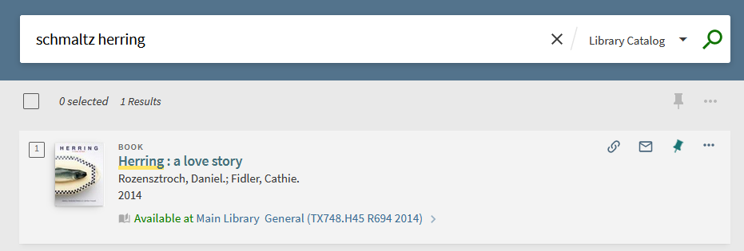
Example Two - Copy from CZ and add non-preferred term
And in Primo an end user can find “Herring: a love story” by searching for non preferred term “Schmaltz herring”

Slide 37
Example Three - Copy similar from CZ and change as needed

Slide 38
Example Three - Copy similar from CZ and change as needed
The institution has a publication from the “Kentucky library association catalogers committee”. The cataloger checks the LCNAMES authorities in the Community Zone and sees that this name does not exist.
The cataloger copies a similar record and changes it to be “Kentucky library association catalogers committee”.
Instead of creating a new record we have decided to copy a similar record and then change it.
The cataloger also adds a non preferred term “Kentucky library association cataloguers committee”.
This way the end user will be able to search for either:
“Kentucky library association cataloguers committee”
“Kentucky library association catalogers committee”

Slide 39
Example Three - Copy similar from CZ and change as needed
This is a similar record in the Community Zone. We will click the title to view it and then click “Copy”

Slide 40
Example Three - Copy similar from CZ and change as needed
Click “Copy”

Slide 41
Example Three - Copy similar from CZ and change as needed
We will keep the defaults

Slide 42
Example Three - Copy similar from CZ and change as needed
The new record is created in the institution and we will edit it

Slide 43
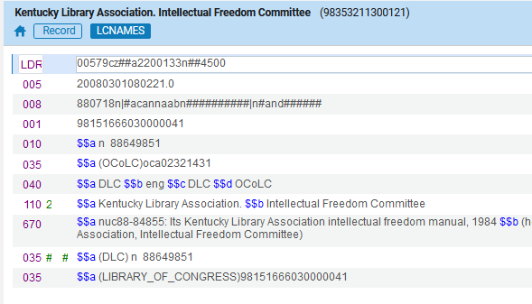
Example Three - Copy similar from CZ and change as needed
Here is the new record we copied

Slide 44
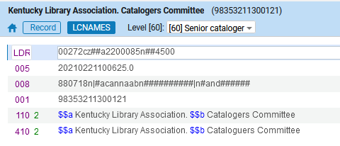
Example Three - Copy similar from CZ and change as needed
And here it is after changing it to our own needs

Slide 45
Example Three - Copy similar from CZ and change as needed
Now we use this new heading in bibliographic record title “Advanced methodologies and technologies in library science”.
We have not yet saved the record.

Slide 46
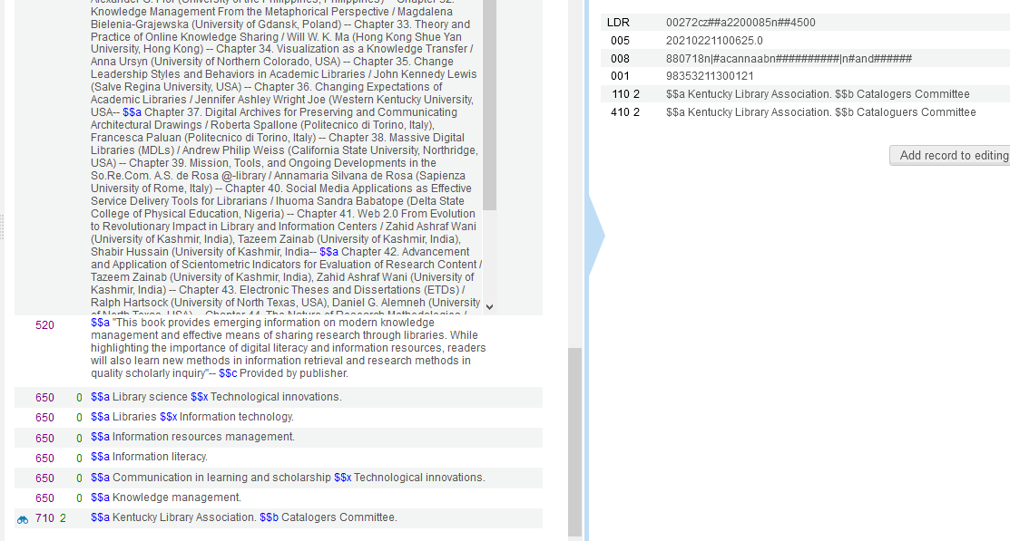
Example Three - Copy similar from CZ and change as needed
After saving it links to the authority record we created

Slide 47
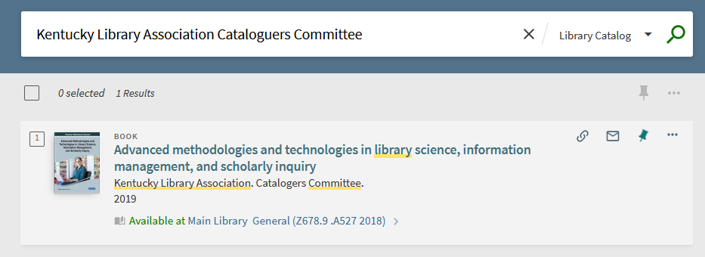
Example Three - Copy similar from CZ and change as needed
And the non-preferred term can be used to find the record in Primo

Slide 48
Searching for local authorities

Slide 49
Searching for local authorities
The institution can find all of their local authorities by searching for authorities in the institution

Slide 50
Searching for local authorities
First example from this session

Slide 51
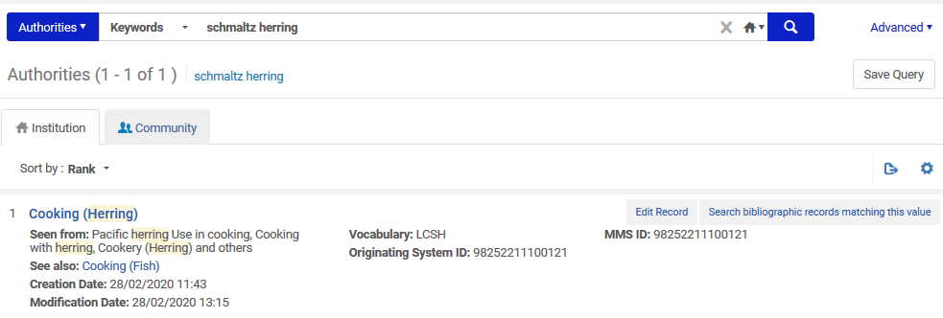
Searching for local authorities
Second example from this session

Slide 52
Searching for local authorities
Third example from this session

Slide 53
Thank you!
xxx@exlibrisgroup.com

