Slide 1
How to add a footer to the Primo pages– Using Primo VE

Slide 2
Introduction
There may be a case where the institution wants to notify all users of a certain message.
There are several ways to do this, one of which is to put the message in the Primo footer to appear on all pages.
In this case we will add a footer stating “Due to unforeseen circumstances the library will be closed indefinitely. Please contact the circulation desk for more information.”

Slide 3
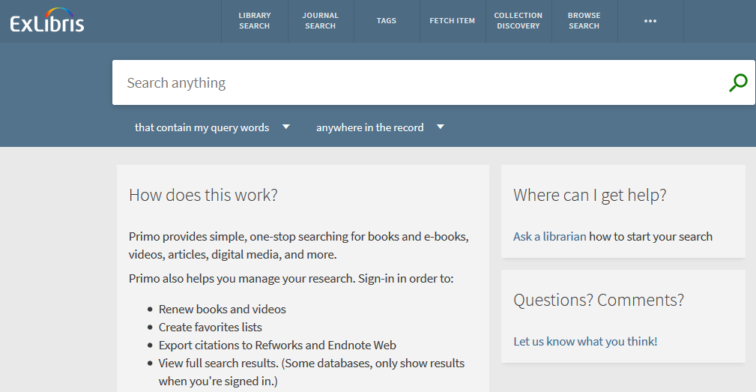
Here is the Primo VE home page now

Slide 4
Download the customization package to change it
We will download the customization package for the default view in order to edit it and then re-upload it.
Access it at “Configuration > Discovery > Display Configuration > Configure Views”
Edit your default view
Switch to the “Manage Customization Package”
Download the “Current View Customization Package”

Slide 5
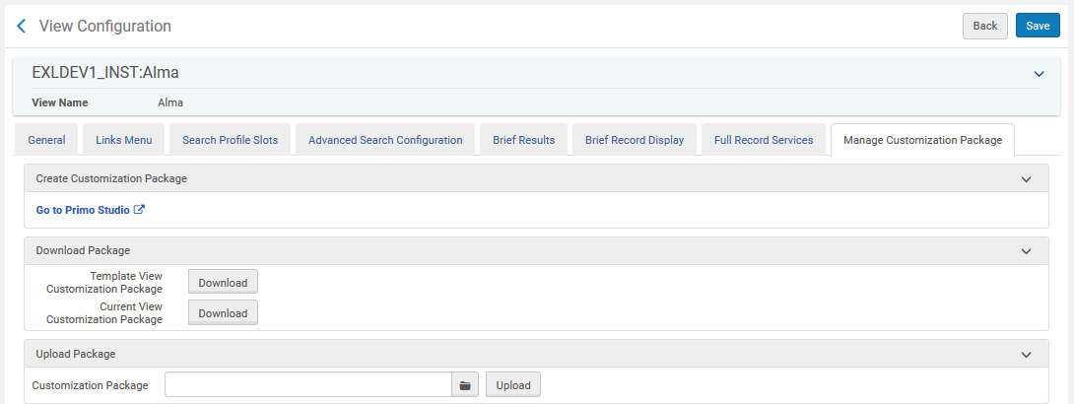
Download the customization package to change it

Slide 6
Begin customizing the package
A zip file will be downloaded
Save a backup of it “just in case” you make an undesired change
Extract the files

Slide 7
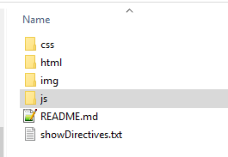
Begin customizing the package
Navigate to the JS folder

Slide 8
Begin customizing the package
Under the “JS” subfolder edit the file “custom.js”

Slide 9
Edit the file “custom.js” and add message
Below we added the text inside a yellow alert bar in the footer:
app.component('prmExploreFooterAfter', {
bindings: { parentCtrl: '<' },
template: '<div role="alert" aria-live="assertive" layout-align="center center" class="layout-align-center-center">\n <div layout="column" class="bar alert-bar layout-align-center-center" layout-align="center center" style="height:100%">\n <span class="bar-text">\n Due to unforeseen circumstances the library will be closed indefinitely. Please contact the circulation desk for more information. \n </span>\n </div>\n </div>'
});

Slide 10
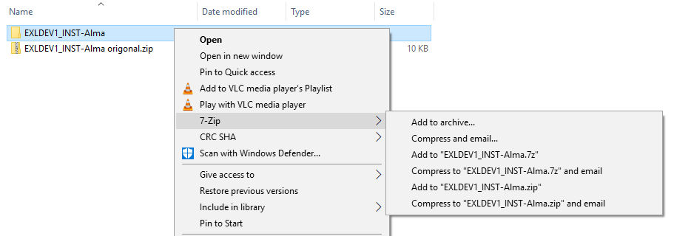
zip the folder structure

Slide 11
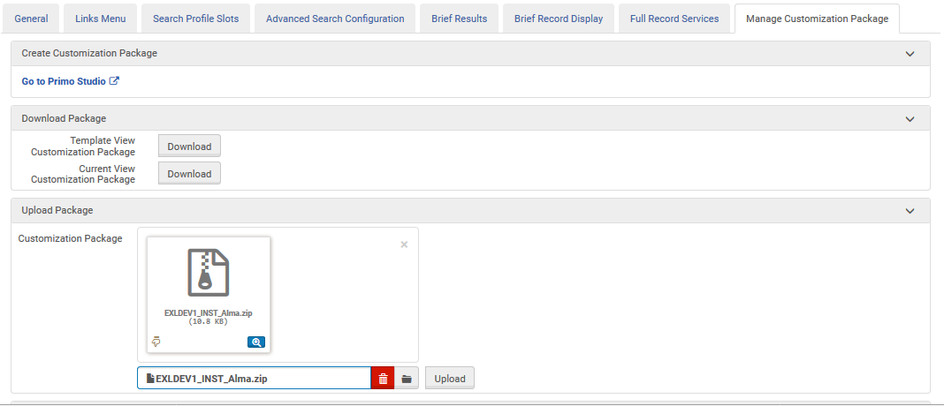
Upload the new customization package
In the default view, from the same location where we downloaded the package we will not upload the new package. After uploading click “save”

Slide 12
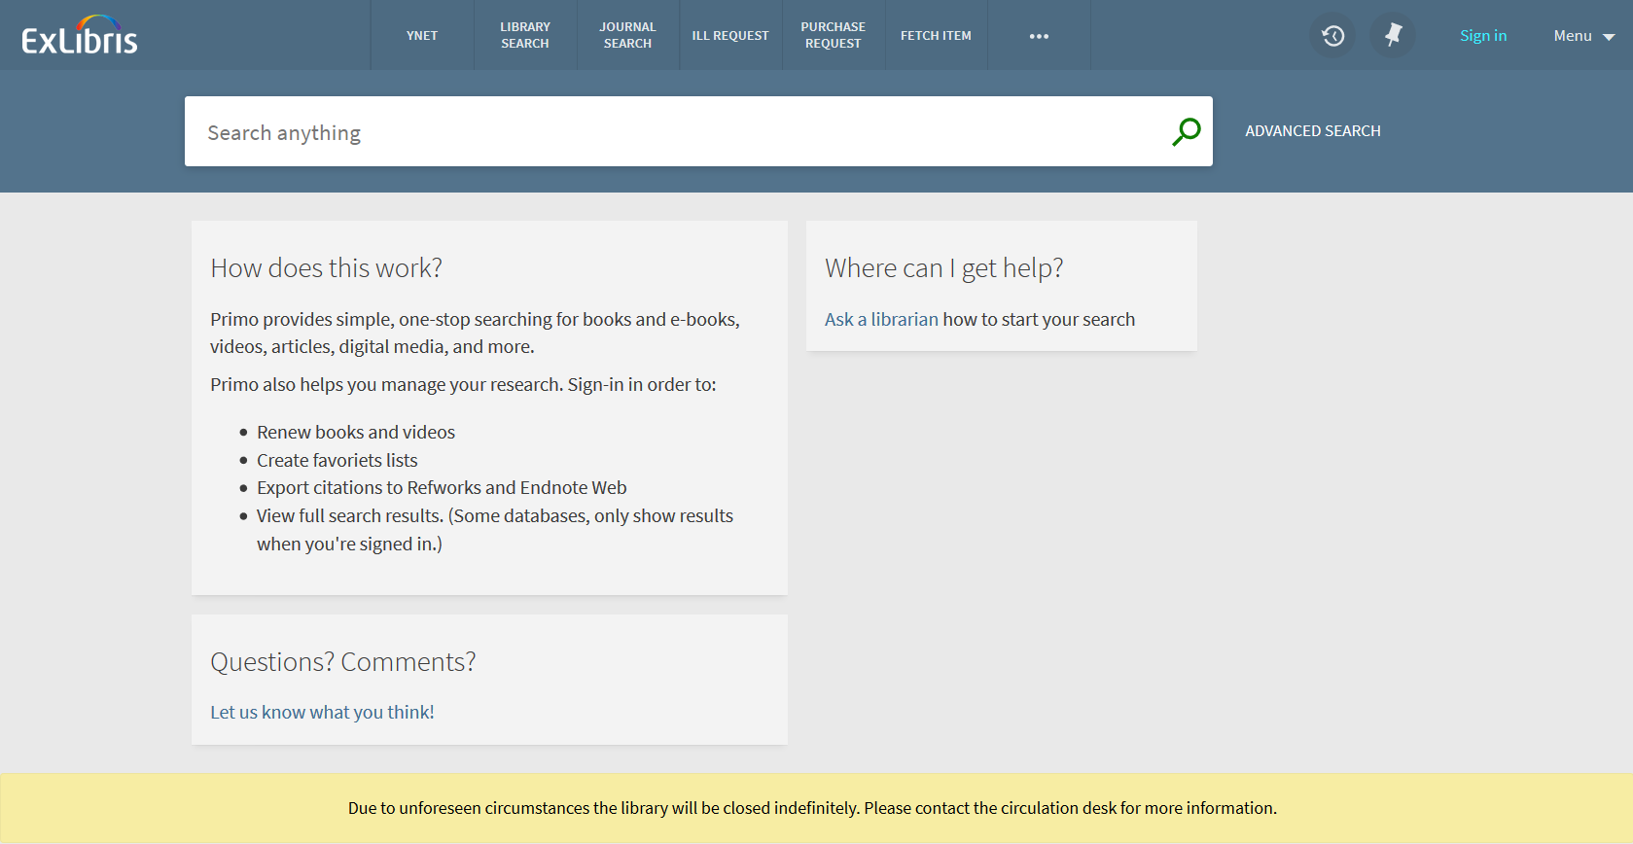
Check results and see change

Slide 13
Thank you!
xxx@exlibrisgroup.com

